Slide 1



Tests at the PSI Proton Irradiation Facility PIF
Wojtek Hajdas
RADNEXT 3st Annual Meeting – 10-11 June 2024

Slide 2
Completed TA campaigns (since July 2022)
RADNEXT 3rd Annual Meeting – 10-11 June 2024C

Slide 3
Cancelled or shifted TA campaigns
RADNEXT 3rd Annual Meeting – 10-11 June 2024C

Slide 4
Action needed TA campaigns
Change of the contact : Sauli Kunnas <sauli.kunnas@iceye.fi>
RADNEXT 3rd Annual Meeting – 10-11 June 2024C

Slide 5
Scheduled TA campaigns
RADNEXT 3rd Annual Meeting – 10-11 June 2024C

Slide 6
Some characteristics
RADNEXT 3rd Annual Meeting – 10-11 June 2024C

Slide 7
User financial support
Requested for two campaigns only
Budget still available
RADNEXT 3rd Annual Meeting – 10-11 June 2024C

Slide 8
Impressions
Campaigns and tests in collaborations
Experimental diversity higher comparing to industry
More demanding requests on beam and setup
RADNEXT 3rd Annual Meeting – 10-11 June 2024C

Slide 9
New developments – pixelated ionization chamber
PIC
RADNEXT 3rd Annual Meeting – 10-11 June 2024C

Slide 10
New developments – detector for low energies
Crystal cube
RADNEXT 3rd Annual Meeting – 10-11 June 2024C

Slide 11
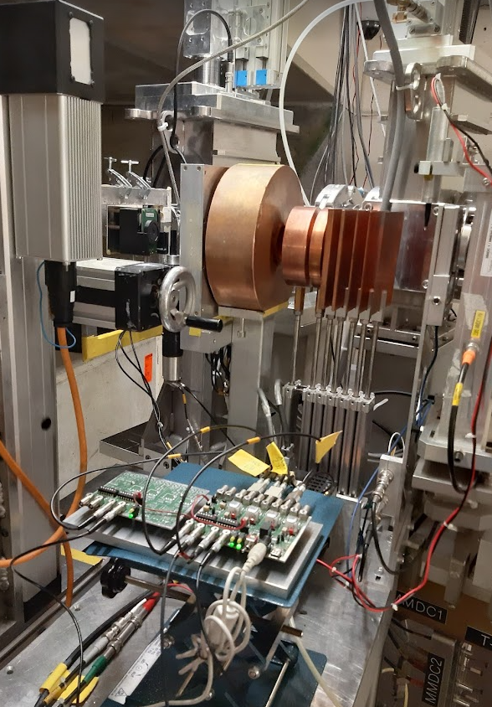
Thanks for your attention!
RADNEXT 3rd Annual Meeting – 10-11 June 2024C

