Slide 1


TRIUMF status and updates for
BL1B and TNF
Camille Bélanger-Champagne
RADNEXT 3rd Annual Meeting – 10-11 June 2024
https://indico.cern.ch/e/radnext-2024

Slide 2
OUTLINE
TRIUMF overview – brief history and capabilities
TNF status and outlook
BL1B status and outlook
Summary of RADNEXT status and plans at TRIUMF

Slide 3
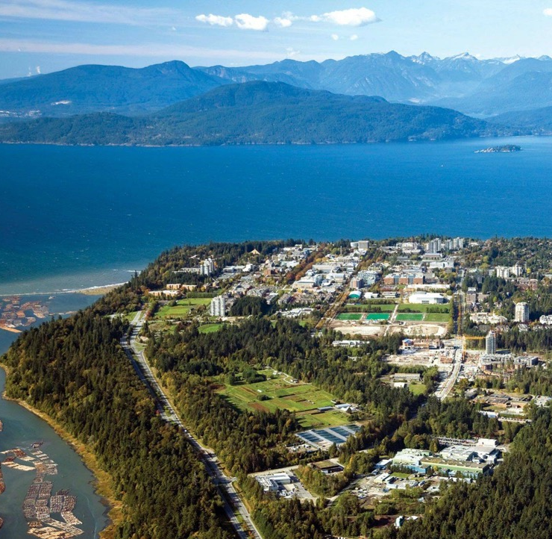
TRIUMF
Canada’s national laboratory for nuclear and particle physics for over 50 years
Located in Vancouver, British Columbia (Canada), on the traditional, ancestral,
and unceded territory of
the xwməθkwəy̓ əm (Musqueam) people
Southern end of the campus of the University of British Columbia
World-class research facility:
  Nuclear and particle physics
  Accelerator technology
  Nuclear medicine and radiopharmacology

Slide 4

TRIUMF - Member Universities
Our multidisciplinary community drives leading-edge research that delivers impact in science, medicine, and industry, positioning Canada as a world leader.
University of Alberta
University of British Columbia
University of Calgary
Carleton University
University of Guelph
University of Manitoba
McGill University
McMaster University
Université de Montréal
University of Northern
British Columbia
Queen's University
University of Regina
Saint Mary's University
Université de Sherbrooke
Simon Fraser University
University of Toronto
University of Victoria
University of Waterloo
Western University
University of Winnipeg
York University
Discovery, accelerated.
4

Slide 5
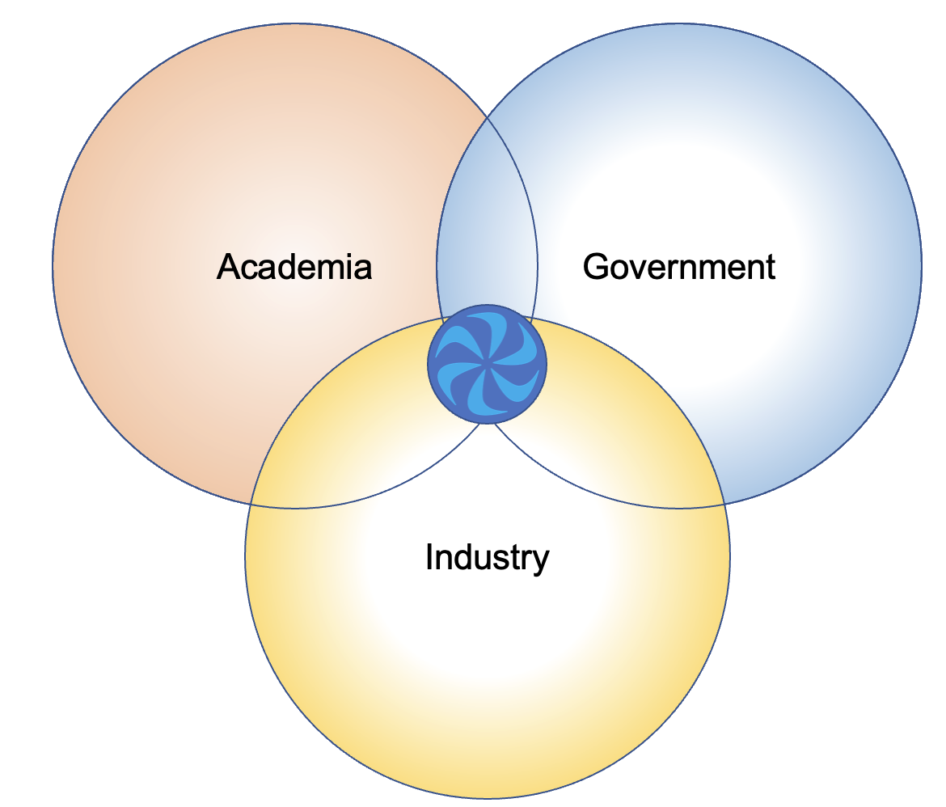
TRIUMF’s role in Canada
TRIUMF operates at the interface between academia, government, and industry – the three pillars of Canada’s research and innovation ecosystem.
Operational funding: National Research Council of Canada, on a 5-year funding cycle.
  2025-2030 funding recently announced: 399.8 M$, first funding increase in real terms after 3 cycles of stagnating funding levels
Additional competitive funding from the tri-agencies on project-by-project basis and commercial funding from sale of services and licensing devices and designs created at TRIUMF

Slide 6
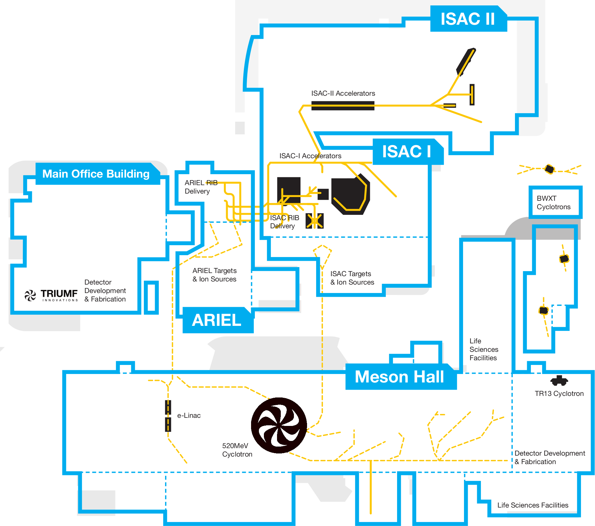
TRIUMF Proton and Neutron Irradiation Facilities
Proton or neutron beam
Neutron beam

Slide 7
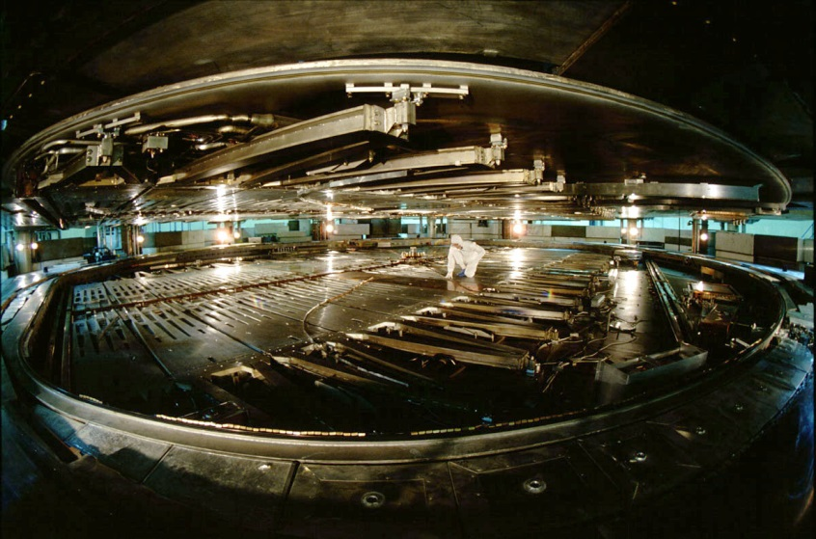
TRIUMF’s main cyclotron
7
Circulating H⁻ beam, converted to proton beam during extraction
Diameter: 18 m
First beam delivered in 1974
Max proton energy: 520 MeV
Typical operation:
  3 or 4 simultaneous beams extracted
  Multiple energies 63 to 480 MeV
  >200 μA total circulating beam
  Continuous-wave beam
Proton beams available for electronic radiation tests since 1995
Neutrons beams since 2002

Slide 8
TRIUMF as a TA facility in RADNEXT
Additional availability for atmospheric-like neutron beams (high demand beam) at TNF
Unique-within-RADNEXT 480 MeV proton beam on BL1B
Initial commitment:
  92 hours TNF (within WP9)
  120 hours BL1B (within WP10*)
Funds transferred in 2023:
  48 additional hours BL1B for a total of 168 hours
  * 20 hours BL1B time transferred to WP9 for low flux neutron beam

Slide 9
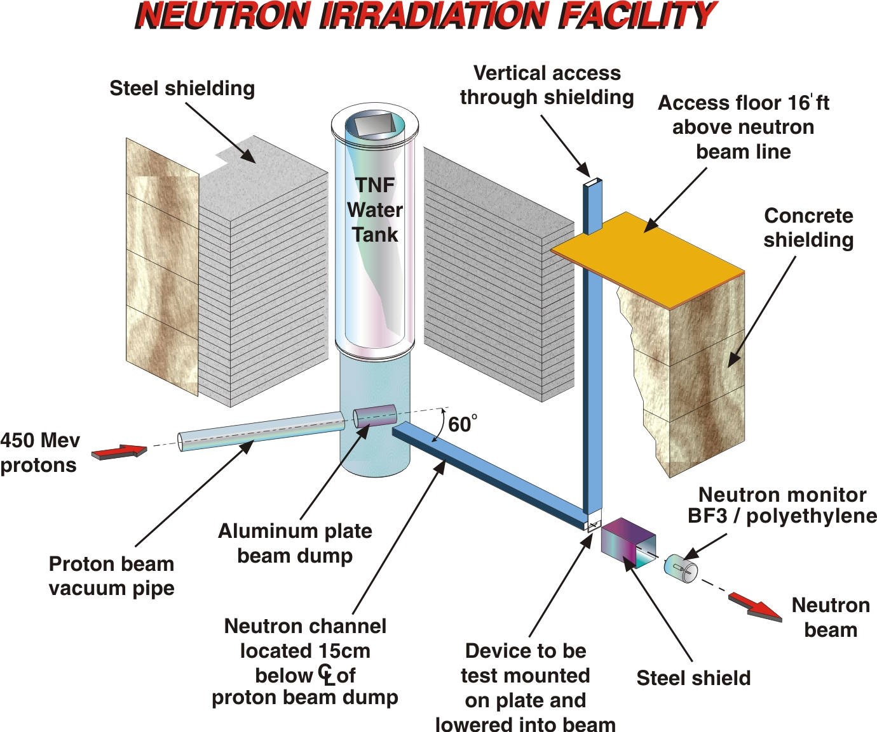
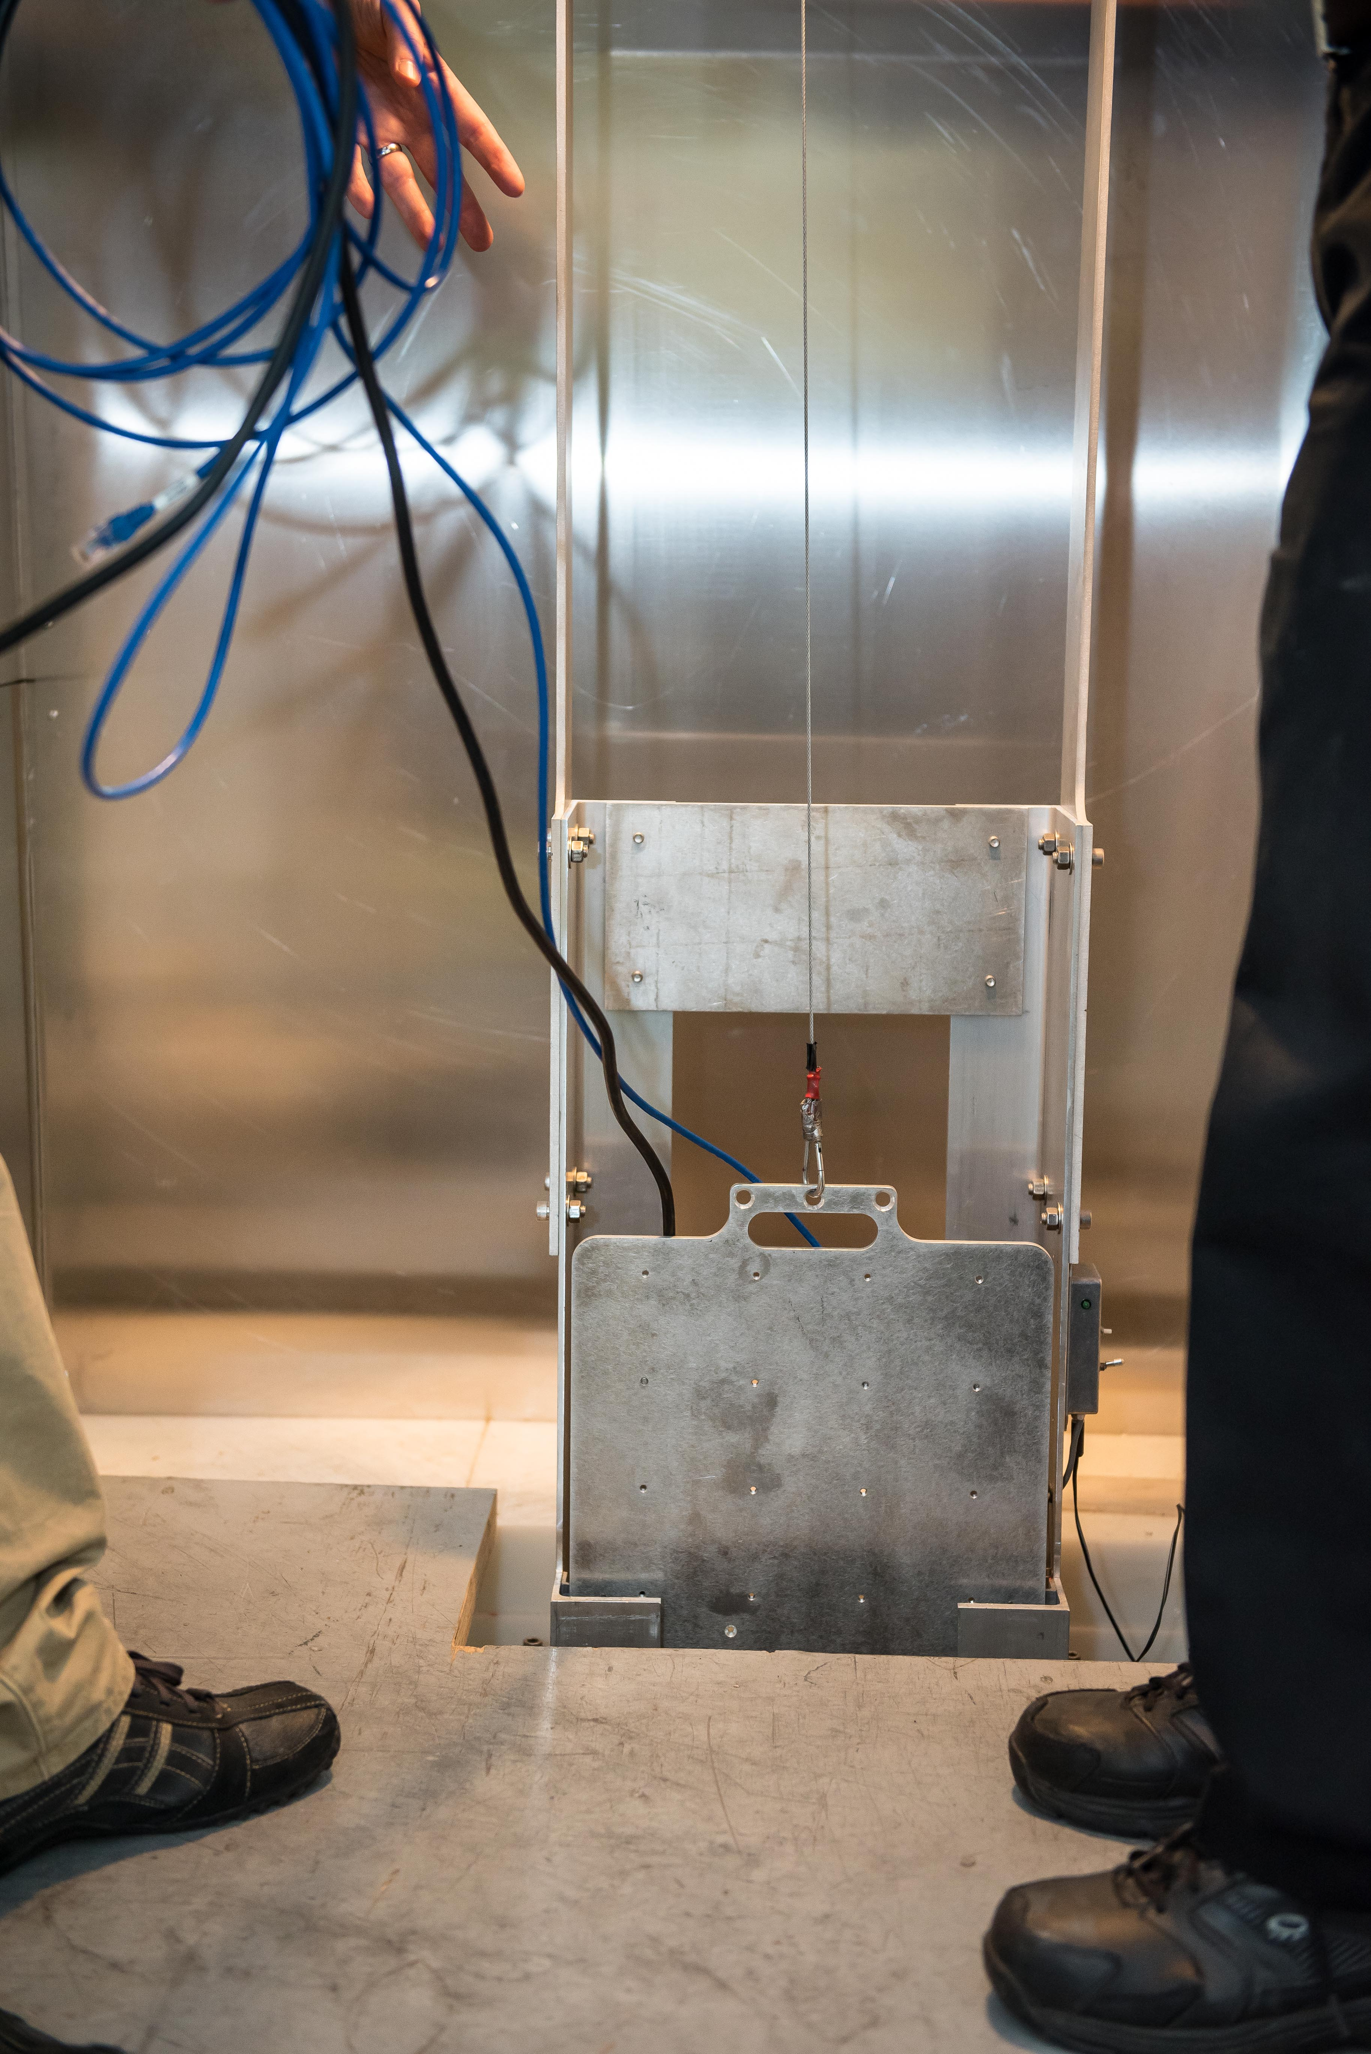
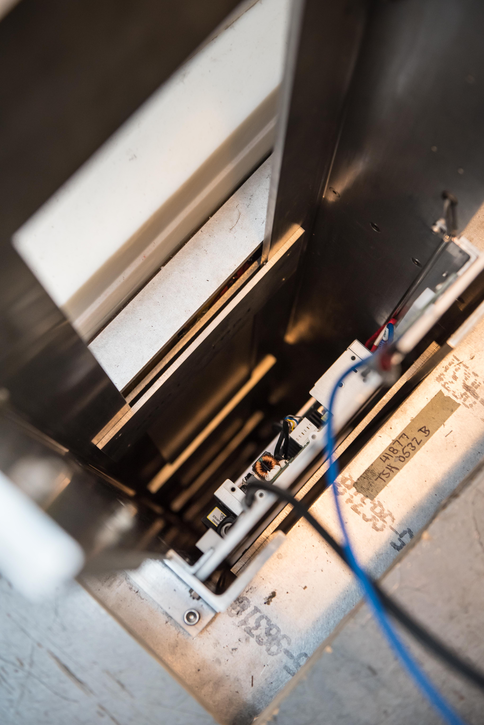
High-intensity neutron beam at TNF
Symbiotic operation with high-current beamline 1A
Neutrons created in the 1A beam dump (water-cooled aluminium)
Energy endpoint 420-450 MeV
Flux fixed by 1A proton beam users, typically 2-3 x10⁶ n_{>10 MeV}/cm²/s
Fixed beam size 5 cm x 15 cm
Narrow channel, trolley plate access

Slide 10
Summary of TA at TNF
Experiment # | Title | Hours | Dates delivered | Notes
TA01-23 | Analysing the impact of Undervolting on the REliability of modern Multicore Processors (UREMP) | 24 | Sept 17-22, 2022 | Delayed by COVID travel restrictions, TRIUMF sponsored 48 extra beam hours User support claimed
TA05-122 | Characterization of a RF Front-end and tester platform in neutron environment (CrateboSDR) | 48 | Aug 23-26, 2023 | User support claimed
Pending campaign: TA10-330: Investigating TPU Architecture Vulnerabilities Combining Fault-Injection and Beam Experiments. 20 hours scheduled for July 28-29, 2024. TRIUMF will again sponsor up to 28 additional hours.
TNF status: - No further beam time available (without additional internal fund transfers)
- All 92 hours from initial commitment will have been delivered by end of July 2024
- TRIUMF will have sponsored an additional 76 beam hours

Slide 11
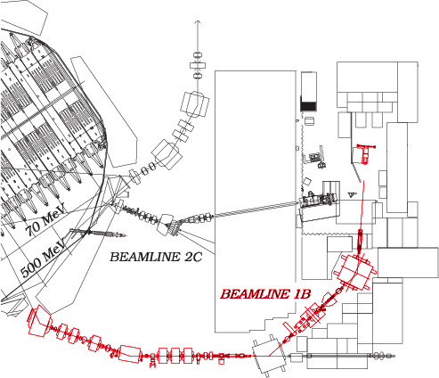
Beamline 1B
11
2 standard extracted proton energies:
  480 MeV (preferred)
  355 MeV
Max proton flux approx. 4x10⁷ p/cm²/s
  Flux adjustable down to 10² p/cm²/s, by user request to cyclotron control room
Max beam size at standard location
  7.5 cm x 7.5 cm
Insertable spallation target to convert to atmospheric-like neutron beam
  Max neutron beam size: 70 cm diameter
  Max neutron flux: 5x10⁵ n_{>10 MeV}/cm²/s

Slide 12
Summary of TA at BL1B
Experiment # | Title | Hours | Dates delivered | Notes
TA05-101 | EXP28 -Proton Test (EXP28-PT) | 12 | Dec 7, 2022 | User support declined
TA05-117* | Characterization of the low-flux mixed neutron fields with the silicon solid-state detectors | 20 | May 27-28, 2023 | Partial user support claim (only customs clearance fees) Neutron beam delivery
TA07-149 | Towards SPACE – Distributed fiber optic Dosimeter (SPACE-D²) | 24 | July 17-18, 2023 | User support declined
TA07-193 | Characterization of Single-Event Latchup and the Effectiveness of Mitigations for the Xilinx 16nm FinFET MPSoC/RFSoC Family Devices | 24 | Dec 2-3, 2023 | User support declined No TA report submitted
TA08-260 | RadJet Space: Radiation Resilience Assessment of Nvidia Jetson Orin GPUs for space application | 16 | Dec 1-2, 2023 | User support declined

Slide 13
Summary of TA at BL1B
Pending campaigns:
    TA07-191: Radiation Hardened LCL for Space Applications. 24 hours scheduled for August 29-31, 2024
    TA10-334: Characterisation of the Performance of Compact Cherenkov Radiators+SiPMs Detector Systems. 24 hours scheduled for July 17-19, 2024.
Unlike TNF, we are not able to sponsor additional time for teams granted BL1B hours through RADNEXT
One atmospheric neutron beam experiment (TA05-117) was scheduled early on when it looked like very high energy proton beam demand would be low, because it required low fluxes that could only be provided on BL1B within RADNEXT
    High proton demand from call #7 onward means we did not do that again!
BL1B status:
  Only 24/168 hours still available (total delivered+scheduled more than initial commitment of 120 hours)
  Can host 1-2 additional experiments.
  Annual winter shutdown Jan-April, possibly longer shutdown in 2025 means we aim to schedule the remaining hours in 2024, despite the recent extension to May 2026.

Slide 14
Summary of user feedback
  Poor facility match on TA01-23 due to highly sensitive components. Lack of adjustable flux at TNF a major hurdle for that experiment.
  Outside EU location/longer, more expensive travel a challenge for most teams.
  Praise for the expertise and support provided by the facility staff.
  Relative ease of scheduling/relatively short facility lead time (outside annual winter shutdown periods).

Slide 15
Facility feedback, thoughts and plans for TRIUMF
Proposals requesting neutrons needed large beam time allocations – fewer campaigns than expected at TNF.
First 18 months of RADNEXT: readiness level of experimenters low, leading to long gap to schedule experiments even though facility was available. COVID access issues.
On-site readiness of experimenters was high, effective use of granted beam time.
Management of user support funds (discussion on expectations, claim processing and payment, exchange rate management and calculations) is a disproportionally burdensome part of the access process. Guidelines from RADNEXT on flexibility and fairness are well-intentioned but tricky in practice as we do not have other source of user funds to supplement with.
Expect 1 or 2 more proposals to be scheduled on BL1B, ideally executed within 2024.
Open to provide more beam hours on either (or both) beamlines, but need financial support at existing hourly-cost rate and clarification from lab management about expected availability in 2025 (expected ~October 2024).

