Slide 1
The R&D proton beam line of HollandPTC for radiation hardness tests
M.Rovituso¹, E. van der Wal¹, T.C. Toet¹, M. Hoogeman¹
Presenter: Dr. Marta Rovituso – HollandPTC Beam line scientist
RADNEXT Annual Meeting 2024 – 11th of June 2024
¹HollandPTC, Research and Development department – Delft, The Netherlands

Slide 2



Consortium of
Founded in 2013
First patient treated in Sept 2018
Final commissioning of beam lines in July 2019
Assignments:
  Perform excellent clinical care.
  Perform R&D from fundamental to clinical research
Specific research tasks:
  Show added value of proton therapy.
  Improve and optimize proton therapy treatment

Slide 3
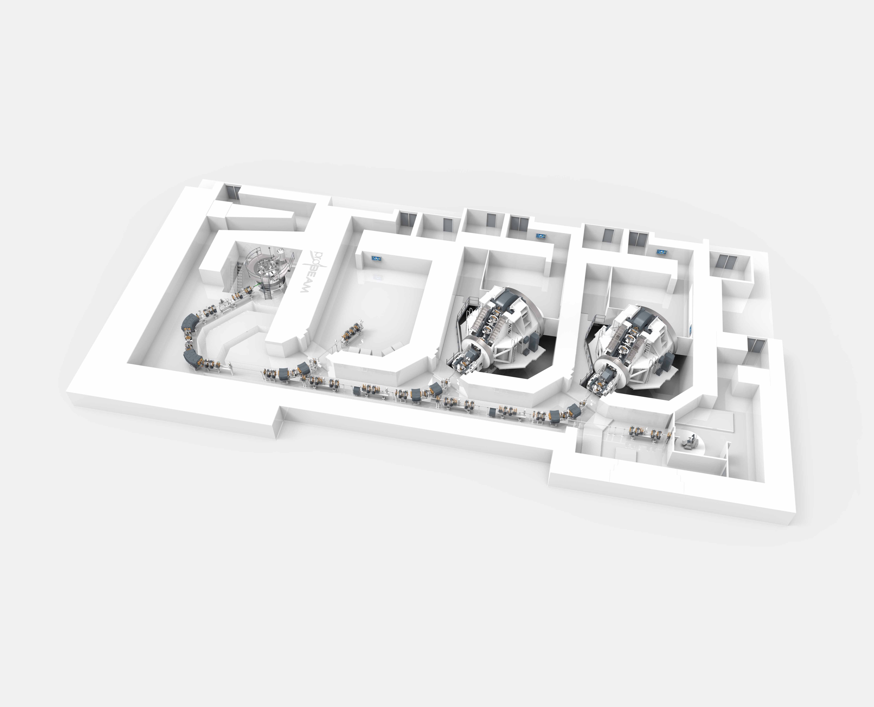
The HollandPTC protontherapy centre
VARIAN Protontherapy Center
Superconductive Cyclotron ProBeam
4 rooms: 2 rotating gantries, 1 eye treatment room, 1 R&D room
In the R&D room:
Proton beam energy from 70 up to 250 MeV
Beam current ranging from 0.04nA up to 340nA
Cyclotron
Gantry I
Gantry II
Experimental
room
ETR

Slide 4
The R&D facility
Biology Lab cell culture work
Physics and Chemistry lab
Pre-clinical preparation room for in vivo experiment

Slide 5
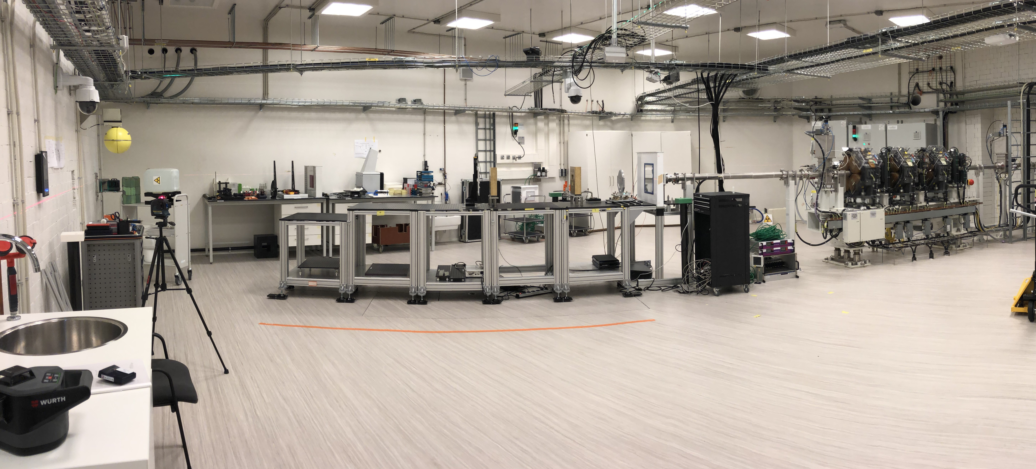
The experimental room
Camera
Laser system
Camera
Beam line
Interphone
Patch panel
Direct Ethernet
BNC
SHV
Modular target station
Thorlabs plates (75x75cm)
0.1 mm precision in alignment
1mm precision alignment in respect to room laser system

Slide 6
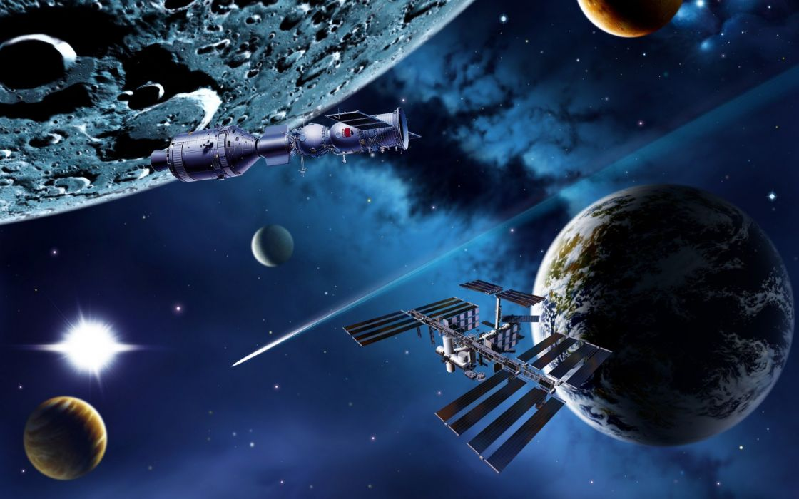
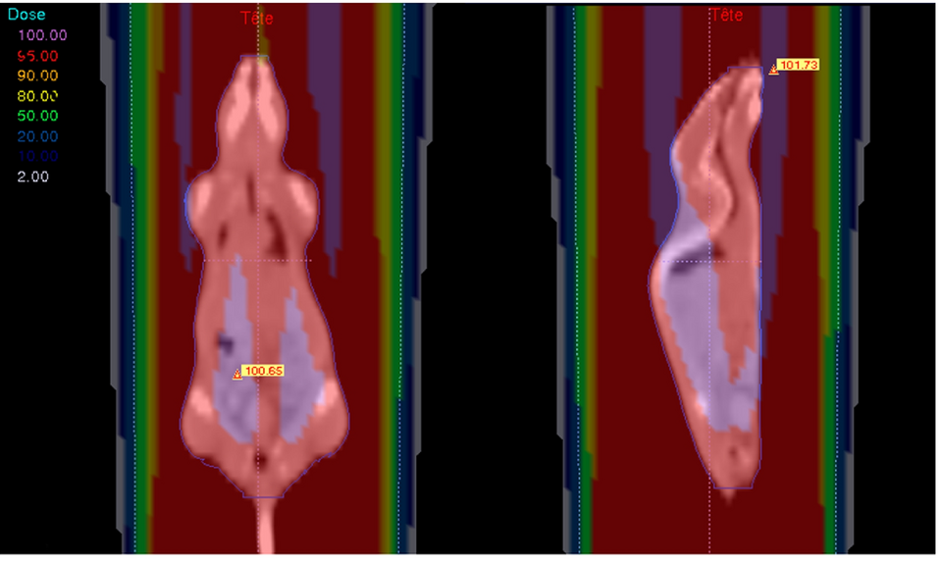
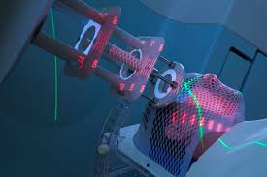
Applications in the R&D beam line
Space applications
Radiobiology
Dosimetry
Advanced Technology

Slide 7
Beam characteristics

Slide 8
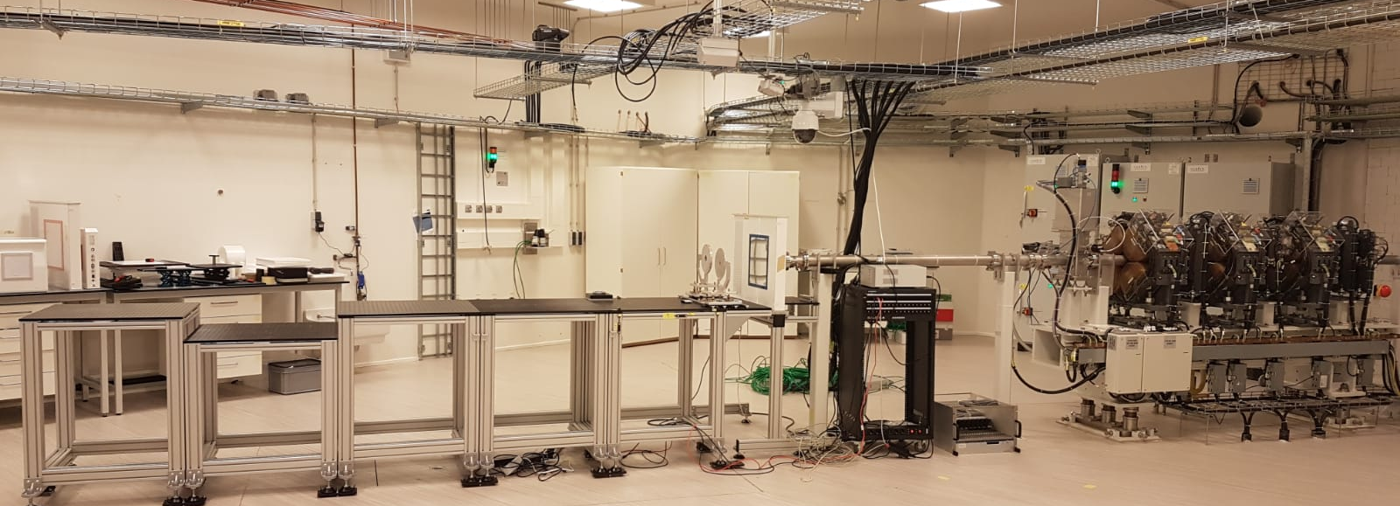
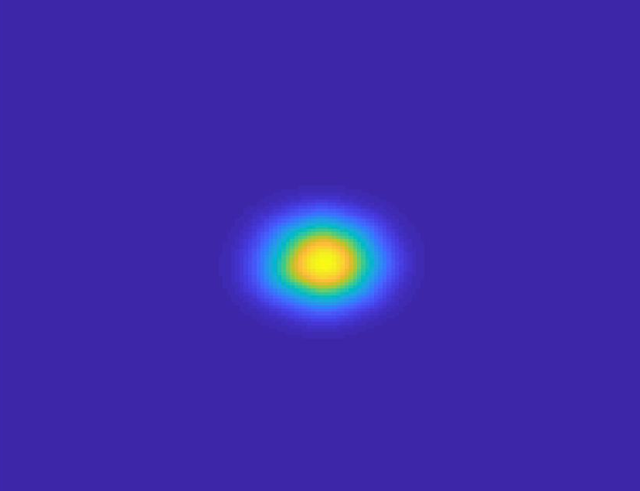
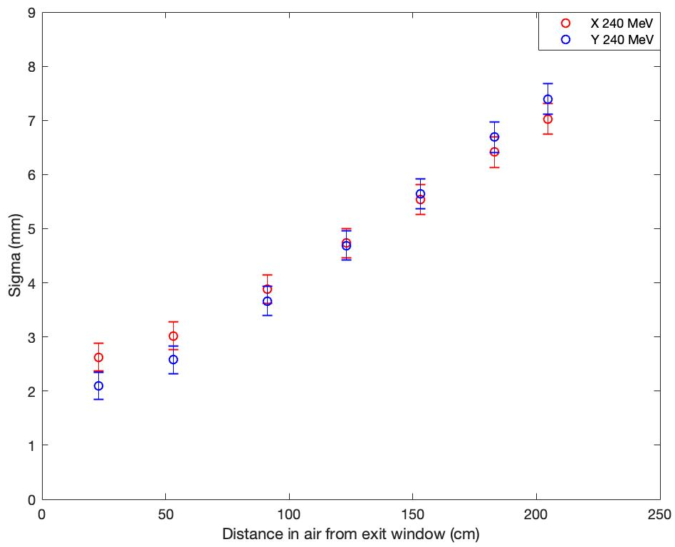
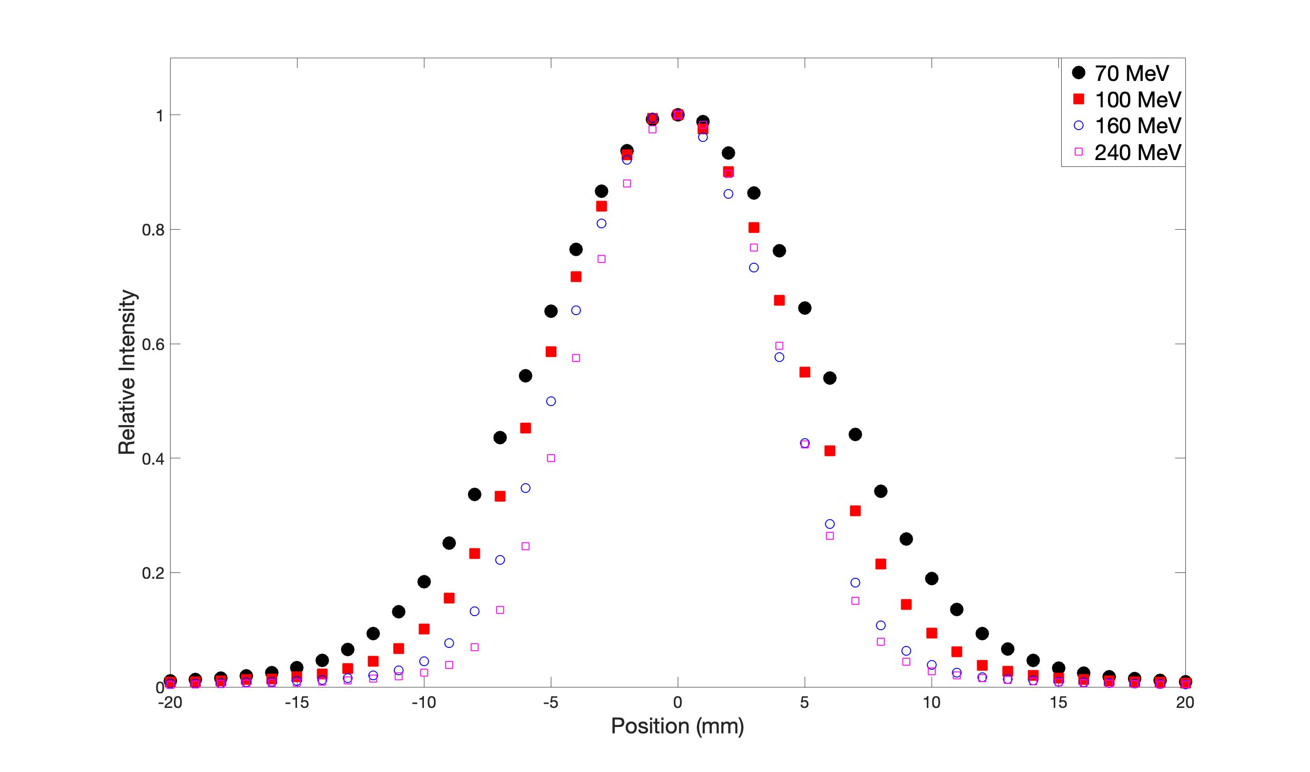
The experimental beam line
Beam monitor
ISO2
ISO1
ISO2
ISO1

Slide 9
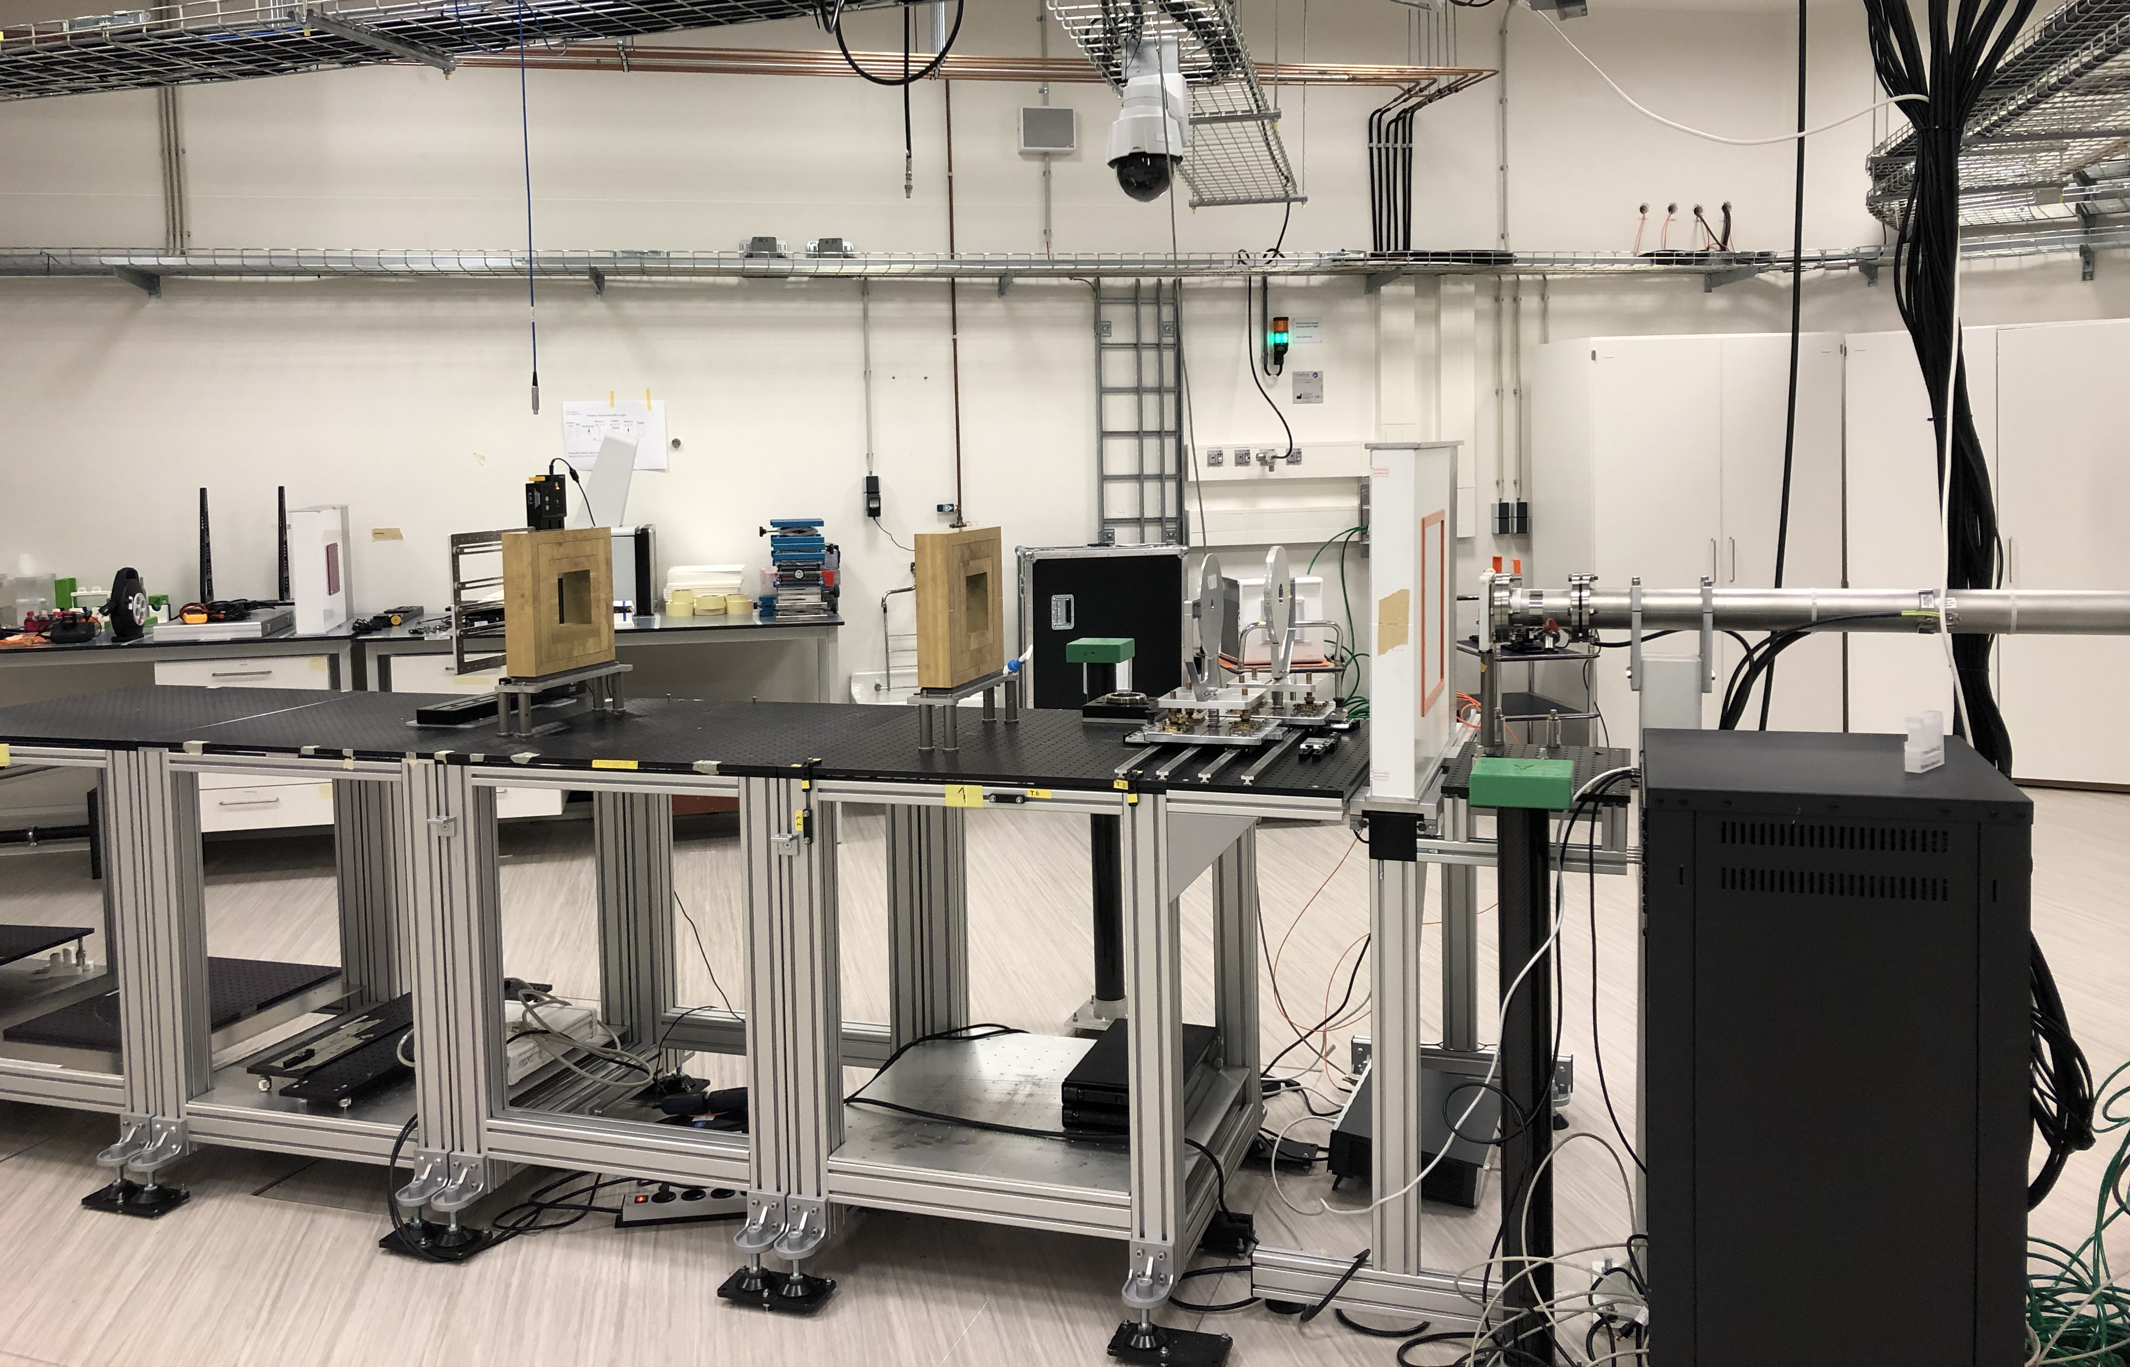
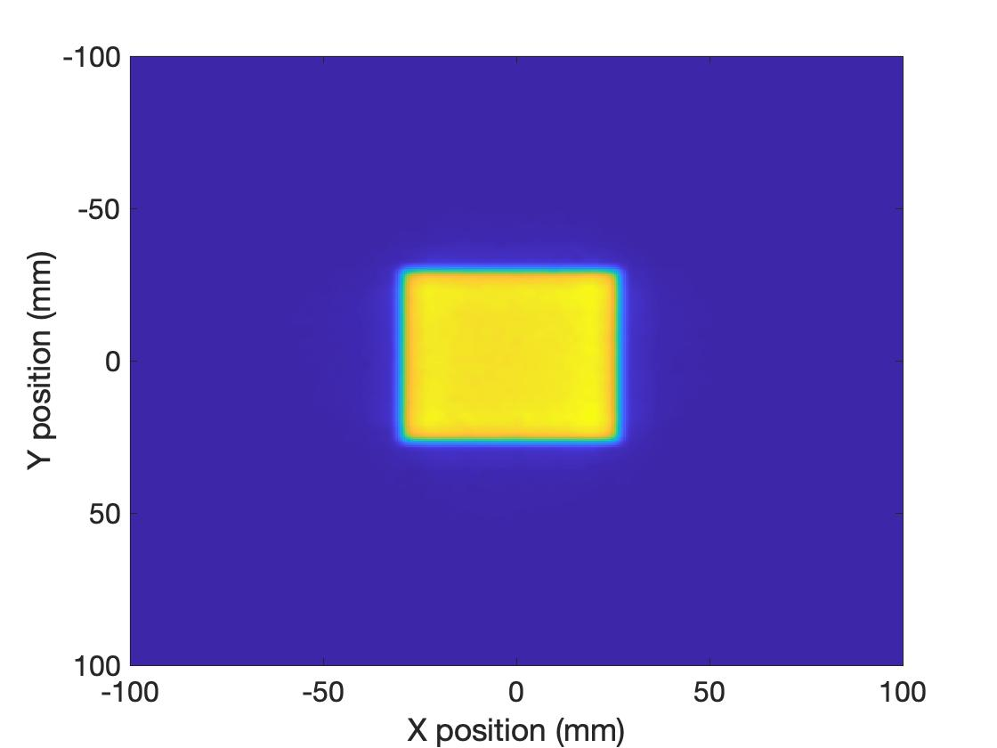
The experimental beam line
Collimator
Dual ring scatterer
Beam vacuum exit window
ISO2
1st scatter foil
Beam monitor

Slide 10
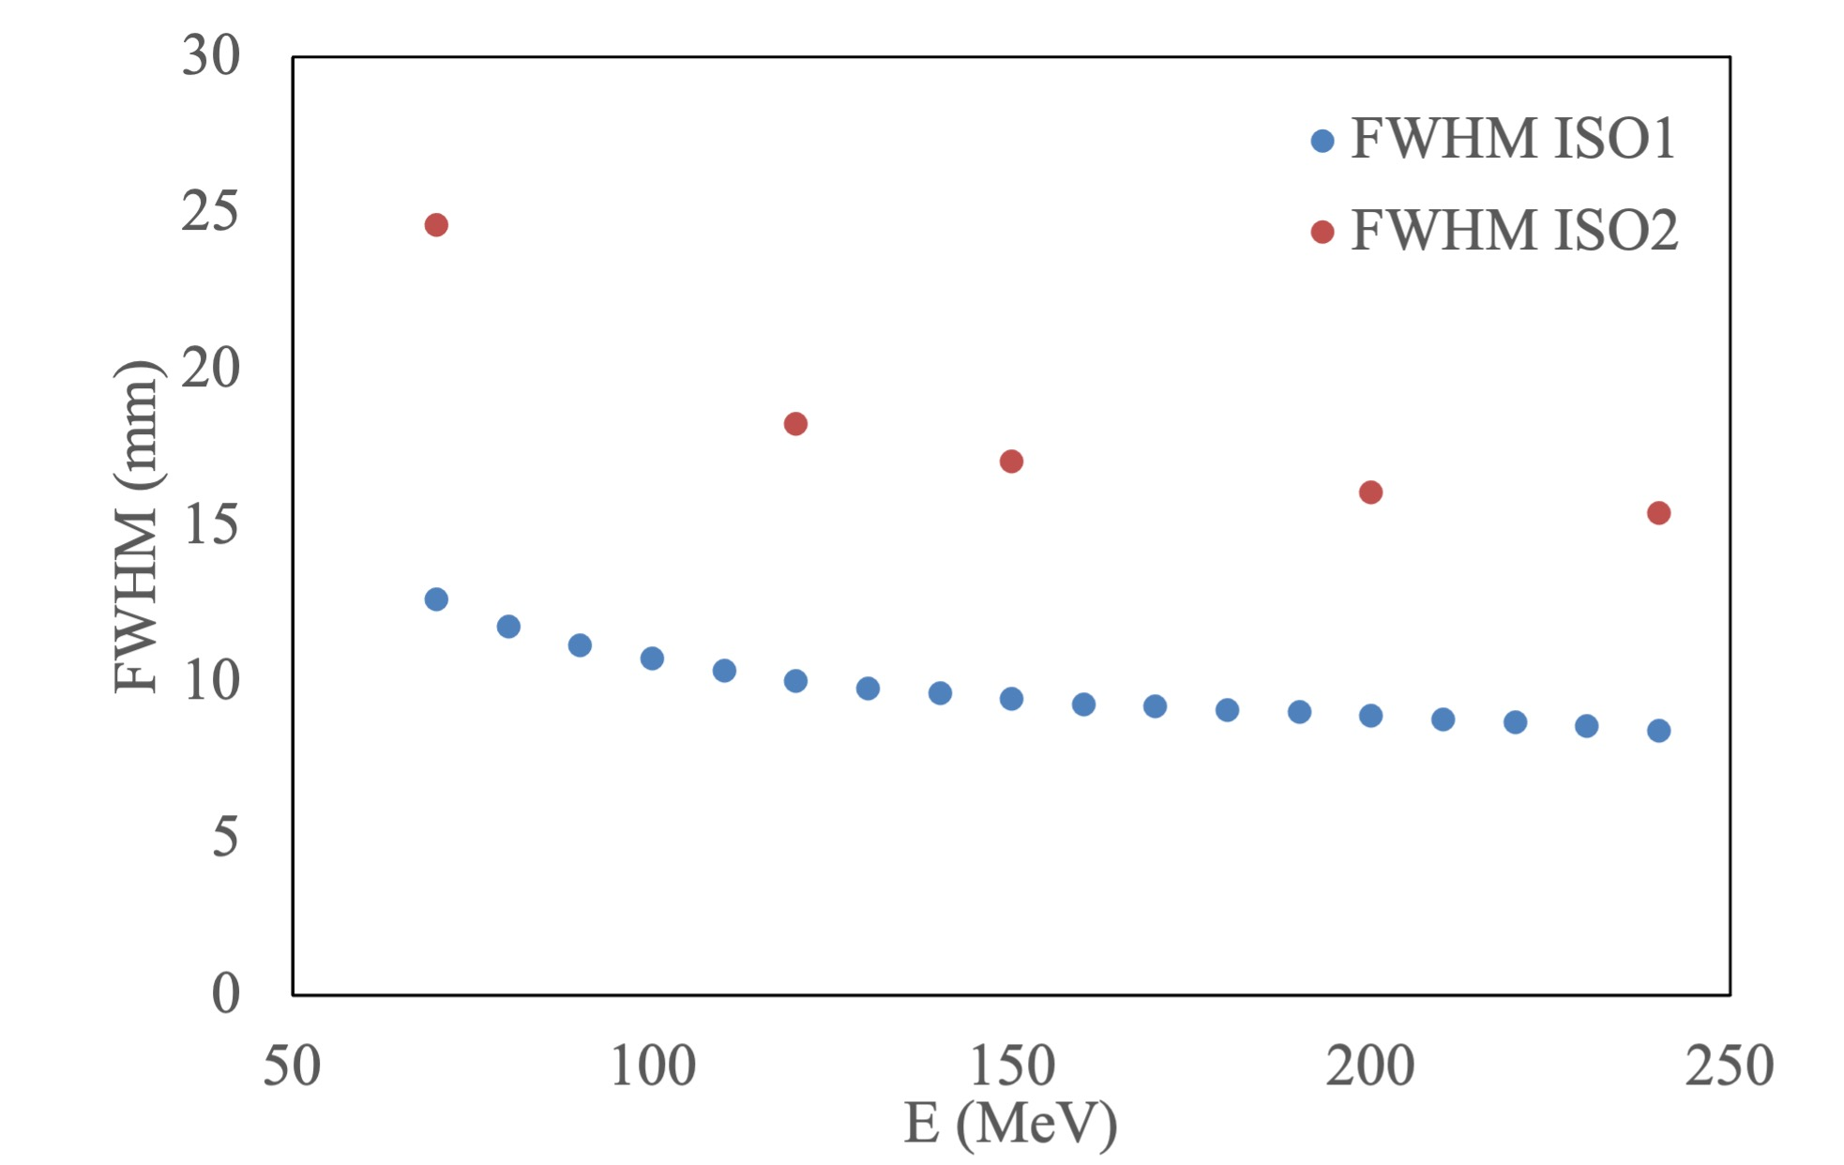
Pencil beam size
Detector: Lynx2D (Fluorescent screen with CCD camera – 0.5mm spatial resolution)
Energy (MeV) | FWHM ISO 1 (cm) | FWHM ISO 2 (cm)
70 | 1,27 | 2,4
80 | 1,18
90 | 1,12
100 | 1,08
110 | 1,04
120 | 1,00 | 1,8
130 | 0,98
140 | 0,97
160 | 0,93
180 | 0,91
190 | 0,91
200 | 0,90 | 1,6
210 | 0,88
220 | 0,87
230 | 0,86
240 | 0,85

Slide 11
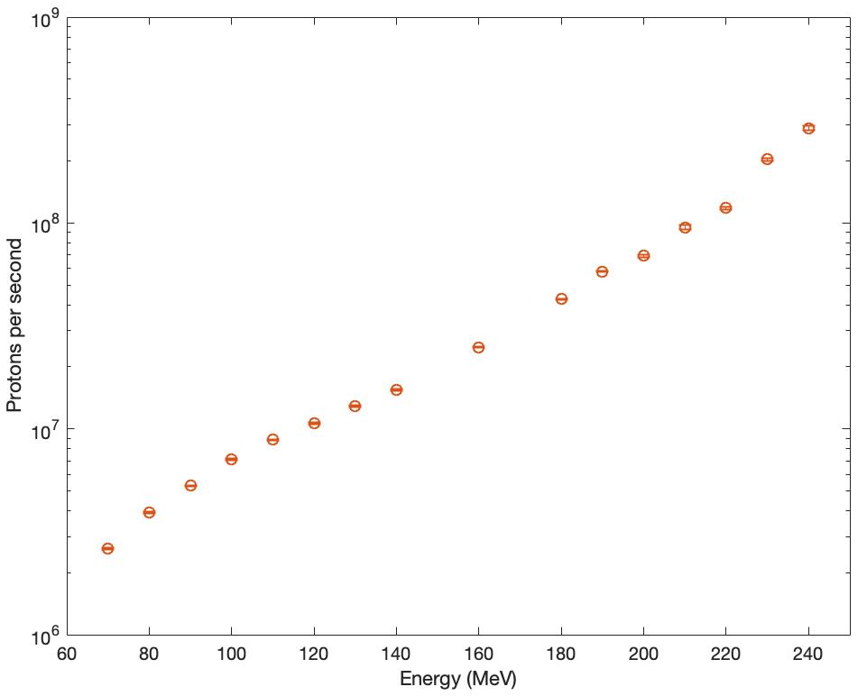
Pencil beam flux
Detector:
Faraday cup (built to measure up to 250 MeV proton beam)
Advanced Markus chamber
For minimum flux
Energy @ target (MeV) | Min Flux (p/s/cm2) | Max Flux (p/s/cm2)
70 | 2.1x10⁶ | 1.7x10⁹
120 | 1.3x10⁷ | 1.0x10¹⁰
200 | 1.1x10⁸ | 8.8x10¹⁰

Slide 12
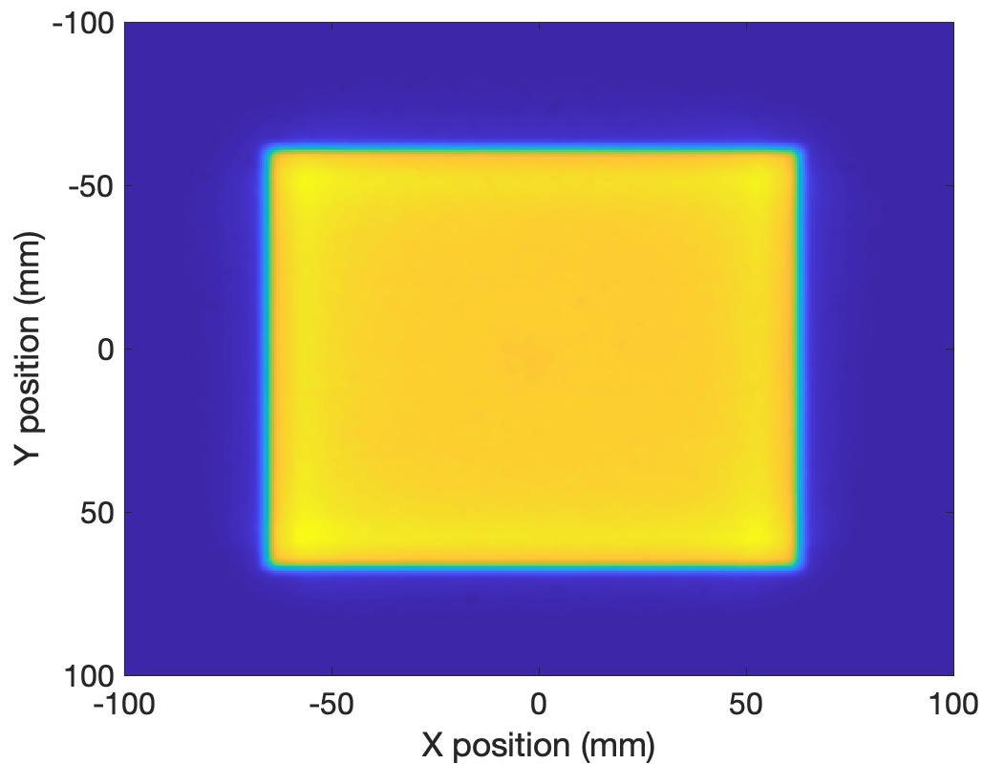
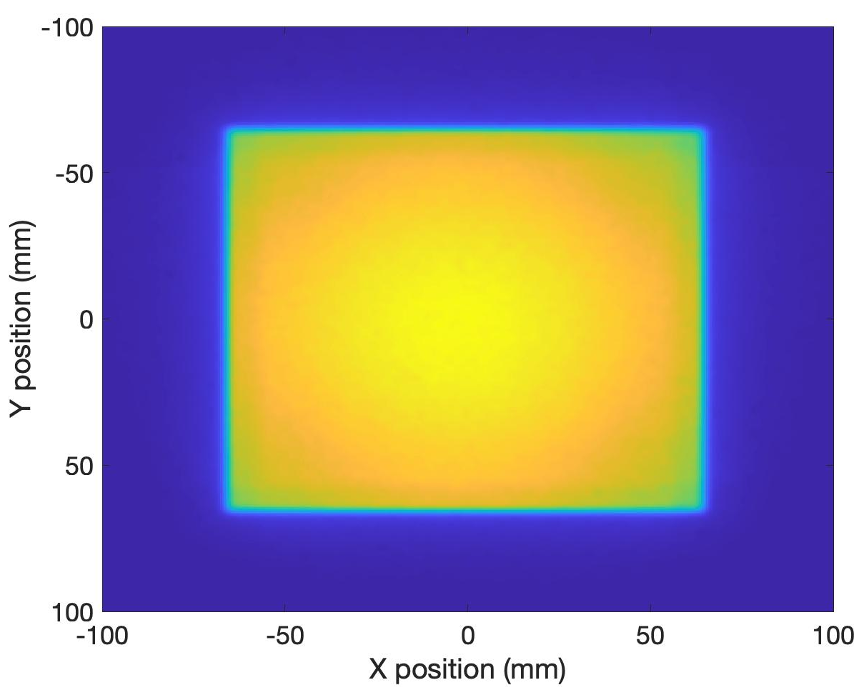
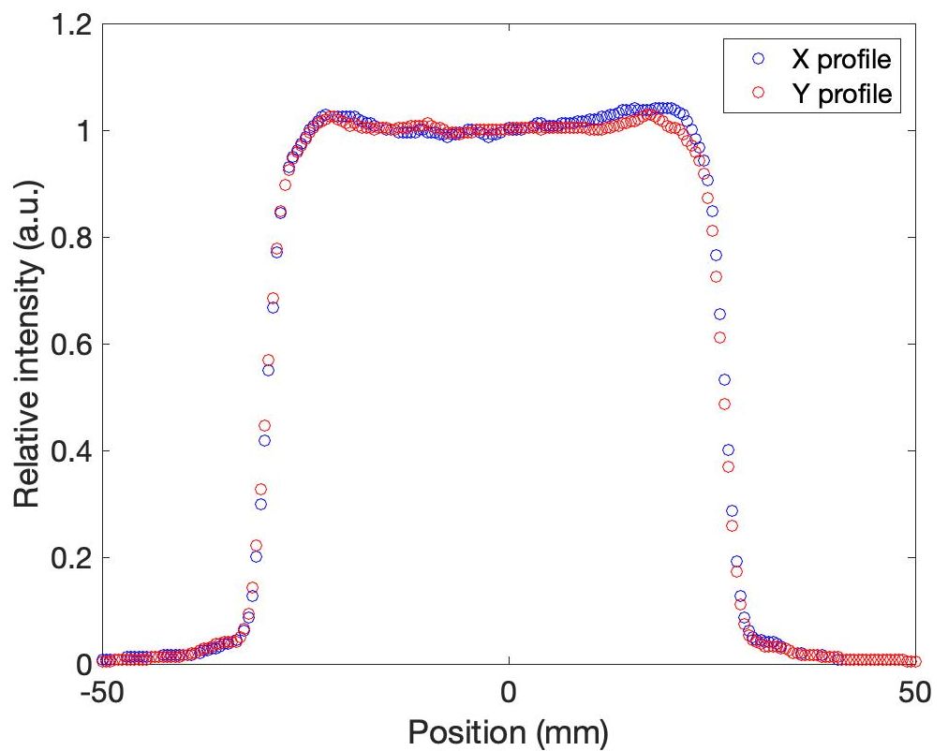
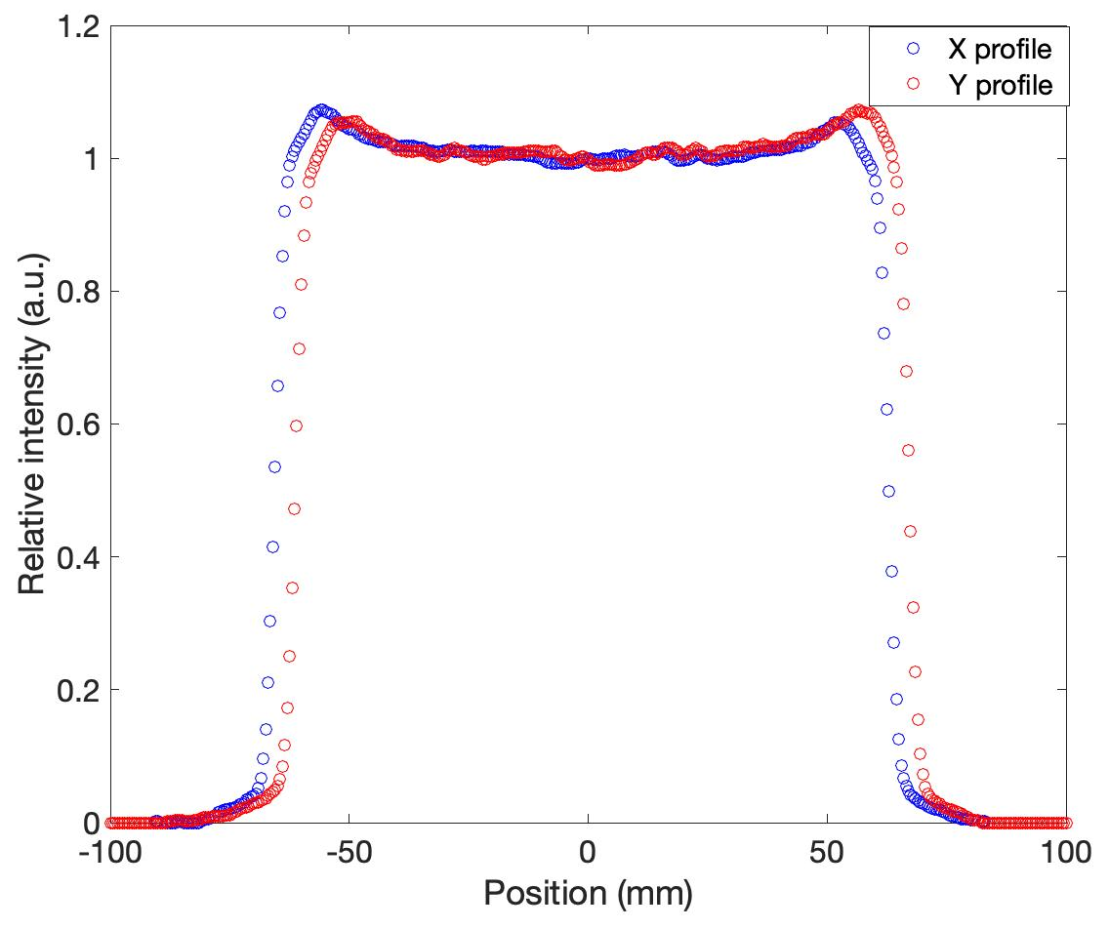
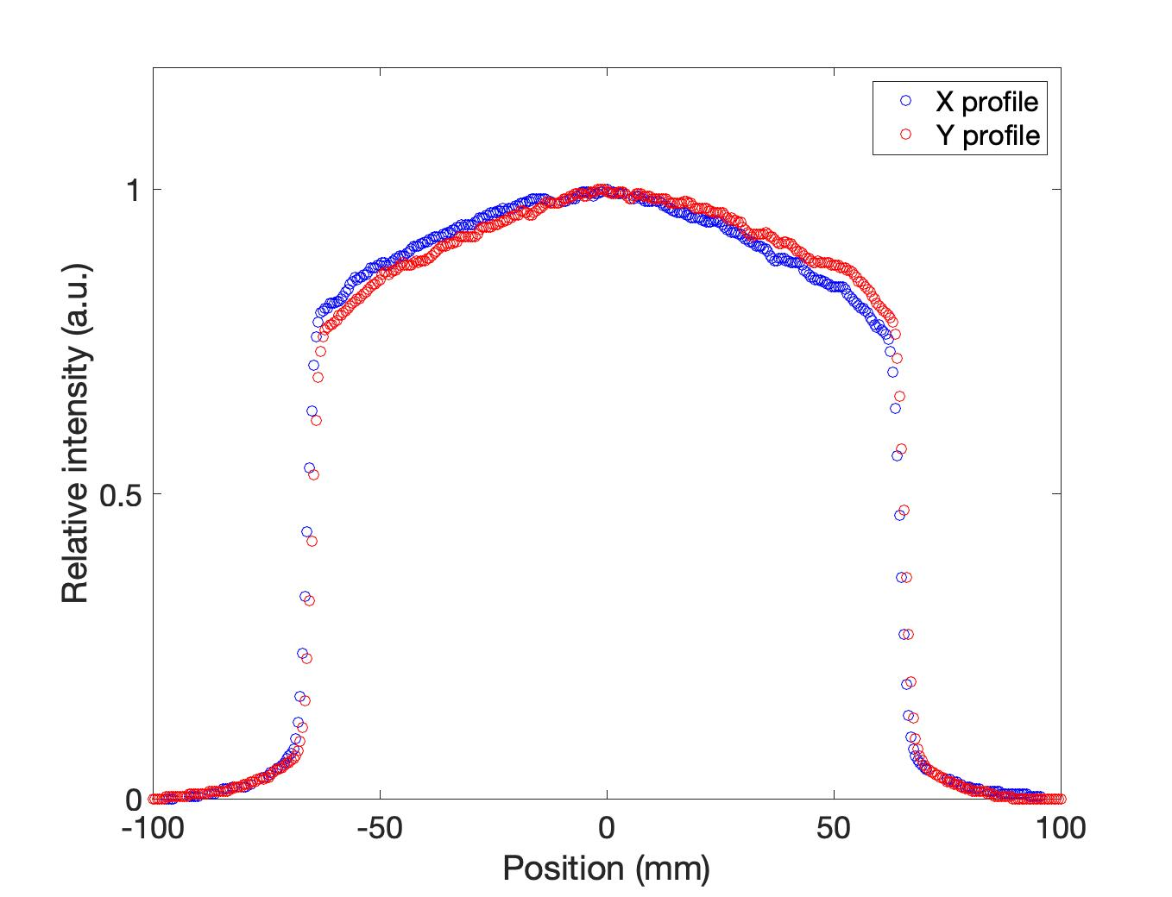
Broad beam profiles
70 MeV @ target 4x4cm 98% Uniformity
120 MeV @ target 10x10cm 98% Uniformity
200 MeV @ target 10x10cm 92% Uniformity

Slide 13
Broad beam flux
70 MeV @ ISO2 - 10cmx10cm Field
Cyclotron Nominal Beam Current (nA) | φ [#/(cm2⋅s)]
1 | 6,87E+04
5 | 3,93E+05
10 | 7,87E+05
20 | 1,57E+06
40 | 3,15E+06
100 | 7,87E+06
200 | 1,57E+07
300 | 2,36E+07
400 | 3,15E+07
500 | 3,93E+07
600 | 4,72E+07
700 | 5,51E+07
800 | 6,29E+07
120 MeV @ ISO2 - 10cmx10cm Field
Cyclotron Nominal Beam Current (nA) | φ [#/(cm2⋅s)]
1 | 6,33E+04
5 | 3,16E+05
10 | 6,33E+05
20 | 1,27E+06
40 | 2,53E+06
100 | 6,33E+06
200 | 1,27E+07
300 | 1,90E+07
400 | 2,53E+07
500 | 3,16E+07
600 | 3,80E+07
700 | 4,43E+07
800 | 5,06E+07
200 MeV @ ISO2 - 10cmx10cm Field
Cyclotron Nominal Beam Current (nA) | φ [#/(cm2⋅s)]
1 | 6,27E+05
5 | 3,13E+06
10 | 6,27E+06
20 | 1,25E+07
40 | 2,51E+07
100 | 6,27E+07
200 | 1,25E+08
300 | 1,88E+08
400 | 2,51E+08
500 | 3,13E+08
600 | 3,76E+08
700 | 4,39E+08
800 | 5,02E+08

Slide 14
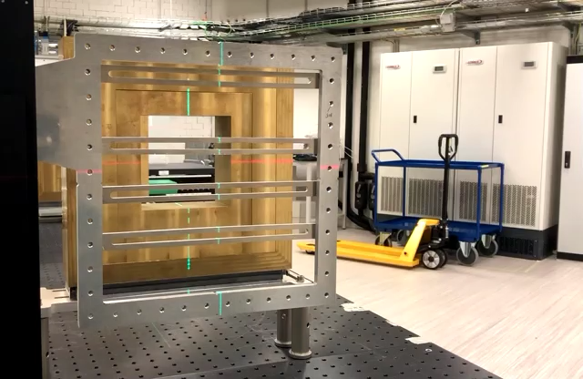
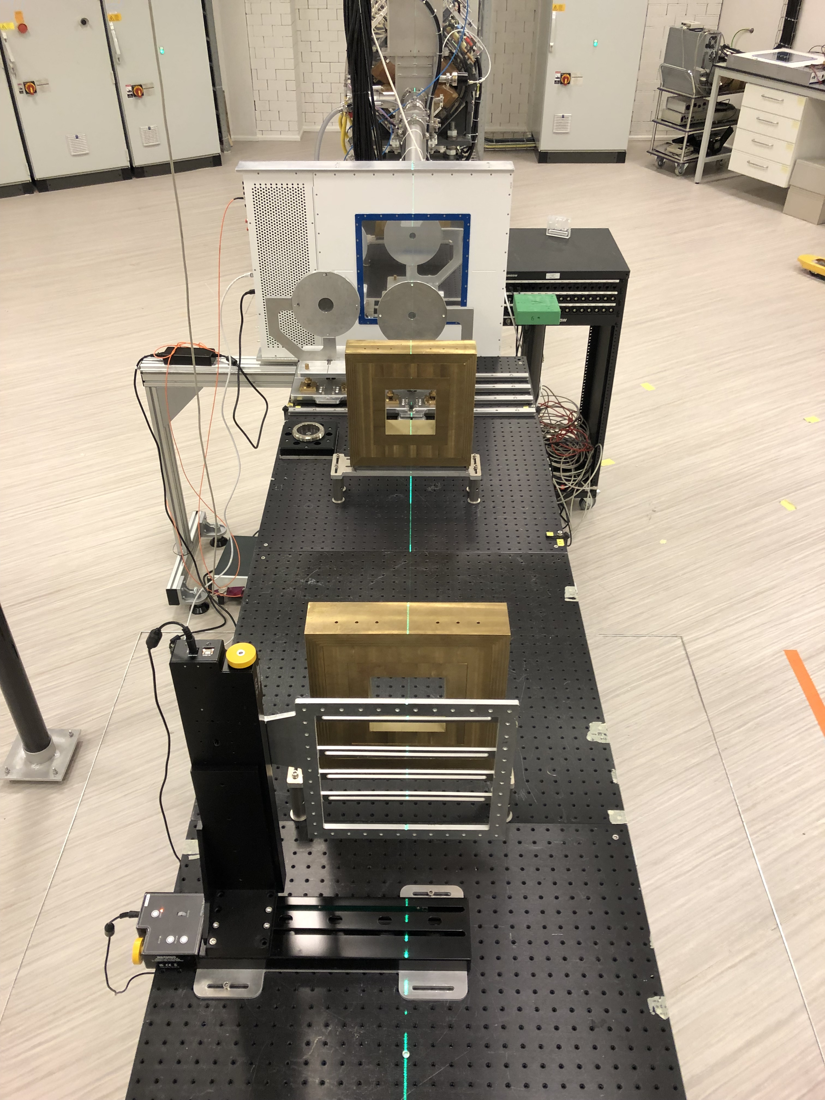
Target station for radiation hardness tests
Motorized X-Y stage remotely controlled

Slide 15
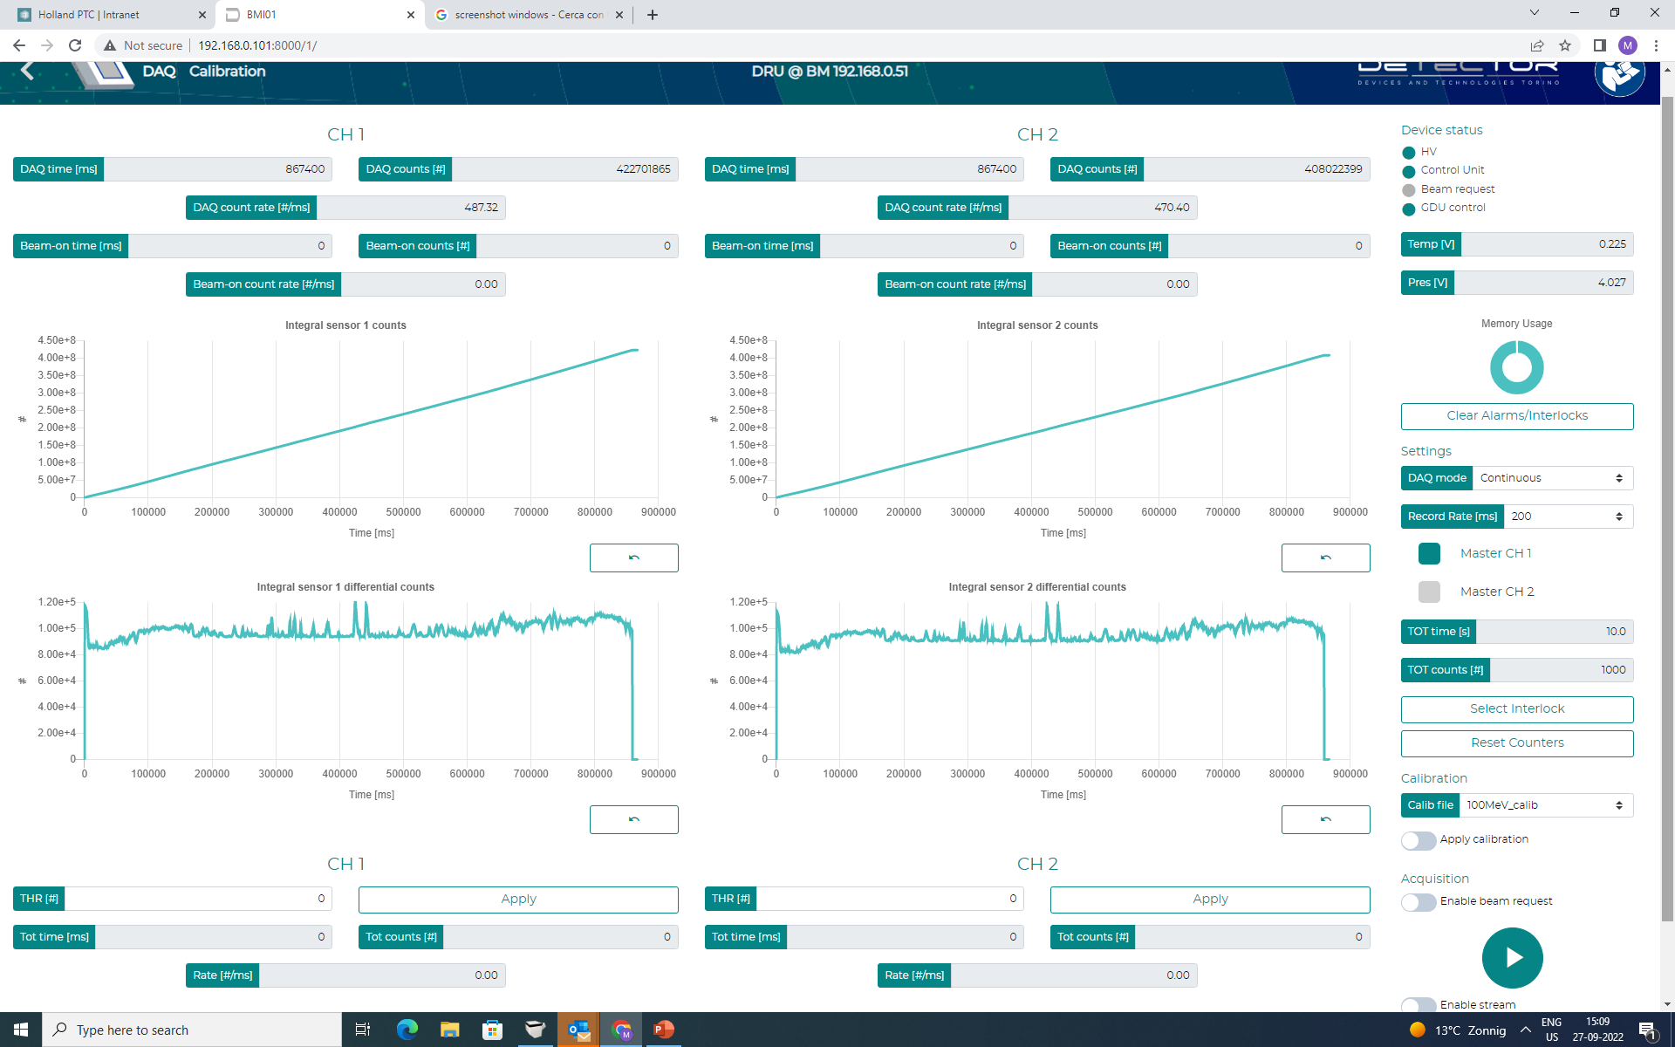


Beam delivery system

Slide 16
What we tried to achieve as service-based facility
  Flexible way to setup your experiment (standard board holder, specific 3D printed holder, remote controlled motorized stage for precise alignment, etc..)
  Flexibility in the planning (scheduling between few weeks and a couple of months
  Comfortable beam time hours, between 5pm and 11pm
  Setup time during day time, possibility to setup the day before (or setup test in the physics laboratory, without extra costs involved)
  Possibility to have 2-3 shifts in a row
  Possibility to have longer shift over the weekend
  Possibility to have short irradiation during day time (below 2min)

Slide 17



The “easys” of HPTC
  Easy to travel to HPTC from Europe (Amsterdam airport 30min away)
  Easy access HPTC and get beam time (no paper work required ☺)
  Easy to get information on the beam line and get a quote (within 1-2 days)

Slide 18
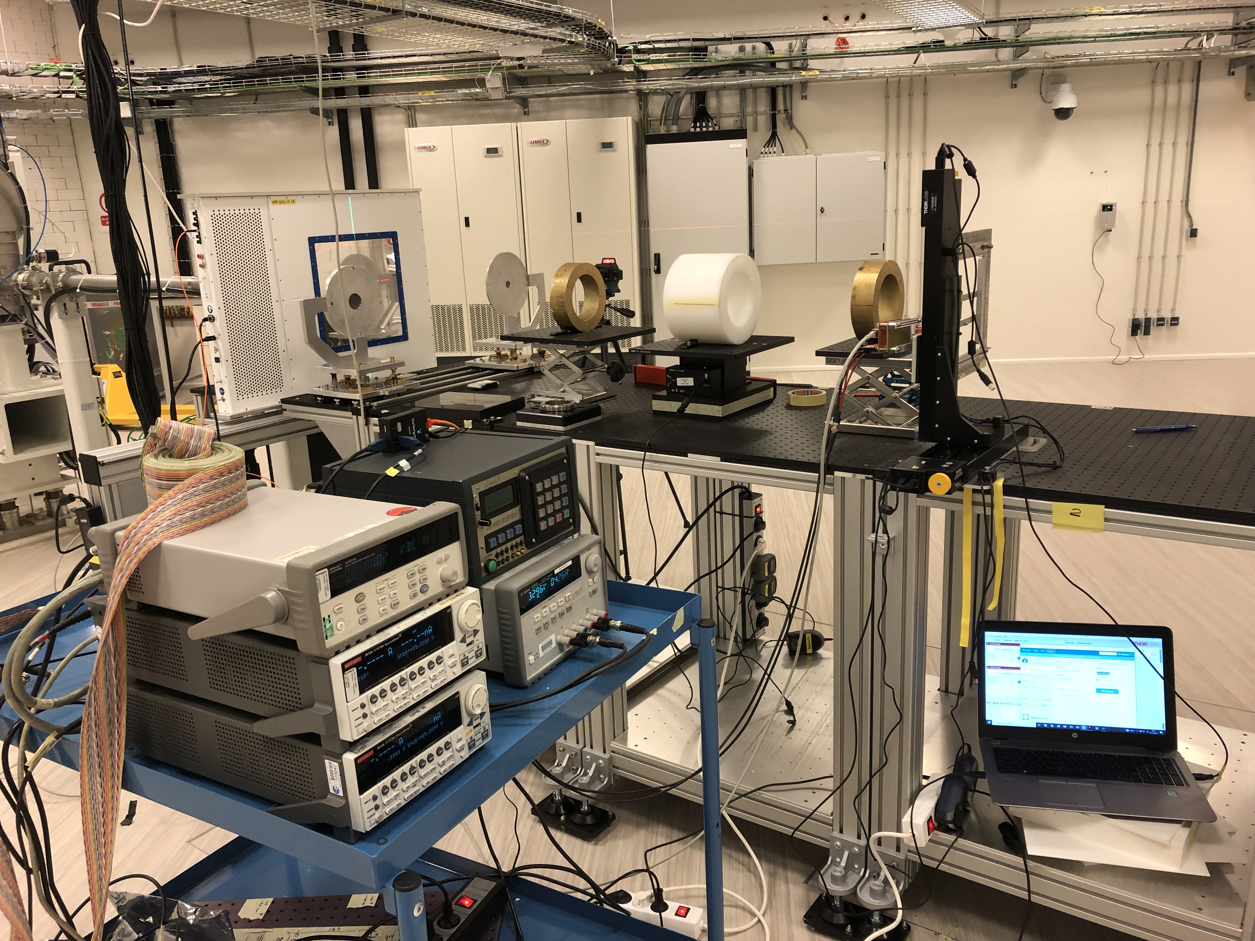
Users from 2022 to 2024
16 experimental campaigns in 2022
22 experimental campaigns in 2023
4 experimental campaigns Q1 2024
Total 42

Slide 19
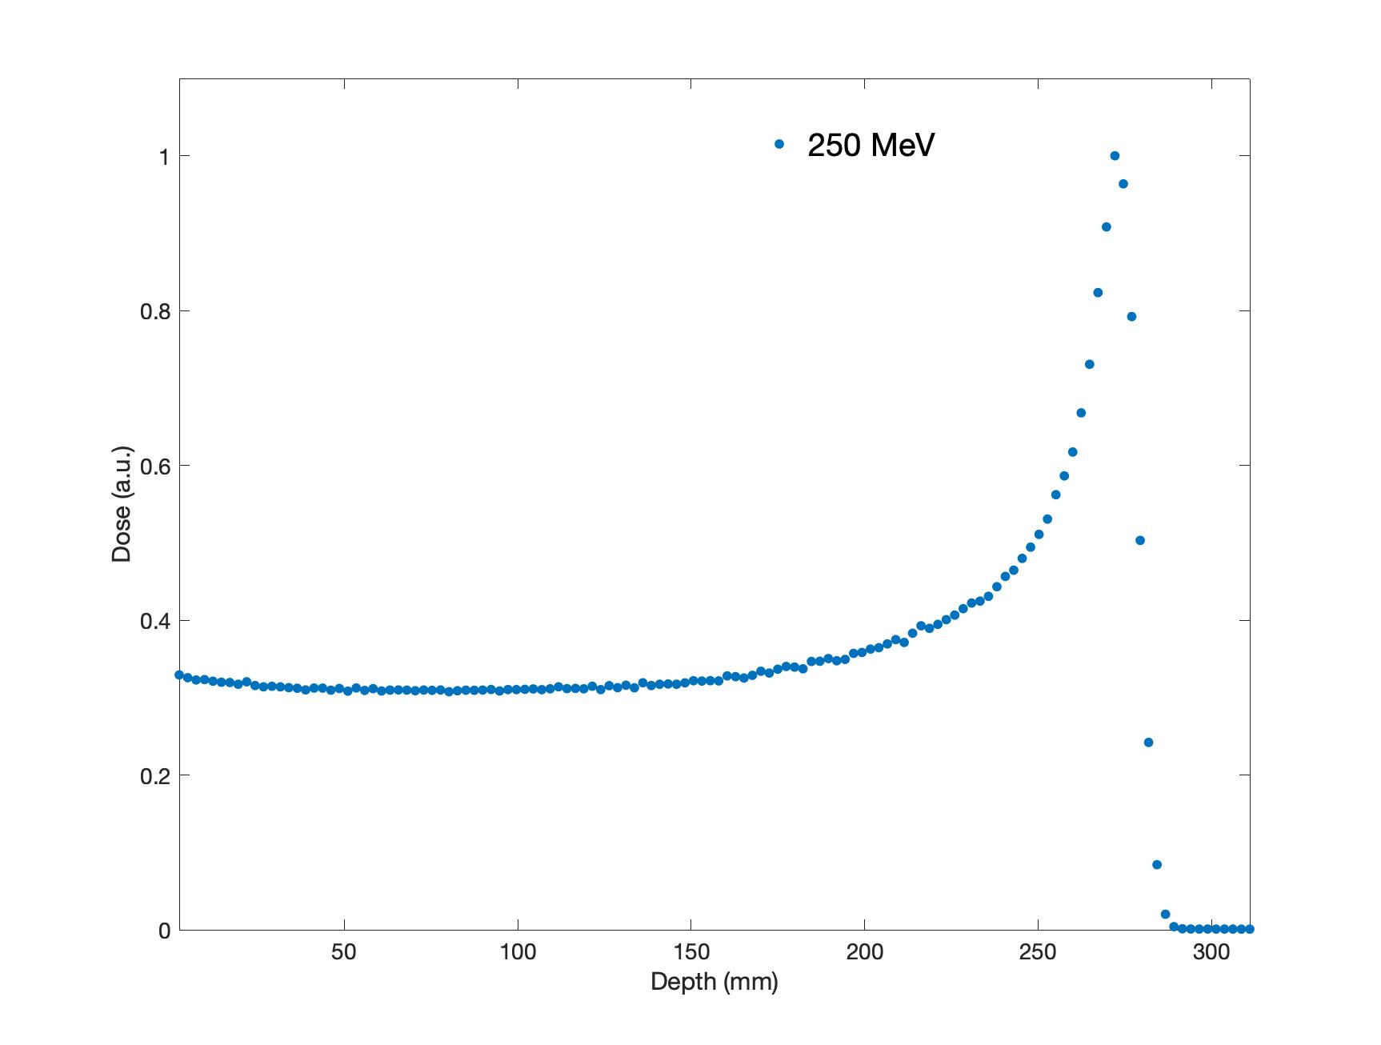
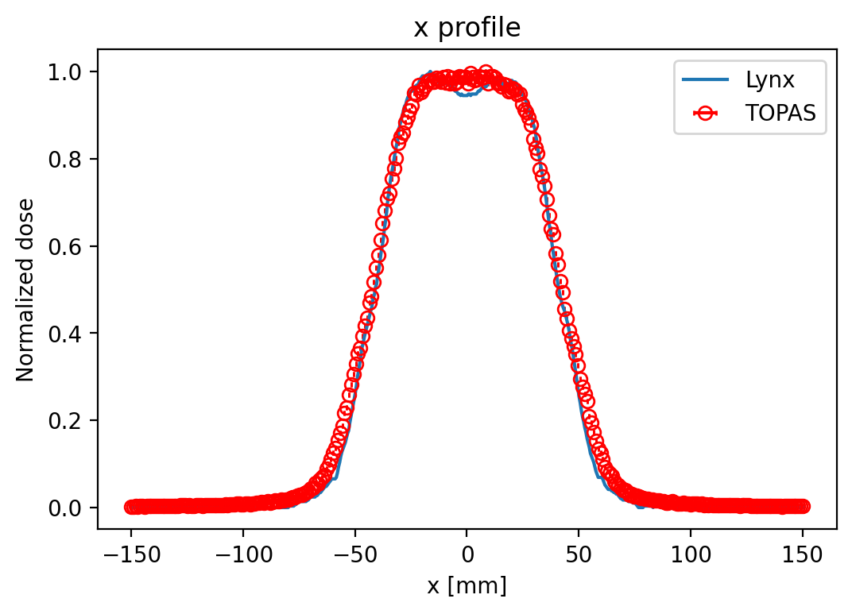
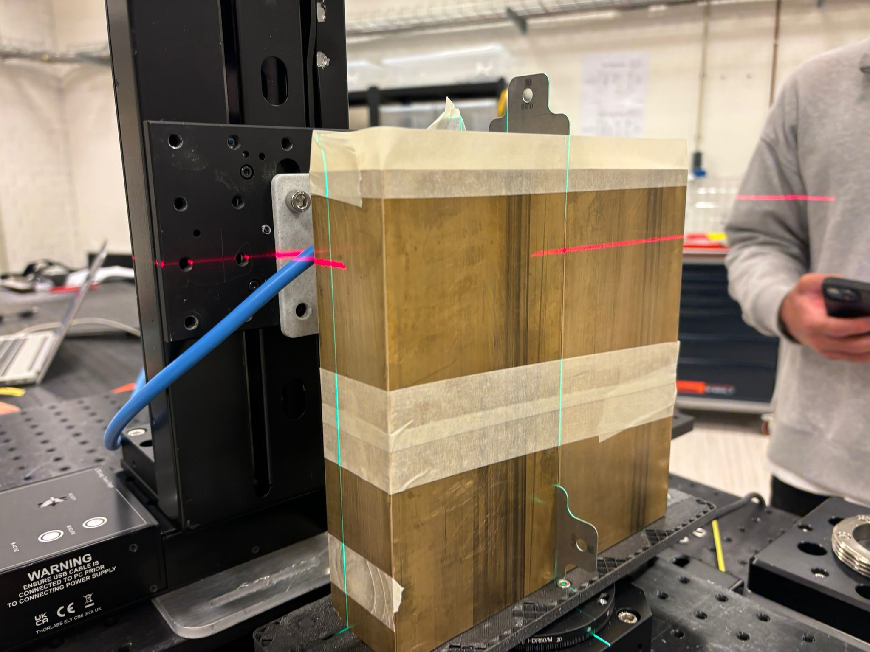
New possible developments
  Tune energies between 200 and 250 MeV for pencil beams and 5x5cm field with the possibility of high fluxes
  Possibility to have small beam size of the order of few mm in FWHM

Slide 20
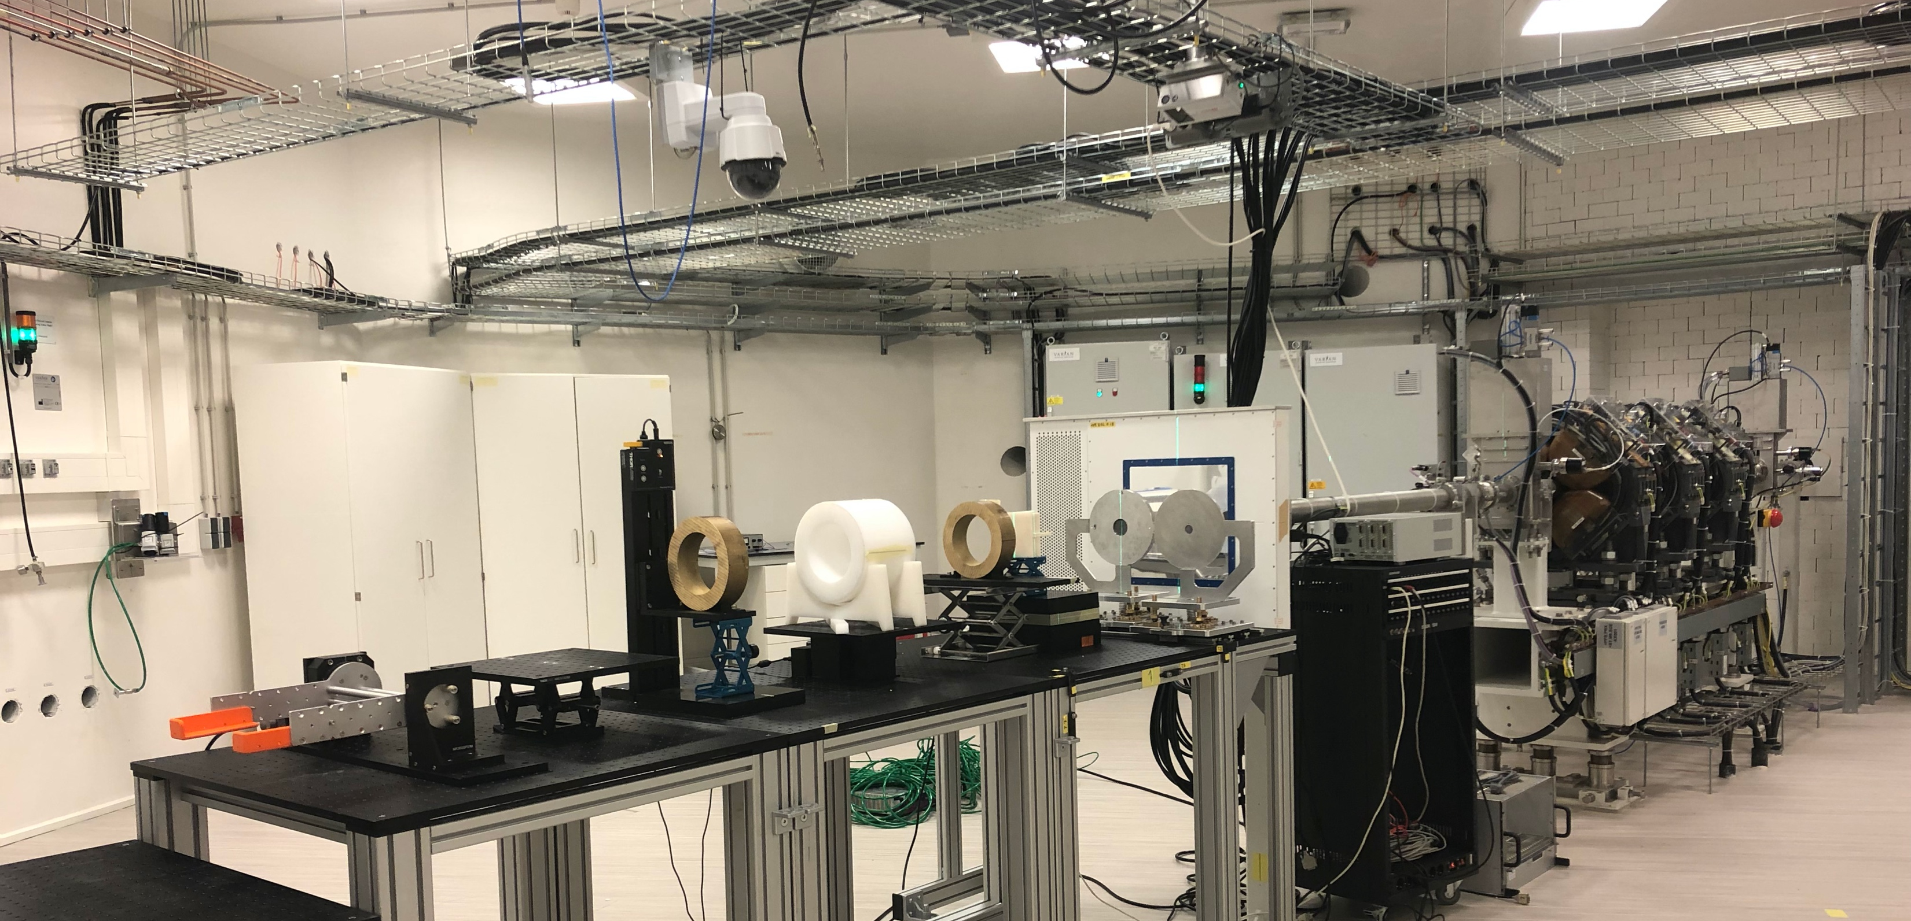

How to get beam time
Direct e-mail to Research office: researchoffice@hollandptc.nl

Slide 21
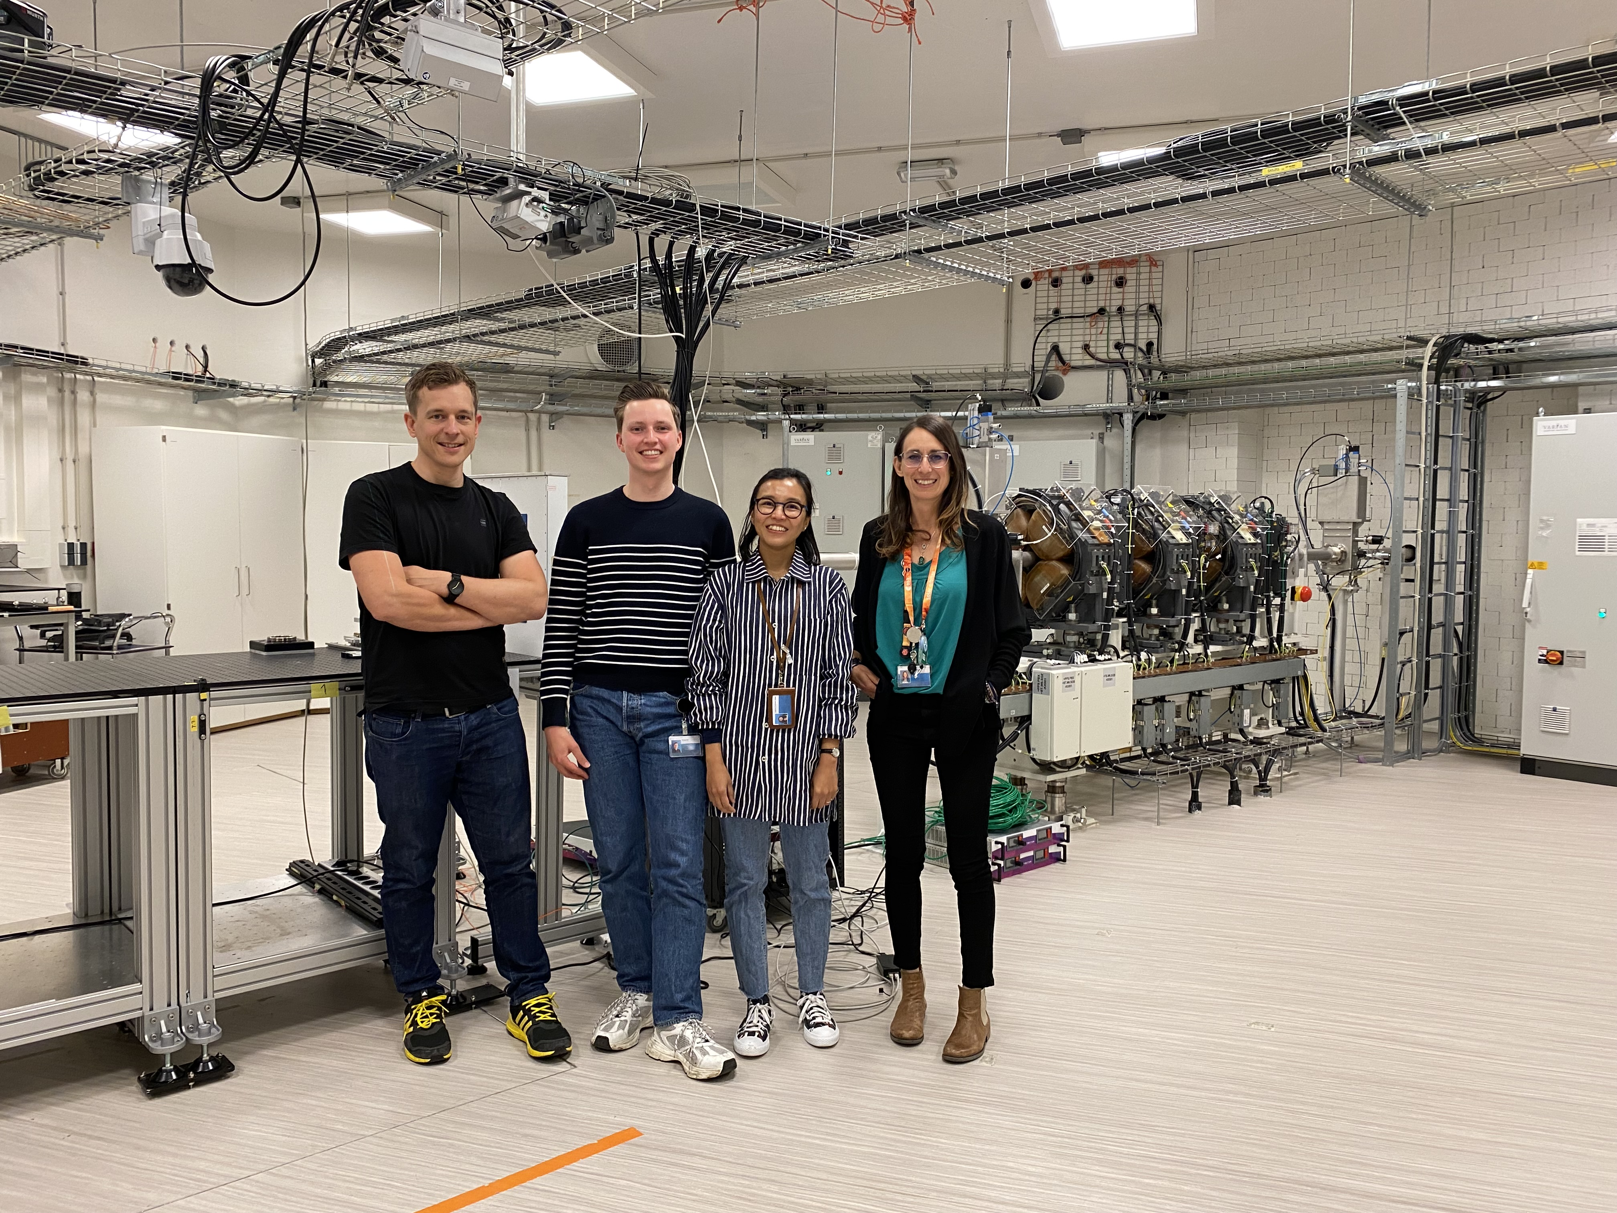
The beam line team
Ernst van der Wal
(beam line manager and beam line engineer)
Thomas Toet
(beam line technician and beam line operator)
Reni Puspitasari-Kokko
(beam line radiobiologist)
Marta Rovituso
(beam line scientist)

Slide 22
Thank you all for your attention!
Special thanks to
ESA-Estec team: A. Costantino - A. Pesce - M. Muschitiello - M. Tali - T. Borrel
HollandPTC R&D head M. Hoogemann & HollandPTC Director I. van Haaren

