Slide 1

WP05-JRA1 Radiation monitors, dosimeters and beam characterization
Sylvain GIRARD (WPL), Cornelia HOEHR (Deputy WPL)
RADNEXT 3rd Annual Meeting – 10/11 June 2024
https://indico.cern.ch/event/1348465/

Slide 2












WP05-JRA1: Main Objective
define and answer RADNEXT facilities and user needs in terms of radiation detectors, beam instrumentation and dosimetry.
  12 RADNEXT partners involved in WP05
  21 members in the CERN e-group
KUL
UU
GANIL
GSI
UJM
CERN
UniPD
UO
UM
TRIUMF
FINT
UKRI

Slide 3
WP05-JRA1: Three main technical tasks
    Definition of the correlation matrix between the facility needs and the established or innovative monitoring solutions as well as the definition and standardization of the relevant beam parameters to be monitored across the facility network
    To investigate innovative instrumentation regarding their potential high impact on facility operation and optimization of radiation to electronics testing
    To develop, characterize and qualify low-cost detectors and dosimeters and have them accessible to RADNEXT users
Main objective: rendering the facility network more accessible, homogeneous and complementary

Slide 4

WP05-JRA1 Task 5.2 : Definition of the RADNEXT facilities & users instrumentation needs, inter-laboratory comparison
Task Leader: UO (Björn Poppe)
Participants: TRIUMF, UJM, UU, CERN, FINT, UnPd, Ganil, GSI, UKRI-STFC
PhD student Andreas PFLAUM
5.2.1 - Definition of the correlation matrix between RADNEXT facilities needs and established or innovative sensing solutions
5.2.2 - Definition and Standardization of Relevant Beam Parameters
5.2.3 - Improving the comparability and accuracy of beam and dose parameters
  Next talk: Recent progress by Andreas PFLAUM (UO)
Andreas PFLAUM

Slide 5
WP05-JRA1 Task 5.3 : Innovative instrumentation applied to RADNEXT facilities
Task Leader: UJM
Participants: TRIUMF, CERN, FINT, GSI, UniPD, UU, GANIL, UKRI-STFC, KUL
PhD student L. Weninger UJM
Optical Fiber-based solutions*
3D NAND Flash
SEU monitor **
Characterization of neutron fields **
SRAM Dosimetry

Slide 6

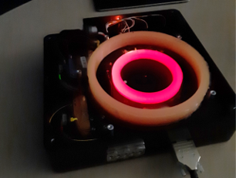
WP05-JRA1 Task 5.3 : Fiber-based solutions
Neutron testing @ ENEA & TRIUMF
  RIL-based dosimetry @ FNG/ENEA atm. Neutrons (TA)
➔ Next talk by Luca Weninger (UJM) & official ENEA/UJM collaboration in progress
  RIA-based dosimetry @ TRIUMF atm. Neutrons
  RIA-based dosimetry @ FNG/ENEA 14 MeV Neutrons (TA)
Low-energy Proton testing @ CLPU (TA)
  Joint UJM-CERN-ELI-CLPU experiment
Distributed sensing: radiation detection along one optical fiber
Luca WENINGER

Slide 7
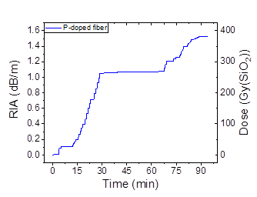
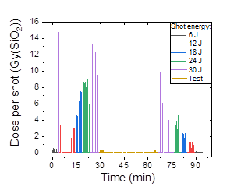
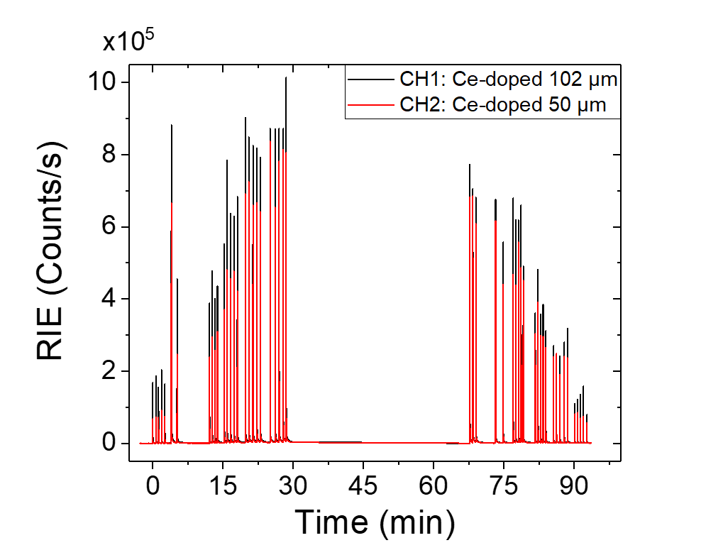
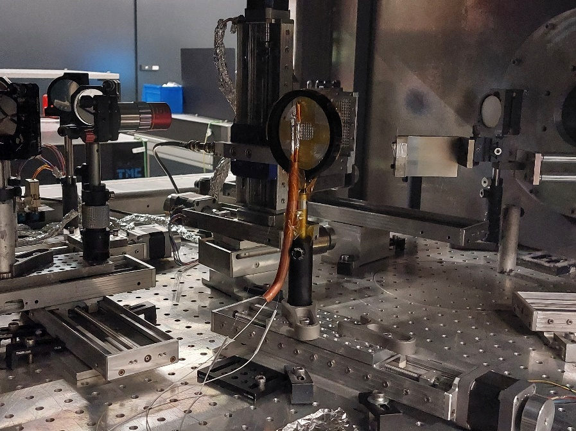
WP05-JRA1 Task 5.3 : RIA/RIL Fiber-based dosimetry
Teaser CLPU Results
RIA
These tests reveal the high potential of fibers to monitor low energy proton flux associated with PW lasers in a EMP-rich environment
RIA-FOD gives absolute dose values on a larger zone while RIL-FOD gives dose rates on a smaller zone . Ideas to optimize the detectors
RIA
RIL
Future: to be done if TA (CHARM?, CNA?, ENEA?)

Slide 8
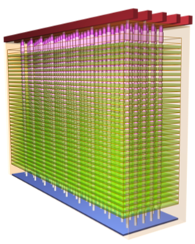
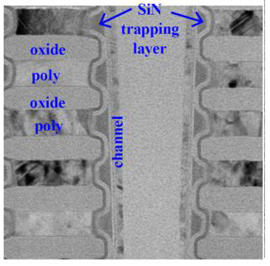
WP05-JRA1 Task 5.3 : 3D NAND Flash SEU monitor (Work by UniPD)
Ionizing radiation causes a threshold voltage shift (ΔV_{th}) in Flash cells and this shift can be exploited to realize a particle detector/ radiation dosimeter
3D NAND Flash devices offer many advantages as an ionizing particle detector, compared to other memories
  ΔV_{th} can be extracted, in addition to the number of errors
  Non-volatility: low power, no data loss with SEFIs, passive detectors, etc…
  Capability of tracking particles in three dimensions, higher precision in determining the beam features, discrimination of errors due to radiation from other errors
3D NAND Flash exploit either FG cells (conductive polysilicon Floating Gate cells) or RG (replacement gate) technology using Charge Trap (CT) cells
The purpose is to explore the feasibility of a high-LET particle detector based on 3D NAND Flash CT memories

Slide 9
WP05-JRA1 Task 5.3 : 3D NAND Flash SEU monitor (Work by UniPD)
Scaling of 3D NAND Flash
Two possible approaches to increase the density of 3D Flash array
  Act on xy plane: reduction of the cell feature size
  Act in z-direction: increase the number of stacked layers (preferred strategy, minimizes the technological and electrical issues associated with taller pillars)
The trend is to reduce the tier pitch (i.e. distance between adjacent WLs)
Tier pitch scaling leads to higher electric fields between adjacent cells and therefore stronger disturbs
The impact of tier pitch scaling on cell array radiation sensitivity needs to be addressed

Slide 10
WP05-JRA1 Task 5.3 : Impact of Tier Pitch on SEE Sensitivity of 3D NAND Flash
SEE sensitivity of Large Tier Pitch (LTP) and Small Tier Pitch (STP) cells was compared
The cross sections show an increase more than proportional to the reduction in tier pitch
The threshold voltage distributions show similar trends
The increase in sensitivity has been attributed to the reduction of stored charge, increased cell-to-cell electric fields, and increased variability in V_{th}
M. Bagatin, S. Gerardin, A. Paccagnella, A. Benvenuti, S. Beltrami, “Impact of Tier Pitch Scaling on Heavy-ion Sensitivity of 3D NAND Flash Memories,” Trans. Nucl. Sci. 2024

Slide 11
WP05-JRA1 Task 5.3 : 3D NAND Flash SEU monitor (Work by UniPD)
Latest Results and Publications
Impact of Tier Pitch Scaling on single event effect sensitivity of 3D NAND Flash memories
  M. Bagatin, S. Gerardin, A. Paccagnella, A. Benvenuti, S. Beltrami, “Impact of Tier Pitch Scaling on Heavy-ion Sensitivity of 3D NAND Flash Memories,” presented at RADECS 2023, Toulouse, France, Sept. 2023
  M. Bagatin, S. Gerardin, A. Paccagnella, A. Benvenuti, S. Beltrami, “Impact of Tier Pitch Scaling on Heavy-ion Sensitivity of 3D NAND Flash Memories,” Trans. Nucl. Sci. 2024
Impact of Tier Pitch Scaling on total ionizing dose sensitivity of 3D NAND Flash memories
  M. Bagatin, S. Beltrami, A. Paccagnella, S. Gerardin, “Total-Dose Induced Threshold Voltage Shift Dependence on Tier Pitch in 3D NAND Flash Memories,” to be presented at NSREC 2024, Ottawa, Canada, July 2024
Future work
  Study of interaction between heavy ions and TID
  TCAD simulations

Slide 12
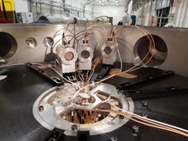
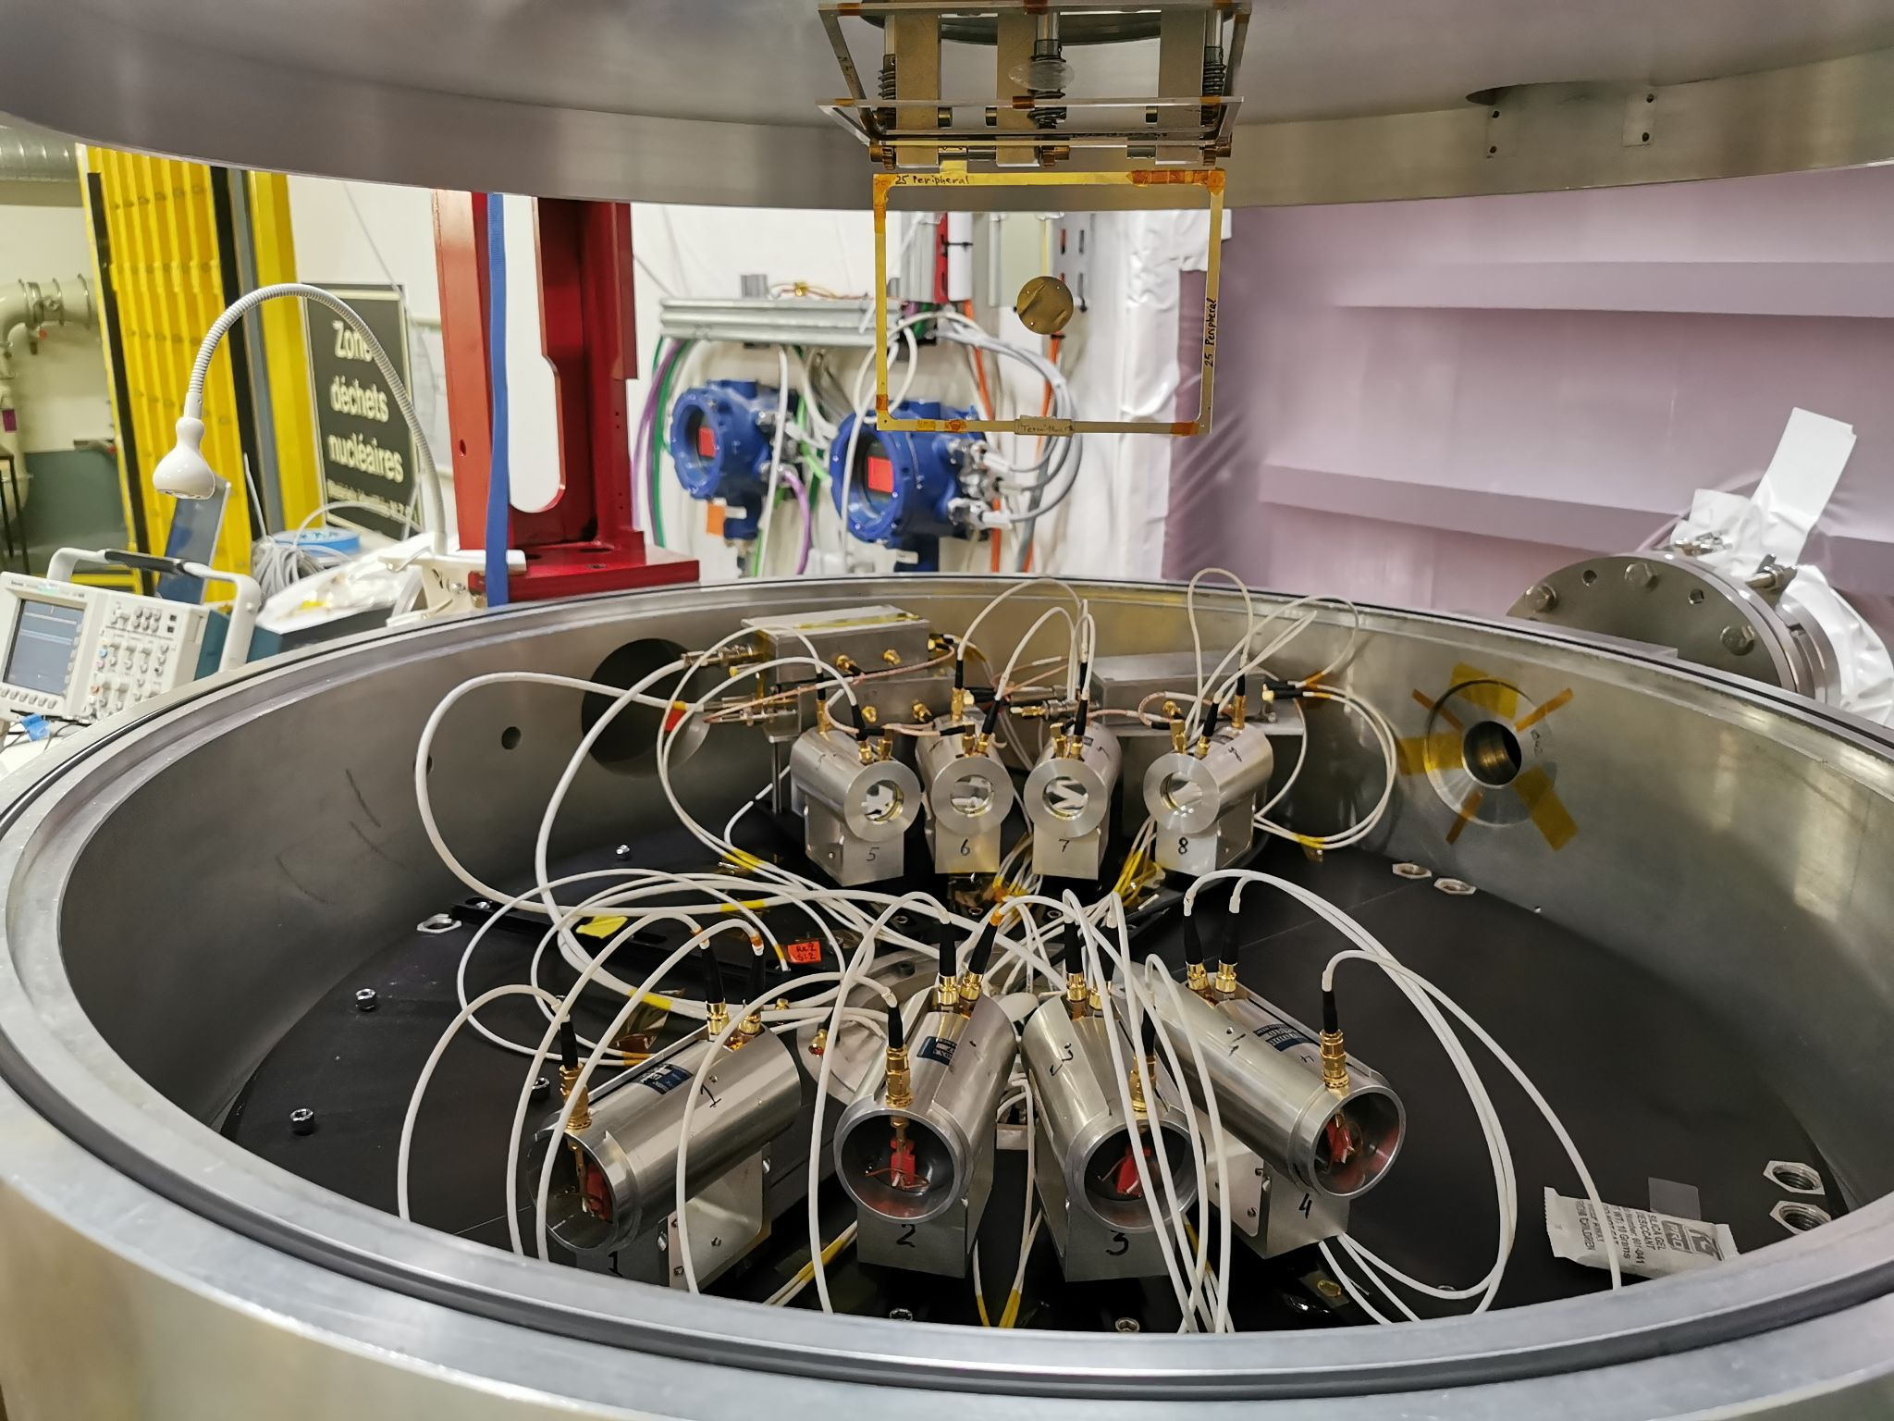
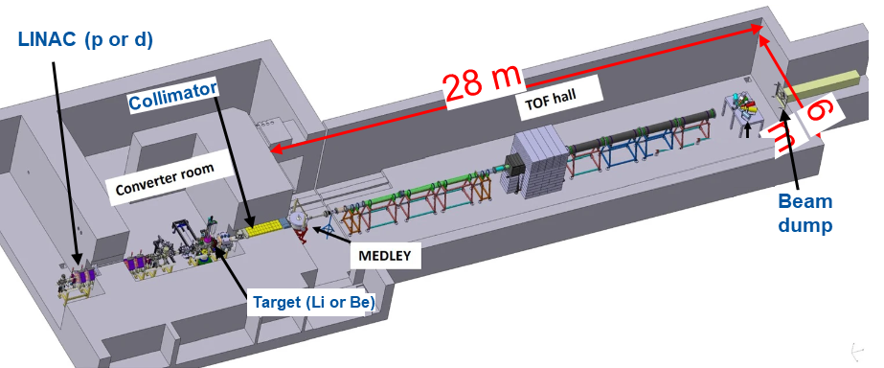
RADNEXT, WP5 - Task 5.3, D5.4 Characterization of neutron fields at the NFS facility
D. Tarrío and S. Pomp (Uppsala University, Sweden), L. de Arruda and X. Ledoux (GANIL, France)
WP05-JRA1 Task 5.3 : Characterization of neutron fields at NFS white neutron beam (Work by UU and GANIL)
  Neutrons for Science (NFS) at GANIL (France) is a new neutron facility, operating since 2019, with a 20 meter long flight path.
  White spectrum neutron beam extends,from ~1 to ~ 40 MeV neutrons, and is produced by 40-MeV deuterons hitting on a 9-mm thick Beryllium target.
Experimental setup: The Medley setup, formerly used at the old TSL facility (Uppsala, Sweden) with quasi monoenergetic neutron beams. Medley was transferred to NFS in 2021 and reconfigured to work with white neutron beams.
The Medley setup consists of a chamber with 8 telescopes, placed at 20° intervals, able to detect and identify light ions.
Medley setup with target installed.
It is also being used in other experiments to measure double-differential cross-sections of light-ion production in neutron-induced reactions.
Scheme of NFS facility, highlighting its main components.
12

Slide 13
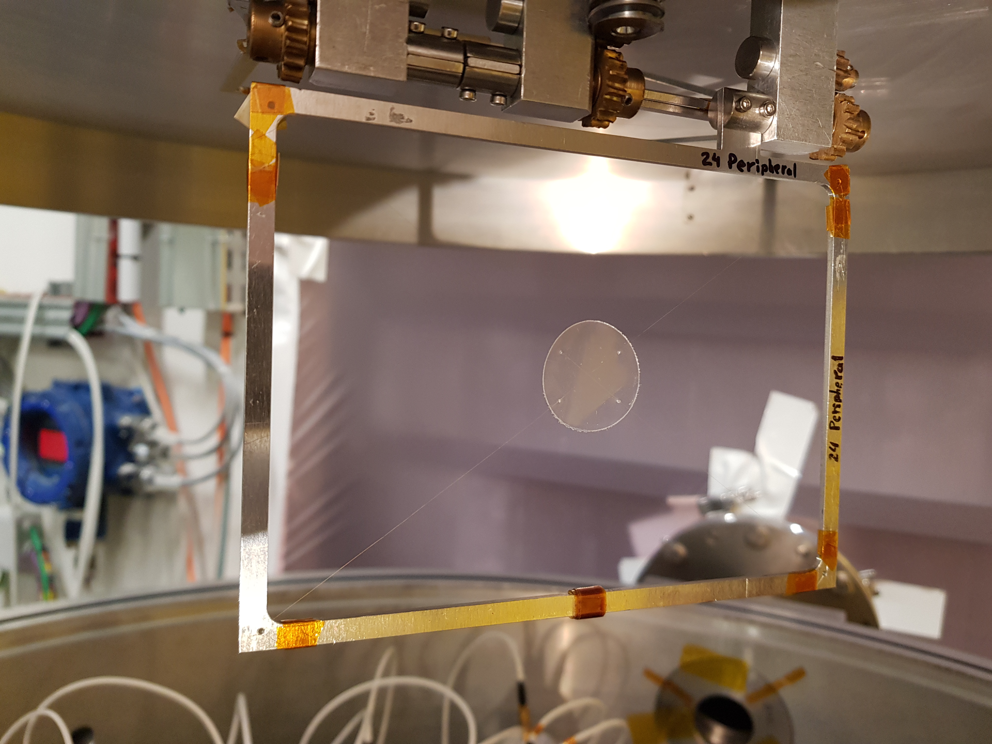
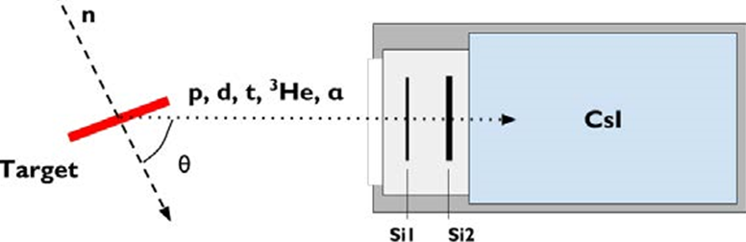
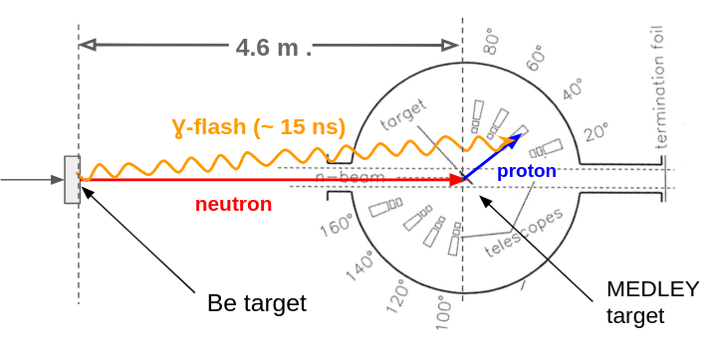
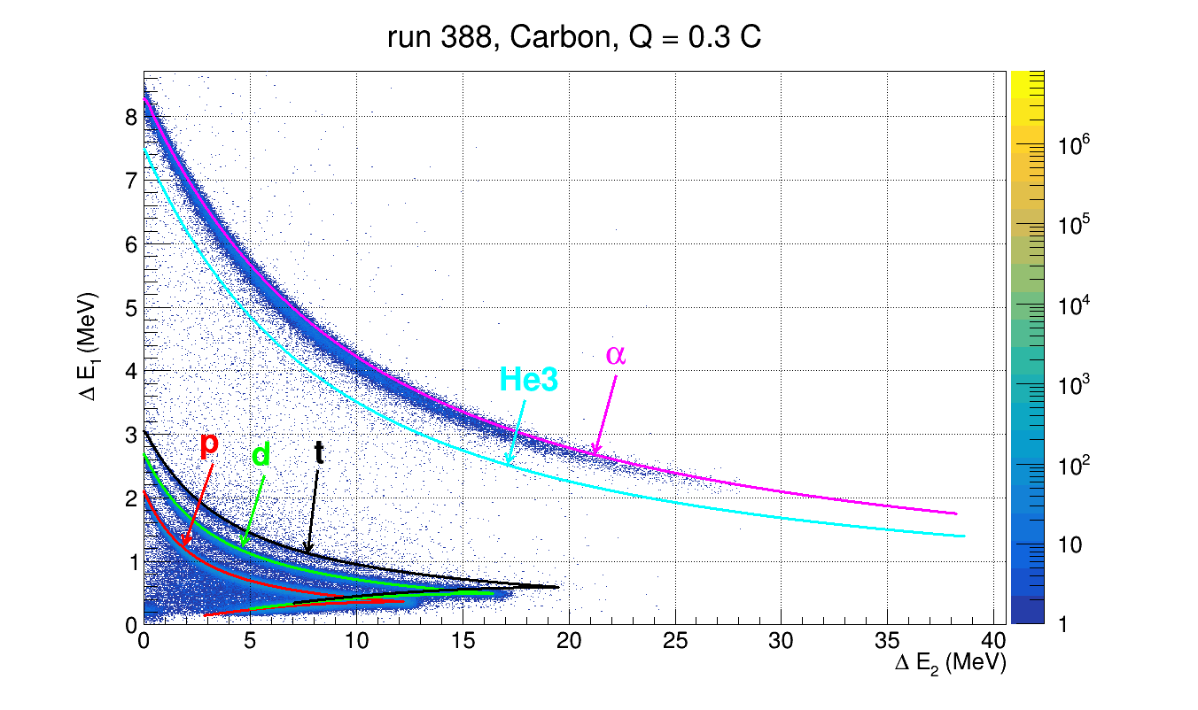
PID capabilities and ToF resolution
WP05-JRA1 Task 5.3 : Characterization of neutron fields at NFS white neutron beam (Work by UU and GANIL)
Each of the 8 telescopes is equipped with two Si (SSBD) detectors with different thicknesses and one scintillation detector, allowing to use the ΔE-ΔE-E technique to identify light ions (p, d, t, ³He, 𝛼).
For each event, the energy of the incoming neutron is deduced from the time-of-flight technique, using the time signal of the proton detection in the telescope, and the radiofrequency signal of the accelerator.
Scheme exemplifying the Time of flight (ToF) technique used on Medley.
The CH₂ target installed in Medley (left), and the working principle of a telescope (right).
Thanks to the good energy resolution of the setup, it is possible to discriminate between individual H and He isotopes.
By measuring the kinetic energy of the proton with the telescope, it is possible to properly correct for the time used by the proton to reach the telescope:
ToF_{NEUTRON} = TOF_{MEASURED} - ToF_{PROTON}(E_{proton})
Particle identification (PID) process. Experimental data for C with simulations superposed.
13

Slide 14
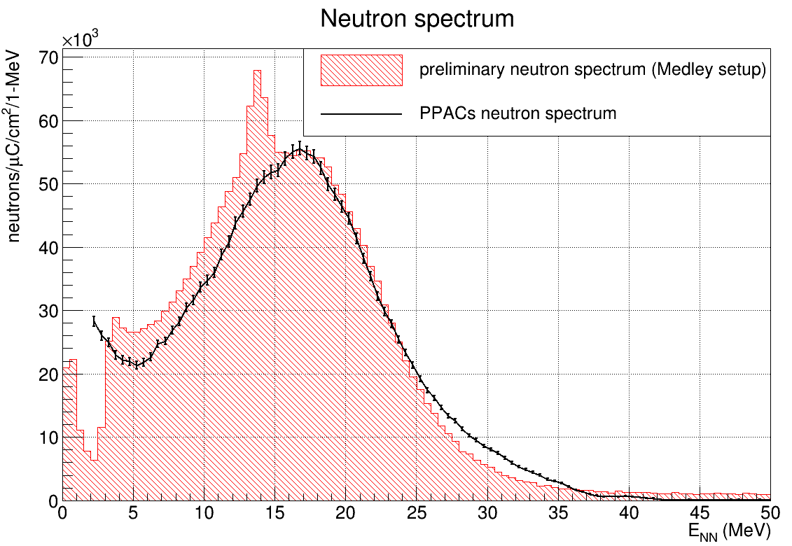
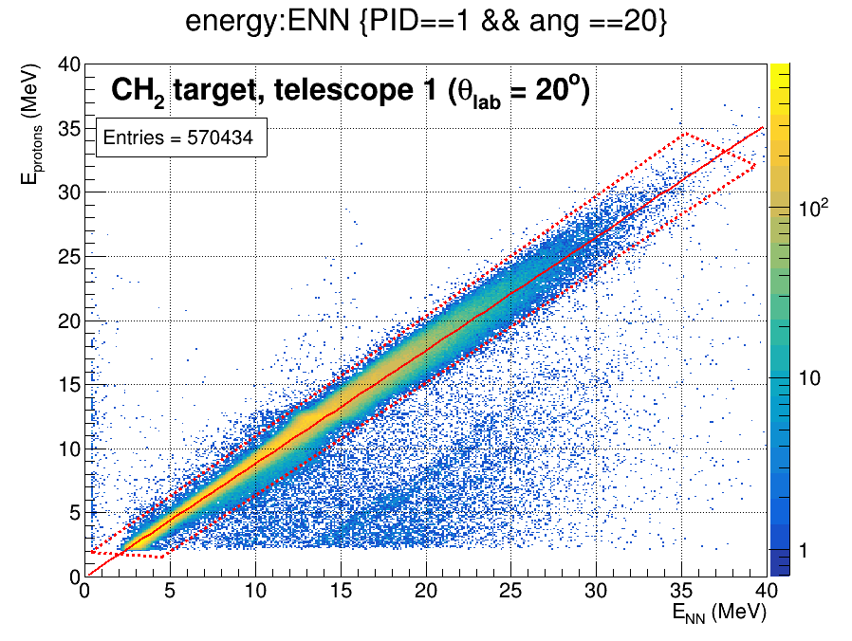
Spectral neutron flux measurement using neutron-proton elastic scattering
WP05-JRA1 Task 5.3 : Characterization of neutron fields at NFS white neutron beam (Work by UU and GANIL)
By measuring the protons elastically scattered in a hydrogen-rich sample exposed to the neutron beam, it is possible to reconstruct the neutron spectral flux by using the well-known neutron-proton elastic scattering cross section.
A Polyester sample (CH₂) was used, in addition to a natural carbon sample (C) to subtract the contribution from neutron reactions in C.
For each event, the energy of the backscattered proton is measured by a telescope and the energy of the incoming neutron, is deduced from the time-of-flight technique.
PRELIMINARY
Comparison between neutron spectral flux from Medley and PPACs.
Conclusions:
The preliminary neutron spectral flux at NFS has been measured and agrees with the value obtained from an external parallel plate avalanche chamber (PPAC) monitor.
The analysis is ongoing to improve the suppression of the non-physical peak near 15 MeV, which corresponds to the punch-through region of the second Silicon in the telescope.
Energy loss corrections have not been implemented yet, which will shift the spectrum towards higher energies.
An unexpected accumulation of events
Theoretical Ep=En*cos²(20º)
There is an unexpected accumulation of events in the punch-through energy region (around 13 MeV for protons), probably related to the detector performance. Work is in progress to suppress it in the analysis.
14

Slide 15
WP05-JRA1 Task 5.4 : Development of low-cost dosimetry systems accessible to RADNEXT users
Task Leader: CERN
Participants: UJM, UM, UO
Main research was applied to low-cost SRAM dosimetry with progress on the following axes (to be detailed in future meetings):
Application of SRAM neutron monitoring solution to a high-energy electron linac medical environment
In-orbit SRAM monitor data collection (mainly on CELESTA)
MCU detection for flux and LET monitoring of heavy ion beams
SEE cross-calibration data for heavy ion facilities
Laser versus heavy ion SEU cross section comparison

Slide 16
Deliverables
Status | ID | Title | Deadline | Responsible (s)
TBD | D5.1 | Book of Knowledge, M38 Definition and Standardization of Relevant Beam Parameters [Milestone 5.1] | 31/07/2024 | UO
TBD | D5.2 | Report, M40 Potential of SEU monitor based on 3D NAND Flash memories for R2E | 30/09/2024 | UniPD
TBD | D5.3 | Prototype, M44 Prototypes of Fiber-based dosimeter and Low cost RadMON detector [Milestone 5.2] | 31/01/2025 | UJM/CERN
TBD | D5.4 | Report, M46 Characterization of neutron fields at the NFS facility | 31/03/2025 | UU
16

Slide 17
Scientific publication and communications
Title | Journal | DOI | Open Access
Radiation Monitoring with Radiosensitive Pure-Silica Core Ultra-Low Loss Optical Fiber | IEEE TNS | 10.1109/TNS.2024.3380999 | YES
Calibration in the Visible and Infrared Domains of Multimode Phosphosilicate Optical Fibers for Dosimetry Applications | IEEE TNS | 10.1109/TNS.2023.3252941 | NO (available on HAL)
Gamma Ray Effects on Multi-Colored Commercial Light-Emitting Diodes at MGy Level | MDPI Electronics | https://doi.org/10.3390/electronics12010081 | YES
Distributed Optical Fiber-Based Radiation Detection Using an Ultra-Low-Loss Optical Fiber | MDPI Radiation | doi: 10.3390/radiation4020013 | YES
Impact of Tier Pitch Scaling on Heavy-ion Sensitivity of 3D NAND Flash Memories | IEEE TNS | 10.1109/TNS.2024.3355939 | No (not on TNS)
17

Slide 18
Scientific publication and communications
Title | Conference or others | If proceedings, DOI: | Open Access
Calibration in the Visible and Infrared Domains of Multimode Phosphosilicate Optical Fibers for Dosimetry Applications | RADECS 2022 | 10.1109/TNS.2023.3252941 | YES
Calibration in the Visible and Infrared Domains of Multimode Phosphosilicate Optical Fibers for Dosimetry Applications | RADECS 2023 | 10.1109/TNS.2023.3252941 | NO (available on HAL)
Impact of Tier Pitch Scaling on Heavy-ion Sensitivity of 3D NAND Flash Memories | RADECS 2023 | 10.1109/TNS.2024.3355939 | No (not on TNS)
Total-Dose Induced Threshold Voltage Shift Dependence on Tier Pitch in 3D NAND Flash Memories | NSREC 2024 | To be presented | N/A
14 MeV and Atmospheric Neutron Monitoring Through Optical Fiber Dosimeters | NSREC 2024 | To be presented | N/A
18

Slide 19
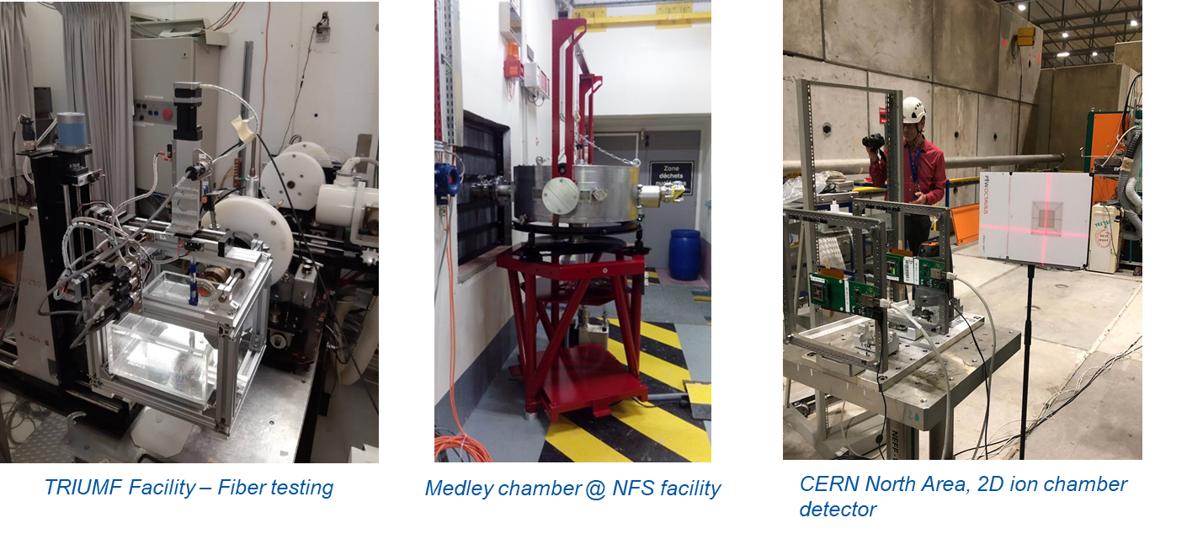
Thanks for your attention!
BAGATIN, Marta (UniPD)
BÉLANGER-CHAMPAGNE, Camille (TRIUMF)
BOCH, Jérôme (UM) WPL WP7-JRA3
HOEHR, Cornelia (TRIUMF)
TARRÍO, Diego (UU)
DELFS, Björn (UO)
POPPE, Björn (UO)
SAIGNE, Frédéric (UM)
WROBEL, Frédéric (UM) WPL WP8-JRA3
LOOE, Hui Khee (UO)
KASTRIOTOU, Maria (STFC)
GERARDIN, Simone (UniPD)
LEDOUX, Xavier (GANIL)
DANZECA, Salvatore (CERN)
GARCIA ALIA, Ruben (CERN)
GIRARD, Sylvain (UJM)
KUHNHENN, Jochen (FINT)
LEROUX, Paul (KUL)
PFLAUM, Andreas (UO)
WENINGER, Luca (UJM)
WYRWOLL, Vanessa (UO)

