Slide 1


WP 5: Spatial Profile of a Very High-Energy 208Pb Heavy Ion Beam at CHARM
Andreas Pflaum (University of Oldenburg), Markus Lapp, Björn Poppe, Andreas Waets, Natalia Emriskova, Eliott Philippe Johnson, Rubén Garcia Alía, Hui Khee Looe, Vanessa Wyrwoll
RADNEXT 3rd Annual Meeting – 10-11 June 2024
https://indico.cern.ch/e/radnext-2024

Slide 2
Outline
Introduction
Methods and materials
  CHARM facility
  Detector arrays
  Experimental setup
Results
  Impact of flux and energy on spatial distribution of the beam
  Comparison of detector array measurements with MWPC
Conclusion
Outlook

Slide 3
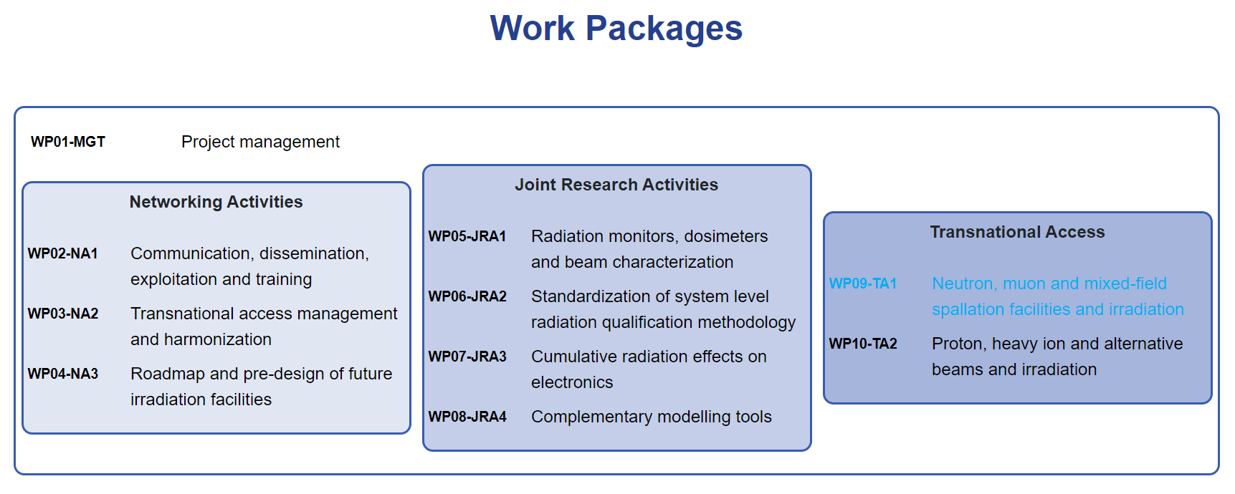
Introduction

Slide 4
Introduction
Thorough irradiation testing of components is an important task for example in space applications or particle accelerators
Exact knowledge of beam properties is of high importance
Representation of two-dimensional intensity beam profile at the position of the experiment is often not available
Detector arrays can fill this gap

Slide 5
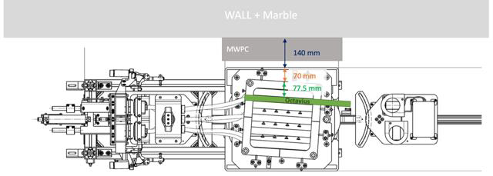
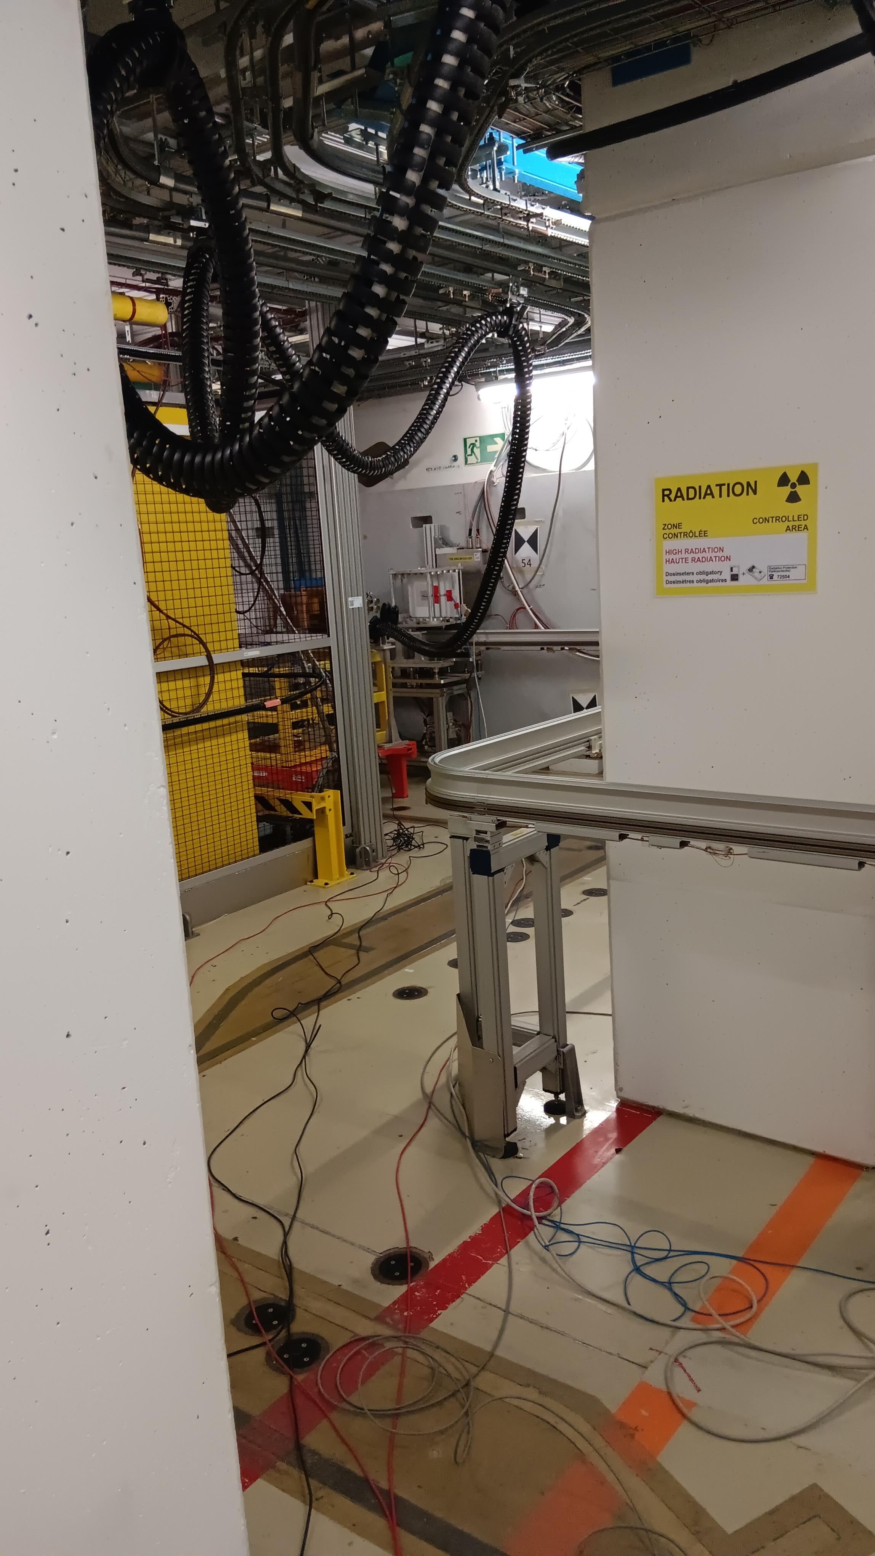
CHARM
Beam perpendicular to the Octavius array (green)
MWPC behind the setup at an angle
Montrac moves setup to the test position

Slide 6
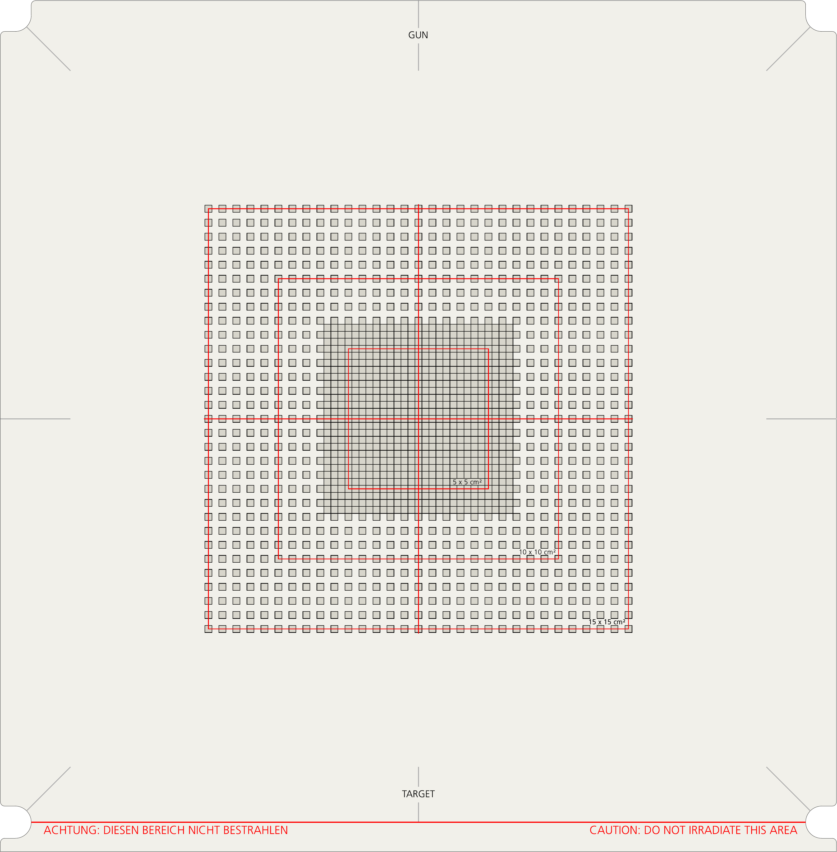
Detector Arrays
1600 SRS liquid filled chambers
  0.2 Gy/min – 36 Gy/min
1600 XDR vented chambers
  0.4 Gy/min – 4000 Gy/min
Sensitive area of 15 cm x 15 cm
Layout of both arrays is the same

Slide 7
Experimental setup
Detector array mounted in metal frame
Alignment of the setup according to a laser cross on a preparation table outside of the irradiation area
Setup is taken off the preparation table and put on the Montrac
Montrac goes along a rail to the test position

Slide 8
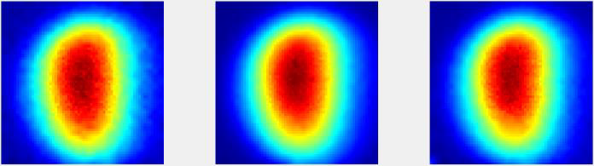
Results
Change of flux
No impact on spatial distribution
Example at 1 GeV/n
(a)
(b)
(c)
(a)
(b)
(c)

Slide 9
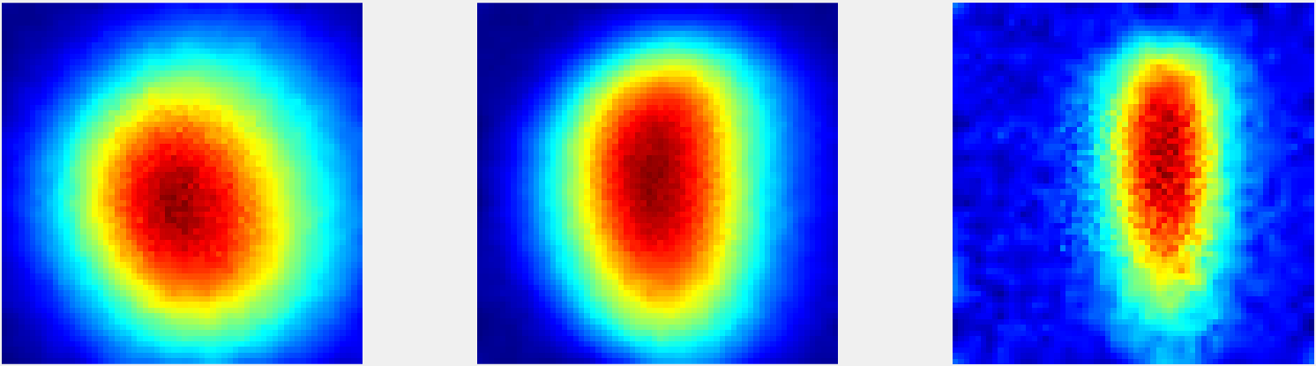
Results
Change of energy
Significant impact on spatial distribution
0.65 GeV/n
1 GeV/n
2 GeV/n
FWHM | 0.65 GeV/n | 1 GeV/n | 2 GeV/n
horizontal | 9.4 cm | 7.3 cm | 4.5 cm
vertical | 10.5 cm | 11.1 cm | 10.2 cm

Slide 10
Results
Position of MWPC compared to array measurement
Approximately 1 cm deviation in vertical direction
Less than 0.5 cm in horizontal direction

Slide 11
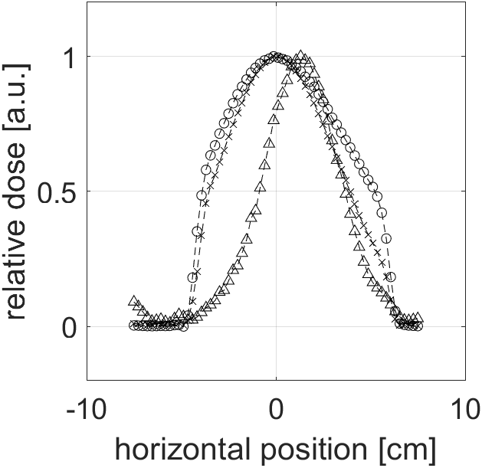
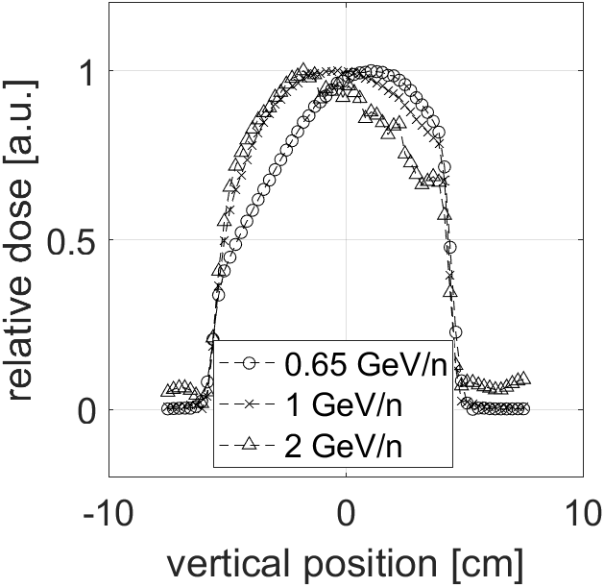
Results
Use of collimators of 10 cm x 10 cm
Transmission on the edges at 2 GeV/n

Slide 12
Discussion
Change of flux did not have an impact on the spatial distribution of the intensity profile
Change of energy had a significant impact on the profile
MWPC and array were misaligned in the vertical direction by (1.1 ± 0.2) cm
MWPC misalignment in the horizontal direction (0.5 ± 0.1) cm

Slide 13
Conclusion
When the energy is changed, a repositioning or readjustment of magnetic optics has to be considered
A change of flux does not require any repositioning or change of optics
The deviation in positon between the MWPC and array measurements in vertical direction should be investigated in more detail
  Deviation introduced by MONTRAC?
  Alignment of MWPC does not coincide with laser positioning system?

Slide 14
Outlook
Further investigations regarding absolute dose and flux, variation of magnetic optics, spill structure in progress

Slide 15
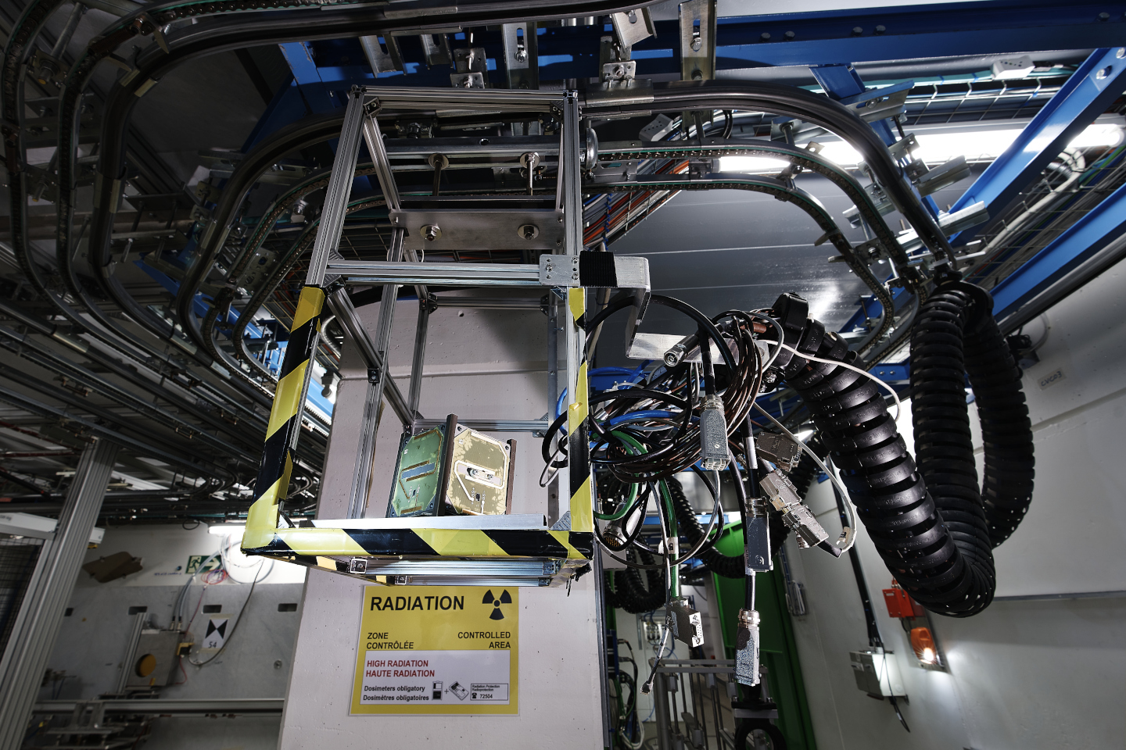
Thanks for your attention!
Image Source: CERN

