Slide 1

WP07-JRA3 Cumulative radiation effects on electronics - Overview of WP7
Jerome BOCH
RADNEXT 3nd Annual Meeting – 10-11 June 2024
https://indico.cern.ch/event/1348465/

Slide 2





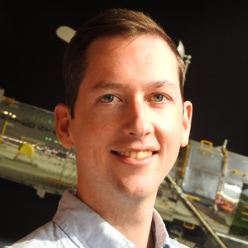



WP7 members
Université de Montpellier
ISAE-SUPAERO
Université de Liège
Université Jean Monnet Saint-Etienne
ATRON
Airbus Defence & Space
Jérôme Boch WPL
Vincent Goiffon Deputy WPL
Alexandre LE ROCH Deputy WPL

Slide 3


WP7 structure
The main objective is to understand the physical mechanisms behind the damage caused by TID and TNID and to propose test methodologies adapted to the use of electronic components and systems in radiative environment.
Two main technical tasks are studied:
Task 7.1: Coordination and communication
Task 7.2: The effects of ionizing dose (TID = Total Ionizing Dose)
PhD recruitment from October 2021 (36 months) at UM
end in October 2024
Task 7.3: The effects of non-ionizing dose (TNID = Total Non-Ionizing Dose)
Postdoc recruitment from October 2022 (12 months) at ISAE-SUPAERO
finished
Vincent GIRONES
Maxence GUENIN

Slide 4

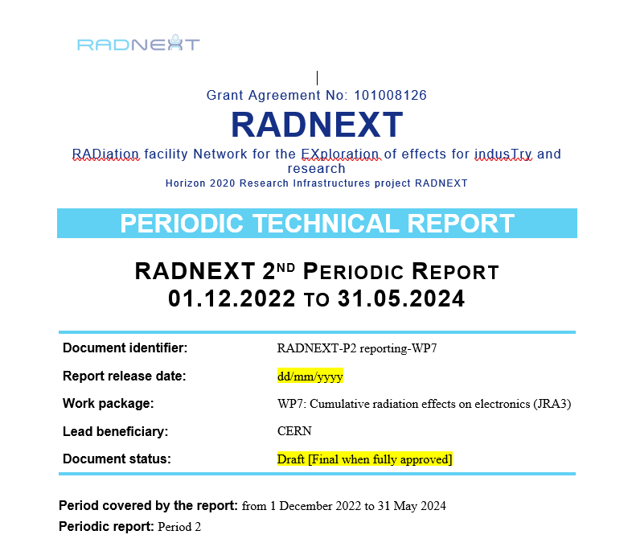
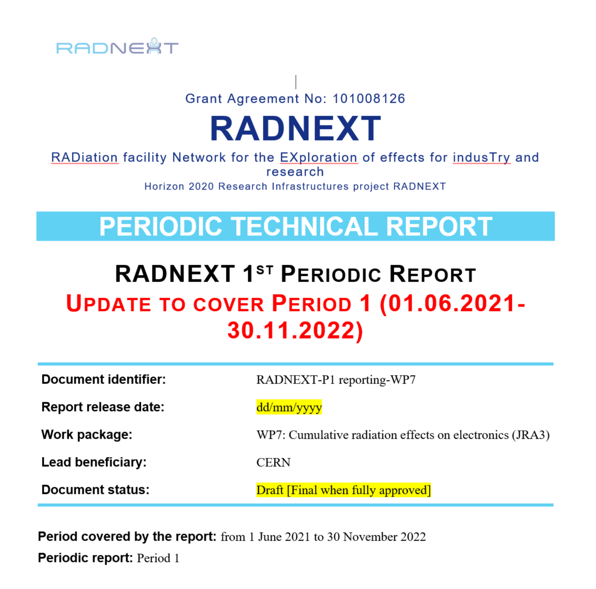
WP7 milestones, deliverables and reports
MS24 | X-ray ATRON Facility modelling | 2023/05/31
MS25 | Comparison of X-ray / cobalt experimental data | 2024/05/31
MS30 | Beginning of TNID irradiation campaign | 2024/05/31
D1 | Comparison of X-ray / cobalt experimental data | 2024/05/31
D2 | Published list of tested components against cumulative effects | 2024/05/31
D3 | Final TID results and guidelines for dose testing with X-ray facilities | 2025/03/31
D4 | Final TID results and guidelines for dose testing with X-ray facilities | 2025/03/31
The report on the second period is currently being written

Slide 5
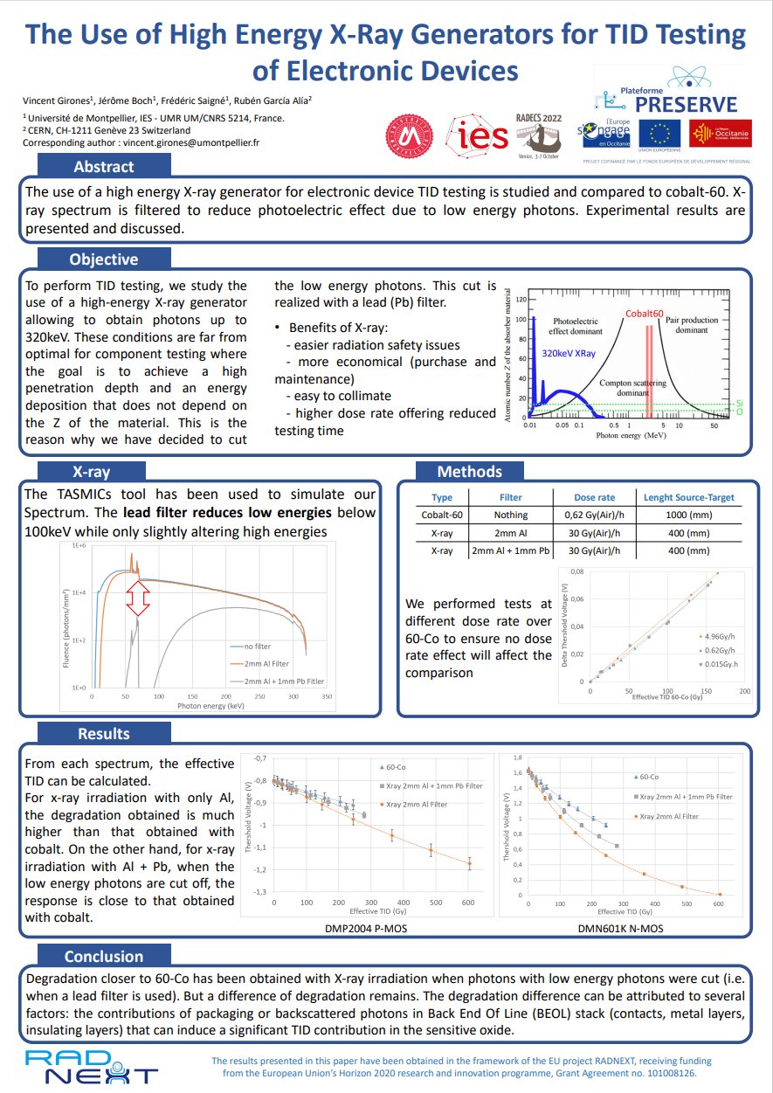
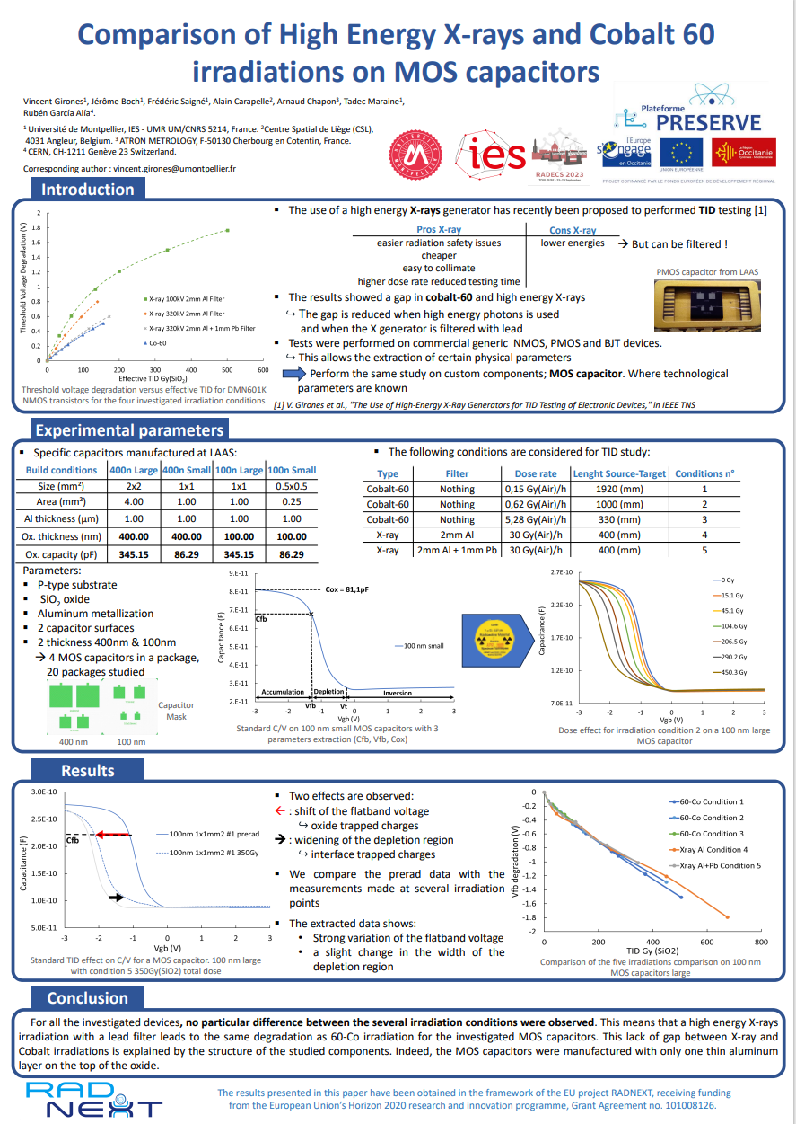
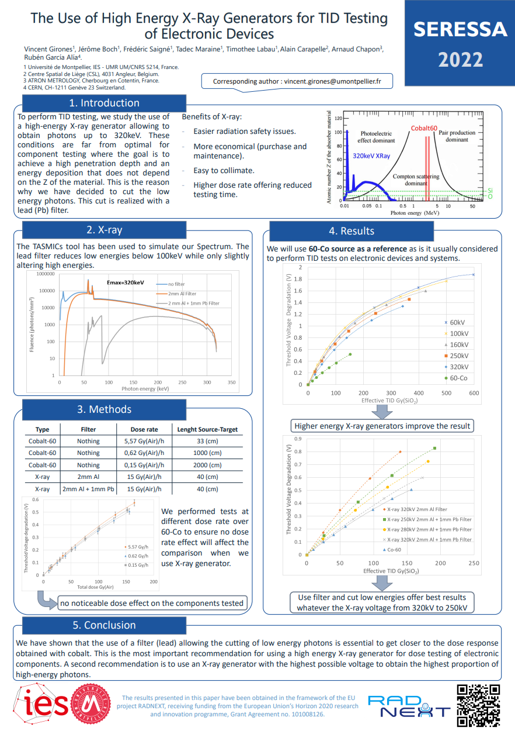
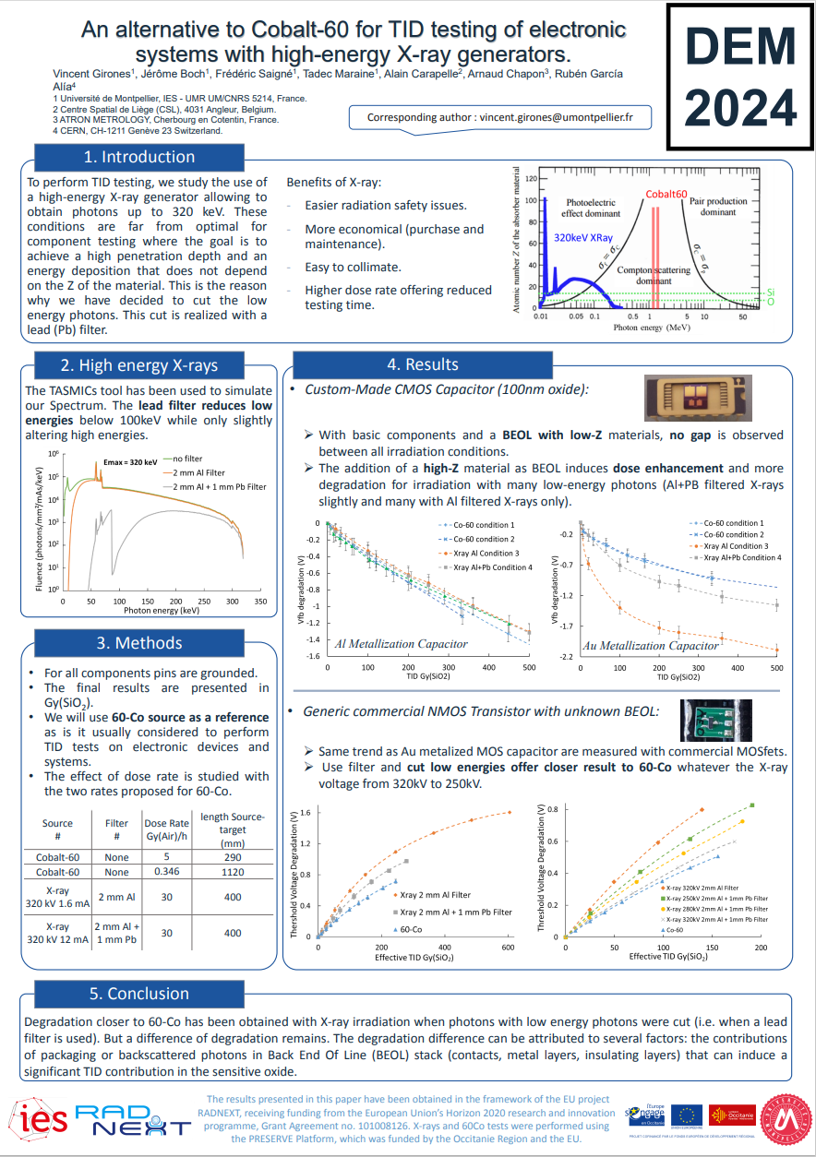
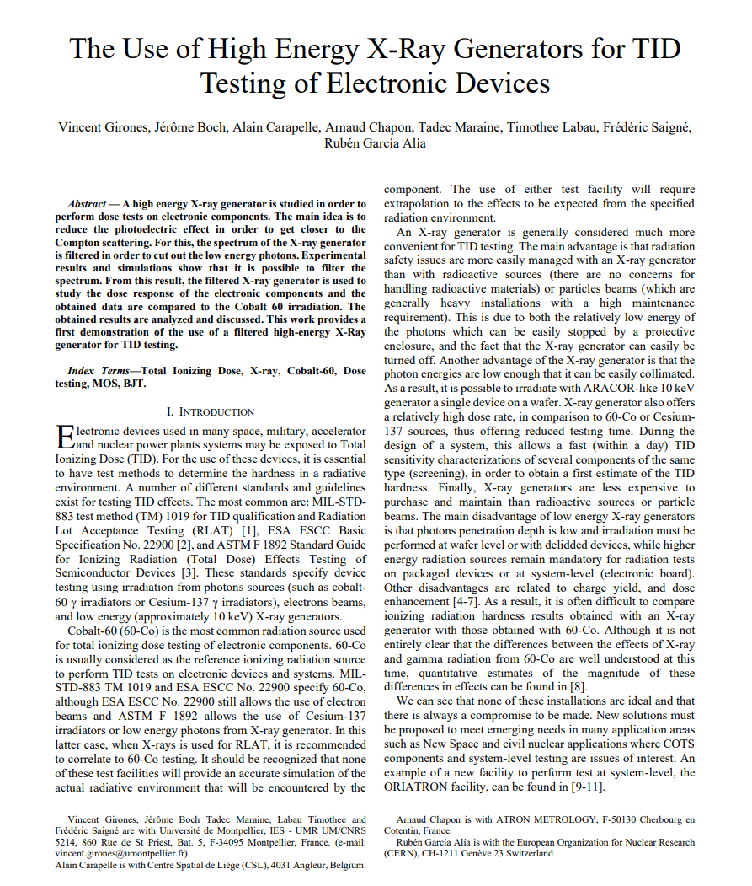
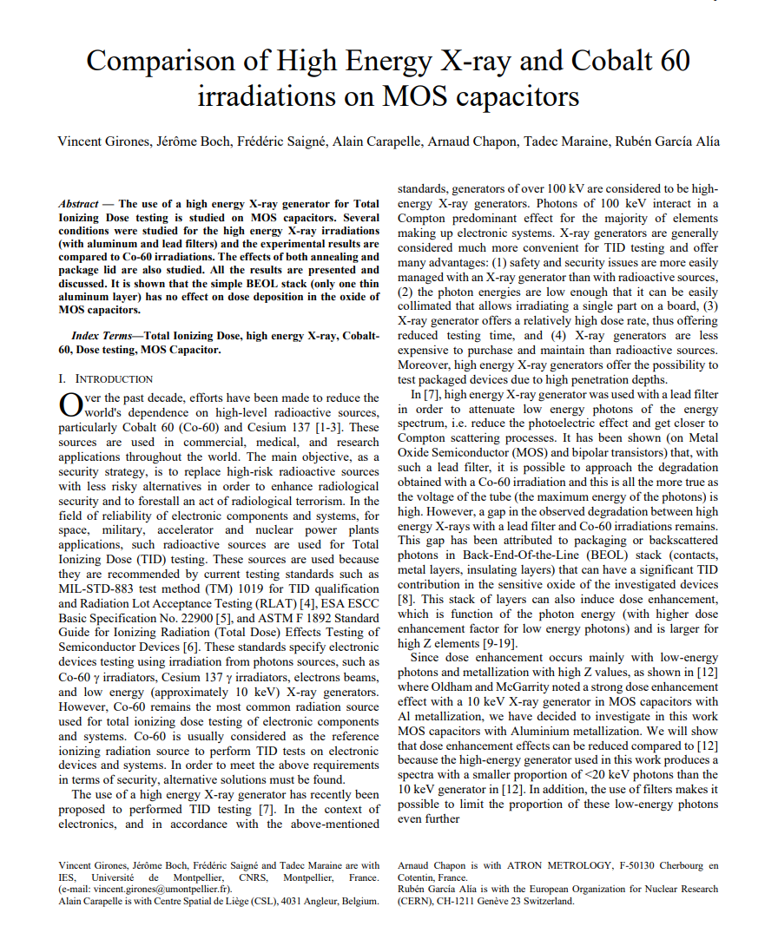
WP7 publications
Journals: 2 IEEE TNS (2023, 2024)
Conferences:
  2 poster presentations in RADECS (2022, 2023)
  1 poster presentation SERESSA 2022
  1 poster presentation DEM2024

Slide 6
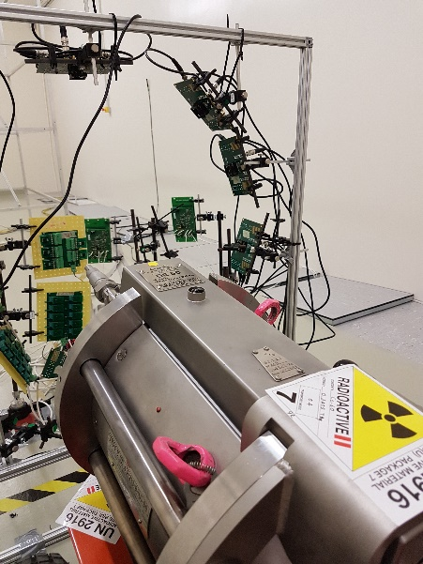
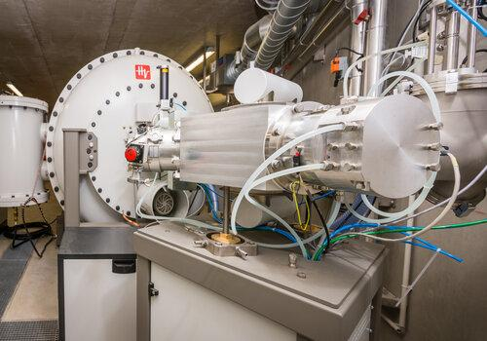
Thanks for your attention!
3.5 MeV e-beam Accelerator
Source: ATRON
Cobalt 60 Irradiator
Source: UM

