Slide 1


WP6, Investigation of Single-Event Effects for Space Applications: Instrumentation for In-Depth System Monitoring
André M. P. Mattos (University of Montpellier)
RADNEXT 3rd Annual Meeting – 10-11 June 2024
https://indico.cern.ch/e/radnext-2024

Slide 2
Outline
Third year achievements and ongoing activities
Summary of test campaigns and publications
Investigation of Single-Event Effects for Space Applications:
Instrumentation for In-Depth System Monitoring
Background
Experimental instrumentation for complex systems
  Objectives/Challenges
  Proposed approach
Conclusion

Slide 3
Third year achievements and ongoing activities
 | Source | Facility | Date | Experiments
1st year | High-Energy Protons | PSI | 12/21* | SDRAM / HyperRAM
 | Heavy Ions | RADEF | 02/22 | SRAM
 | Atmospheric Neutrons | ChipIr | 05/22* | RISC-V / SoC / NoC
 | High-Energy Protons | PARTREC | 06/22* | RISC-V / SoC
2nd year | Mixed-Field | CHARM | 10/22 | RISC-V / SoC
 | Atmospheric Neutrons | ChipIr | 11/22* | RISC-V / SoC
 | High-Energy Protons | PSI | 12/22 | SRAM
 | Pulsed Laser | ESTEC | 05/23 | SRAM
3rd year | Atmospheric Neutrons | ChipIr | 05/24 09/24 | ARM / RISC-V / AI accelerator
 | High-Energy Heavy Ions | GSI | 06/24* | RISC-V SoM
 | High-Energy Protons | PSI | 09/24* | RISC-V SoM

Slide 4
Third year achievements and ongoing activities
Journal publications:
[1] André M. P. Mattos, Douglas A. Santos, et. al., “Investigation on Radiation-Induced Single-Event Latch-up in SRAM Memories on-Board PROBA-V”, TNS, 2024.
[2] André M. P. Mattos, Douglas A. Santos, et. al., “Investigation of Single-Event Effects for Space Applications: Instrumentation for In-Depth System Monitoring”, Electronics, 2024.
[3] D. A. Santos, P.M. Aviles, A.M.P. Mattos, M. Garcia-Valderas, L. Entrena, A. Lindoso, L. DiLillo, “Hybrid Hardening Approach for a Fault-Tolerant RISC-V System-on-Chip”, TNS, 2024.

Slide 5
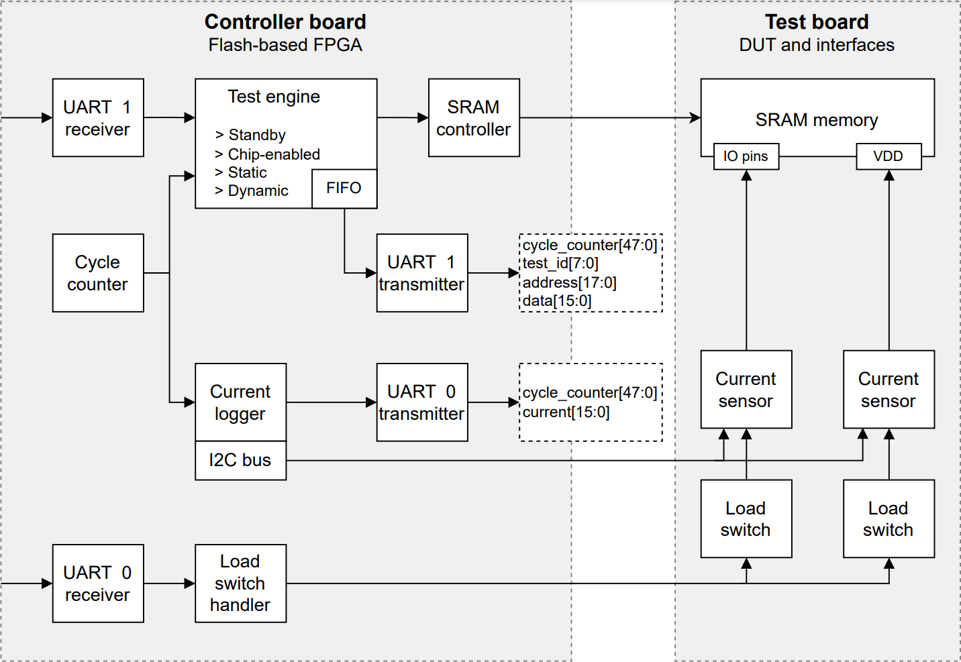
Background
Investigation of SEL in COTS SRAM memories onboard PROBA-V:
Understanding the flight behavior and observed error rates
Experiments: RADEF, PSI, ESTEC
Enhanced experimental setup:
Precise timing and current measurements
Coherent monitoring between memory errors and current measurements
Many test modes with realistic stimuli
Robust and flexible test setup

Slide 6
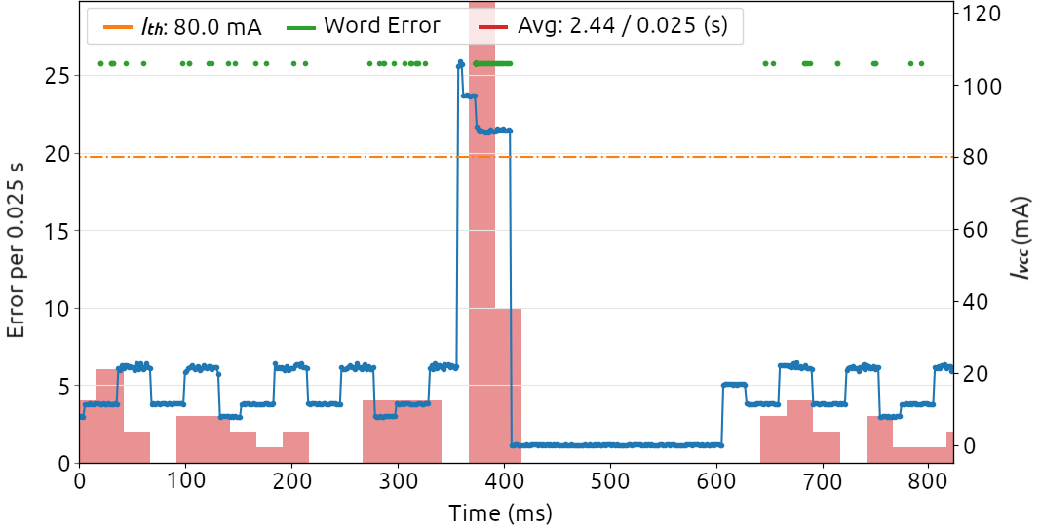
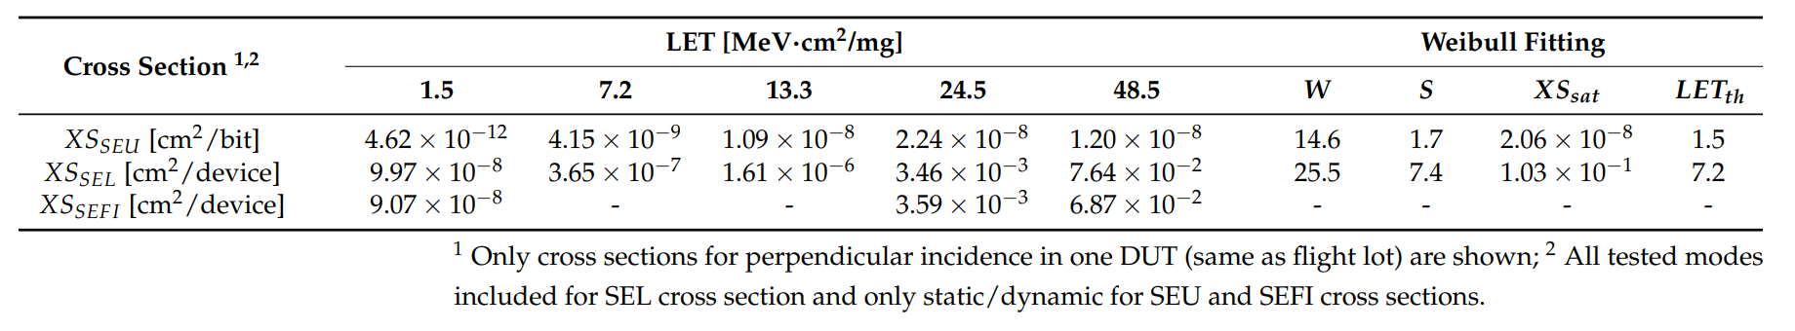
Background
Outcomes (test setup):
Analysis of various SEE with enhanced synchronization
Superposition of different parameters (e.g., current/errors)

Slide 7
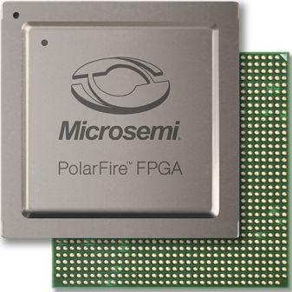
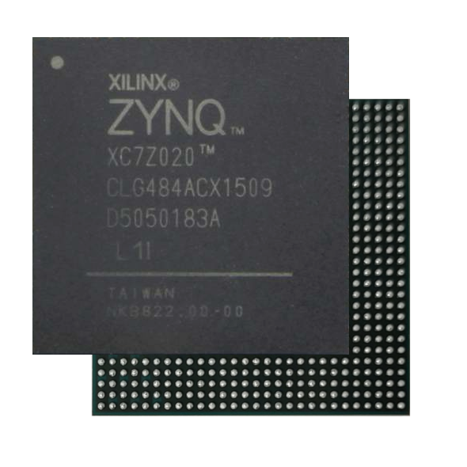
Experimental instrumentation for complex systems
> Objectives/Challenges
Objectives:
Performing tests on complex systems-on-chip
Provide the necessary circuitry to operate these systems
Provide the necessary circuitry for radiation testing needs
Provide additional features to support enhanced observability
Challenges:
Design a compact and robust solution
Maintain costs comparable to COTS development kits
Provide reliability to the test setup itself (secondary particles, industrial environment)
Project driven by real testing needs

Slide 8
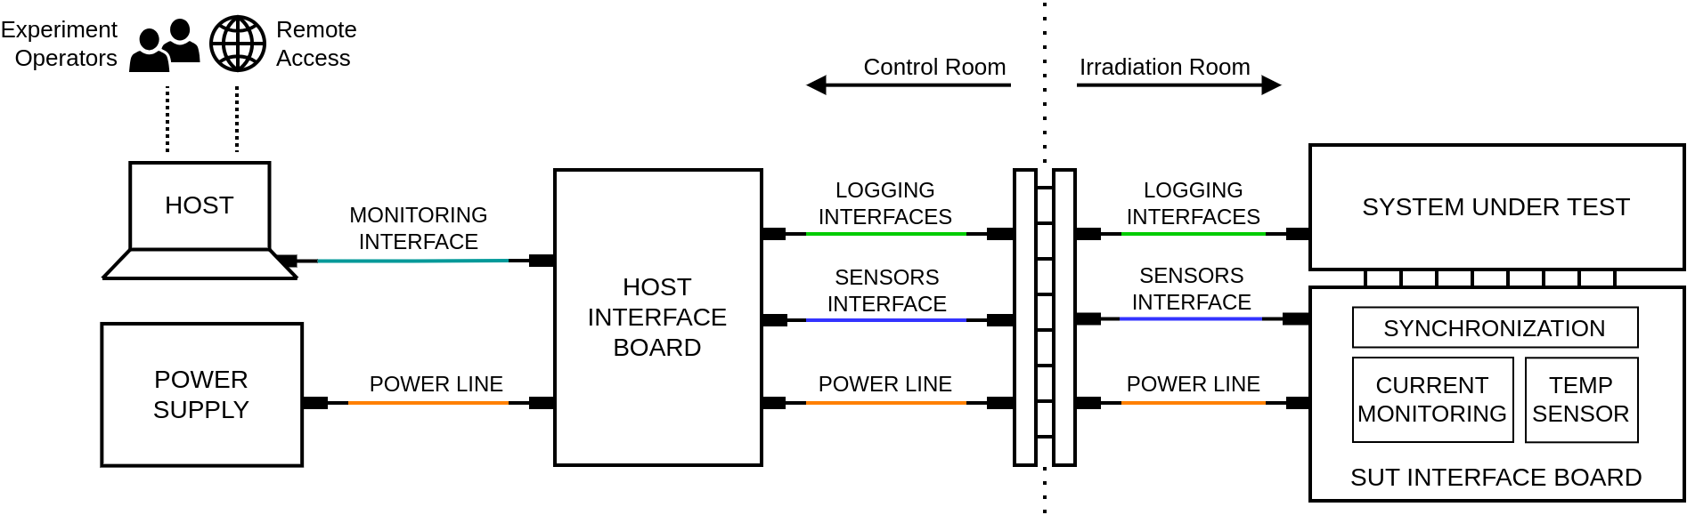
Experimental instrumentation for complex systems
> Proposed solution
Same foundation:
Precise timing
Coherent monitoring
Realistic stimuli
Robust and flexible
HOST side
SUT side

Slide 9
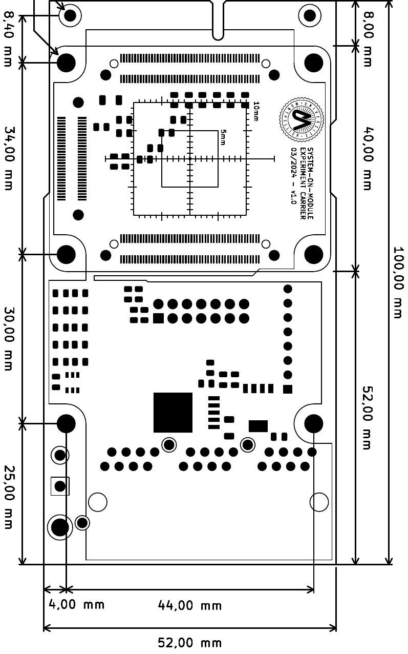
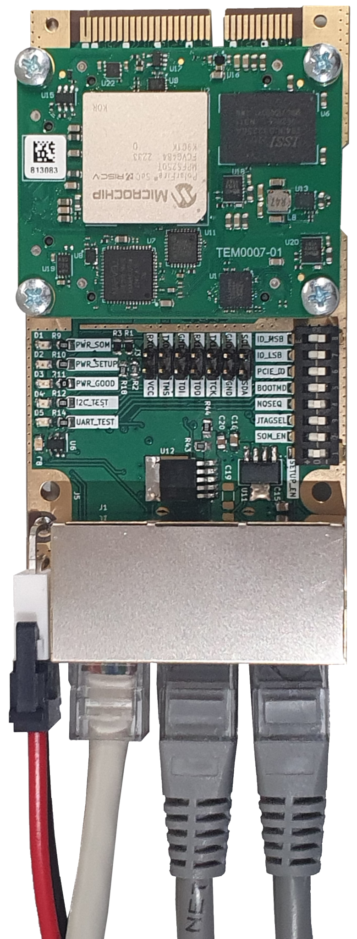
Experimental instrumentation for complex systems
> Proposed solution: SUT Side
Functions supporting in-depth testing:
SUT logging interfaces (>100 meters)
Setup interface (>100 meters)
  Voltage/Current for the SUT (with protection)
  Board temperature
  Configurable external watchdog timer
  User GPIOs (control on HOST side)
JTAG programming interface (~20-50 meters)
Onboard power regulation (>100 meters)
DIP switch for easy hardcode configuration
Edge extension connector (e.g., add-on DUT)
  48x high-speed data signals
  Length matching / impedance control
  Access to setup interface
Indication LEDs (power good, boot, interface test)
Carrier: 100x50mm
SoM: 50x40mm

Slide 10
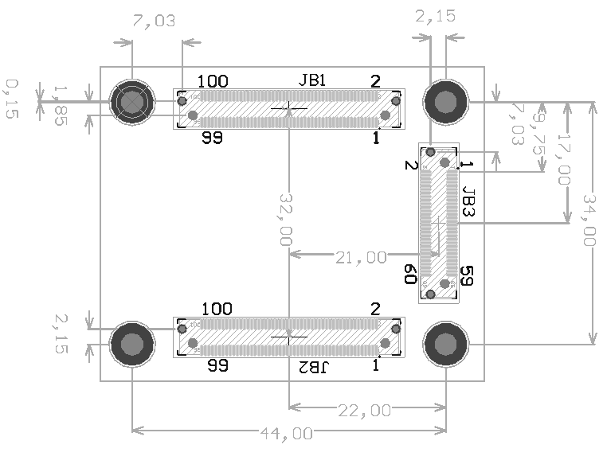
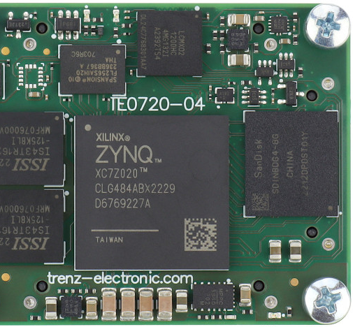
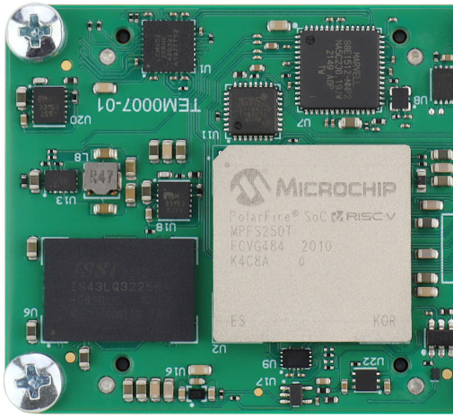
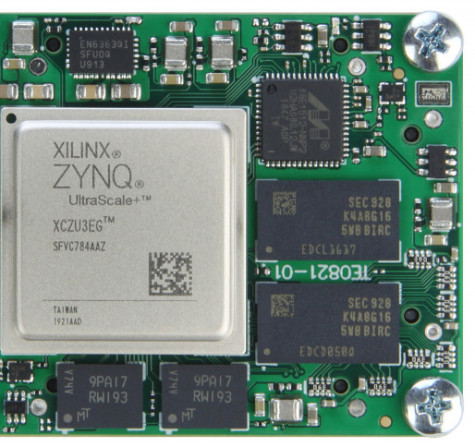
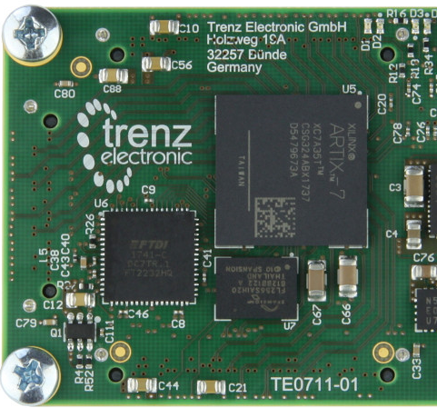
Experimental instrumentation for complex systems
> Proposed solution: SUT Side
Many “low-cost” COTS options available in this form factor for rapid test development, but a fully custom solution can also be designed

Slide 11
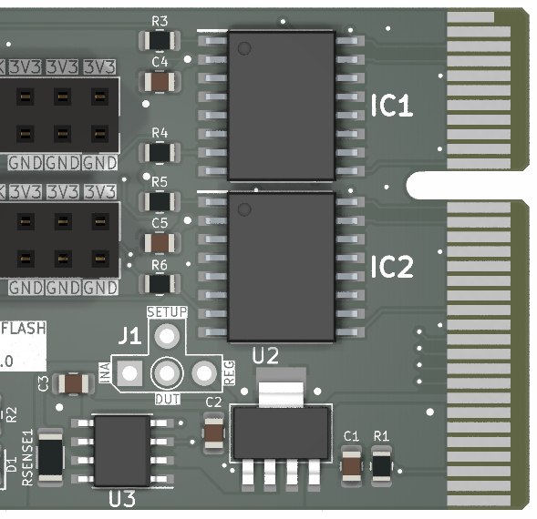
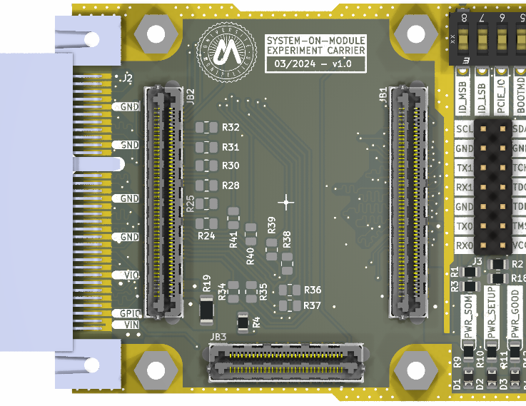
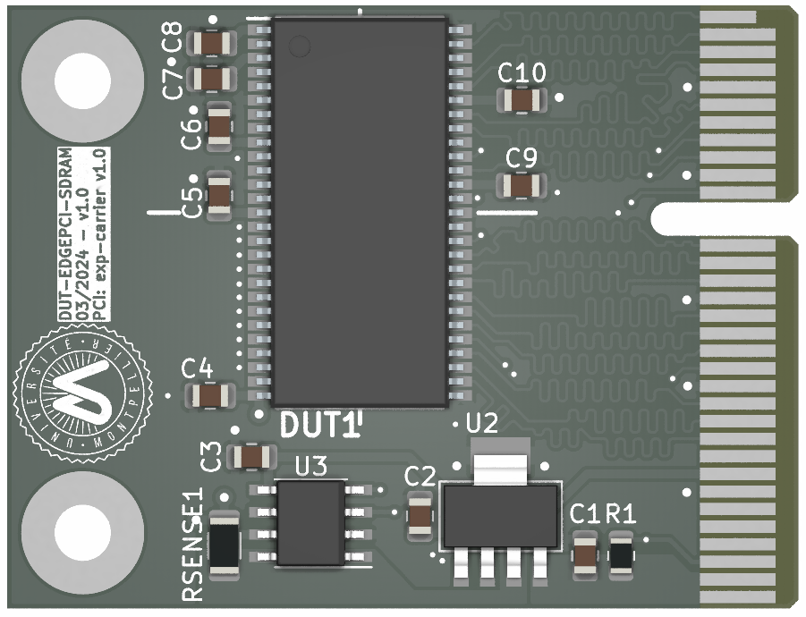
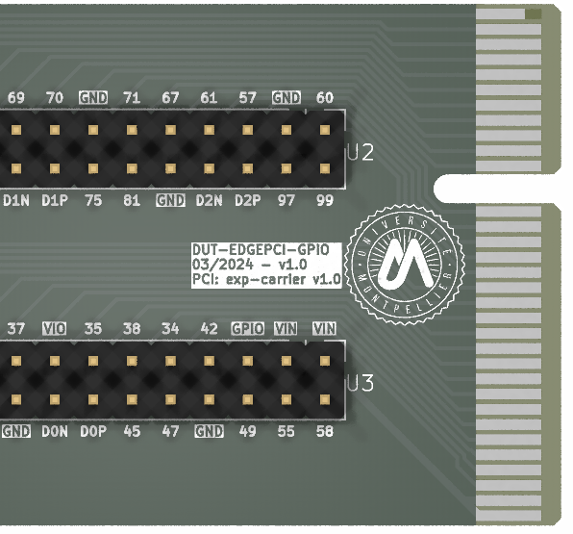
Experimental instrumentation for complex systems
> Proposed solution: SUT Side
Add-on non-volatile
memory expansion
Extension boards:
Add-on DUTs
Debugging boards
Function extension
Test fixtures
Add-on SDRAM
DUT board
IO breakout
for debugging

Slide 12
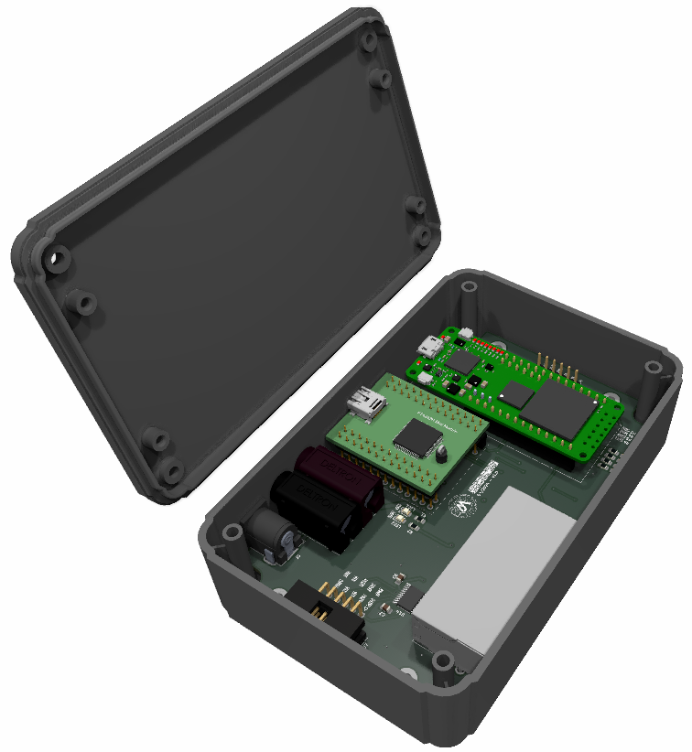
Experimental instrumentation for complex systems
> Proposed solution: HOST Side
Functions supporting in-depth testing:
Data interfaces (connected to SUT side)
  Logging, setup, and JTAG
FPGA for handling experimental operation
  Manage user requests (e.g., turn ON/OFF the SUT)
  Enable fast SEL monitoring/protection/reporting
  Append precise timestamp for all SUT log data and sensor measurements received (without HOST computer “jitter/desynchronization” nor overheads)
Single USB interface with HOST computer using a serial converter
  Four channels (SUT#1, SUT#2, SENSE, and CMD)
  Even with computer jitter/desynchronization in the reception, all data was precisely timestamped beforehand in the FPGA
Compact (easy to mount on the facility), simple to operate, and highly automated (reducing human error)

Slide 13
Conclusion
Development of custom, compact, and robust test setup targeting complex devices:
  Adequate radiation testing fixtures
  Enhanced SUT observability
  Synchronization / coherence
Support to different projects:
  Development standard hardware platform for radiation testing (KUL / UM)
  Characterization of a high-performance multicore RISC-V SoC and a low-cost RISC-V soft-core (UM)
    GSI (06/24) and PSI (09/24)
  … and potentially to other future partners interested on the developed platform

Slide 14
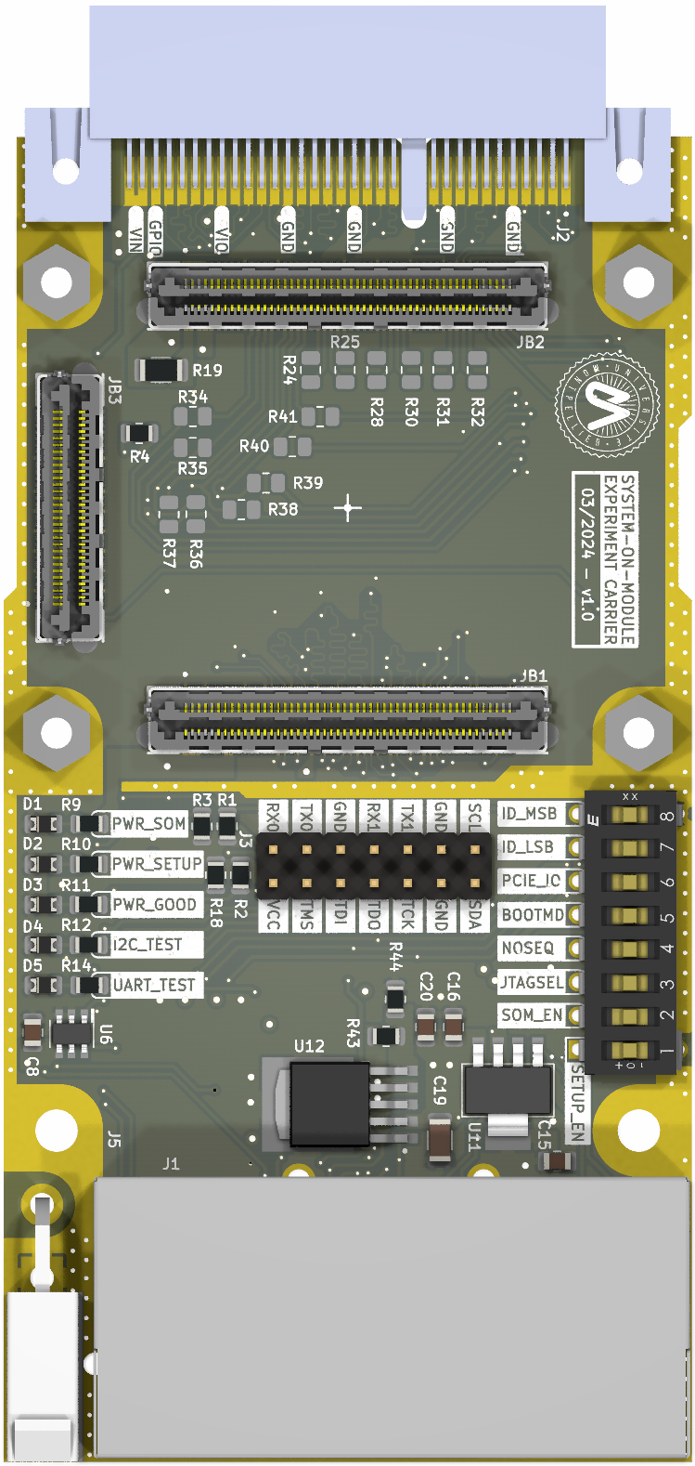
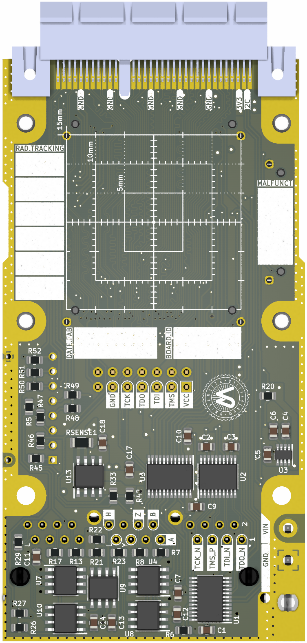
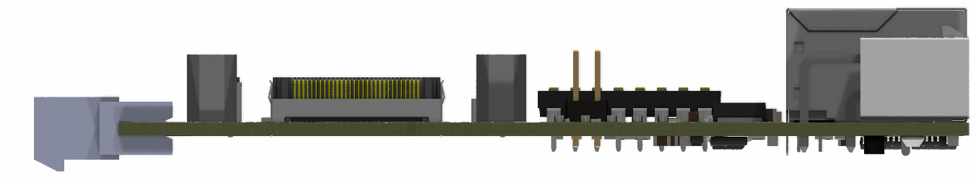
Thanks for your attention!
André M. P. Mattos
PhD at University of Montpellier
andre.martins-pio-de-mattos@umontpellier.fr

