Slide 1


WP9 Overview
Camille Bélanger-Champagne (TRIUMF)
Carlo Cazzaniga (STFC-ISIS)
RADNEXT 3rd Annual Meeting – 10-11 June 2024
https://indico.cern.ch/e/radnext-2024

Slide 2
WP9 facilities: neutrons, muon, mixed-field
Facilities | Beam type and energy range | Flux (s⁻¹cm⁻²) | Yield (s⁻¹) | Production mechanism | Country
ChipIr (UKRI) | Atmospheric neutrons | 6 · 10⁶ | - | Spallation (up to 800 MeV) | UK
TNF (TRIUMF) | Atmospheric neutrons | 5 · 10⁵ - 3 · 10⁶ | - | Spallation (up to 500 MeV) | CA
FNG (ENEA) | 14 MeV (or 2.5 MeV) neutrons | - | 10¹¹ | DT (or DD) | IT
Fraunhofer INT (INT) | 14 MeV (or 2.5 MeV) neutrons | - | 10¹⁰ | DT (or DD) | DE
NESSA (UU) | 14 MeV (or 2.5 MeV) neutrons | - | 4 ·10¹⁰ | DT (or DD) | SE
CNRS-LPSC | 14 MeV (or 2.5 MeV) neutrons | - | 8 · 10⁹ | DT (or DD) | FR
PTB | monoenergetic neutrons up to 20 MeV | 10³ - 10⁸ | - | Nuclear reactions | DE
NPI-CAS | quasi-monoenergetic neutrons up to 30 MeV | 10³ - 5 · 10⁸ | - | ⁷Li(p,n) | CZ
GANIL-SPIRAL2 (GANIL) | quasi-monoenergetic neutrons up to 30 MeV |  | - | ⁷Li(p,n) | FR
ILL | Thermal neutrons | 3 ·10⁹ | - | Nuclear Reactor | FR
EMMA (UKRI) | Thermal neutrons | 2 ·10⁶ | - | Pulsed, spallation moderated | UK
NPI-CAS | Low+intermediate energy white beam neutrons | 10¹¹ - 10¹² | - | Be converter | CZ
GANIL-SPIRAL2 (GANIL) | Low+intermediate energy white beam neutrons | 10¹¹ | - | Be converter | FR
PTB | Low+intermediate energy white beam neutrons | 10⁸ | - | Be converter | DE
nELBE | Low+intermediate energy white beam neutrons | 5 · 10⁷ | - | Photoproduction: ~1 MeV (100 keV - 10 MeV ) | DE
CHARM (CERN) | Mixed field | Varies by position |  | Spallation (24 GeV protons) | CH
RAL-RIKEN (UKRI) | Muons 60 MeV/c | 7 · 10⁴ |  | Pion decay | UK

Slide 3
Beam delivery progress by TA call (1)
TA call #1 status: 6 accepted proposals, 5 delivered, 1 cancelled by RADNEXT
TA call #2 status: 3 accepted proposals, 2 delivered, 1 cancelled by user
TA call #3 status: 4 accepted proposals, 3 delivered, 1 pending due to facility
    #9 @RIKEN-RAL (muons)
TA call #4: 6 accepted proposals, 6 delivered
TA call #5 status: 7 accepted proposals, 7 delivered
TA call #6 status: 4 accepted proposals, 3 delivered, 1 w/ status to be clarified
    #143 @CHARM
TA call #7 status: 8 accepted proposals, 7 delivered, 1 cancelled by RADNEXT
TA call #8 status: 6 accepted proposals, 6 delivered
TA call #9: 4 accepted proposals, 1 delivered, 1 pending beam, 1 pending due to users, 1 pending due to facility
    #289 @ RIKEN-RAL (muons)
    #300 @ ChipIR – beam cancelled twice by users
    #303 @ FNG
TA call #10: 7 accepted proposals, 6 confirmed or scheduled, 1 facility match stage, 2 w/ reviews pending
    #327 @ CHARM
    #337 @ CHARM
    #325 @LPSC (tentatively)
TA call #11: 3 proposals under review

Slide 4
Beam delivery progress by TA call (2)

Slide 5
Beam delivery progress by facility (1)
Facility | Original hours | Modified hours | Completed | Allocated | Remaining
CHARM | 800 | 1176 | 840 | 168 | 168
TRIUMF TNF | 92 | 92 | 72 | 20 | 0
RAL-RIKEN | 140 | 140 | 0 | 140 | 0
ChipIR | 620 | 620 | 492 | 96 | 32
LPSC - GENESIS | 160 | 160 | 0 | 36 | 124
PTB | 90 | 175 | 96 | 0 | 79
FNG | 530 | 530 | 312 | 86 | 132
nELBE | 150 | 150 | 72 | 0 | 78
GANIL | 90 | 90 | 12 | 0 | 78
NPI-CAS | 80 | 80 | 36 | 0 | 44
EMMA | 150 | 150 | 72 | 48 | 30
ILL | 100 | 100 | 72 | 48 | -20
Total | 3002 | 3463 | 2032 | 650 | 781

Slide 6
Beam delivery progress by facility (2)

Slide 7
Beam delivery progress by facility (3)
60% of revised beam commitment delivered, 78% delivered+allocated.
  69% delivered, 90% delivered+allocated compared to initial total number of hours, but biased by the large increase in hours CHARM agreed to deliver compared to original commitment. Those hours have no effect on budget as they are provided at no cost to RADNEXT.
As expected, atmospheric neutron beams are in high demand and have very limited remaining availability. Lots of 14 MeV beam delivered.
Typical time between proposal accepted and delivery is around 6-8 months.
Cannot assign France-affiliated users to GANIL/LPSC – few other matching proposals.
  2 proposals accepted at LPSC were cancelled/rejected by the user.
Other facilities with low allocated beam hours (nELBE, NPI-CAS) are due to low demand for those beam types.
PTB initial commitment of 90 hours allocated within first 5 calls, total allocation raised to 175 hours by budget transfer but no matching proposals in last 5 calls.
Unable to deliver muon beam at RAL-RIKEN so far:
  Clarify timeline to availability at RAL-RIKEN? in 2025?
  Move muon experiments to M20 at TRIUMF? (28.5 MeV/c surface μ+ beam, flux 5.5E5/s, must be scheduled together as one block, earliest availability August 2024, then at irregular intervals in Oct-Nov 2024, and likely June-Nov in 2025).

Slide 8
Additional remarks from WP9
User readiness to schedule beam has improved in recent calls, but timely execution continues to be a challenge
  Anecdotally, long delays are more often due to users than facilities
User teams usually well prepared for their beam once experiment can be scheduled
Lack of integrated tracking and reporting tools in the portal and/or shared between WP3 and WP9/10 will probably make final few calls more challenging to manage, especially with the extended duration
  Remaining beam hours per facility, or budget per facility are critical to avoid budget overruns
  Not always clear if facilities track their used/billed hours differently than what is granted and tracked by WP9 and listed in the portal (on each proposal, no central overview)
  P2 reporting might be a good point to assemble the necessary data and work from there...
  Additional support in portal or an internal checkpoint within P3 reporting period would help

Slide 9
Conclusion
WP9 progress in delivering beam is roughly as could be expected with 1 year to go in the original RADNEXT timeline
WP9 will run into issues with its ability to accept proposals and match them with facilities soon as only few beam types will remain available
All beam types except muons have been delivered to users
All but 2 of the facilities with ongoing commitments to RADNEXT have hosted an experiment
  RAL-RIKEN (muons)
  LPSC (DD/DT neutrons)

Slide 10
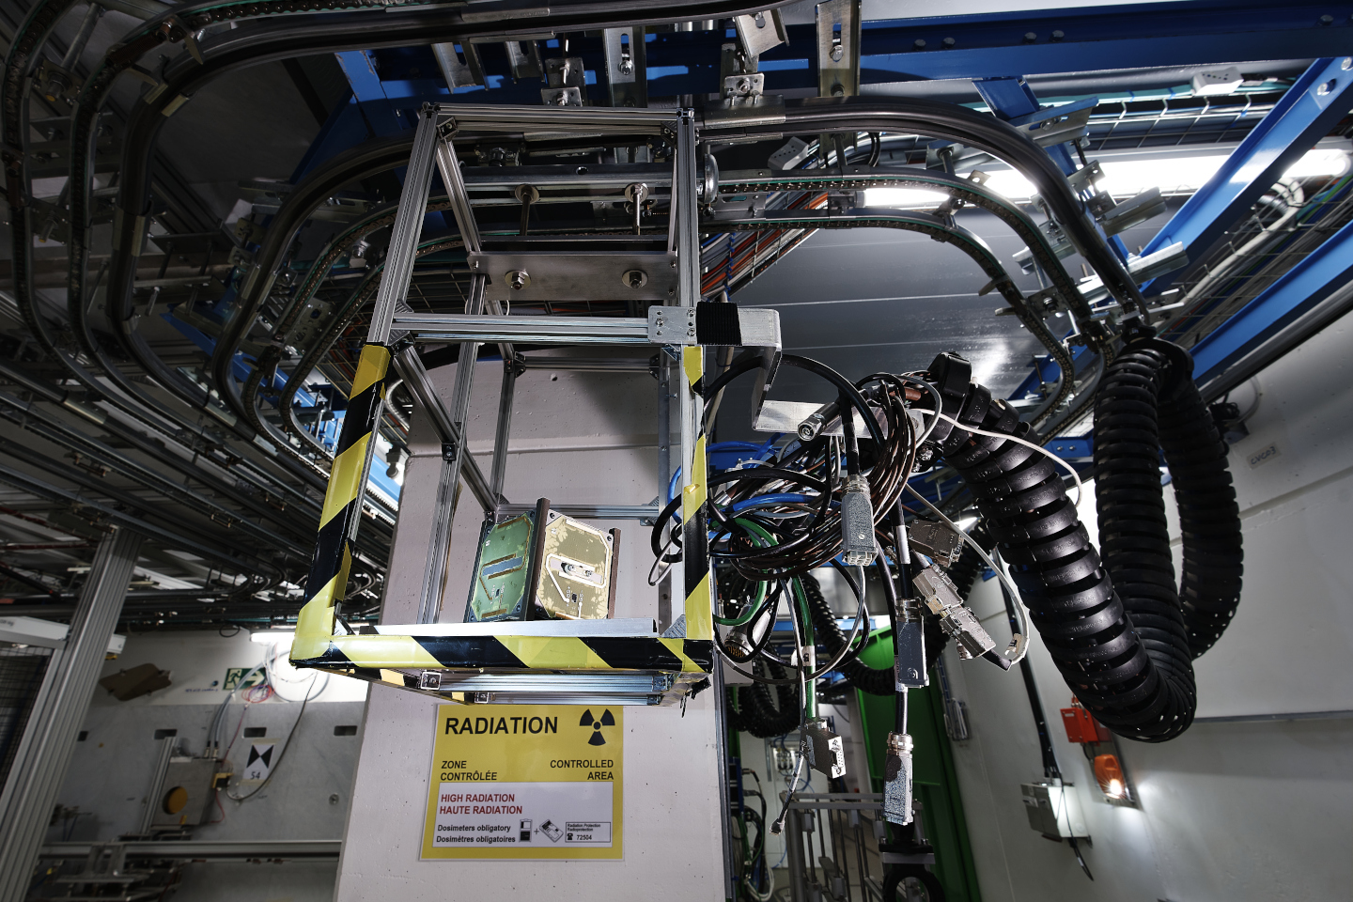
Thanks for your attention!
Image Source: CERN

