Slide 1


WP10, Transnational Access - Proton, heavy ion and alternative beams and irradiation
Françoise Bezerra (CNES)
Arto Javanainen (University of Jyvaskyla)
RADNEXT 3rd Annual Meeting – 10-11 June 2024
https://indico.cern.ch/e/radnext-2024

Slide 2
Outline
Facilities addressed by WP10 - TA02
Statistics after 10 calls
  Acceptance ratio
  Allocated beam time (HI, P, AF)
Beam time by facility
Reports: Status
Conclusion

Slide 3
Third year achievements and ongoing activities
Facility/Country | Heavy ions | Protons | Alternative
GSI - Germany | P
UMCG PARTREC - The Netherlands | P | P
GANIL France | P | P
RADEF Finland | P | P
UCLouvain Belgium | P | P
PSI Switzerland |  | P
CNA Spain |  | P
NPI CAS Czech Republic | H+,D+,3He2+,4He2+ | P
TRIUMF Canada |  | P
HZDR Germany |  | P | e-, γ
ESRF France |  |  | Pulsed Xrays
CLPU Spain |  | P | e-, Xrays
CERN Switzerland | P
HPTC - The Netherlands |  | P

Slide 4
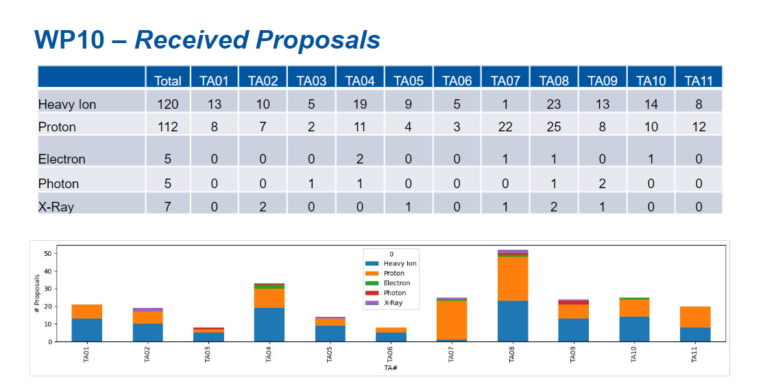

Slide 5
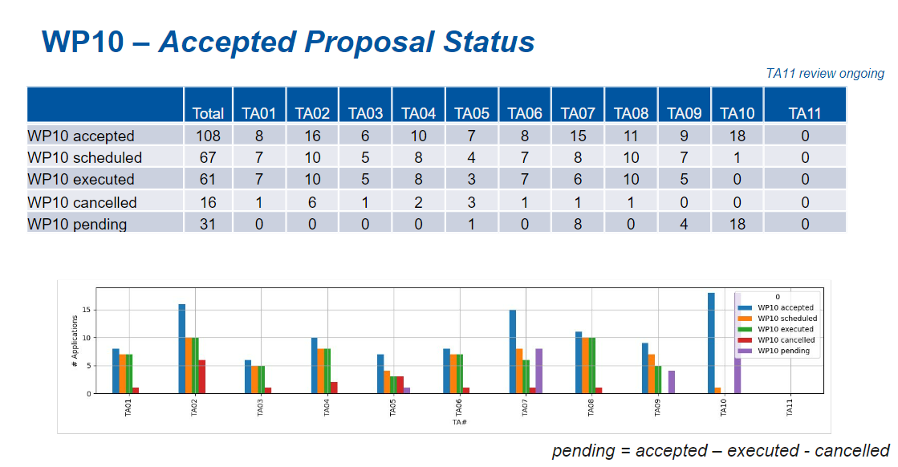

Slide 6
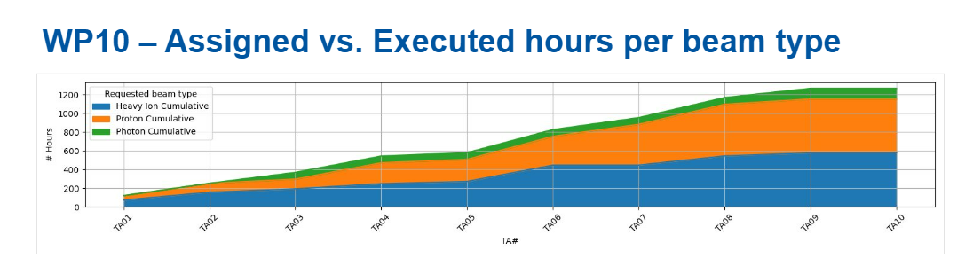
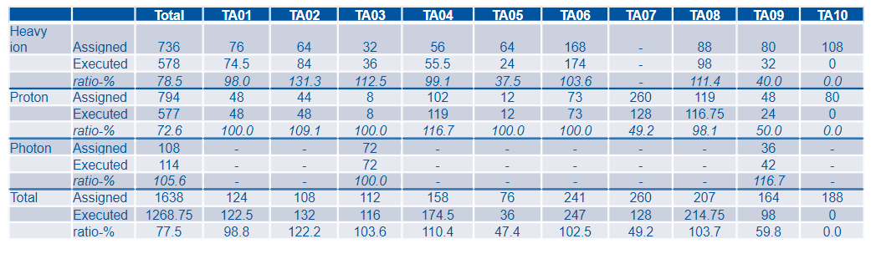

Slide 7
Third year achievements and ongoing activities
Heavy ions: Beam hours by facility
Facility | TA available (h) | Assigned (h) | Scheduled (h) | Delivered (h) | TBD (h) | delivered/ available (%)
GSI – Germany SIS18 | 64 | 40 | 16 | 16 | 8 | 25
GSI – Germany UNILAC | 128 | 32 | - | 48 | - | 37,5
UMCG PARTREC - The Netherlands | 12 | 12 | - | 12 | - | 100
GANIL France | 158 | 72 | 40* | 32 | - | 20
RADEF Finland | 255 | 224 | 12 | 199 | 24 | 78
UCLouvain Belgium | 280 | 268 | 200 | 197 | 68 | 70
CERN Switzerland (CHIMERA) | 500 | 96 | 96 | 102 | - | 20
*GANIL: The 40 scheduled hours will be done in September (32h) and march 25 (8h)

Slide 8
Third year achievements and ongoing activities
Protons: Beam hours by facility
Facility | TA available (h) | Assigned (h) | Scheduled (h) | Delivered (h) | TBD (h) | delivered/ available (%)
UMCG PARTREC - The Netherlands | 323 | 145 | - | 85 | 64* | 26
RADEF Finland | 45 | 45 | - | 45 | - | 100
PSI Switzerland | 193 | 211 | 8 | 123 | 84 | 64
CNA Spain | 200 | 128 | - | 104 | 24 | 52
NPI CAS Czech Republic | 40 | 21 | - | 15,75 | - | 39
TRIUMF Canada BL1B | 148** | 124 | - | 76 | 48 | 51
HZDR – Germany DRACO | 82 | - | - | - | - | 0
CLPU Spain VEGA | 128 | 108 | - | 128 | - | 100
HPTC - The Netherlands | 26 | - | - | - | -
*PARTREC: The TBD 64 hours will be cancelled if PARTREC doesn’t provide beam in October.
**TRIUMF BL1B: In addition 20 h initially committed to protons were used to provide low flux neutrons

Slide 9
Third year achievements and ongoing activities
Alternative facilities: Beam hours by facility
Facility | TA available (h) | Assigned (h) | Scheduled (h) | Delivered (h) | delivered/ available (%)
HZDR Germany gElbe (gamma) | 108 | 108 | - | 114 | 106
ESRF France ID09 (Pulsed Xrays) | 288 | TBC* | - | - | 0
*ESRF:
The unique accepted proposal to ESRF local PAC was to be submitted in February 2024 => no feedback yet
3 other proposals were accepted and had to be cancelled:
  1 proposal rejected by ESRF local PAC
  2 proposal removed because not acceptable in the frame of RADNEXT (French teams)
  => Accepted by ESRF local pack and performed out of the RADNEXT project

Slide 10
Third year achievements and ongoing activities
Reporting
Delivered reports vs performed test
Beam Type - TA call | TA01 | TA02 | TA03 | TA04 | TA05 | TA06 | TA07 | TA08 | TA09 | TA10 | Total
Heavy ions | 4/5 | 6/6 | 3/3 | 4/4 | 2/2 | 4/4 | 0/0 | 0/5 | 0/2 | 0/0 | 23/31
Protons | 2/2 | 4/4 | 1/1 | 4/4 | 1/1 | 3/3 | 5/6 | 4/5 | 0/1 | 0/1 | 24/28
Alternative Facilities | 0 | 0 | 1/1 | 0 | 0 | 0 | 0/0 | 0 | 1/2 | 0 | 2/3
Total | 85% | 100% | 100% | 100% | 100% | 100% | 83% | 40% | 20% | 0% | 79%
  => Only 1 report is missing for more than 6 months

Slide 11
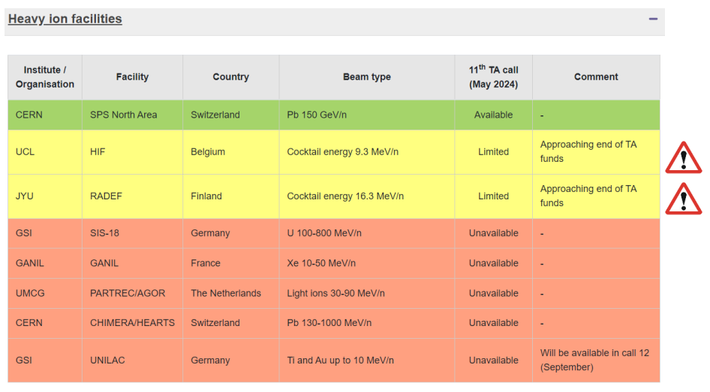
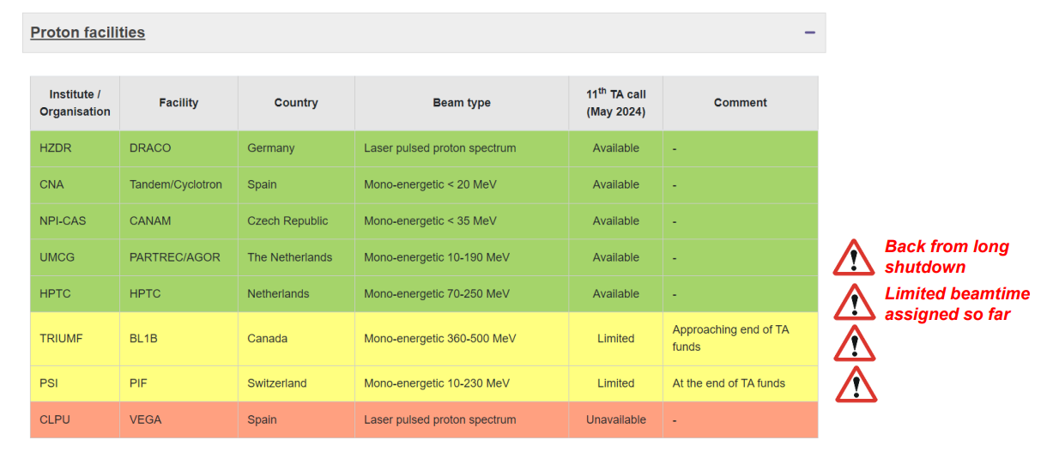
Conclusion: Current situation
Some facilities are close to the end of TA funds
Other facilities are temporary not available
A new proton facility: HPTC (70-250MeV up to 26h)
HZDR-DRACO never used (no need for proton spectrum)
Deliverables: P2 Technical report due by 15/06/2024.
Thanks to Andrea Coronetti, former WP deputy

Slide 12
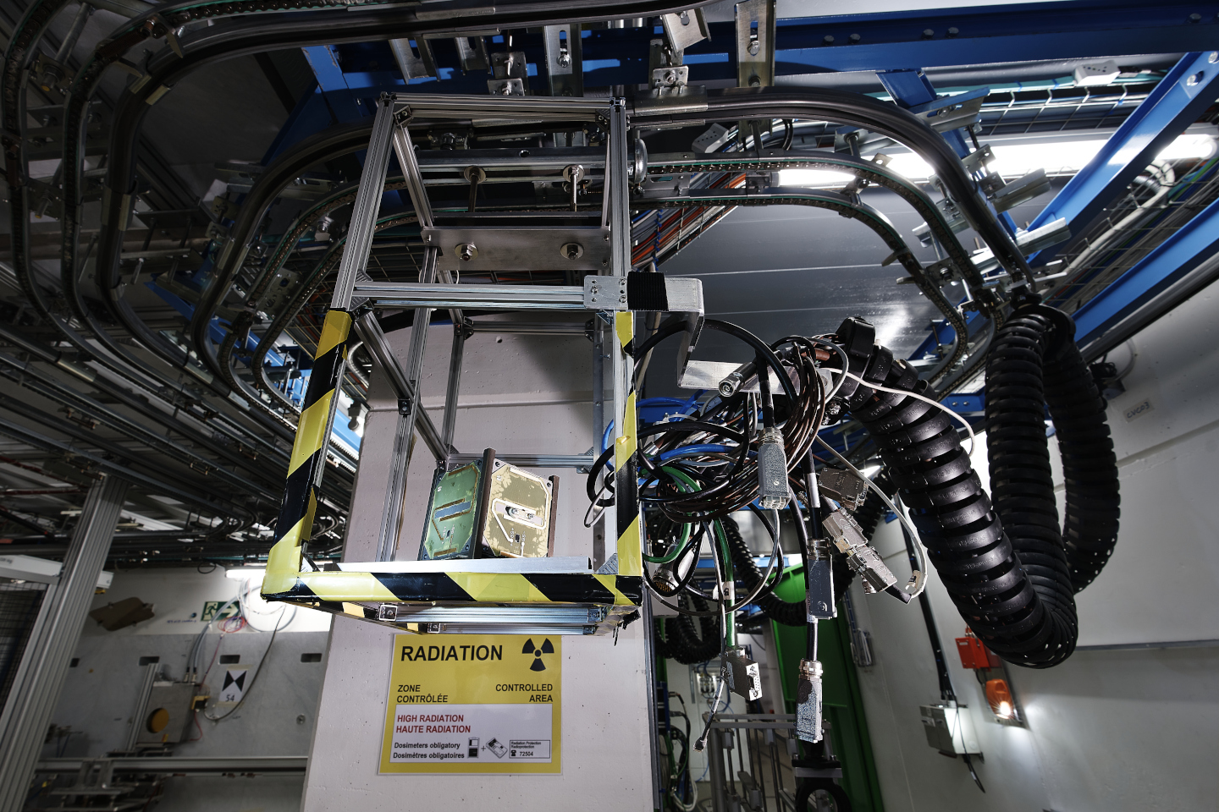
Thanks for your attention!
Image Source: CERN

