Slide 1


Dealing with Beam Instrumentation Big Data
BI Technical Board - 7th December 2023
M. González Berges, A. Guerrero, J. Kearney, J. Martínez Samblas
Input from: D. Belohrad, E. Calvo, T. Levens

Slide 2

Content
Why we need another system?
BI Big Data
BI Solution based on HDF5
Reference Architecture
Storage
Visualization & Analysis
Conclusions

Slide 3
Why we need another system?
BI Use cases that don’t fit in NXCALS
Large amounts of data
  NXCALS
    Individual insertions limited to 2 MB per property (can go up to ~20-30 MB)
    Clients with high insertion rated can be slowed down or disconnected temporarily
  BI Systems (next slide)
    Diamond BLMs, LIU wirescanners, Head-Tail, etc
Temporary data
  MDs, capture data for studies, etc
Simulation data
  Doesn’t fit Device-Property model
  BI Systems: ISpy simulation results (including metadata)
Data Analysis results
  Could be sent to NXCALS
  Retrieval speed not enough for interactive visualization
  BI Systems: OAF

Slide 4
BI Big Data
Diamond BLMs
Use for IQC, UFO detection, beam studies, etc
Several systems
LHC, SPS (BLMDIAMONDVFC)
East Area - F61 (Picoscope)
Capture buffer max size ~536 Msamples x 2 channels
FESA property
Max size ~3.2 GB
Typical sizes: from 10MBs to several 100MBs per cycle
LIU wire-scanners
LHC prototype 1 channel in/out capture data is ~110MB for ~only 10mm scan.
SPS ~200MB for a medium speed scan of ~80mm
PS ~50MB for high speed scan of ~100mm
Spill Monitor
100 ms per spill cycle x 2 channels
Raw data: ~100 Msamples per 20 seconds
Slow data: ~20 Msamples per 20 second
Head-Tail
Max acquisition size is 3.2 GB (readout ~30 seconds)
Systems
LHC: frequent triggers when instability trigger enabled
SPS: once per cycle
Other systems using file storage
LHC BPMs
LHC BLMs
Data for studies
ALPS capture data
BSRL intermediate histograms
etc

Slide 5
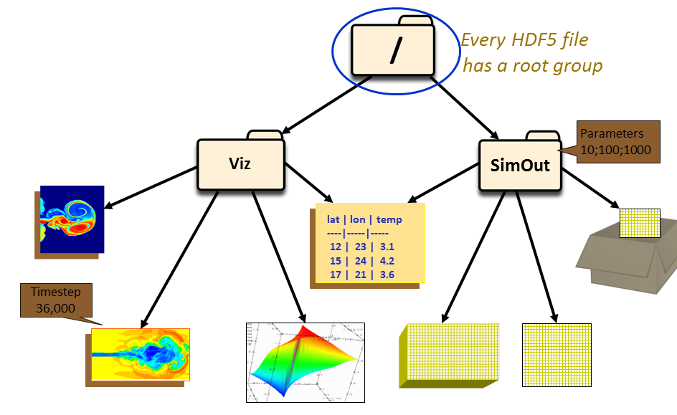
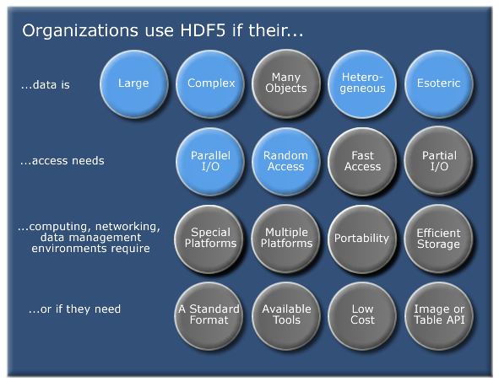
BI Solution based on HDF5
Hierarchical Data Format 5
Supports large, complex, heterogeneous data
File directory like structure
Advanced features
  Compression, parallel I/O, caching, etc
Portable across platforms
APIs in many languages (e.g. Python, C++)
Strong community
  Wide used in industry and science (including at CERN!)
  Forums, tools available, etc
Previous experience in BI
  OAF, head-tail system
https://www.hdfgroup.org/

Slide 6
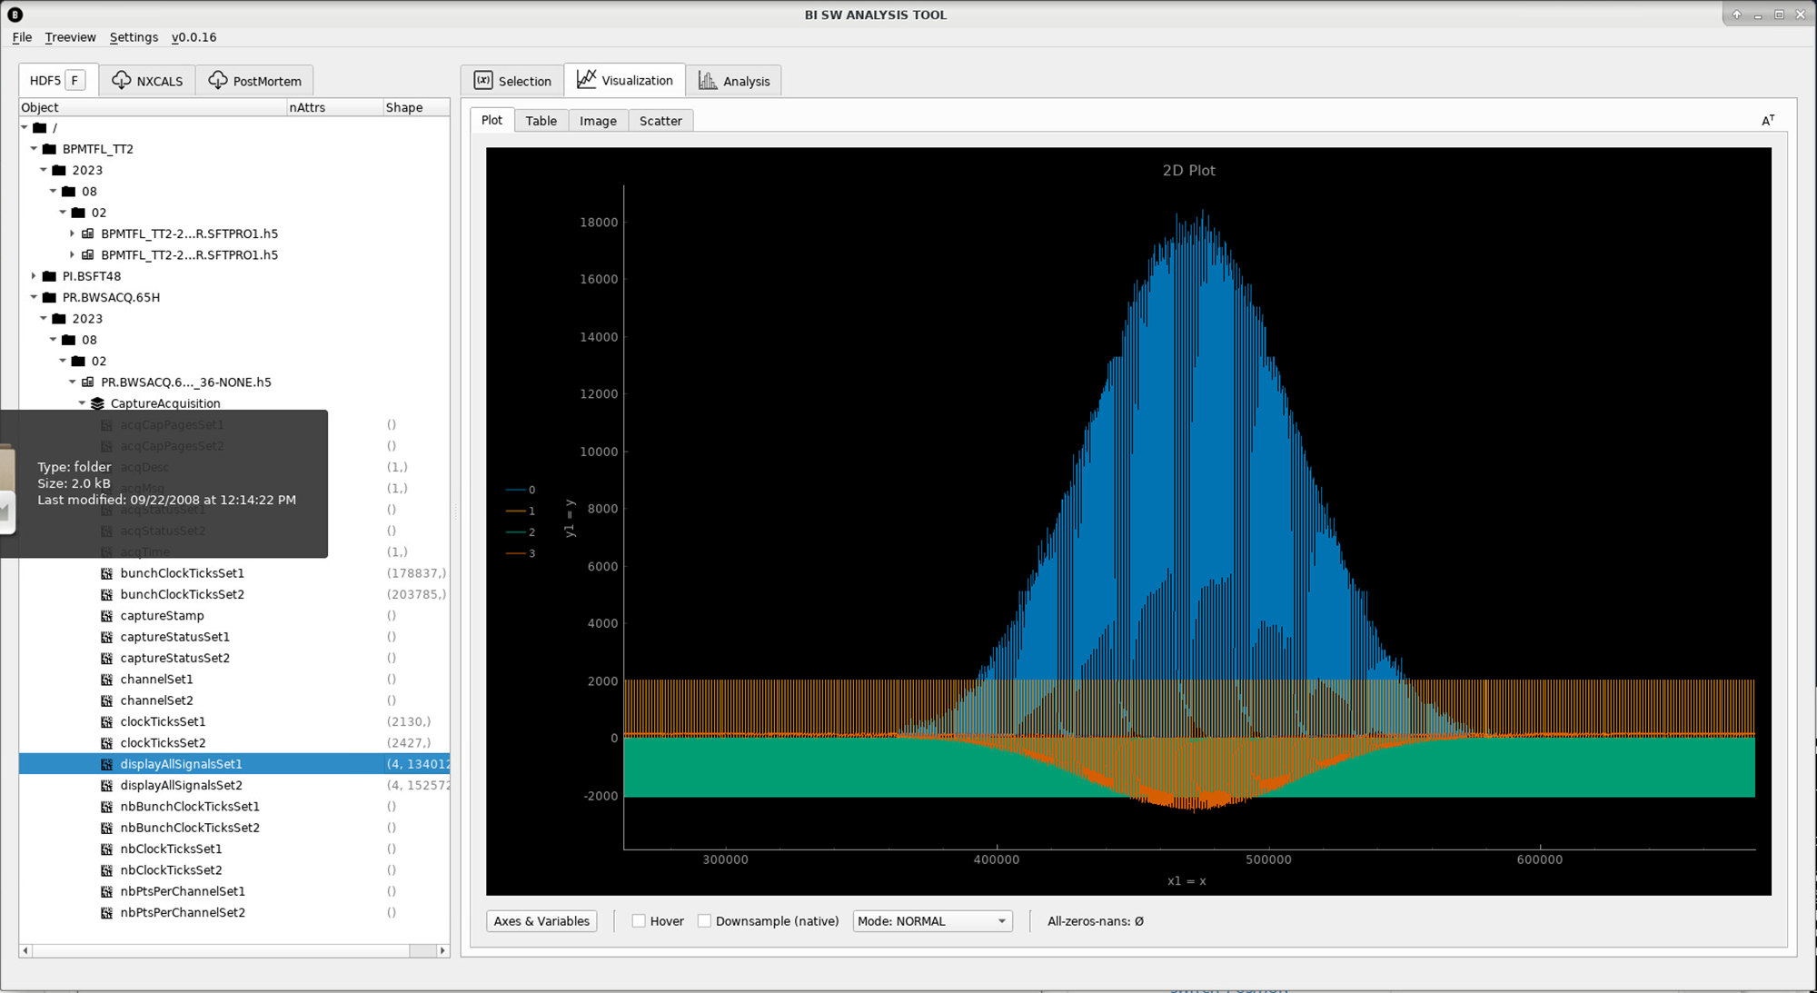
Reference Architecture*
HDF5 files
(Full data + metadata)
Temporary location
(e.g. NFS, local drive)
HDF5 files
(Full data + metadata)
Final location
(e.g. EOS)
FESA Server
Metadata +
Partial data
NXCALS
View/Analyze
* Not necessary to have all components

Slide 7
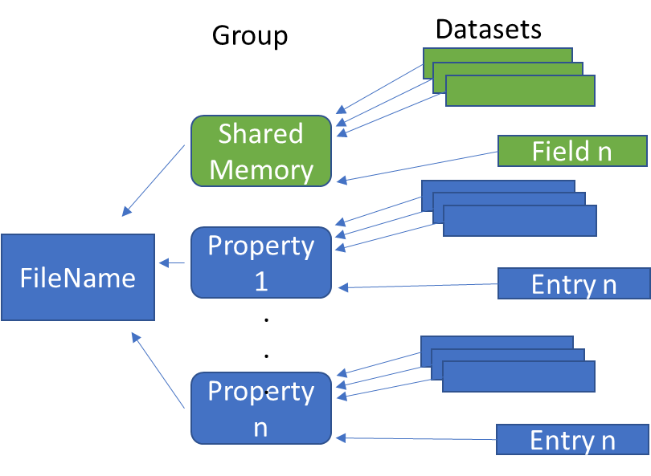
Storing from FESA
HDF5 files
(Full data + metadata)
FESA Server
Temporary location
(e.g. NFS or local SSD)
Two possibilities
Simple interface in FESA
  Dump fields stored in shared memory or in CMW DataMaps (device/property model)
  Library with example:
    https://gitlab.cern.ch/bisw-cpplibrary/biswhdf5
Direct coding
  Needed in some specific cases (e.g. VME pages, chunking)
File Naming
Convention
  Directory Path: { Accelerator } / { FEC } / { FESA Device Name } / { Year } / { Month } / { Day }
  File Name: { FESA Device Name } - { DateTime } - { Timing User }.{ Extension }
Available in C++ library
  https://gitlab.cern.ch/bisw-cpplibrary/bi-data-file-handling

Slide 8
Transfer to Final Location
Temporary location
(e.g. NFS, local drive)
HDF5 files
(Full data + metadata)
Final location
(e.g. EOS)
Recommended to have an EOS project per BI system
Long term storage
Size limit = 20 TB
Are larger spaces needed?
Reusable python script for the transfer
Synchronizes data across locations
Bash script to run synchronization from a Cron task
  Set up per system with specific scheduling (typically every few minutes)
https://gitlab.cern.ch/bisw-python/bi-data-file-handling)

Slide 9

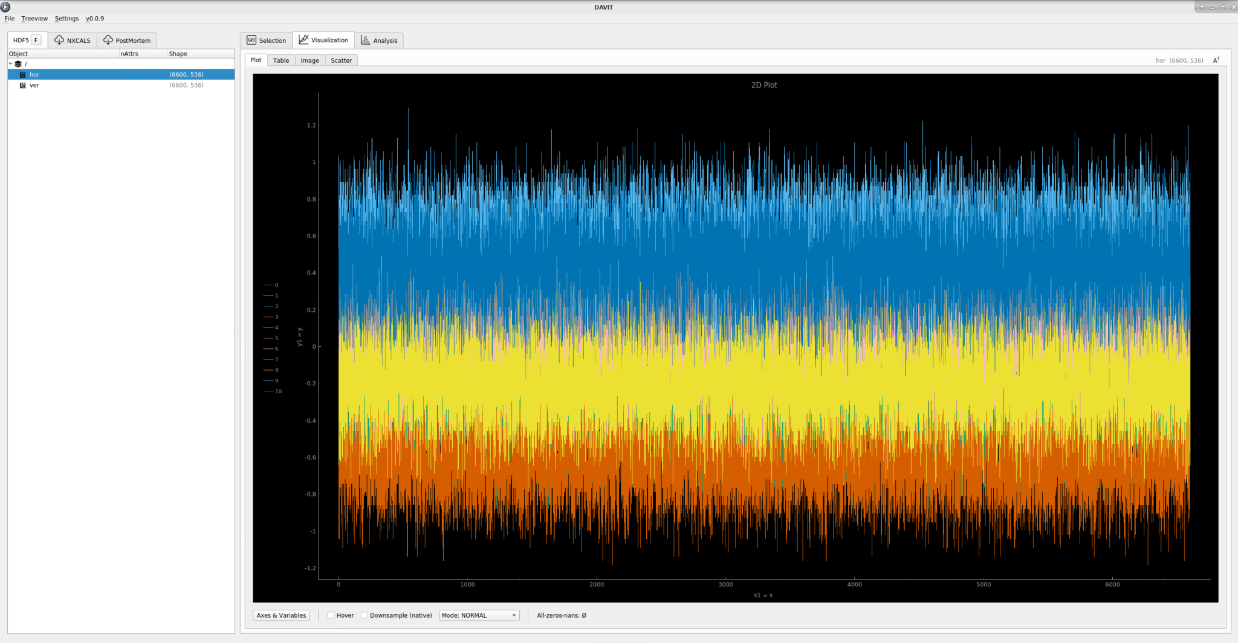
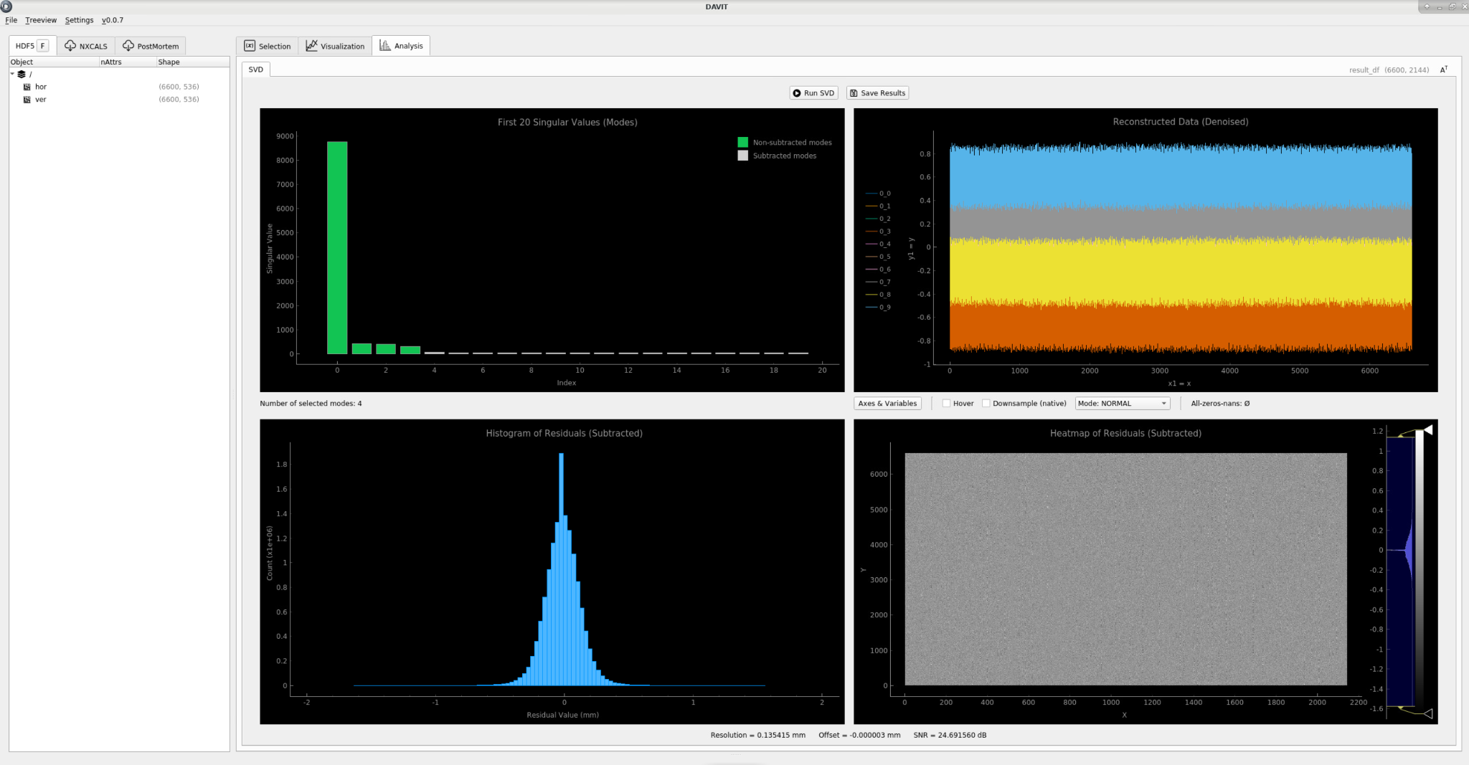
DAVIT: Data Analysis & VIsualization Tool
HDF5 files
Instrument (FESA, others)
Simulation (ISpy)
Analysis Results (OAF)
View
Process
NXCALS
Analyze
PostMortem*
* Under development
Will be presented in detail in a future Student & RD meeting

Slide 10
Conclusions
A number of BI use cases are not covered by standard tools
Chosen a solid platform (HDF5) to develop the necessary solutions with minimal effort
Ready to move to standard tools once the BI requirements are covered
Next steps:
  Finalize performance measurements
  Extend generic analysis in DAVIT
  Discussion with CSS on NXCALS evolution

Slide 11
Questions?

