Slide 1

Area Integration Reports – Comments on new version to be released
RR13/RR17
RR53/RR57
USC55
Miguel Navarro Baeza, ATS-DO, HL-LHC WP15 Integration
17/11/2023

Slide 2
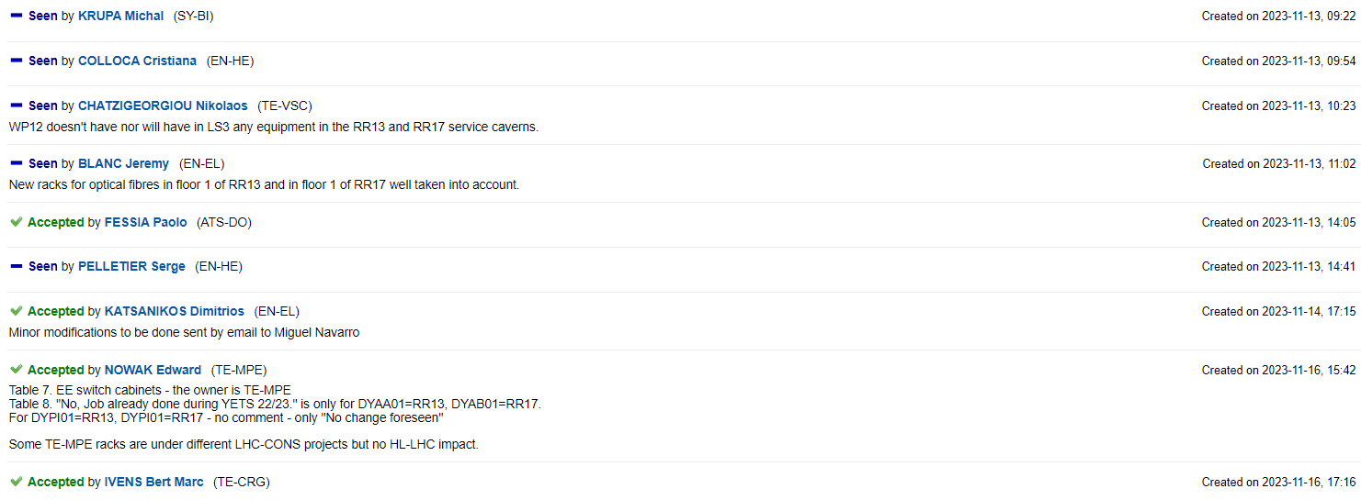
RR13/RR17
AREA INTEGRATION REPORT: Integration of RR13 and RR17 Caverns, EDMS 1758110
Version 2.7 to be released after changes

Slide 3
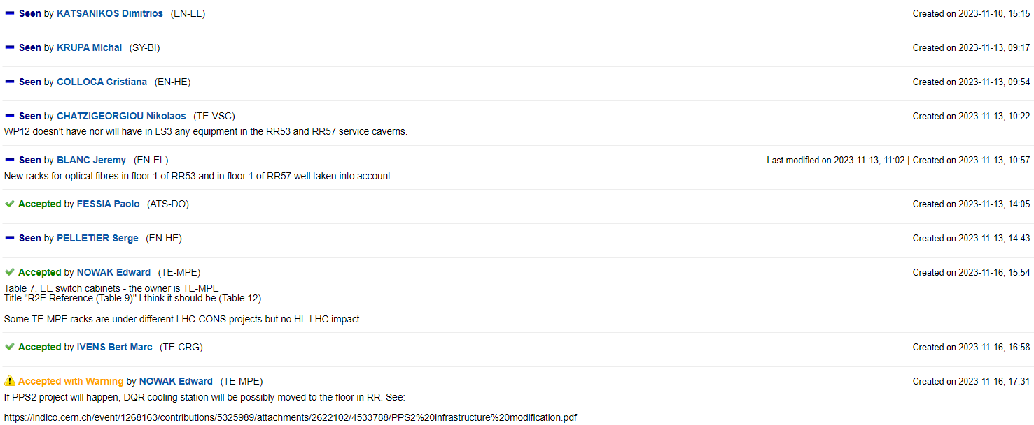
RR53/RR57
AREA INTEGRATION REPORT: Integration of RR53 and RR57 service caverns, EDMS 1758153
Version 2.7 to be released after changes

Slide 4
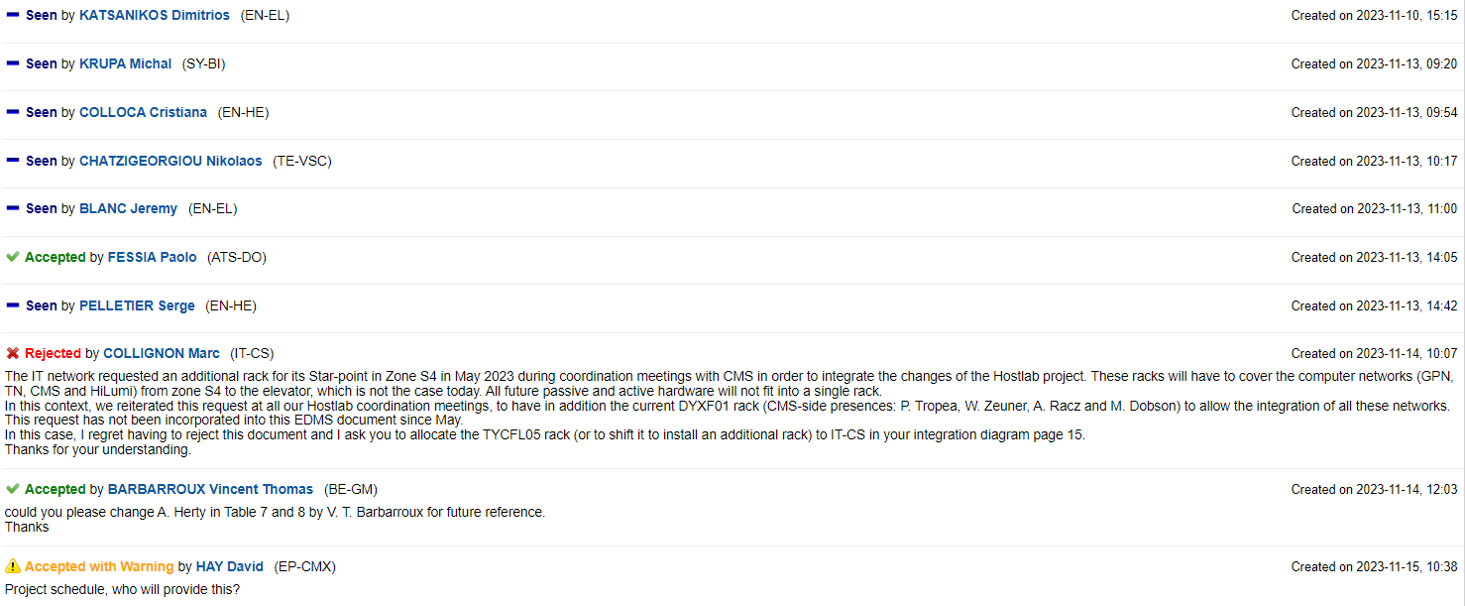
USC55
AREA INTEGRATION REPORT: Integration Report of USC55, EDMS 1836699

Slide 5
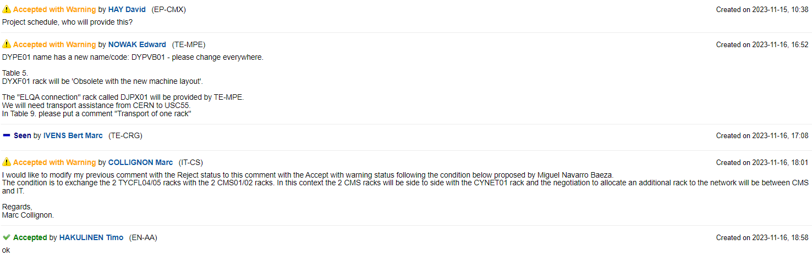
USC55
AREA INTEGRATION REPORT: Integration Report of USC55, EDMS 1836699
Version 1.8 to be released after discussions and changes

Slide 6
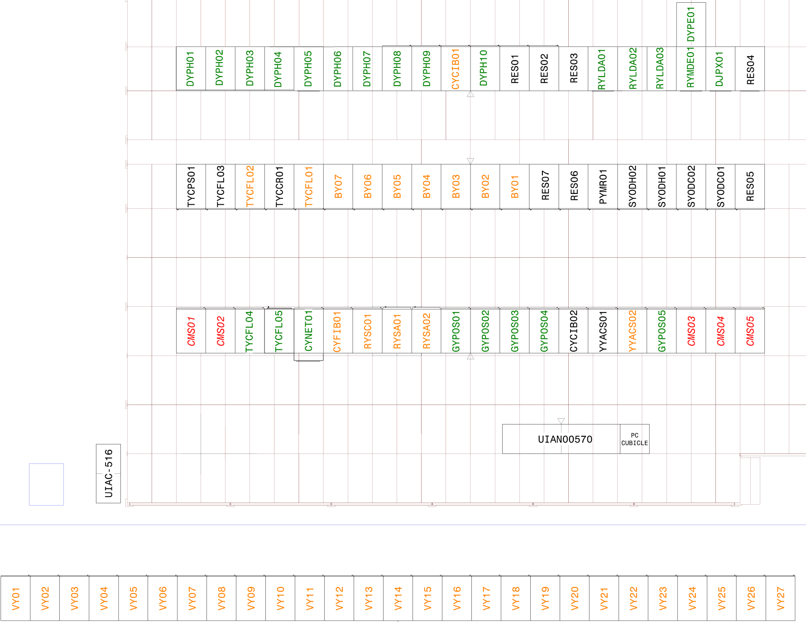
USC55
Swap
BE-CEM ok?

Slide 7
References
AREA INTEGRATION REPORT: Integration of RR13 and RR17 Caverns, EDMS 1758110
AREA INTEGRATION REPORT: Integration of RR53 and RR57 service caverns, EDMS 1758153
AREA INTEGRATION REPORT: Integration Report of USC55, EDMS 1836699

