Slide 1
Energy Management Panel at CERN, A selection of Highlights
Serge Claudet, on behalf of all teams involved in Energy Management Panel at CERN
Jan-2024
(~0.2 FTE eq.)

Slide 2
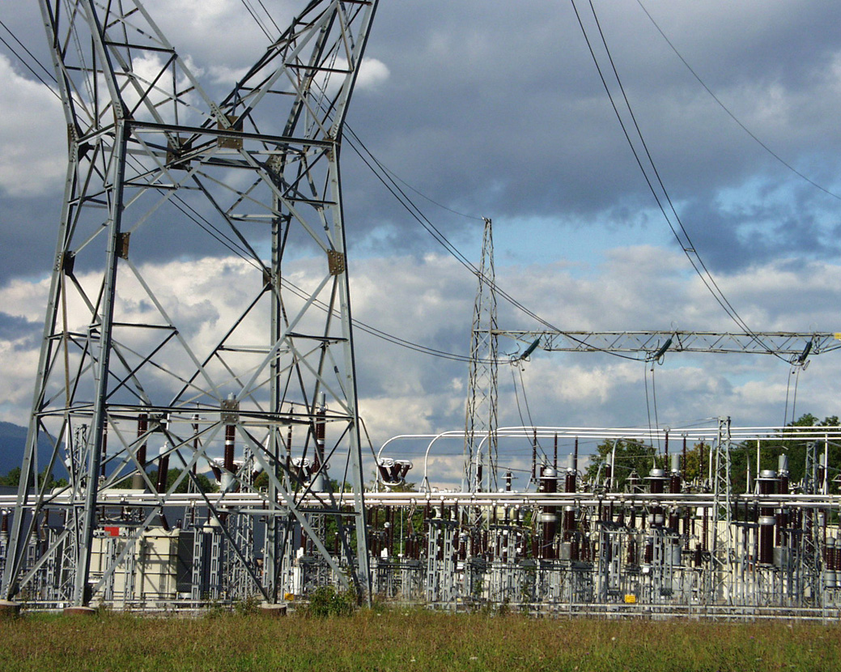
Content
Introduction to EMP
Energy consumption, forecasts & virtual invoices
Improved efficiency, heat recovery, projects
Renewable energy (PV) & long term projects
Exchange of information & Way-forward
CERN Prevessin Electrical feeding point

Slide 3
Origin of EMP
2014: Need to prepare for a new type of electricity contract for 2016 onwards, moving from "protected tariffs" to "market based" (deadline for industry as defined by EU)
WG established including EN-EL, IPT, a representative of ATS sector (me!) and steered by F. Bordry (ATS_Dir), R. Saban (EN_Dh) & S. Baird (EN-EL_GL ad interim)
Multiple contacts with energy providers in Europe (10 from 7 countries) and with other research institutes on the french grid (ESRF, ITER)
Contract established spring 2015
2015: EMP formally established to support the new electricity contract, and much more!
Since: Energy management and Energy efficiency well in place at CERN, and formally considered in CEPS, ISO50001, Sustainable Accelerator Panel

Slide 4
CERN Energy Management Panel (EMP)
(Mandate, Oct. 2015)
The CERN Energy Management Panel reports to Director of Accelerators,
and is expected to bring all main energy consumers and stakeholders at CERN together in order to:
(Equipment & operations >= 3 MW and/or >= 25 GWh/y)
Make the main energy consumers aware of the new conditions and rules under CERN’s new energy supply contracts.
Compile estimates of CERN’s projected power and energy consumption up to and including HL-LHC, in coordination with the various users and EN-EL power network operations.
Manage CERN energy consumption, with regular checks against planned consumption.
Define how CERN will handle changes to projected energy consumption due to changes in programs, both foreseen and unforeseen.
Implement the mechanism by which CERN will inform CERN’s energy supplier(s) of changes to the projected energy consumption. The mechanism itself will be defined in the supply contract(s).
Develop degraded operation scenarios for periods of reduced power availability. EN/EL will provide the estimations for the reduced available power.
Define and implement the mechanisms by which the degraded operation scenarios, as defined above, will be triggered.
Make recommendations to reduce CERN’s energy bill with minimal impact on CERN’s operations.

Slide 5
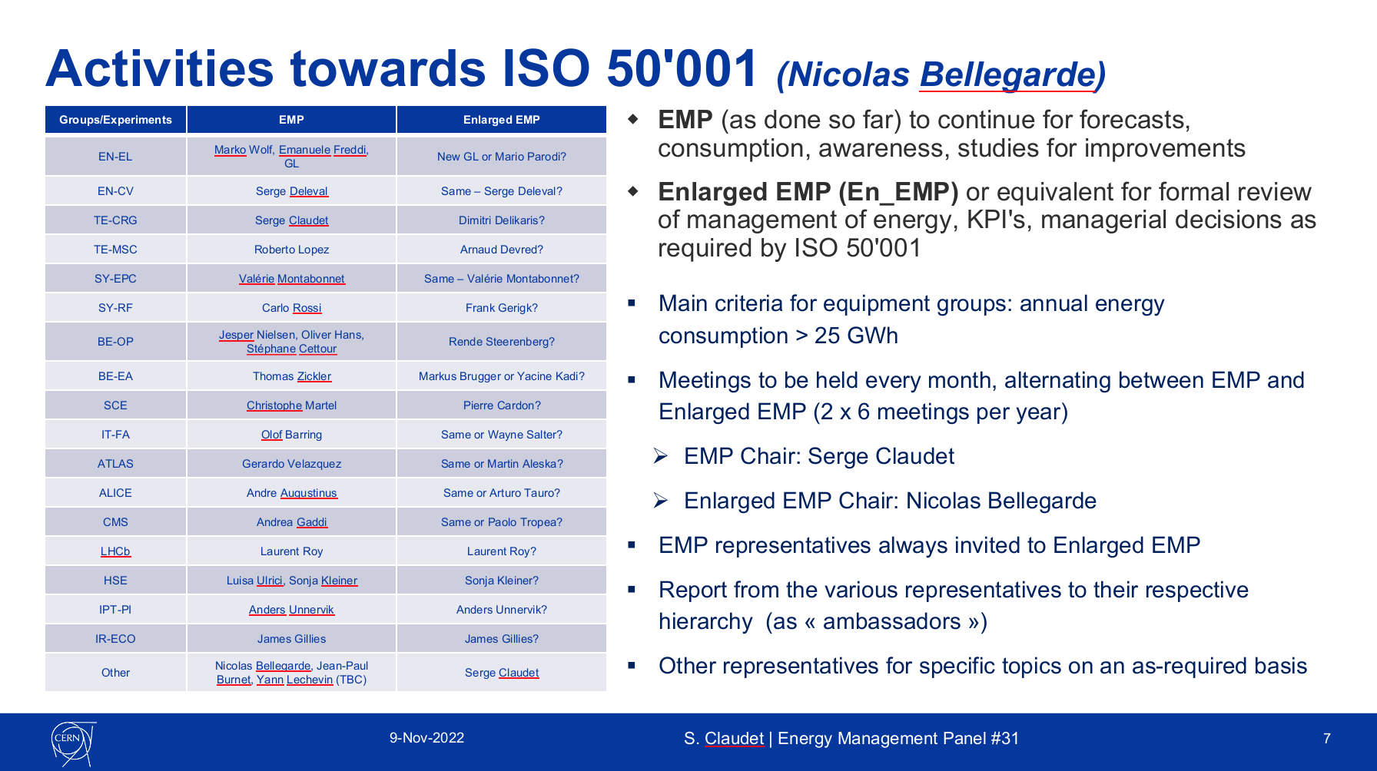
EMP in a nutshell
36 plenary meetings so far
(intro & general news, consumption Vs forecasts, Electricity market news, technical topic(s), AOB)
New mandate
EDMS#2788210
since Nov'22
Group representatives updated when necessary
All presentations/minutes available from inside CERN on Indico under:
EMP Plenary meetings

Slide 6
Content
Introduction to EMP
Energy consumption, forecasts & virtual invoices
Improved efficiency, heat recovery, projects
Renewable energy (PV) & long term projects
Exchange of information & Way-forward
CERN Prevessin Electrical feeding point

Slide 7
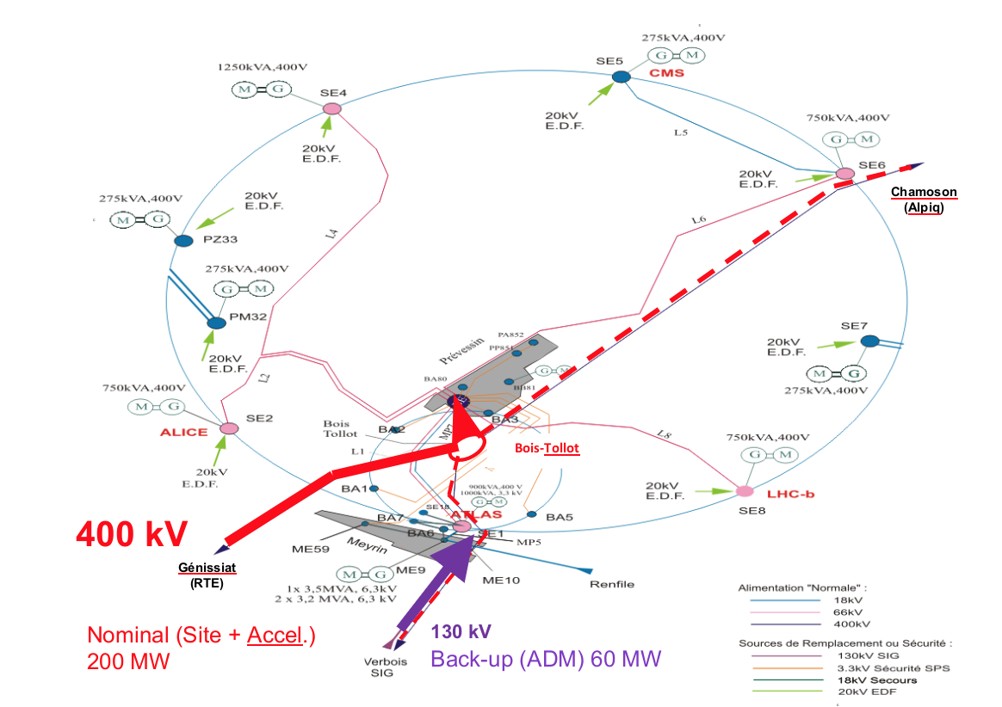
Electrical distribution at CERN
Energy contracts in place for both feeding points
(F and CH)
Energy
(competitive tenders)
Transport
(not competitive tenders)
Main feeding point from a 400kV line (interconnection F-CH)
Mandatory for CERN accelerators
(capacity and stability)
Back-up from 130kV
(limited capacity)

Slide 8
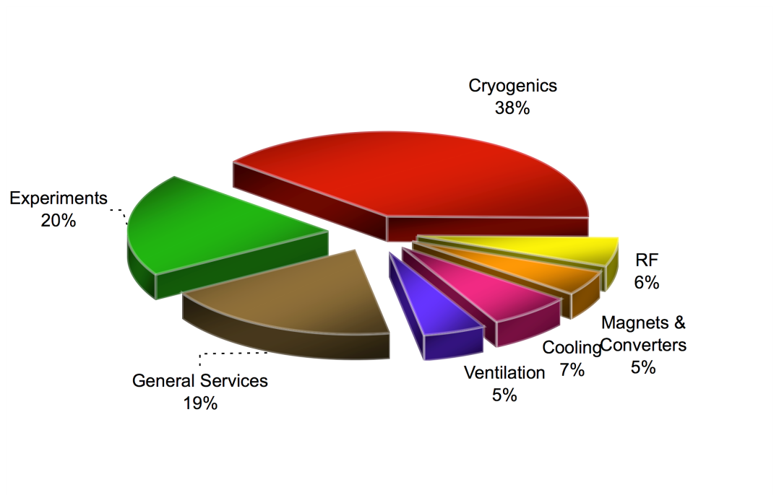

Energy Consumption
245 GWh
Energy per origin, yearly average "Beams"
Fuel: 4 GWh, 0.3 %
Gas: 67 GWh, 5.2%
Electricity: 1'220 GWh, 94.5%
35 GWh
125 GWh
650 GWh
30 GWh
120 GWh
31 GWh
42 GWh
Breakdown (averaged) per major system for LHC
Contained consumption
(SPS-2016, EYETS-2017)
Long Shut-down No1
Long Shut-down No2
~90% for accelerators, detectors and test facilities
Buildings computer center and conventional facilities represents about 10% of the total EL energy consumption, (similar to gas consumption)
Electricity
Graph now updated within ISO 50'001 activities
2010
2011
2012
2013
2014
2015
2016
2017
2018
2019
2020
2021

Slide 9
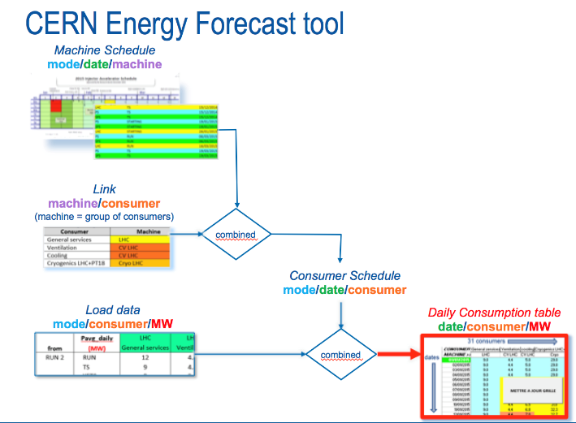
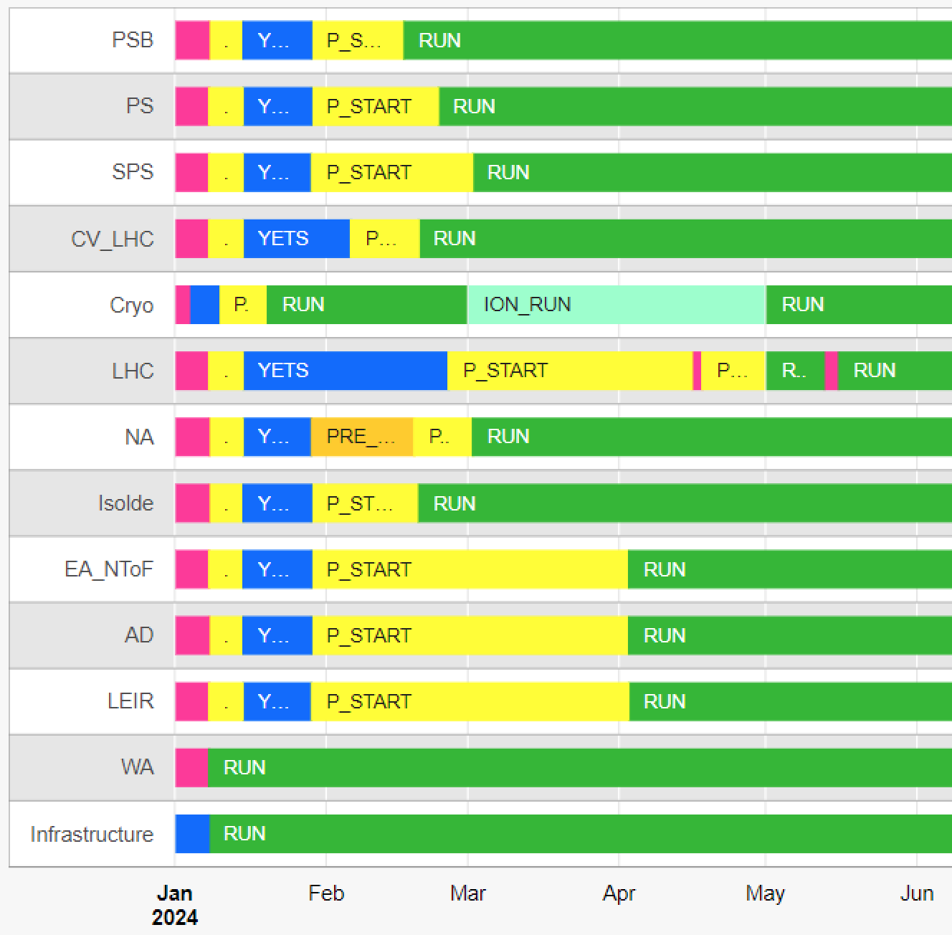
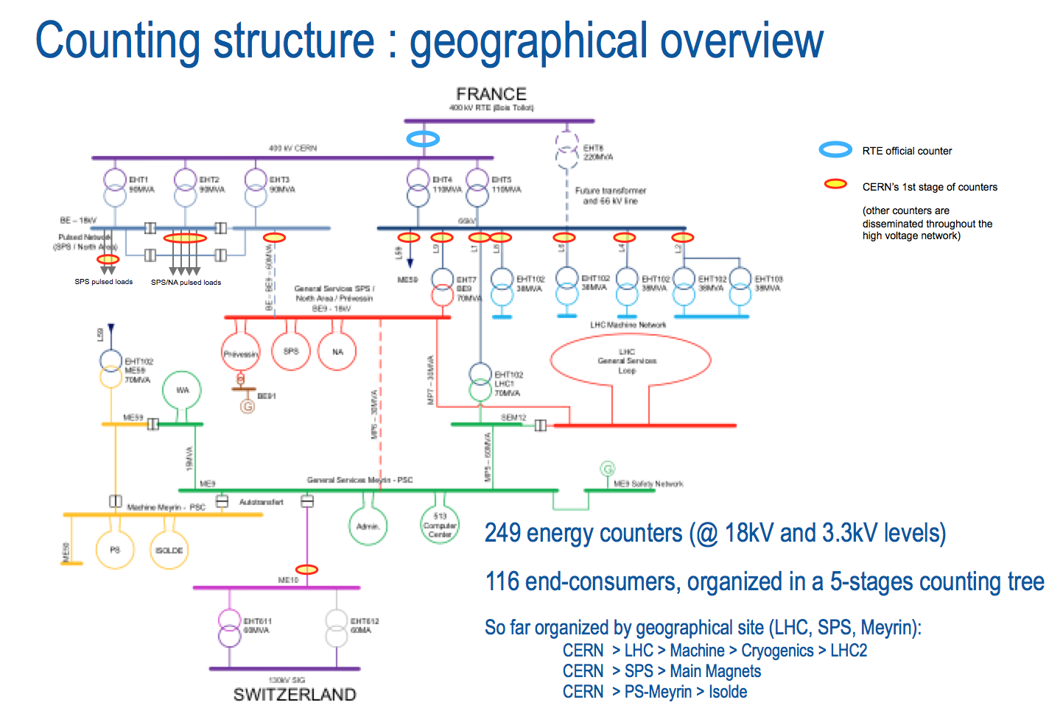
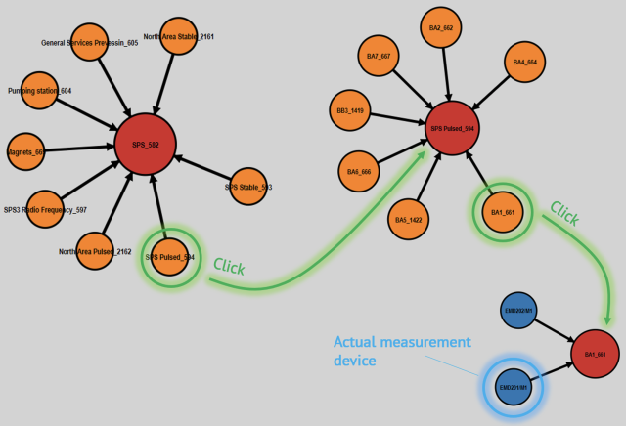
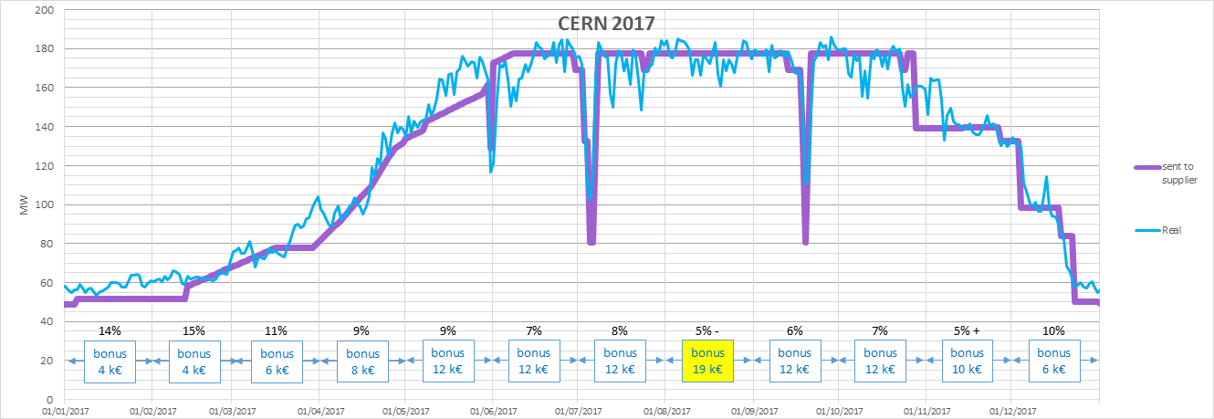
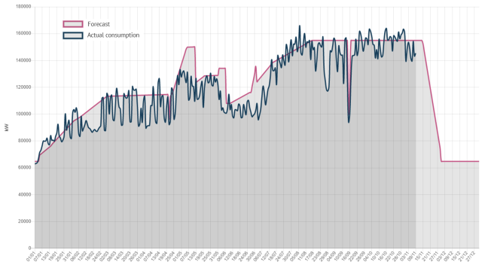
Forecasts & measures
2nd version, integrated in Web-Energy tool to combine forecasts & measures
Measures: global accuracy better than 1% !
Model output sent to Energy Contractor
= model − communication and modelisation delays
Bonus for accuracy: 12/12 => 120 k€ !!!
2021

Slide 10
Long term forecasts, degraded modes, load shedding or LS consumption & actions
2016-EMP1_to_5: Introduction and main consumption parameters for each main user
2017-EMP6-7-8 : Possible early load shedding and consumption profiles
2019-20 EMP#17-18 : Future loads post LS2 (EN-EL + EMP)
2021-22 EMP#25-27 : Future loads post LS3 (EN-EL + EMP)
2023-EMP#34 : Degraded modes (G. Podoleanu & EN-EL)
2022-EMP#29 : LS consumption and possible actions (J. Moxon) => to be continued
2023-EMP#35 : Load shedding measurements (J. Nielsen)

Slide 11
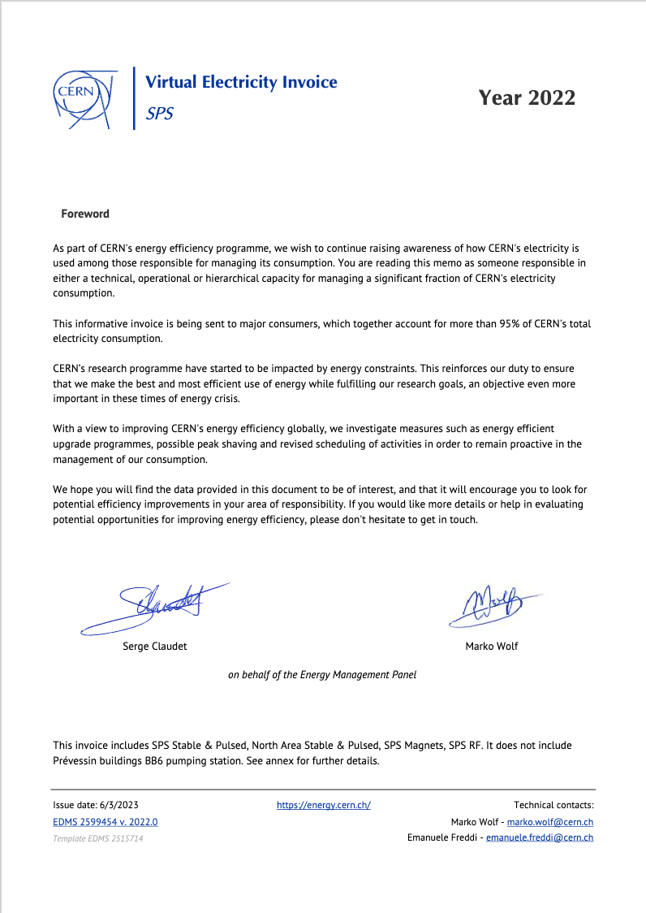
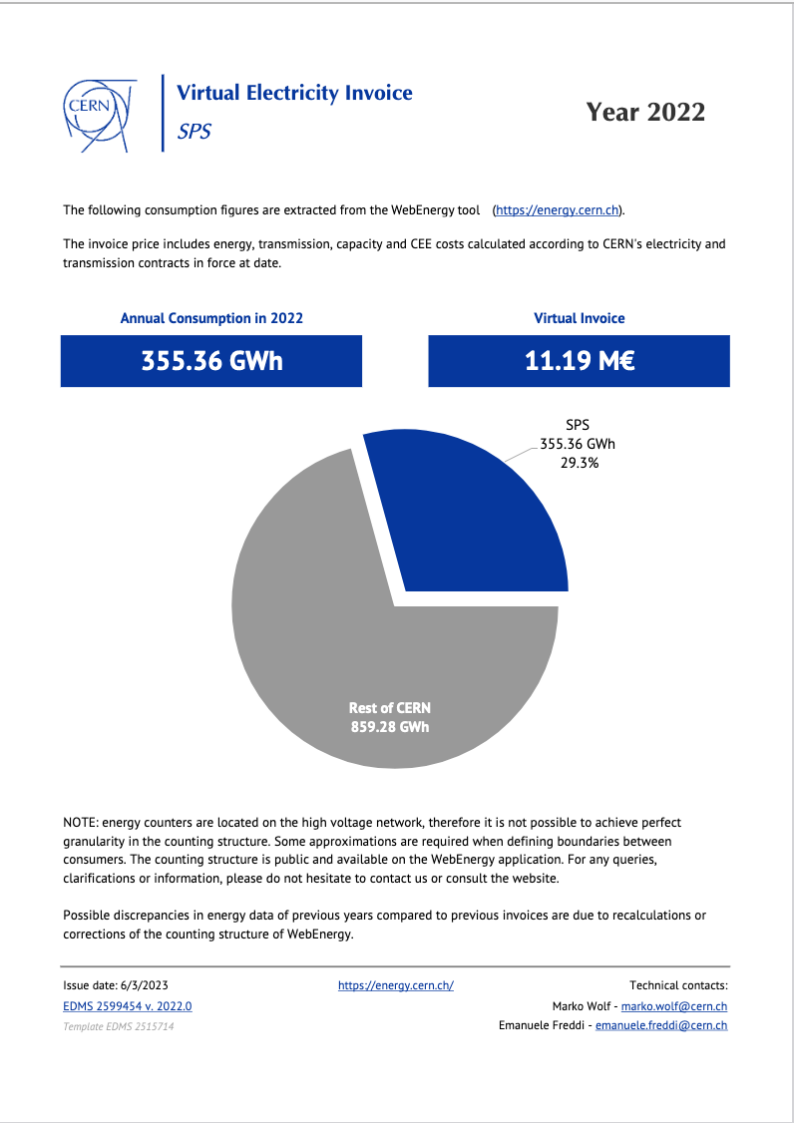
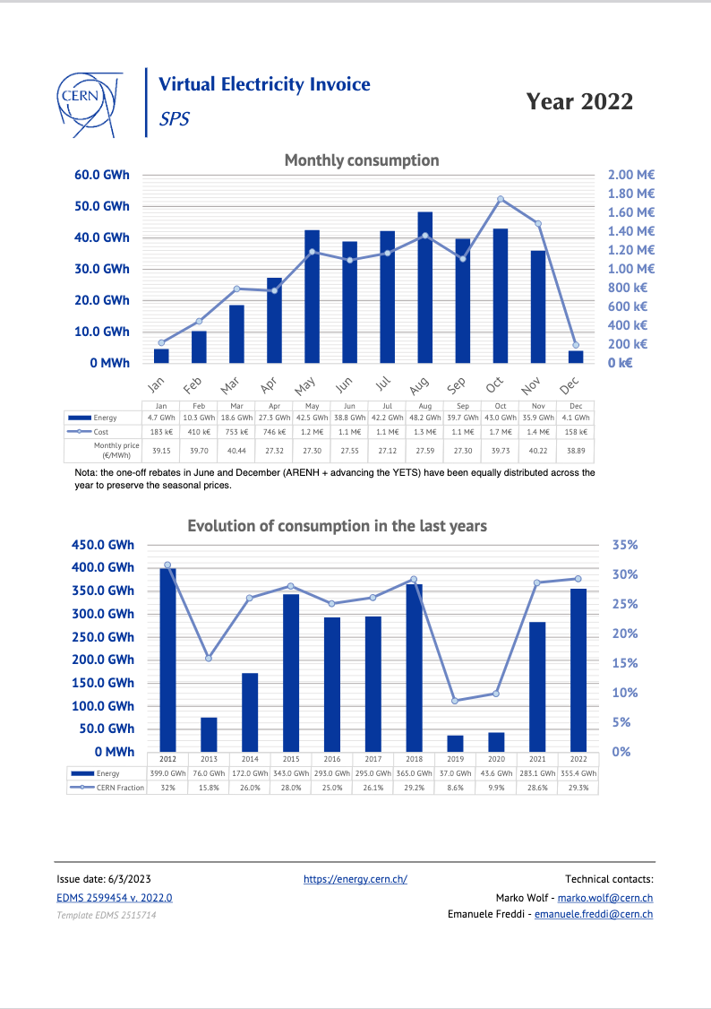
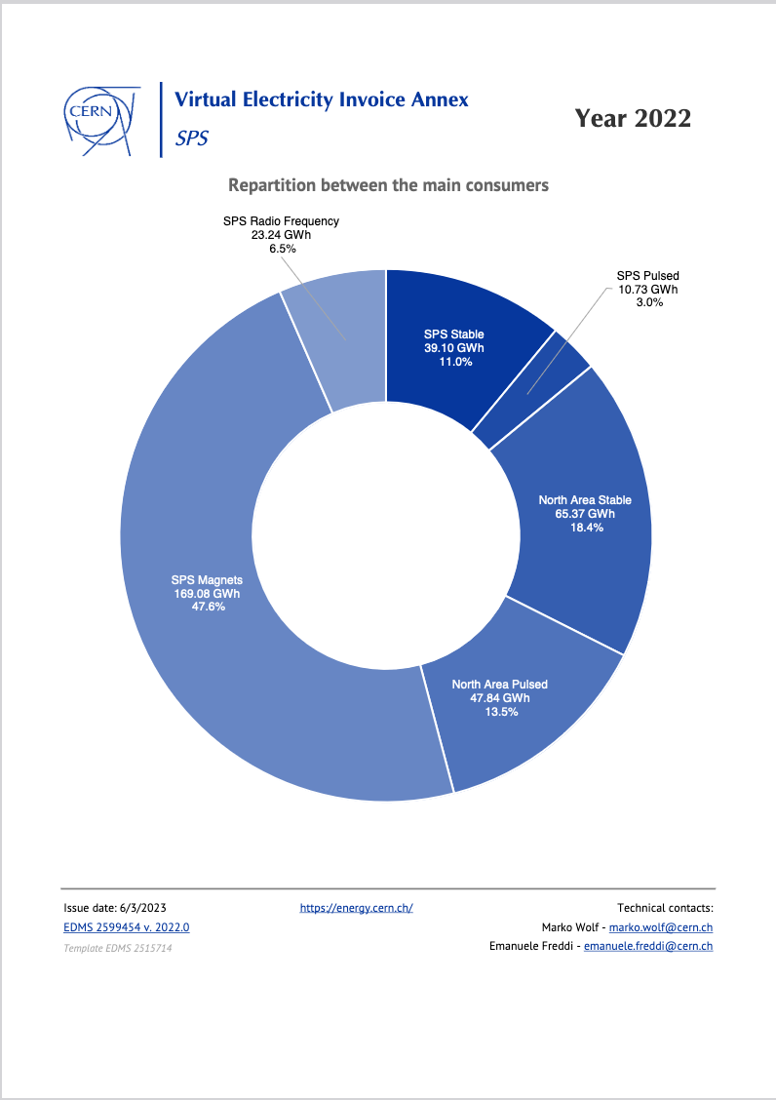
Virtual invoices, since 2018: AWARENESS
Sent every year to usual EMP contacts and respective GL's, DH's, Dir
Thanks to Marko Wolf & Emanuele Freddi for their help with this !

Slide 12
Content
Introduction to EMP
Energy consumption, forecasts & virtual invoices
Improved efficiency, heat recovery, projects
Renewable energy (PV) & long term projects
Exchange of information & Way-forward
CERN Prevessin Electrical feeding point

Slide 13
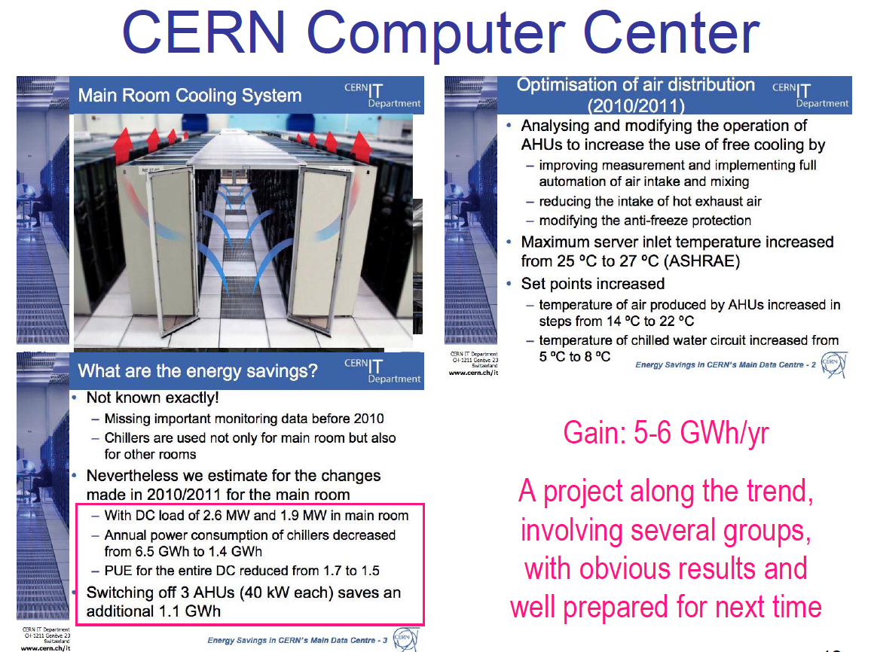
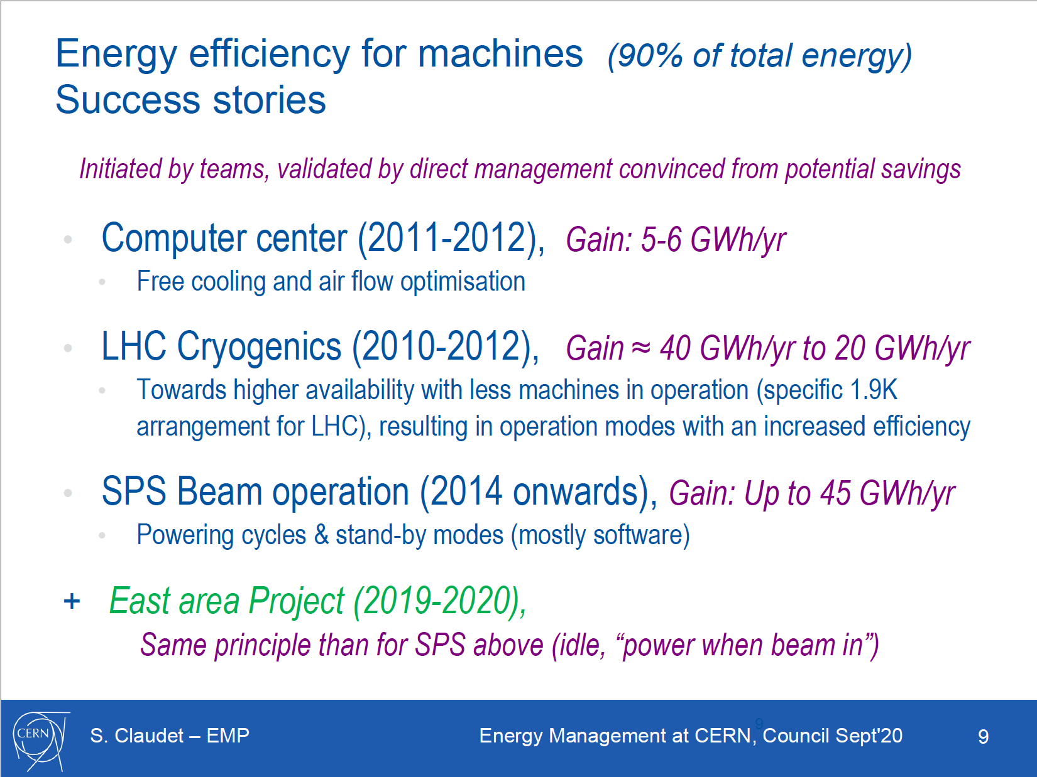
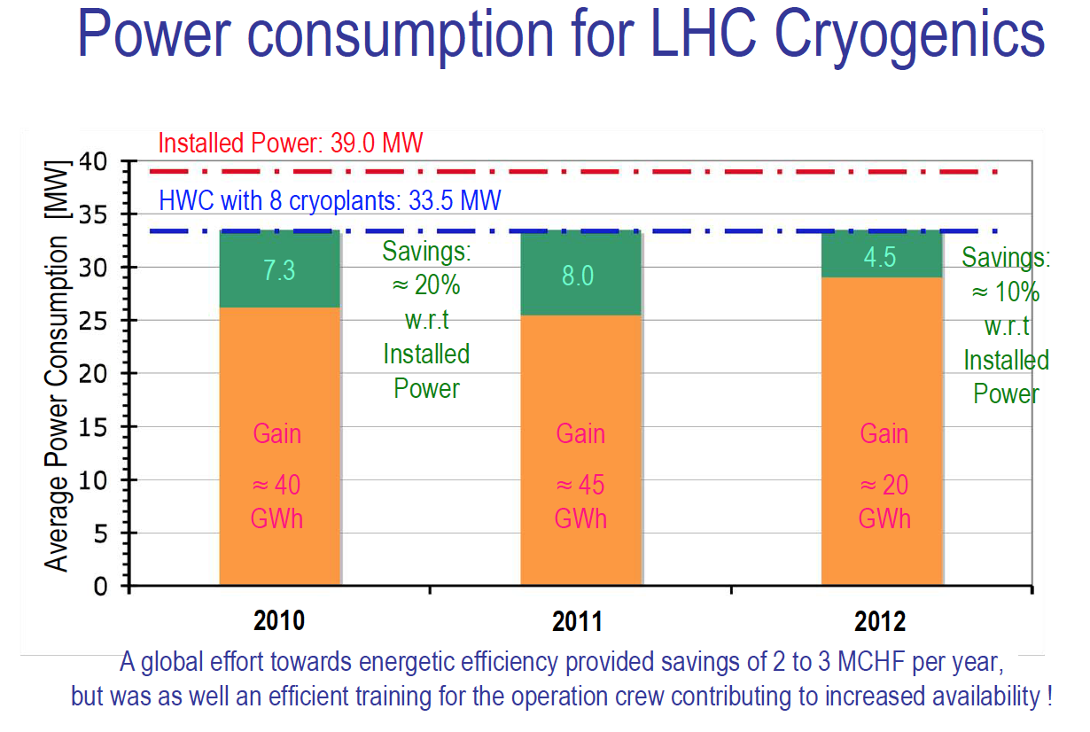
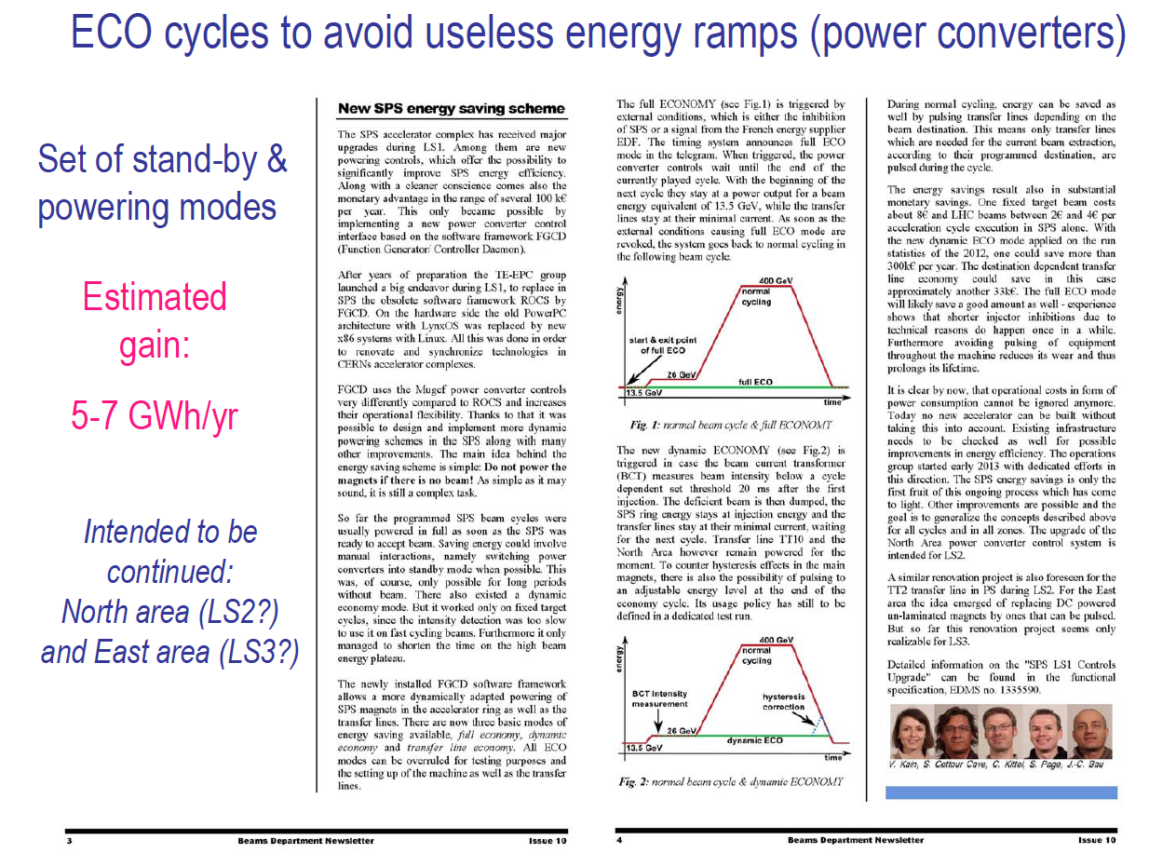
Energy efficiency, operation modes
Some success stories before EMP start end 2015
Up to 45 GWh/yr

Slide 14
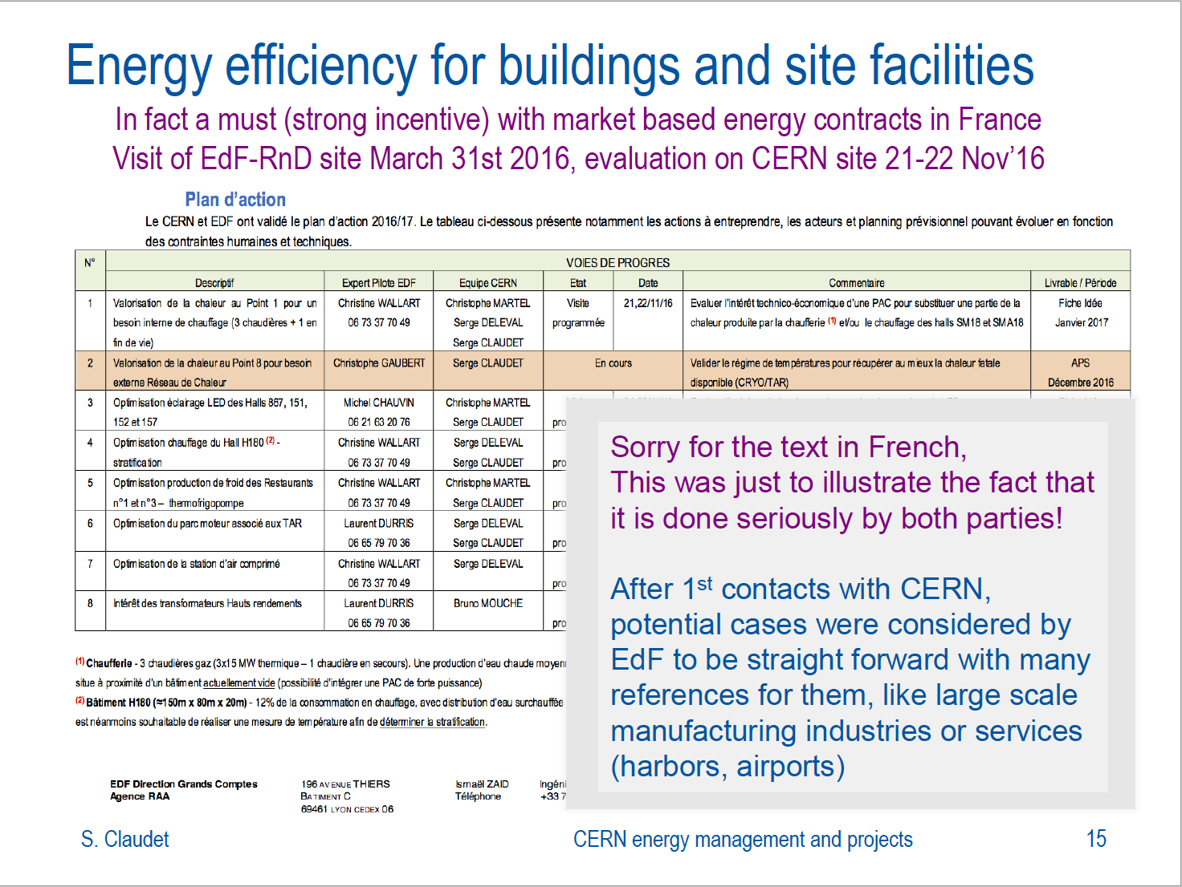
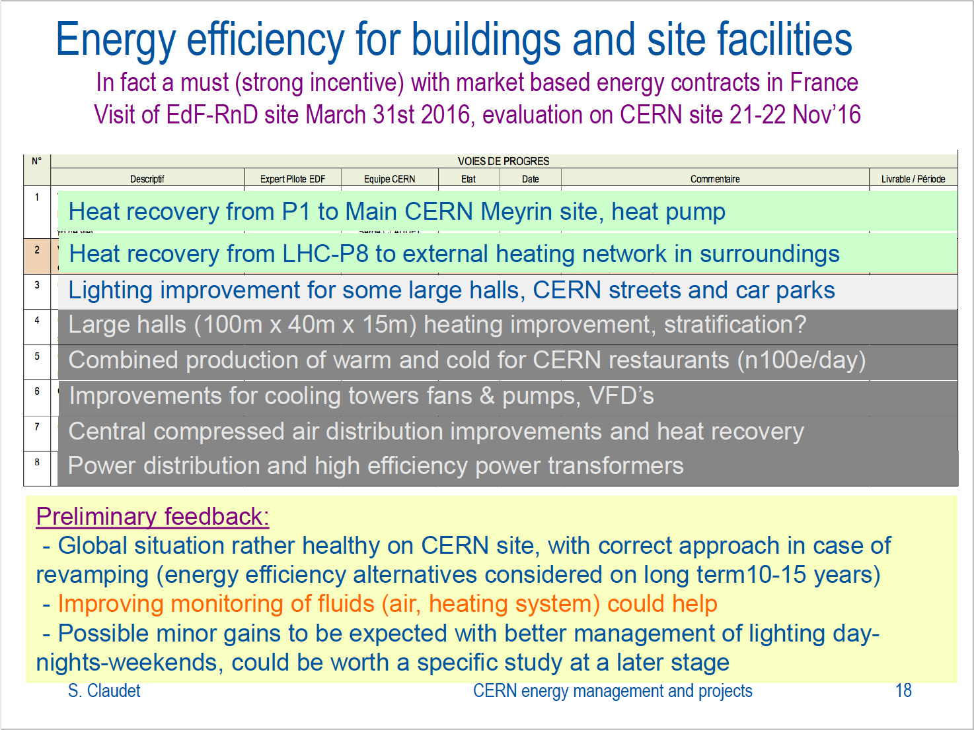
2016-17: Evaluation of consumption practice (not accelerator related)

Slide 15
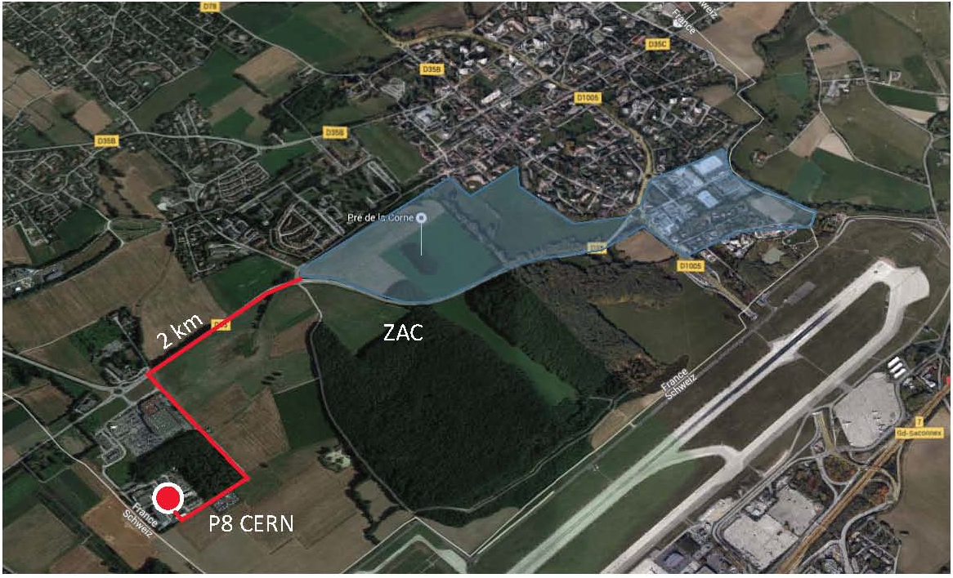
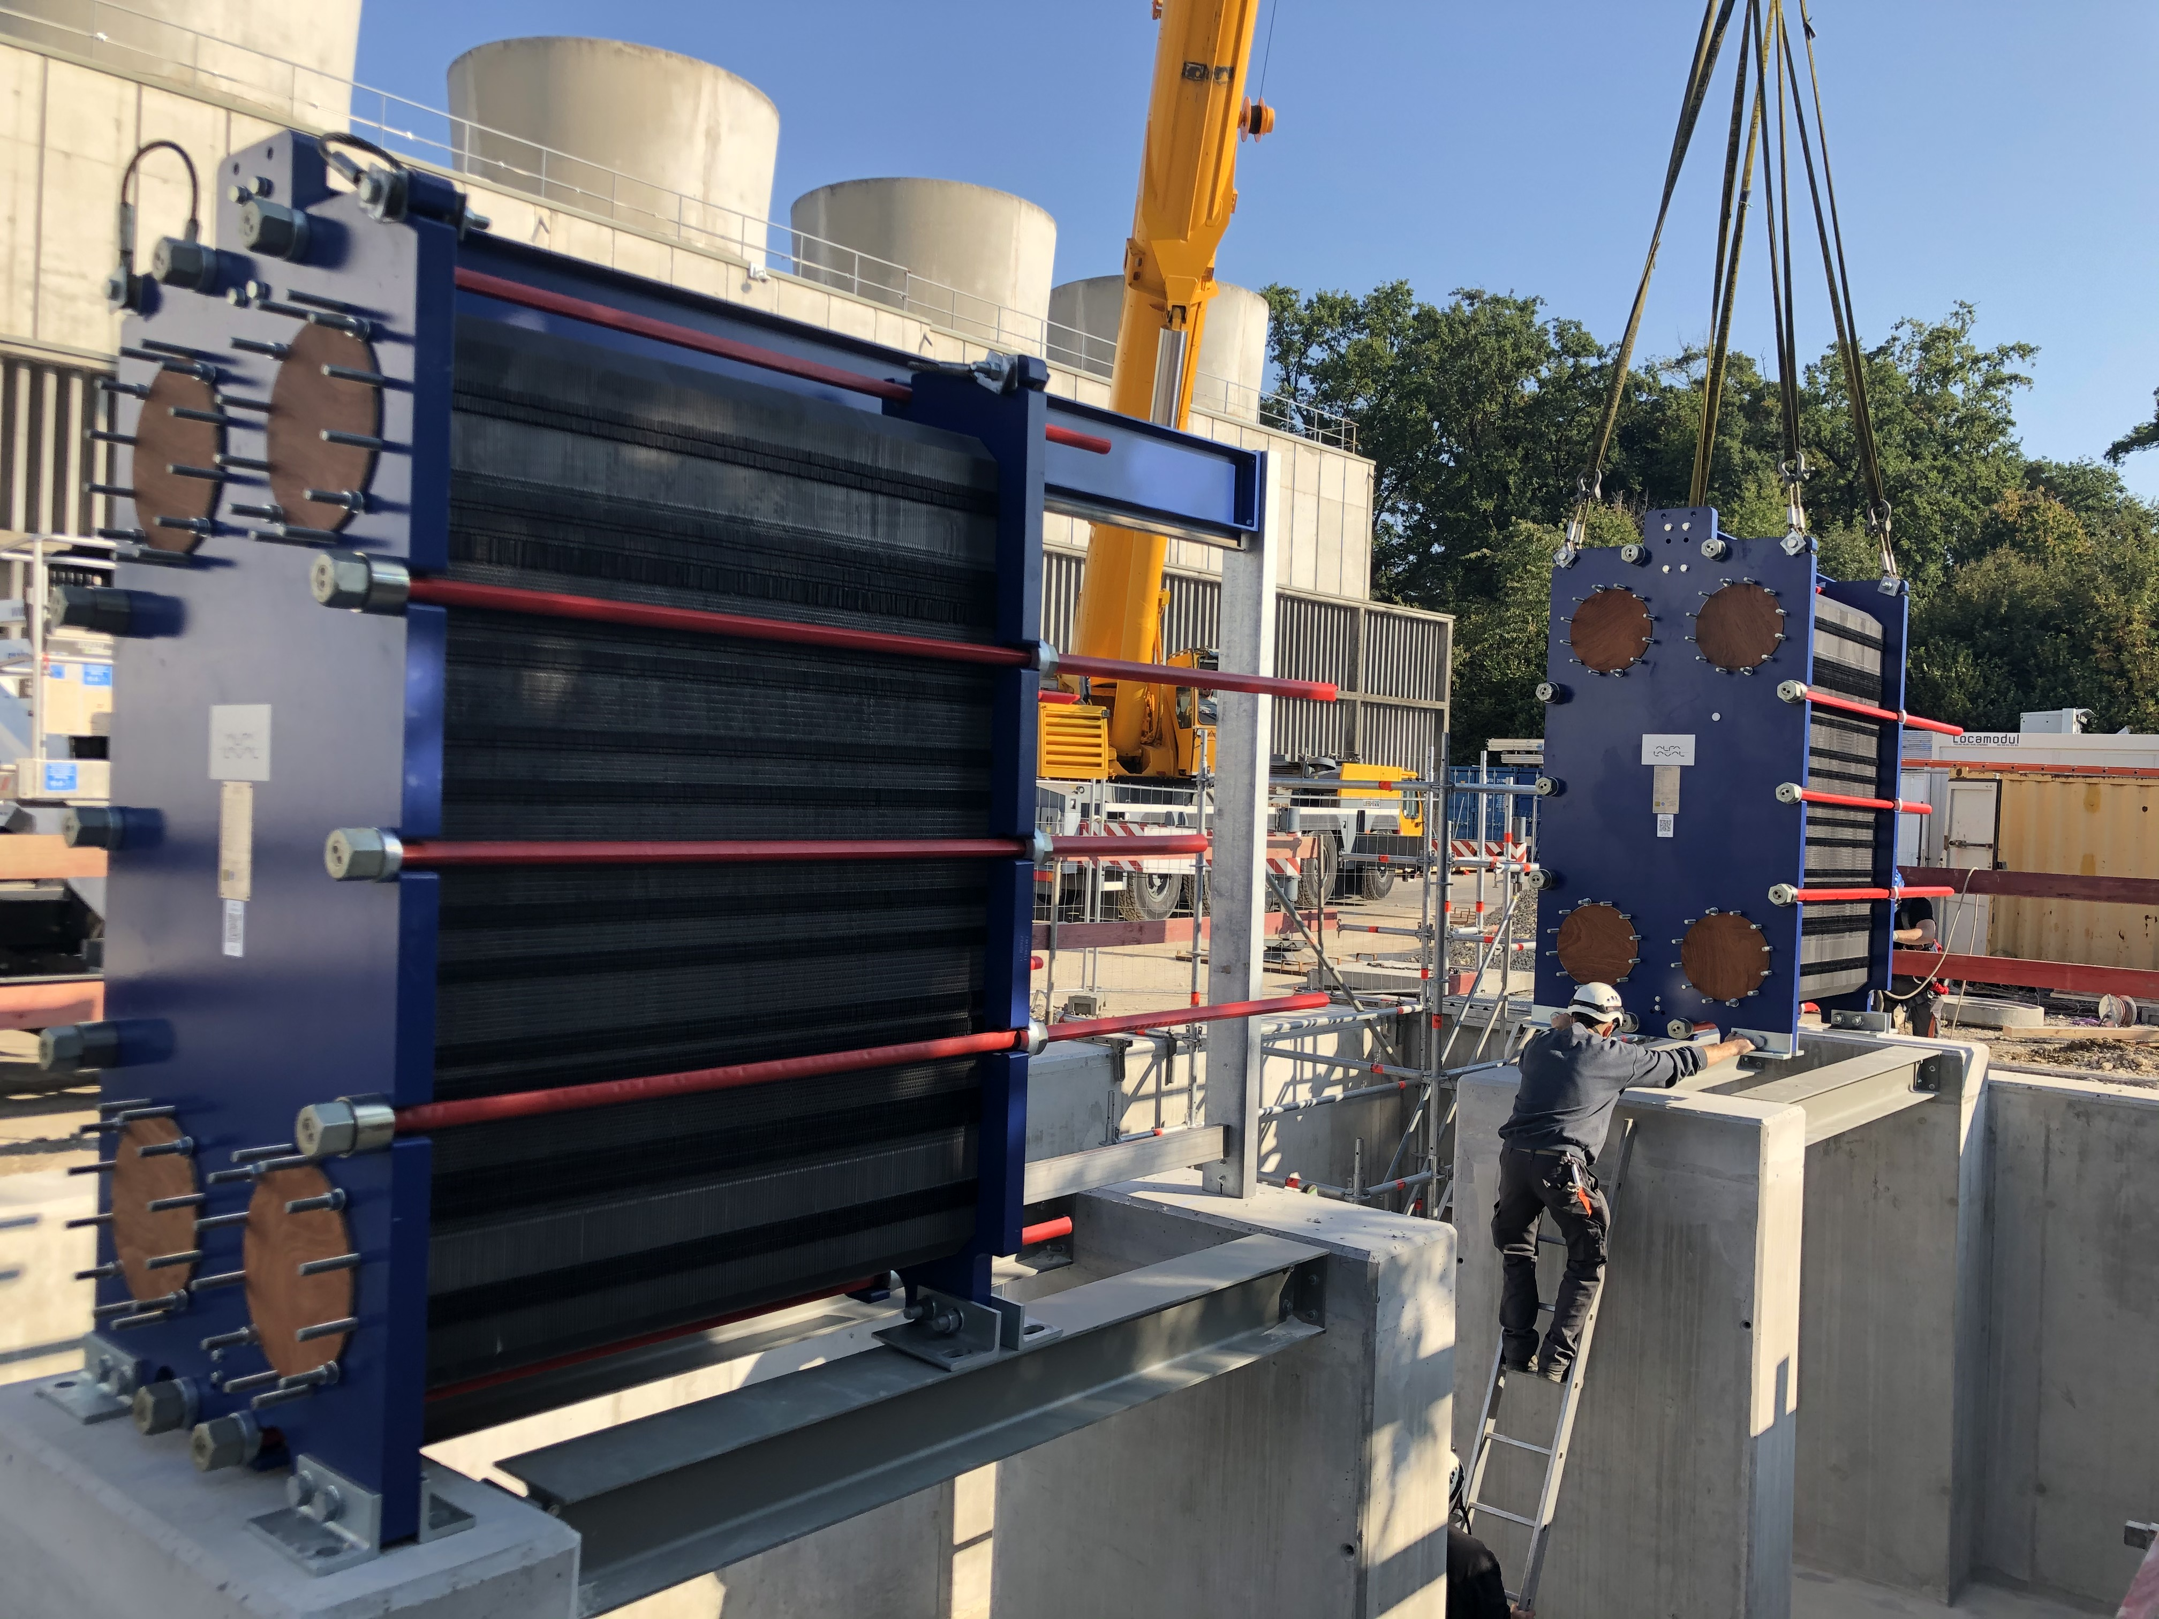
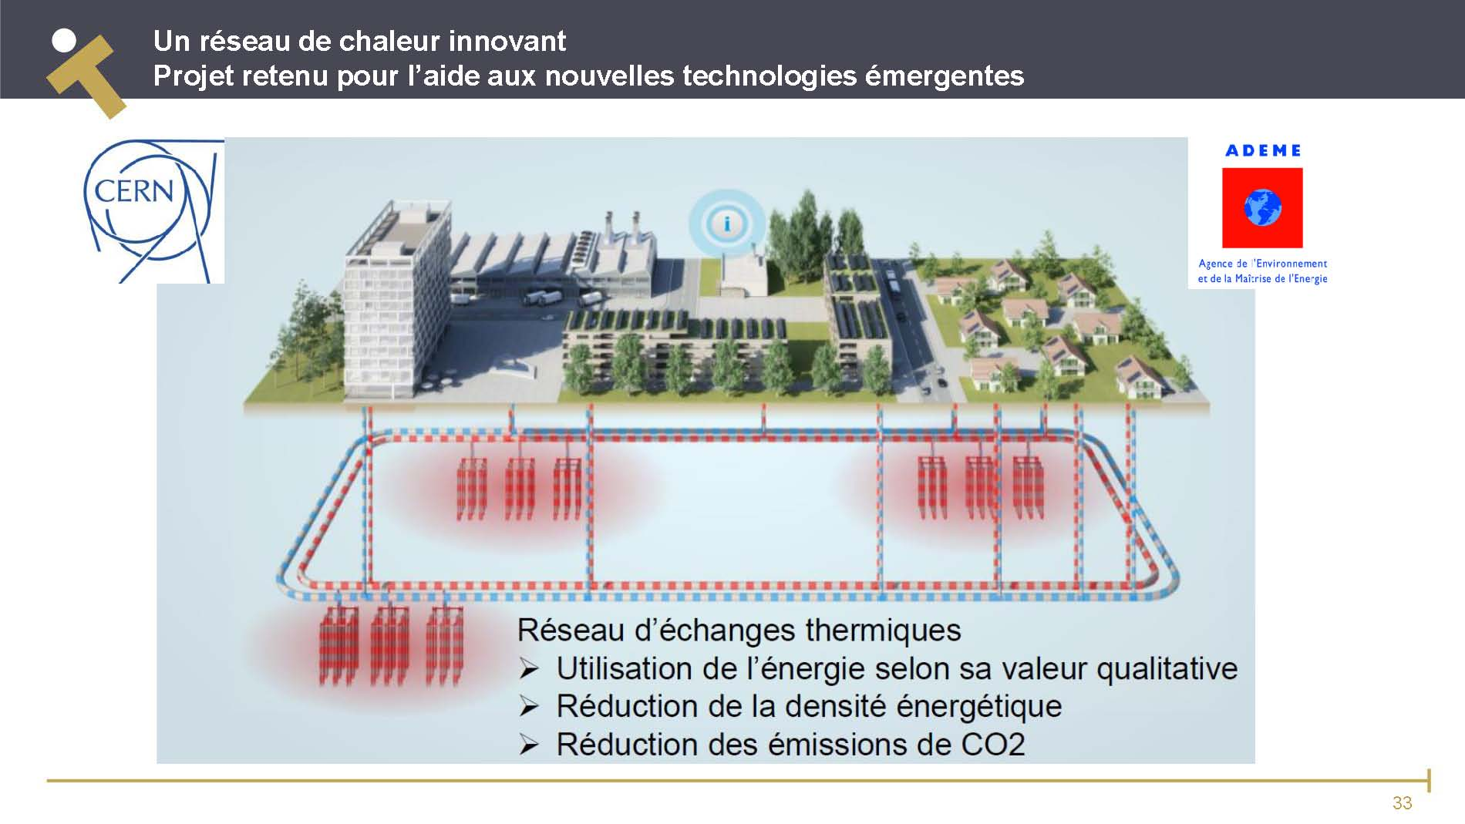
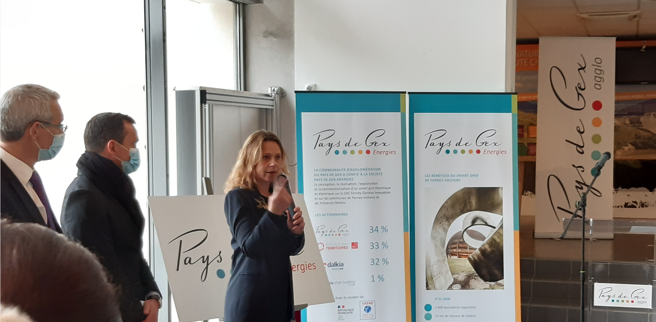
Heat recovery projects (EMP as a pioneer)
Heat recovery from CERN-P8 to be injected in a local “anergie” loop
(ZAC Ferney-Voltaire innovation, convention signed in 2019)
1st contacts: 2015
All equipment on CERN site installed during LS2, including 10 MW heat exchangers, no impact on LHC activities
2km "link" to local community to be installed in 2023, while LHC is in operation
New entity established to operate the new network (2025)
Ferney-Voltaire Innovation
17 Sept 2020
23 Nov 2021

Slide 16
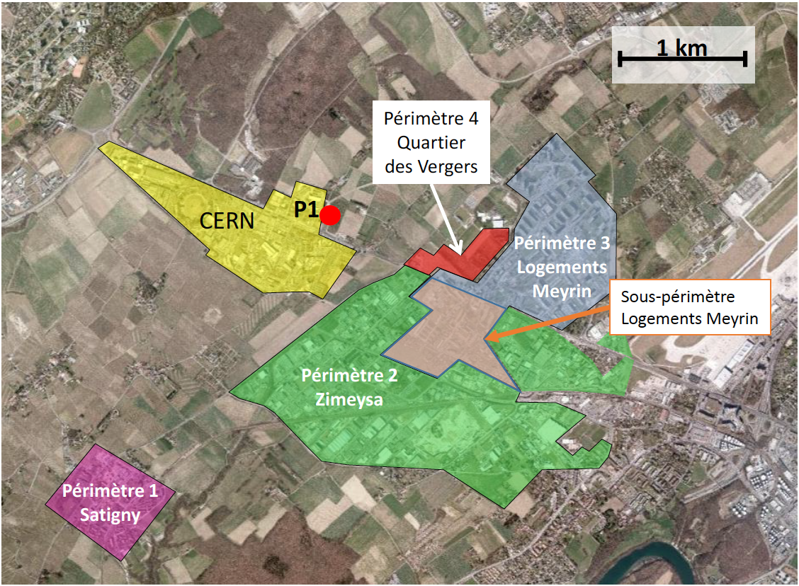
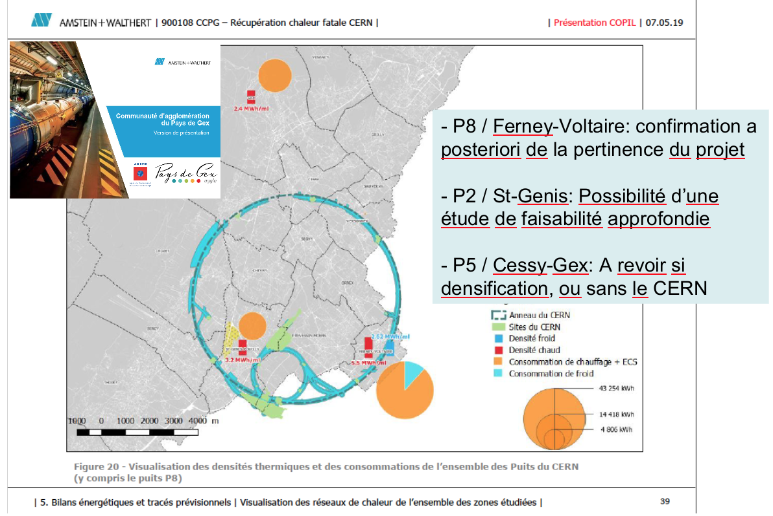
Heat Recovery, Complete evaluation of possible synergies
2019, with entities in France
2020, with entities in Switzerland
Recent constructions or to far,
=> to be revisited if/when new heating networks considered

Slide 17
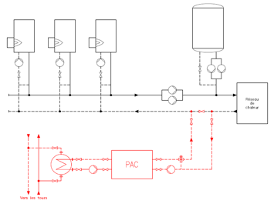
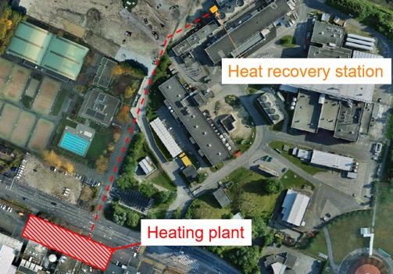
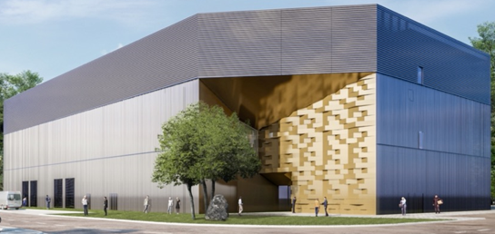
Heat recovery projects (2 under implementation)
Refurbishment of the Prevessin heating plant (F) including heat recovery from the new Data Centre (PDC) planned to heat buildings of the site as of 2025 – reducing emissions from the gas heating plant located on the site (~1900 tCO2e/y).
Ongoing studies to recover waste heat from CERN cooling tower units at LHC Point 1 to heat buildings on the Meyrin site (CH) – reducing emissions from the gas heating plant located on the site (~2000 tCO2e/y).
New Prevessin (FR) Data Center
Heat pump to boost existing heating plant
Meyrin (CH) - LHC P1 Heat recovery studies

Slide 18
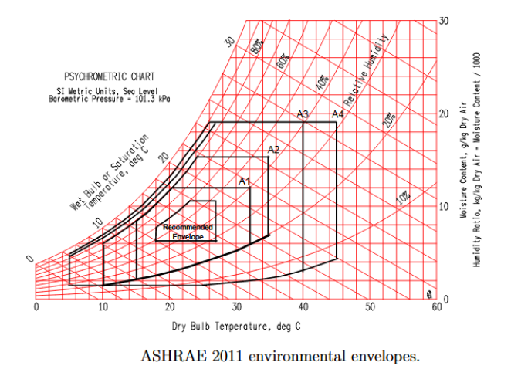
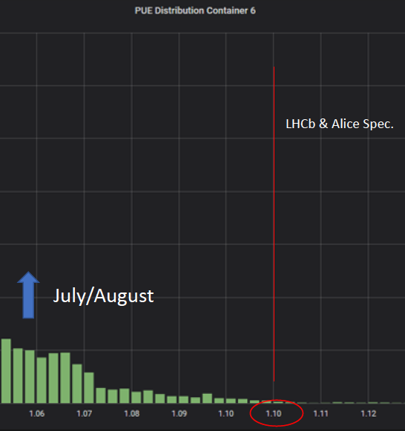
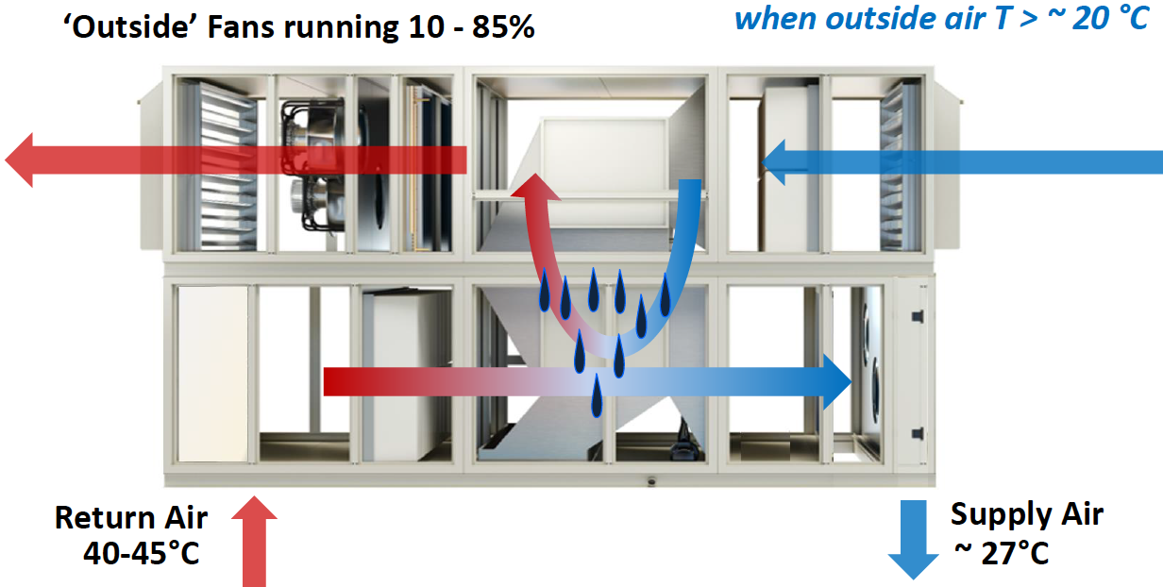
Data centers and efficiency
Valuable exchanges to support change of technology, REX, and new opportunities
2016-EMP#5 : B513 possible improved efficiency (V. Doré & S. Deleval)
2018-EMP#12 : Air cooled computer centers LHCb/ALICE (L. Roy & A. Augustinus)
2018-EMP#14: B513 update, Air cooled B773 (P. Pepinster)
2020-EMP#19-21: REX on data centers at P2/P8
2021-EMP#24 : New air cooled PDC with heat recovery potential (O. Barring)
2023-EMP35 : B513 refurbishment done (S. Deleval)

Slide 19
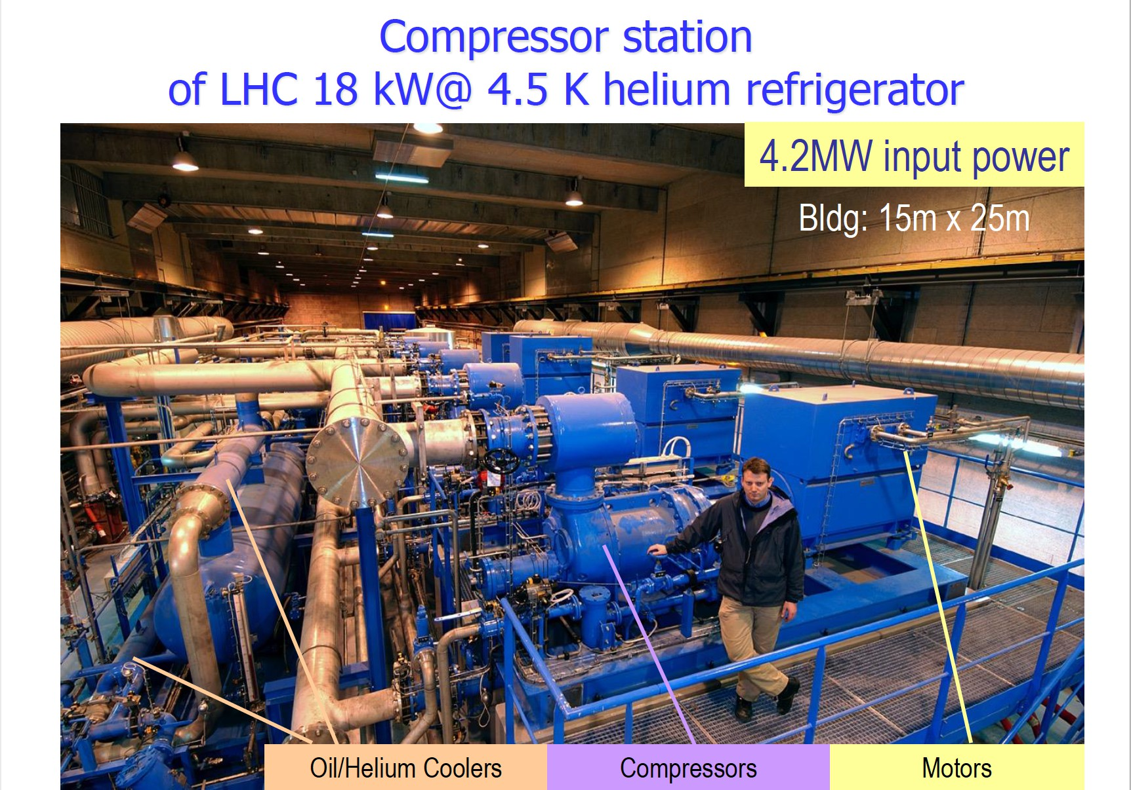
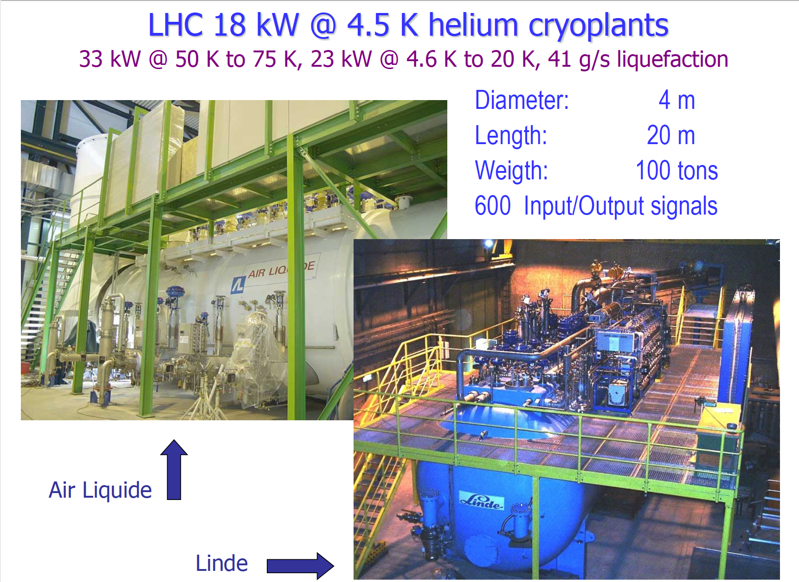
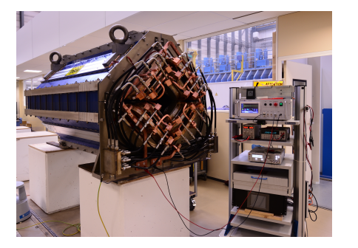
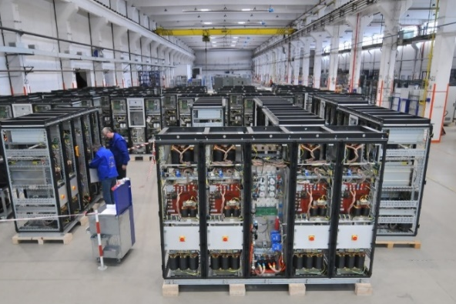
Improved efficiency, recent cases
Facility upgrades: East Area Renovation (done during recent LS2)
New equipment (Cryogenic Refrigerators for HL-LHC)
A set of requirements (performance, technology) to allow industry to provide the optimum for a given scenario:
Adjudication: CAPEX + OPEX (10 years)
Powering energy:
From 11 GWh/year to around 0.6 GWh/year
(> 90% reduction)
Warning: Optimisation of a system (powering, cooling) makes sense only when considering collective effects on users !!!

Slide 20
Content
Introduction to EMP
Energy consumption, forecasts & virtual invoices
Improved efficiency, heat recovery, projects
Renewable energy (PV) & long term projects
Exchange of information & Way-forward
CERN Prevessin Electrical feeding point

Slide 21
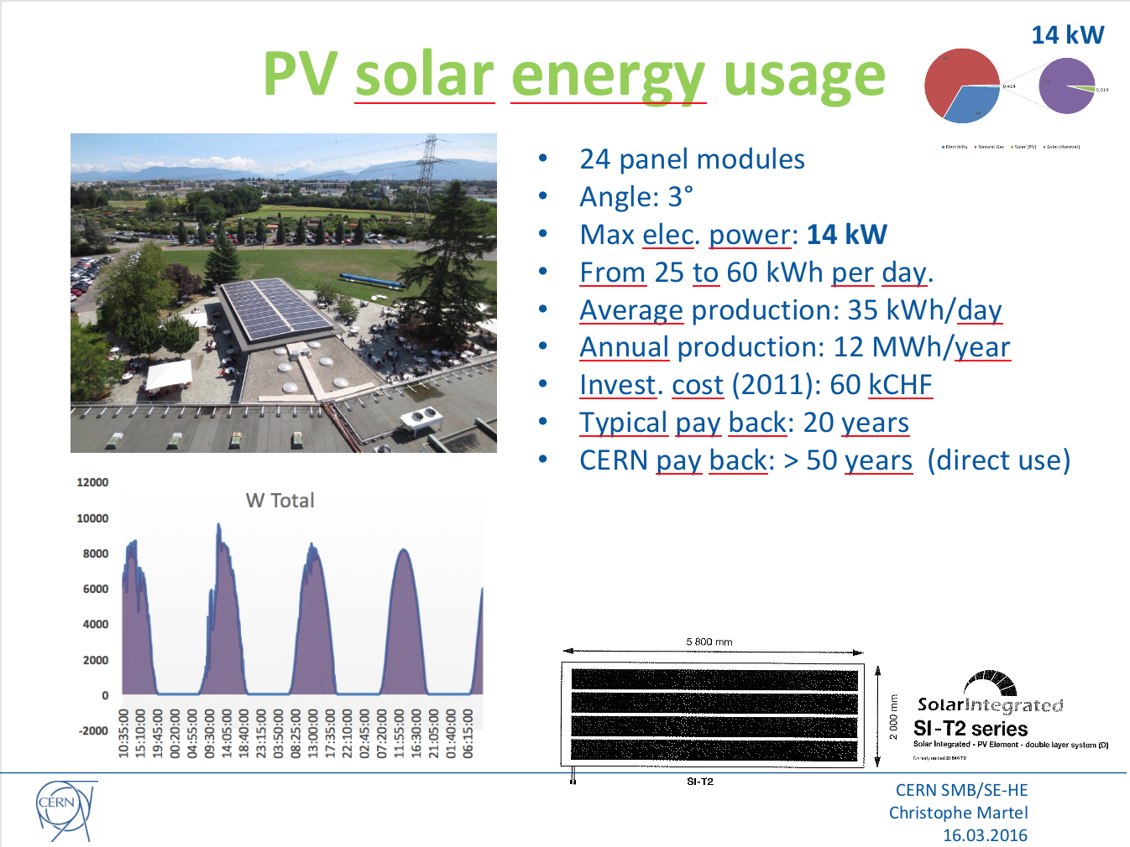
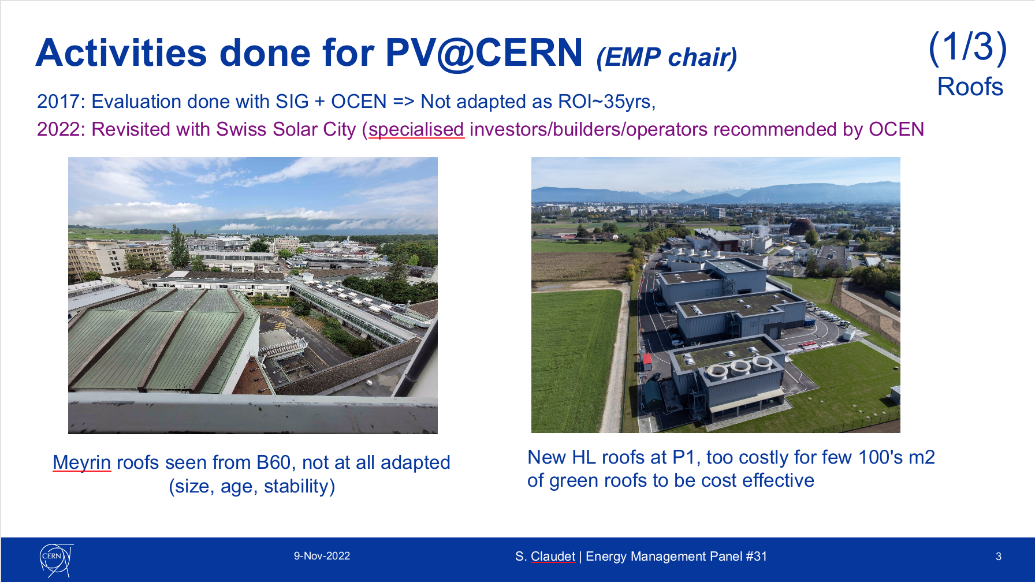
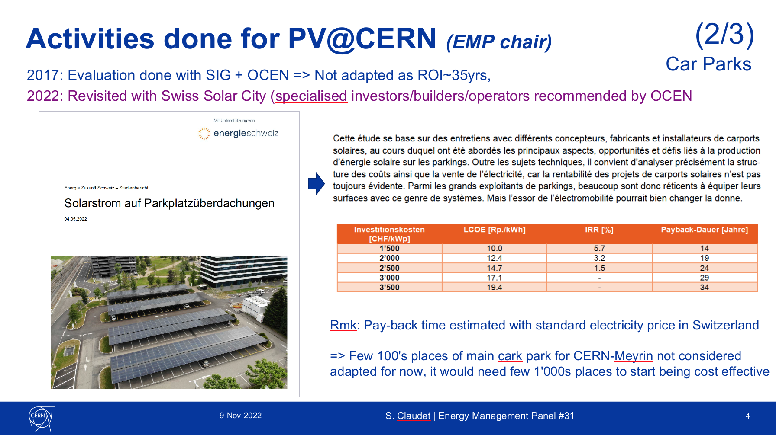
Renewables, PV
On CERN site (roofs, car parks), PV has not been found a viable solution. So far, it is therefore only considered when mandatory for new infrastructures to obtain the authorisation to build (work permit)

Slide 22
General considerations for PPA-REN for CERN
PPA-REN: Power Purchase Agreement based on Renewable energy for 15 to 20 years
WIND
Preamble:
Cross border links (limited capacity) only for use by National balancing entities,
not for commercial use!
=> REN abroad can only bring "certificates of origin" and is exchanged (+/-) on abroad spot market, obliging to purchase on local spot market the corresponding energy
WIND
=
Powerful
and Robust
Grid
=
Renewable Energy Sources:
- Local (limited, not optimum efficiency, costly)
- Abroad ("massive", efficient), but only virtual PPA with compensation via spot markets (availability, cost)
- Physical PPA on the french grid, real new REN source compatible with present "baseload" type of contract
PV
PV

Slide 23
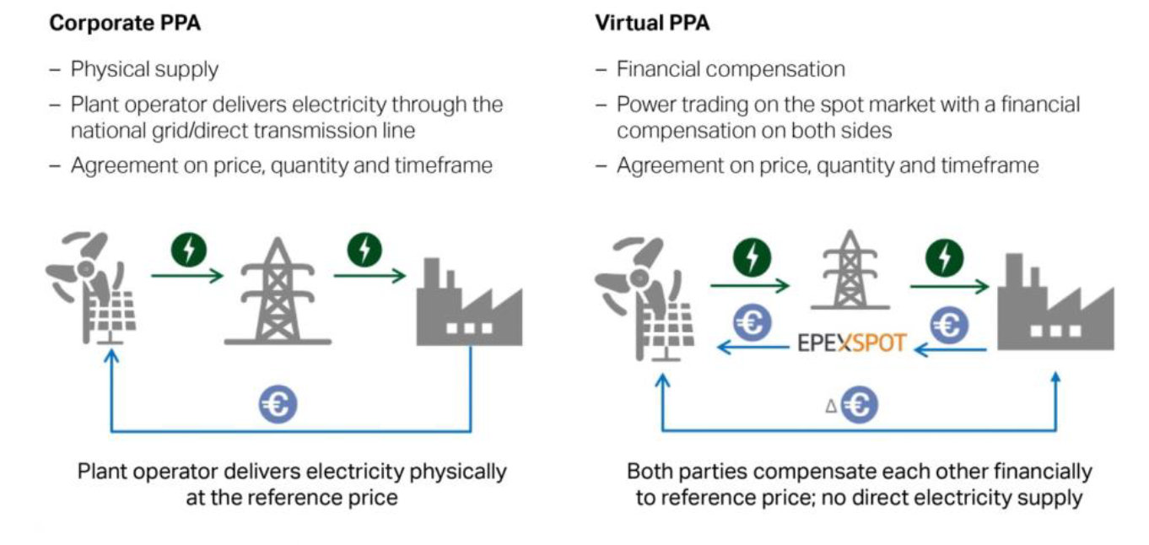
Activities done for PV@CERN (energy team)
(3/3)
External
PPA-PV, Power Purchase Agreement Photo-Voltaïc seriously considered,
No possibility to get it from abroad (limit at the border, balancing between states is for grid stability and not for commercial use),
Serious pists for about 100GWh for 15 years, under more detailed investigation
This would represent ~10% in Run mode (equivalent to tertiary needs), and wish to not impact the main electricity contract (90%!)
Offers-contracting to be considered for french market-grid
1st offer was made early Nov'22 for 50-70 GWh: not selected
2 offers made during 2023, now (being) formalised by LOI after FC-Oct'23
=> Earliest delivery expected in 2027
X
PS (feeling): PPA is a must towards better management of energy costs, and to get support and confidence from stakeholders

Slide 24
Future machines and technologies
2018-EMP#16 : Energy Efficiency for accelerators (Ph. Lebrun)
RF: 2017-EMP#11: Global approach (E. Jensen)
2022-EMP#30 : Klystrons (N. Lasheras)
East Area: 2020-EMP#20 : Presentation of the renovation project & goals (S. Evrard)
2023-EMP#33 : REX & measures (S. Evrard)
2022-EMP#27 : Linac4 & PSB (V. Barbet)
FCC: 2017-EMP#10 : FCC Energy aspects (J. Gütleber)
2023-EMP#29 : FCC powering scheme (JP. Burnet)

Slide 25

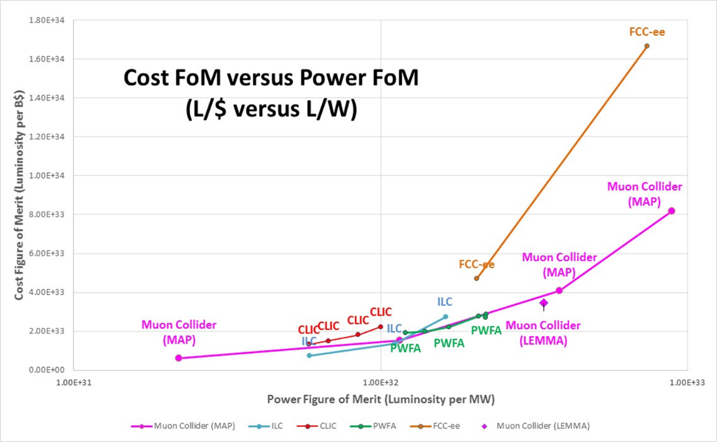
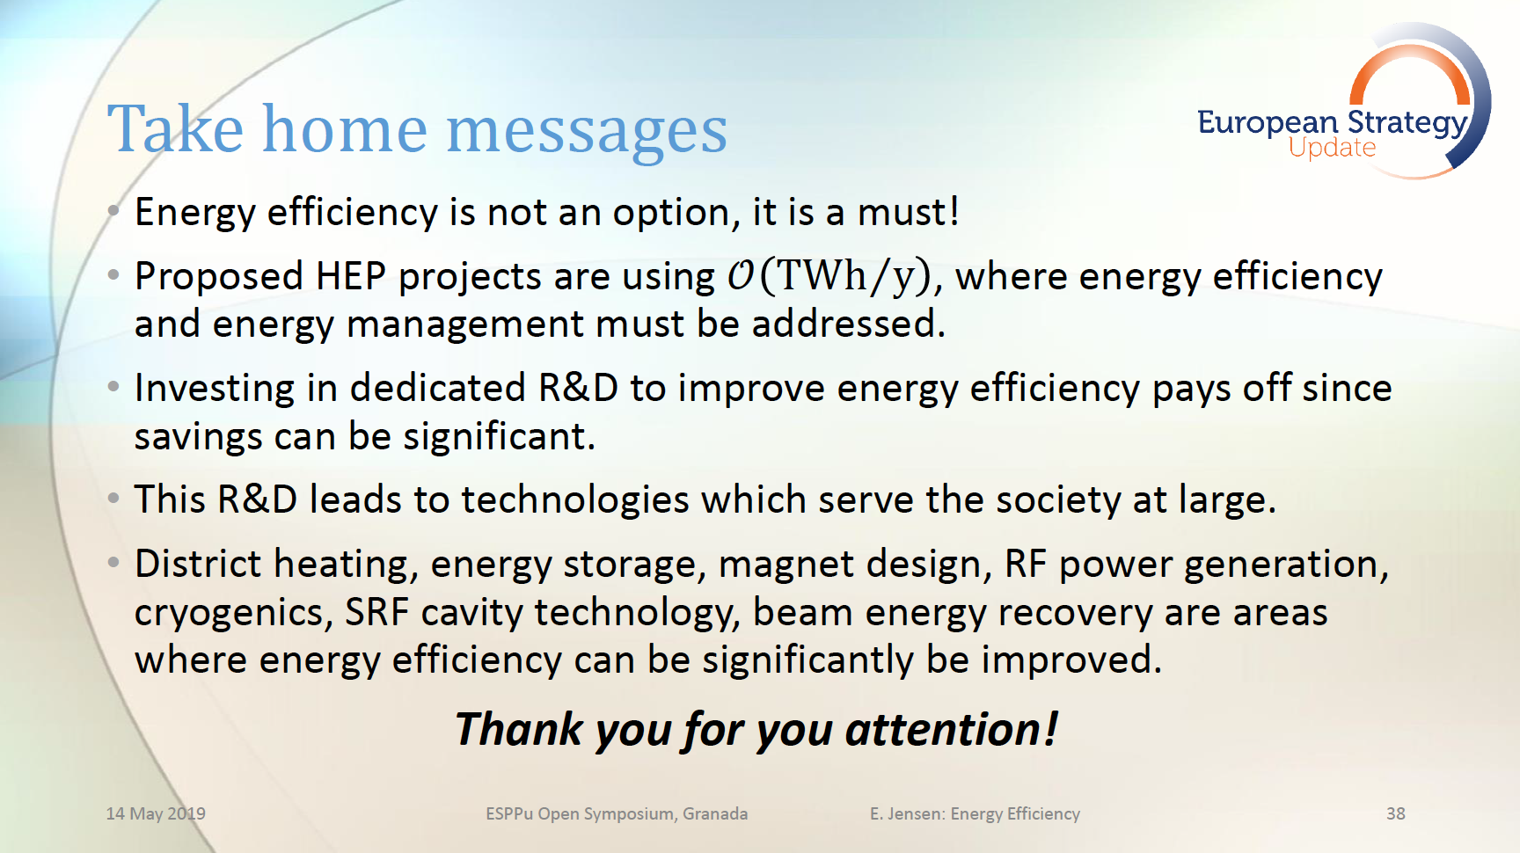
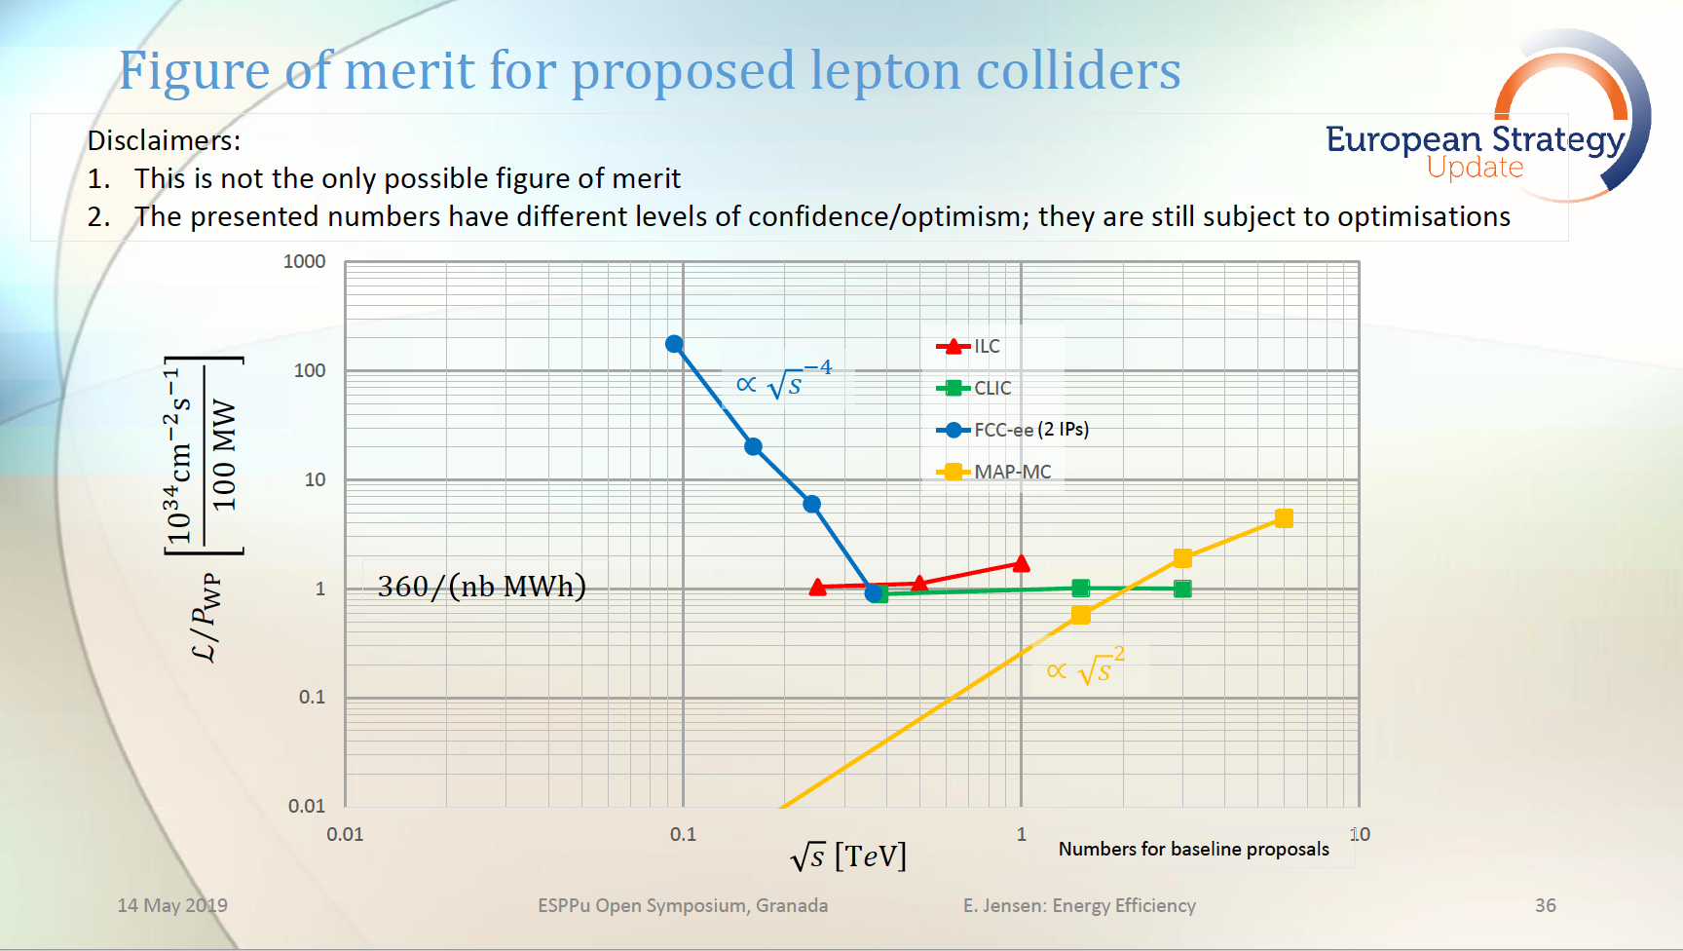
Future infrastructures
Energy efficiency:
a key design parameter for project acceptability
Energy affordability:
Long Term investment-agreement as part of the acceptance ?

Slide 26
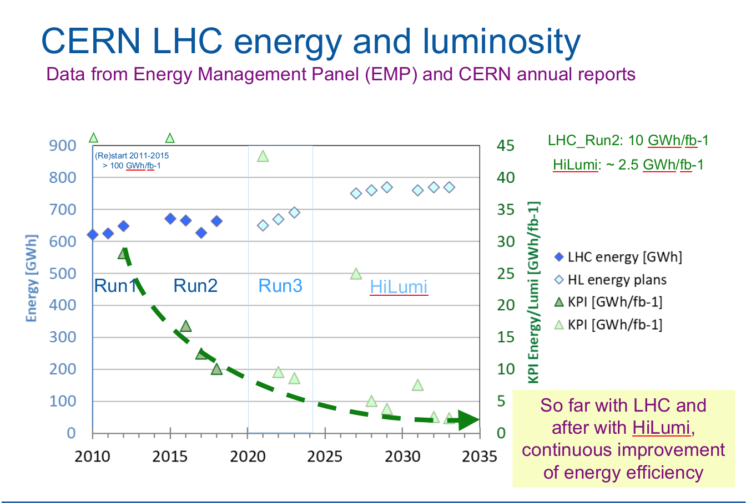
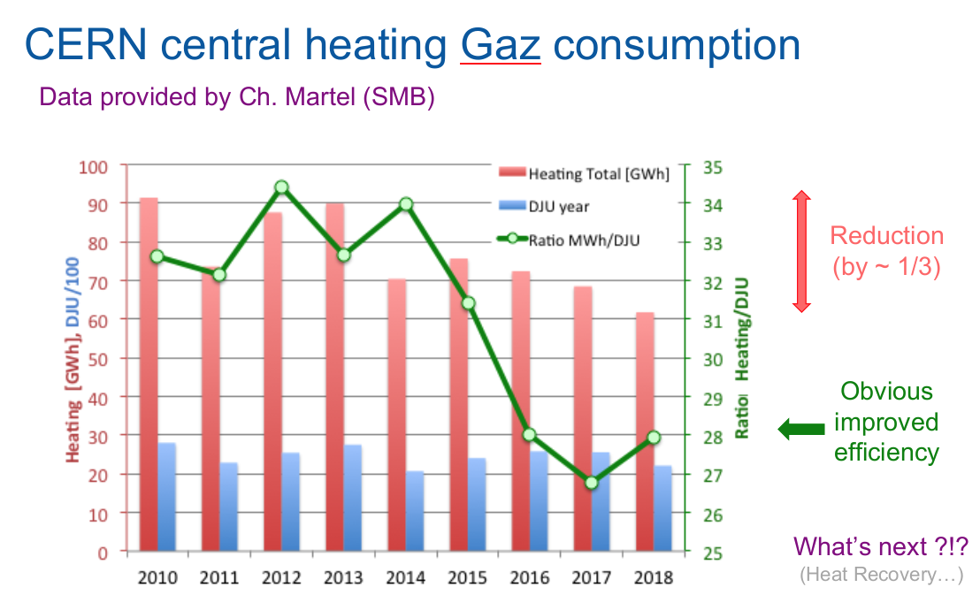
KPI's proposed for existing activities
Other KPI being considered for injectors & campus (access to data & configuration not that systematic)
All now considered in a systematic way and revised at least annually within ISO 50'0001

Slide 27
Content
Introduction to EMP
Energy consumption, forecasts & virtual invoices
Improved efficiency, heat recovery, projects
Renewable energy (PV) & long term projects
Exchange of information & Way-forward
CERN Prevessin Electrical feeding point

Slide 28




ESSRI 2024, Energy for Sustainable Science at Research Infrastructures
Energy management, Energy efficiency, Identify good practices, stimulate initiatives, cooperation amongst institutes
CERN at the origin of this series, organiser of 2nd event
2011, ESS - Lund (S)
125 participants, mostly Europeans
2013, CERN (CH)
189 participants, 14 countries (incl. JP & USA)
2015, DESY - Hambourg (D)
Stabilised participants, format
2017, ELI-NP - Bucharest (RO)
From concepts to realistic actions
“Economy, Reliability, Efficiency”
2019, PSI - Villigen (CH)
Web: essri.psi.ch
2022, ESRF - Grenoble (F)
Web: indico.esrf.fr/event/2/, ~90 persons
2024, CIEMAT - Madrid (ESP) t.b.c
7th
September
25th, 26th and 27th, 2024
Madrid, Spain
Research infrastructures do not want to represent an energy issue for society,
But wish to contribute to good practices and solutions for the future !
Save the date, stay tuned,
weblink to come before end'23

Slide 29
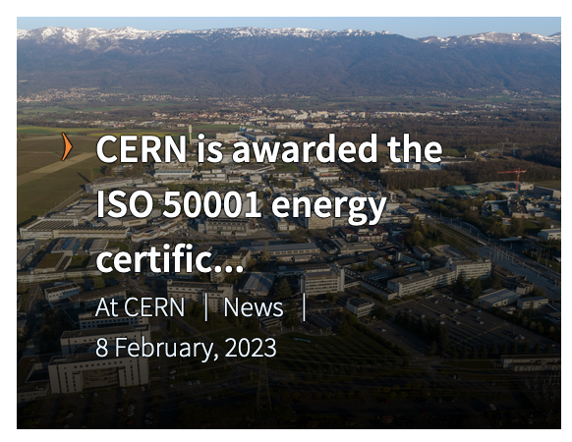
Energy management and ISO 50'001
Evaluated in 2016 but too far away from previous "tariff" culture, considered as a source of inspiration so far
Reconsidered autumn 2021:
Mike Lamont (ATS): we have a "moral obligation" to consider energy properly
Raphael Bello (FHR): there is a potential for a subside worth ~3 MCHF per year
Many: we want to contribute to a better image for CERN w.r.t energy
Task force (Nicolas Bellegarde) and audit (EDF-consultant) done by 30Nov'21
Significant culture already in place (54% of ISO expectations, with 15% close)
General lack of formalism, with complementary monitoring and KPI to be implemented
Dedicated team (~3 FTE) to be put in place for 2022
Commitment to provide a Plan de Performance Energétique (PPE) by end Jun'22
First audit for ISO Oct'22, certificate Feb'23 !!!

Slide 30
EMP messages after almost 10 years
At CERN level, primary energy consumption kept ~ constant while LHC is producing more physics output
Energy management is now in place with good forecasts and monitoring tools. Energy efficiency awareness is progressively diffusing through the CERN community, with coordinated actions from machines to site and tertiary infrastructures.
Heat recovery projects of multi MW class are built (1), under progressive implementation (1) or under study (1)
A CERN Environmental Protection Strategy is in place, coordinating efforts on 11 domains for which improved objectives are being given despite increased activity and physics outcome
There will be no future large-scale scientific project without a serious energy management policy, including a strong incentive for energy efficiency and energy recovery amongst the major objectives. A selection of specific programs for consolidating existing infrastructures is a way to put into practice these good intentions, and to acquire expertise with proven references.
LESS
BETTER
RECOVER
RESPONSIBLE
CREDIBLE

Slide 32
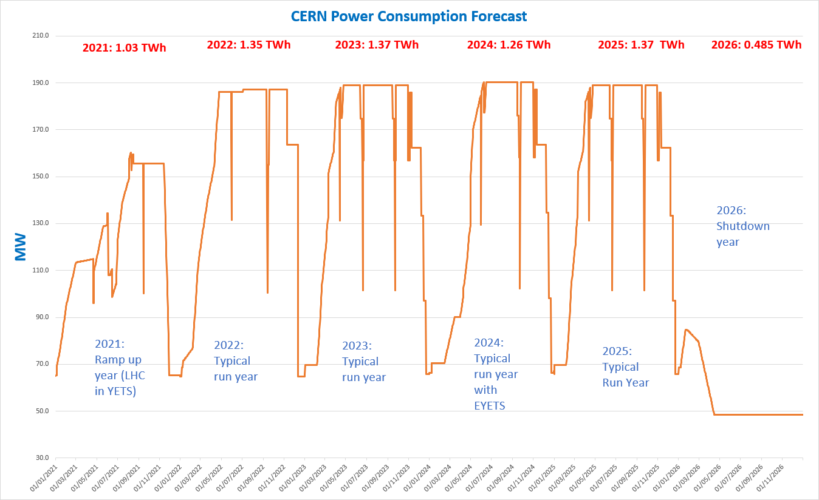
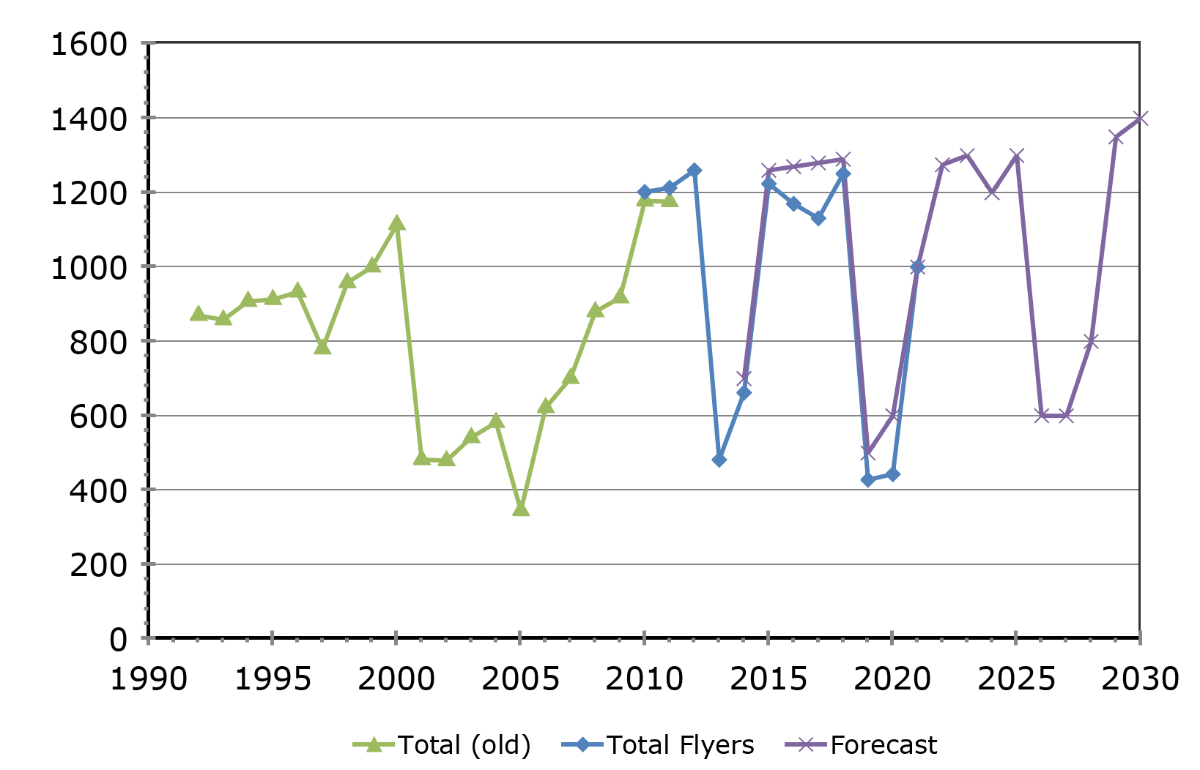
Multi-years overview
LHC
HL-LHC
LEP
Yearly Energy Consumption [GWh]
Multi-years cycles,
considering physics Run and Long Shut-down
Typical yearly profiles with
Year-End-Technical-Stops and Physics
(moderate increase of energy consumption while increasing by ~ 70 collision energy LEP to LHC or by ~ 7 luminosity LHC to HL-LHC)

Slide 33
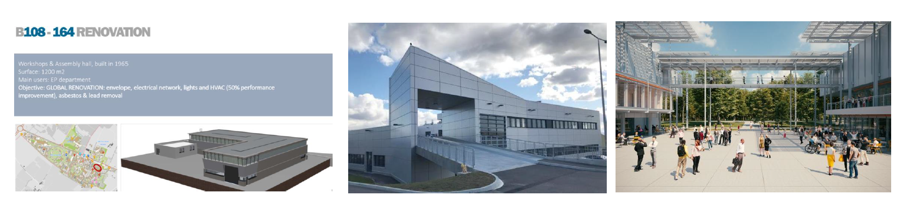
Buildings and site management
CERN's objective is to align with energy efficiency standards related to buildings, integrating the insulation of the buildings envelope, HVAC systems and lights
Renovation of up to two buildings per year on CERN's main sites, integrating all these aspects, is planned over the next ten years
Energy Efficiency standards are systematically applied for new constructions at CERN

