Slide 1
Energy management and ISO 50001
Nicolas Bellegarde, CERN’s Energy Coordinator
Sustainable Accelerators Panel – https://indico.cern.ch/event/1348808/
25th January 2024
EDMS 3019719

Slide 2
Agenda
  Energy consumption at CERN
  Electricity contracts
  Energy management and ISO 50001
  Conclusion and take-away messages

Slide 3
Energy consumption at CERN

Slide 4
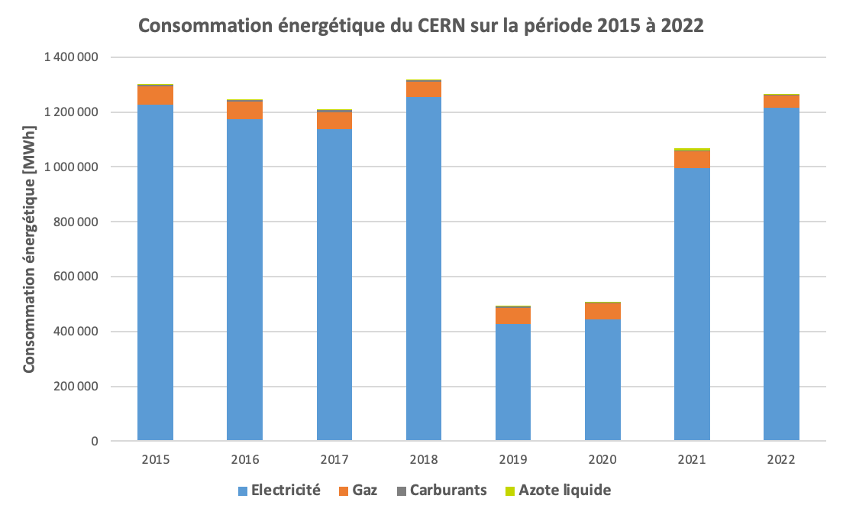
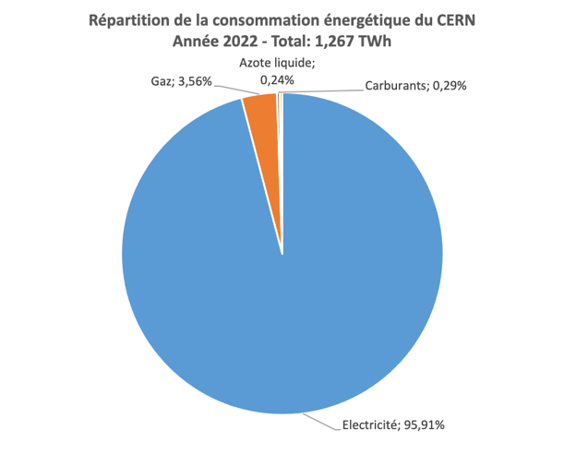
Energy consumption at CERN
  Four types of energy used
    Electricity for most uses
    Gas for heating
    Fuel for CERN fleet, diesel generators and heating (only as a back-up in Meyrin)
    Liquid nitrogen to cool down the Helium

Slide 5
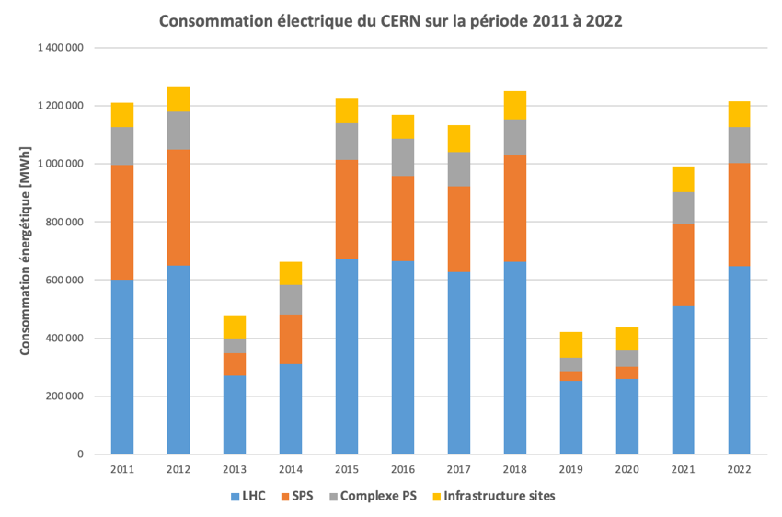
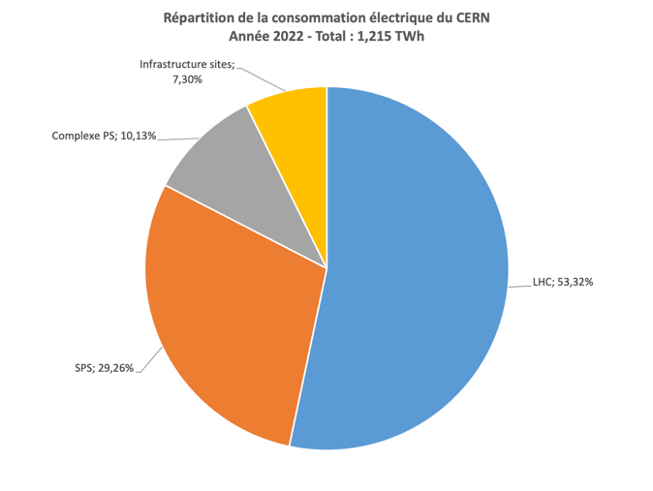
Electricity consumption
  Electricity consumption breakdown (~ 95% of the total)
  Main tool to monitor electricity use: WebEnergy (energy.cern.ch) → 320 measuring devices used (high voltage side), likely moving to 520 in 2024 (massive increase of granularity!)

Slide 6
Gas consumption
  Gas consumption breakdown (~ 4% of the total)
  Reduction of gas consumption by 25% in 2022 compared to 2021
    Impact of mild weather and measures taken by the Organisation in the context of the energy crisis (delay start of heating, decrease of heating temperature)
    Better to do the analysis with the unified degree day (neutralize effect of outstide temperature) → See performance indicator

Slide 7
Electricity contracts

Slide 8




Electricity contracts at CERN
  French electrical network – Main source
  Swiss electrical network – Back-up source (limited to 60 MVA)
  Supply contracts: Best Value For Money
  Transmission contracts: Monopoly
The biggest component of CERN’s electricity cost
+
Supply of Energy
Transmission costs
+
Supply of Energy
Transmission costs

Slide 9
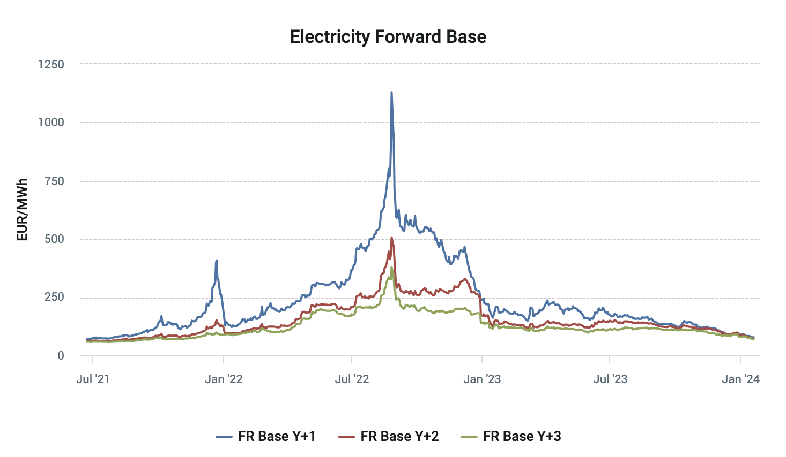
Main electricity supply contract
  Contract in place until end of 2025
  CERN has access to ARENH « Accès régulé à l’Electricité Nucléaire Historique », allowing to purchase electricity at a fixed price (currently 42 € / MWh)
  ARENH currently covers ~ 80% of our annual electricity consumption
  The remaining 20% are purchased on the market through yearly calendar products (baseload and peakload)
~ 1130 € / MWh
~ 50 € / MWh
~ 70-80 € / MWh
ARENH

Slide 10
Medium and long-term outlook
  ARENH mechanism finishing at the end of 2025
    Next steps: both reforms to be approved by the relevant institutions (European Council and Parliament, French Parliament) → Planned for 2024 with implementation in 2025
    → Increased complexity of electricity supply for industrials confirmed by all parties
    (incl. French authorities)!
Electricity market reform in Europe
Key points:
→ No radical change in the market design
→ Promote mechanisms aiming at restoring long-term certainty (PPA, CfD and power future contracts)
Main expectations:
→ More renewables, less price volatility, longer-term visibility
Post-ARENH reform in France
Key points:
→ Agreement found between EDF and French Government
→ Mechanism aiming at redistributing EDF’s revenues to final customers when market selling price of produced nuclear energy is above given thresholds
→ Complemented by long-term nuclear production allocation contracts linked to existing assets for some energy-intensive consumers
Main expectations:
→ Less price volatility, longer-term visibility

Slide 11
Medium and long-term outlook
  CERN’s current contract strategy for 2026 and beyond
    Use Power Purchase Agreeements (PPAs) – See next slides
    Assess possibility to use long-term nuclear production allocation contracts (may not be possible)
    Re-tender current contract for remaining volume as soon as new rules are known → Exposition to market prices with potential redistribution of EDF’s revenues
  Current market prices: 70-80 EUR/MWh
    Significantly lower than 2022-2023 prices…
    …. but much higher than ARENH price (42 EUR/MWh)

Slide 12
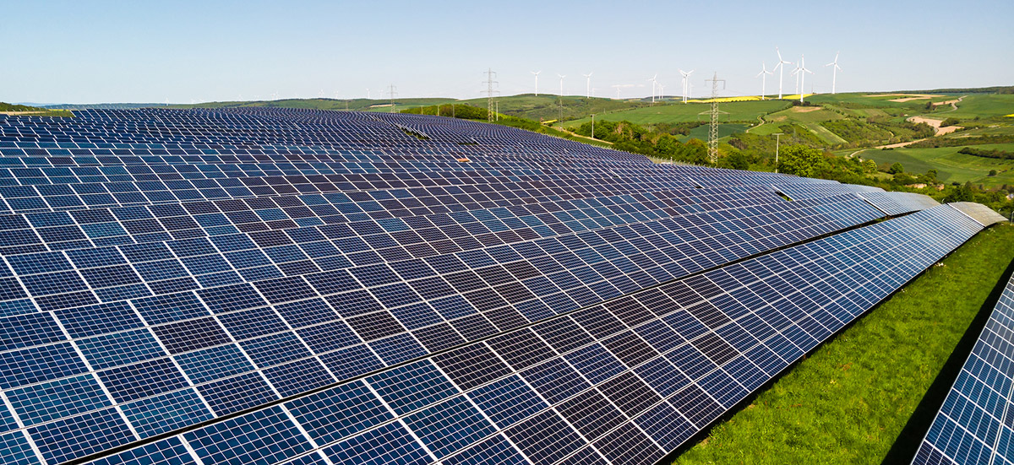
Preparing the future – Renewable energy
  Diversification of energy sources – Revisiting renewable energy solutions (mainly solar with considerations on wind and other energies with low CO₂ emissions)
  High interest for PV plants, with material cost decreasing and energy cost increasing
    On-site (size ~ 1 to 2 football pitch(es), covering less than 1% of CERN’s electricity consumption) → Study carried out with results not encouraging so far
    Off-site (size ~ 150 football pitches, covering ~ 10% of CERN’s electricity consumption) –
    « Power Purchase Agreements – PPA » → Offers ongoing

Slide 13
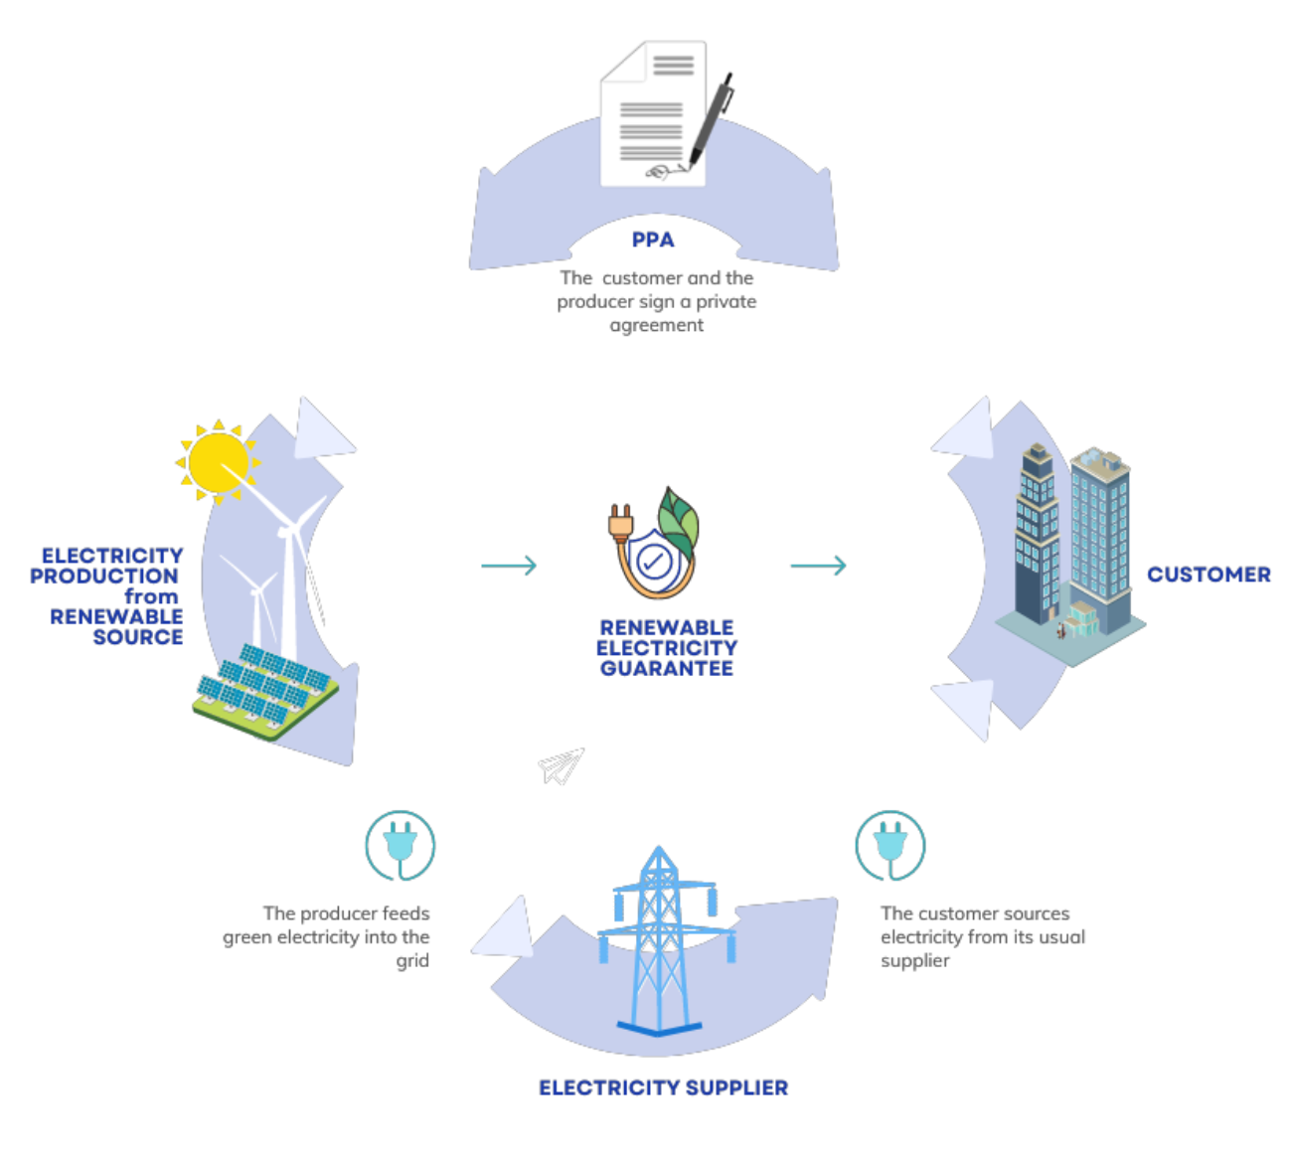
PPA implementation at CERN
  Off site – Physical PPA in France
  CERN’s initial objective is still to secure approx. 130 GWh per year of its electricity consumption through photovoltaic PPAs by 2027
  → Approx. 10% of CERN’s annual electricity consumption in run and 25% in LS
  → Equivalent to tertiary needs and not impacting CERN’s main electricity contract
  Two projects (covered with NDAs) for which we have now entered into exclusive negociation
  Approval from Finance Committee (4 October 2023) to sign associated LOIs (most likely by end of month)
CERN is therefore about to be at the origin of new solar power plants: ~100 ha or 1 km2
Difficult to envisage locally!

Slide 14
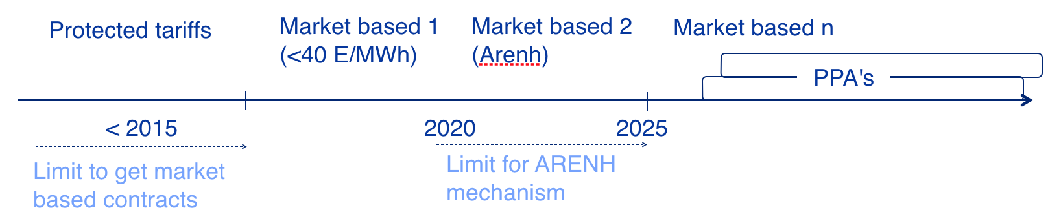
PPA implementation at CERN

Slide 15
Energy management and ISO 50001

Slide 16
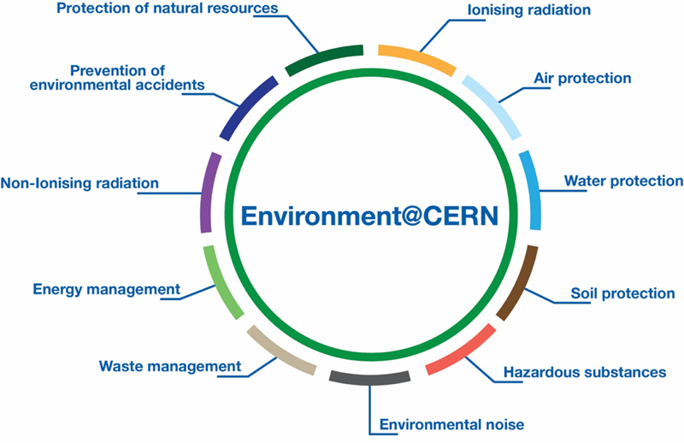
Energy management at CERN
  In place since many years with governance well established (and reinforced in 2022)
    Full-time Energy Coordinator
    Energy Management Panel
    Enlarged Energy Management Panel
    CERN Environmental Protection Steering Committee
Main objectives: keep the energy required to a minimum, improve energy efficiency, recover waste energy

Slide 17
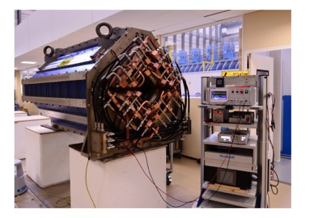
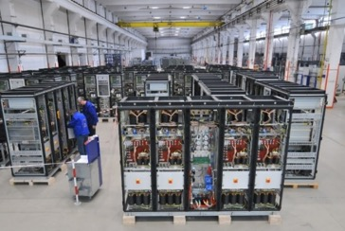
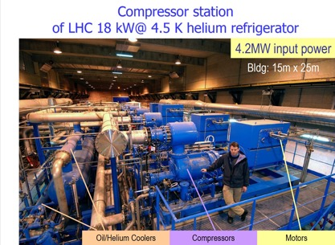
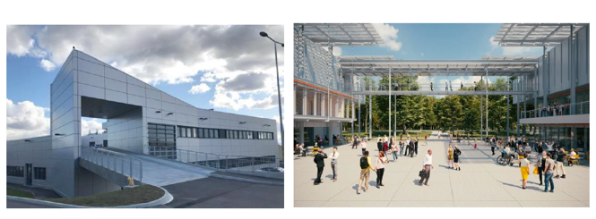
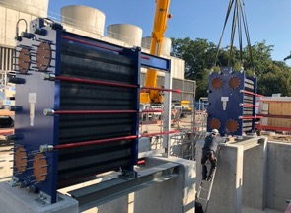
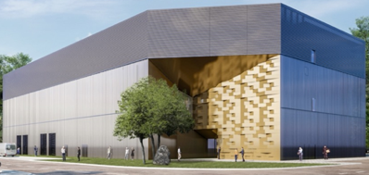
Energy management at CERN
  Facility upgrades: East Area renovation
  Buildings and site management
  New equipment: cryogenic refrigerators
  Heat recovery
Powering energy:
From 11 GWh/year to around 0.6 GWh/year
(> 90% reduction)
Award on CAPEX+OPEX
Renovation of up to two buildings per year (enveloppe, HVAC, electricity)
For internal or external use

Slide 18
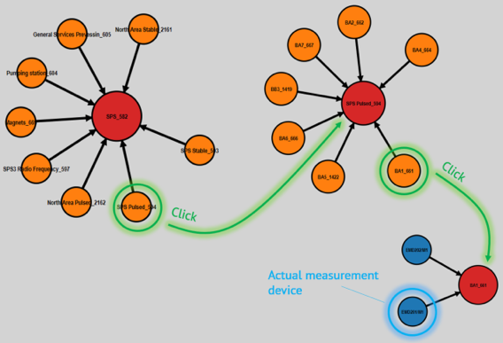
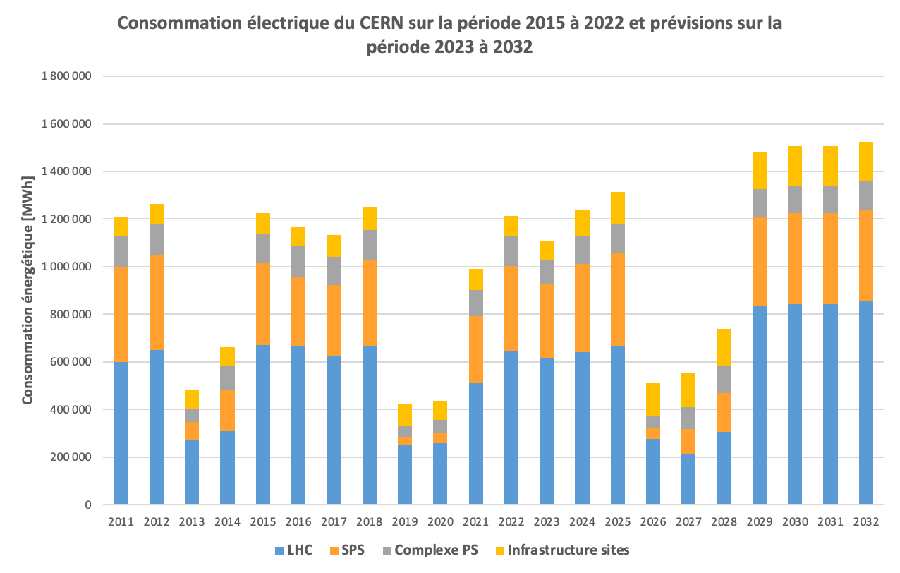
Energy management at CERN
  Measurements
    More than 500 measuring devices for electricity (high voltage side)
    Dedicated tool to monitor energy use
  Electricity consumption forecast
    Multi-year overview (10+ years)
    Short-term forecast – Global accuracy better than 1%

Slide 19

Energy management and ISO 50001
  At the end of 2021, CERN decides to become compliant with the main international reference standard related to energy performance (ISO 50001)
Main benefits:
• Improve performance level from an initial energy baseline, fix energy targets and objectives to meet them
• Improve energy management governance and structure whilst reinforcing good practices
• Include energy performance in all relevant organisational processes
• Continually improve energy management (audits, benchmark against other institutes)
• Involve all members of the personnel on subject of common interest
• Value and demonstrate to internal and external stakeholders CERN’s commitment on energy performance improvement

Slide 20
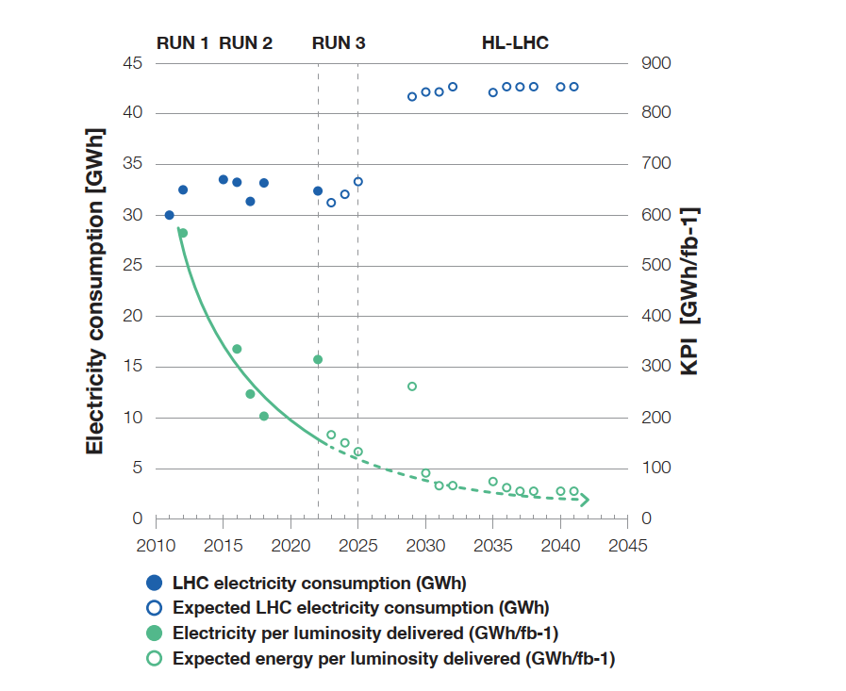
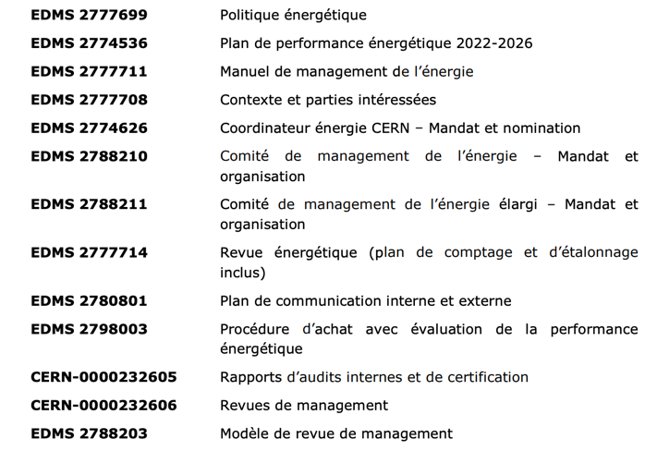
Energy management and ISO 50001
  Many quality and technical documents developed, approved and audited

Slide 21
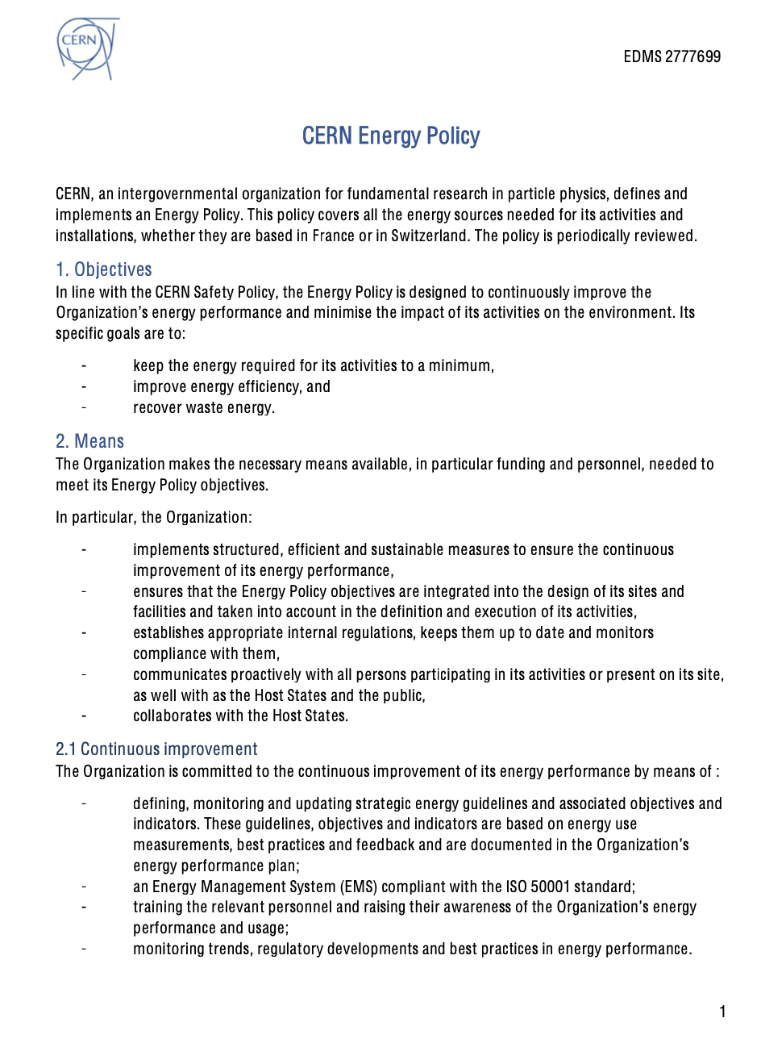
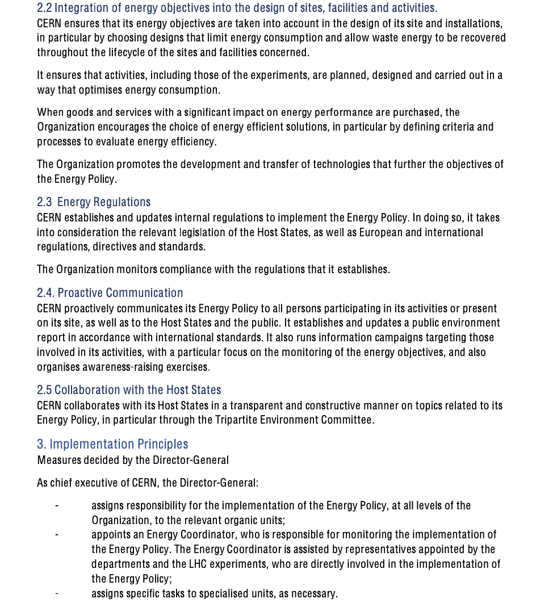
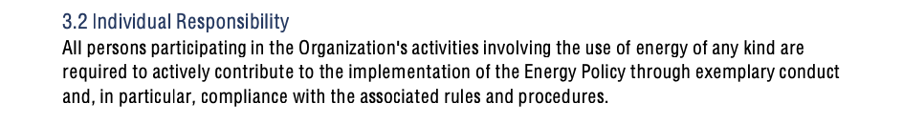
Energy Policy

Slide 22
Energy management team
  Incorporation of ISO 50001 requirements in an Enlarged EMP (started in 2023)
  Mandate
    Review and update CERN’s energy baseline on a yearly basis (modifications to energy uses, metering plan evolution, etc.)
    Review and update CERN’s energy performance plan on a yearly basis as requested by the French authorities
    Set up, monitor and review CERN’s energy performance indicators following inputs to be received by concerned services on a monthly basis
    Follow up CERN’s action plan and report to CERN’s management on results
    Coordinate the identification, assessment and ranking of new improvement potentials related to the CERN’s energy management system (technical and non-technical) and regularly give inputs to CERN’s management for decision
    Follow up (via a consultant) the evolution of legal requirements and other requirements in the Host States related to energy, measure the impacts and give recommendations to CERN’s management for decision on applicability
    Follow up results from internal and certification audits as needed (non-conformities, sensitive points, etc.)

Slide 23
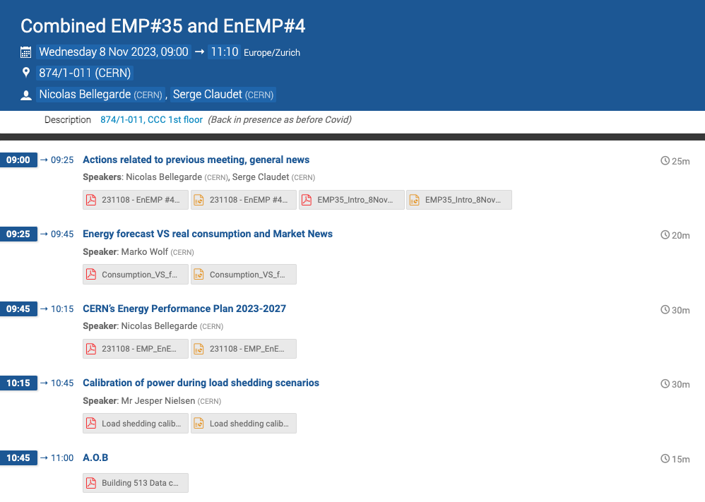
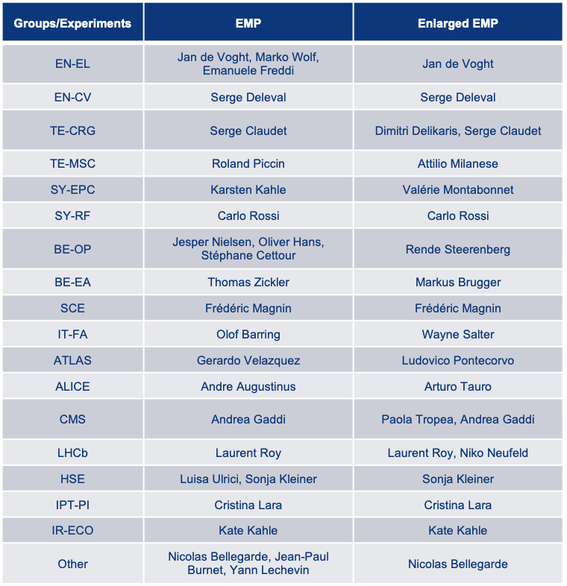
Energy management team
  Energy Management Panel and Enlarged Energy Management Panel – 7 meetings in total in 2023 (https://indico.cern.ch/category/7364/)
  → Following positive feedback from internal stakeholders, pursued as it is for 2024 and review potential synergies for 2025 and beyond

Slide 24
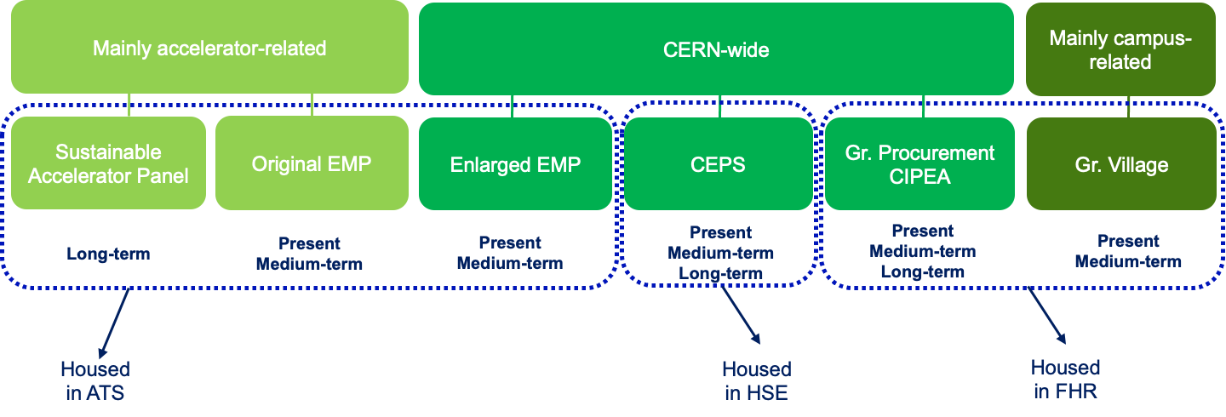
Interface with other bodies (CERN internal)

Slide 25
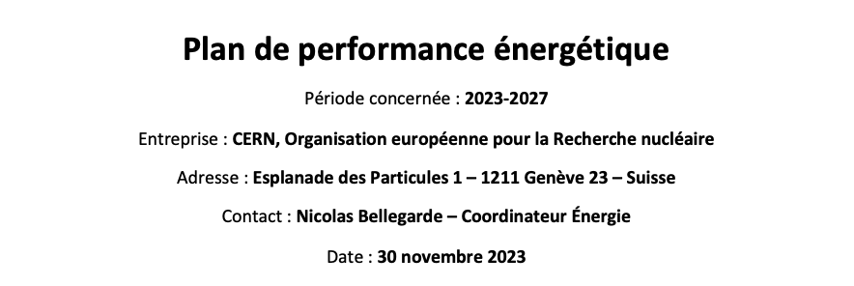
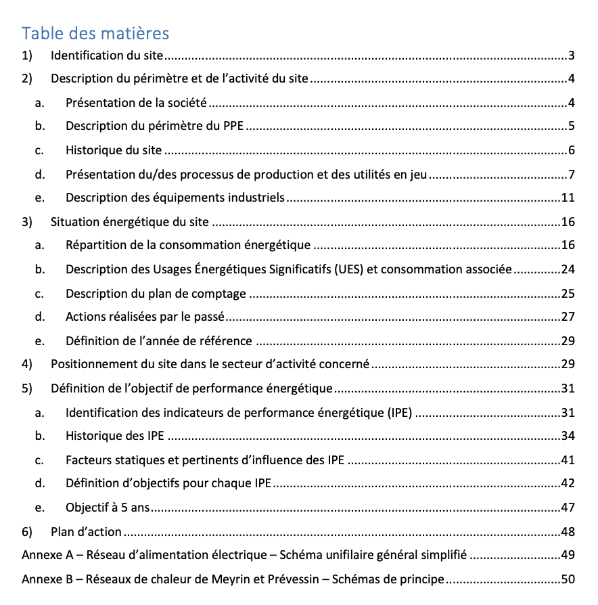
Energy Performance Plan
  Main technical document linked to ISO 50001
  To be officially submitted to the French authorities every year
  Main topics
    Energy baseline of the Organisation
    Review of energy performance from previous year (i.e. 2022)
    Updated forecast for the next 5 years (period 2023-2027) at normal operating conditions
  Document complemented with the energy review (EDMS 2777714), providing all technical details together with CERN’s approved action plan related to energy perfomance activities

Slide 26
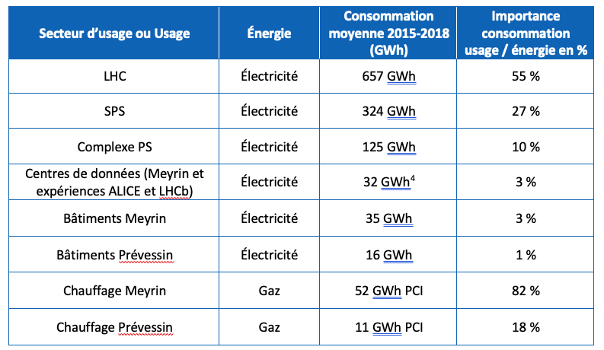
Energy Performance Plan
  Significant Energy Uses (SEUs) – Energy use accounting for substantial energy consumption and/or offering considerable potential for energy performance improvement
  At least one performance indicator to be defined (or planned to be defined) per SEU
  Fuel and liquid nitrogen not retained as SEU (minor part of overall energy consumption and limited improvement potential)
Performance indicators to be defined (if possible) after implementation of additional granularity on WebEnergy

Slide 27


Energy Performance Indicators – Examples
  LHC complex
  Heating in Meyrin
$$\frac{\text{LHC} \text{annual} \text{electricity} \text{consumption} \text{[}\text{GWh}\text{]}}{\text{Annual} \text{luminosity} \text{produced} \text{by} \text{the} \text{LHC} \text{[}\text{fb}\text{−1}\text{] }}$$
$$\frac{\text{Annual} \text{gas} \text{consumption} \text{of} \text{Meyrin} \text{site}\text{ [}\text{MWh}\text{]}}{\text{Unified} \text{degree} \text{day}\text{ [}ºC\text{] }}$$
  Note: LHC failure in 2023 will impact objective for run3 (data being consolidated)

Slide 28
Energy Performance Plan – Action plan
  Agreed action plan (2023-2027)
    ~ 100 lines, covering approved activities improving energy performance for the next 5 years
  Main items
    Heat recovery projects (LHC1 and PCC): ~ 25-30 GWh/year of expected savings on gas consumption
    Optimization of cryogenic operation modes: ~ 20 GWh/year of expected savings
    Building consolidation activities: 10+ GWh/year of expected savings (thermal + electrical)
    Cooling and ventilation consolidation activities: ~ 6 GWh/year of expected savings
    Ongoing energy saving studies: North Area in particular for 2023/early 2024
    WebEnergy evolution: increase of granularity and incorporation of other energies and EnPIs
    Organisation of before/after measurement campaigns: progressively being rolled out by Groups
    Regulatory watch: progress with text analysis (FR and CH) – next steps: decisions about applicability and evaluation of compliance

Slide 29
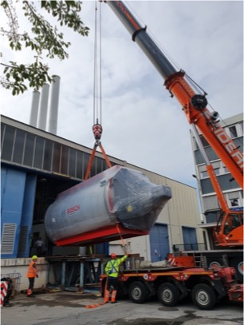
New heat recovery projects
  Meyrin – Heating plant refurbishment (completed) and heat recovery from the LHC cooling towers (horizon 2026-2027)

Slide 30
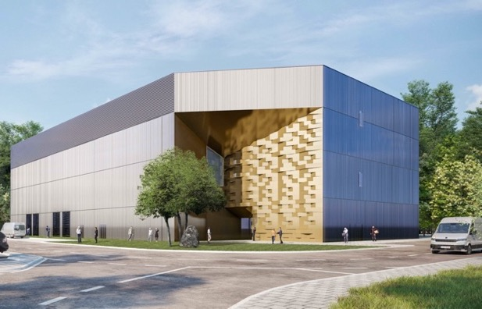
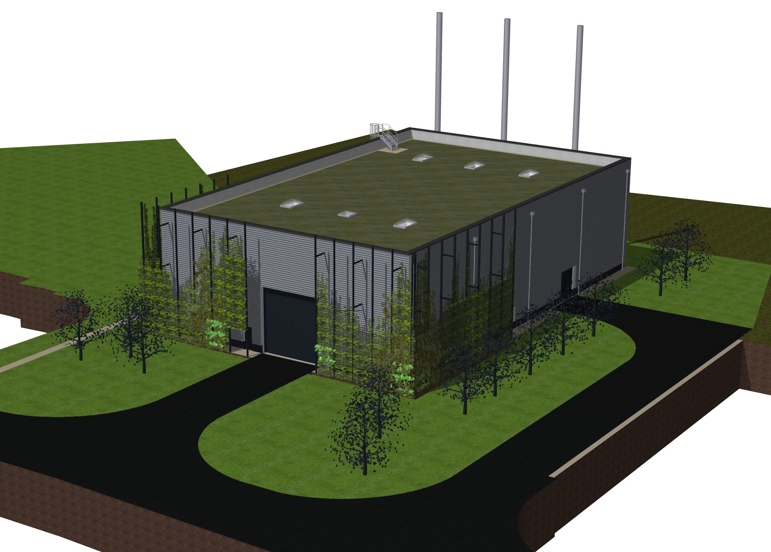
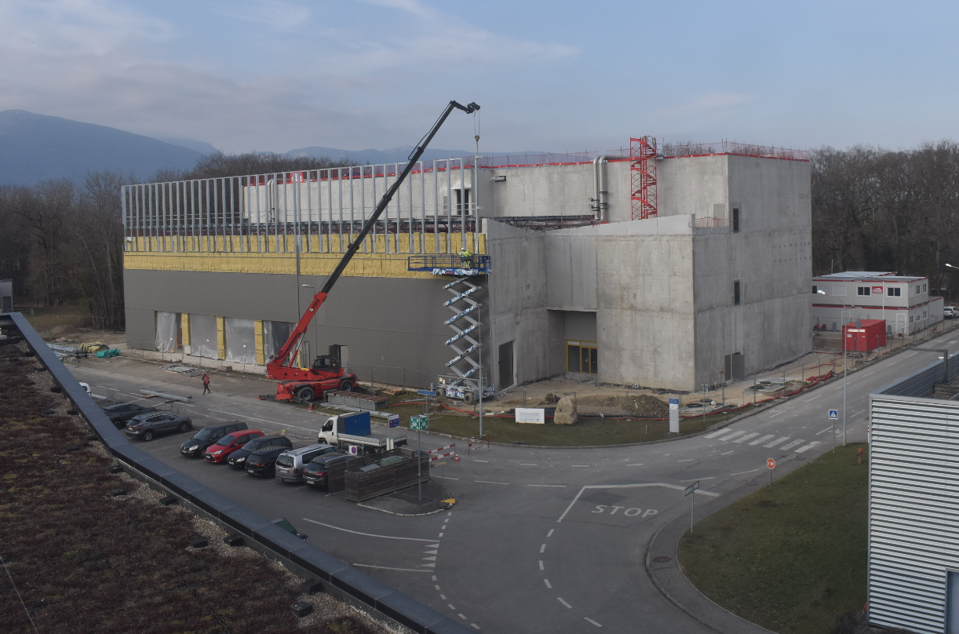
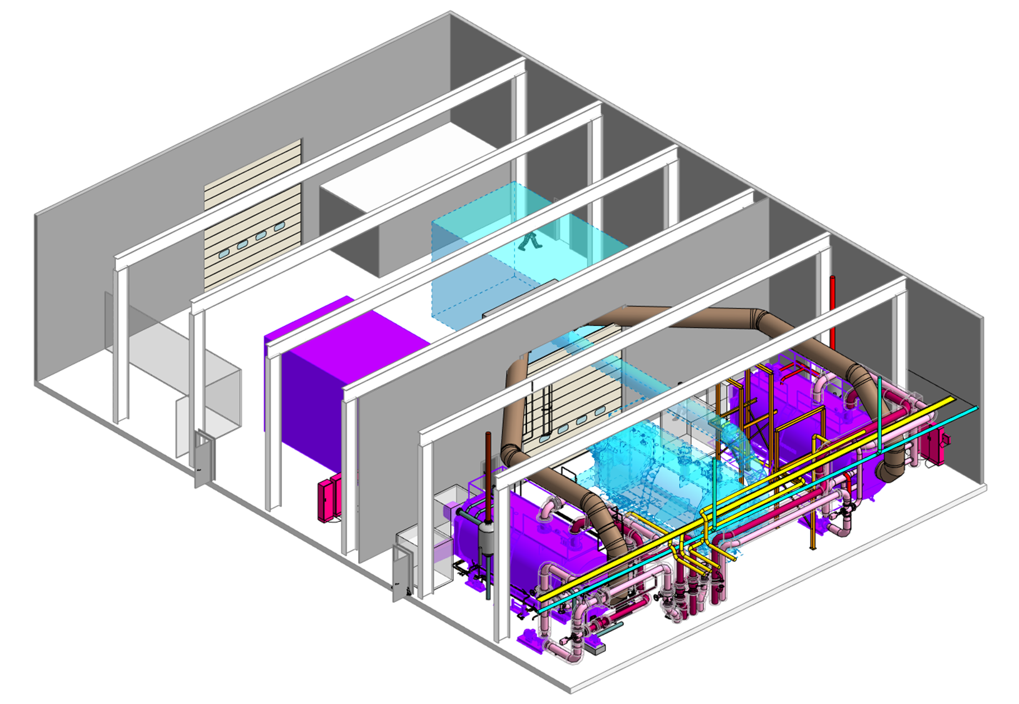
New heat recovery projects
  Prévessin – Heating plant refurbishment and heat recovery from the new data centre (horizon 2026-2027)
Prévessin Computing Centre
Nouvelle installation de chauffage
Design
Feb 2023
éco-bâtiment pour accueillir la nouvelle chaufferie
2/2023
Pompes à chaleur + gaz d'appoint
Phase 1: 3 MW
Phase 2: 4 MW
Prevesin: besoin moyen en chauffage : ~3MW

Slide 31
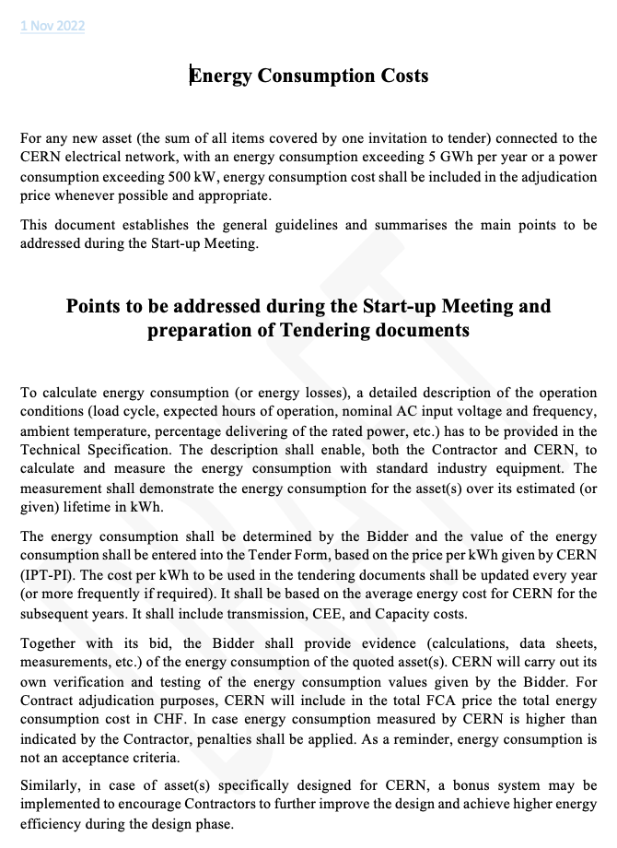
Energy performance in procurement
  Procurement guidelines evaluating energy performance over the planned or expected operating lifetime when procuring equipment, products and services
    → Criteria (sum of all items covered by one invitation to tender): power consumption > 500 kW or annual energy consumption > 5 GWh
  → Heat recovery capabilities also assessed
  (in case of interest to CERN)

Slide 32
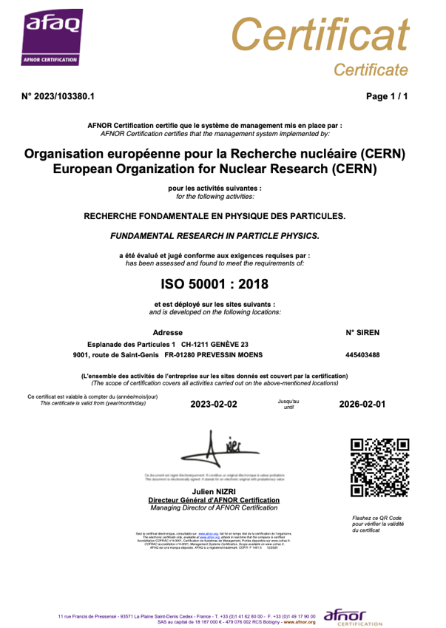
ISO 50001 certification and next steps
  Internal and certification audits carried out at the end of 2022
  ISO 50001 certification obtained on 2 February 2023, for an initial period of 3 years
  Certification covering the entire perimeter of the Organisation (i.e. all sites, activities and energies)
  First surveillance audit planned in February 2024 → Internal audit completed with very positive outcome

Slide 33
Conclusion and take-away messages

Slide 34
Conclusion – Take-away messages (1/2)
  Energy management and ISO 50001
    Energy management in place at CERN since many years, with energy management panel formally established in 2015
    Excellent understanding on CERN energy use and metering plan in place
    Electricity consumption forecast well established
    Governance and structure reinforced in 2022 with energy performance taken into account in all relevant organisational processes → ISO 50001 certification obtained in February 2023
    Full implementation of ISO 50001 requirements ongoing, with adjustments as required (continuous improvement)
    Human resource ramp-up ongoing (ATS-DO, SCE, etc.)
    Next official audit: 28 February – 1 March 2024

Slide 35
Conclusion – Take-away messages (2/2)
  Electricity contracts
    Energy crisis impact limited thanks to current contract structure including ARENH mechanism → At least until the end of 2025!
    Major uncertainty after 2025 following the unknown evolution of regulatory framework
    Clear goal of the Organisation to enter into offsite PV physical Power Purchase Agreements, for the moment up to 10% of CERN’s annual electricity consumption during run periods – With other types of Power Power Agreements also being studied
  Medium/long-term perspectives
    Electricity consumption forecast known up to 2041 included (end of the LHC operation) – Between 1.3 and 1.5 TWh/year maximum
    Future CERN projects (feasibility studies ongoing) taking into account energy performance as a major parameter for decision making (equipment consumptions, types of energy, sourcing, etc.)

