Slide 1
April 10 2024
INFN CNAF TIER1 Update
State of the new Datacenter
CNAF-CERN DCI Preproduction
S.Zani

Slide 2
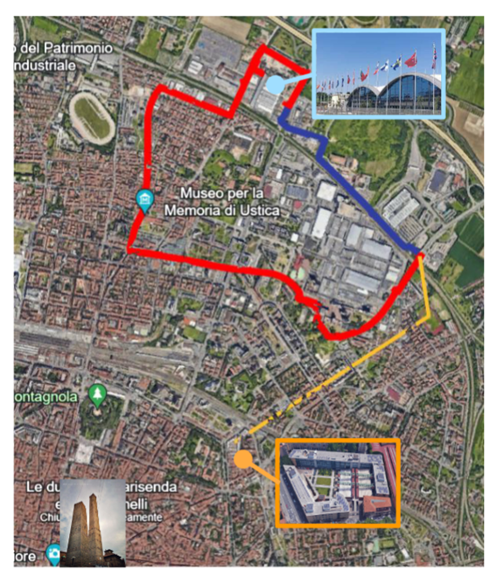
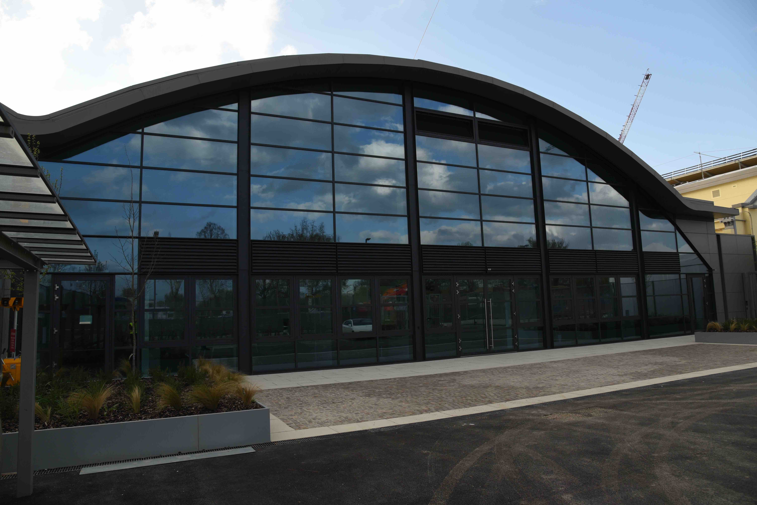
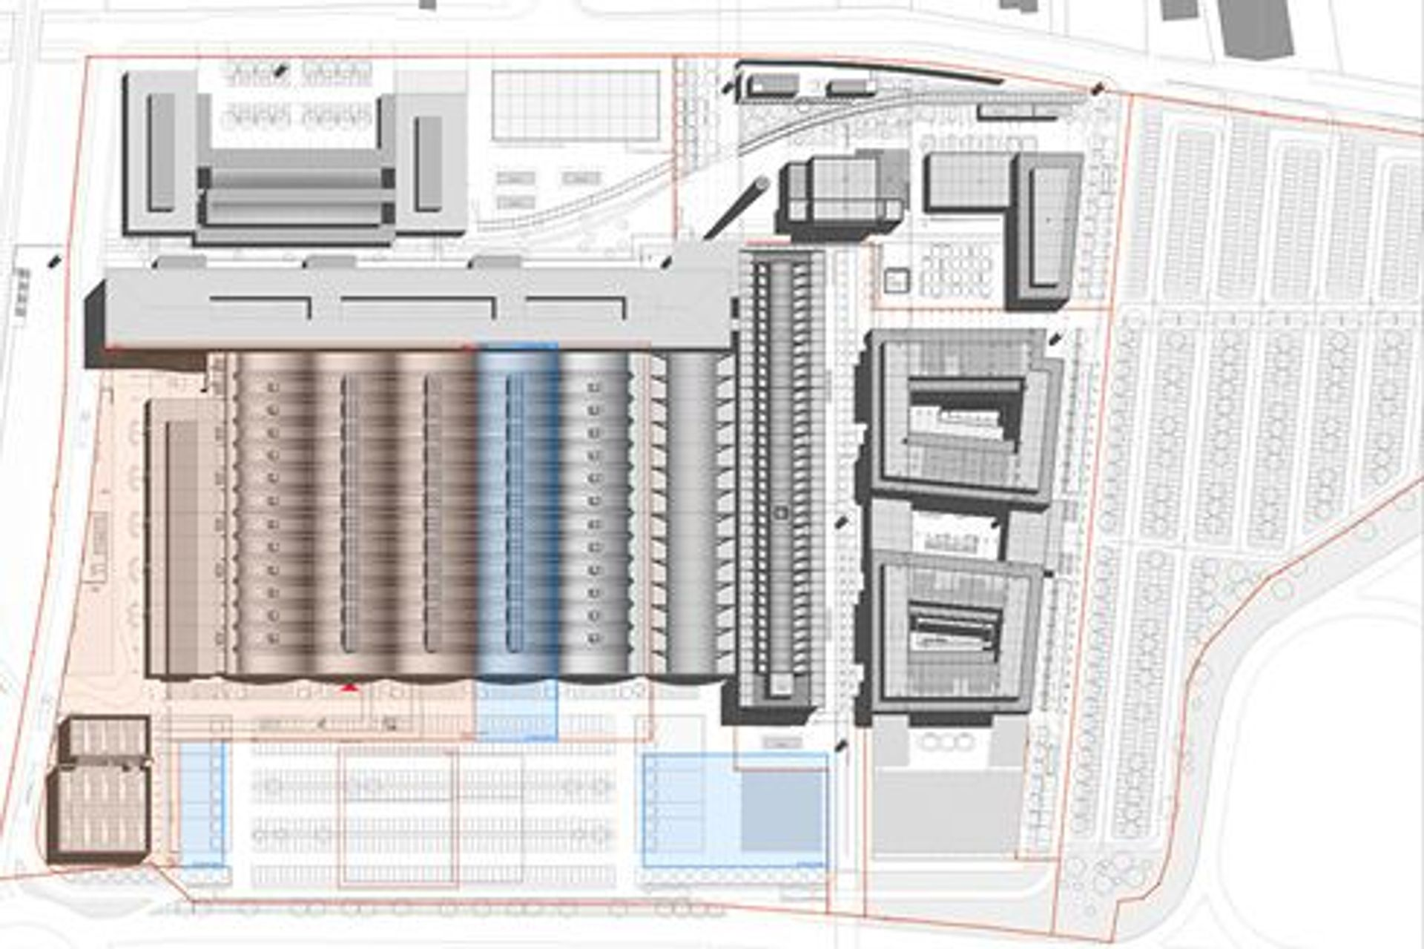
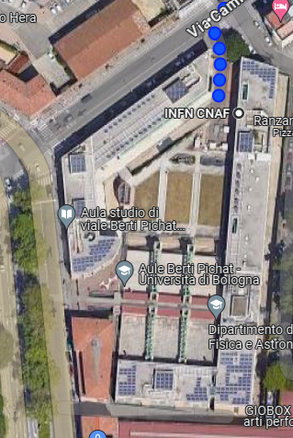
New Datacenter state of art
New Datacenter at Technopole
2,4km walking distance
7 km far fiber path
NEW DATACENTER
(Via Stalingrado)
B5 Building OK
CURRENT
DATACENTER
(Viale Berti Pichat)
ECMWF
CINECA
INFN
B5
C2

Slide 3
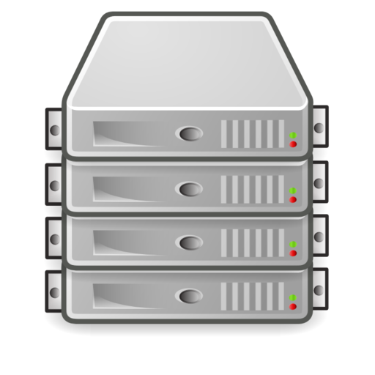
Areas of the new Datacenter
Cold water (26°C inlet) only for Air cooling (Cold isle) system (Up to 16 kW/Rack)
100m
FARMING
NOC
SOC
MEETING
ROOM
High Density
And
Expansion
AREA
LOW Density Computing
AREA
INFN DC
Building
B5
“Temperate” water (36°C inlet) for DLC and cold water for Air Cooling
Up to 80kw/Rack
TAPE
LIBRARY
NETWORK
30m
CNAF-Leonardo
Direct cabling connection <100m
High Density
Expansion
AREA
CINECA DC
Building
C2
16x100Gb Ethernet
LEONARDO
OPN/ONE
Skyway
Skyway
IB
Dragon Fly
IB
IB
CORE-1
A7812
CORE-2
A-7812
IB
IB
IB
FARMING / STORAGE
Resources
FARMING / STORAGE
Resources
LEONARDO

Slide 4
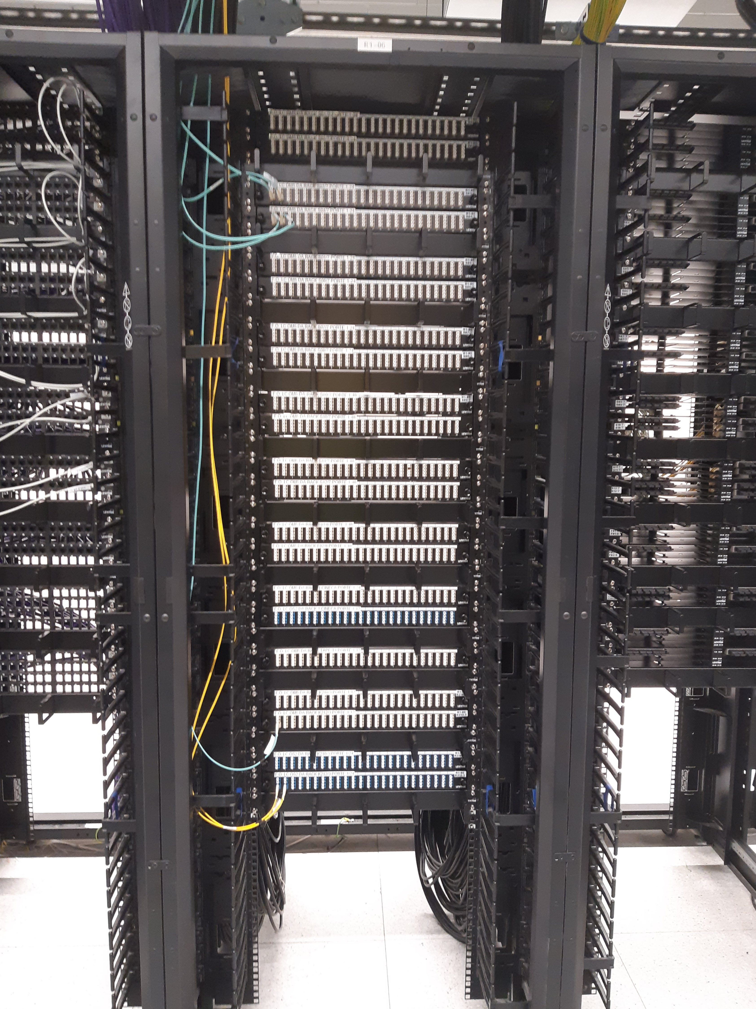
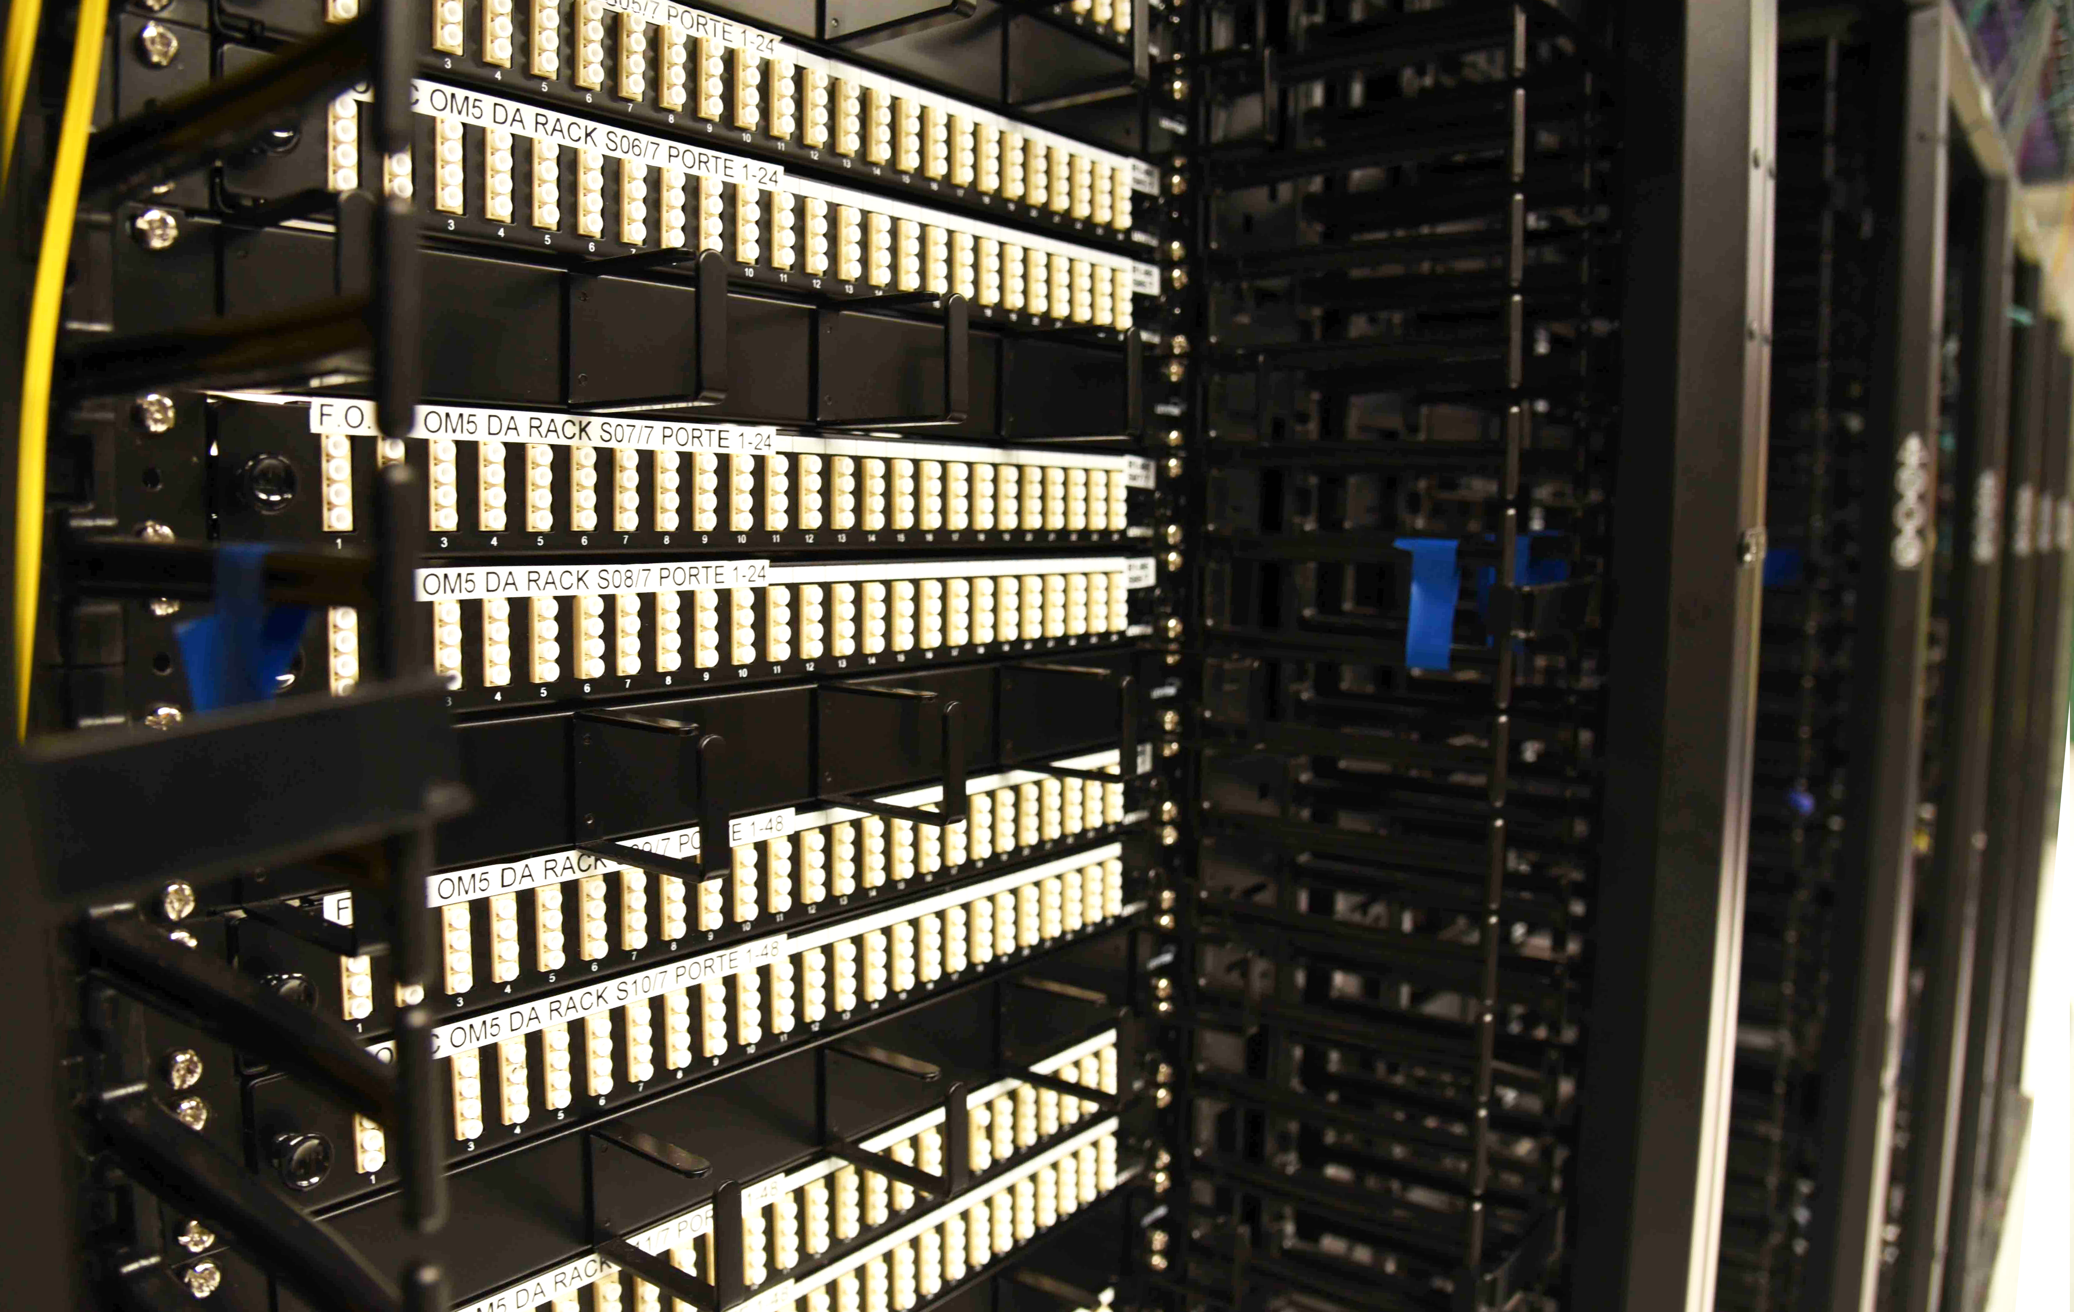
Cabling
The Cabling system is concentrated from every row in the Network Room (Close to center of the building)
LC-LC MM (OM5) →1-100Gb Ethernet
LC-LC SM->1-400Gb →Longer distance and 400G-FR4 Ethernet
MPO-12 MM (OM5) →40G-SR4, 100G-SR4, 400G-SR4.2 Ethernet
MPO-12 SM →400G Ethernet (400G-DR4)
RJ45 →1-10Gbps
Cabling complete!

Slide 5
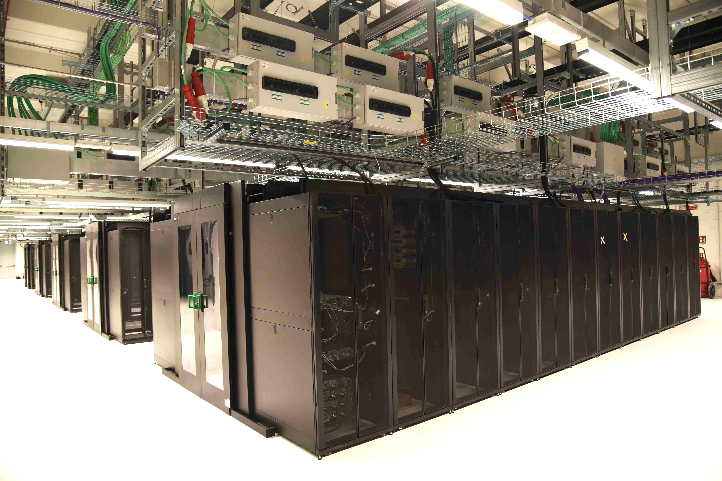
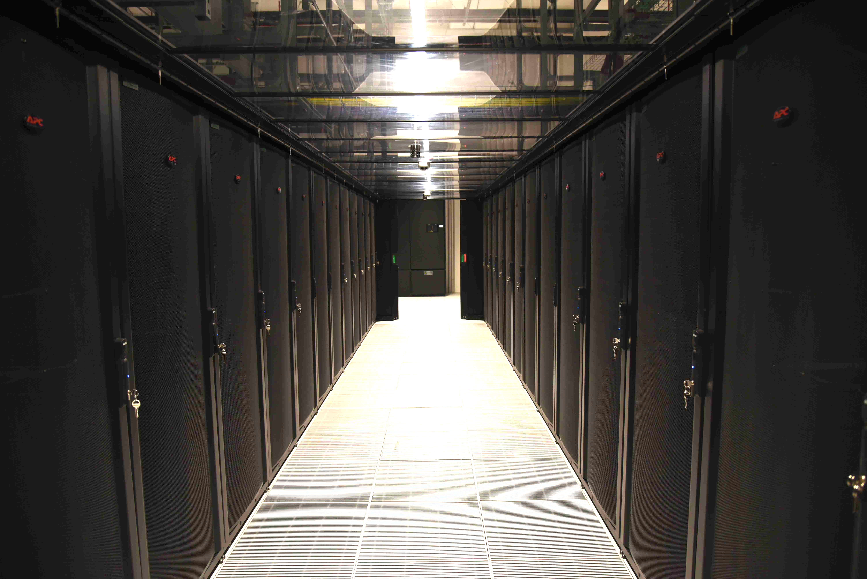
Low density Area
150 racks in place
Under Floor Cooling System operational
First Computing and storage resources
First 5 CPU Racks transferred in the new data center In low density area →In production
First 64 PB of new storage resources are installed in the new data hall → configuration in progress

Slide 6
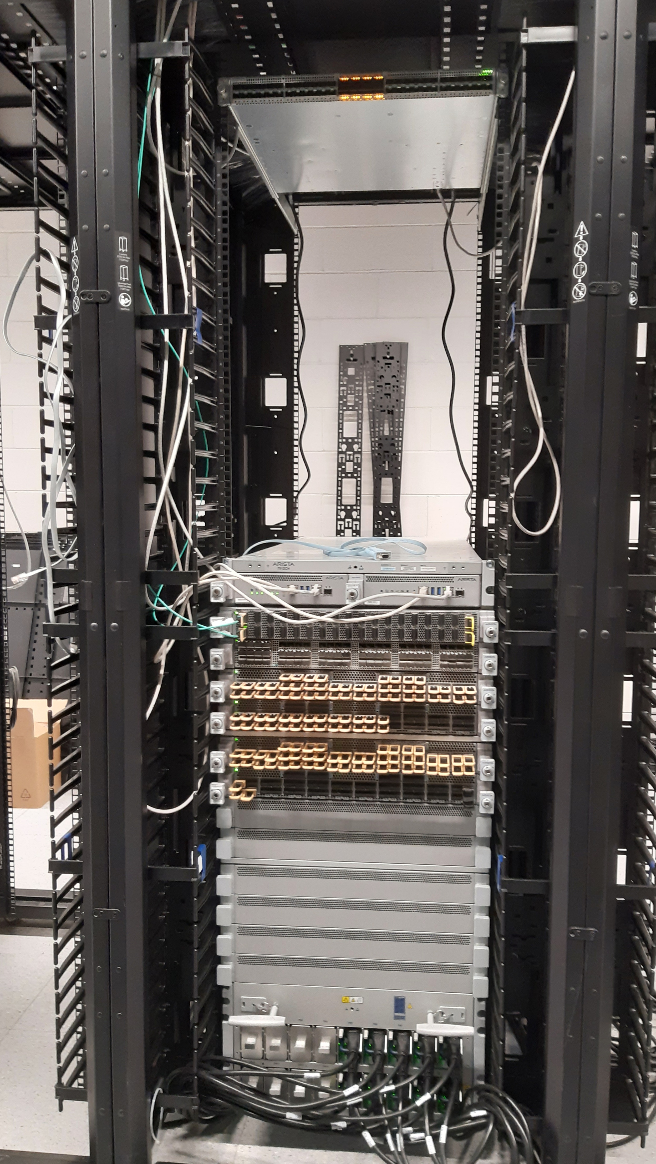
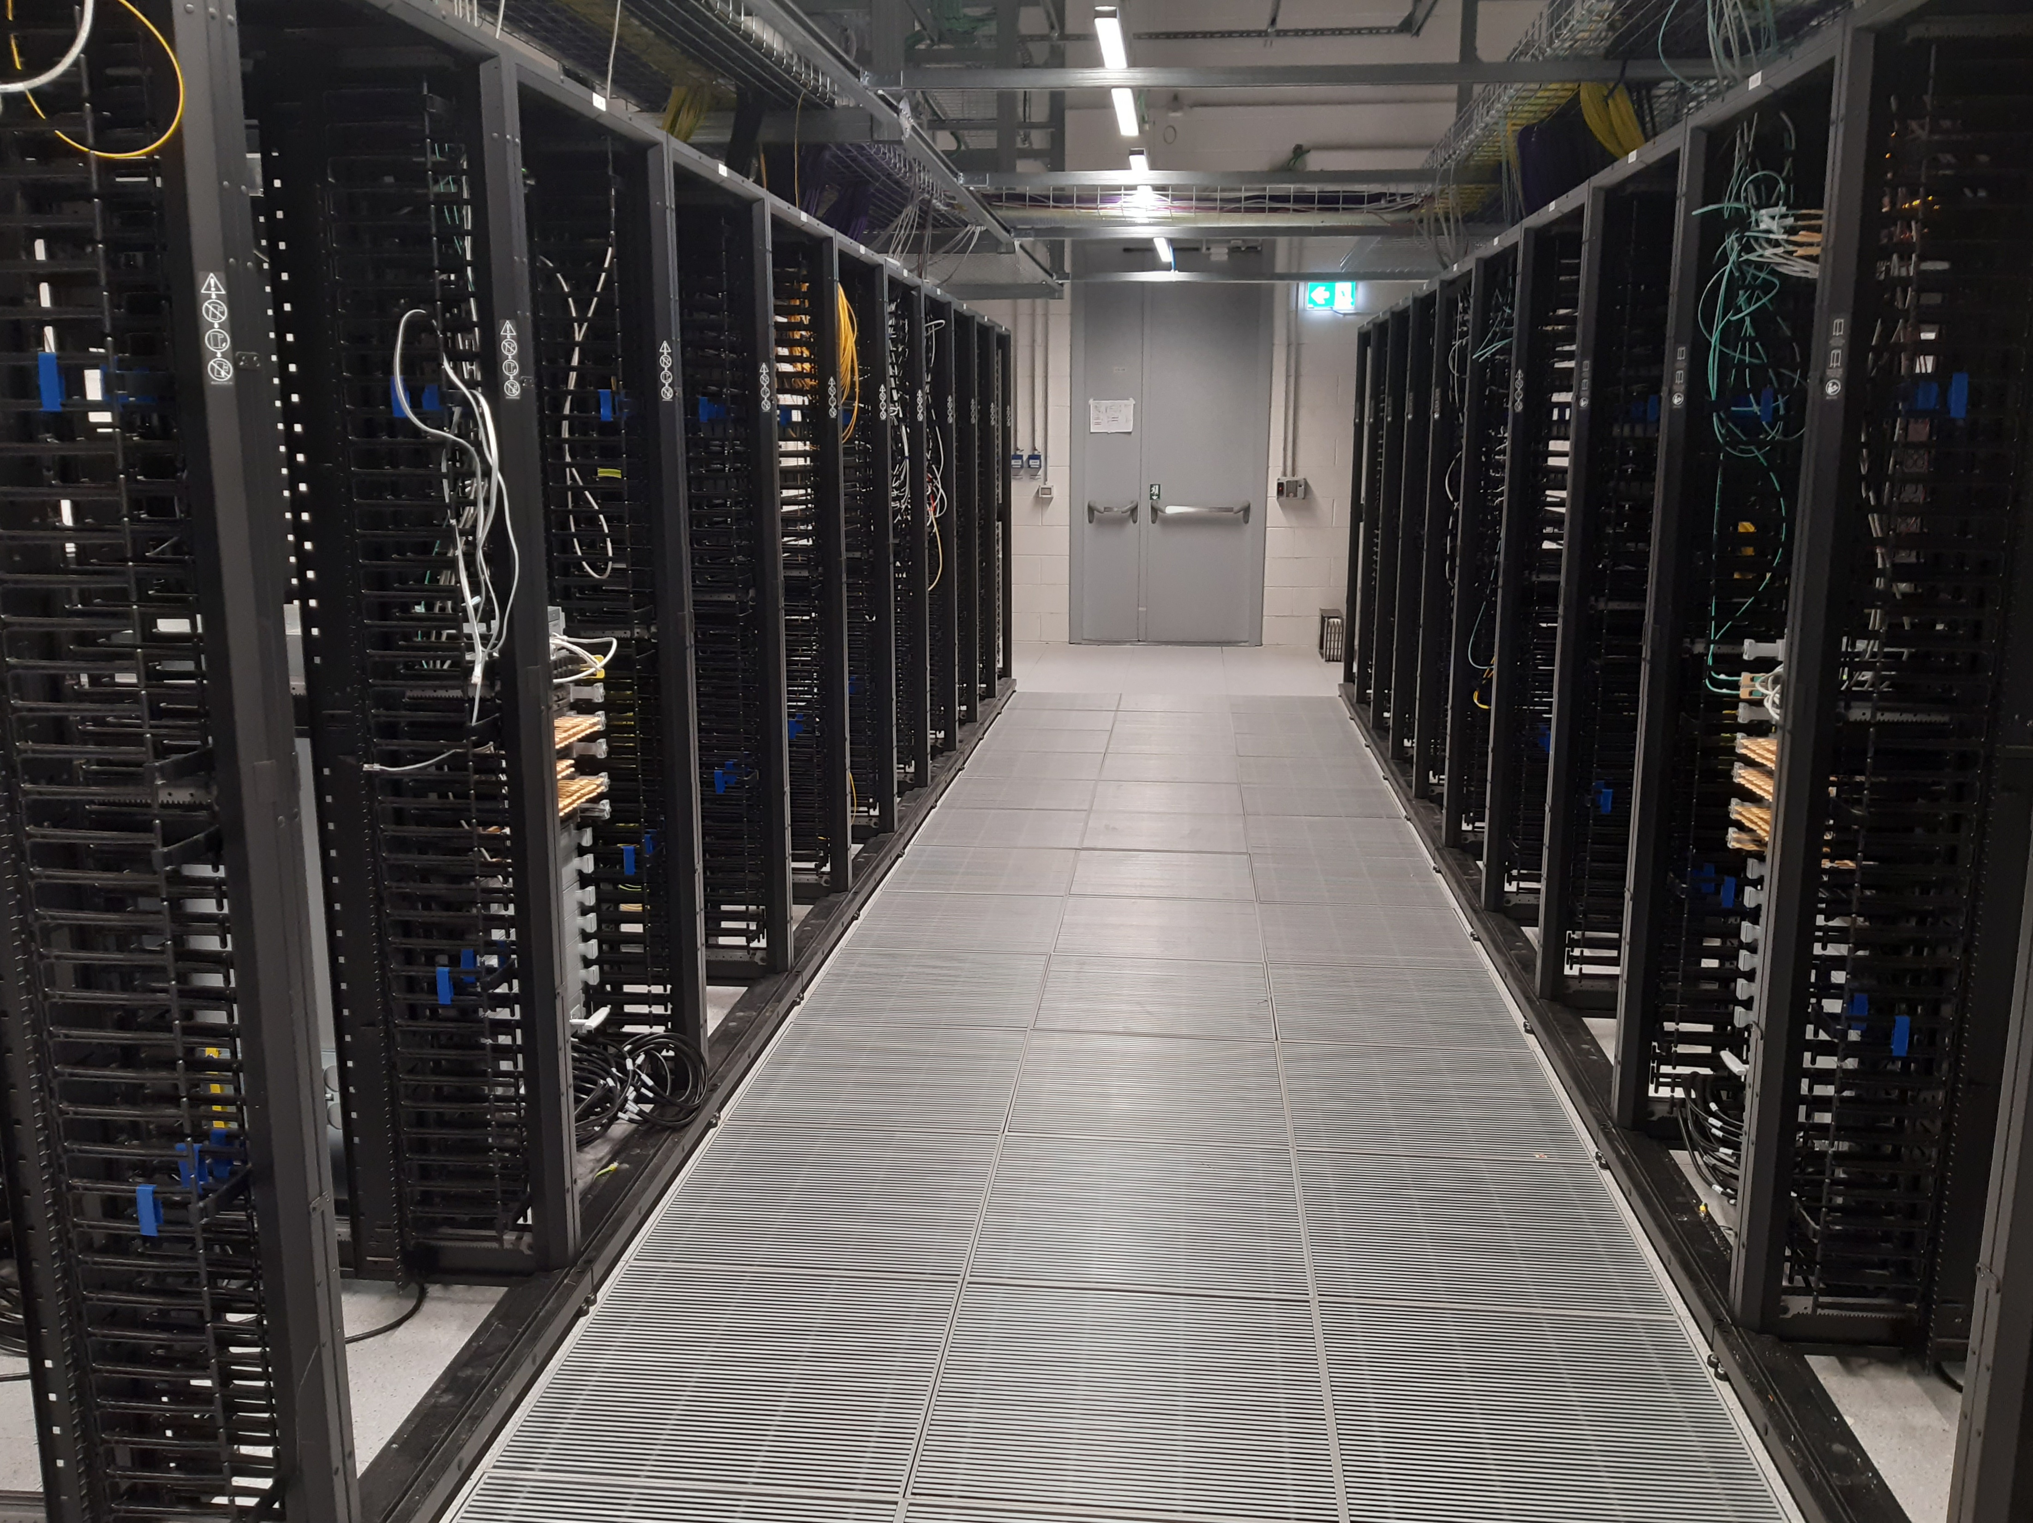
Network Area
ONE OF THEN TWO
CORE AND ROUTER RACKS
Cabling system from Network Area to every row in place
2x Modular Core Switch/Router (ARISTA 7812) –TIER1 Scientific DC
2x ”Switch/Router” (ARISTA 7280) – General Internet Access
15x Management Switch
2 Racks for GARR POP
Everything in place (Configuration of the devices in progress)
ARISTA 7280
NETWORK ROOM
ARISTA 7812

Slide 7
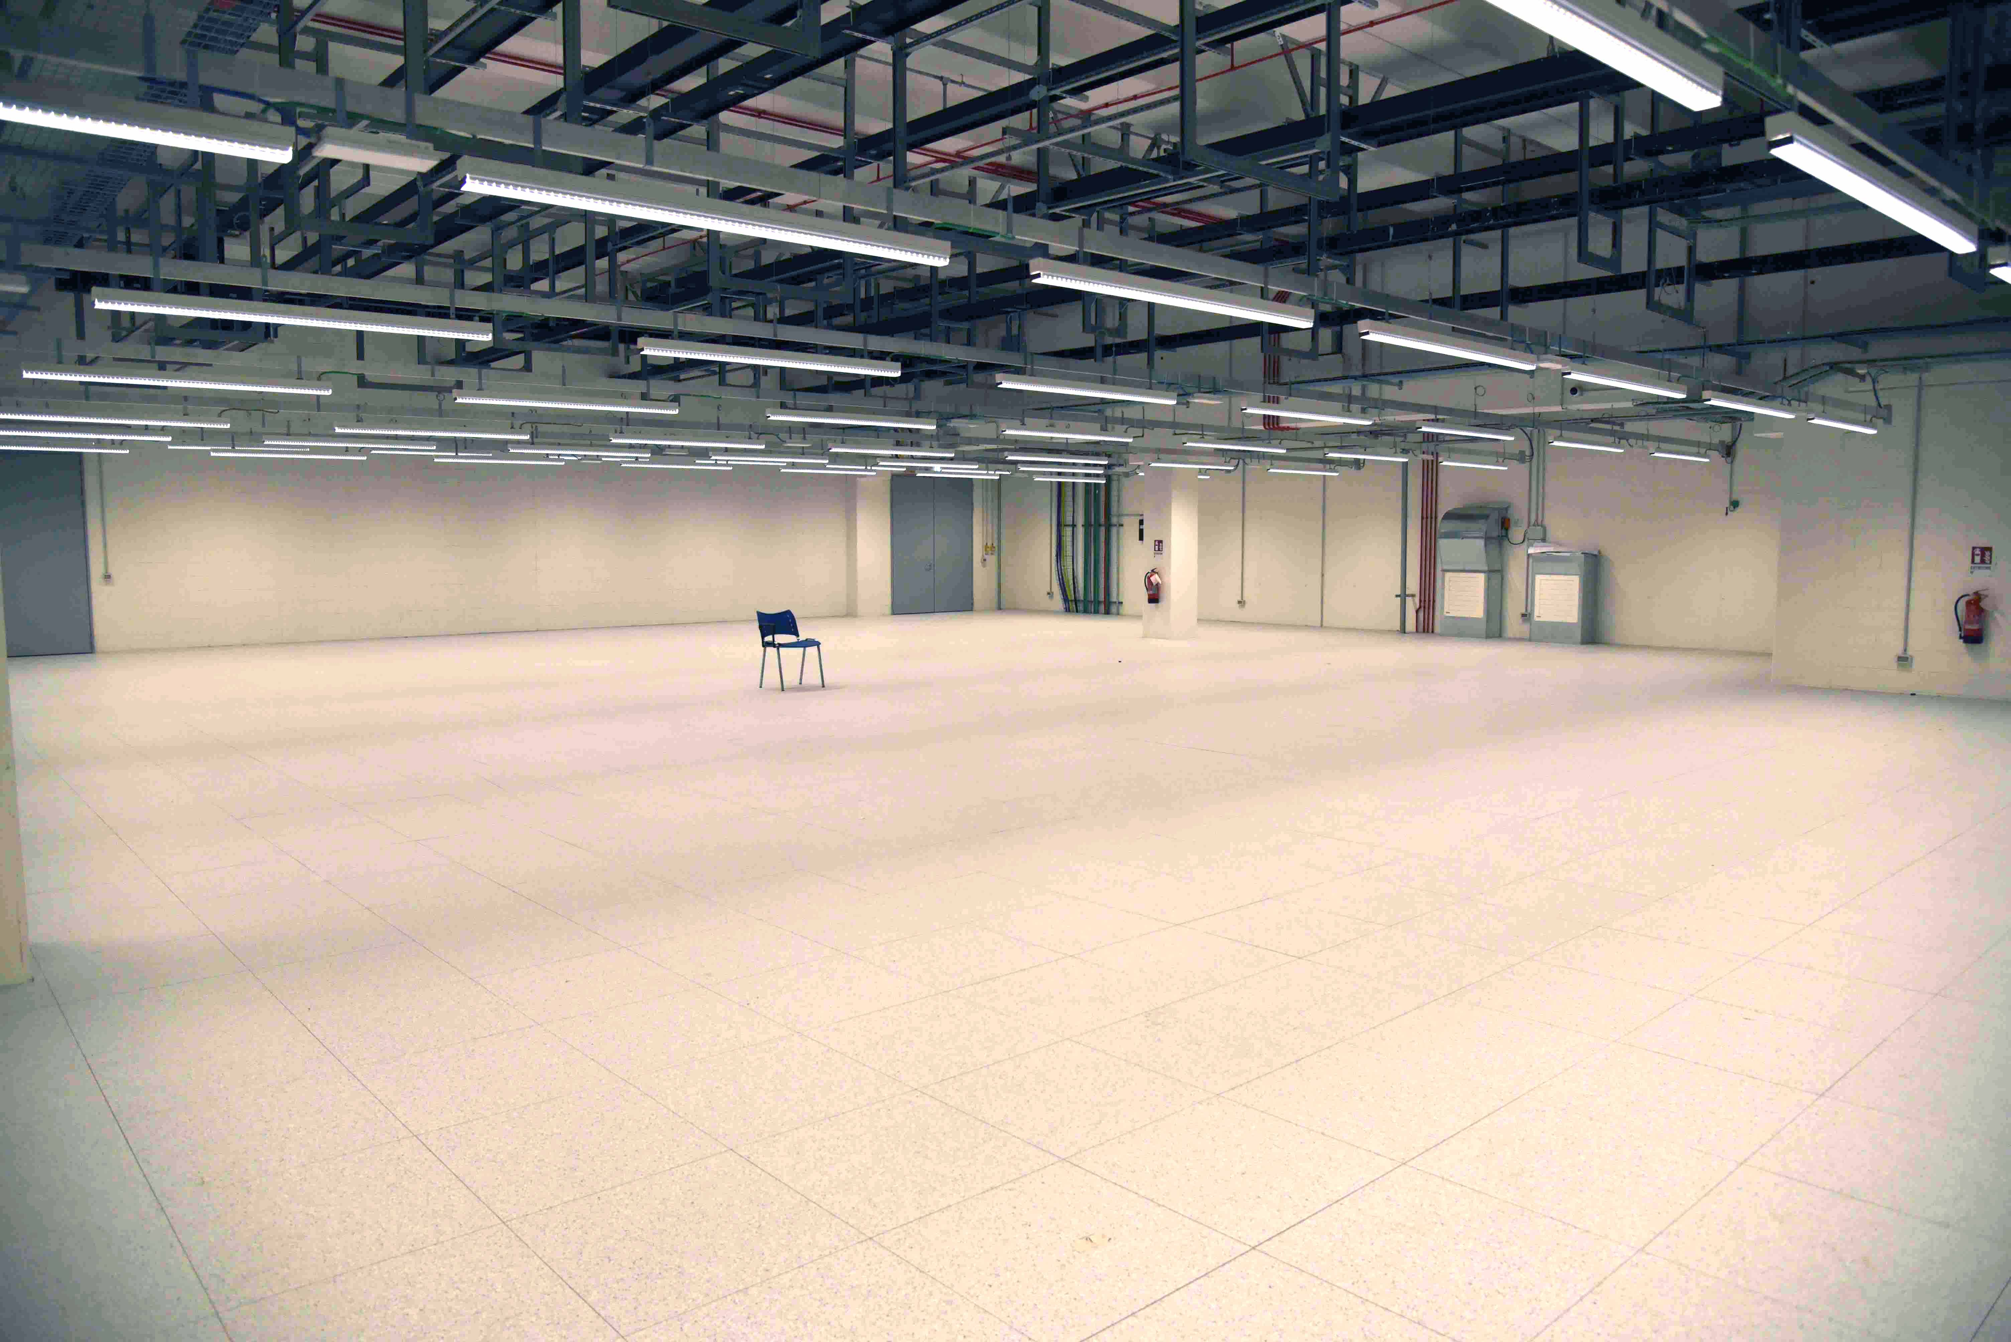
High Density and expansion area
FREE EXPANSION AREA
Network Cabling racks are in place
The High density farming area can host 3 rows of 16 Racks full of DLC systems (Up to 80 kw/Rack) or very dense air cooled systems (Up to 30kw/Rack)
An Expansion area of about 800 sqm is available for future use

Slide 8

Physical connectivity of the building
Fiber access from Via Ferrarese
Technopole AREA
Differentiated optical fiber accesses are foreseen for network operators from the two sides of the Technopole Area (Via Stalingrado e Via Ferrarese)
At the time of this presentation more than 140 single mode fibers have been installed by Lepida e TIM entering form via Ferrarese.
K2
INFN
ECMWF
CINECA
Fibers in the other way (From Via Stalingrado) will be installed as far as the underground big anti flooding water expansion pool will be finished
Anti flooding
pool
WORK IN PROGRESS
Fiber access from Via Stalingrado
(To be done)

Slide 9
Datacenter Extension
Between Current CNAF site and New Technopole site
INFN DC
(Old site)
INFN DC
(TECHNOPOLE)
Transponders
Transponders
MUX A
MUX A
10x100G Ethernet(DCI)
7km
10x100G Ethernet(DCI)
G30-1
G30-1
DCI
1,2Tbps
(3,2Tbps)
Available
CISCO
Nexus 9516
CISCO
Nexus 9516
ARISTA
7812
ARISTA
7812
vPC
MUX B
MUX B
G30-2
G30-2
Collapsed
IP FABRIC
Stackwise
Virtual
C-9500
C-9500
2x100G (General IP)
A-7280
2x100G (General IP)
A-7280

Slide 10
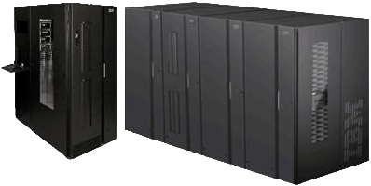
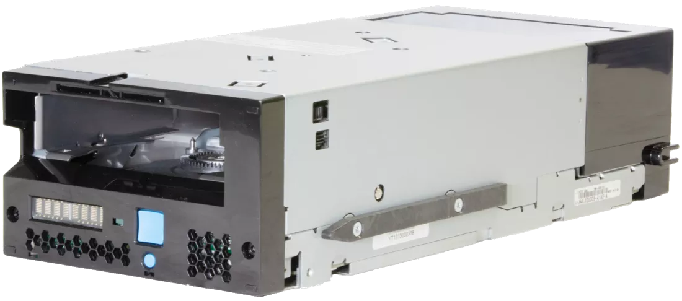
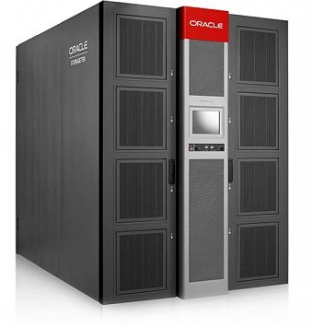
Tape Area Network Extension
INFN DC
(Via Berti Pichat
Old site)
INFN DC
(TECHNOPOLE)
Transceiver FC SFP+
FC 32 Gb LWL on SM Fiber (10Km)
Brocade
IBM TS4500
19 Tape Drive
IBM TS1160
New IBM TS4500
18 Tape Drive
IBM TS1170
FC Switch
FC Switch
SAN 64B-6
2 Dedicated Dark Fibers (7 km)
FC Switch
FC Switch
SAN 64B-6
Tape data transfer will be done on this extension
Dedicated Dark Fibers are in place
LW 10Km FC Transceivers acquired and installed on Berti Pichat FC Switches
New IBM TS4500 Tape Library and new FC Switches in provisioning phase
1st IBM lib to be relocated at TP
The data migration will continue through the remote SAN, until the Oracle lib will be emptied
Oracle SL8500
- 20 Tape Drive
- 42 PB to be migrated
- To be dismissed
TSM – HSM
7 Servers
(old)
TSM – HSM
7 Servers
(new)

Slide 11
Conceptual CORE network Configuration
General IP
WAN
General IP
WAN
Possible Scale UP
Evolution
SW/Router-1
SW/Router-2
Router-1
Router-2
Underlay: IS-IS
Overlay: VLXLAN BGP EVPN
OPN/ONE
SPINE
SPINE
CORE-1
A7812
CORE-2
A-7812
Collapsed
IP Fabric
OPN/ONE
ESI
DC
CORE-3
DC
CORE-1
DC
CORE-2
DC
CORE-4
L2 LACP
Port Channel
FARMING or STORAGE
Resources
ESI
OTHER
Resources
FARMING or STORAGE
Resources

Slide 12
DC Transfer phases
LHC OPN/ONE
LHC OPN/ONE
B5
C2
100Gb/s
100Gb/s
Nx100Gb/s
Nx100Gb/s
DCI 1,2Tb/s
8x100 Gb/s
IB/ETH GW
TR
TR
CORE
CORE
8x100Gb/s
IB/ETH GW
800Gb/1Tb (T1-T1 + T1-WAN)
Nexus 9516
Nexus 9516
TOR
TOR
TOR
TOR
CORE /
SPINE
CORE /
SPINE
2x100G (General IP)
Nexus 7018
DCI Between the two Datacenters
Data copy and devices transfer
Swap of the Wide Area Network Routing as far as hardware resources have been moved to the new Datacenter
Decommissioning of the old datacenter
TOR
TOR
TOR
TOR
Leonardo
TIER1
Berti Pichat
INFN
CINECA

Slide 13
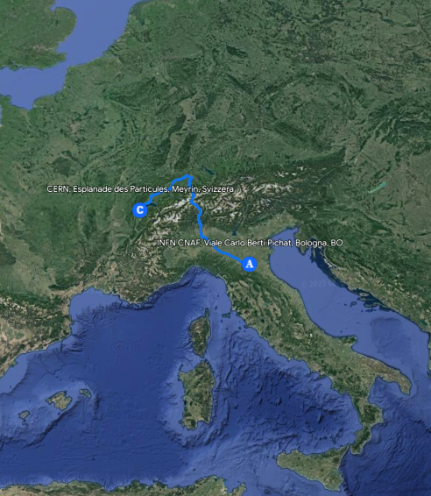




CERN – CNAF DCI
As presented last year we have a pilot link based on multidomain Spectrum sharing Connection.
We managed to activate a 4x100Gbps to be used as LHCOPN link for INFN-T1 during the Data Challenge 2024
Geneva
CERN DC
Bologna
CNAF DC
Nx100 G
or
Nx400 G
Nx100 G
or
Nx400 G
TRX
TRX
1.6 Tbps
Add/Drop
Add/Drop
GEANT
Open Line System
ROADM
ROADM
GARR
Open Line System
8x AMP
3x AMP
Milan PoP
13

Slide 14
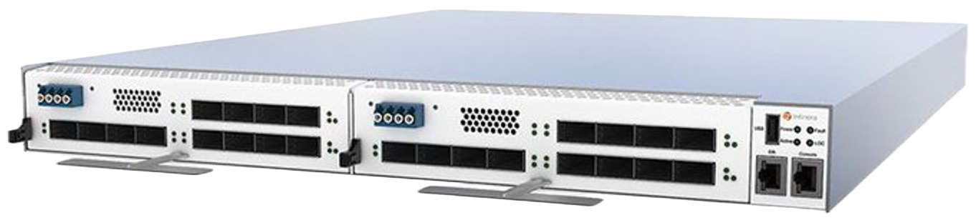
CERN-CNAF DCI (Pre production)
Primary and backup path CERN-CNAF
CNAF
CERN
2 Transponders
Infinera G30@CNAF
LHC-OPN traffic on DCI Link 4x100 Gbps
2 Transponders
Infinera G30@CERN
PRIMARY PATH (as-path: 2038-513)
SCS
Spectrum Sharing (1,6Tbps over 400Ghz)
1000 km
4x100G
4x100G
0
Nexus 9516
Nexus 9516
CERN Router1
CERN Router2
L3 Overlay
LHC-ONE
LHC-OPN (Backup)
2x100G
2x100G
Router GEANT
Router GARR
BACKUP (as-path 2038-137-20965-513

Slide 15
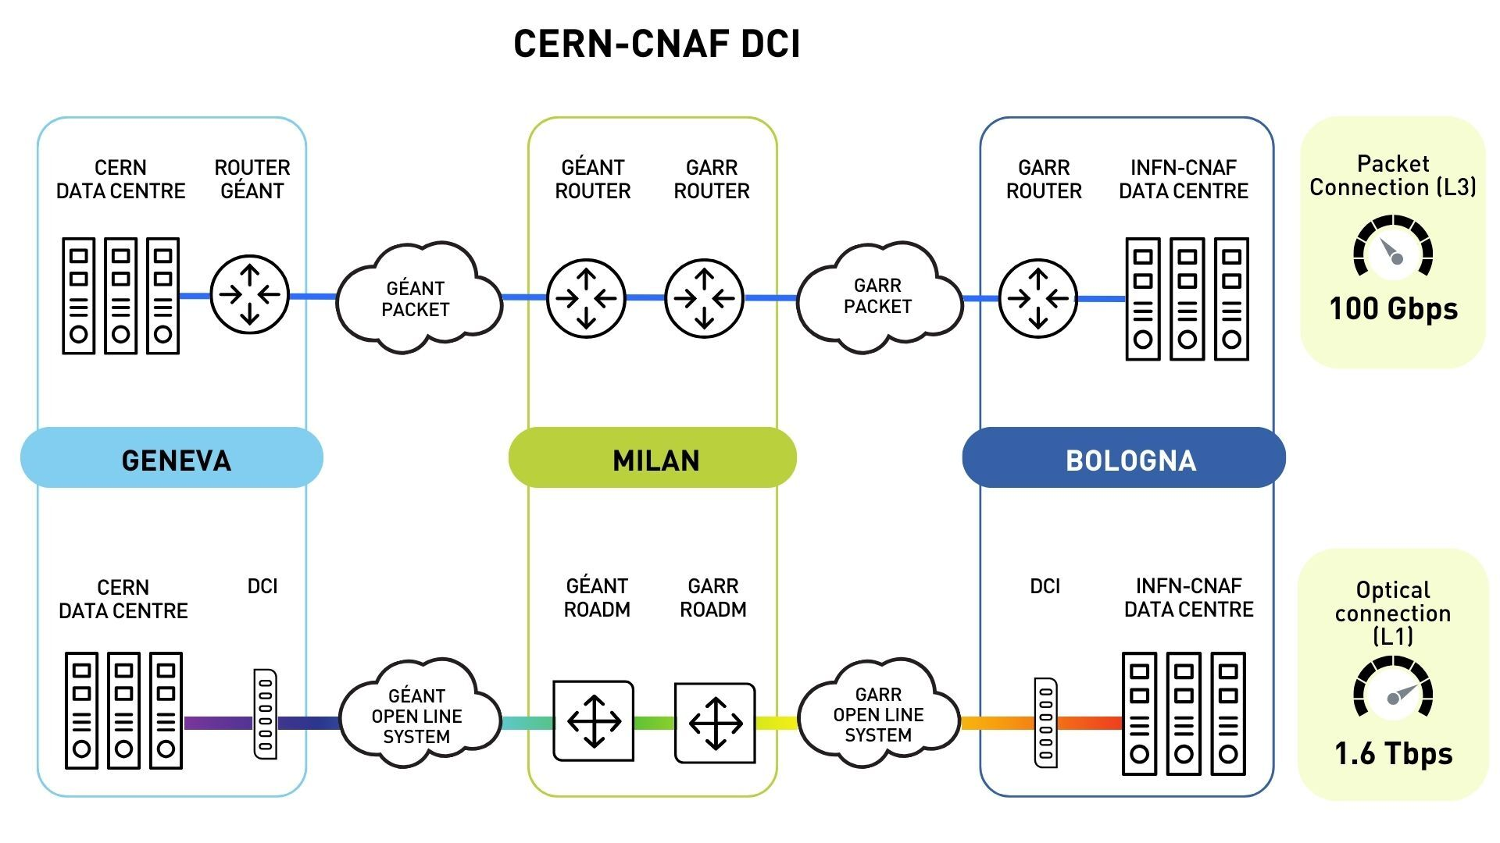
CERN-CNAF DCI
RTT
15 ms
RTT
9.5 ms
Courtesy GARR

Slide 16
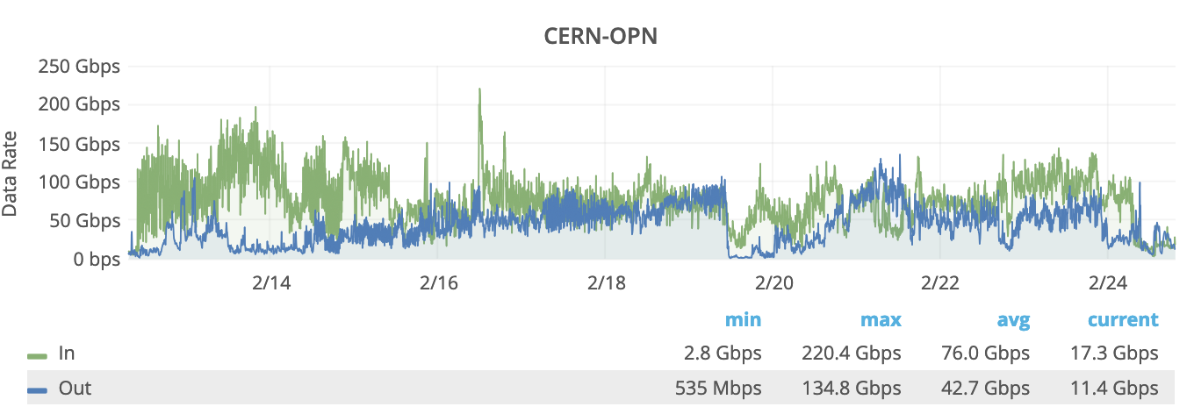
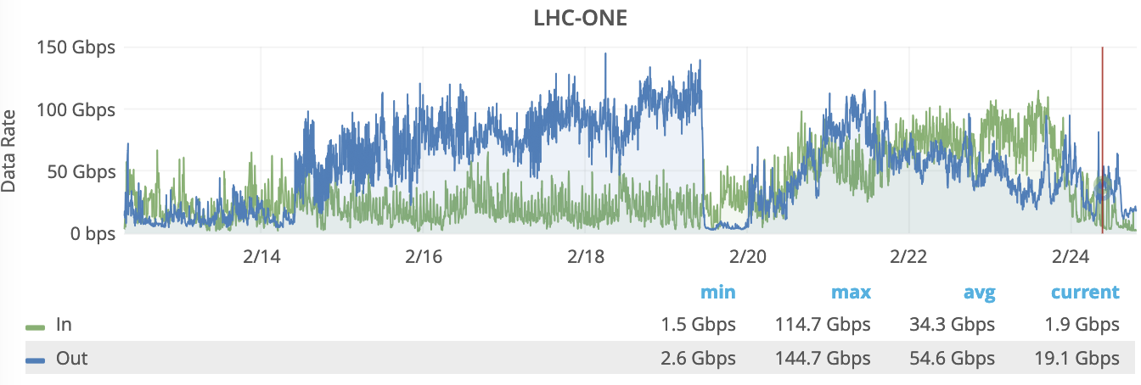
Data Challege 2024 (Using DCI link)
On 400Gbps CNAF-CERN DCI Reached 220 Gbps (5 minute average)
On LHCONE (T1-T2 + T1-T1 per FZK e IN2P3) Reached 145 Gbps
Quite good rates reached (>200Gbps) and network don’t represent a limit for the data movement (Never saturated)

Slide 17
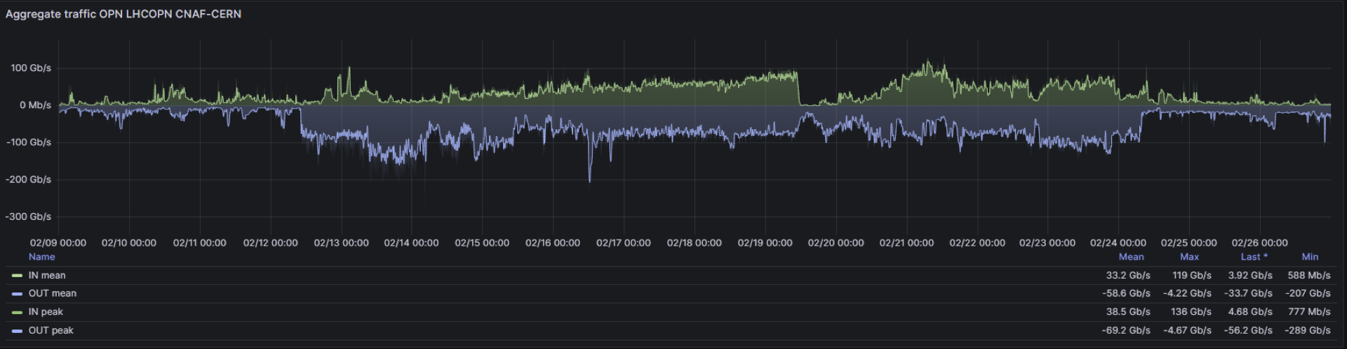
Telemetry (On transponders)
Data observed via Telemetry on transponder devices (peaks close to 300Gbps)
285 Gbps
Telemetry gives us instant data (not average) and it is better to observe peaks.

Slide 18
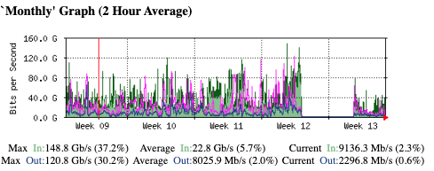
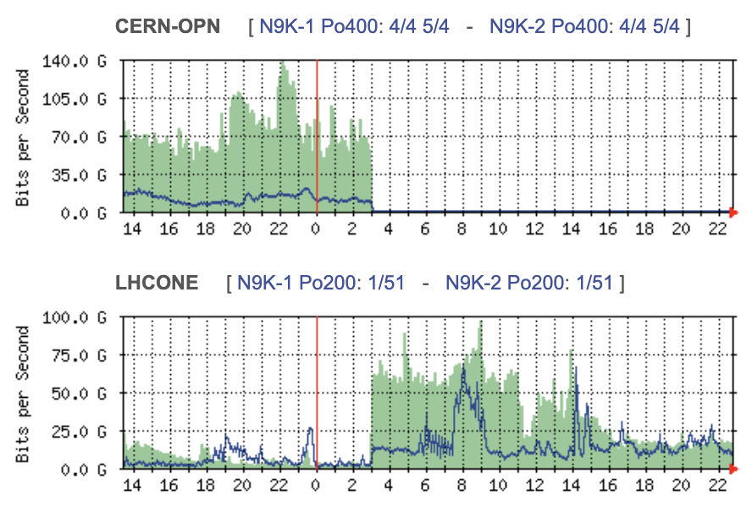
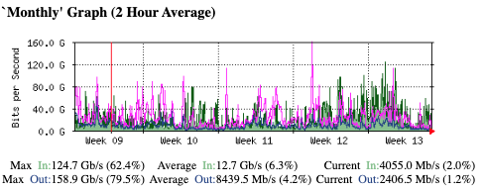
Fiber CUT on DCI (22/3/2024 – 27/3/2024)
During “CUT time” traffic
Flowed on LHC-ONE “Routed” Path
CUT 22/3/2024
OPN CERN – CNAF DCI
OPN-ONE CERN – CNAF (backup)

Slide 19




CERN-CNAF DCI (Next steps)
DCI on spectrum sharing is ready for production
Pilot activities will continue
400Gbps and multiple 400Gbps Ethernet connections
Extension of the pilot to the new datacenter @Tecnopolo
Try to find a second optical path for redundancy
Improve automation on optical network programmability
Acknowledgments:
GARR Optical : Colantonio, Vuagnin
GARR Packet : Inzerilli, Marletta, Valiante
GARR DC & DevOps : Cesaroni, Chiarelli, Marzulli
CNAF Team: Zani, De Girolamo
CERN Team: Martelli
GEANT Team: SCS Team, Roberts
GARR Management/Amm/CTS

Slide 20
That’s it

Slide 21
Backup Slides

Slide 22
Connection to Leonardo
General IP
WAN
16x100Gb Ethernet
OPN/ONE
Syway 2
Syway 1
IB
IB
IB
IB
IB
IB
CORE-1
A7812
A-7812
Dragon Fly
ESI
L2 LACP
Port Channel
LEONARDO
FARMING or STORAGE
Resources

Slide 23
Outline
New Datacenter state at Tecnopolo
  Schema, Photos, Numbers
Datacenters Interconnection between the two DCs
  Two ways fiber access to the building
  1Tbps DCI provided by GARR
  Tape Area Network Extension
  Complete plot of the extensions (CINECA, Berti Pichat, Technopole)
Plan for the transfer
  Challenges
New network infrastructure
  Cabling system and technologies used
  Devices HW description
  Description of the collapsed IP Fabric for the CORES
  Leonardo Interconnection
    PoC done last year
    New infrastructure
  Focus on CERN-CNAF DCI
    State of art
      Next steps of the experimentation
    Data Challenge analysis from network point of view
Different kind of workflows and different confidentiality of data (GDPR compliancy and WLCG)
Conclusions

Slide 24
