Slide 1

23 January 2023
DRD4 – Detector R&D Collaboration on
Photodetectors and Particle ID
+ SciFi tracking + Transition Radiation
Constitution Meeting
Organizers: P. Krizan and C. Joram
On behalf of DRD4 Preparation Team

Slide 2
We came a long way
The Roadmap (248 p) https://cds.cern.ch/record/2784893?ln=en
Implementation of the ECFA Detector R&D Roadmap
DRD 4 Implementation zone. Incl. short chronological overview: https://indico.cern.ch/event/1214407/
In short
Peter and I were mandated by ECFA to prepare the launch of an R&D collaboration on PD and PID.
First zoom meeting of some senior people – 8 March 2023 => send out a questionnaire (215 copies)
A live community event on 16 and 17 May at CERN. Some 50 participants were present plus about 30 per zoom. Main goals: discuss the scientific and organisational backbones of DRD4.
The proposal writing process was launched. A preparation team of volunteers was formed to promote the process.
A community update event was held on 15 June (by zoom). Lots of work in the background to discuss scope, work packages, working groups.
Submission of proposal (33 pages) 31 July 2023
Submission of a revised R1 version : 31 October 2023
Submission of a revised R2 version : 14 November 2023
Presentation to DRDC (Rok Pestotnik and C. Joram),4 December 2023

Slide 3
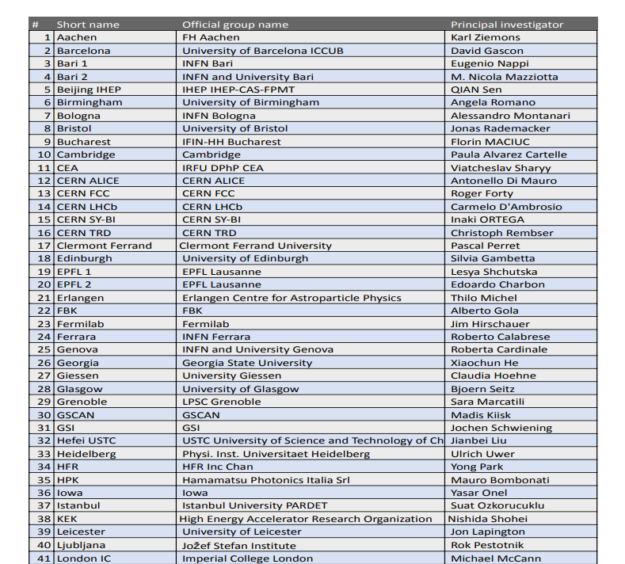
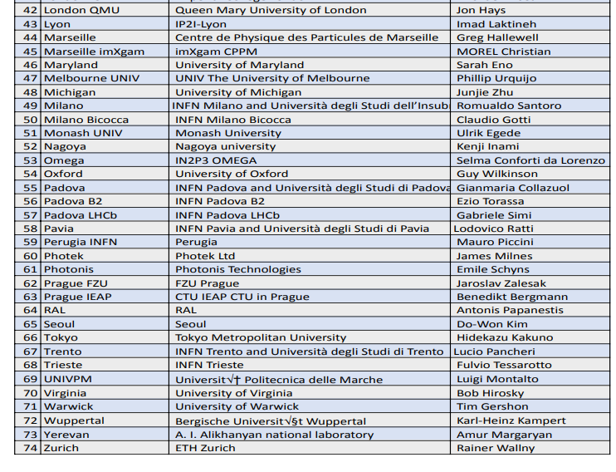
74 institutes expressed wish to become a DRD4 member institute

Slide 4
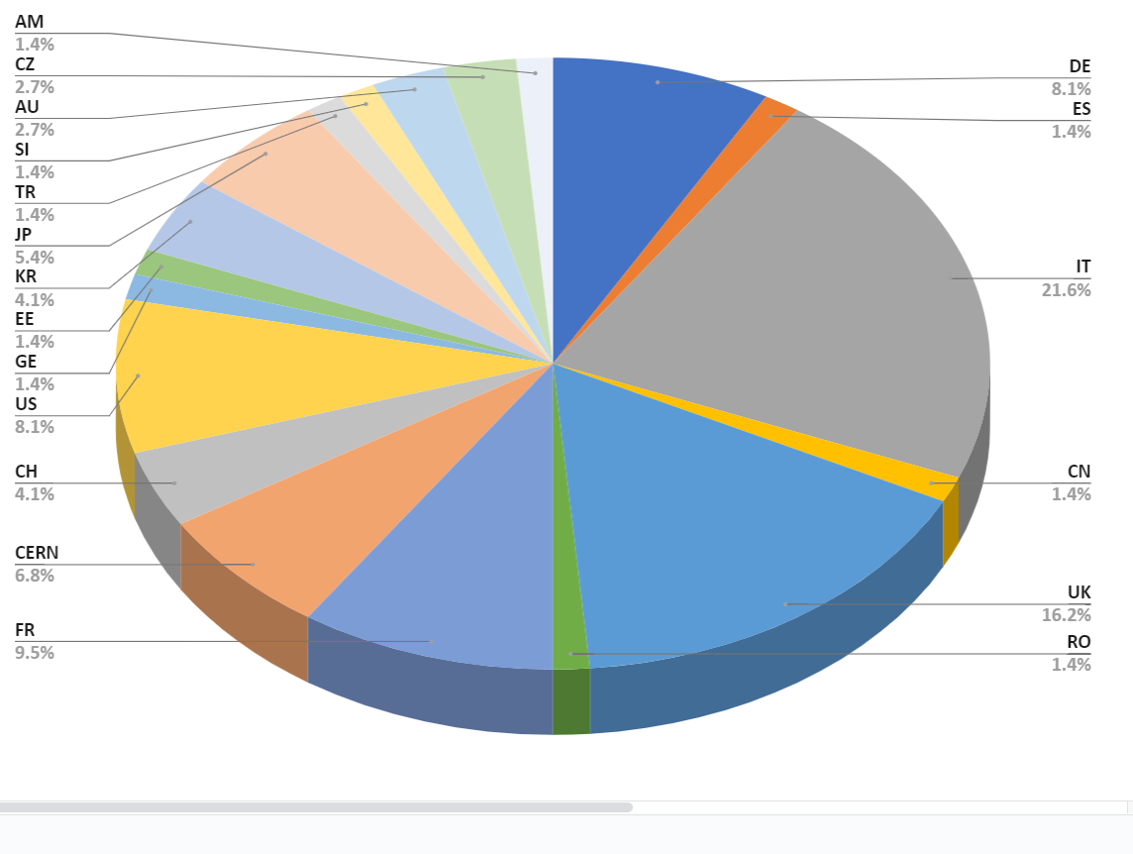
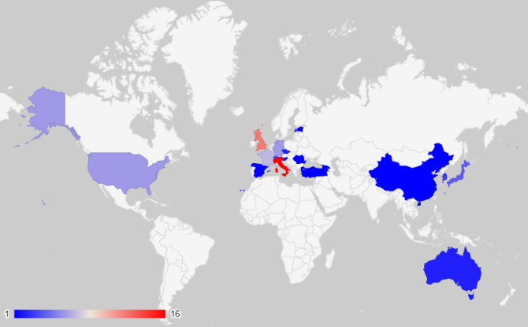
The DRD4 collaboration
74 institutes want to join the DRD4 collaboration. Some more in the pipeline.
19 nationalities
many small groups
No prior experience in large
R&D collaborations

Slide 5
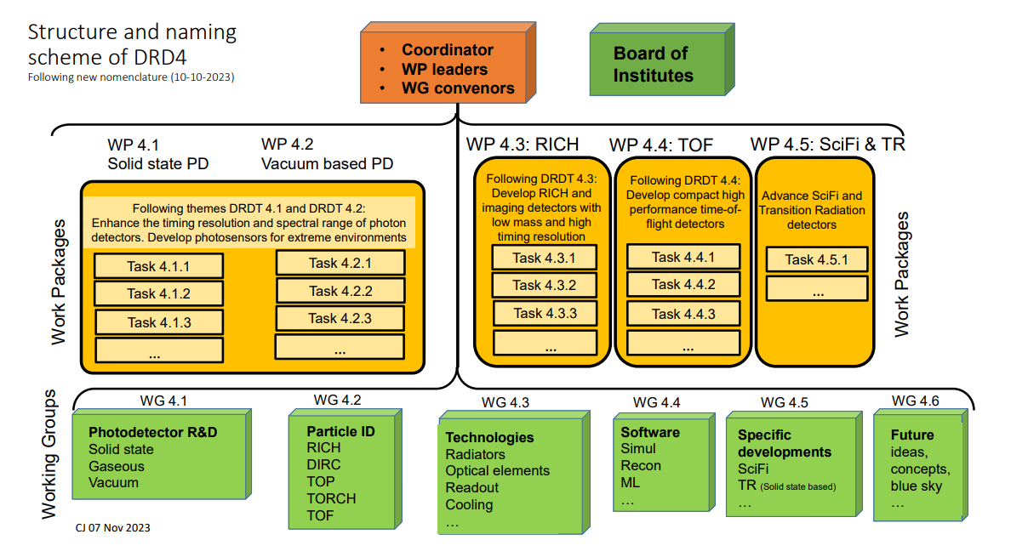

Slide 6
Organisation of the DRD4 collaboration
DRD4 has a dual structure
5 work packages reflecting the main themes and goals described in the ECFA roadmap
  WPs are subdivided in tasks, have a work & resource plan, milestones & deliverables
  Groups commit resources. Joining and leaving a WP entails formalities
6 working groups reflecting the main areas of R&D. WG facilitate exchange of information (from different experiments), samples, students, infrastructure, know-how.
  WGs serve as forums. No agreed tasks, no committed resources.
  We expect many groups to enter DRD4 on WG level and to join a project after some ‘apprentice’ period.
Roles and elections (Constitution meeting on 23 and 24 January 2024)
  Elect DRD4 Coordinator (+ deputy)
  Elect 5 WP leaders (+ deputies)
  Expect task leaders to emerge from tasks
  Elect WG convenors
  Initial terms: 1 year, with the possibility of an extension
  Common fund to be decided on
  Plenary meetings: 3 in 2024, incl. kick-off on 23 and 24 January, then 2 meetings per year

Slide 7
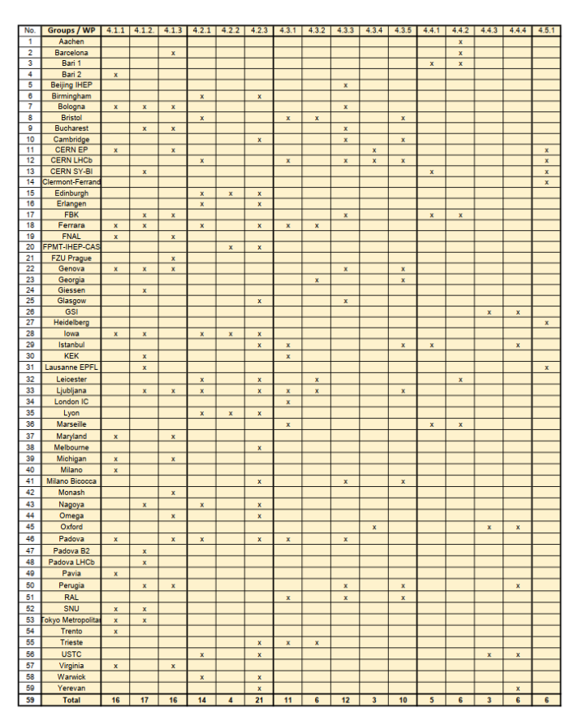
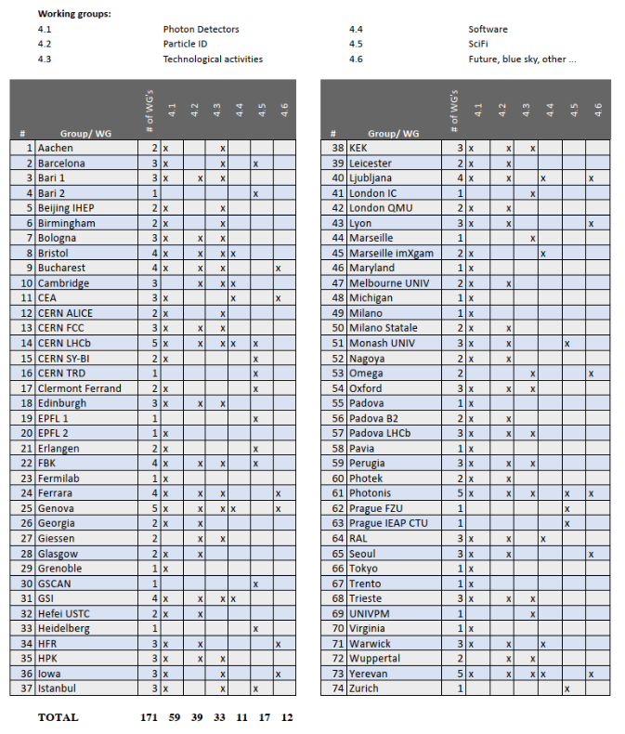
59 DRD4 groups want to participate to one or several tasks.
Average N_{tasks}/group = 2.6
All 74 DRD4 groups want to participate
to one or several WGs. Average N_{WG}/group = 2.3
15 groups join initially only WGs.

Slide 8
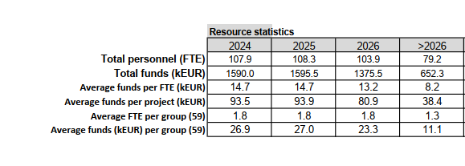
DRD4 resources
The group and resource landscape of DRD4 is rather fragmented
Total personnel = about 105 FTE (per year)
Total funds available = 1.5 MEUR (per year)
Average group size is 1.8 FTE
Average financial resources per task (project) are 90 kEUR (per year)
Average funds per group are 27 kEUR (per year)
➔ Numerous groups need to join forces (FTE + €) to reach the goals.
It will take some time to grow relations and mutual trust.
← Only resources that are
expected to be available

Slide 9
Summary and conclusions
Particle ID remains a key component in modern high energy physics experiments. Often, PID is achieved with Cherenkov and TOF detectors, that in turn often rely on photodetection.
Photodetection is undergoing a strong transformation. SiPMs invade in fields of applications that were occupied since decades by vacuum and gas based devices.
The DRD4 proto-collaboration has formed and proposed a broad but focused R&D program on photodetectors and particle ID devices.
Since RD26 (1992) “Development of a Large Area Advanced Fast RICH Detector for Particle Identification at the Large Hadron Collider Operated with Heavy Ions” this is the first international R&D collaboration in this field.
The scope of DRD4 includes also SciFi tracking and Transition Radiation detectors. They fit well into DRD4.
74 groups from 19 countries, with a lot of relevant background, are prepared to become collaboration members.
Their small average group size and scarce resources are a concern.
The success of DRD4 will also depend on the ability of the groups to grow and to find additional resources.

