Slide 1
WP4.2
Vacuum Photo-Detectors
M. Fiorini, S. Gambetta, I. Laktineh

Slide 2
DRD4 – WP 4.2 – Vacuum Photo-Detectors (VPD)
VPD are still the fastest photon detectors
Their intrinsic spatial resolution is not yet well exploited
We want to better exploit the current VPDs and develop a new generation with better time and spatial resolution to prepare for future experiments and use in many applications
23 groups joined this WP and several industrial partners showed their interest to help achieve our goals.

Slide 3
DRD4 – WP 4.2 – Vacuum Photo-Detectors (VPD)
4.2.1: VPD: New material, new coatings, longevity and rate capability study
  This concerns the R&D on new materials to produce VPD, new shapes and new coatings and their consequences on their longevity and rate capability
4.2.2: VPD-PMT: New photocathode materials, structure and high quantum efficiency VPD
  New photocathode materials, new structures and their impact on improving the quantum efficiency for different wavelengths
4.2.3: VPD time and spatial resolution performance
  Study of VPD timing and spatial performance using appropriate readout electronics and appropriate anode structures

Slide 4
DRD4 – WP 4.2 – Vacuum Photo-Detectors (VPD)
4.2.1: VPD: New material, new coatings, longevity and rate capability study
  This concerns the R&D on new materials to produce VPD, new shapes and new coatings and their consequences on their longevity and rate capability
Milestones:
M4.2.1.1 Report on state-of-the-art technologies to produce electron multipliers with excellent timing and spatial resolutions (M18)
M4.2.1.2 Report on state-of-the-art long lifetime and high-rate capability VPDs (M24)
Deliverable:
D4.2.1 Prototype production of a new generation of MCP-PMT using innovative techniques (M36)

Slide 5
DRD4 – WP 4.2 – Vacuum Photo-Detectors (VPD)
4.2.2: VPD-PMT: New photocathode materials, structure and high quantum efficiency VPD
  New photocathode materials, new structures and their impact on improving the quantum efficiency for different wavelengths
Milestone:
M4.2.2 Realization of a reflective photocathode with granular structure of a few microns pitch (M24)
Deliverable:
D4.2.2 Production of photocathodes made of different materials using either granular structure or different structure (M36)

Slide 6
DRD4 – WP 4.2 – Vacuum Photo-Detectors (VPD)
4.2.3: VPD time and spatial resolution performance
  Study of VPD timing and spatial performance using appropriate readout electronics and appropriate anode structures
Milestone:
M4.2.3 Design of read-out electronics capable to reach O(10 ps) timing resolution (M24)
Deliverable:
D4.2.3 Production of a read-out system demonstrator able to fully exploit timing and spatial resolution of MCPs (M36)

Slide 7
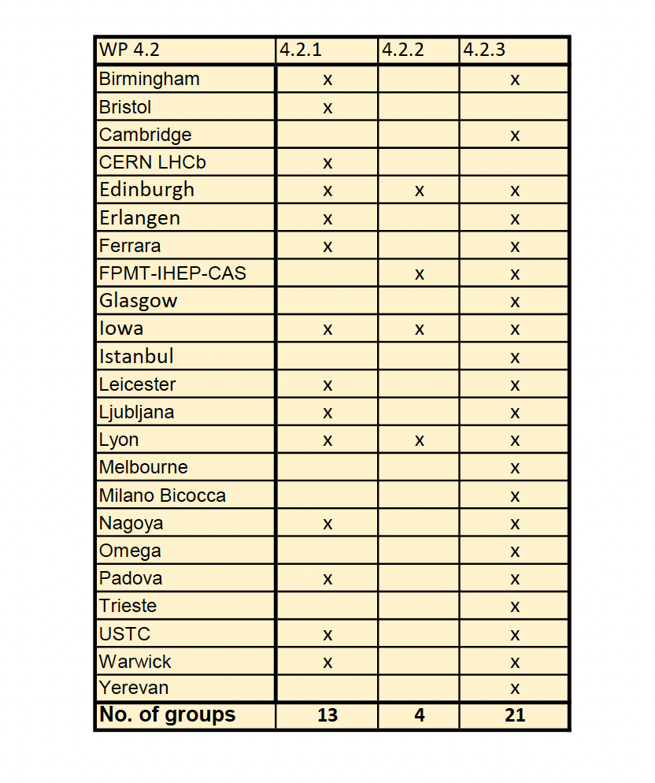

Slide 8
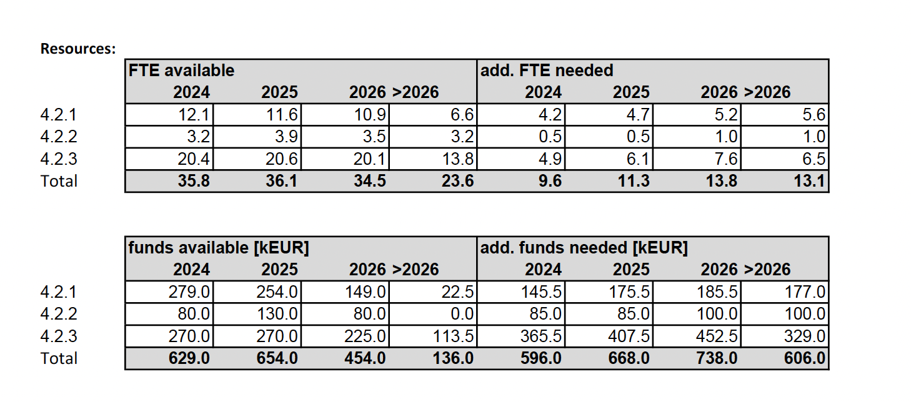

Slide 9
Next steps
We should start organizing ourselves in the coming weeks with all WP4.2 groups to:
  Assess where we stand and establish an inventory of what we have already achieved and the tools at our disposal.
  Share responsibilities for the different milestones and deliverables
  Structure the way to work together and organize exchange with industrial partners
  Structure the way to work with the WG1 and WG6

