Slide 1


Review of WG 4.2
DRD4 meeting
From C.Joram and S.Easo
On behalf of the preparation team
S.Easo
23-01-2024

Slide 2
Preamble
Reliable particle identification (PID) has become an indispensable tool for some of the HEP experiments
In the future, physics results from high luminosity colliders to underground facilities require new generations of PID
detectors that would cover a large momentum range from a few hundred MeV/c to above 100 GeV/c.
Recent advances in photon detector technology and their readout electronics, offer opportunities for designing new PID
detectors with unprecedented levels of performance.
Main goals of this WG:
Develop advanced PID techniques.
Discussions of common issues related to PID among different experiments.
Validate the usage of novel photon detectors that are being developed in DRD4 for PID.
Current status:
In the DRD4 proposal, 39 groups have expressed interest in this WG.

Slide 3
Remit of this WG :
The techniques used for PID in all Cherenkov-based and Time-of-Flight (TOF) detectors.
These include RICH, DIRC, TOF,TOP, TORCH and any new concepts
Some of the common challenges for different PID techniques:
Optimal optical design
Need to detect single photons
Development and usage of new radiators
Issues related to mechanical integration
Efficient operation of new detectors
Making use of fast timing
Selection of a PID technique depends on many factors
Examples : Momentum range, available space and budget, photon detector technology

Slide 4
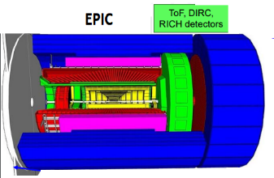
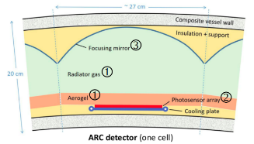
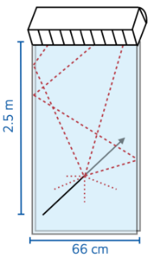
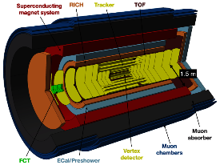
Examples of new detectors and new designs
ePIC
EIC
FCC
TORCH in LHCb
ALICE 3

Slide 5
Plans
It is envisaged that this WG will be a forum that will facilitate :
Discussions on advanced PID techniques
Design of detectors that will operate in high luminosity environments
Example : LHCb in Upgrade2
Development of new RICH concepts
Examples: ‘pressurized argon RICH’, TORCH
Studies that evaluate the impact of time-resolved readout for future RICH detectors
Calibration and alignment of Cherenkov detectors, in online and offline
This WG will focus on evaluating the achievable performance and intrinsic limitations of new designs.
This will be done using simulations.
Typical design process for a new detector :
Start with fast simulations or analytical calculations
Move on to full simulations using GEANT4
Develop PID algorithm and use it to evaluate the performance of the simulated data

Slide 6
Plans
It is expected that the results from the activities of this WG be useful for other working groups in DRD4.
This WG gives the opportunity to :
+
Help new members to gain experience in detector design and software.
Enable the exchange of ideas among experiments to develop novel detector concepts.
These can lead to the creation of new WPs.
Issue:
--
At present there are only very few people with the relevant expertise on various PID techniques. It may be difficult for them to provide voluntary support over extended periods of time to train new members in the WG.
Expecting regular discussions among active members of this WG

