Slide 1

Review of WG 4.4
DRD4 meeting
From C.Jones and S.Easo
On behalf of the preparation team
S.Easo
23-01-2024

Slide 2
Introduction
Goals:
Develop the software related to the next generation of detectors to be designed in DRD4.
Make use of the recent advances in software technologies for the simulation and analysis of data.
Some of the topics considered:
Explore the use of the machine learning techniques to improve PID algorithms.
Develop software that runs on hardware such as GPUs to speed up simulation and reconstruction.
This would be useful for Cherenkov detector projects that will simulate and reconstruct billions of events.
Simulate the next generation of photon detectors and their readout.
Create a framework to evaluate the new algorithms that will be developed on different software platforms.
Development of algorithms for real-time data analysis and detector calibration
Creation of new software tools that may be of interest in WG 4.2 for new PID techniques
In the DRD4 proposal, 11 groups have expressed interest in this WG

Slide 3
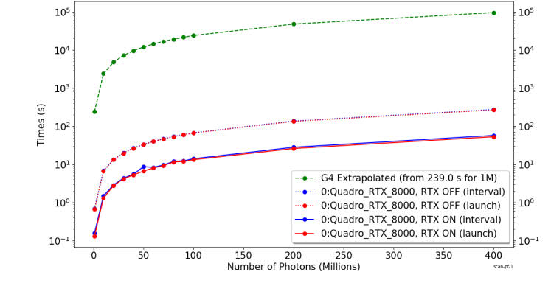
Example of the speedup in CPU time achieved in optical photon simulation using GPUs for a Cherenkov detector.
Simulation time vs number of photons
Green: GEANT4 alone
Solid Red: GPU with RTX
Dotted Red :GPU without RTX
Speedup factor above
1600 obtained with GPU usage
Ref: S.Blyth,
EPJ Web Conf, 251 (03009) , 2021
From JUNO experiment
Using ‘OptiX’ + ‘Opticks’ + “GEANT4’
Recently, this technique was used in LHCb, for a simplified RICH system as a proof-of-principle.
This has shown great potential for speedup. Details in
Eur.Phys. J.C (2023) 83: 1036
Some groups in USA are also using this method.
Other similar methods are also being explored.

Slide 4
Plans
This WG may facilitate :
The exchange of new ideas in software
Share experiences from software developments in different projects
Develop software packages of common interest to the DRD4 community
+
When appropriate, the WG members may collaborate with experts
from other software organizations such as :
WLCG (Worldwide LHC computing grid), HSF (HEP software foundation), GEANT4 collaboration
Some of these developments may result in the creation of new software WPs
Issues:
--
Addressing some of the topics may need significant investment in time.
The relevant experts may not always be available to the WG to develop the software for this.
Expecting regular discussions among active members of this WG

