Slide 1

23 January 2023
DRD4 – Detector R&D Collaboration on
Photodetectors and Particle ID
+ SciFi tracking + Transition Radiation
Interlinks with other DRDs
C. Joram

Slide 2
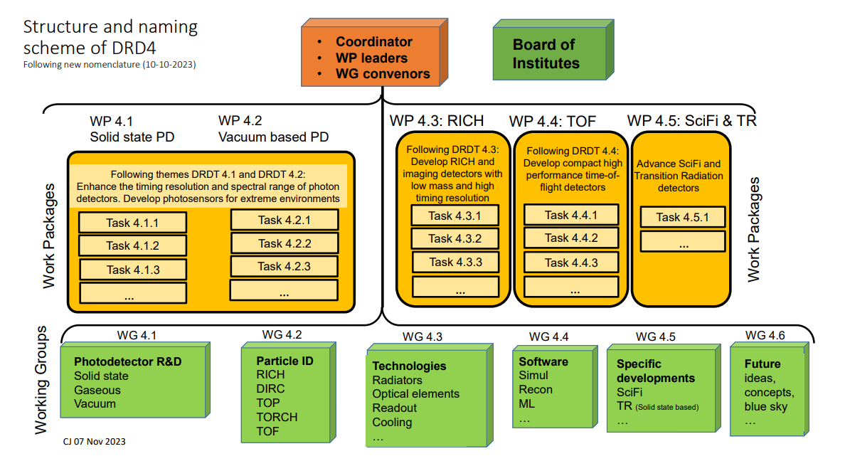

Slide 3
DRD4 is a collaboration covering a variety of topics
Photodetectors (vacuum, solid state, hybrid), single photon sensitive
Particle Identification (PID) techniques (Cherenkov based, Time of Flight)
Scintillating Fibre (SciFi) tracking
Transition Radiation (TR) using solid state X-ray detectors
Scope
DRD4 does not perform active R&D but follows with interest …
Gas based photodetectors → DRD1, e.g. Picosec
Gas based PID, e.g. dE/dx, TR → DRD1
SiPM for cryogenic noble gas temperatures → DRD2
LGAD R&D for TOF → DRD3
DRD7 will provide advice and expertise but will not develop ASICs for us.
Outside Scope
I expect cooperation between DRDs to increase as of the 2nd year. In 2024 we are busy to organise ourselves.

