Slide 1



Digital single photon detector with highest sensitivity
Fabrice Retiere (TRIUMF)
Work done within the PHoton for Astro-particle and Applied Research (PHORWARD) group at TRIUMF
Collaboration with U.Sherbrooke (QC, Canada) for the Photon to Digital Converter

Slide 2
Aim: Digital SPAD arrays
Photon
Bias
Scalability
  High cumbersome analog solution when area > few m²
High performance
  Timing resolution and re-triggering
  Eliminate after-pulse
  Lowest dark noise
Address specific SPADs
  Position reconstruction
  Wavelength filtering
Amplifier
Need power
to buffer
capacitance
Analog to Digital
Conversion
Comparator (more power)
Waveform digitizer
Photon search engine
In software or firmware
~0.1nF/mm²
Photon time stamp
Photon
Bias
AQ
Active
Quench
Photon time stamp
Digital processing

Slide 3
Aim: back-side illuminated SPAD arrays
Front Side illumination (ala Sherbrooke)
photon
Thin passivation ~100nm
e⁻
Ultra-thin contact 1-5nm
Low drift field region
h
e⁻
Drift field region
Versatility
  Visible to IR via thickness control
  Deep UV through Back-side surface processing
    Unconventional Anti-reflective coating: black silicon, graphene, 3D structures
  Non-photon detection
    Minimum ionizing
    keV scale electron (hybrid photo-detector)
    Dark matter
Avalanche region
Molecular bonding
CMOS
Aka. electronics
Back side illumination
photon
Thin passivation ~100nm
Ultra-thin contact 1-5nm
Low drift field region
e⁻
e⁻
Drift field region
Avalanche region
Molecular bonding
CMOS (in 2D or 3D)
Aka. electronics
3

Slide 4
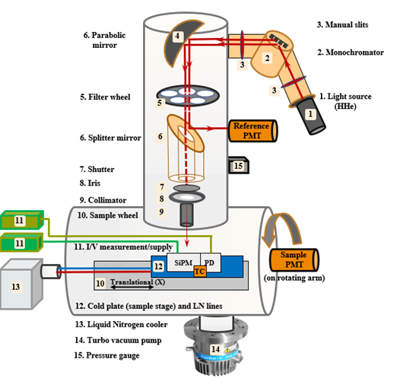
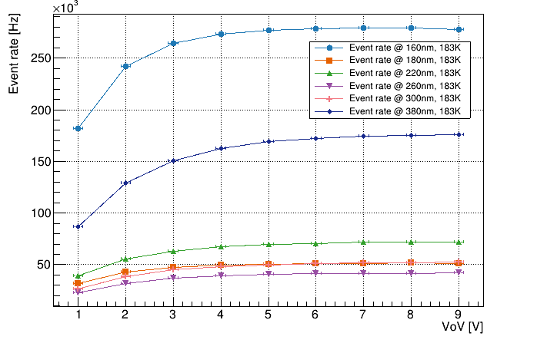
Asset: Vacuum Ultra-Violet Efficiency reflectivity and Absorption setup (VERA)
For example: inferring the number of electrons produced per VUV photon

Slide 5
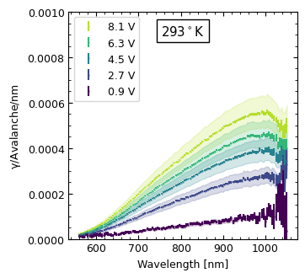
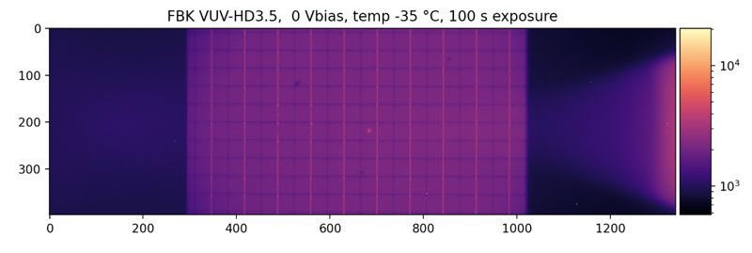
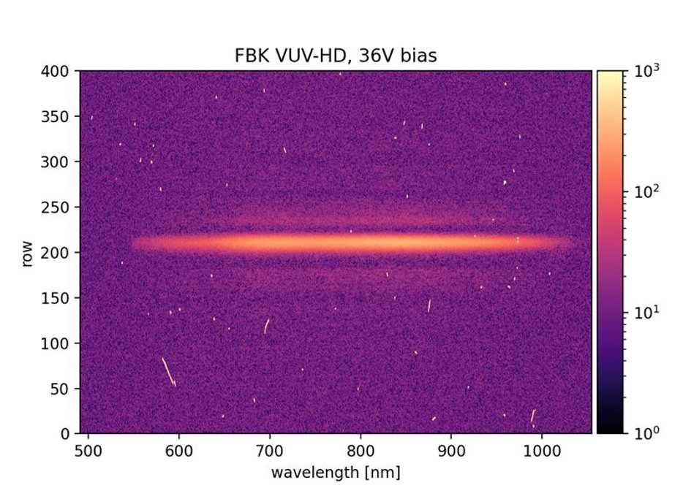
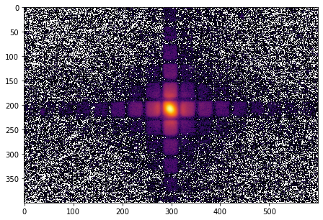
Asset: MIEL
Cooled X-Y Stage
SPAD
Vacuum Window
SiPM Surface
Vacuum Chamber
Objective
FBK Reflected Light and Laser Spot
Dichroic Mirror
Tunable laser
300 - 1500nm
Emission Filter
Emitted Light
IX-83 Microscope
Diffraction
Grating
B)
A)
Spectroscopy
Imaging
Spectrometer and Cryogenically Cooled Camera
2D Emission Map

Slide 6
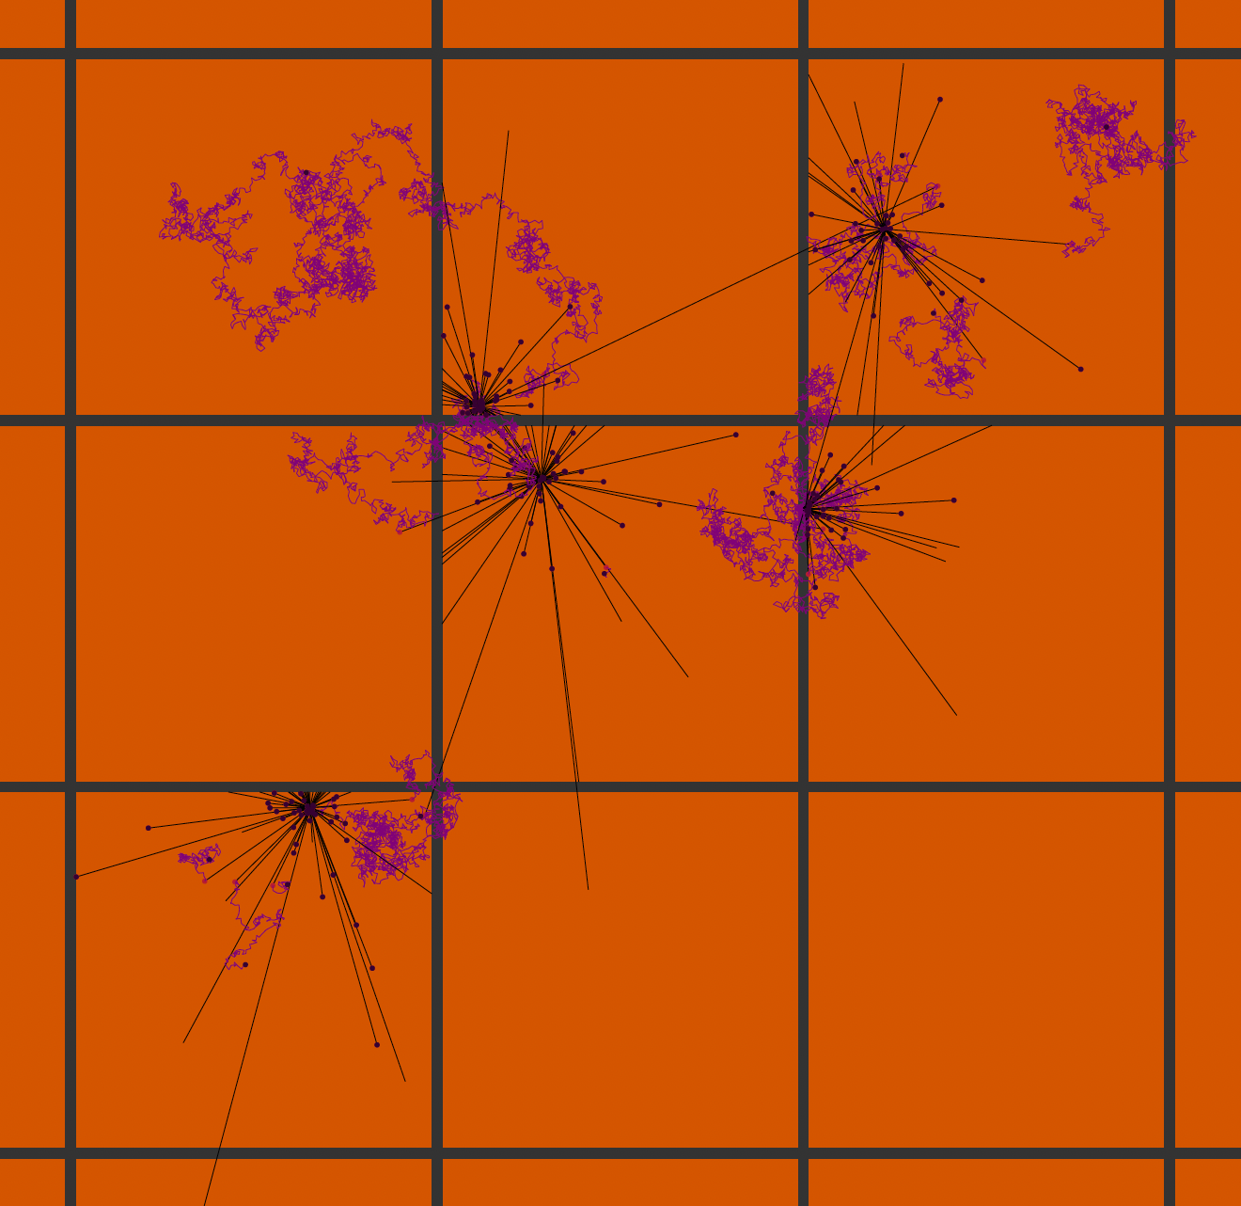
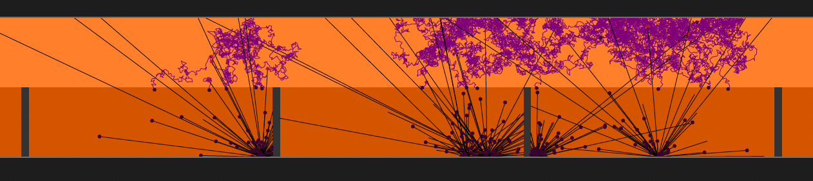
Assets: simulations
Example: QLADS used with diffusion region on top for MIP detection (ASGAP concept)
Collaboration with ANSYS – Lumerical
Development of ”Quanta Level Avalanche Diode Simulator” (QLADS)
  Mixing charge carrier and photon transport
  U. Alberta, TRIUMF, U. Victoria
  Current focus on non-photon applications: Minimum Ionizing, keV electrons and dark matter

Slide 7
Act: from concept to design to implementation
Analog BSI
  FBK + BSI processing at Teledyne-e2v
  Other option
2D implementation. Hoping to establish collaboration
  Heidelberg (Peter Fischer) + Fraunhoffer
  Use Lfoundry process in collaboration with DESY?
2.5D with FBK?
3D implementation
  Teledyne-DALSA + Sherbrooke: focus on front-side illuminated will likely continue for several more years
    New Canadian grant to expand access to DALSA. Results in April 2024.
  Establish collaboration with EPFL?

Slide 8
Act: finding a path to making BSI SPAD
Find one or more facility to make prototypes
Simulate implementation and physical processes as well as possible
  Fairly clear path forward for that
Deal with Intellectual Property
  By now, most ideas have been claimed
  But ownership is not always clear
  Major roadblock overall
My hope is that we can build a functional collaboration within DRD4 to develop high performance digital BSI SPAD array in less than 5 years

Slide 9
Act: development and funding strategies
Our (Canadian) funding situation
  Ongoing project funding
    nEXO and liquid Argon (DarkSide) supporting SiPM testing infrastructure and Sherbrooke Photon to Digital Converter R&D
  Some R&D funding
    SuperContinuum laser development
    Preparing new “Innovation Driven Integrated Detector” major request
  Some tech transfer funding
    Neutron detector for General Fusion
    Early Forest fire sensing system
Lacking funding and path forward for new detector fabrication
  Canada is now part of Horizon program
    Not exactly sure what it means
    But may be a path forward
  Can we pull resources together?
    Fabrication
    Design
    Characterization
Task 4.1.x → enabling the digital SPAD array revolution in PP/NP

Slide 10
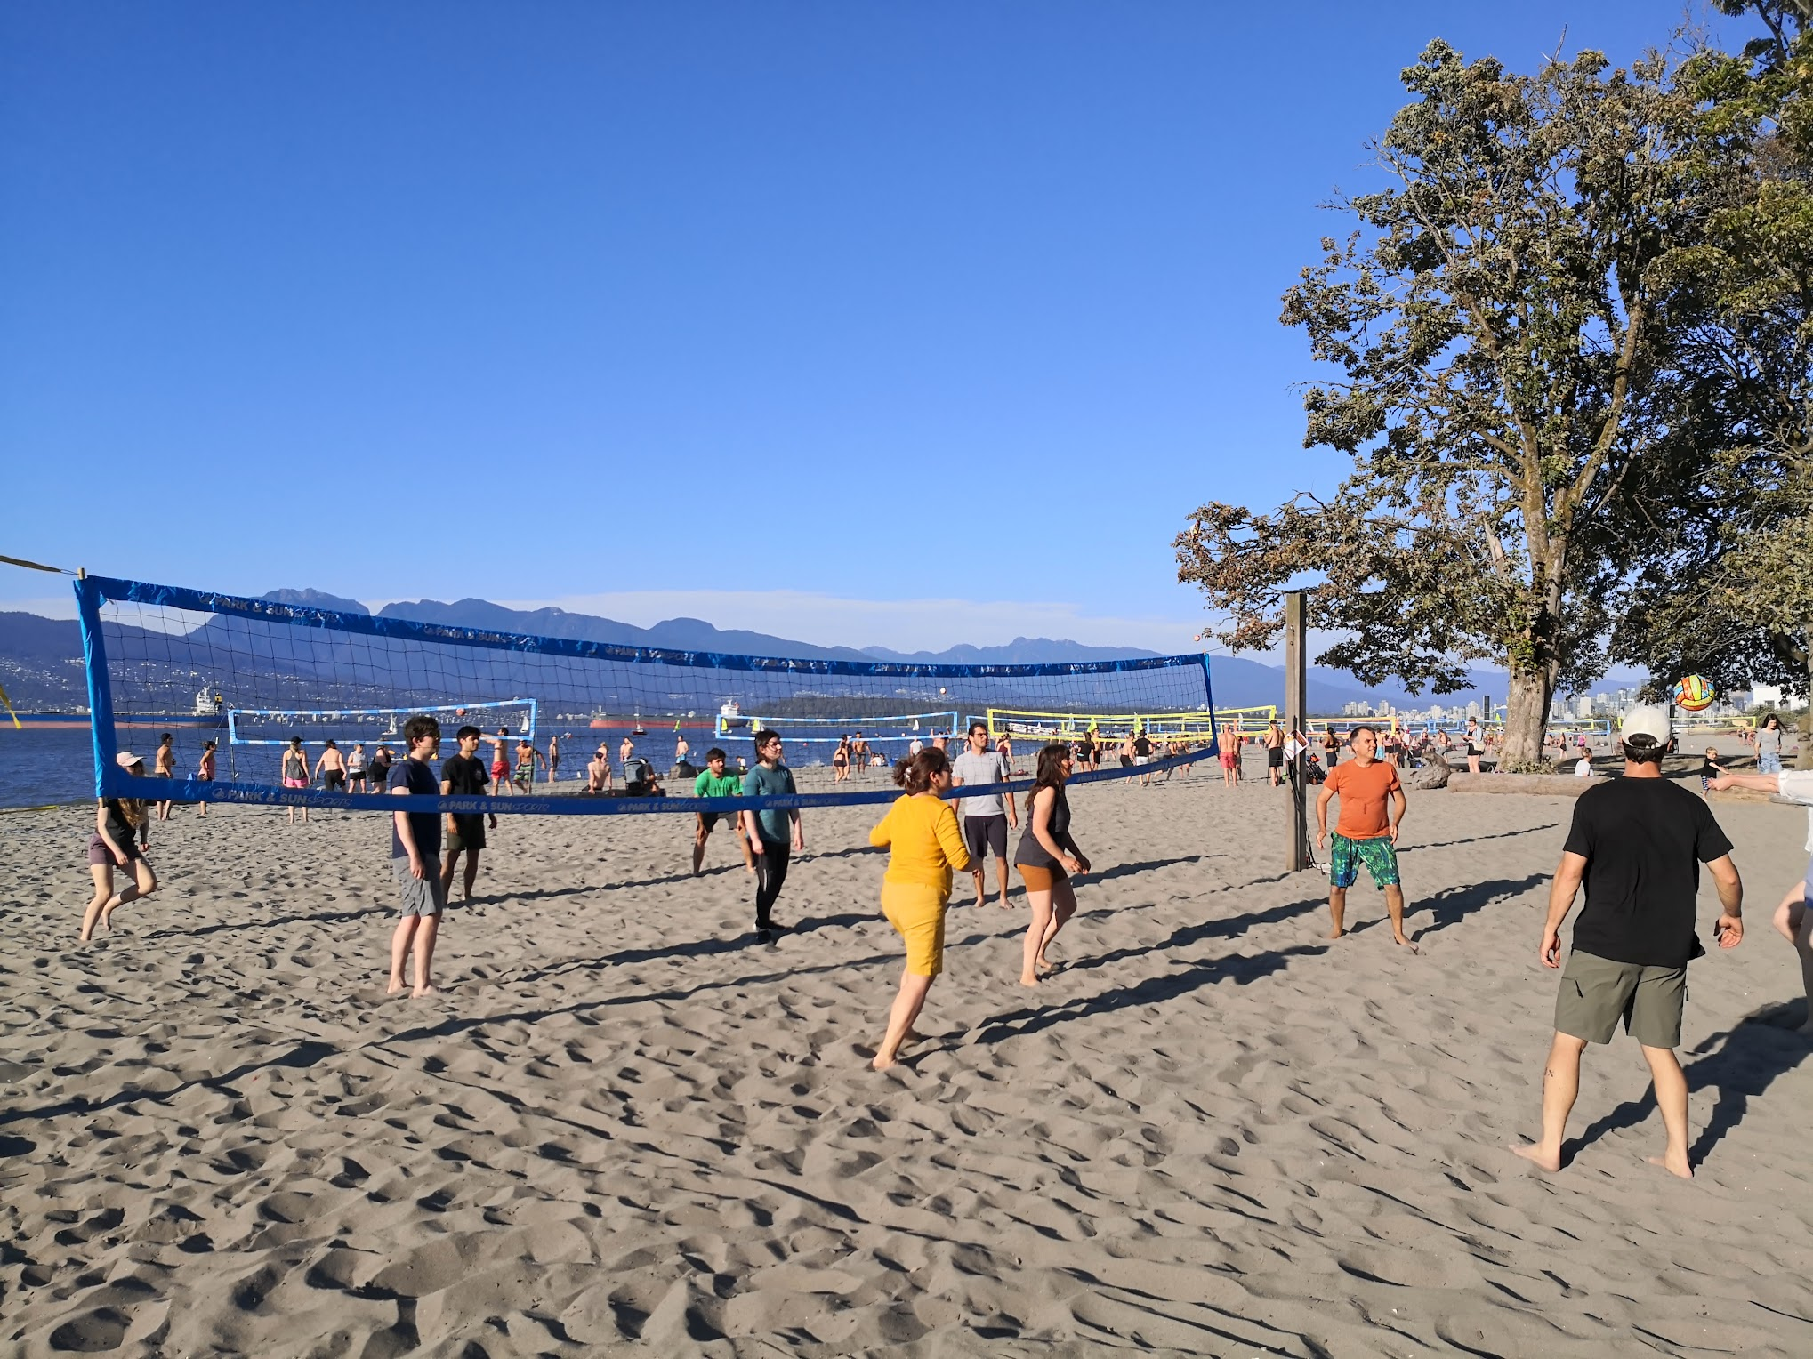
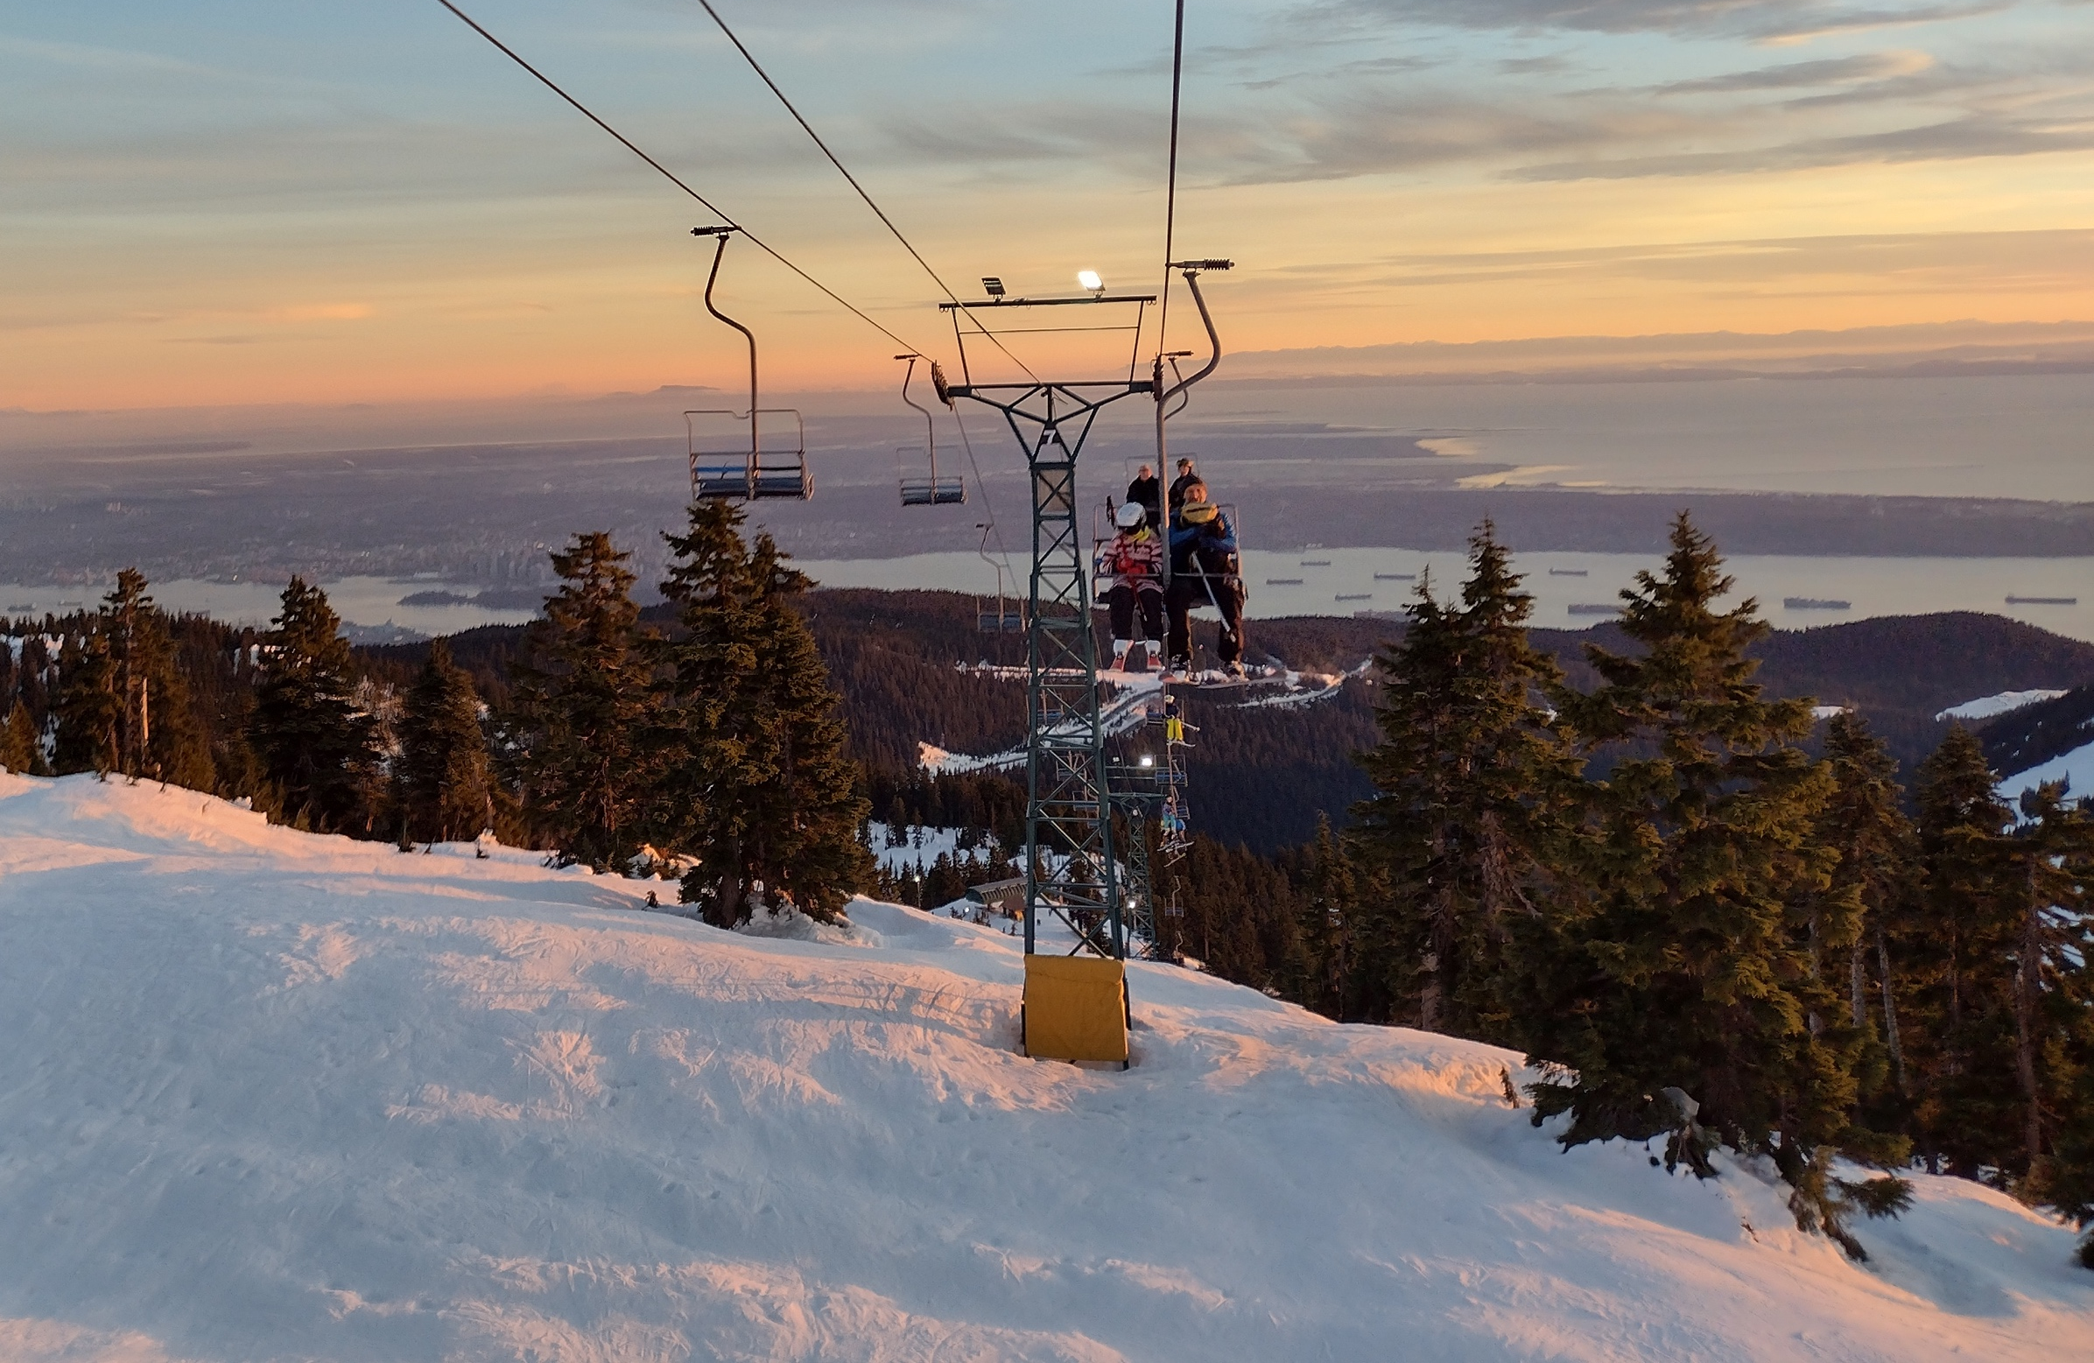
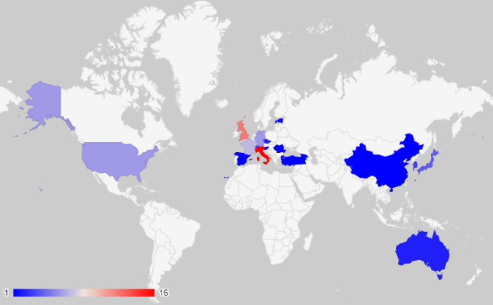
The end

Slide 11
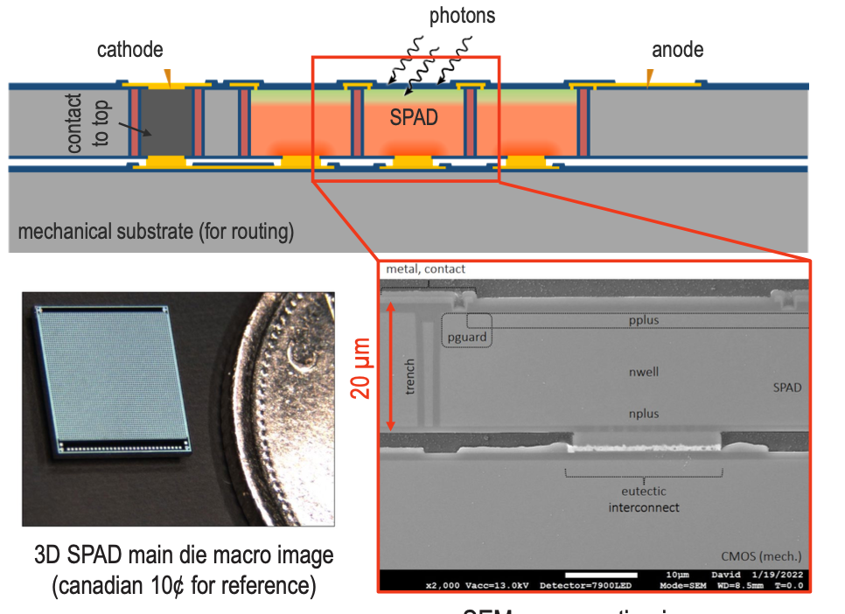
Building upon Photon to Digital Converter
PDC developed for Astro-particle physics
“Front-side” illuminated single photon detector
Designed at U.Sherbrooke (QC, Canada)
Built at Teledyne-DALSA (QC, Canada)
Parent, Samuel, et al. "Single photon avalanche diodes and vertical integration process for a 3D digital SiPM using industrial semiconductor technologies." 2018 IEEE Nuclear Science Symposium and Medical Imaging Conference Proceedings (NSS/MIC). IEEE, 2018.
JF Pratte NSS 2022 plenary talk

Slide 12
Mitigation strategies
Minimize diffusion region thickness → limited by efficiency requirements
Absorb photons at front and back surface
Absorb photons in trenches
  The smaller the pitch the better
Minimize production by running at lowest possible gain
  Gain scales by diode capacitance so the smaller the better
Absorb photons at surface
Absorb photons
in trenches
CMOS – ch 0
CMOS – ch 1
CMOS – ch 2

Slide 13
Quanta-Level Avalanche Diode Simulator (QLADS) for ASGAD
Charge particle simulation
  Use Bichsel cross-section for 45 GeV/c pions
  Normal incidence randomly over all area
Dark noise
  Assess the probability distribution function for the number of avalanches produced by 1 seed avalanche
  Use 50 Hz/mm² for scale
Electron transport
  Random walk
    Diffusion constant = 3.9 um²/ns
    Electron life time = 100 ns
  No explicit EField
Photon from avalanches
  Vary average number of photons per avalanche + Poisson statistics
  Use measured spectrum
  Track photons but absorb on all surfaces
    Simplest but not most conservative

Slide 14
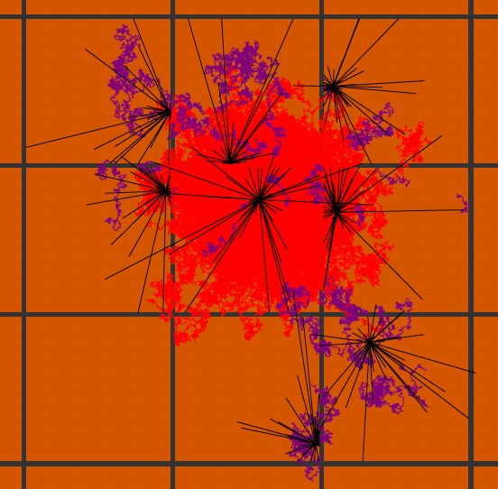
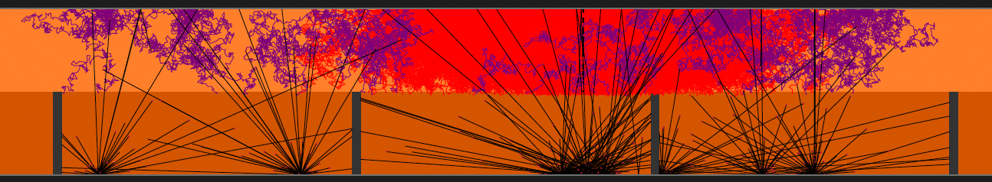
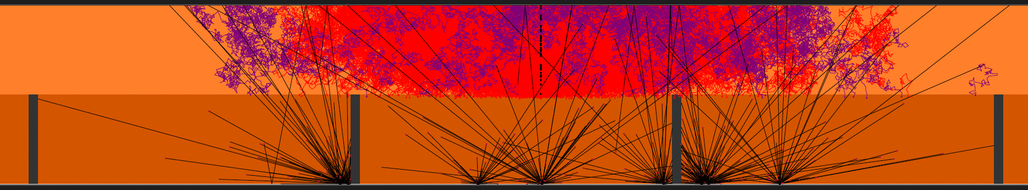
Event display
Sam de Jong (UVic)
Primary e⁻ in red
e- from photons in purple
MIP
Single seed avalanche

Slide 15
Beyond ASGAD – Back-side illuminated for everything
p+
p
p-epi
p-epi
Even dark matter search
n+
n
Poly
SiO2
100-500 um
Electron trajectories
Geiger mode avalanche
Hole trajectories
Linear avalanche
VUV – Blue photon
Charged particle
Neutron or dark matter
5-50um
Un-depleted
depleted
80um
5-20um
CMOS
CMOS
CMOS
CMOS
Front side avalanche diode
Back side avalanche diode
Extended
Ultra-thick

Slide 16
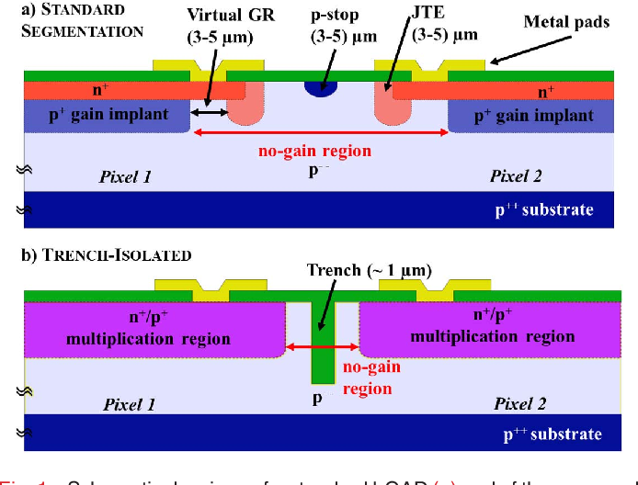
From trench isolated LGAD to Single Photon Avalanche Diode
Picture of a SPAD from the Photon to Digital Converter system
G. Paternoster et al. 10.1109/LED.2020.2991351

Slide 17
Wavelength that are problematic

Slide 18
The 3D integrated master plan

Slide 19
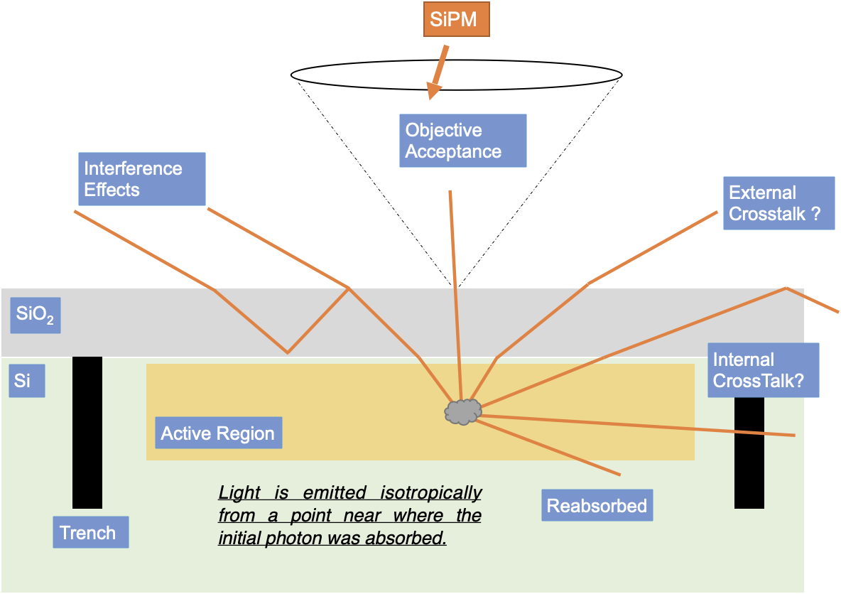
Light emission to crosstalks
Single Photon Avalanche Diode
Light emission assumptions:
  At p-n junction – maximum field
  Isotropic
External cross-talk
  Photon escaping the SiPM surface
Internal cross-talk
  Photons being absorbed in a neibhoring SPAD
We measure photons escaping with objective acceptance

