Slide 1
CERN’s Campus Services
CNPEM visit
Laetitia Lejeune & Cédric Garino SCE-SSC
CERN, 4th of December 2023

Slide 2
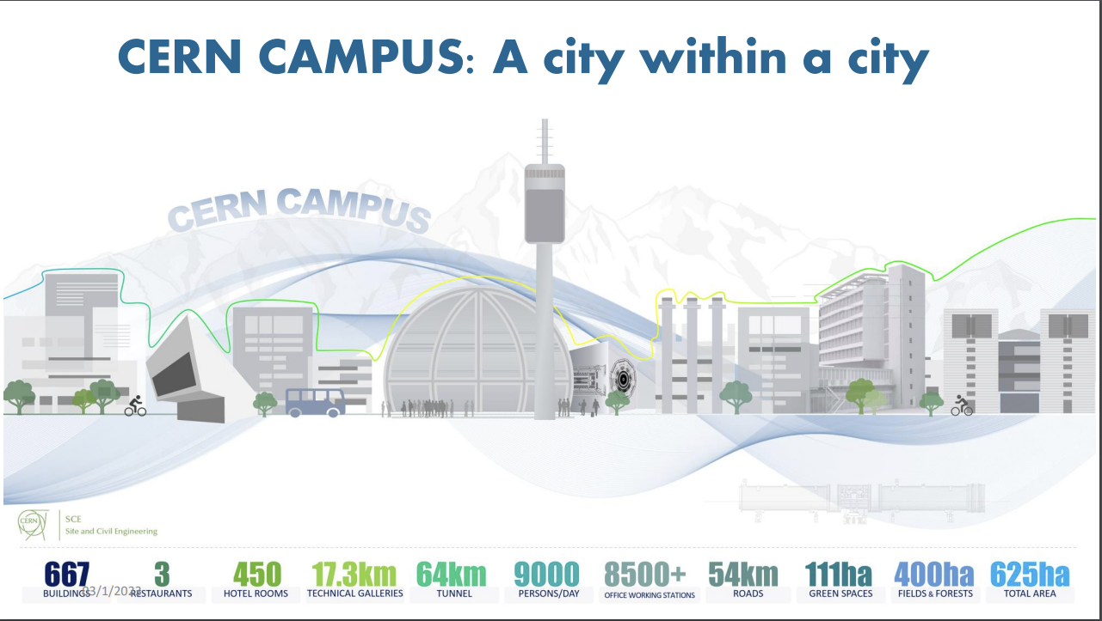
Agenda
Waste management
Mobility
Housing
Catering
Supply chain & logistics

Slide 3

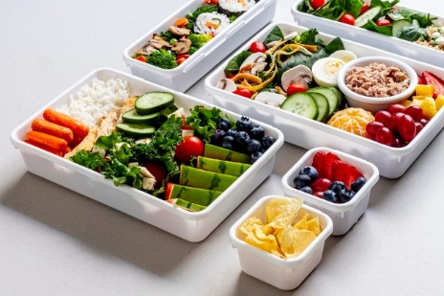


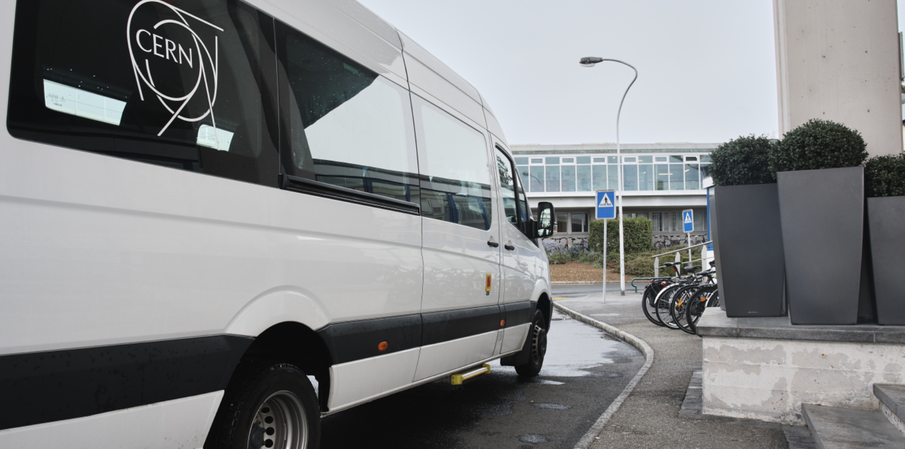
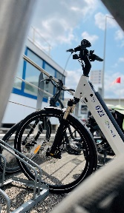
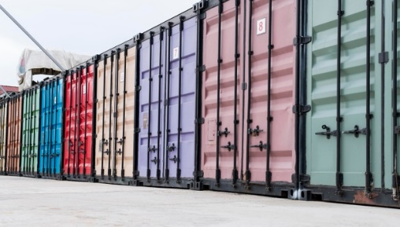

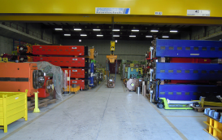


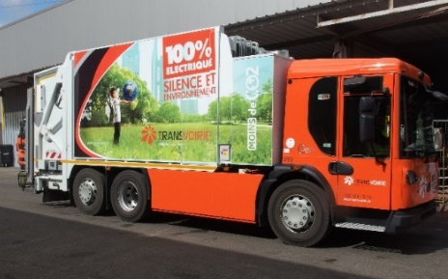
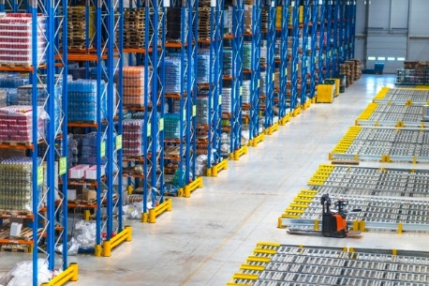

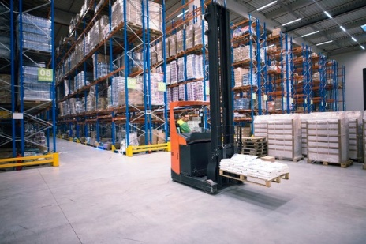
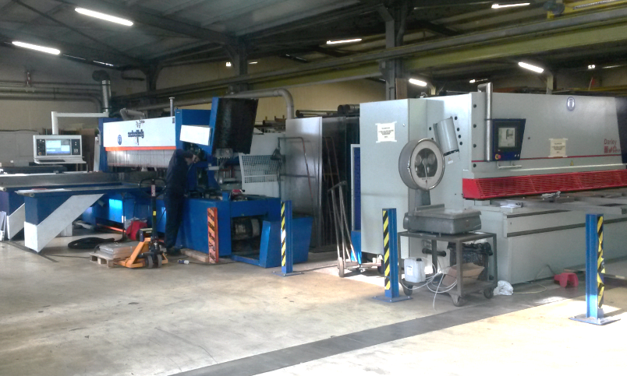
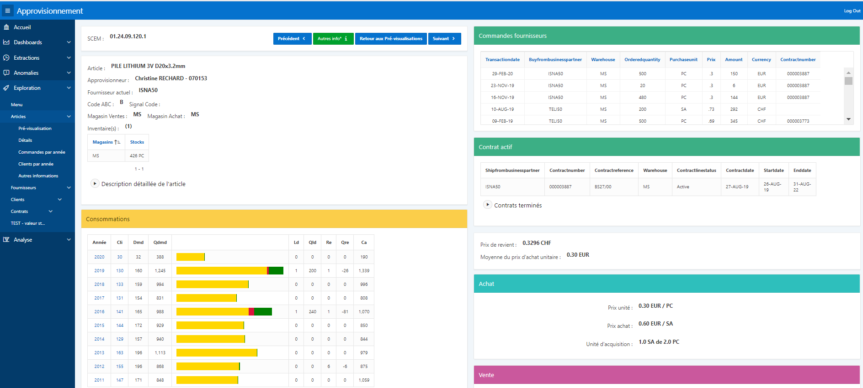

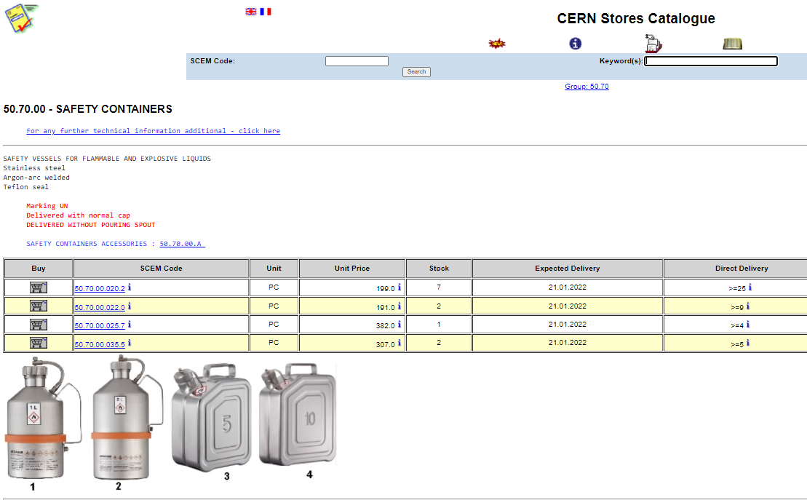
Context: Services & Supply Chain group
Provides the CERN’s community with high standard campus experience and optimal industrial supply chain execution by offering the following rationalized, efficient, and transparent services:
installation | housing | catering | mobility |  | shipping
storage | mail | cleaning | waste management | goods reception | internal distribution
central stores | raw materials | replenishment |  | sales and recuperation | referencing

Slide 4
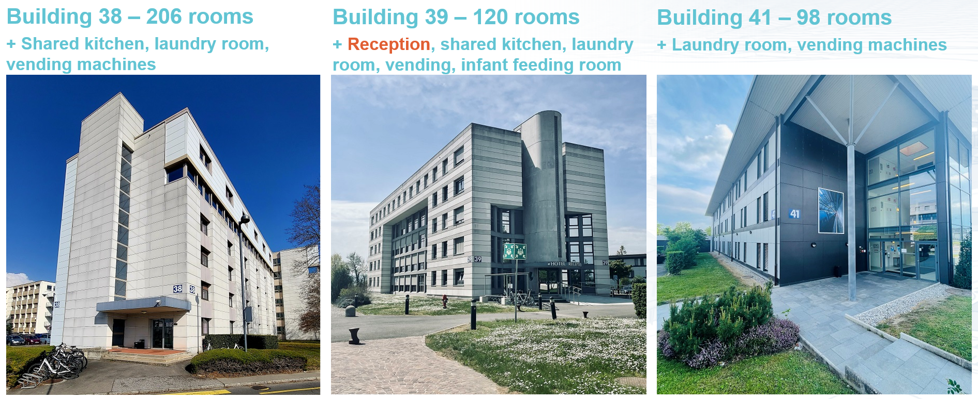
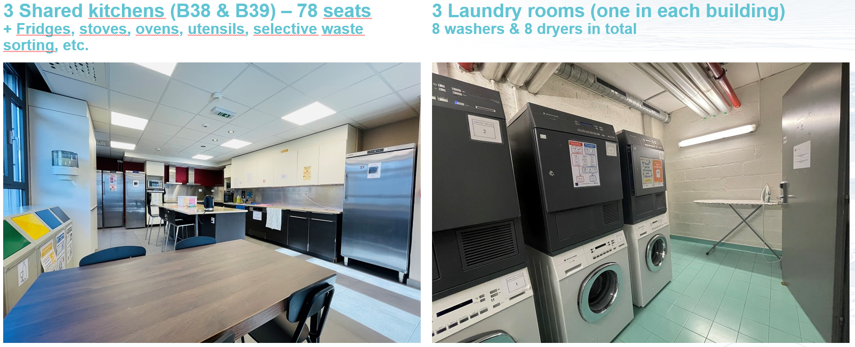
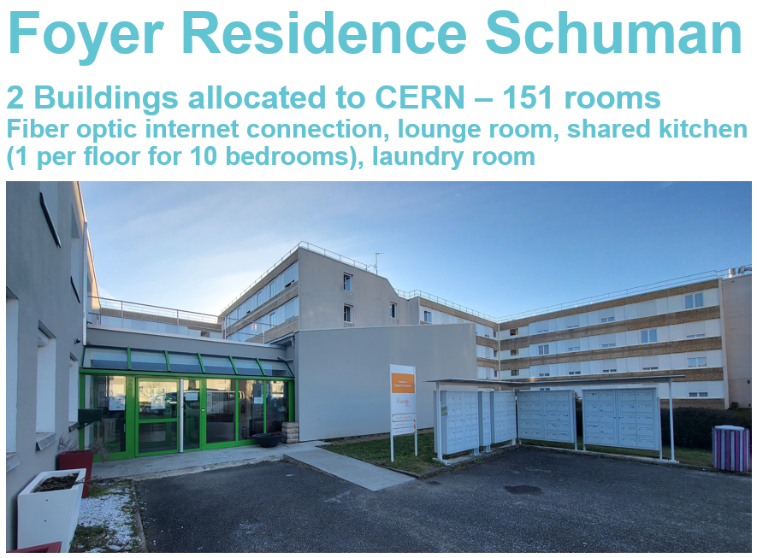
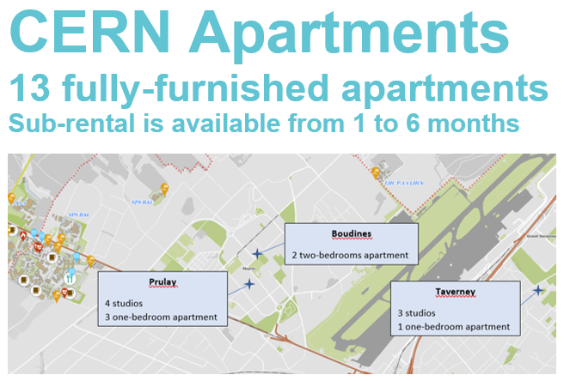
Housing
Hotels on Meyrin Site
Reception
Outside CERN
CERN Apartments
13 fully-furnished apartments
Sub-rental from 1 to 6 months

Slide 5
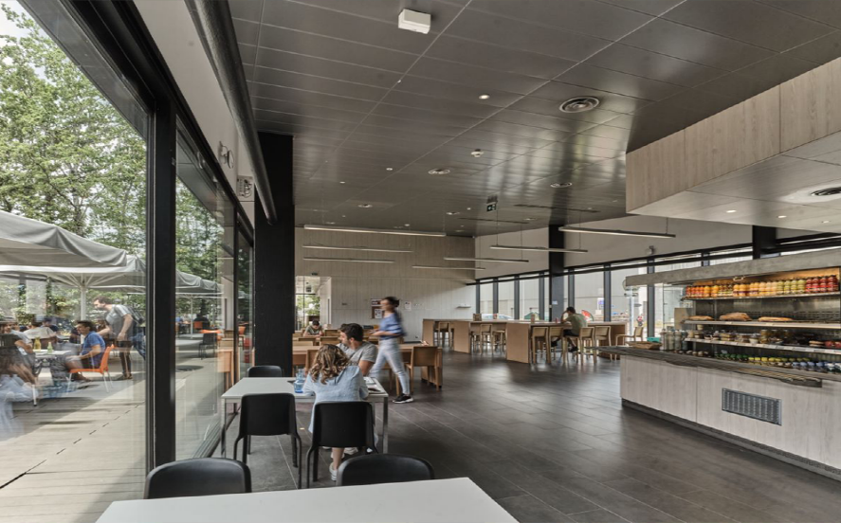
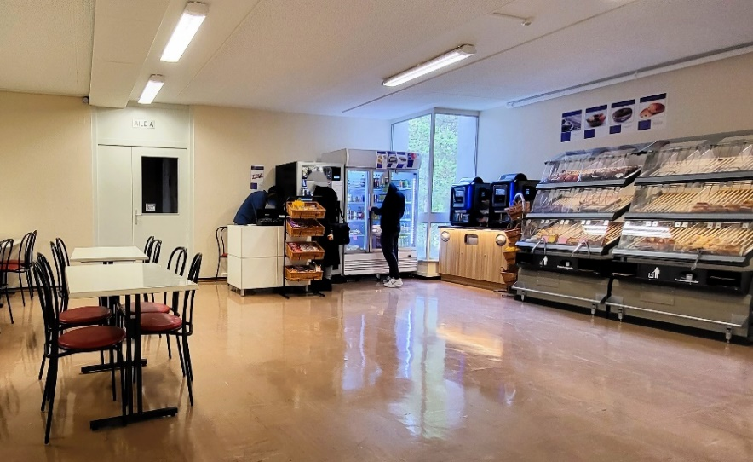
“CERN’s catering strategy and objectives are to provide, at a reasonable price, a range of options answering the catering needs of every person entering the CERN site. The term catering covers all forms of food and beverage in the broad sense.”
Catering
OBJECTIVE: Increase the offer of vegetarian/vegan meals up to 50% of the total offer
OFFER
  3 restaurants (R1, R2, R3), self-service + service à table (Glassbox @ R1; Brasserie @ R2) + Kiosk – ~2800 meals/day
  8 cafeterias (Meyrin: 6, 13, 30, 40, 54 / Prevessin: 864, 774)
  70 vending machines
  Water fountains (~160 connected with filter, and ~220 water bottles distributors)
  Click & Collect
  Catering for corporate and private events

Slide 6
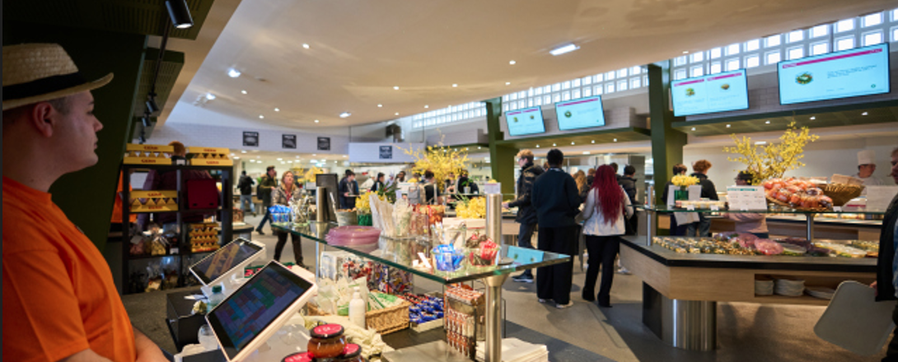

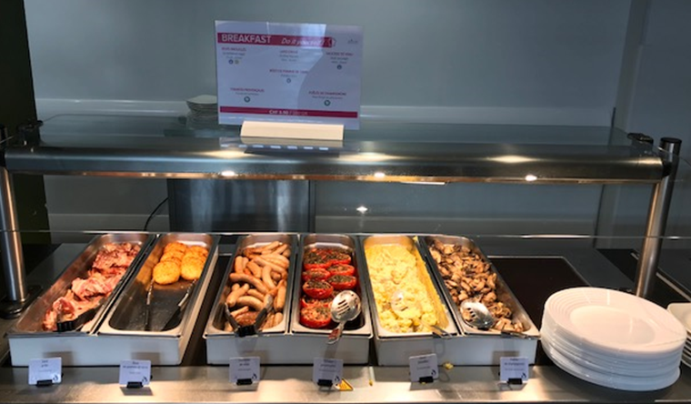
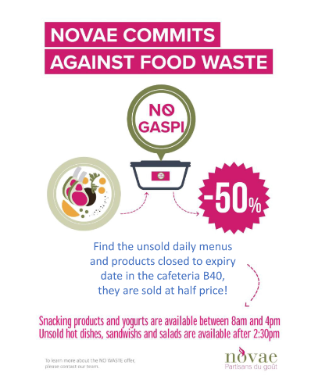
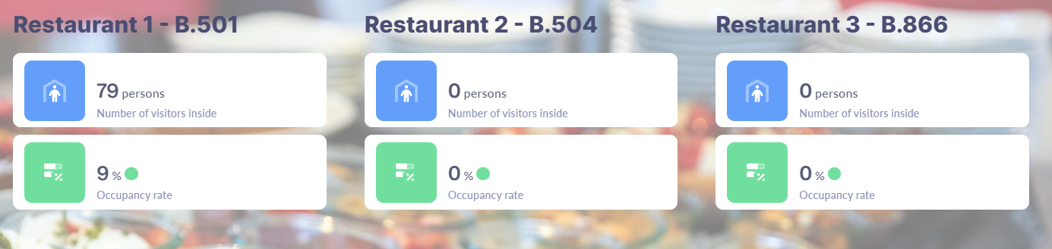
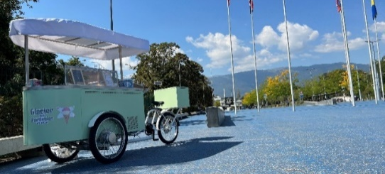
Catering: Recent Projects
R1 renovation
  Counting systems webpage (R1, R2, R3)
    All 3 restaurants are now connected to the same system (Technis)
SGW Big Bang Café
    Opening to public on October 8 / Tue-Sun 8am-5pm
New / Alternative offers
    Hot savory breakfast back at R1
    “No Gaspi” initiative: Unsold daily menus and products closed to expiry date are sold at half price from 14:30, in R1, R2, and B40.
    Glacier des Particules – Pilot:
      An electric ice-cream cart is located on the Esplanade des Particules since September 4, until the end of October, depending on the weather
      Artisanal ice-creams and vegan sorbets
      Open from Tuesday to Saturday, starting at 12:30
6

Slide 7
SCE Mobility framework: Strategy
SUSTAINABLE MOBILITY
People Needs
Integrated development
Infrastructures
Information
Promotion
Short, medium, long-term actions
Stakeholders’ involvement
Sustainable and eco responsible
MANDATE
The CERN Site and Civil Engineering (SCE) Department is responsible for providing and maintaining the infrastructure and services necessary to ensure the mobility of all persons entering the Organisation in a transparent, efficient, and sustainable manner.
LONG TERM OBJECTIVES
Adapt the supply of work vehicles and the supply of parking to the constraints of the different types of users and demand.
Promote accessibility to public/shared transportation and monitor the improvement of the accessibility to the CERN sites by bicycle.
Strengthen the transport service offer for inter-site travel.
Encourage soft modes of transport by enhancing and improving dedicated infrastructure.
STRATEGIC PRINCIPLES
Focus on people needs.
Integrate transport modes. Adapting to the means used by the community and proposing modal services that can be combined together increasing flexibility.
Adaptable to the future needs of the organization.
Sustainable and eco responsible while respecting the individual needs.
Communicate, cooperate with local actors, and involve the community.
ISR, 1971
7
Notes:
Focus on people needs. Commuting, and Inter-site mobility taking in consideration the needs of the different members of CERN independently of their status.
Integrate transport modes. Adapting to the means used by the community and proposing modal services that can be combined together increasing flexibility.
Adaptable to the future needs of the organization. Exploring how mobility can be in the next decades and getting prepared for those changes.
Sustainable and eco responsible while respecting the individual needs. Considering the global carbon footprint and proposing and encouraging eco responsible options with a reasonable investment
Communicate, cooperate with local actors, and involve the community. Developing together and measuring together the success. Using best practices and listening the feedback of the community.

Slide 8
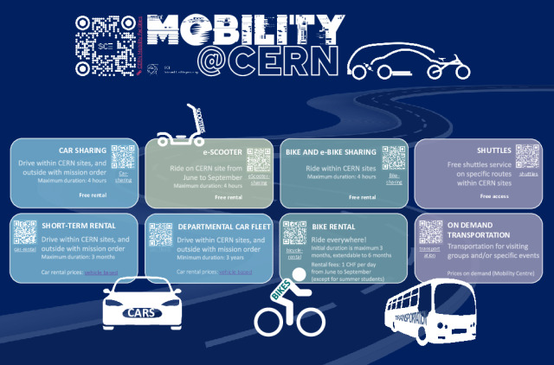
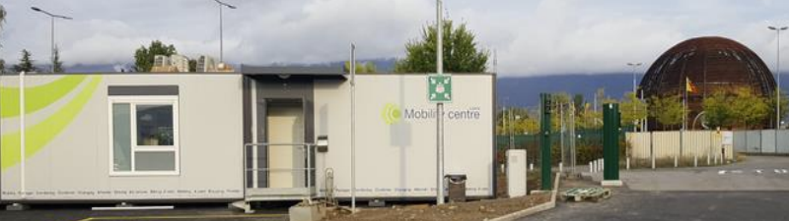
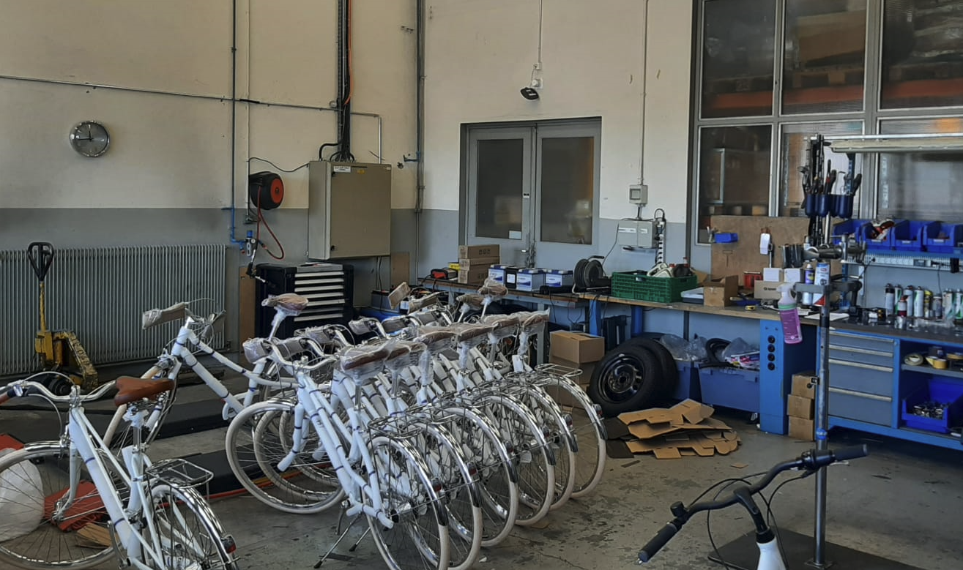
Mobility portfolio & infrastructure
Mobility center
50 e-bikes (+30 summer)
20 e-Scooter (summer only)
~200 trips / day
~45 vehicles
~90 reservations / day
4 circuits
~380 passengers/day
Garage
~4 reservations / day
~680 vehicles
~500 bikes
Winter: ~50%
Summer: Fully booked
Garage
ISR, 1971
27.11.2023
8

Slide 9
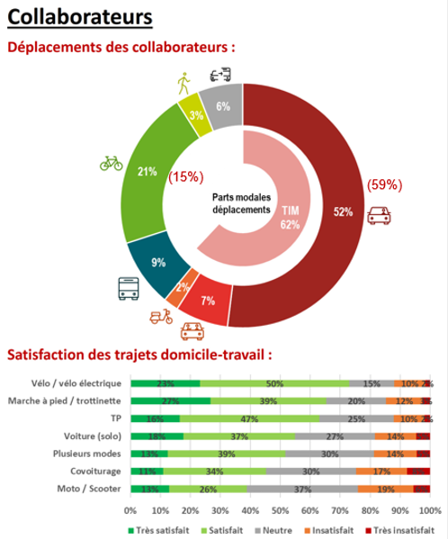
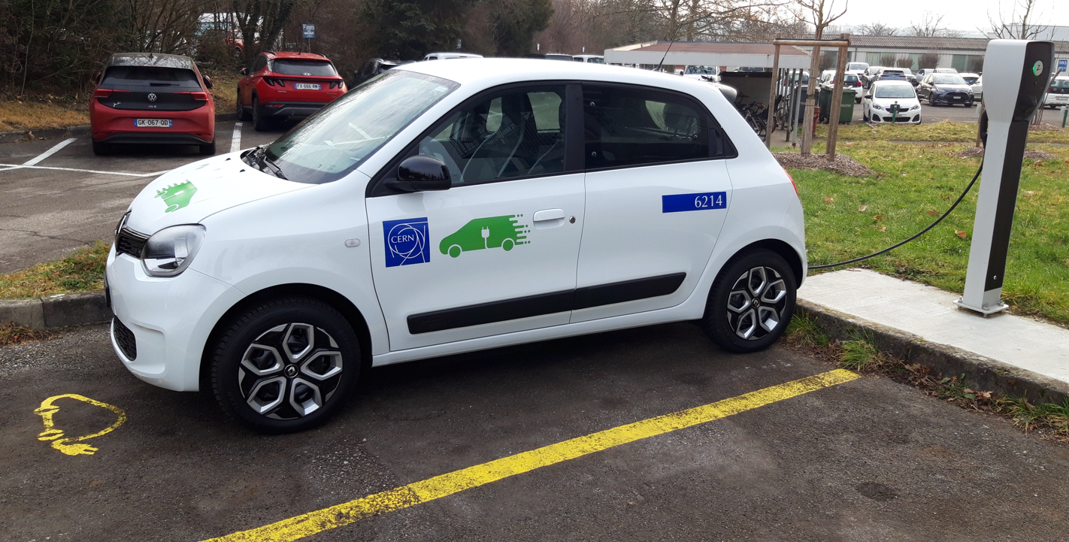
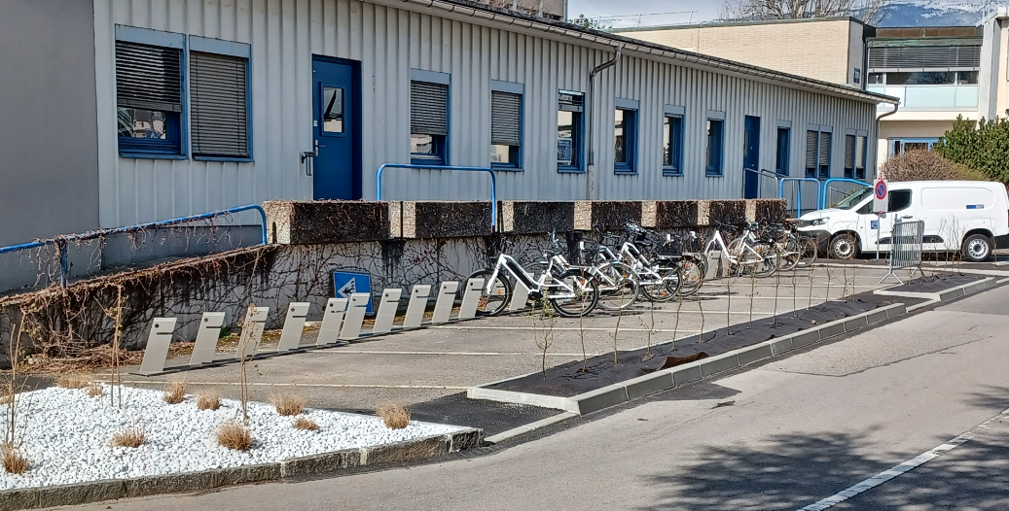

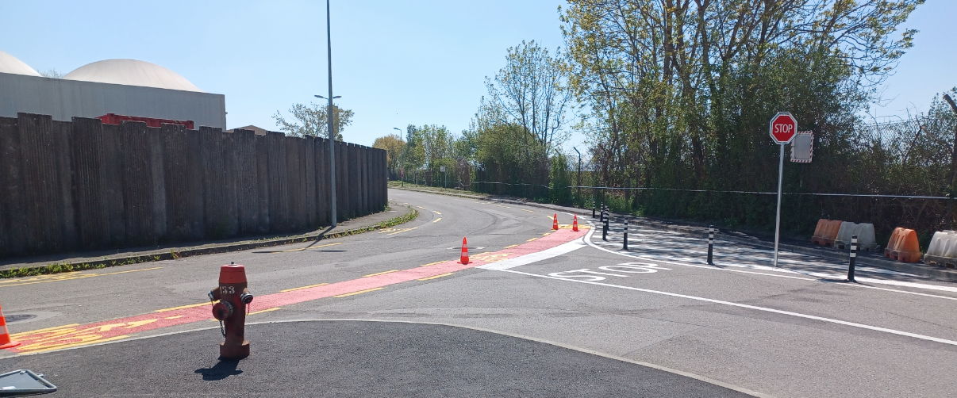
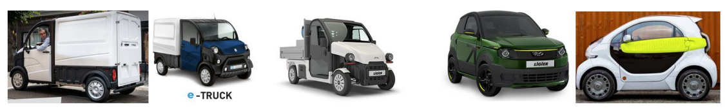
Mobility ongoing actions (highlights)
Fleet optimization
  Reduction -> -25%
  Electrification -> 50%/50%
Bike shelters, parkings and roads
Carpooling
ISR, 1971
27.11.2023
9
Notes:
Focus on people needs. Commuting, and Inter-site mobility taking in consideration the needs of the different members of CERN independently of their status.
Integrate transport modes. Adapting to the means used by the community and proposing modal services that can be combined together increasing flexibility.
Adaptable to the future needs of the organization. Exploring how mobility can be in the next decades and getting prepared for those changes.
Sustainable and eco responsible while respecting the individual needs. Considering the global carbon footprint and proposing and encouraging eco responsible options with a reasonable investment
Communicate, cooperate with local actors, and involve the community. Developing together and measuring together the success. Using best practices and listening the feedback of the community.

Slide 10
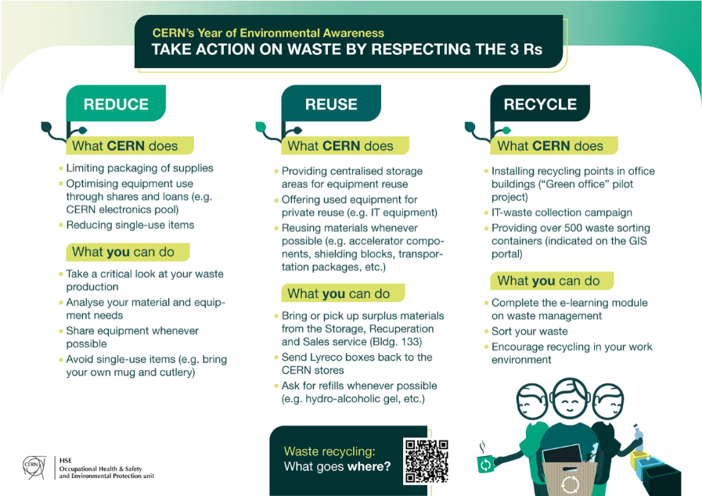
CERN Waste management- Strategy
MANDATE
This service is responsible for the collection and disposal of conventional & dangerous waste (excluding radioactive ones) from the CERN's sites.
LONG TERM OBJECTIVES
Embrace the environmental transition laid down in CERN’s Environmental Protection Strategy and CERN’s Masterplan 2040, fully aligned with priorities of CERN, communities surrounding the sites and Geneva international organizations. Become an eco-exemplary campus.
Maintain full compliance with France and Switzerland regulations while operating waste management and waste disposal. Be an Align priorities to long-term plans of host states and local authorities.
Per producer category (campus, industry, work site), reduce the total quantity of waste generated by CERN, increase reuse and recycling rates.
STRATEGIC PRINCIPLES
Adhere to 3 ‘R’s: Reduce, Reuse, Recycle.
Integrate internal and external actors in a holistic and sustainable waste management flow.
Consolidate equipment and infrastructure related to waste management.
Implement best-practices of the industry and optimise waste management operations.
Steer the service based on data.
Communicate, cooperate with local actors, and involve the community.

Slide 11
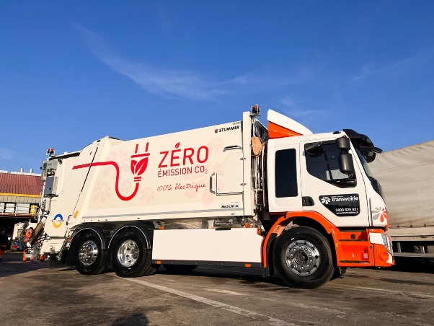
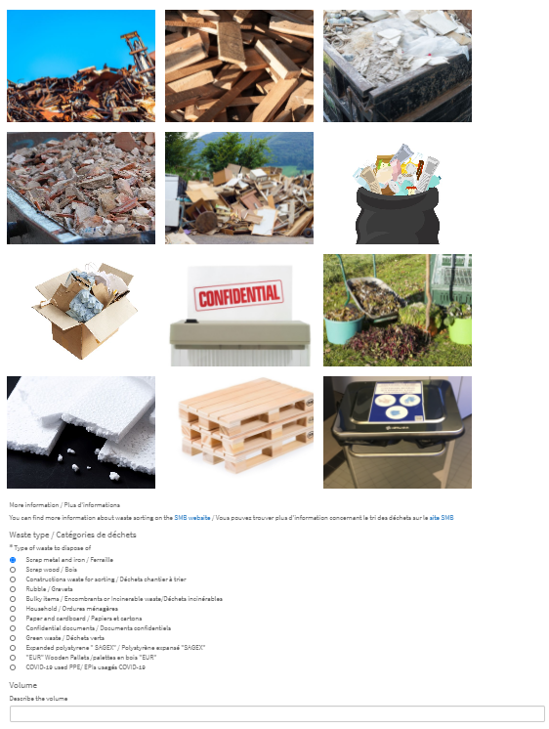
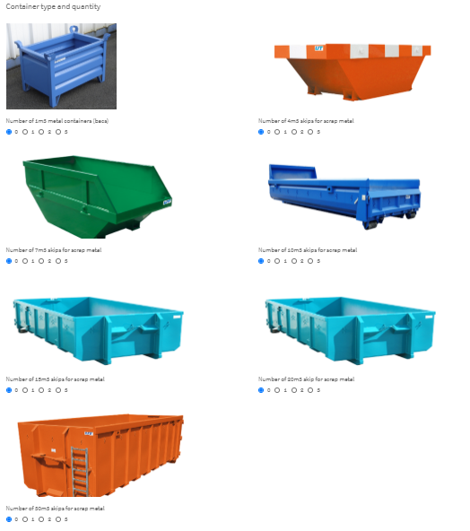
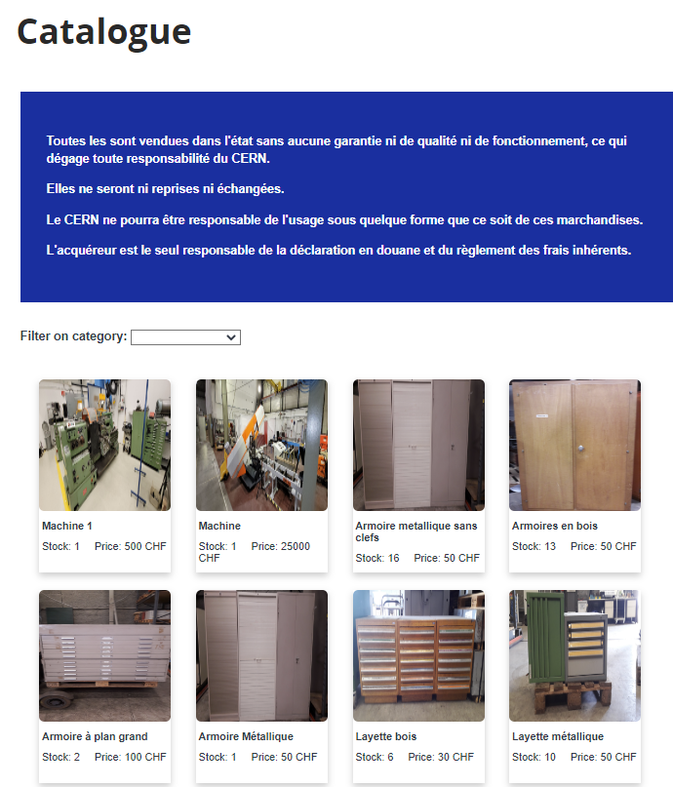


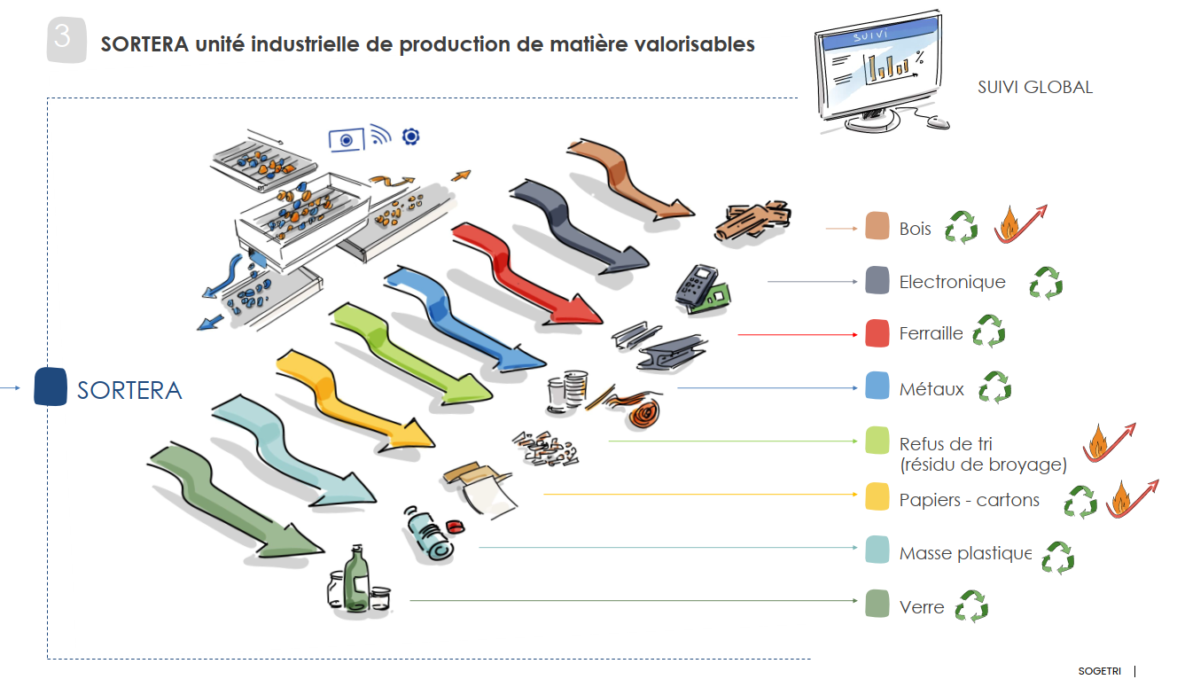
CERN Waste management- Service overview
Regular collect tours
On-request skips
Recuperation & sales
- Any equipment or material with value can be bring or transported there
- Containers for electronics (blue) and computer equipment (red)
- Containers for metals (stainless steel, aluminium, copper, steel, brass, lead, copper cables, aluminium cables)
- All batteries
- Other wastes (incinerable) x2 x1
Everything which cannot be sorted, incinerable
- Paper/carboard x2 x1
- Metals x2 x1
Recycling areas :
- PET, aluminium cans
- Glass
- Nespresso capsules
Others:
- Organic (R1 & R2) x3 / week
- Printer toner cartridges
- Scrap wood (near buildings) ~1/month
Treatment
Special wastes
- Upon transport request
- Battery collection points
- Chemical & laboratory wastes, neons & all types of lamps, etc…
Notes:
Focus on Sortera ecopole, industrial infrastructure equipped with robots for mass sorting. Massive investment in 2019 (~20M CHF). Biggest infrastructure in CH so far.
At least 1/3 of CERN waste pass through this industrial process, allowing to extract additional fractions of recycling material.
70% of bulky items, 14% of other wastes (incinerable) are now recycled and don’t end up at Cheneviers for energy recovery

Slide 12
CERN Waste management- Key figures

Slide 13
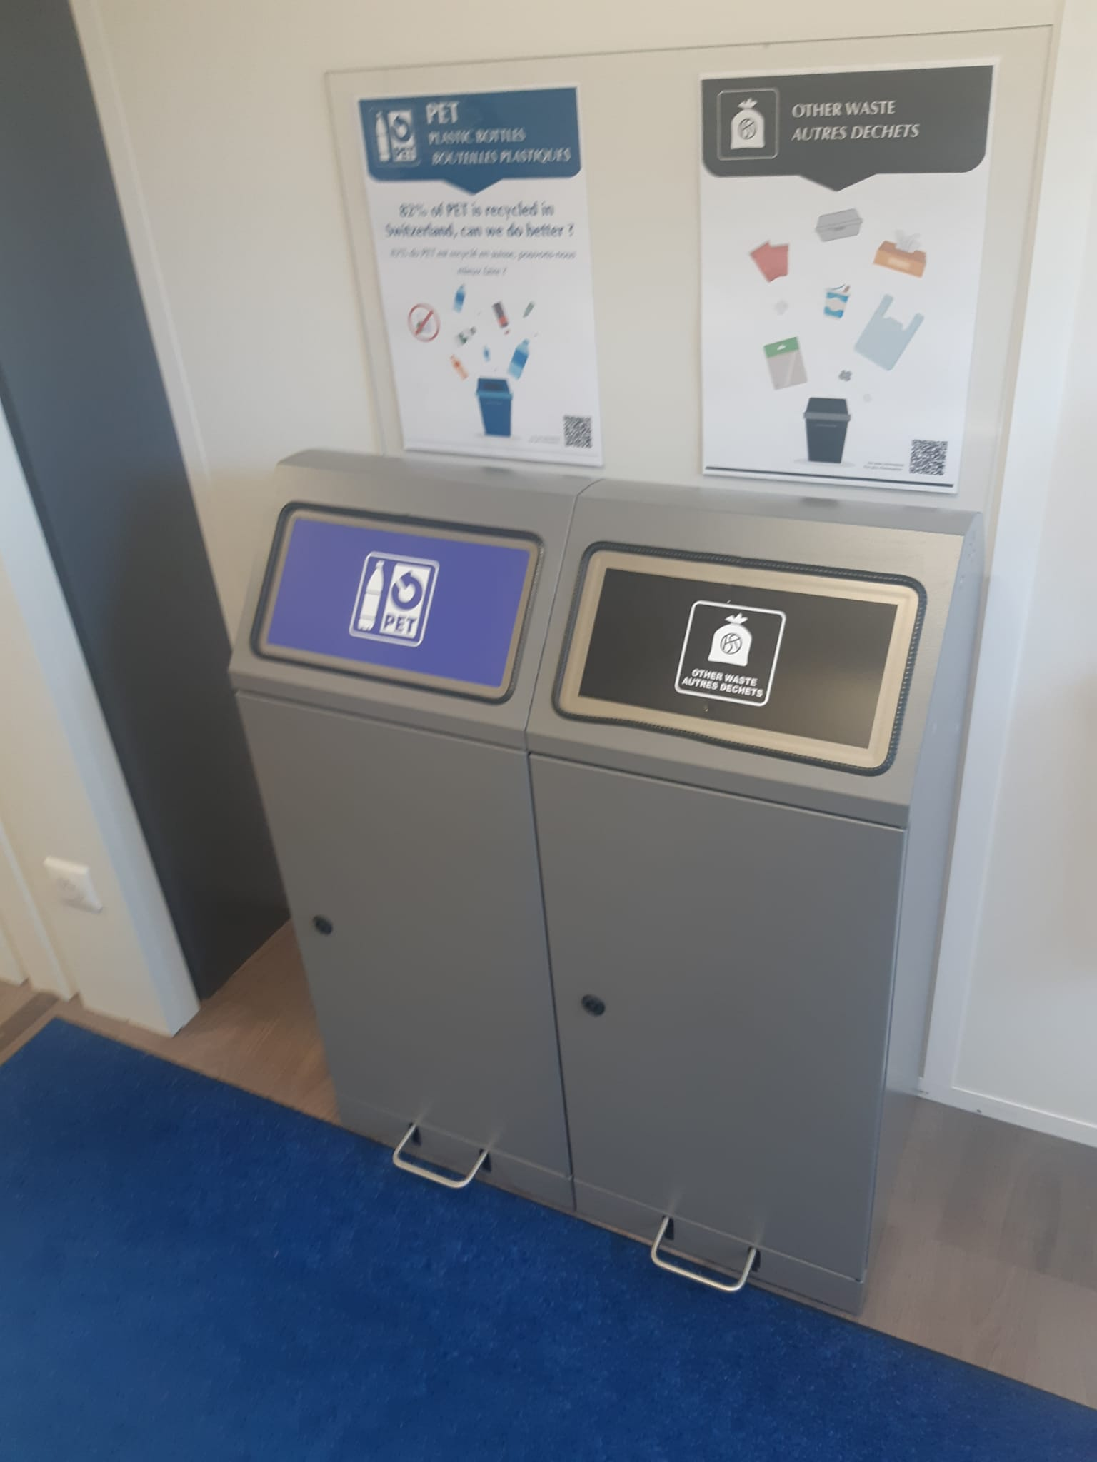

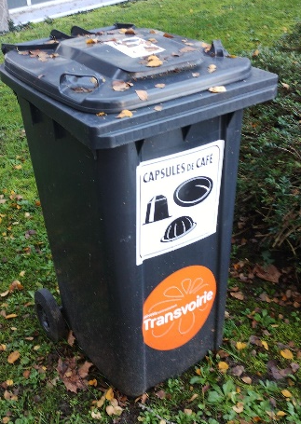
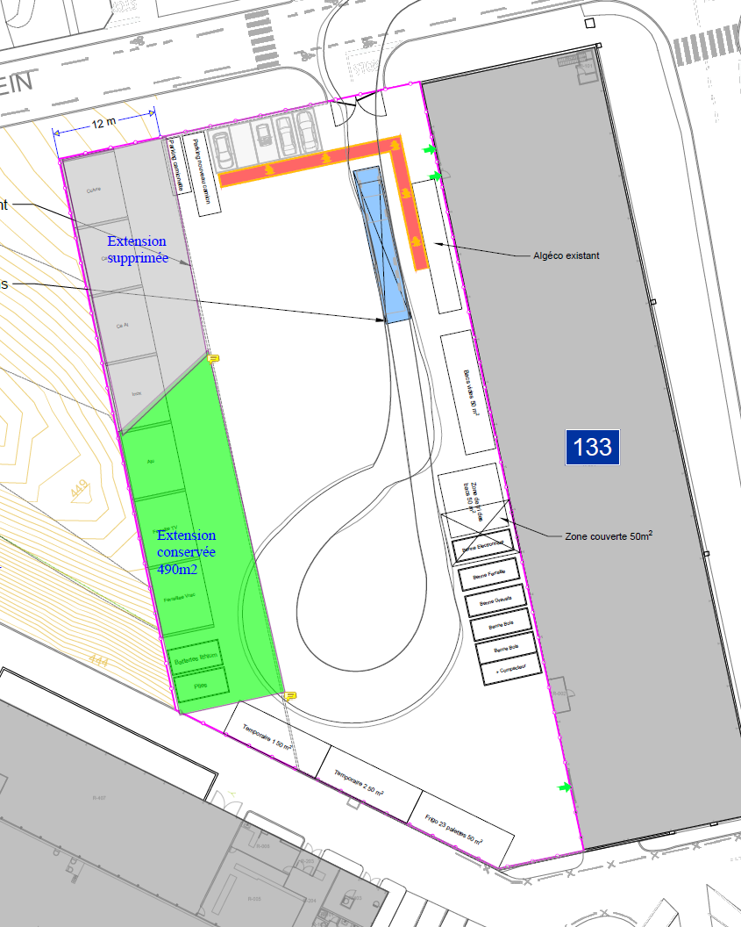
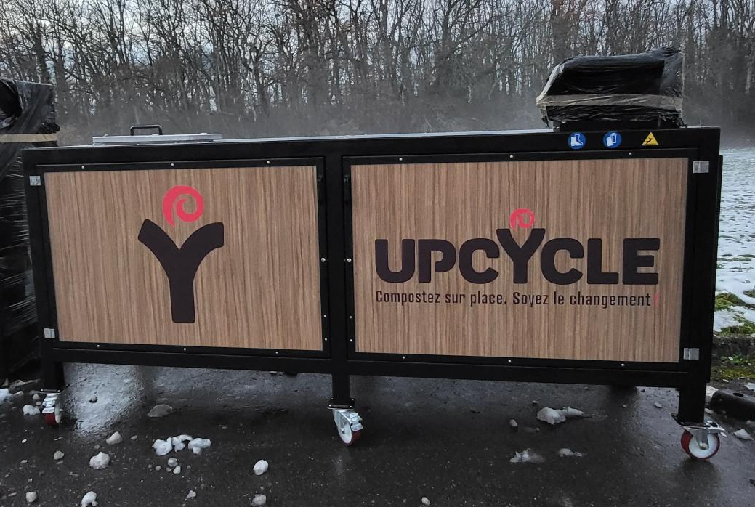
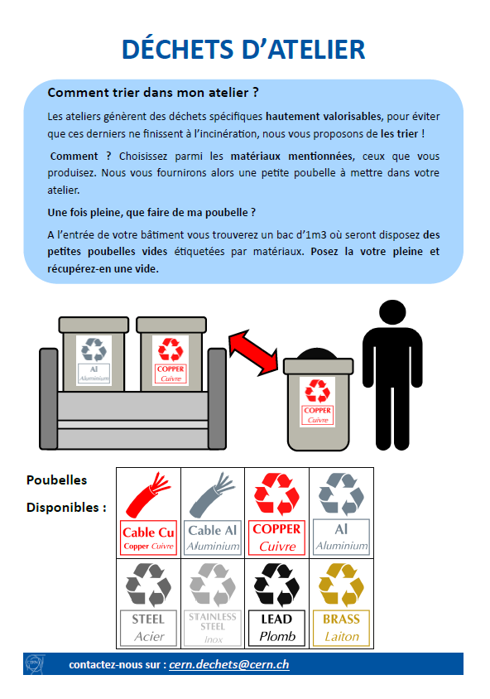
CERN Waste management- On-going actions
Electro-composter
Visual harmonization
Infrastructure
KPIs & objectives
- Maintain a recycling rate (product and material recovery) within the objectives of the Canton of Geneva (currently 80%)
- Increase the tonnage of product recovery (reuse, reemployment, repurposing) by 10% between 2025 and 2030
- Reduce the tonnage of campus waste per person on site by 5% between 2025 and 2030

Slide 14
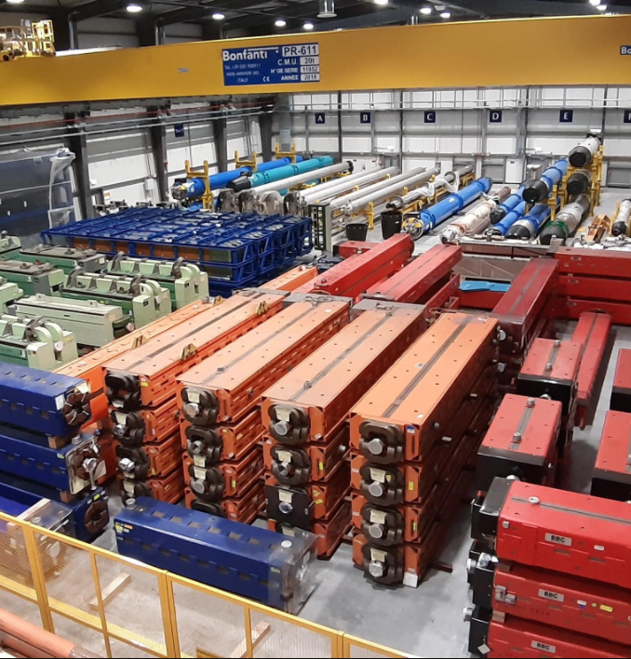
Supply Chain & Logistics: Strategy
MANDATE
Provides CERN’s community optimal logistics services associated to goods/material/mail inbound and outbound flows, long-term storage & CERN stores management (referencing, replenishment and warehousing operations).
VISION
Professional and integrated Supply Chain to support all CERN’s community advancing the scientific program.
LONG TERM OBJECTIVES
Simplify material request and fulfilment experience for all CERN’s community & reshape distribution of demand fulfilment routes.
Reduce inventory value and contain operational costs.
Avoid the construction of new storage buildings in the future.
Reduce environmental impact of all SC activities. Feed circular economy.
Leverage the added value of a central stores service through a higher degree of collaborative integration with key partners (internal and external with suppliers).
Limit duplication of local storage service resources.
Maintain a healthy, safe and pleasant working environment to sustain high team engagement.
STRATEGIC PRINCIPLES
Collaboration: Foster goal alignment aiming for structured collaboration and create dedicated partnerships with key stakeholders.
Process & organisation.
Technology: Leverage technology and digitalization to modernize the entire SC.
Service: Adapt and evolve the service offer to CERN’s community needs.
Integration: Increase maturity of the SC integration, internally and externally.
Sustainability: Implement sustainable procurement and eco-responsibility guidelines.
High professional standards: Apply industry best-practices ensuring a sustainable economic model.

Slide 15
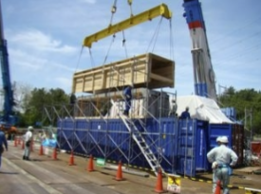
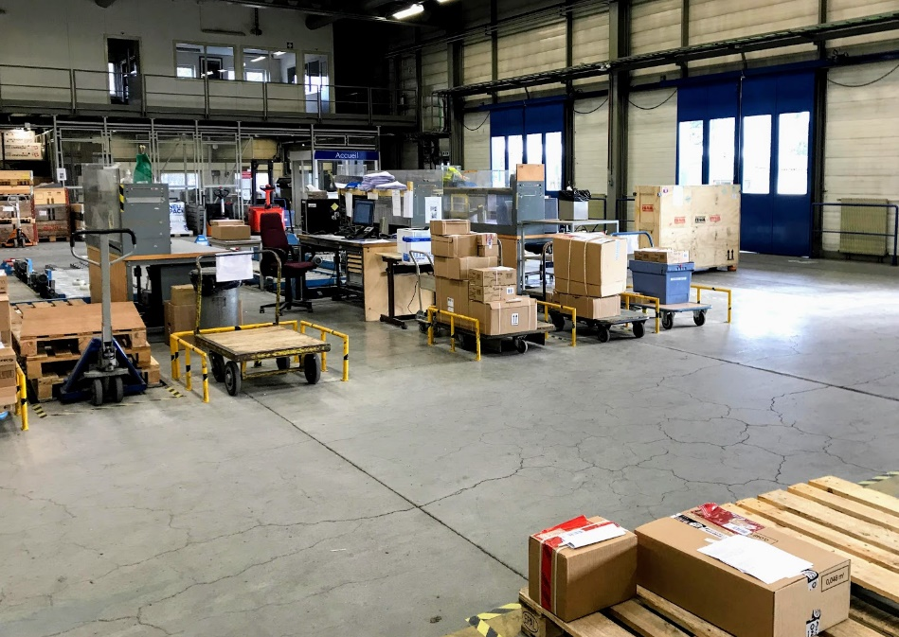
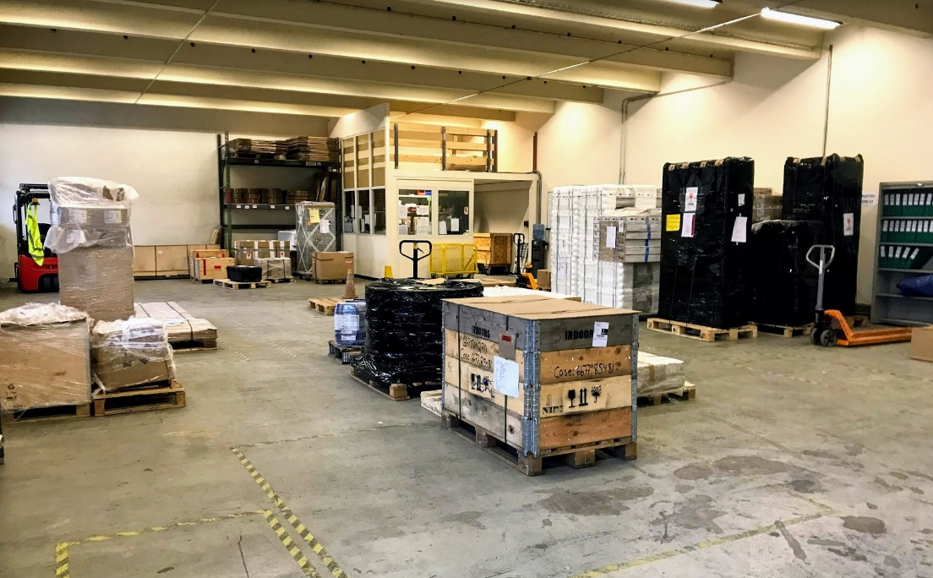
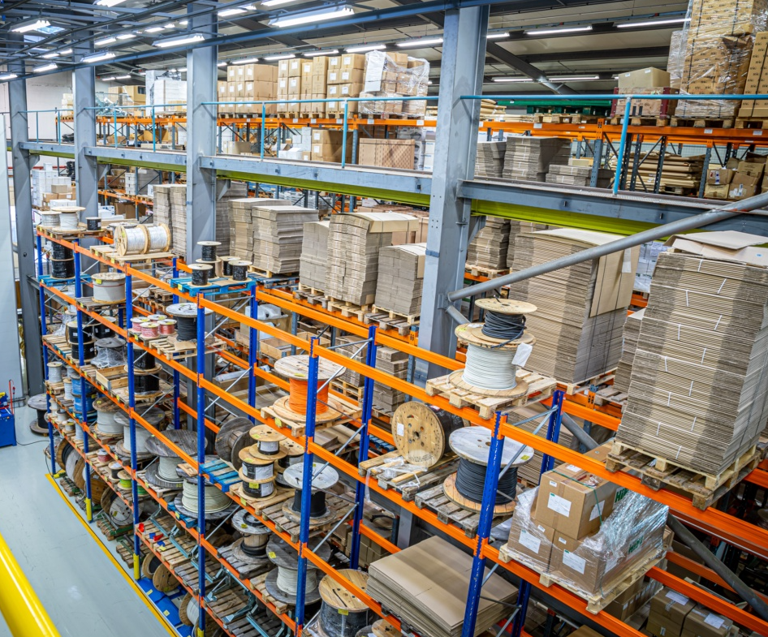
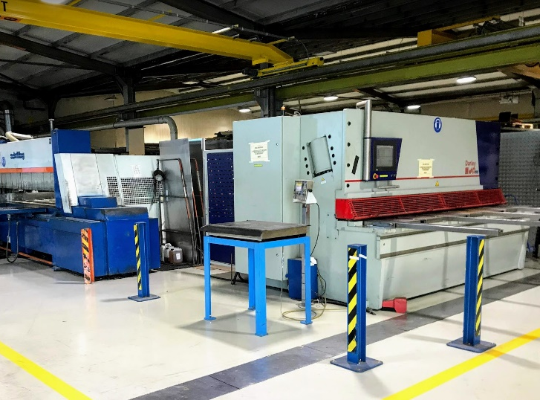
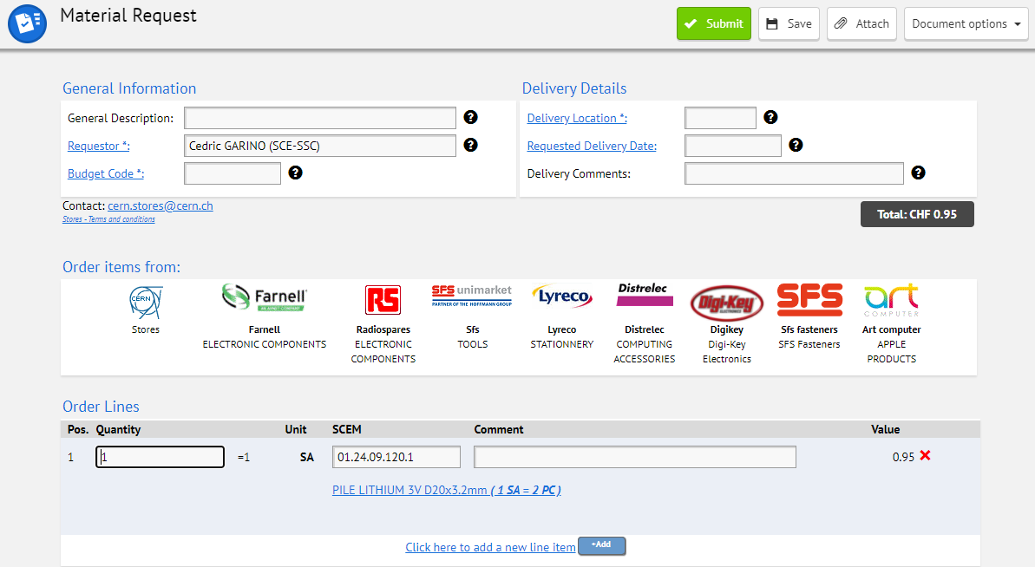
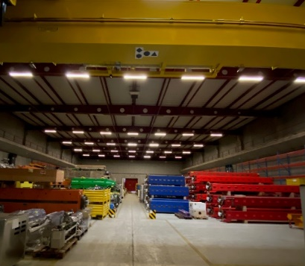



Supply Chain & Logistics: Service & functions overview
Import/export formalities & customs + VAT (~4k expeditions/y). Control of goods received. Packaging.
Goods receptions
Shipping
Stores
Web catalogue (~12.5k refs, ~65k sales/y), referencing, replenishment, warehousing operations, cuttings, PPEs.
Referencing & replenishment
Central
Raw materials
Catalogue
Long-term storage
Internal removals
Mail
Internal distribution
Collect & distribution (~110k/y), mail inbound & outbound, removal of offices (~1,5k/y), long-term storage of accelerator equipment (20k m2)

Slide 16


CERN Campus App

Slide 17

Thank you! Questions?

