Slide 1
















CERN
SITE AND CIVIL ENGINEERING DEPARTMENT
Mar Capeans

Slide 2
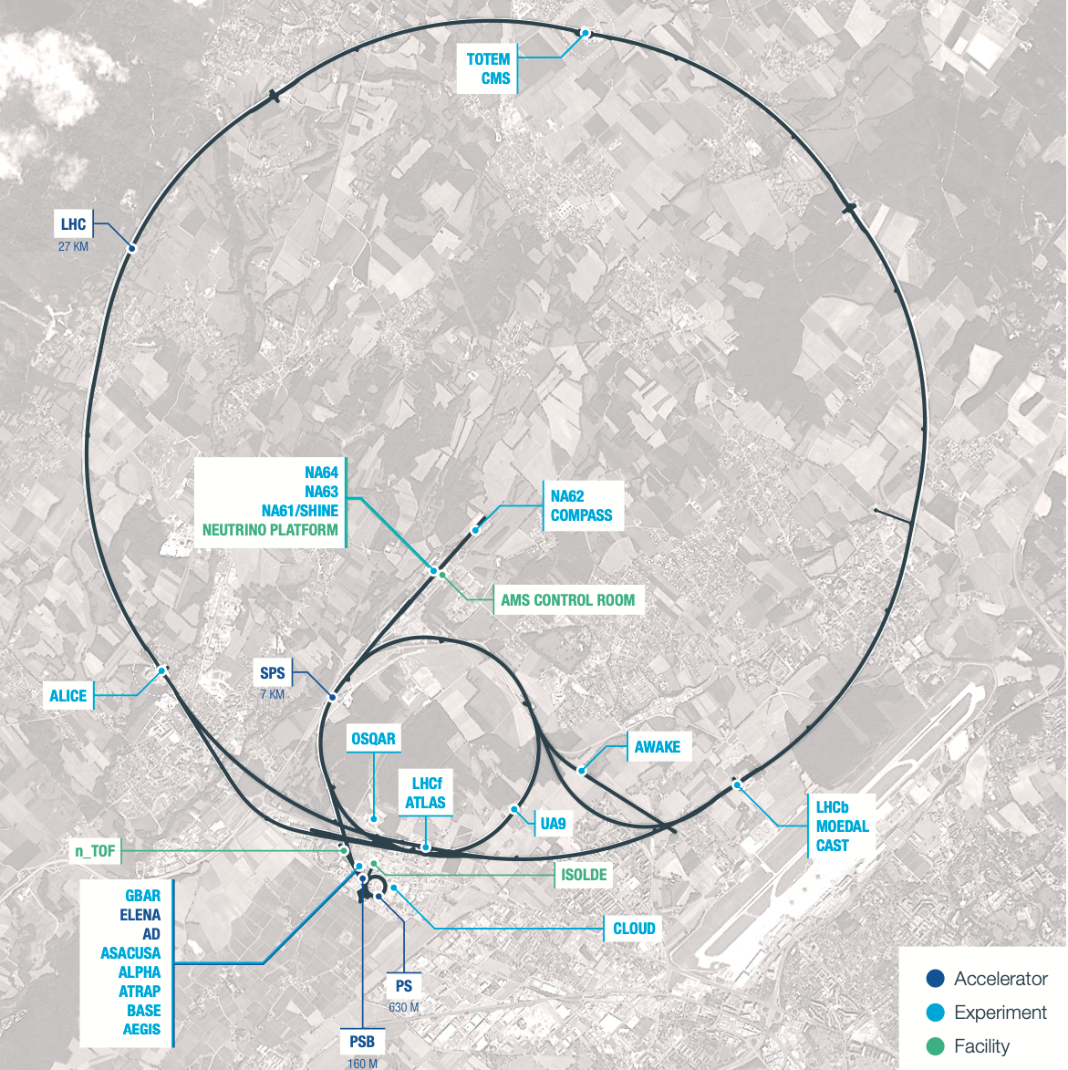
CERN
23 Member States
3,600 employees
12,500 scientists (110 nationalities) using the Laboratory’s facilities
35 Non-Member States with Co-operation agreements with CERN
1,200 MCHF annual budget

Slide 3
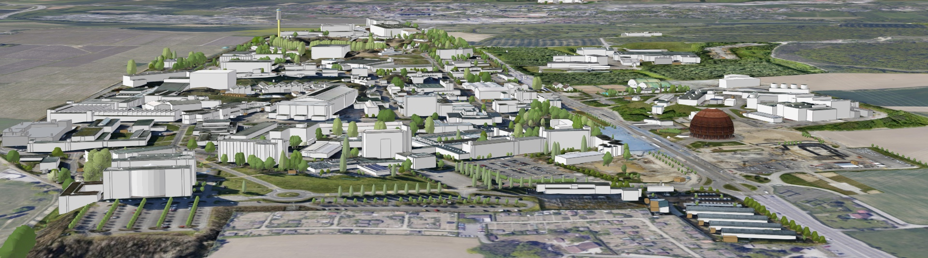
KEY FIGURES
590 ha (220 fenced)
2 main sites and 15 satellite sites
670 buildings from 10 m² to 20.000 m²
65% built before the 70’s
70 km tunnels and 80 caverns
30 km roads
1000 km technical galleries and trenches
9000 persons/daily
490 hostel rooms
8500 working places
4300 parking places in Meyrin, 1400 in Prévessin
25000 daily movements to- and inter-sites
Public transport links in CH, not in FR

Slide 4

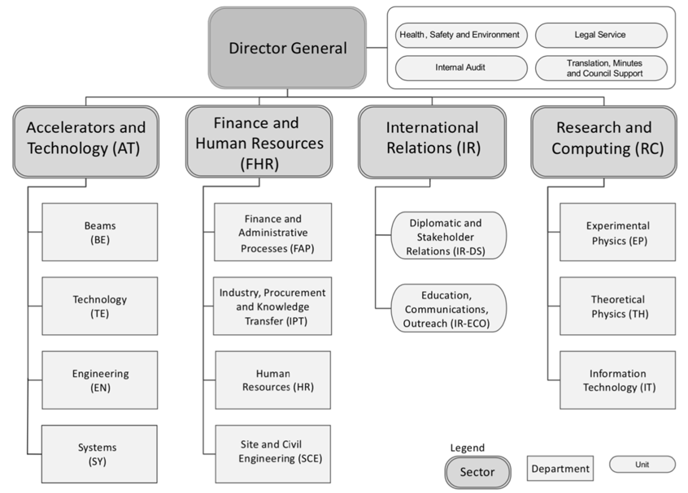
Site and Civil Engineering (SCE) Department
The Site and Civil Engineering (SCE) Department manages and develops CERN’s real estate assets and infrastructures in agreement with CERN’s scientific strategy, as well as all the services related to the caretaking and operation of the CERN site.

Slide 5

Values and vision
Create an inspiring and welcoming environment for
CERN’s scientific community now and in the future.
Manage site assets and services in a transparent way
Cooperate with other CERN Departments, the Experiments and the Host States
Plan at long-term, regularly updating and aligning to evolutions in CERN's scientific program and future projects
Protect the site by a reflected interplay between preservation and modernization
Ensure working conditions at the site providing a high level of safety, reliability and security
Implement coherent service management
Plan and prioritize projects according to strategic importance, urgency, financial viability and within environmental and mobility objectives.

Slide 6
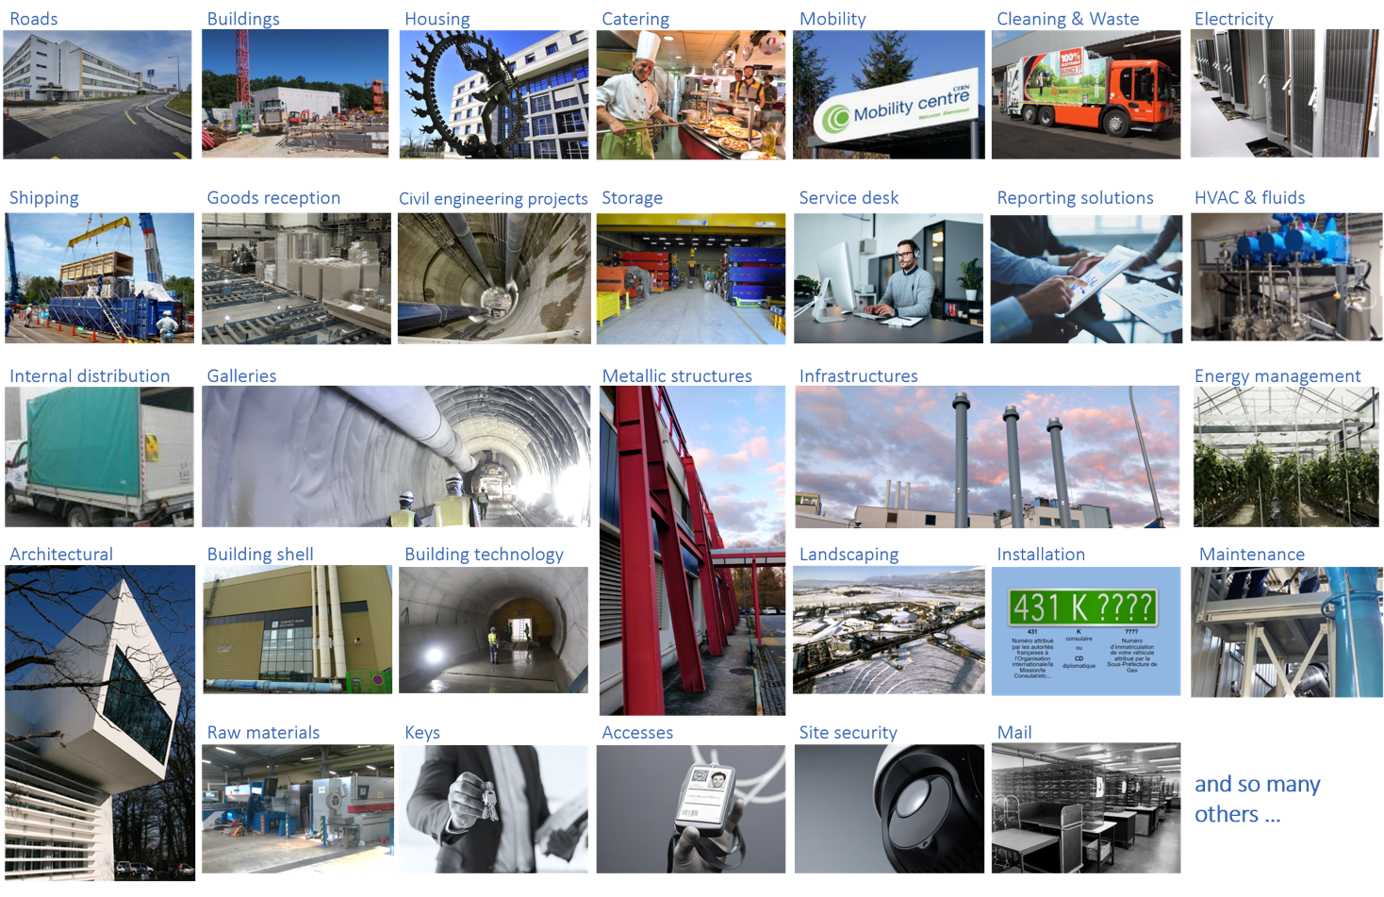
An extensive offer dedicated to CERN’s Community

Slide 7
Structure
Site and Civil Engineering
(SCE)
Departmental Operation and Development
(DOD)
DH: Mar Capeans
DDH: Cedric Garino
Strategic cross-​sectional projects, management of resources, admin hub, Safety, Site Security.
Project Portfolio
Management
(PPM)
Site Asset
Management
(SAM)
Services
and Supply Chain
(SSC)
Service Management
and Support
(SMS)
GL: Natacha Lopez
DGL: Pieter Mattelaer
GL: Pierre Cardon
DGL: Michael Poehler
GL: Cedric Garino
DGL: Laetitia Lejeune
GL: Gyorgy Balazs
DGL: Isabel Fernandez
Responsible for the major developments of CERN in the field of civil engineering. It consists of project managers and specialists developing, monitoring and managing the major civil engineering projects during the execution phase.
Responsible for monitoring the condition of current buildings and infrastructure on campus, and conducting relevant renovation projects. Study and early support of user-​initiated construction projects (IPP lead).
Responsible for providing the CERN community with high standard campus experience and optimal industrial logistics by offering rationalized, efficient, and controlled services.
Responsible for the clear and coherent implementation and monitoring of service management. Business analytics.

Slide 8
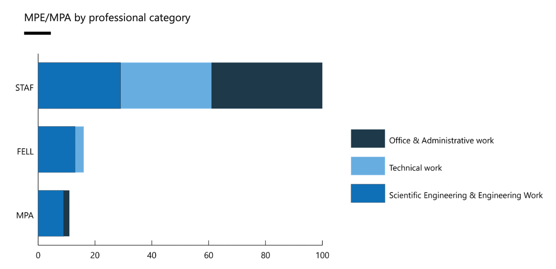
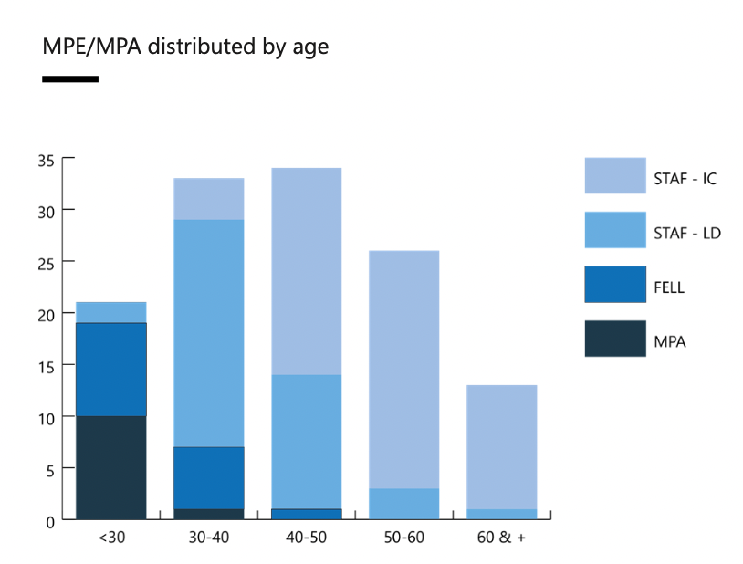
Profile
(2022 data)
Activities
(SCE budget MCHF, average 21-25)
139 FTE workforce
OPERATION
40% Site Services M&O
25% Site Assets M&O
20% Site Security & Registration
5% IT Services (SNow)
25 M
CONSOLIDATION
Yearly program
Emergencies
ATS Consolidation
16 M
PROJECTS
60% New buildings
30% HL-LHC
9% Renovation
1% Security Infrastructure
43 M

Slide 9

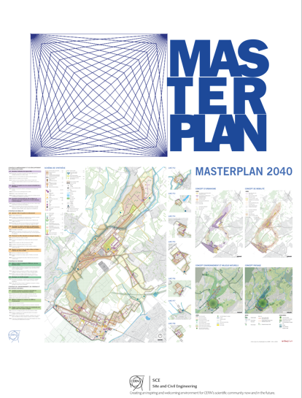
CERN’s Masterplan2040
It is a document to inform and inspire a reasoned and meaningful dialogue about the management and update of CERN’s site. It is therefore a key document to guide and improve the management and use of land and space at CERN
The Masterplan will be used in a variety of practical ways such as:
To deliver better on CERN’s environmental objectives;
To support decisions in the approval process of infrastructure projects;
To reveal trends and analyse effectiveness of land planning and management;
To connect spatial and infrastructure planning with budgeting and investment decisions;
To ensure that “privileges over” and “ownership of” space do not hamper the optimization of the existing space and potential savings;
To favour top-down Project Proposals initiated by a high-level objective;
To plan better services for the Organization and its scientific community.

Slide 10
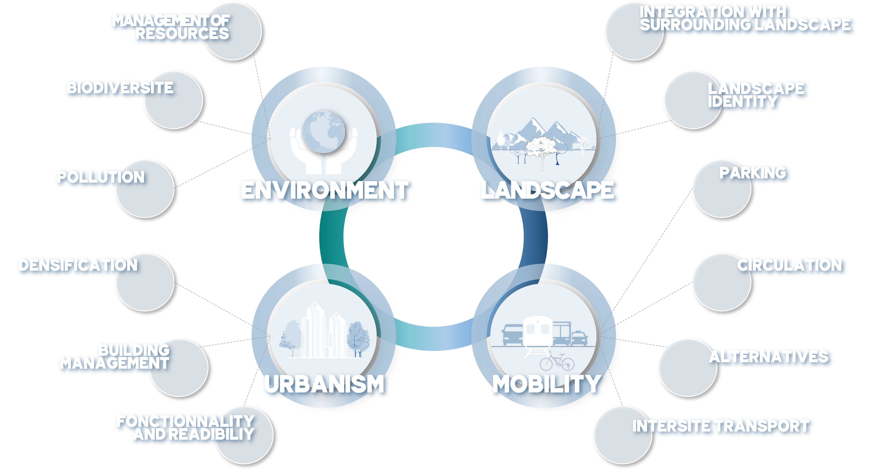

MASTERPLAN2040
Framework objectives and measures

Slide 11

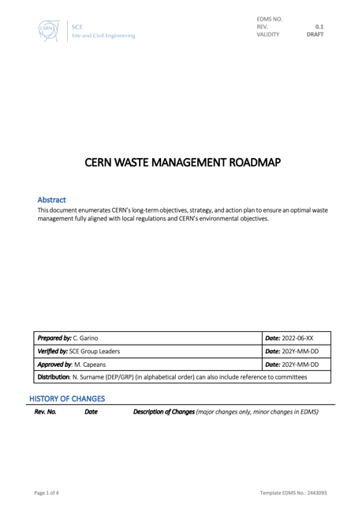
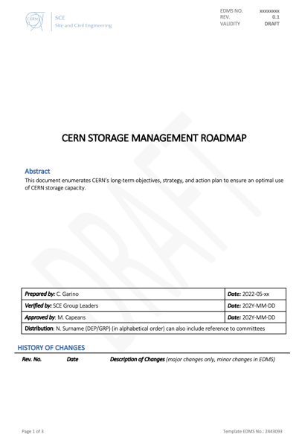
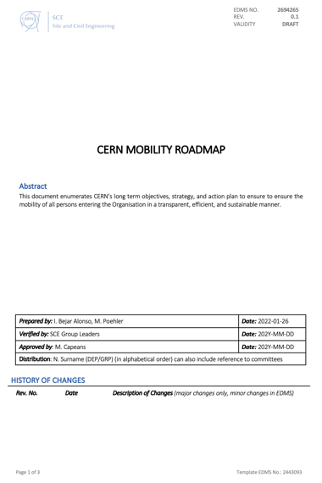
Campus Services Roadmaps
CERN Masterplan 2040
WASTE
STORAGE
MOBILITY

Slide 12
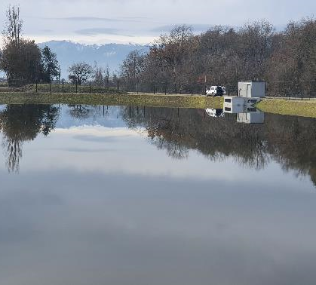


MASTERPLAN2040
MANAGEMENT OF
RESSOURCES
Control the resource requirements for the operation of tertiary infrastructures:
Improve energy consumption and reduce greenhouse gas emissions
Promote new energy-generation technologies
Limit the increase in water consumption.
BIODIVERSITY
Initiate an action plan in favour of biodiversity, green spaces and protected species:
Continue to implement the rainwater management strategy at CERN
Draw up an inventory of the existing biodiversity, protected species and green spaces
Continue the development of the ecological continuity of environments and wildlife corridors.
POLLUTION
ENVIRONMENT
Control and mitigate CERN's environmental pollution:
Limit noise pollution
Increase the recycling rate and reduce waste production

Slide 13
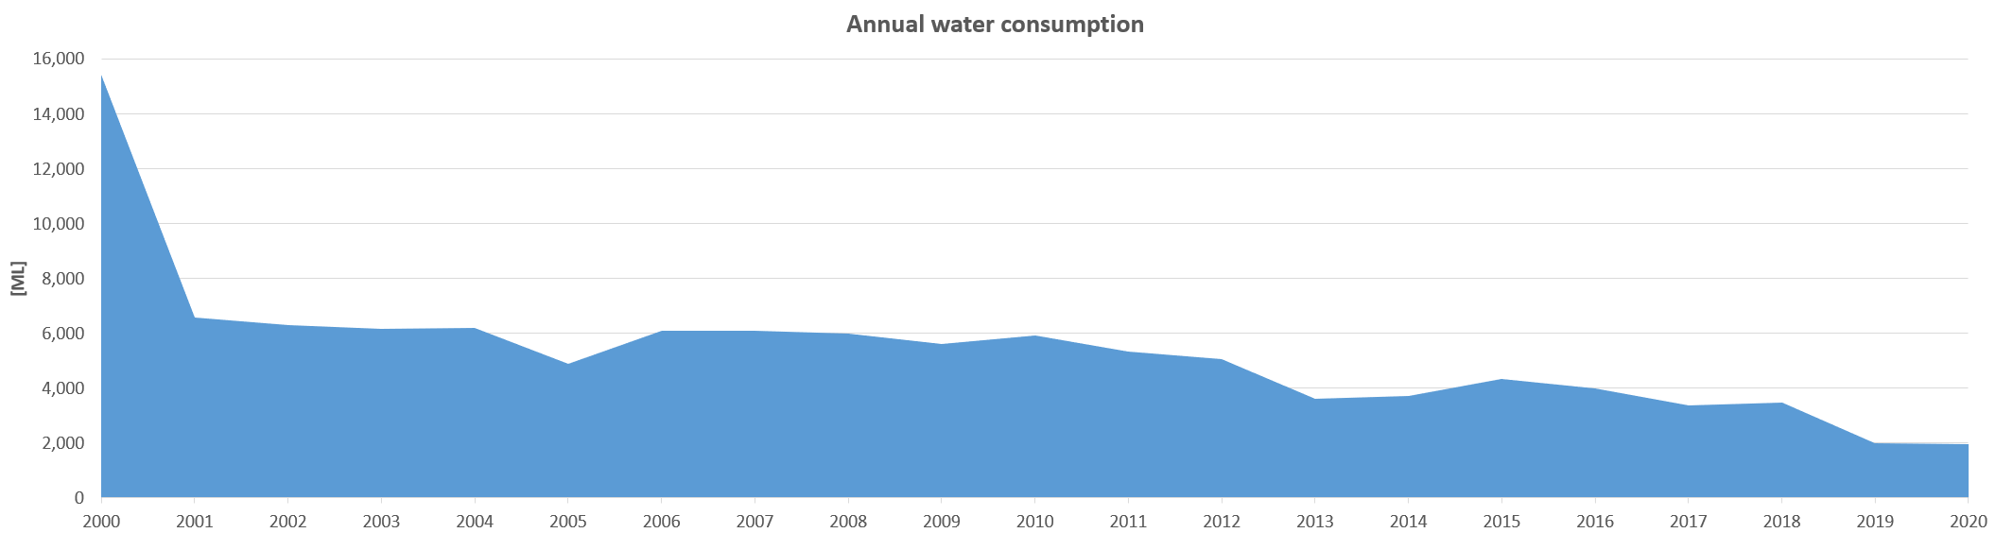
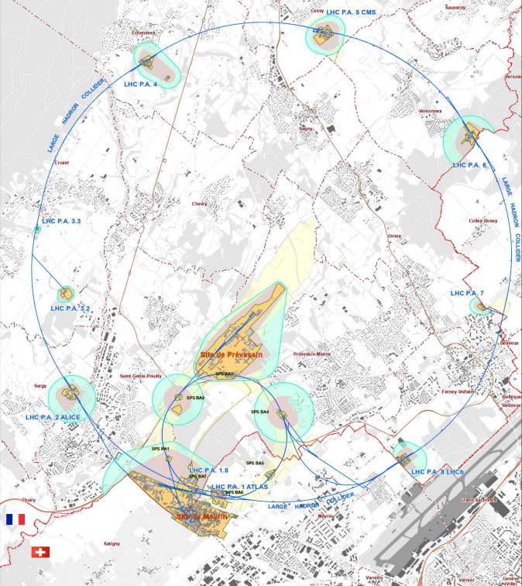
MASTERPLAN 2040: Environment
WATER
NOISE

Slide 14
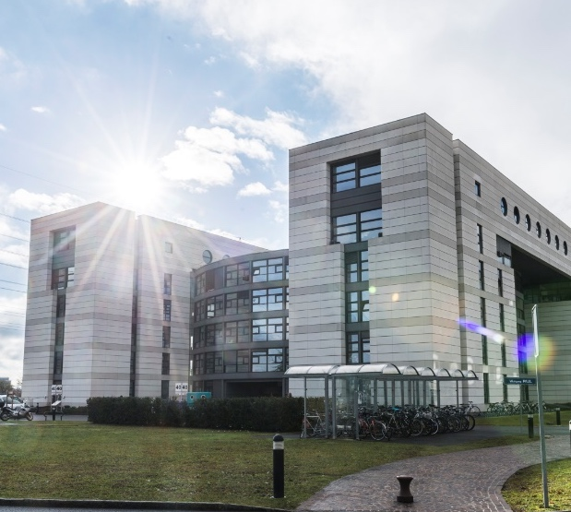

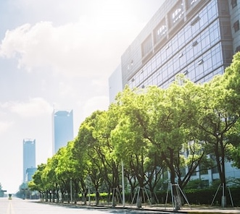
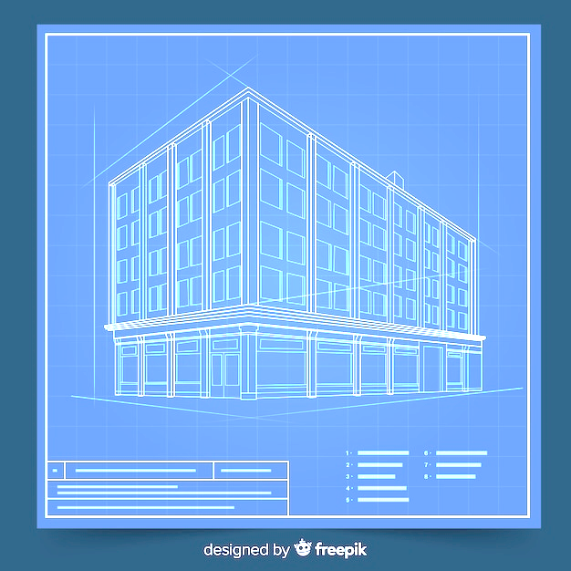
MASTERPLAN2040
DENSIFICATION
Densify land occupation by ensuring flexibility of use
Identify the areas set aside for development and define priorities
Continue to monitor CERN’s development
Draw up a land improvement plan
Favour taller buildings where site conditions and building use so permit
BUILDING MANAGEMENT
Standardise the use of built-up areas:
Develop a policy for the management of built-up areas with a specific strategy for each purpose
Continue monitoring existing buildings
Continue the renovation programme
Propose a specific land-use area on the Swiss side of the CERN site and define regulatory provisions
URBANISM
FUNCTIONALITY & READABILTY
Consolidate the functionality of the Meyrin and Prévessin sites and the experiment sites, and make the Prévessin site autonomous :
Enhance the organisation and coherence of the sites by creating specific zones: visitor, academic, scientific–technological .
Create one or more decentralised service hubs on the existing and future sites, notably bringing together amenities, restaurants, public spaces, lawns, gathering areas, etc

Slide 15
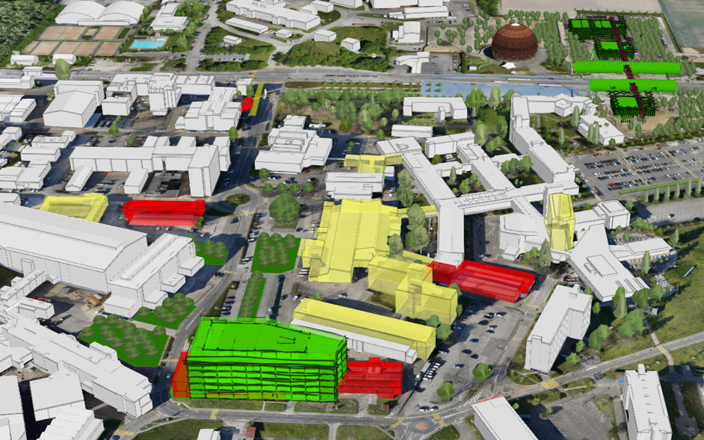
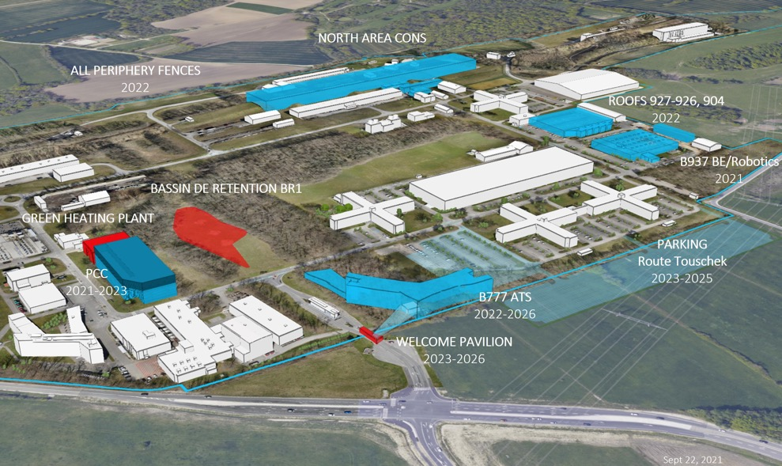
Renovations, consolidation and demolitions
Meyrin
Prévessin
New construction
Planned and funded
Renovation
Planned and funded
Demolition
Notes:
Exemple de programme de rénovation – démolition – nouvelles constructions sur le site de Meyrin et Prevessin

Slide 16
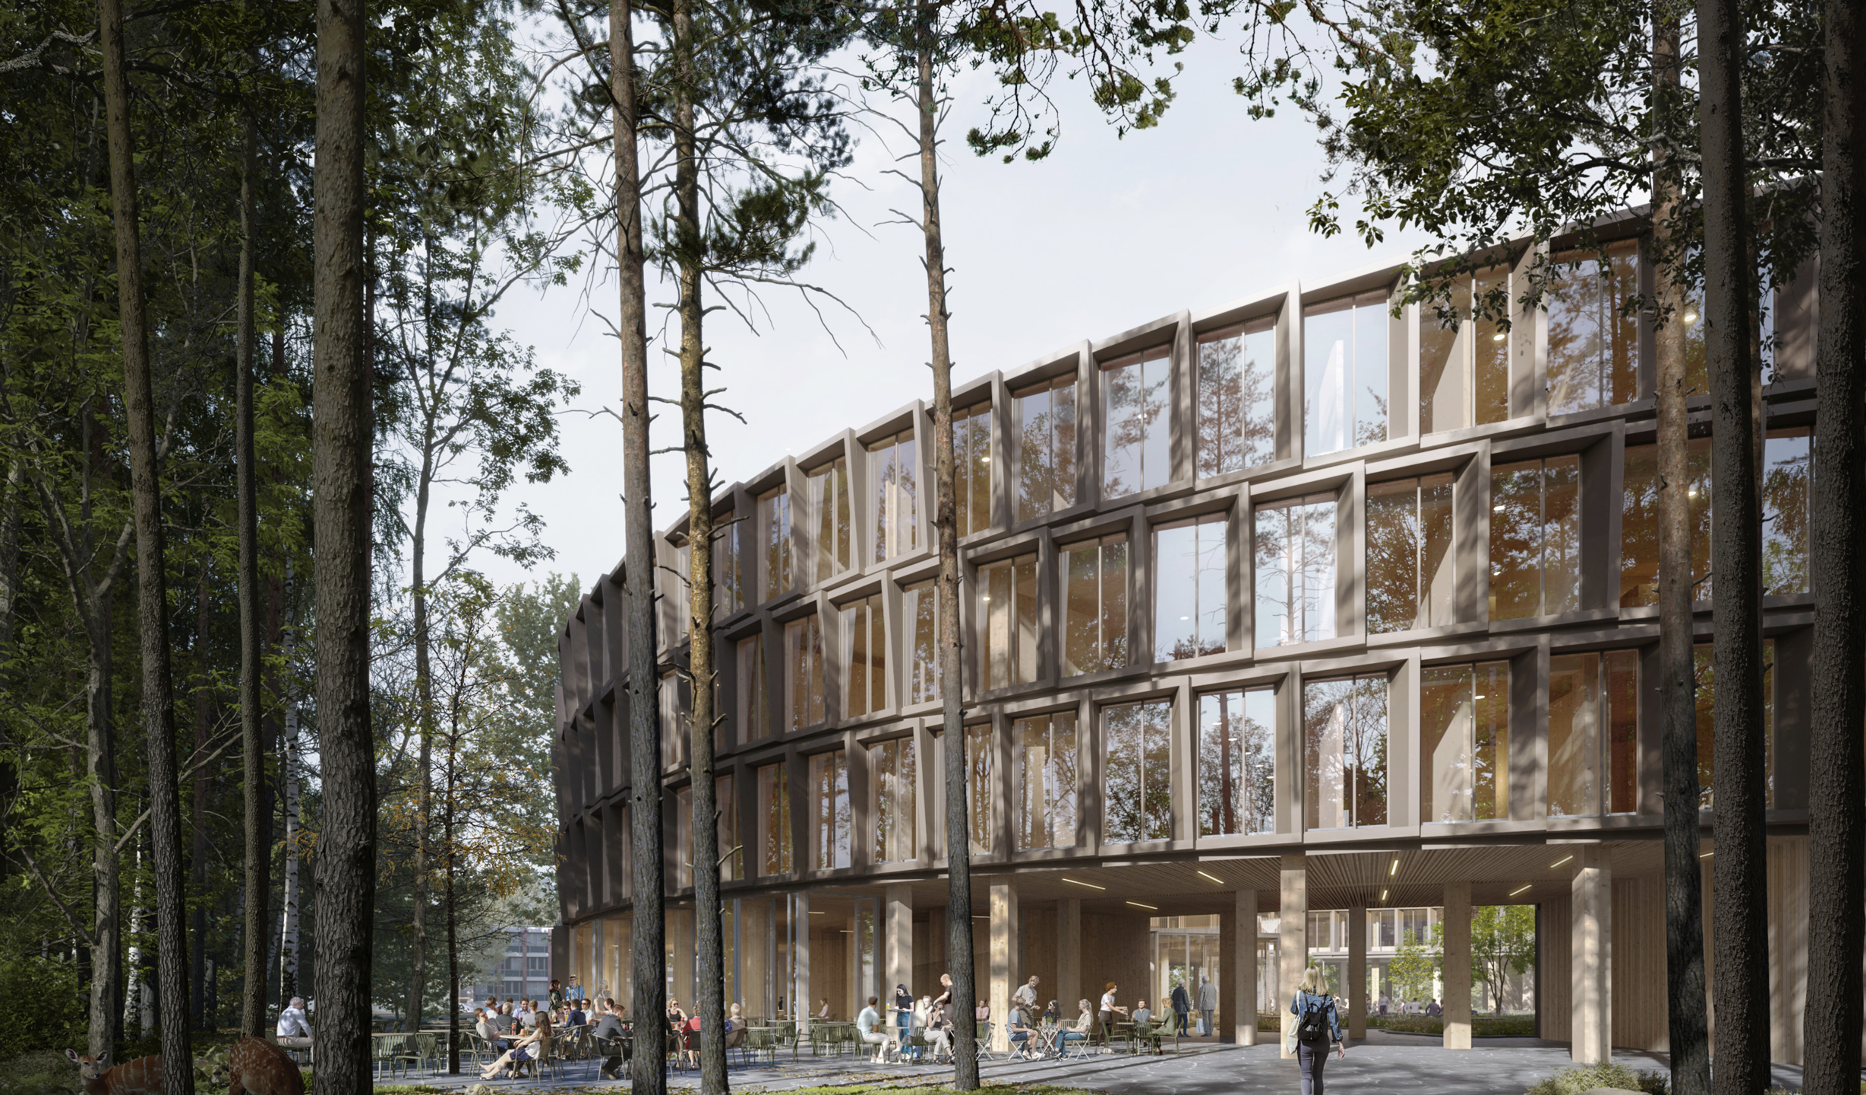

B777
https://building777.web.cern.ch
Functional objectives
New office (≈ 475p) and laboratory space (≈ 1000 m²) and meeting rooms for Accelerator & Technology Sector
Social & service hub for Prévessin Site, incl. new Restaurant
Soft mobility features
Status:
Preliminary design completed
Design development: value engineering and internal space distribution being finalized (~530p)
Building permit Q1 2024
Construction tender dispatch planned Q3 2024
B777 [m²] | Net area | Demolished | Emptied | Transferred | Rental End | Ratio
 | 6700 | 1700 | 1500 | 3000 | 0 | 90%

Slide 17
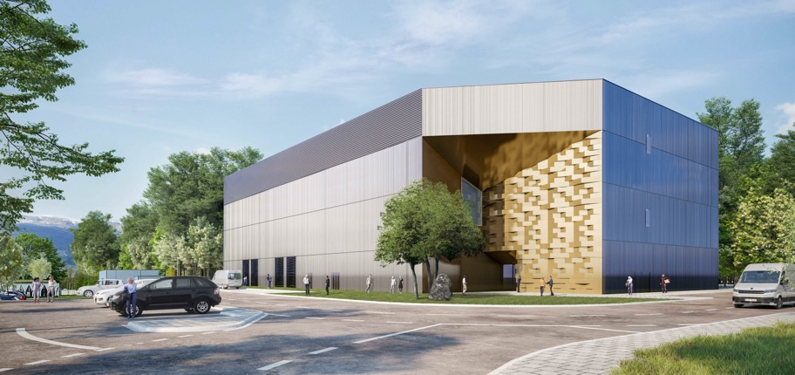
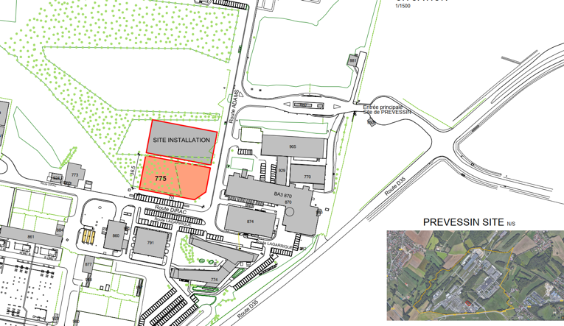
PREVESSIN COMPUTING CENTER
Purpose : The Contract is for the design, construction and 10-year M&O of the building and equipment.
Needs : Initial capacity of 4 MW available for IT equipment with stepwise future increases to 12 MW.
To meet CERN's environmental goals the project incorporates the following considerations :
The PCC is designed to be energy efficient with a target PUE (Power Usage Efficiency) of 1.10 (1.15 contractual)
Optimised water consumption via a recirculation system lowering consumption in hot periods
All cleared vegetation will be reconsolidated
The acoustic study used for design of the building follows CERN commitments
A heat recovery system is foreseen for up to 25% of power produced to be recovered
Green terrace on the roof
  CIVIL WORKS EXECUTION :
  Building foundations – 80%
  Ground level concrete works – 50%
  Below slab networks – 25%
  TESTING & COMPLETION :
  PCC Testing – Mar to Sept 23
  Operational from October 23
  PREVESSIN HEATING PLANT :
  MTP request 2021 and again in 2022
  Operational from 2026 if approved in this MTP

Slide 18
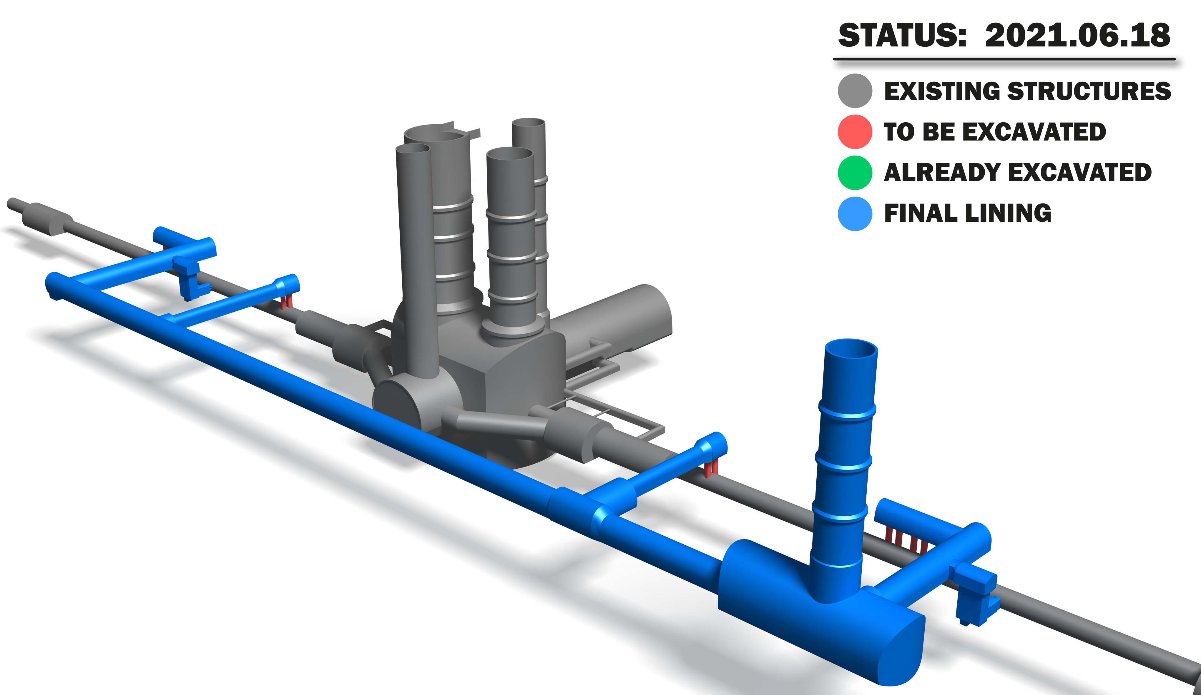
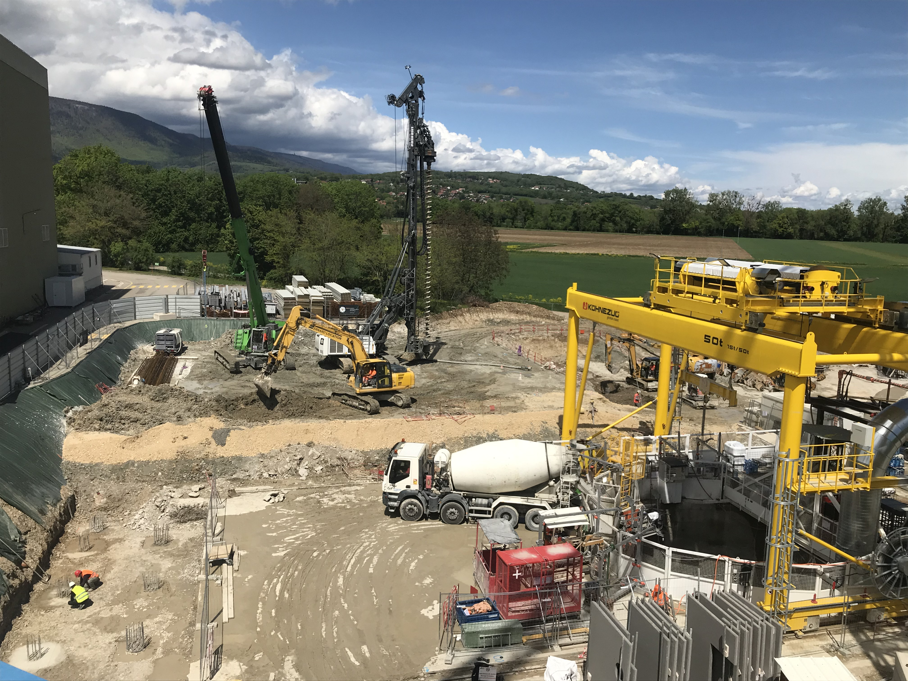
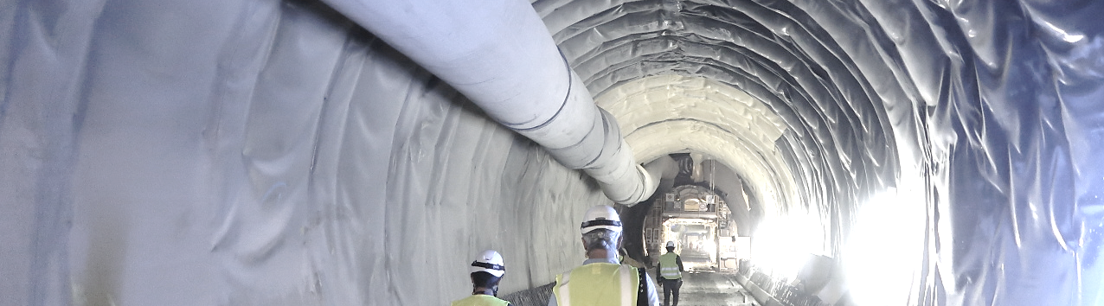
High Luminosity LHC

Slide 19
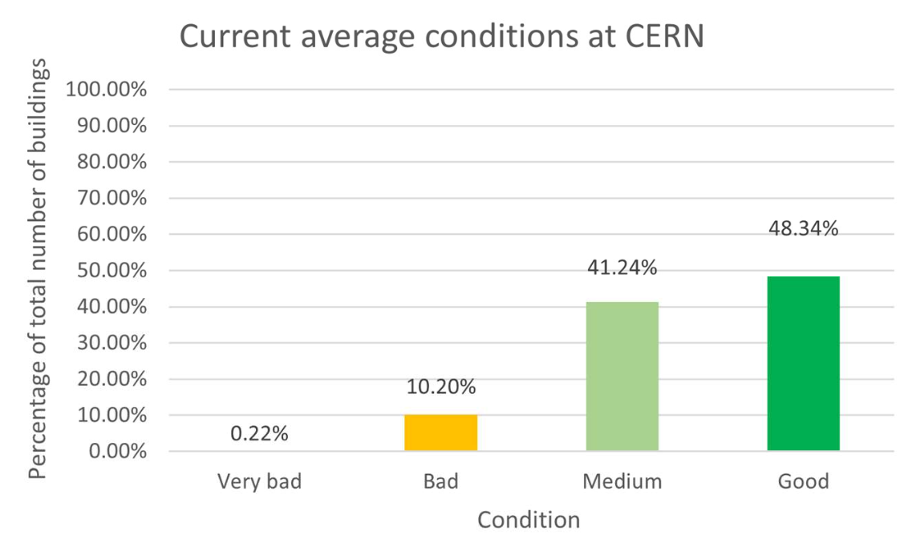
SITECONSOLIDATION
PRIORITIES
PROCESS
SPECIFICATIONS
Safety
Strategic value wrt scientific goals
Sustainability: durability, environmental impact, energy performance
Data-driven decisions
Standardization of requirements definition according to Masterplan objectives and approval process for execution
5-year view
Global renovations
Regulations compliance
Energy efficiency improvement: > 60%
Monitoring heating, electrical and lighting consumption
Operation of HVAC, Heating and lighting consumption according to the outdoor temperature, occupation of the premises, eco-mode
Favor centralized networks
AMBITIONS
Global renovation of up to 2 buildings/y
Densify consolidated space
New space management policy
Demolish depreciated space

Slide 20
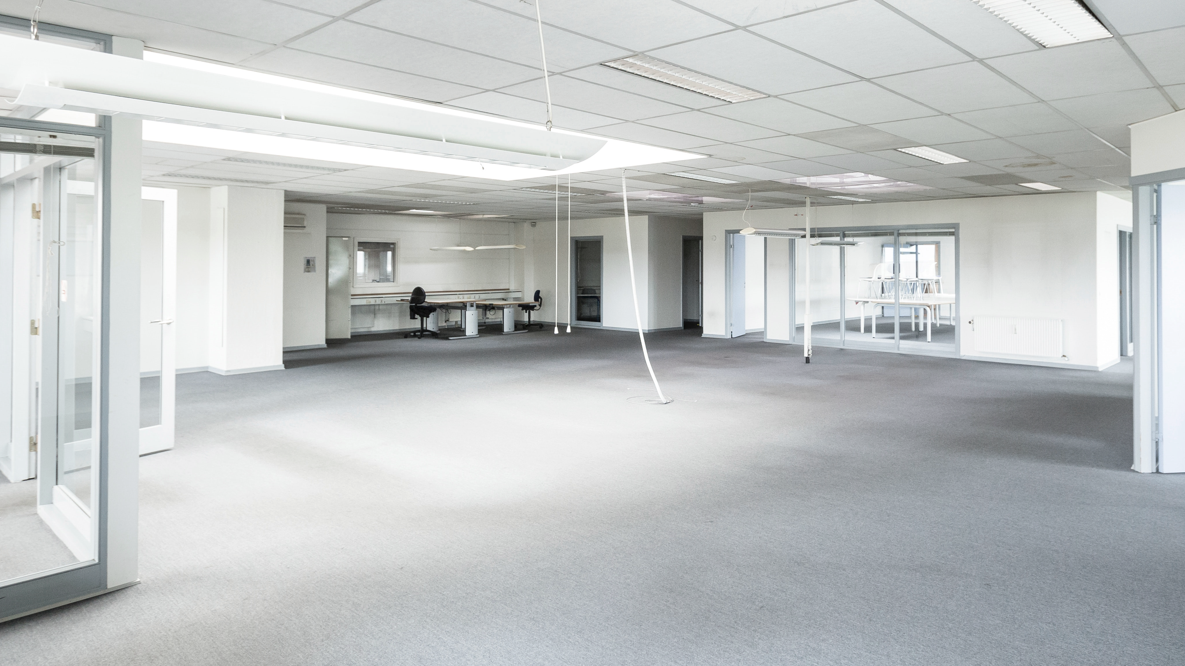
Impact on surface
Total surface built at CERN: 430 000 m²

Slide 21
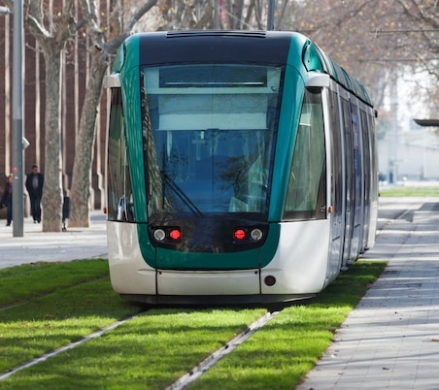
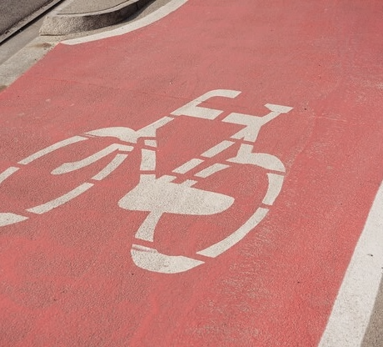

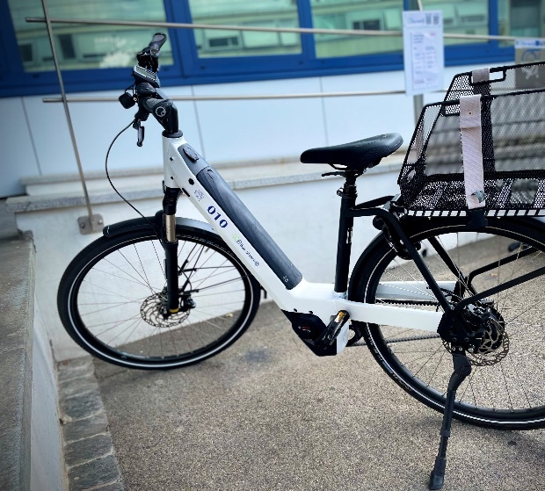
PARKING
MASTERPLAN2040
Optimise the car-parking facilities and their management :
  Limit car parking
  Privilege car parks close to the main road network in the context of new developments
  Continue the development of facilities for soft-mobility
  Develop communication promoting a reduction of the impact of people’s mobility at CERN
CIRCULATION
Promote efficient and fluid access to and circulation on the CERN sites :
  Optimise the fluidity of access to the CERN sites.
  Improve the hierarchy of the road network inside the CERN site.
  Continue developing accessible facilities for people with reduced mobility.
ALTERNATIVES
MOBILITY
Encourage alternatives to individual motorised transport for commuting :
  Encourage car sharing.
  Improve the continuity, safety and comfort of soft-mobility routes and provide parking for bicycles.
INTERSITE TRANSPORT
Promote alternatives for travelling between the CERN sites :
  Continue developing facilities associated with collective transport on site.
  Optimise the management and supply of CERN vehicles
  Expand and diversify CERN’s bicycle fleet.
  Continue developing the network of footpaths and cyclepaths on site.

Slide 22
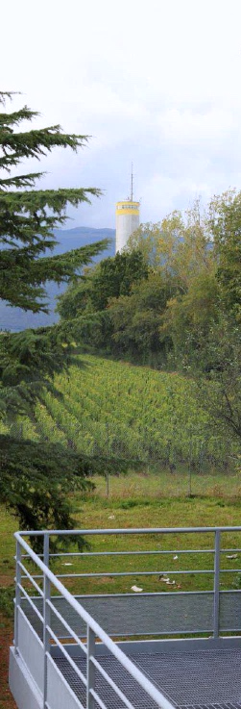

MASTERPLAN2040
INTEGRATION WITH SURROUNDING LANDSCAPE
Integrate the CERN sites with the surrounding landscape :
Integrate sites harmoniously with the existing features of the overall landscape and with the views onto that landscape
Enhance the CERN site perimeters by planting diverse hedgerows that will contribute to the overall ecological network
Implement an architectural strategy to enhance the image of CERN’s buildings and emblematic public areas
LANDSCAPE IDENTITY
Develop a landscape identity :
Harmonise and enhance the attractiveness of the landscape developments and gathering areas, and create a furniture and signage catalogue
Reduce islands of heat and plant trees and shrubs close to existing and future paved or tarmacked spaces, car parks and roads
LANDSCAPE

Slide 23
TECHNOLOGY & ENVIRONMENT
INNOVATION PROGRAMME ON ENVIROMENTAL APPLICATIONS
GREEN
VILLAGE
FROM SOCIETY TO CERN TO SOCIETY
Enabling rapid access to CERN campus as a test site for technologies linked to environment and sustainability
Accelerating the commercialization of ideas, technologies and prototypes
Involving Young Innovators (new ideas for unforeseen applications)
Challenges: waste management, mobility, energy efficiency for tertiary activities on campus, space management, IoT, Zero-waste, urban analytics, …
FROM CERN TO SOCIETY
CIPEA: Developing advanced technologies linked to environment and sustainability
E.g. solar thermal panels derived from vacuum technology; CO₂ cooling technology; superconductive power transmission lines and current leads

Slide 24

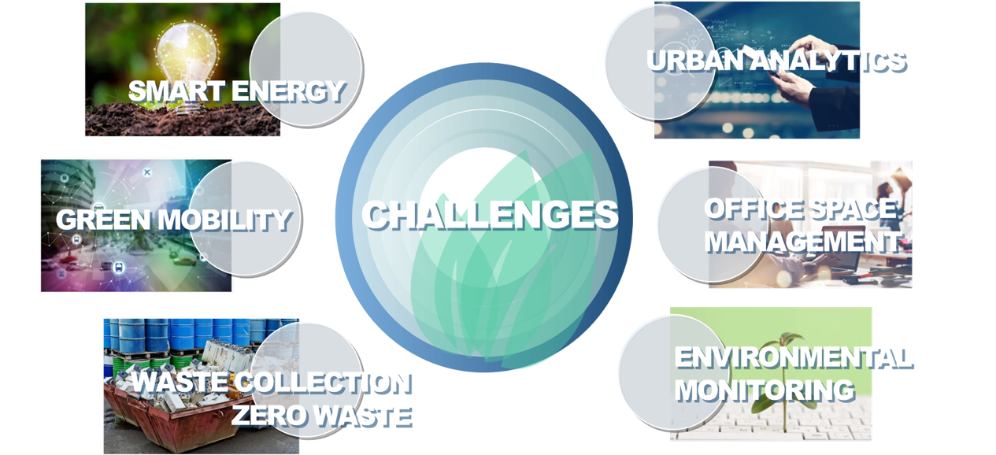
Green Village: Focus Areas for Collaboration
Main conditions:
Technology Maturity: Must be beyond proof-of-concept (TRL 4-6).
Sustainability Focus: Address a clearly identified sustainability challenges at CERN.
Timeliness: Should be feasible in reasonable timescale.
Acceleration of sustainable solution
Realistic Testing Environment: Should necessitate a city-like environment to accelerate the sustainable solution.
Focus on research collaboration; not procurement.
Compliance: Must adhere to CERN’s Health, Safety, and Environment (HSE) standards and access rules.
24
24

Slide 25
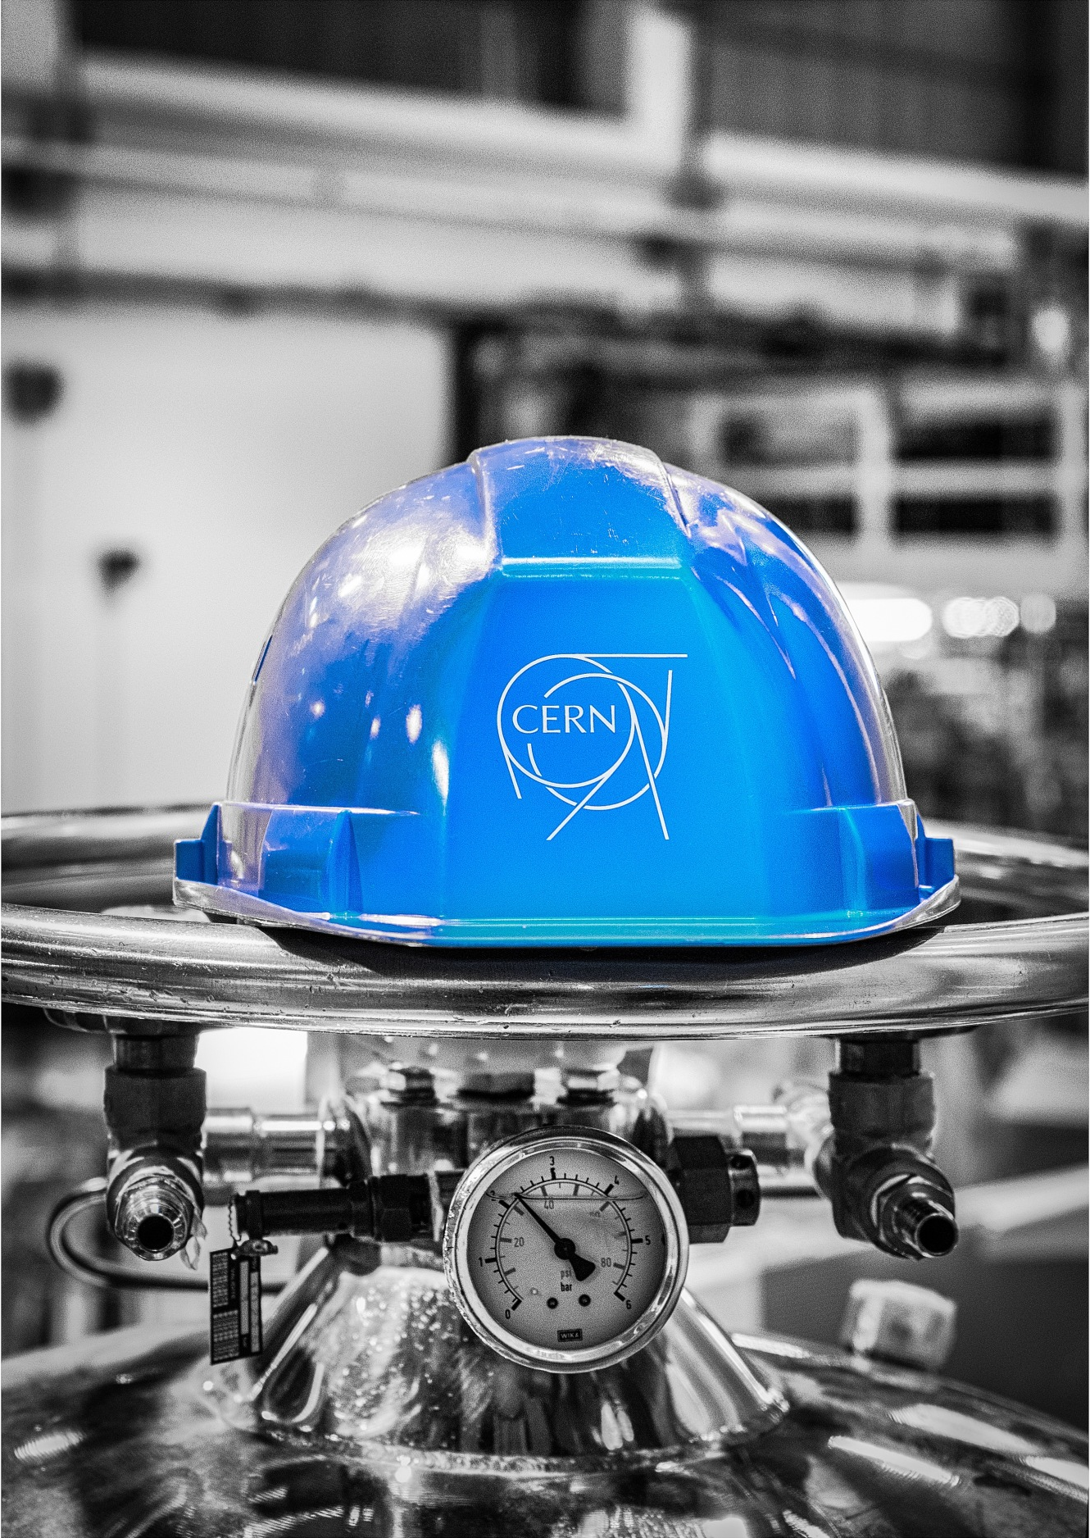


https://sce-dep.web.cern.ch

