Slide 1

CERN SCIENCE GATEWAY
Frédéric Magnin – 4.12.2023

Slide 2
Project brief
CERN's visitor centre to promote science, technology, engineering and mathematics to a wide audience(300k visitors/y) of all ages.
The centre will offer multipurpose spaces on a floor area of 7’000 m2:
Exhibition areas
900-seat auditorium
Educational Laboratories for school groups
Welcome reception and a shop
Restaurant
Outdoor spaces

Slide 3
Other specificities and challenges
Special permitting required
Integration with the Esplanade des Particules and the Globe of Science and Innovation
Enhanced flexibility for multi-purpose usage
  Very high energy performance certification + Carbon neutral
  Fully funded by donation

Slide 4
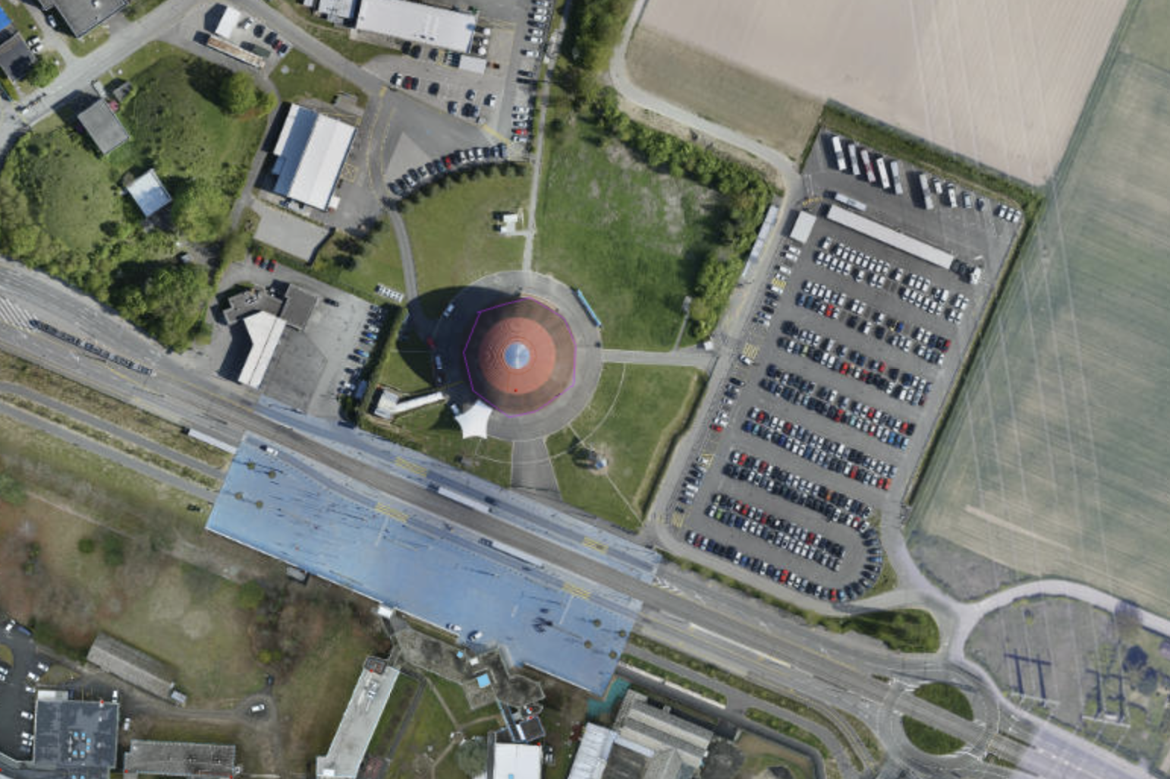
2018…

Slide 5
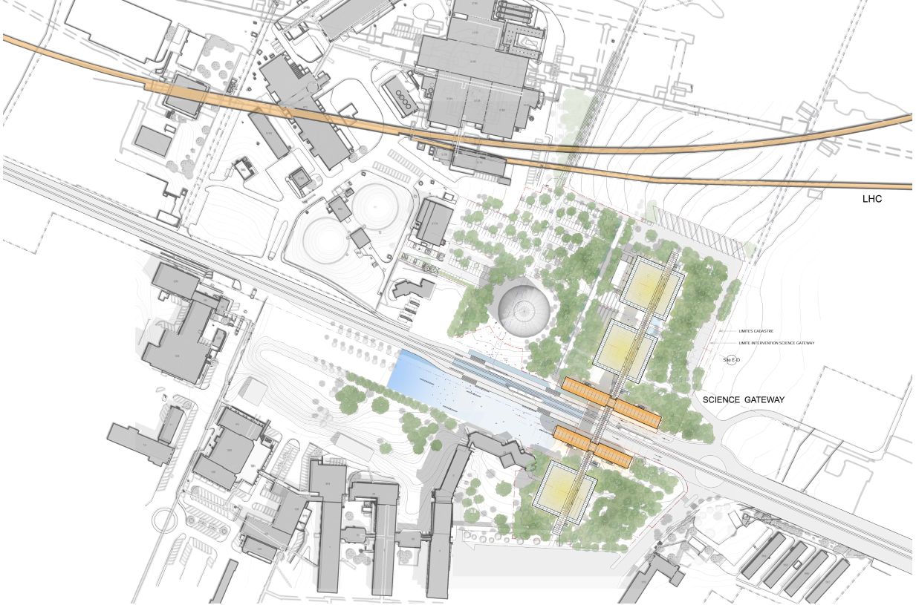

Slide 6
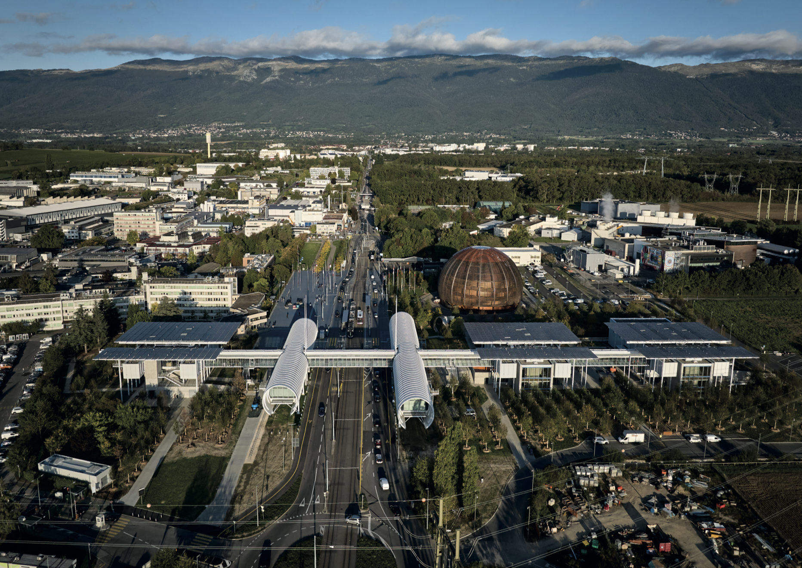
2023 !

Slide 7
A vision
Promote STEM to contribute facing tomorrow’s challenges
Inspire the youngest generation (as of 6 years old)
Science museum where fundamental research takes place
Hands-on experience and meeting scientists & engineers
Not just a building but a campus

Slide 8

Sharing the vision

Slide 9
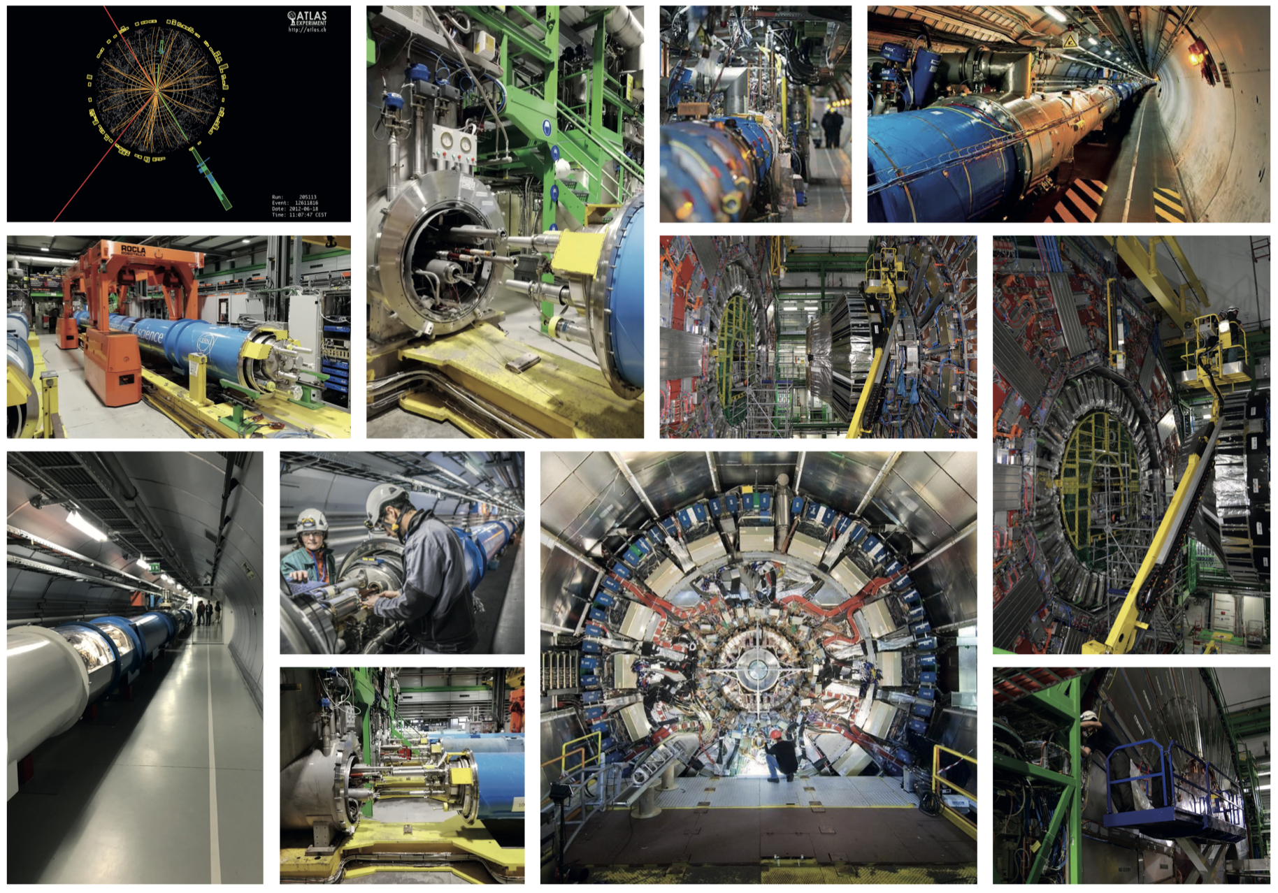
Inspiration

Slide 10
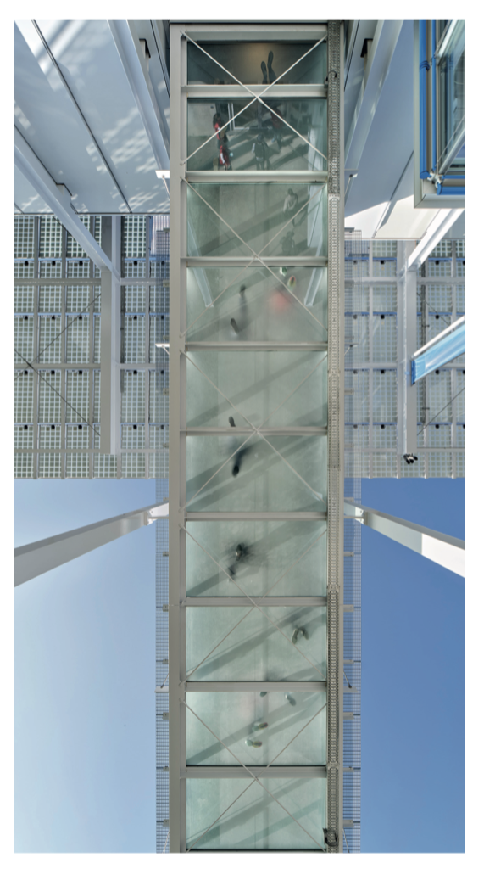
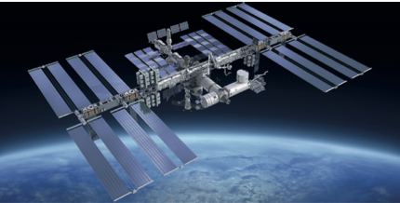
Some poetry…

Slide 11
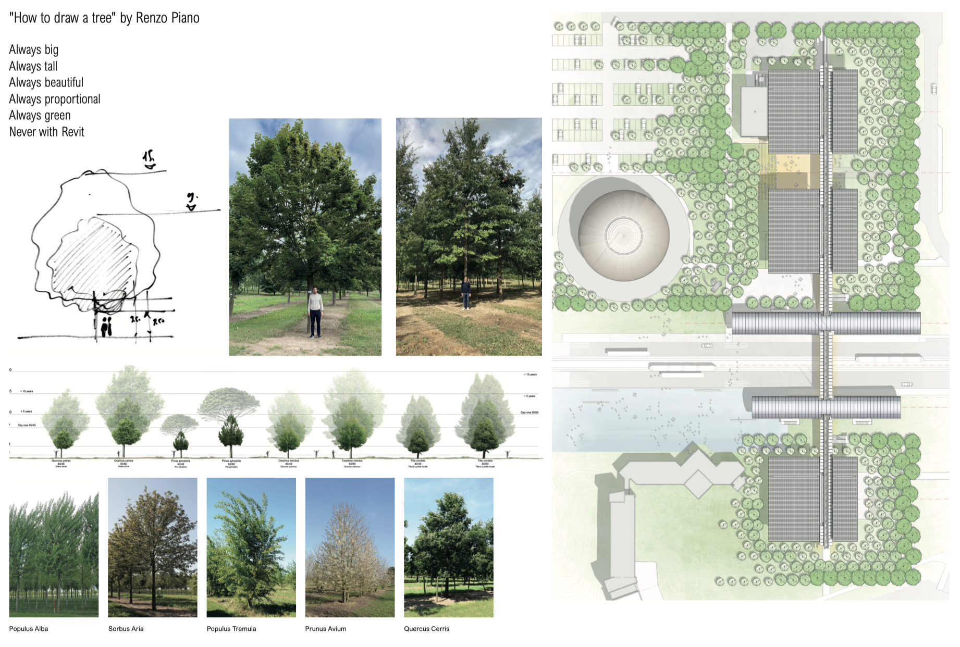

Slide 12
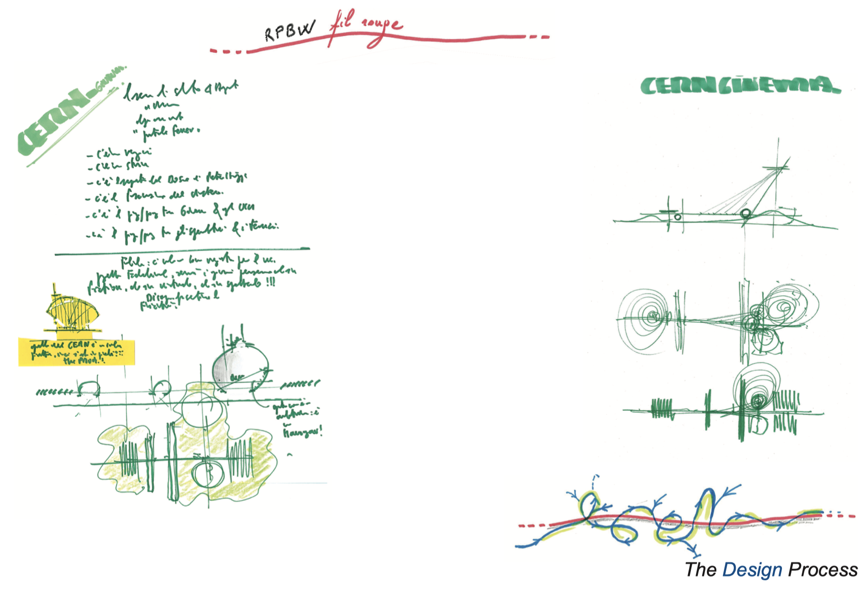
A journey…

Slide 13
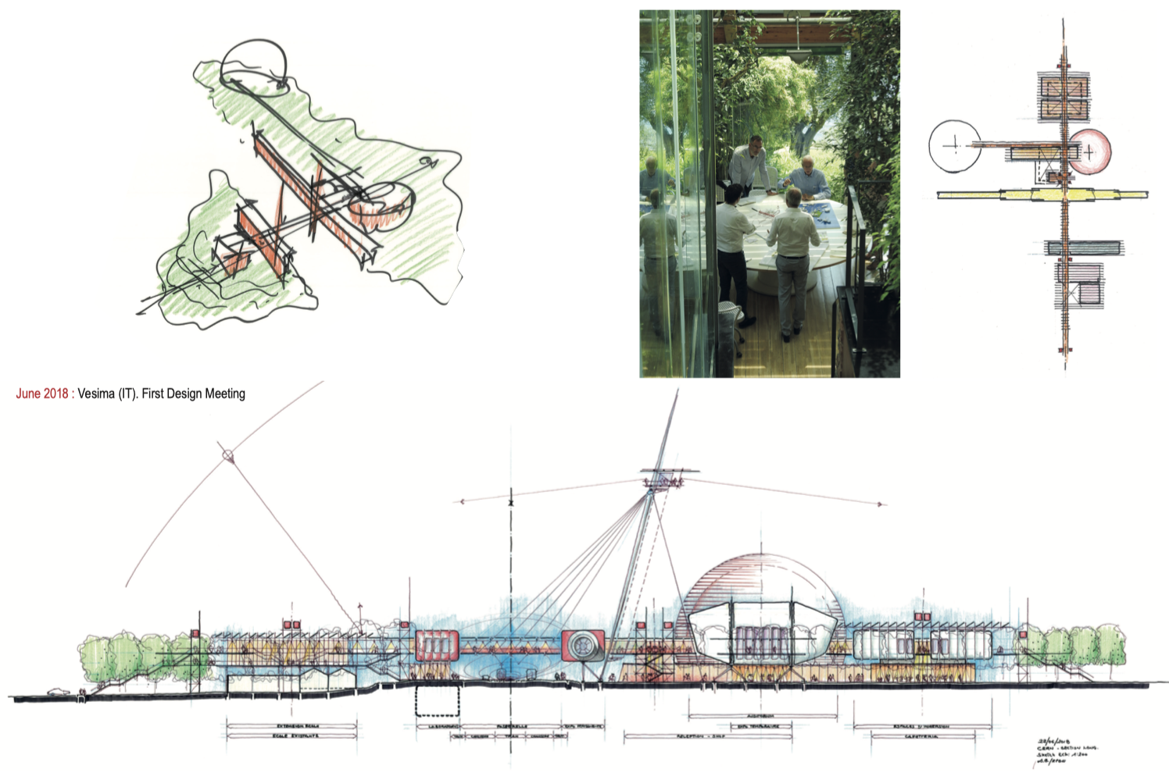

Slide 14
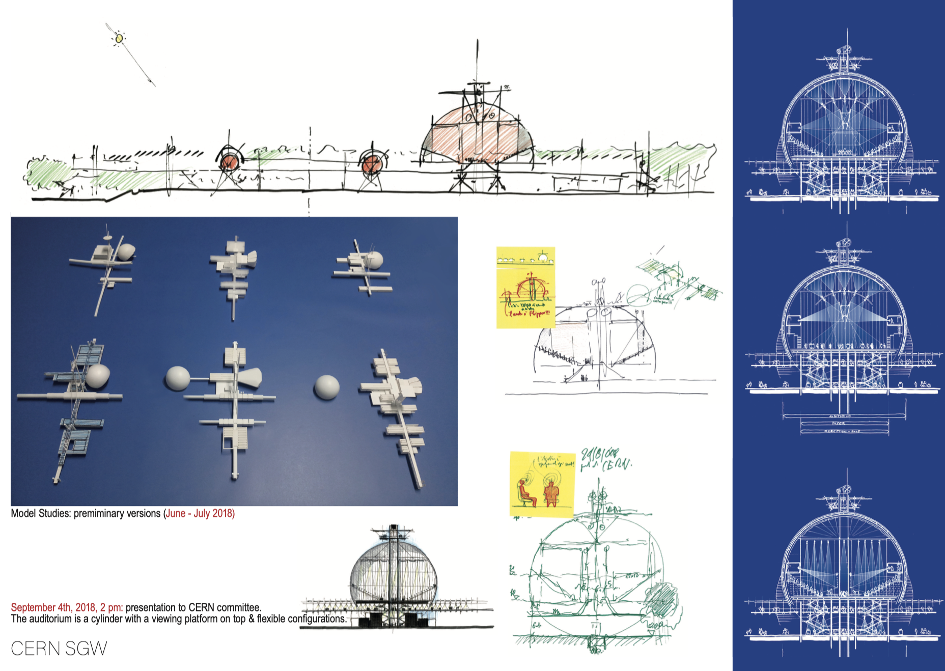

Slide 15
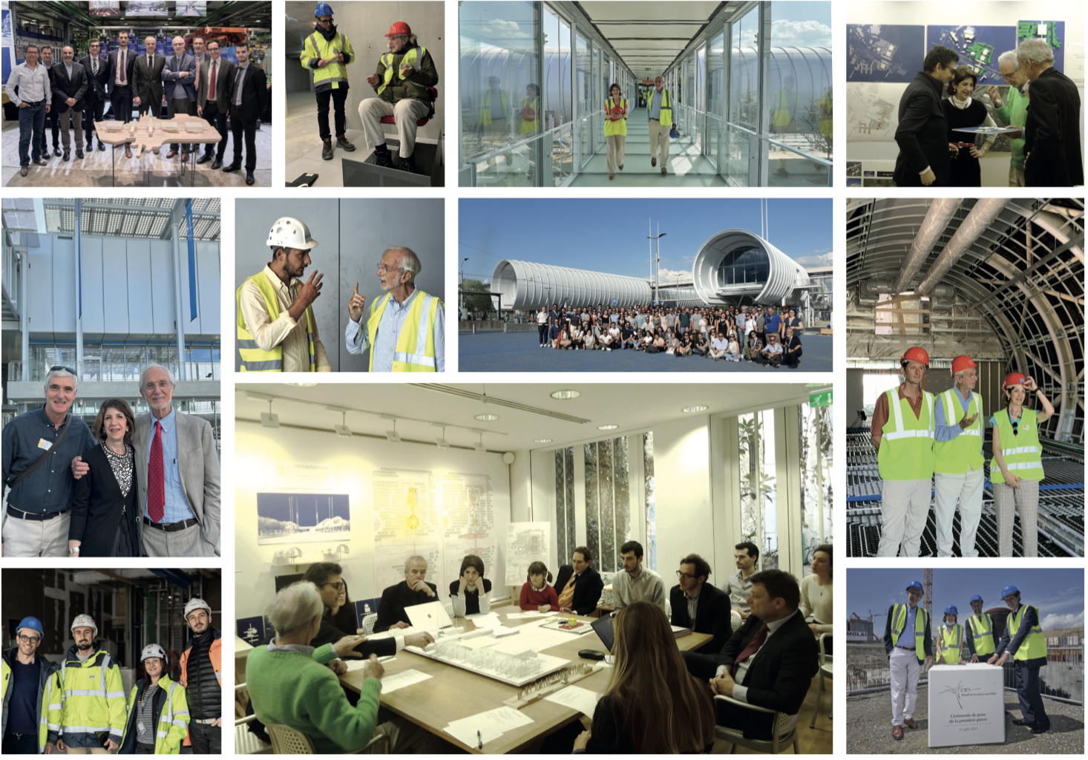
Collaboration

Slide 16
Thank you for your attention
Frédéric Magnin – 4.12.2023

Slide 17


CERN’S GREEN VILLAGE Initiative
CERN’s GREEN VILLAGE INITIATIVE
Roy Pennings
Senior EU-projects manager

Slide 18





CERN’s environmental track record
2016 | 2017 | 2018 | 2019 | 2020 | 2021 | 2022 | 2023 | 2024 | 2025
Environmental Protection Steering Board
Baseline year
2017-2018
Environment Report
2023-2024 Environment Report
Materiality analysis
Environmental Noise policy
2021-2022 Environment Report
2019-2020 Environment Report
Energy Performance plan
Environmentally Responsible Procurement Policy
Environmental Responsible Procurement Policy Project
ISO50001 certification
Masterplan2040
Green Village
Innovation Programme on Environmental Applications

Slide 19

Green Village is a visionary initiative linking CERN’s Environmental roadmap with industrial solutions for sustainability and the talent of innovators.
a village-size laboratory.
agile and flexible.
an ideation and experimentation space.
a platform for engagement with innovators.
a showcase for innovation and societal engagement.

Slide 20
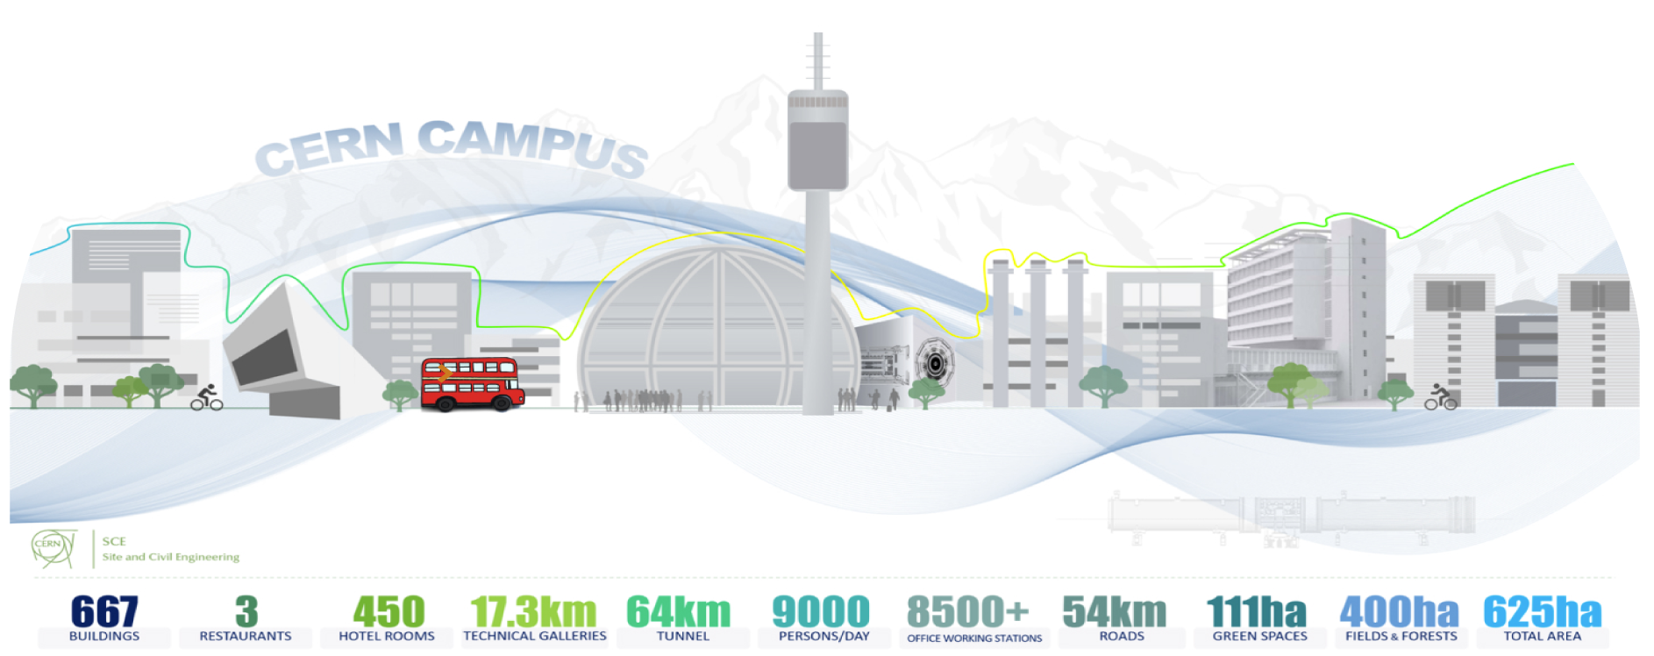
Our value proposition..
CERN offers its campus as a demonstration partner in Horizon Europe consortium projects and/or as a testbed for early-stage sustainable technologies developed by individual companies and start-ups.
Partners gain access to
CERN’s elaborate infrastructure
Top-level expert in many fields
CERN’s international network.

