Slide 1




FCC-ee Higgs CP Studies
Nicholas Pinto (JHU), Andrei Gritsan (JHU), Jan Eysermans (MIT), Valdis Slokenbergs (JHU)
<Link to Indico>
11 December 2023

Slide 2
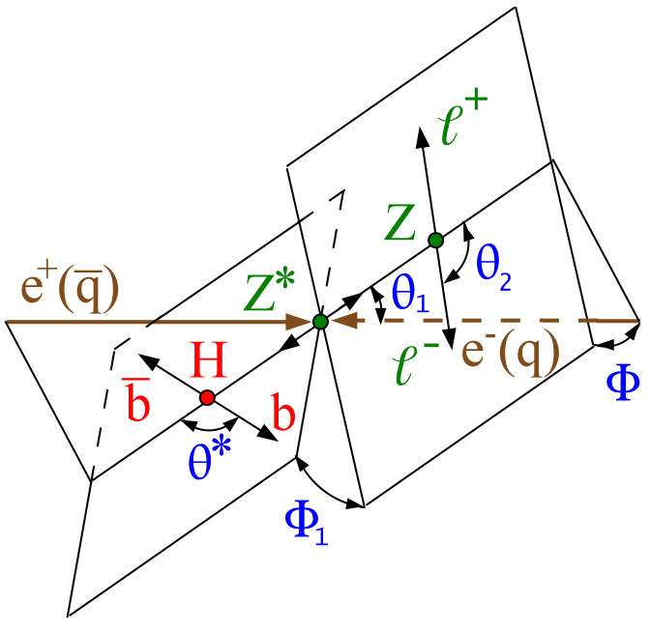
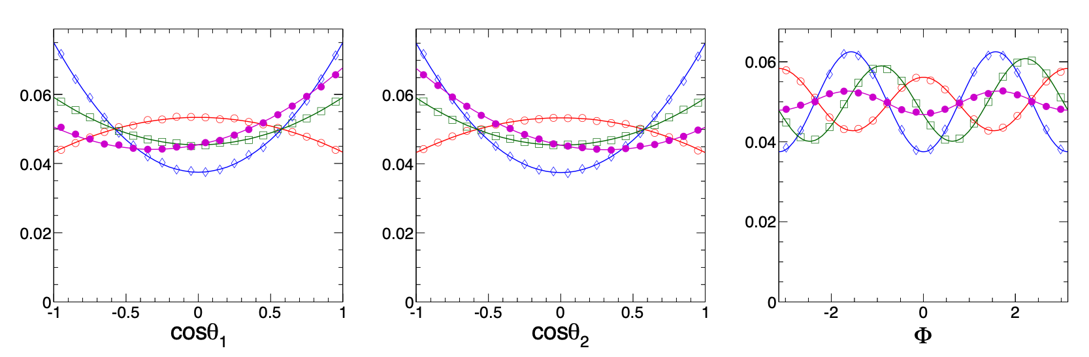
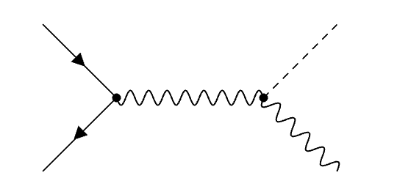
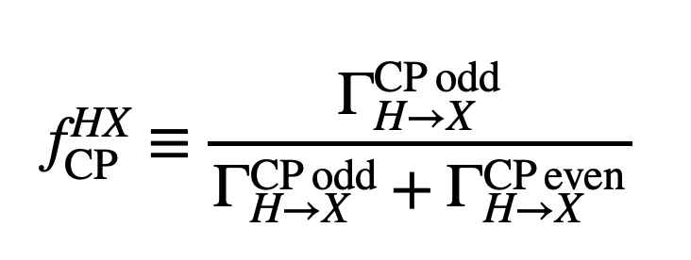
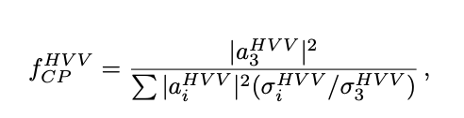









Past Studies: Snowmass 2013
arXiv:1309.4819
$$0^{+}$$
$$0^{−}$$
$$f_{CP}^{VH}=0.5,φ=\frac{π}{2}$$
$$f_{CP}^{VH}=0.5$$
$$e^{−}$$
$$H$$
$$Z^{∗}$$
$$e^{+}$$
$$Z$$
Notes:
Note to self, do I need these?

Slide 3
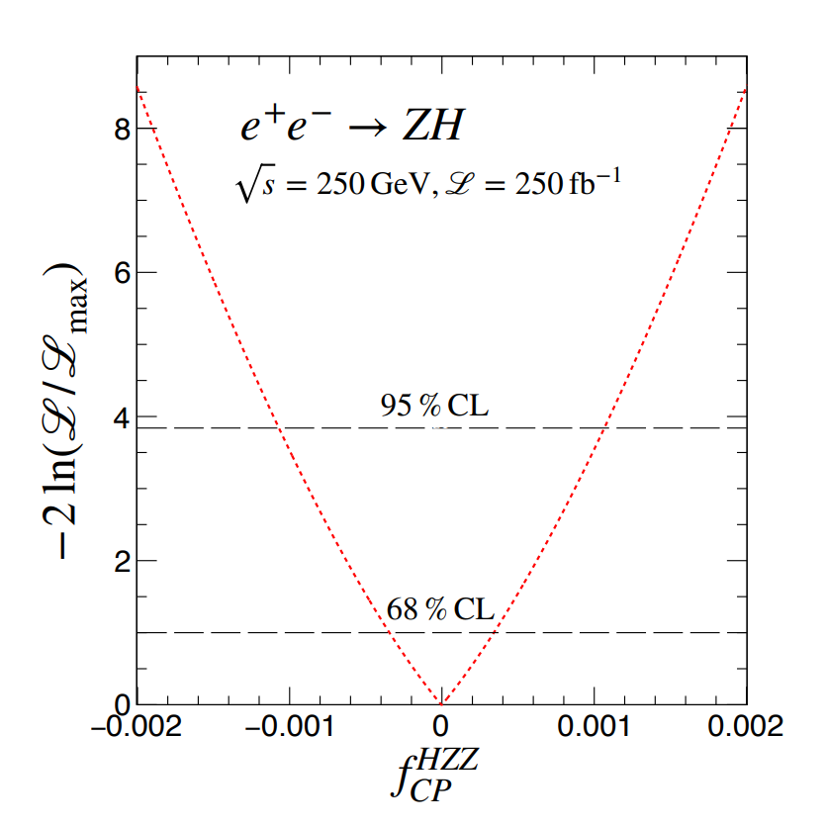
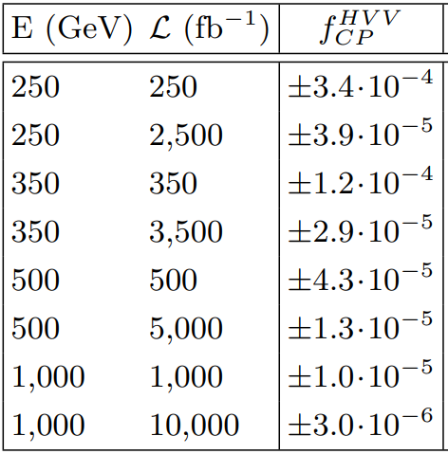
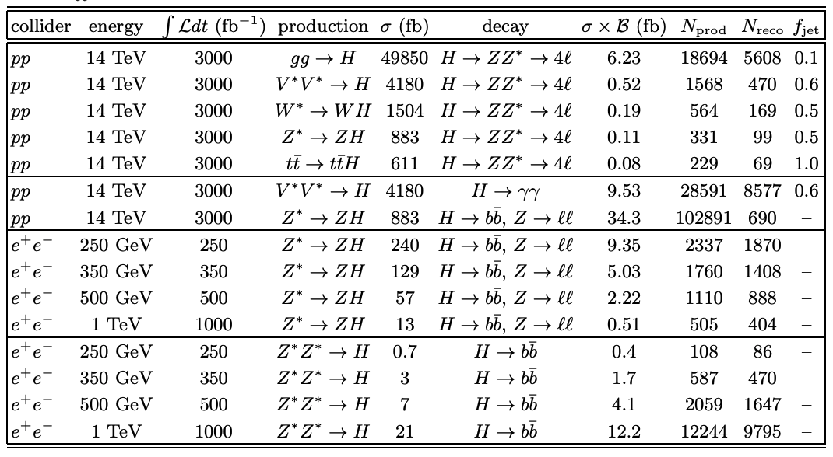
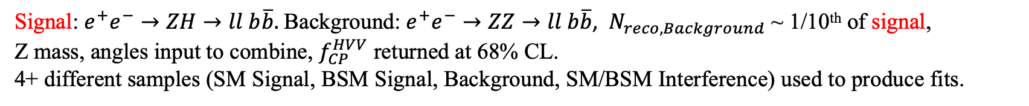
Past Studies: Snowmass 2022
arXiv:2205.07715
Signal: $e^{+}e^{−}→ZH→ll b\overline{b}.$Background: $e^{+}e^{−}→ZZ→ll b\overline{b}$, $N_{reco, Background}$ ~ 1/10th of signal,
Z mass, angles input to combine, $f_{CP}^{HVV}$ returned at 68% CL.
4+ different samples (SM Signal, BSM Signal, Background, SM/BSM Interference) used to produce fits.

Slide 4
Current Study
Goals:
Within FCC Framework, reproduce past study fits using templates from FCC Reco-level simulation and yields from past LHE-level study.
Reproduce fits but with the yields re-calculated based on luminosity, cross sections, and selection of the FCC samples.
Generate 1 sample instead of many, use Matrix Element Likelihood Approach (MELA) to reweight to other samples.

Slide 5
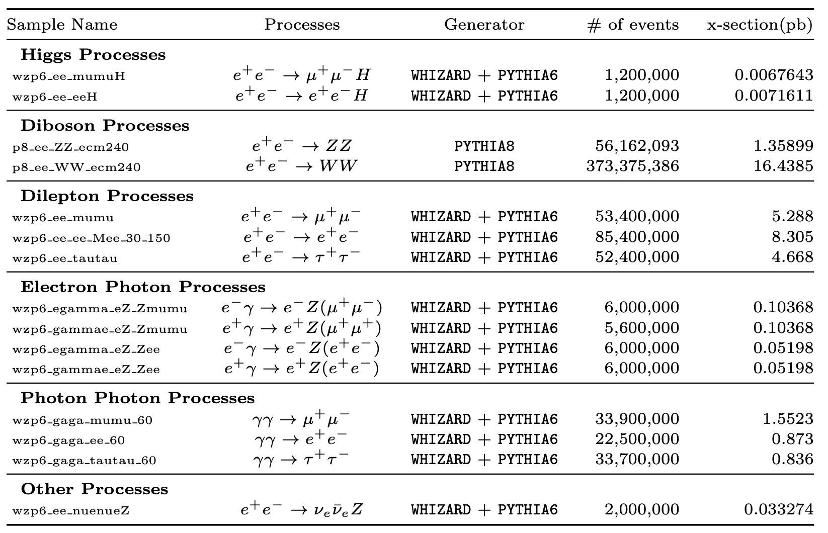
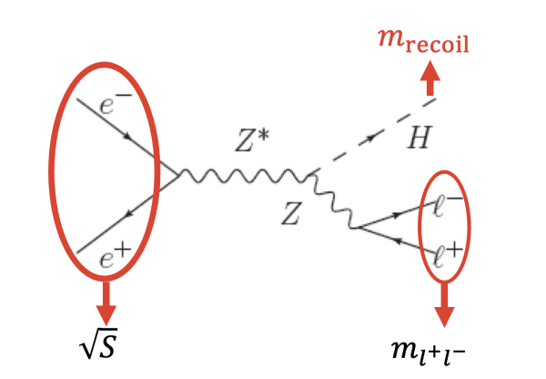

Current Study
This study shares selection with Jan Eysermans’ and Ang Li’s cross-sectional analysis.
This analysis does not fully reconstruct the Higgs, it decays inclusively.
Only manipulating $a_{3}^{HVV}$
The study is run over the Winter2023 Campaign.
These come from Jan’s and Ang’s study.

Slide 6
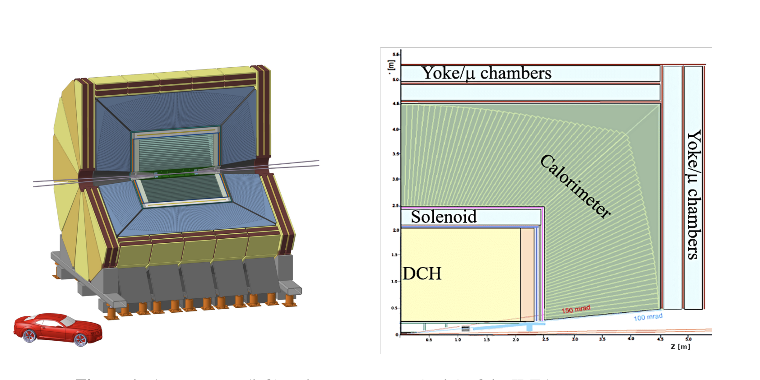
FCC-IDEA Detector
The IDEA detector concept for FCC-ee
Detector simulation is done in the DELPHES framework.

Slide 7
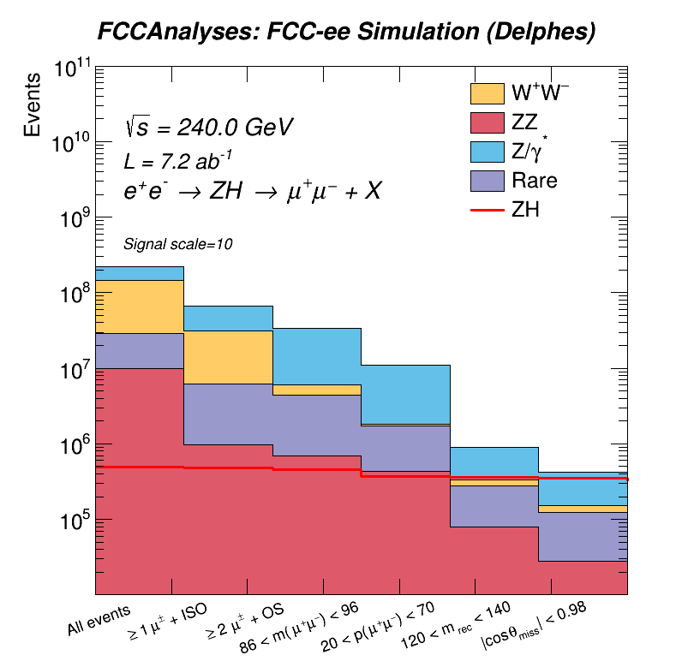
Current Cuts Made
≥ 1 isolated lepton.
≥ 2 charge conj. leptons.
86 < dilepton inv. mass < 96
20 < dilepton system momentum < 70
120 < Recoil mass < 140
|Cos(t)_miss| < 0.98

Slide 8
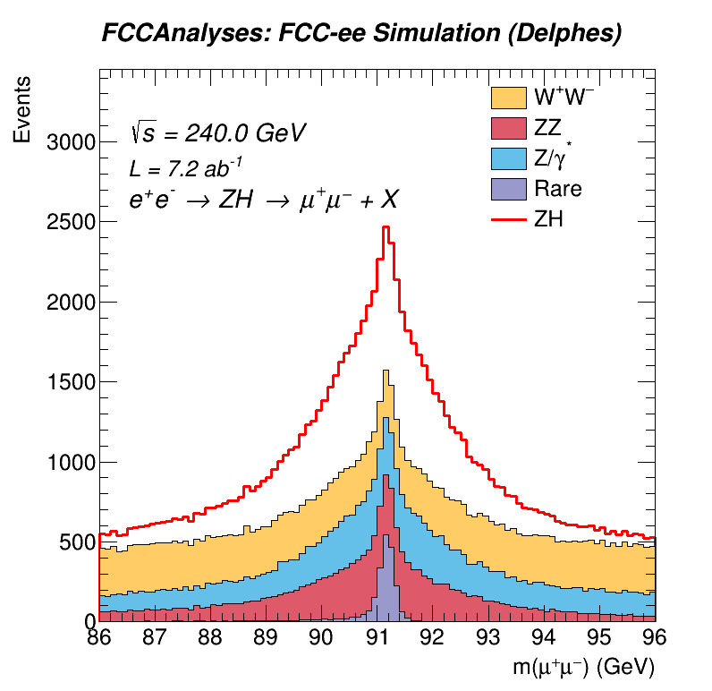
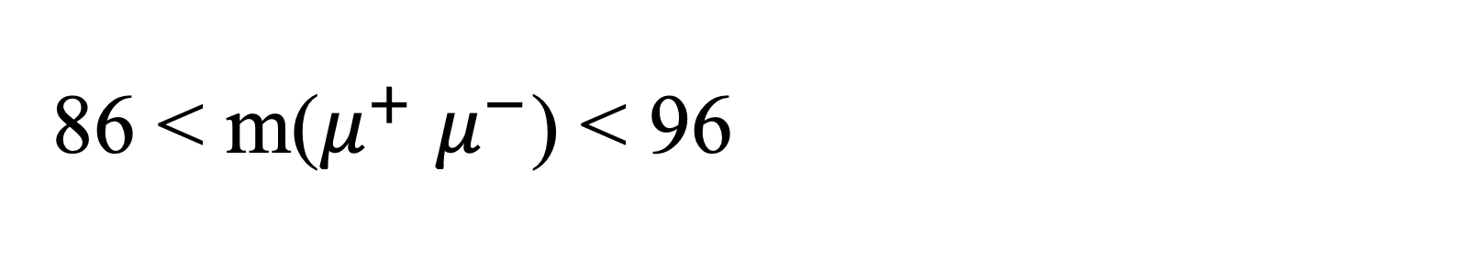
86 < m($μ^{+}$ $μ^{−}$) < 96

Slide 9
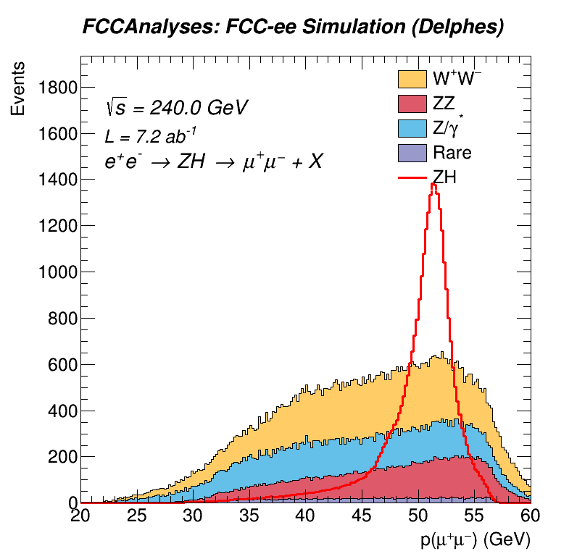
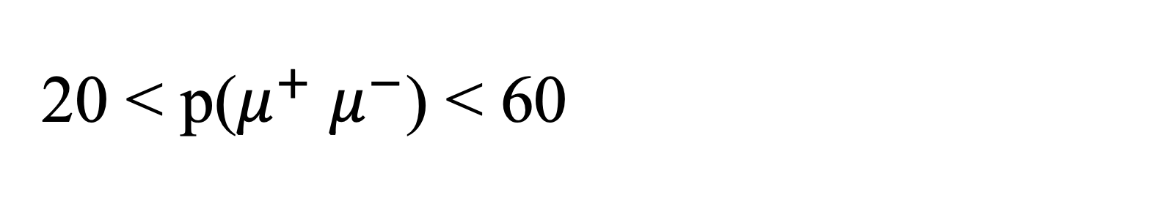
20 < p($μ^{+}$ $μ^{−}$) < 60

Slide 10
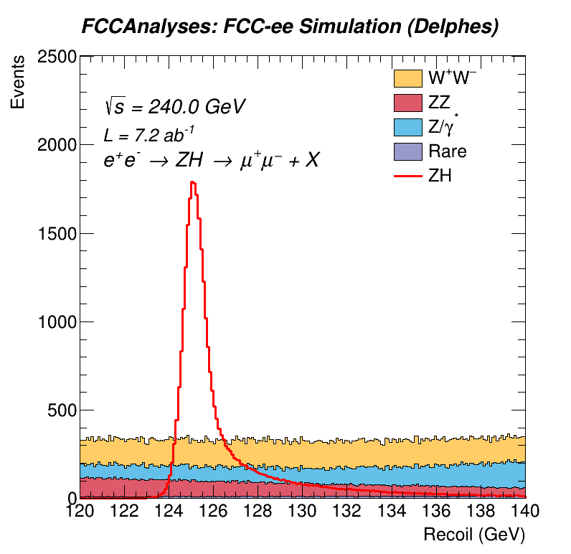
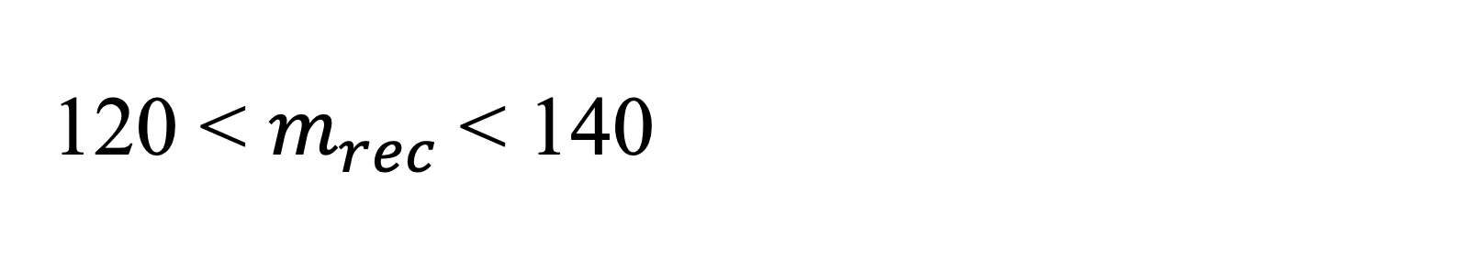
120 < $m_{rec}$< 140

Slide 11
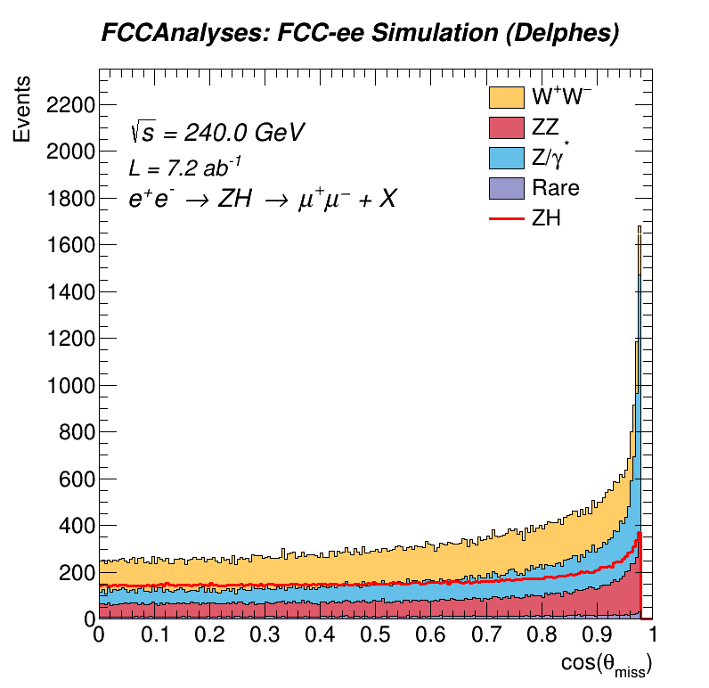
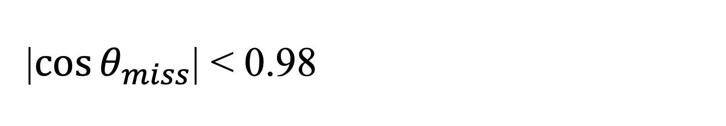
|$\cos{θ_{miss}}$| < 0.98

Slide 12
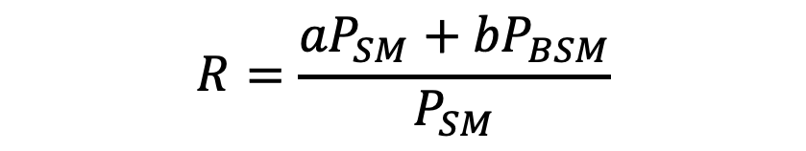
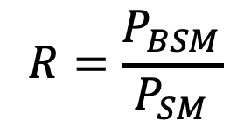
What is MELA?
Use event kinematics to reweight from SM hypothesis to BSM hypothesis.
Also reweight from SM hypothesis to mixed states.
$$R=\frac{P_{BSM}}{P_{SM}}$$
$$R=\frac{{{aP}_{SM}+bP}_{BSM}}{P_{SM}}$$

Slide 13
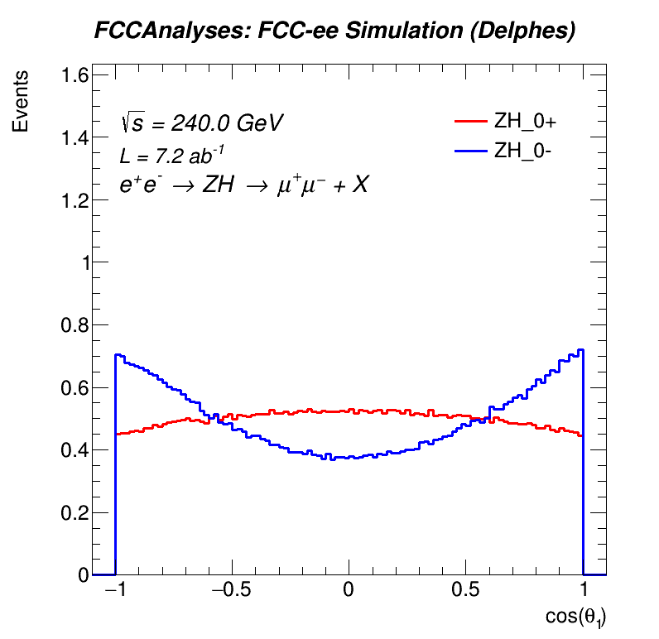
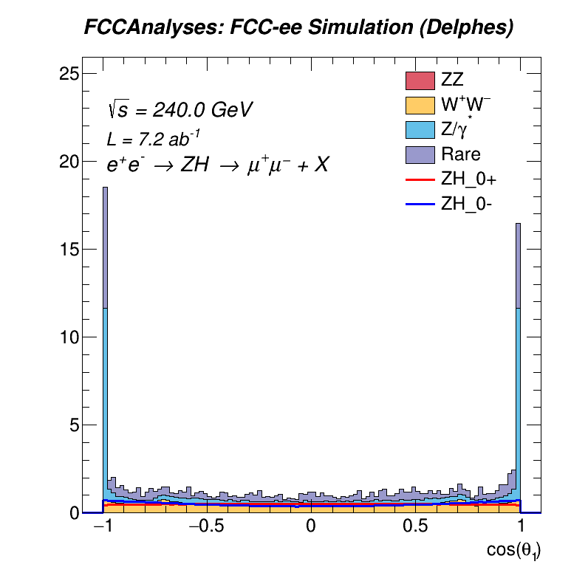
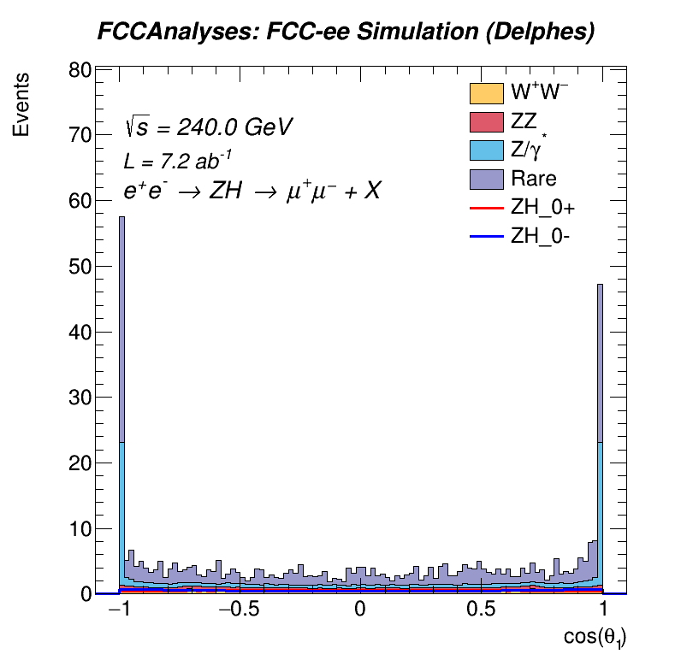
Reco-Level Angular Distributions

Slide 14
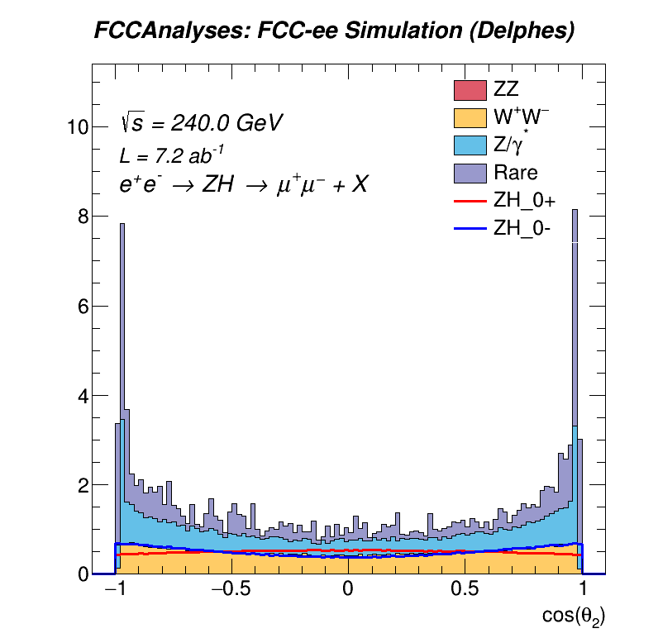
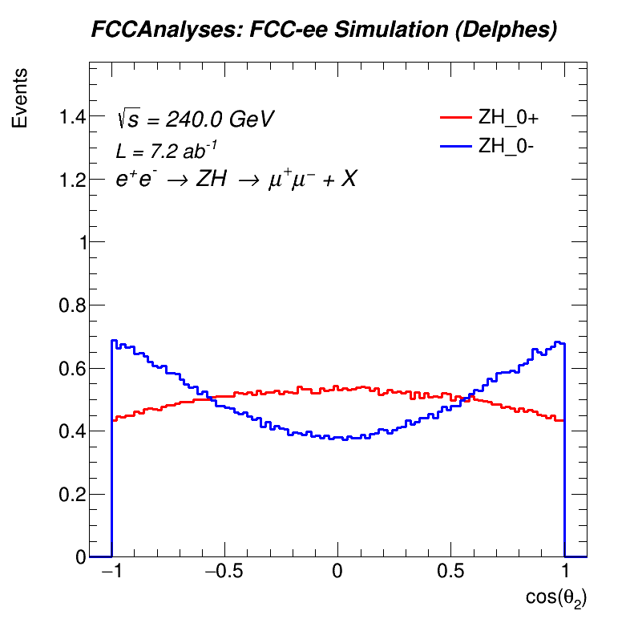
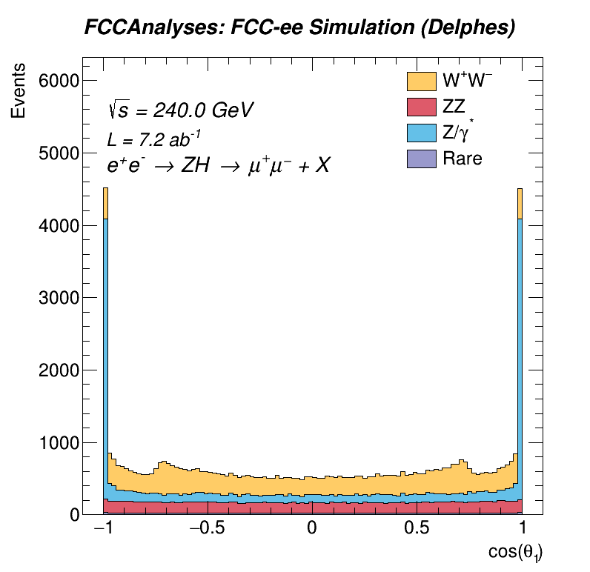
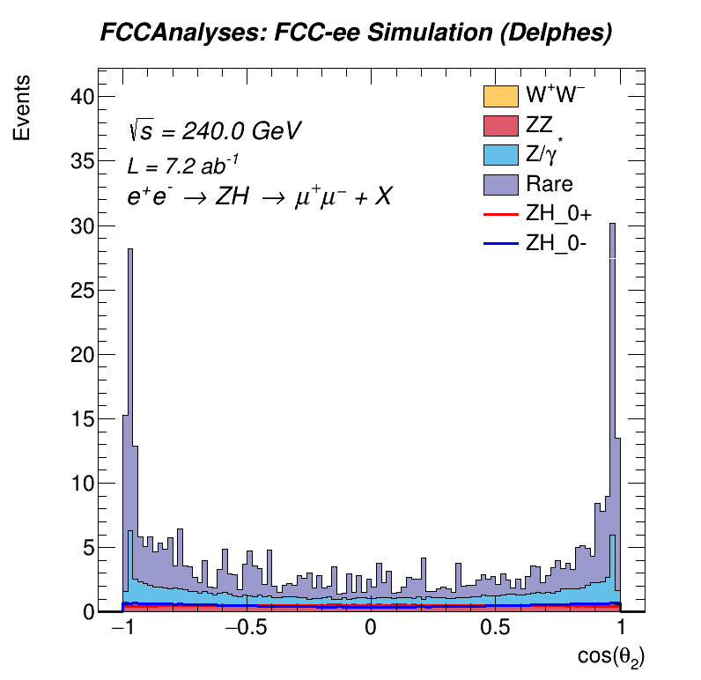
Reco-Level Angular Distributions

Slide 15
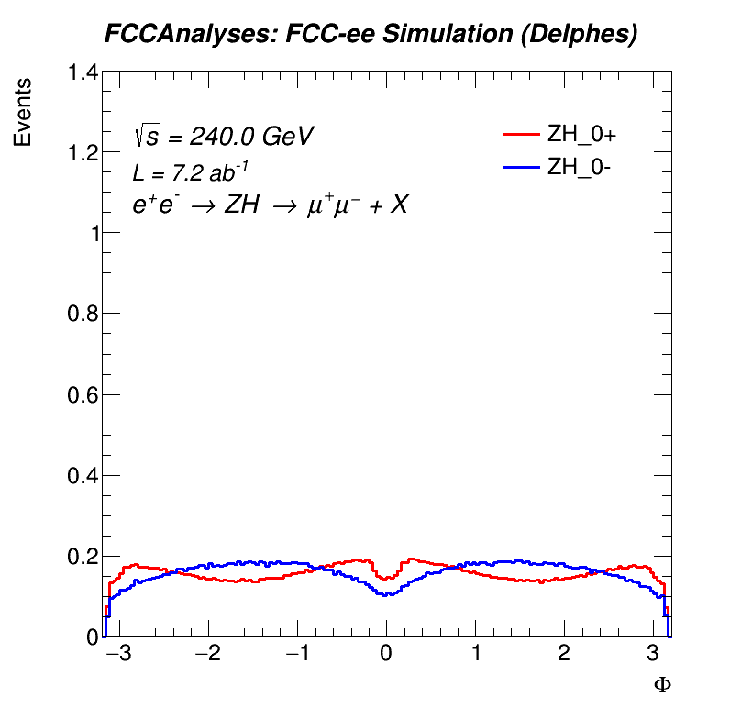
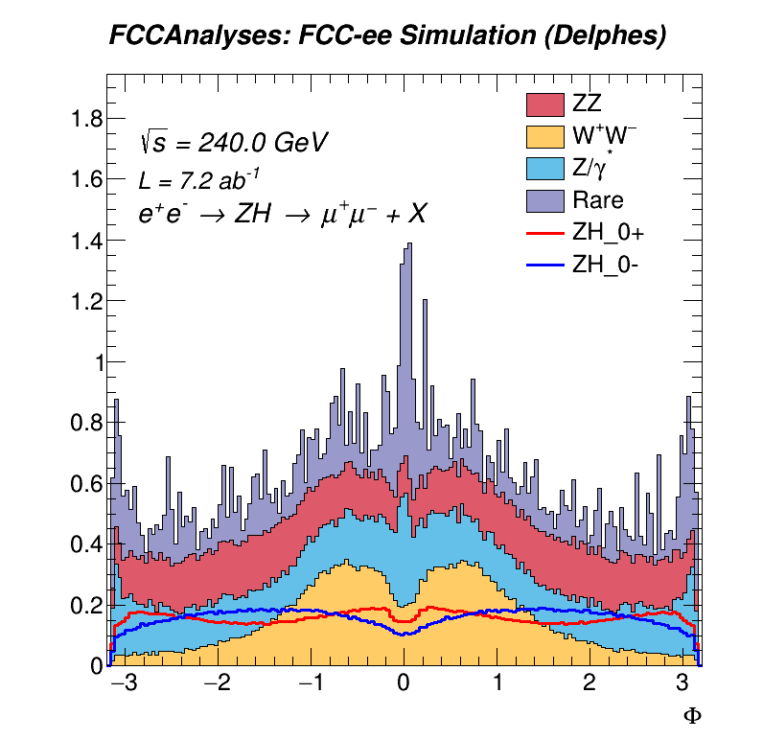
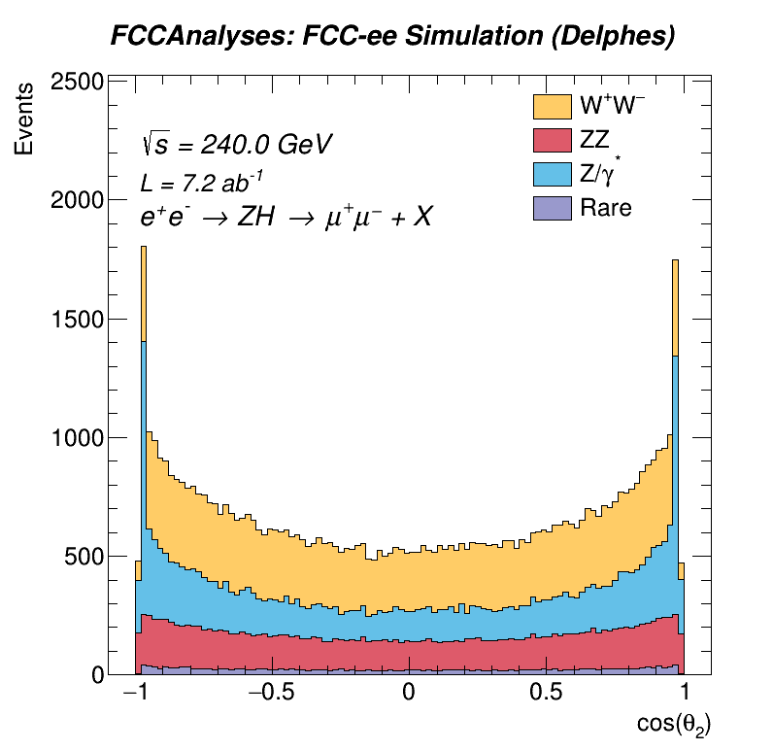
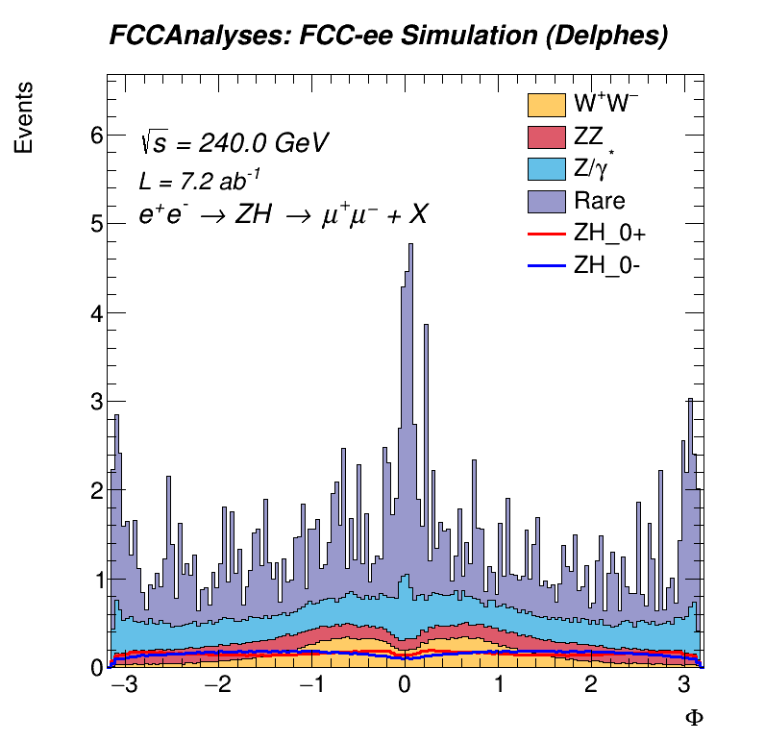
Reco-Level Angular Distributions

Slide 16
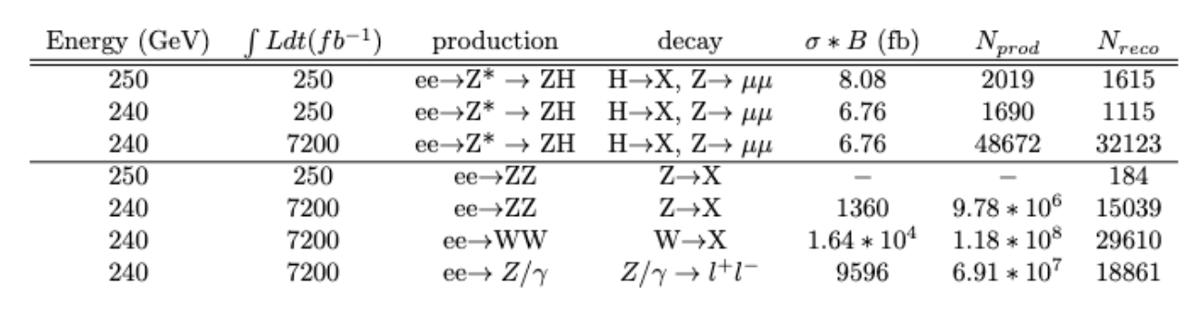
Yields
Snowmass 2022

Slide 17
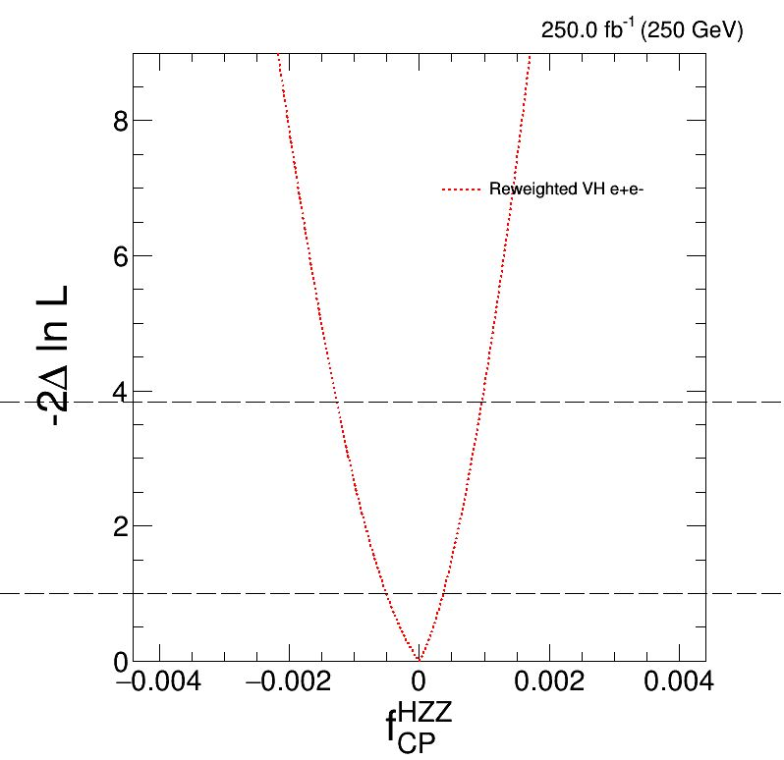

Combine Fits: FCC LHE-Level Data, Snowmass Yields
FCC LHE-level data used as input.
Yields use values from Snowmass.
68% CL $f_{CP}^{HZZ}$ $≈±4.4∗{10}^{−4}$
Verify that $f_{CP}^{HZZ}$ values are comparable
to Snowmass 2022.

Slide 18
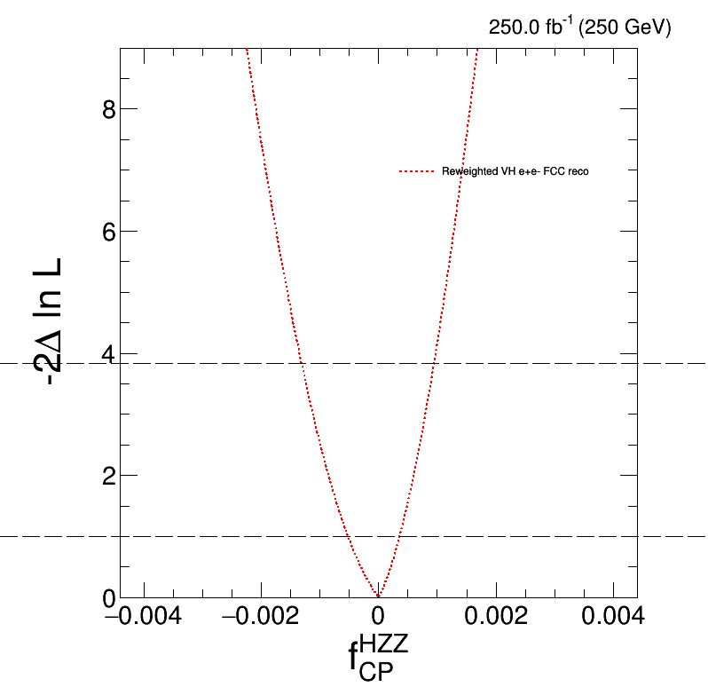

Combine Fits: FCC Reco-Level Data, Snowmass Yields
FCC Reco-level data used as input.
Yields use values from Snowmass.
68% CL $f_{CP}^{HZZ}$ $≈$± 4.1$∗{10}^{−4}$

Slide 19
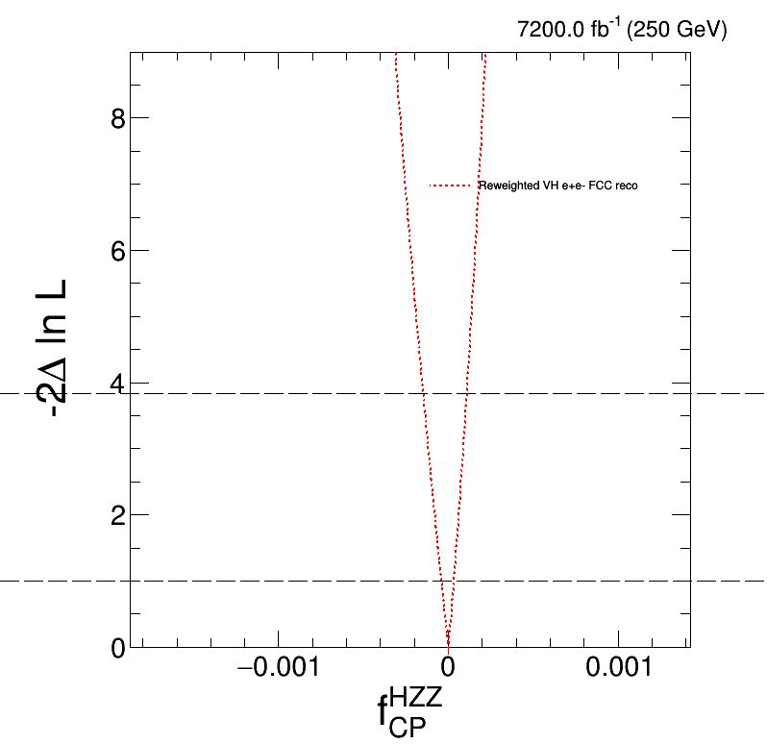

Combine Fits: FCC Reco-Level Data, FCC Yields, Snowmass Background
FCC Reco-level data used as input.
Yields use values from FCC.
68% CL $f_{CP}^{HZZ}≈±3.7∗{10}^{−5}$
Aligns with Snowmass
projection for increased luminosity,
even with detector effects.

Slide 20
Conclusions
Technical Progress
  Angular Distributions and MELA Reweighting now integrated with FCC Framework.
Fits with yields from FCC parameters and templates have been created.
  We seem to agree with Snowmass.
Next steps: Incorporate full backgrounds

Slide 21
References
https://inspirehep.net/files/64b3c8108ce781ee7a215284970eec70
Snowmass 2013: https://arxiv.org/pdf/1309.4819.pdf
Snowmass 2022: https://arxiv.org/pdf/2205.07715.pdf

Slide 22
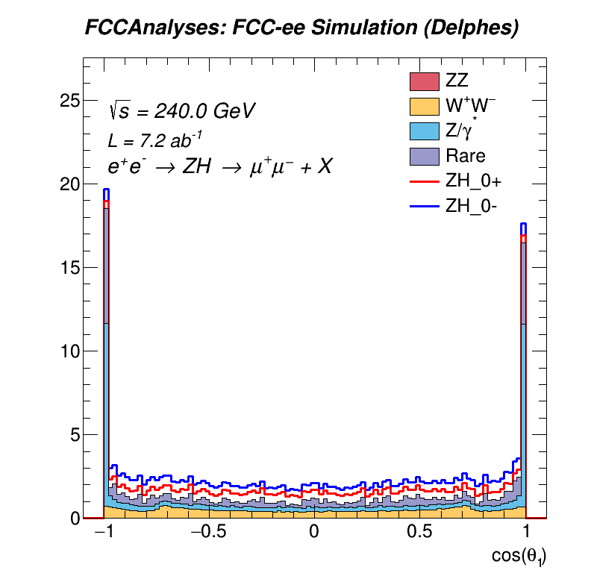
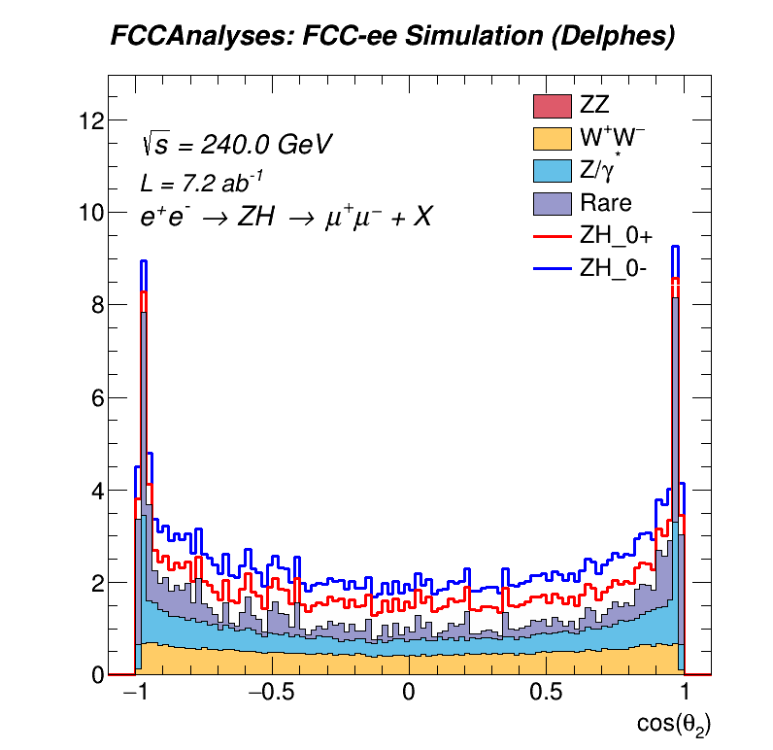
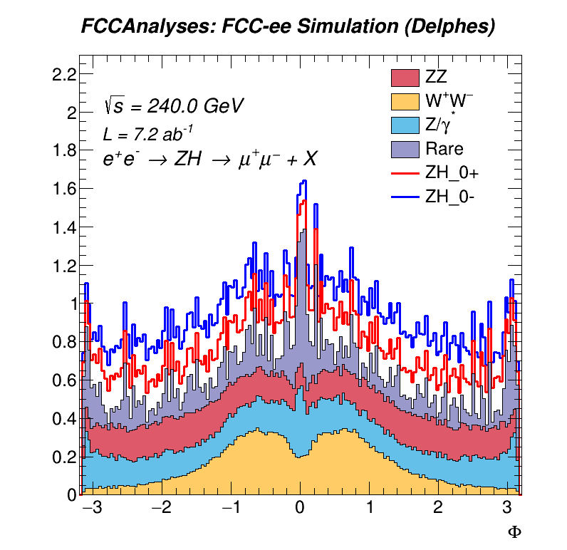
Backup Plots: Stacked Histograms

Slide 23
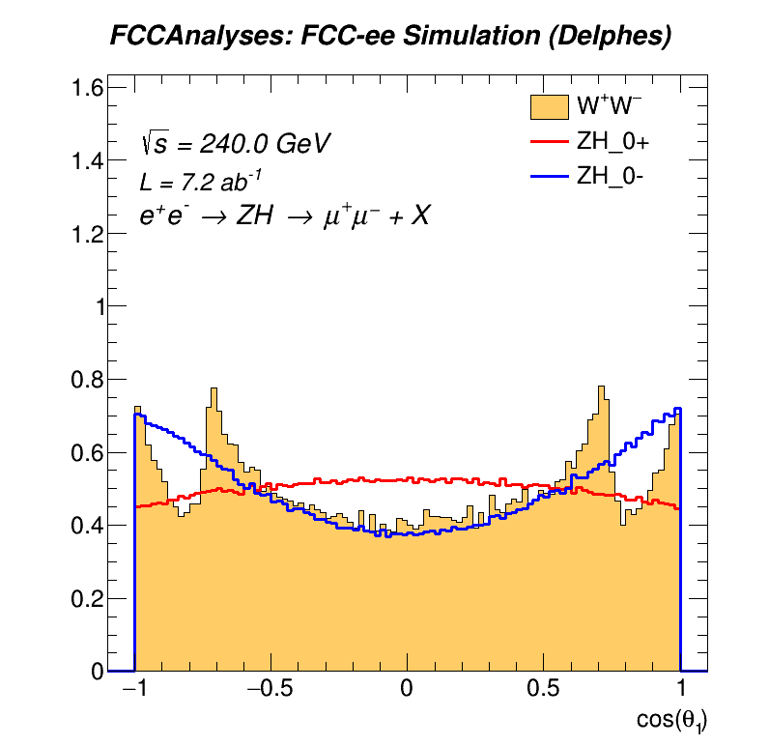
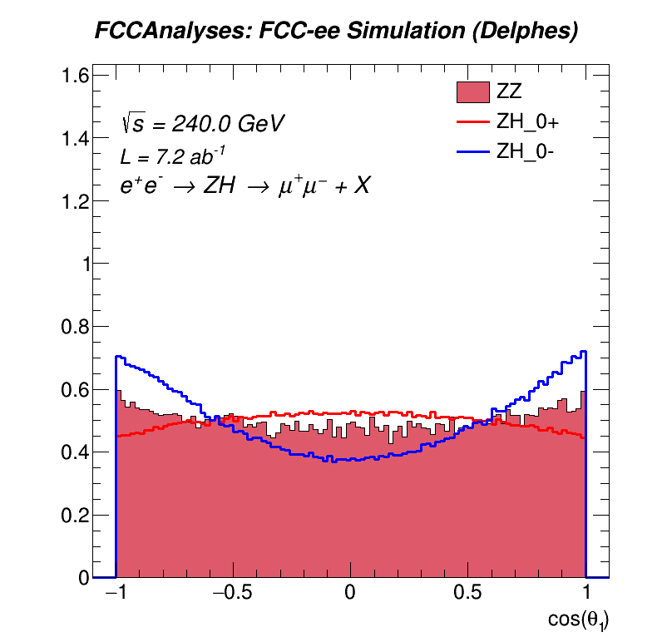
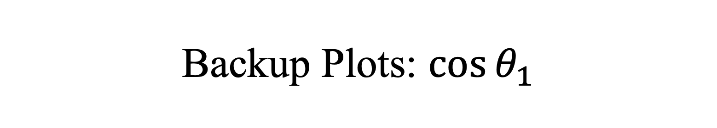
Backup Plots: $\cos{θ_{1}}$

Slide 24
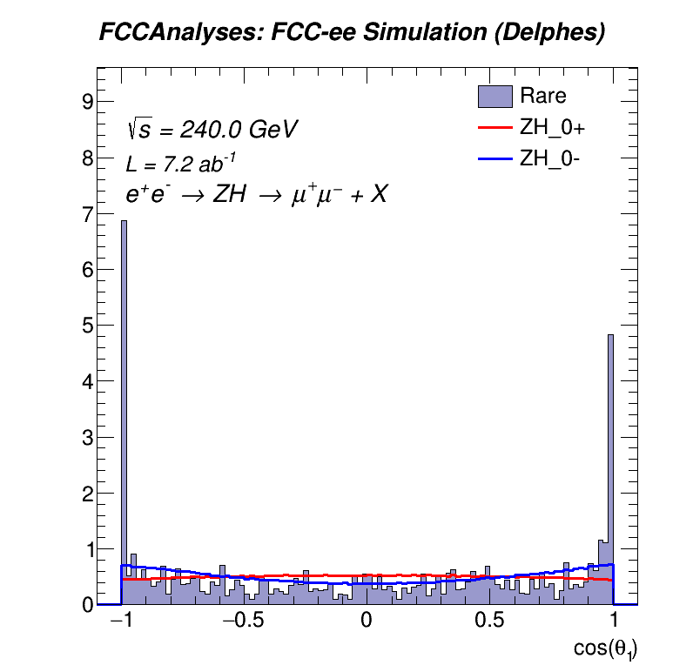
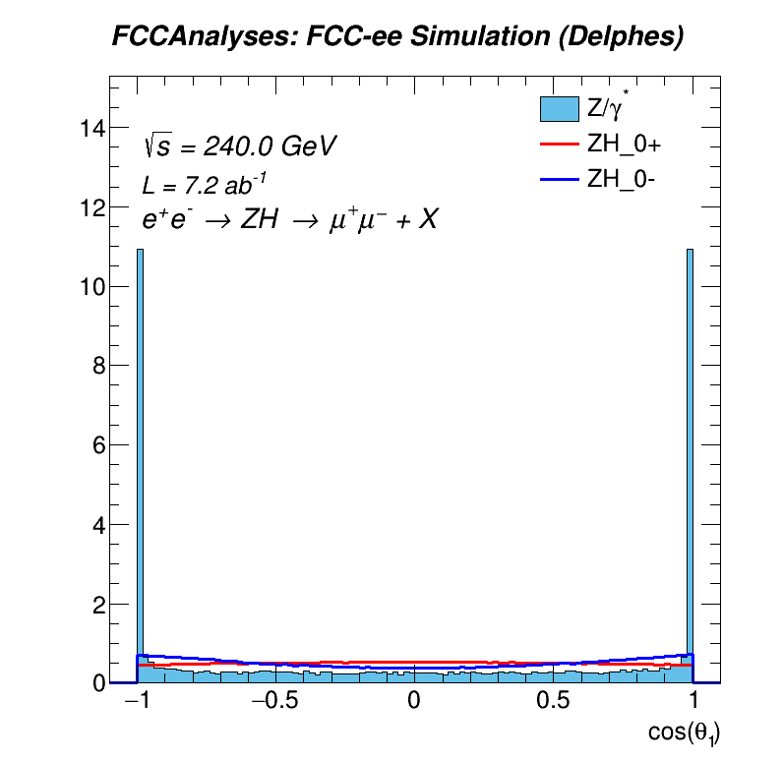
Backup Plots: $\cos{θ_{1}}$

Slide 25



Backup Plots: $\cos{θ_{2}}$

Slide 26


Backup Plots: $\cos{θ_{2}}$

Slide 27



Backup Plots: $Φ$

Slide 28


Backup Plots: $Φ$

