Slide 1

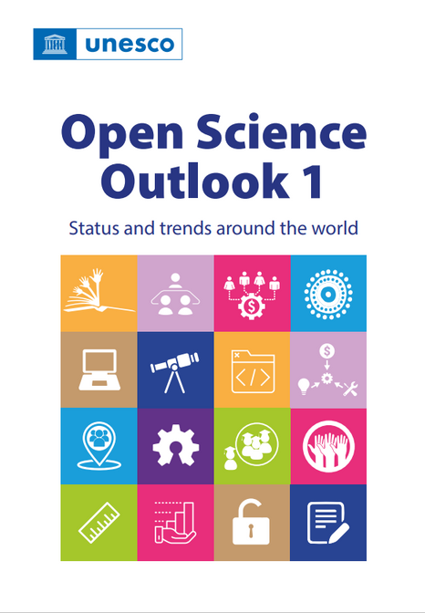
Launch of the UNESCO Open Science Outlook
UNESCO
Open Science Outlook:
Key messages and findings
1

Slide 2

Key messages and next steps
For open science to reach its full potential, it must be a
truly global, equitable phenomenon.
Inequities in STI systems exist. Context affects experience and prioritization of open science.
Who sets norms and practices? Who creates and has access to systems?
Open science is growing—but unevenly.
Obstacles remain, linked to existing inequities. There are:
-differences among pillars of open science.
-differences among disciplines.
-differences across contexts.
    The transition to open science requires a shift in the culture of science.
The Recommendation‘s 7 areas of action provide structure.
Collective, collaborative and coordinated action and investment are needed
to accelerate the transition to a truly global, equitable open science.
The shared values and principles provide a framework.
2

Slide 3

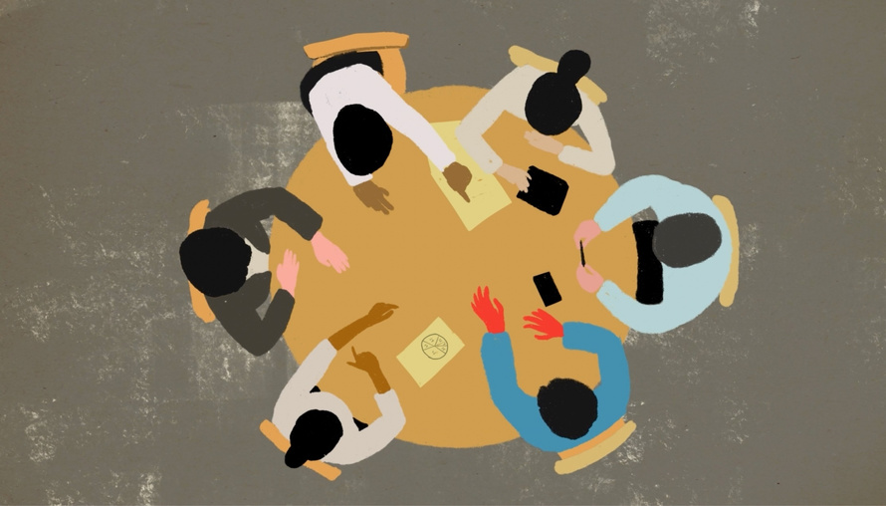
Creating a global Open Science Outlook
Five Working Groups
  Policy
  Capacity
  Infrastructures
  Incentives and financing
  Monitoring
Over 700 participants
from all regions
Shared expertise
and exploration
is essential as
open science evolves.
3

Slide 4


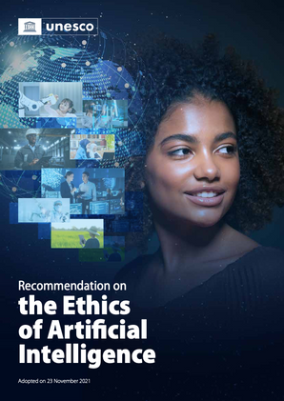
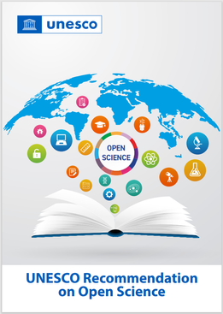

Creating global and equitable open science
Where are we now?
Where are we headed?
- Global commitment
- Regional priorities
- Relation to emerging tech
and intellectual property
- Benefits of transformation
©
4

Slide 5
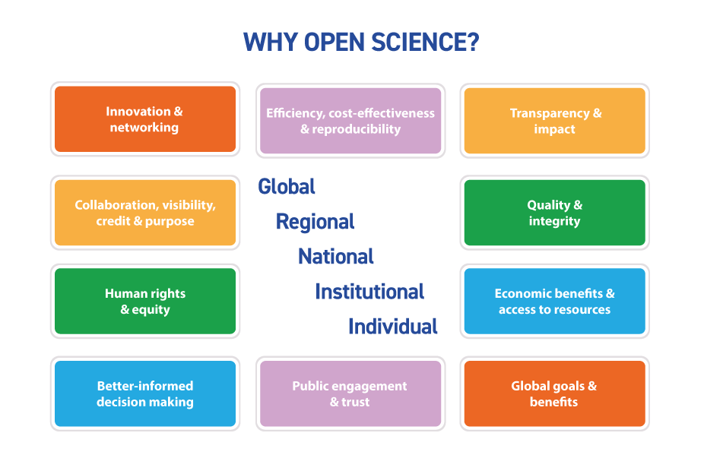
Benefits of open science
5

Slide 6
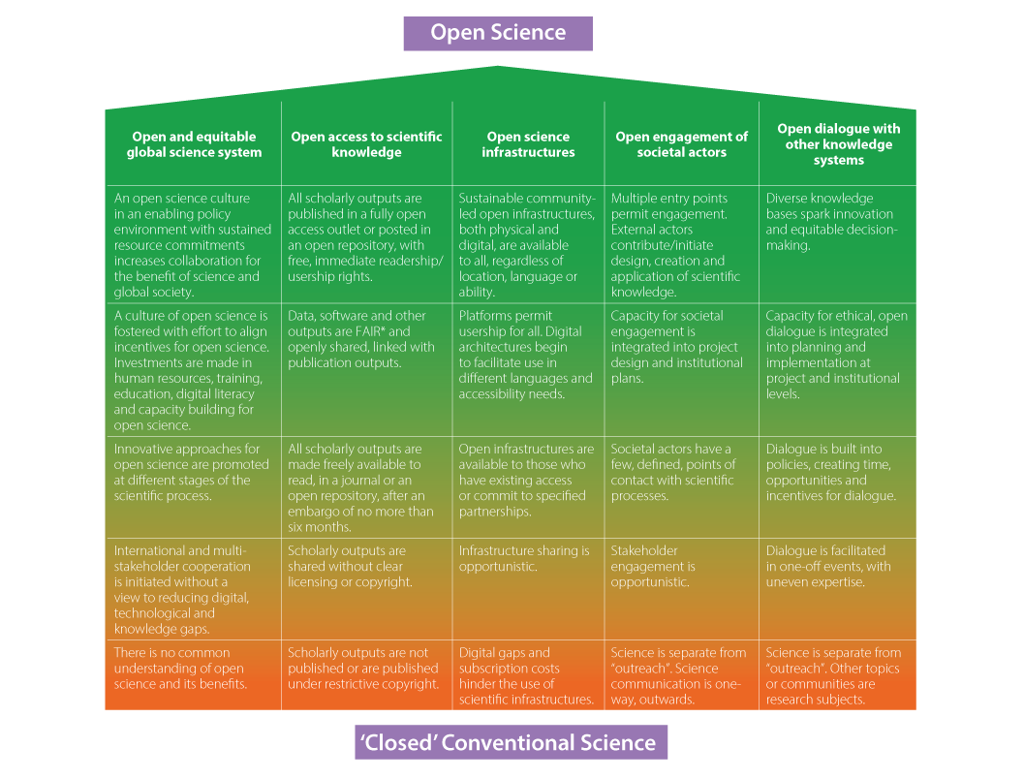
The spectrum of openness is
within reach of all.
6
Notes:
Open science in context: the global commitment to open science
Purpose and the Recommendation
Transformation and its benefits
Regional priorities
Relation to AI and to
intellectual property

Slide 7
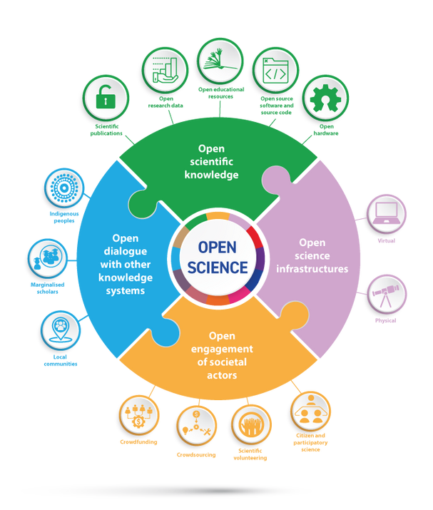
Assessment of open science
7

Slide 8

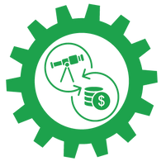
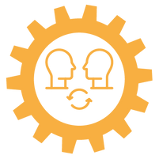
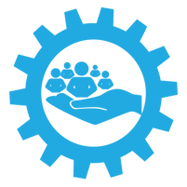
Assessment of open science
Strengthening the focus on people,
not just products
Lack of assessment
Lack of assessment
7

Slide 9
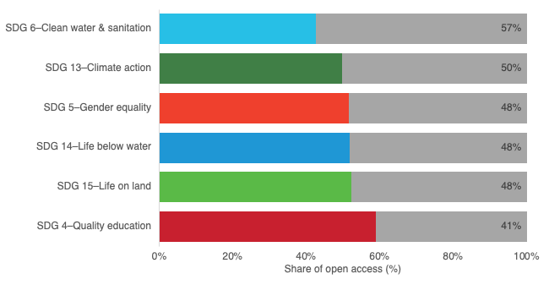
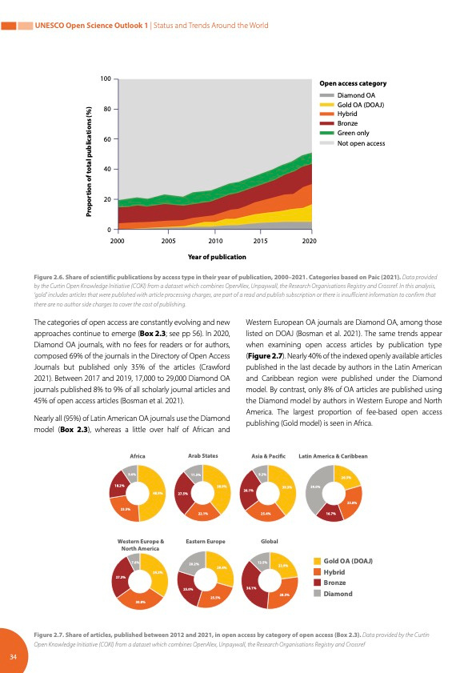
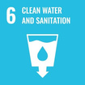





Trends: Open scientific knowledge
  % of scientific publications in open access rapidly growing, yet only 1/3 of all scholarly literature (since 2000) is currently under open access.
  A growing number of countries and institutions are adopting or facilitating open access policies and workflows.
  A range of mechanisms are used to provide open access, with different consequences in diverse local contexts.
  Different subject areas are differently represented in open access publications.
8
Notes:
OA is growing and there are multiple pathways to OA. We see the emergence and growth of gold and diamond…

Slide 10
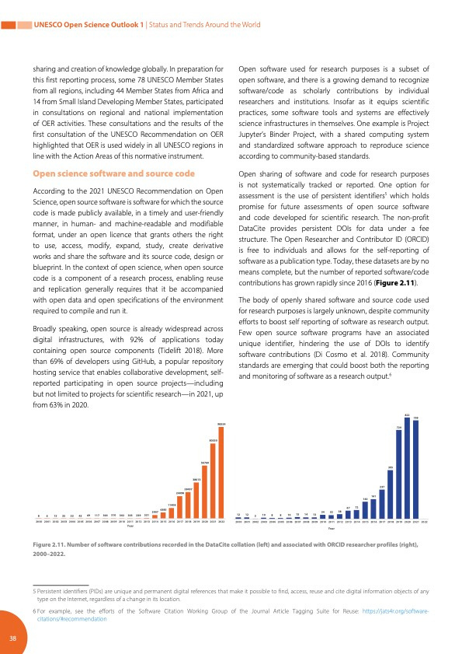
Assessment will require more than counting
  Monitoring of open research data sharing is in its early stages.
  Open hardware licensing is growing, with an unknown proportion used for scientific research.
  The body of openly shared software and source code used for scientific research purposes is largely unknown.
    Sharing and monitoring both rely on available systems and infrastructures.
9
Notes:
Who is creating these datasets and software tools?

Slide 11
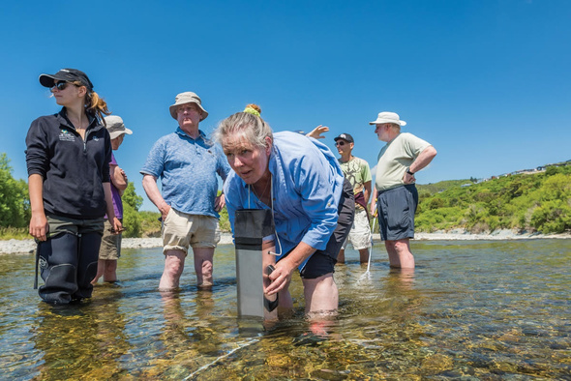
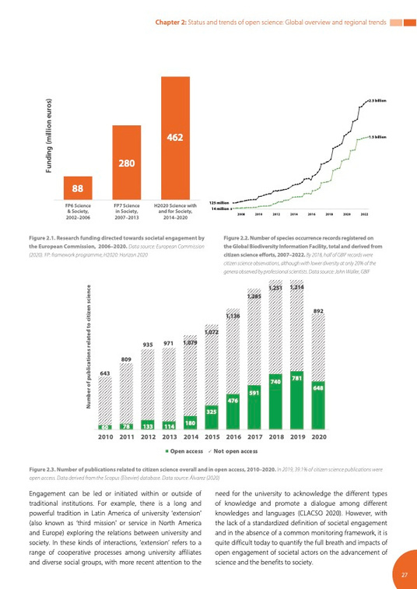
Assessing engagement and dialogue
Engagement and dialogue are
not yet among mainstream factors considered in monitoring of open science practices.
Citizen scientist Beth Reille takes a water clarity reading on the Hutt River. [Photo: Dave Allen, NIWA]
Rise of interest in scientific projects incorporating societal engagement:
  Increase in funding
  Increase in recorded numbers of citizens engaging in science or producing data products
  Increase in number of scientific publications related to citizen science
10

Slide 12
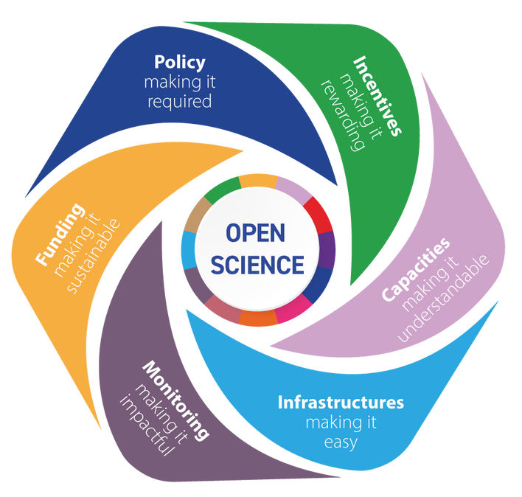
Shifting the culture of science
Need practical actions and cultural shifts
Equitable
collaboration
Actions are underway
around the world:
Cases from all regions demonstrate opportunities
11
Notes:
Open science challenges traditional norms and practices of ‘science’
Grounding in agreed values and principles
We will require innovation in the way concepts and practices of ‘collaboration’, ‘participation’, ‘dialogue’ and ‘partnerships’ are perceived, defined and realized by a wide range of actors and stakeholders in the science, technology and innovation (eco)systems across the globe.

Slide 13
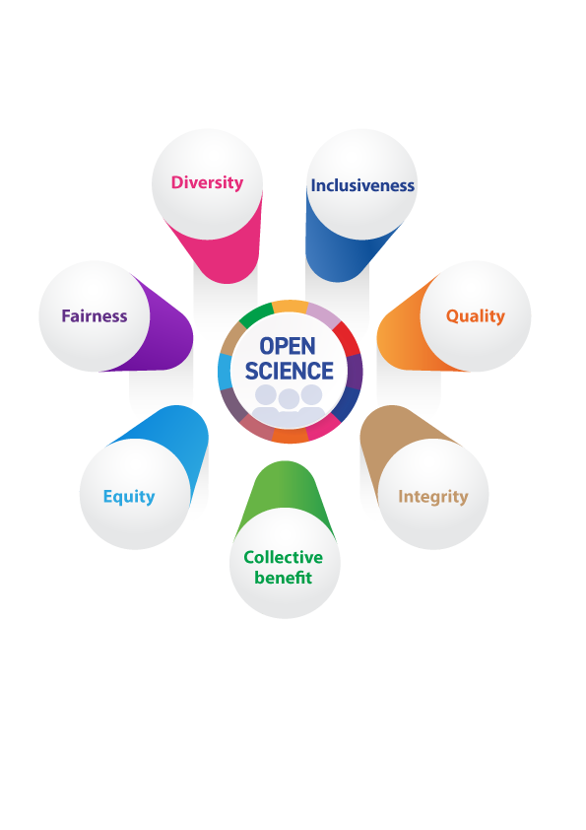
Open science values provide a
shared and flexible framework
12

Slide 14
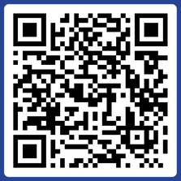
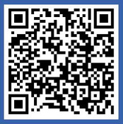
Join the Global Open Science Movement
Join the UNESCO Open Science Partnership
Contribute to global open science calls
Engage in the global discussions
Be in touch!
UNESCO Open science website: https://www.unesco.org/open-science
Read the Open Science Outlook:
Contact: openscience@unesco.org
Notes:
TO CONCLUDE:
Strengthening citizen science for digital health and AI means more than accessing their data or buying new tech. Strengthening societal engagement in science requires transformation in the way we train, evaluate and practice science.
Open science should be different science. It should be better science. In the context of digital health and AI technologies, this means more openly created and assessed, more equitably informed and implemented, and more transparently co-created by diverse participants.
By embracing citizen science as an integral part of our global open science efforts, we can collectively shape a future where health innovations are equitable, inclusive and accessible to all.
I therefore invite you all to join us in promoting the open science movement across the world!
13

Slide 15
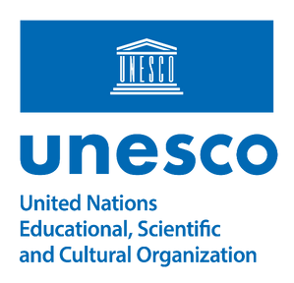
Thank you

