Slide 1
HEPDipo
Status of the cable trials
Historic of the conceptual design
New studies
MSC-MDT
April 2, 2020 – D. Martins Araujo

Slide 2
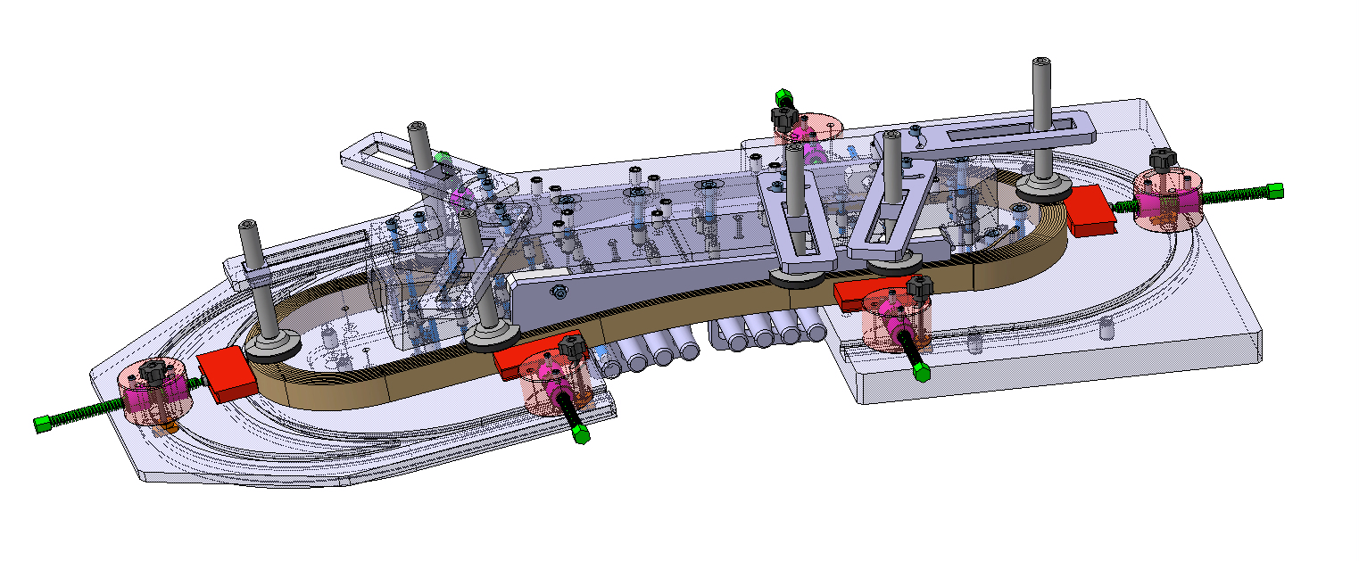
Status of cable trials
3D view of the tooling used for cable testing of several geometries
Conceptual design and drawings – November 2019 to January 2020
Manufacturing – February 2020
Cable trials – February and March 2020
Data analysis – March 2020 ongoing
Thanks to P. Martin
April 2, 2020 – D. Martins Araujo

Slide 3
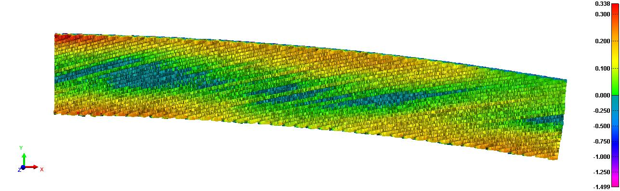
Baseline geometry with 25 kg of load – hard way bend – z deviation
tooling
Analysis being performed
The method allows to compute the
strands relative position
As example, a deviation of ~300 um
can be observed
No pop out strand was identified in this case
Thanks to C. Sequeiro
This measurement will help us to better choose the winding machine parameters
April 2, 2020 – D. Martins Araujo

Slide 4
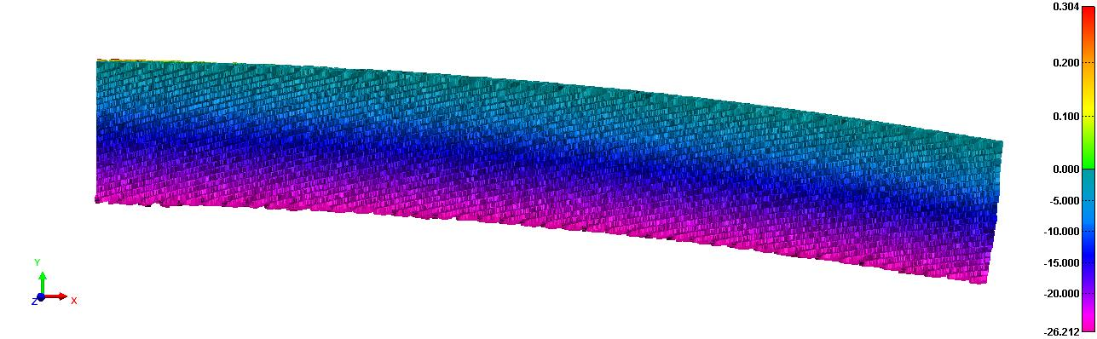
Baseline geometry with 25 kg of load – hard way bend – radial deviation
tooling
Analysis being performed
The method allows to compute the
strands relative position
Max deviation of only ~100 um on
cable dimension
No pop out strand was identified in this case
This measurement will help us to better understand differences between the ideal coil geometry and reality
April 2, 2020 – D. Martins Araujo

Slide 5
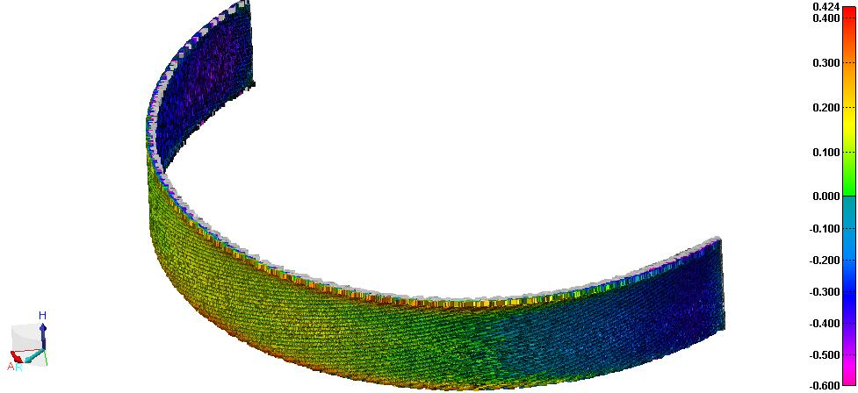
Baseline geometry with 25 kg of load – easy way bend – radial deviation
tooling
Analysis being performed
No pop out strand was identified in this
Case
Dishing is difficult to be measured with a
caliper
The method allows to compute
dishing
As example, a dishing of ~250 um
can be observed
This measurement will help us to better predict coil geometry
April 2, 2020 – D. Martins Araujo

Slide 6
Status of cable trials
Magnet / option | Ramp angle (°) | Winding machine load 25 and 50 kg | Geometric measurements | Laser track
HEPDipo baseline | 10 | ✓ | ✓ | ✓
HEPDipo baseline | 17 (FRESCA2) | ✓ | ✓ | ✓
HEPDipo 4 coils Outer coil | 10 | ✓ | ✓ | ✓
HEPDipo 4 coils Outer coil | 17 (FRESCA2) | ✓ | ✓ | ✓
DEMO 16 T for FCC Inner layer | - | ✓ | ✓ | ✓
DEMO 16 T for FCC Outer layer | - | ✓ | ✓ | ✓
Status | finished | finished | finished | Data under analysis
April 2, 2020 – D. Martins Araujo

Slide 7
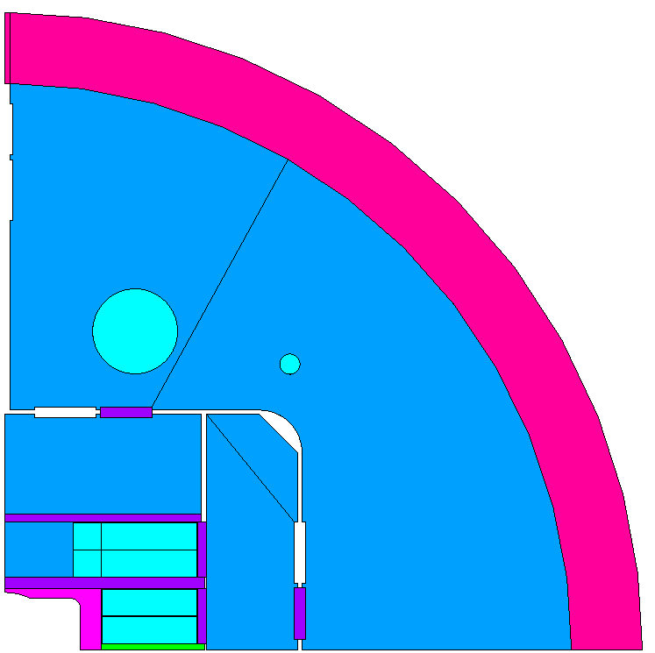
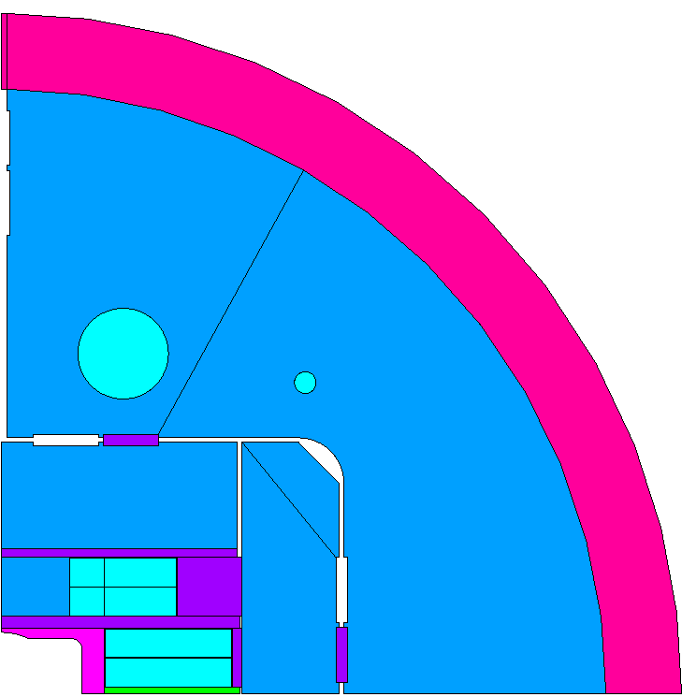

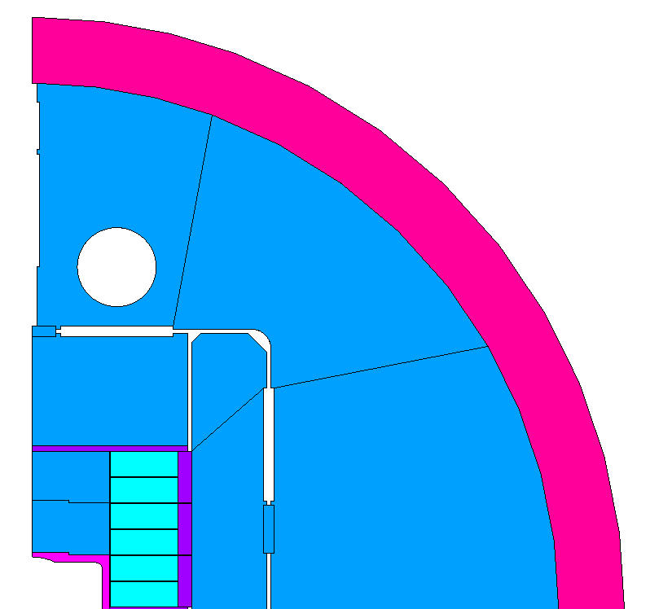

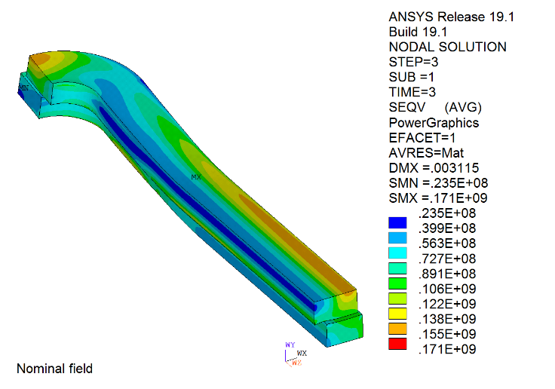
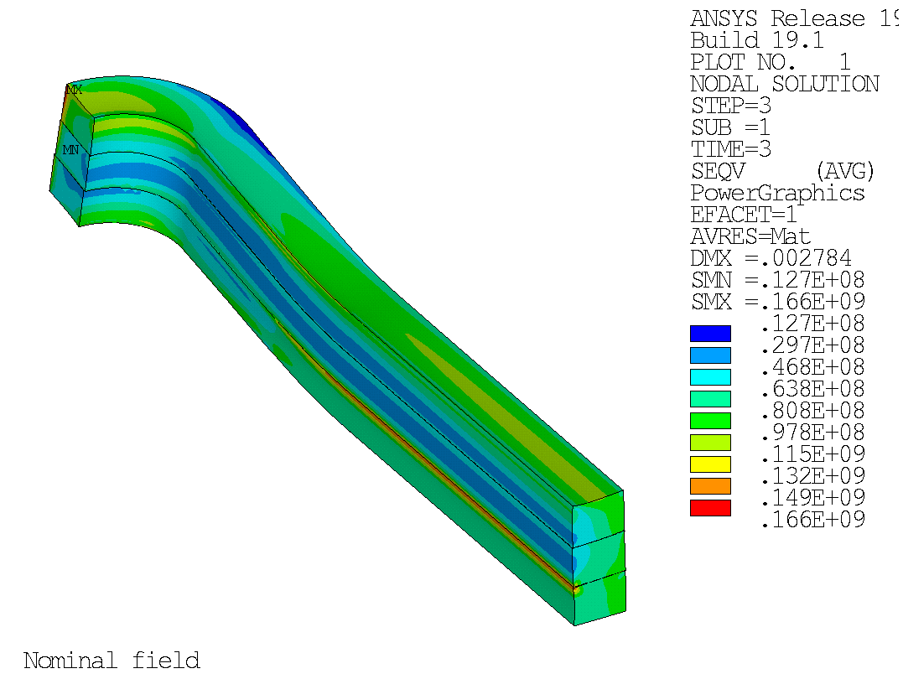
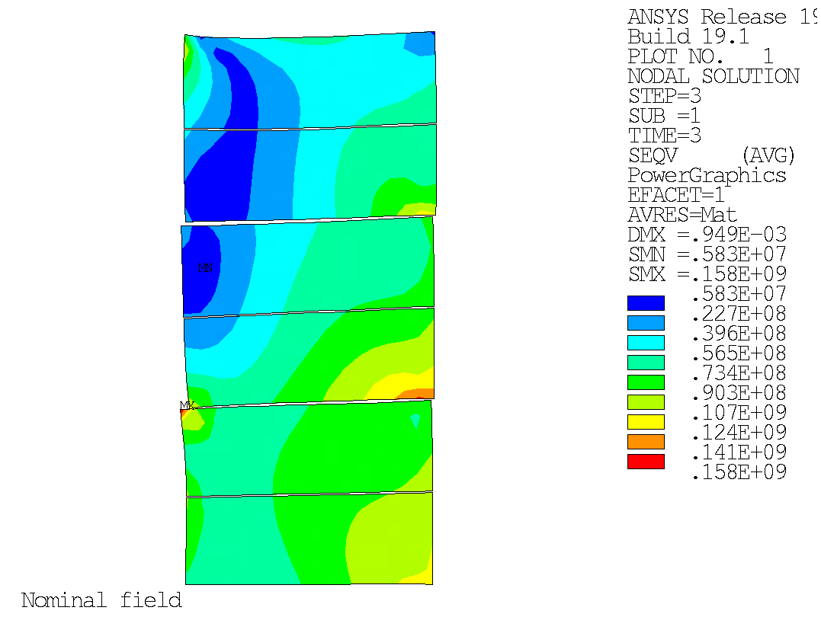
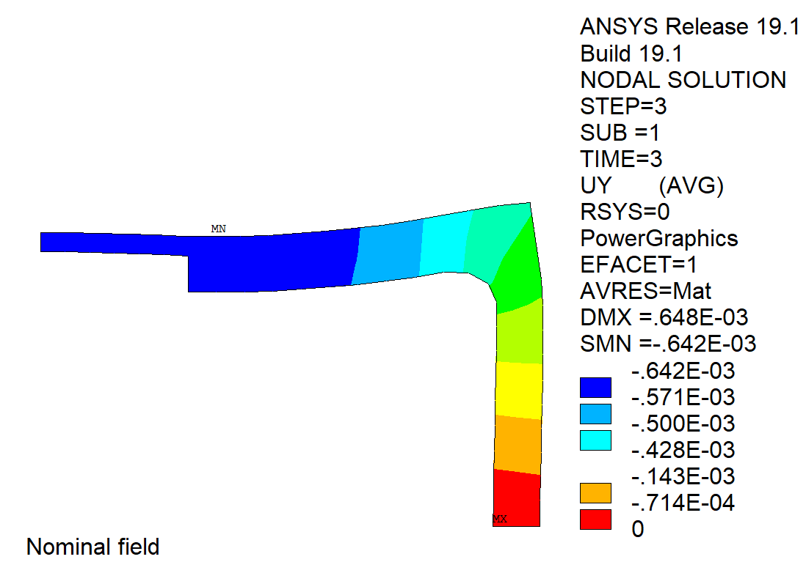

Brief historic of modelling and options
ASC 2018
End of 2018 - review
2019
End of 2019 - review
2020
Peak of 170 MPa
At nominal field
Peak of 166 MPa
April 2, 2020 – D. Martins Araujo

Slide 8
Status of models and design
Model | Baseline | 4 coils option
2D Ansys magnetic | ✓ | ✓
2D Opera magnetic | ✓ | ✓
2D Roxie magnetic | ✓ | ✓
2D Ansys mechanical | ✓ | ✓
3D Ansys magnetic | ✓ | ✓
3D Opera magnetic | ✓ | ✓
3D Ansys mechanical | ✓ | Updating for the new 4 coils solution
Magnet protection | ✓ | Updating for the new 4 coils solution
Status of design | Addressing issues: pre-load criterium Ti pole deformation Stress on the wedge Rod (Al / SS) | Addressing issues: pre-load criterium Stress on the end plate etc..
April 2, 2020 – D. Martins Araujo

Slide 9


New studies: 4 coils option vs 6 coils (baseline)
Aluminum Shell
vertical
pusher
Coil3
iron pole
Coil2
Yoke
Coil2
inter-coil
shim
Coil1
Coil1
titanium
pole
mid-plane
shim
horizontal pad
April 2, 2020 – D. Martins Araujo

Slide 10
4 coils option vs 6 coils (baseline)
boat
32 turns
iron
pole
42 turns
32 turns
42 turns
32 turns
50 turns
32 turns
50 turns
32 turns
32 turns
titanium
pole
rails
mid-plane
shim
 | Turns (1/4)
4 coils | 92
6 coils | 96
April 2, 2020 – D. Martins Araujo

Slide 11
Magnetic results comparison (85 % of LL – 4.2 K)
Parameter | 4 Coils value | 6 Coils value
Bap - aperture field (T) | 14.84 | 14.82
Bpk - Coil peak field (T) | 15.17 | 15.31
Field quality b3, b5, b7, b9 (units) | - 5.86, - 4.01, 2.05, - 0.10 | 42.08, - 10.49, - 0.80, - 0.14
Energy per length (MJ/m) | 7.3 | 6.86
Horizontal Lorentz force (1/4) (MN/m) | 14.37 | 14.41
Vertical Lorentz force (1/4) (MN/m) | - 8.56 | - 7.11
Operational current (kA) | 14.67 | 14.28
(Bap/Bpk)/(SC_area) (1/mm²) | 8.09E-5 (+5.5%) | 7.68E-5
April 2, 2020 – D. Martins Araujo

Slide 12
Stress on coils comparison
HF
region
Outer
coil
HF
region
Outer
coil
HF
region
Inter
coil
High field
region
Inner
coil
HF
region
Inner
coil
15 T operation | 4 Coils von Mises stress | 6 Coils von Mises stress
Inner / inter / outer coils | 145 / / 120 MPa | 158 / 115 / 110
April 2, 2020 – D. Martins Araujo

Slide 13
Mechanical results comparison
Parameter | 4 Coils value (MPa) | 6 Coils value
 | Room temperature / cooling down / 15 T | Room temperature / cooling down / 15 T
Inner coil | 9 / 52 / 145 | 48 / 110 / 158
Inter coil | - | 74 / 154 / 145
Outer coil | 55 / 103 / 135 | 53 / 113 / 117
Iron pole (S1) | 1 / 13 / 280 | 1 / 15 / 246
Horizontal pad (S1) | 92 / 157 / 109 | 100 / 200 / 130
Vertical pad (S1) | 44 / 54 / 128 | 57 / 77 / 78
Yoke (S1) | 92 / 155 / 194 | 105 / 108 / 140
titanium pole (Von Mises) | 81 / 590 / 800 | 370 / 766 / 1225
Shell (Azimuthal) | 70 / 163 / 154 | 123 / 215 / 234
April 2, 2020 – D. Martins Araujo

Slide 14
Parametric analysis: horizontal tolerance
Horizontal misalignment
Horizontal misalignment
Outer
coil
Outer
coil
Horizontal
misalignment
Inter
coil
Inner
coil
Inner
coil
Fixed position
for the inner coil
Fixed position
for the inner coil
April 2, 2020 – D. Martins Araujo

Slide 15
Parametric analysis: horizontal tolerance
4 Coils
6 Coils
For a mm of displacement
the peak of stress of the 4 coils
option remains the same.
The peak is stress of the 6 coils
option goes from 157 to 186 MPa
April 2, 2020 – D. Martins Araujo

Slide 16
Parametric analysis: vertical tolerance
Outer
coil
Outer
coil
Inter
coil
Inner
coil
Fixed position
for the inner
coil
Inner
coil
Fixed position
for the inner coil
The inner coil position is fixed. An interference, representing the dimension tolerance is introduced between coils ( )
April 2, 2020 – D. Martins Araujo

Slide 17
Parametric analysis: vertical tolerance - coils
4 Coils
6 Coils
For a mm of interference between
Coils, the peak of stress of the
4 coils option goes from 145 to
187 MPa
The peak of stress of the 6 coils
option goes from 157 to 290 MPa
April 2, 2020 – D. Martins Araujo

Slide 18
Parametric analysis: vertical tolerance – Ti pole
4 Coils
6 Coils
For a mm of interference between
coils the peak of stress on the Ti
Pole of the 4 coils option goes from
800 to 1438 MPa
The peak is stress on the Ti pole
of the 6 coils option goes from
1225 to 2262 MPa
April 2, 2020 – D. Martins Araujo

Slide 19
Conclusions about the 4 coils option
Magnetic analysis
          The 4 coils option is more efficient
          It presents a better field quality
          It requires less sc conductor
Mechanical analysis
          The 4 coils option seems to be more robust in respect to tolerances
          It is easier to reach compression criterium (end)
          It presents less stress on the Ti pole
Coil manufacturing
          It requires 6 coils (4 + 2 spares) instead of 9
          Since it requires less coils, it could be delivered faster
April 2, 2020 – D. Martins Araujo

