Slide 1
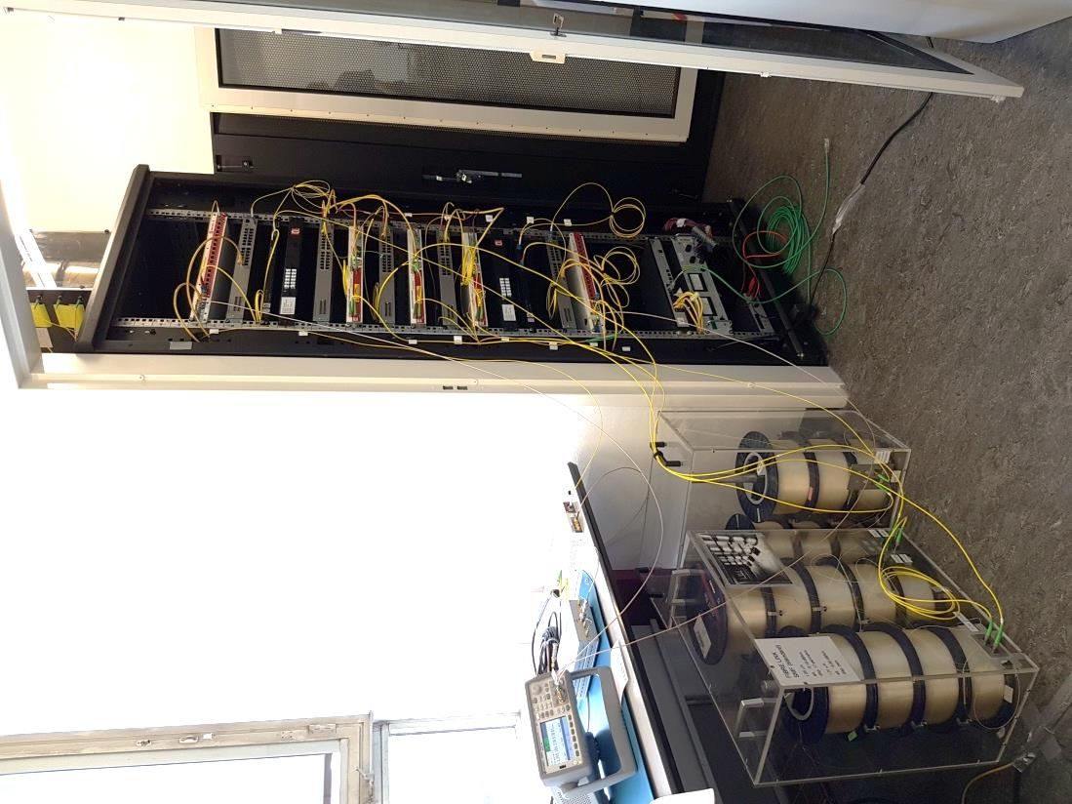














Applications enabled by precise time & frequency services and their integration into existing networks
Dr. Jeroen C. J. Koelemeij
Vrije Universiteit Amsterdam (The Netherlands)
GÉANT Time and Frequency Workshop
CERN
February 8, 2024
Research carried out in collaboration with/with support from:
Marc Weiss Consulting

Slide 2
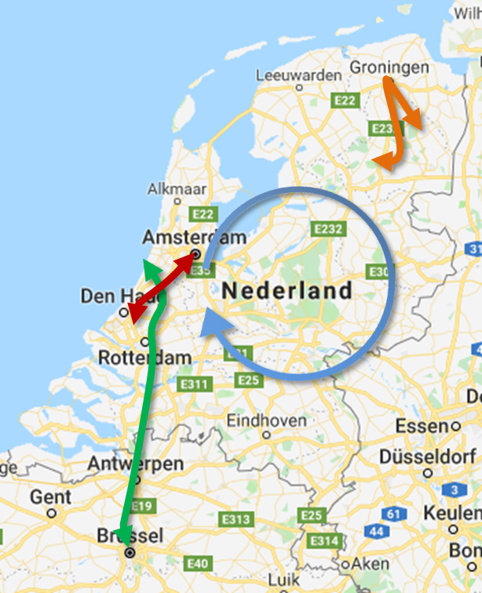
White Rabbit research in the Netherlands
Many groups active in WR worldwide
WR research in the Netherlands:
Nikhef Amsterdam (WR hardware, KM3NeT neutrino telescope)
VSL Delft [UTC(VSL)]
SURF (NREN)
JIVE Dwingeloo (VLBI radio astronomy)
ASTRON (LOFAR radio telescope)
VU Amsterdam
  ⇒ OPNT B.V. (spin-off company, 2014)

Slide 3


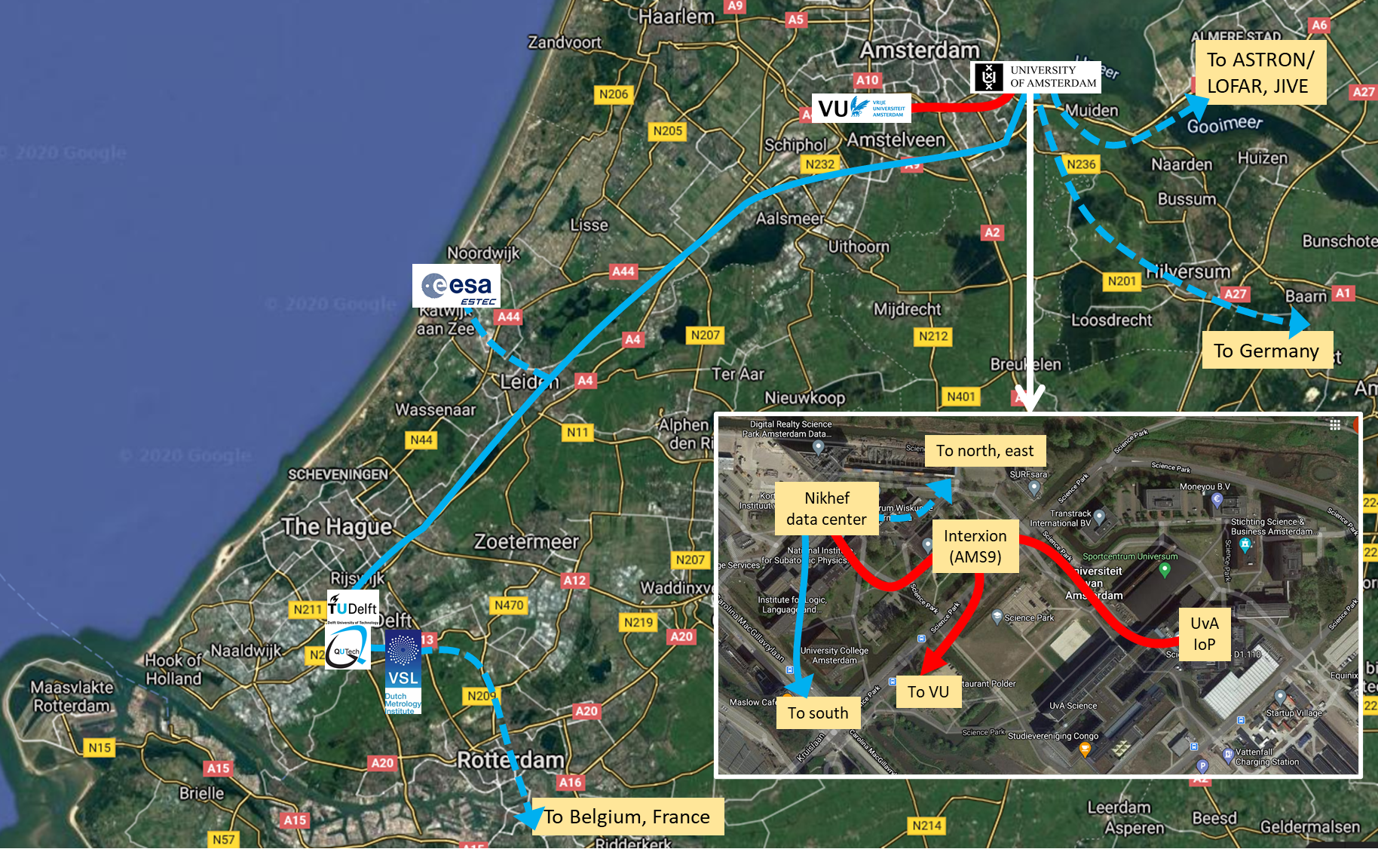
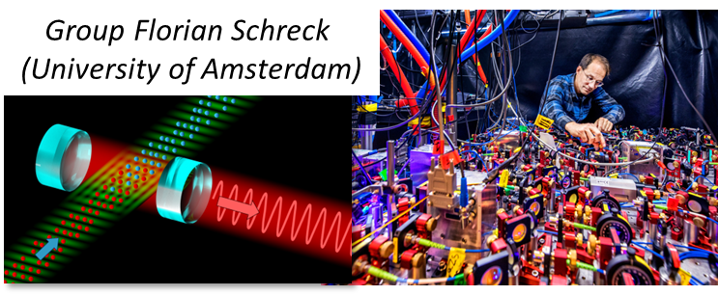
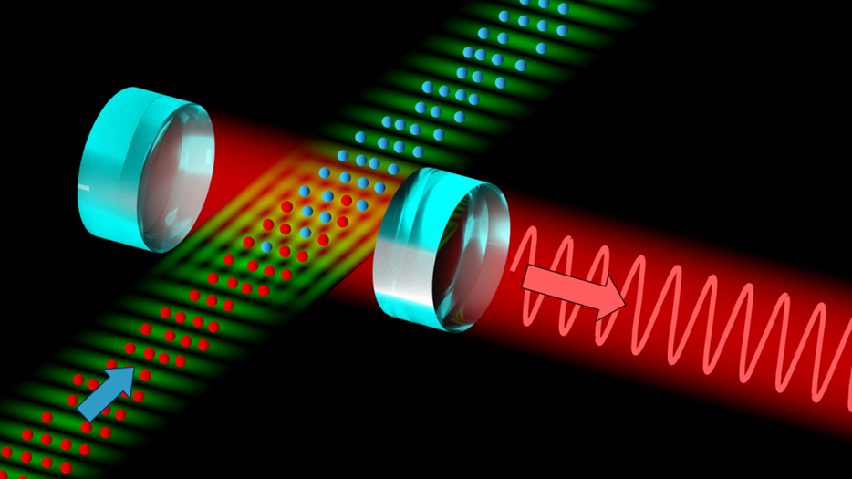
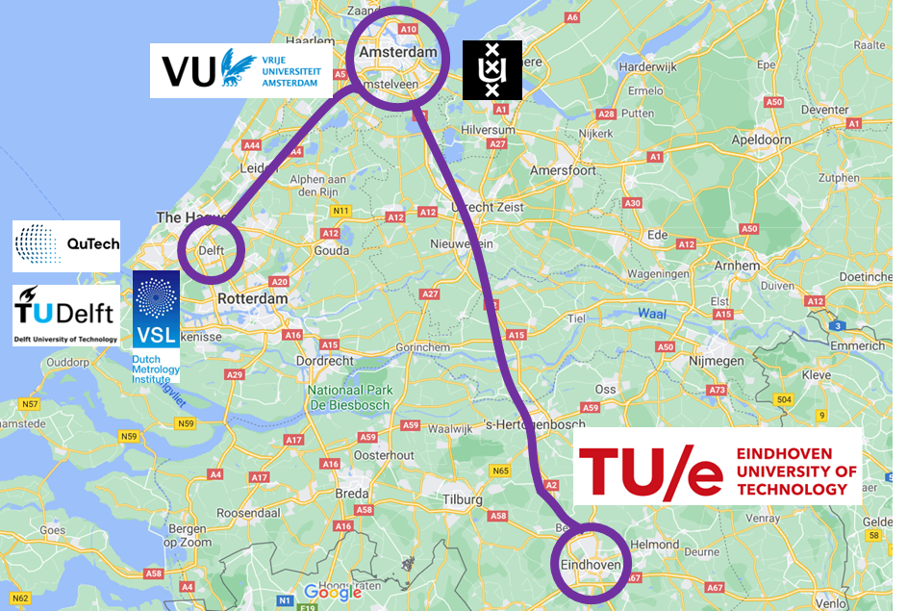

Local fiber-optic testbed (WR + ultrastable laser)

Slide 4
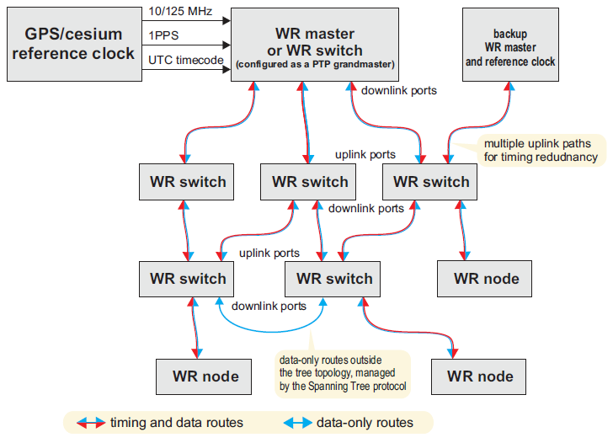
WR: subnanosecond network timing
‘Timing’ = node clocks display same time of day
White Rabbit (see also talk Javier Serrano, CERN)
  Other technologies exist (e.g. ELSTAB, Poland) with even better performance
WR residual timing errors can be as small as 0.1 ns
0.1 ns timing happens to be the requirement for two potentially ground-breaking new network technologies…
Atomic clock
Graph: WR project website

Slide 5
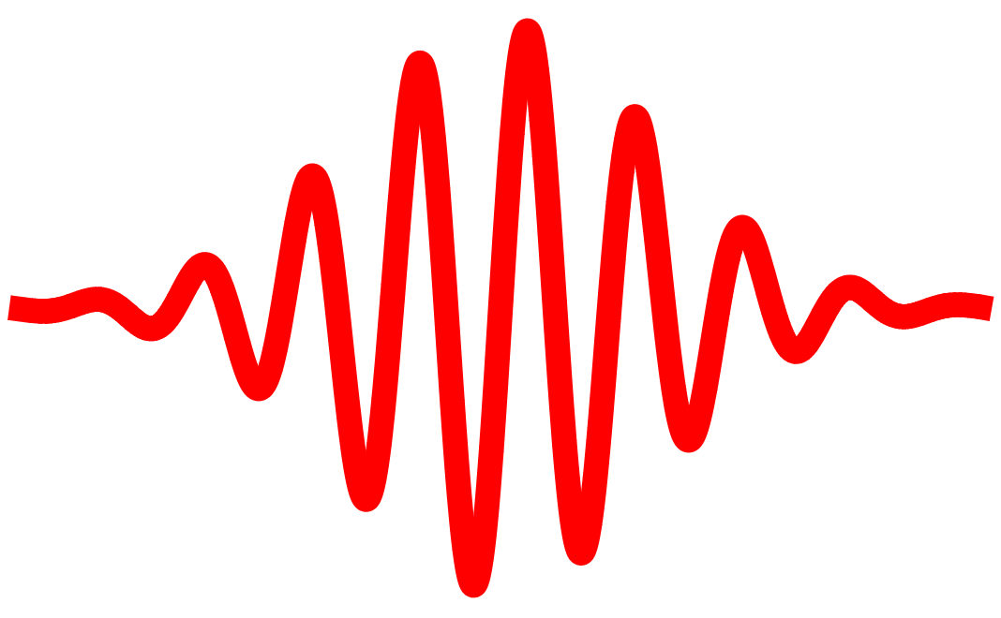
1. Quantum Internet
Quantum networks:
  Now: Quantum Key Distribution (QKD) – secure exchange of quantum information (photons)
  Future: networks of entangled qubits and photons for distributed quantum information processing
detector 1
detector 2
optical network
photon B
optical beam
splitter
photon A
qubit A
qubit B
Quantum information processing requires entangling qubits A and B
Entanglement achieved if two photons arrive at the same detector
- but only if two photons are indistinguishable: same color, same arrival time
In practice: photon emissions must be timed within 0.1 nanosecond*
* Moehring et al., Nature 449, 68 (2007); Stolk et al., PRX Quantum 3, 020359 (2022)

Slide 6
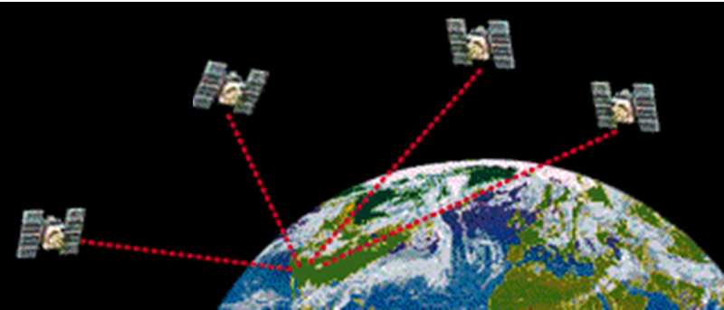
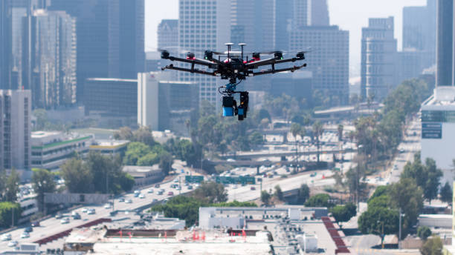
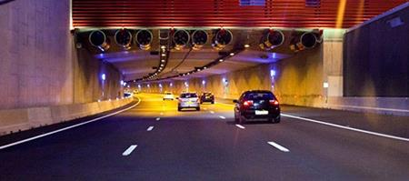
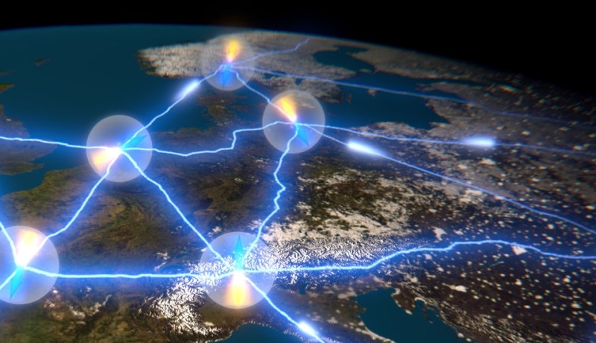
2. PNT systems beyond GNSS
GNSS: global navigation satellite systems
PNT: positioning, navigation and timing
Electromagnetic wave at speed of light in vacuum: 1 ns ⇔ 0.3 m
  c = 299 792 458 m/s
Uncertainty GNSS receiver: 5-50 ns, or 1.5-15 m (or even worse)
Lane-level positioning of cars (decimeter-centimeter level) requires ∼ 0.1 ns…
Quantum Internet requires ∼ 0.1 ns…

Slide 7
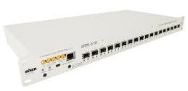
WR can help achieve this – but how?
Must use existing fiber-optic infrastructure, in parallel with telecom data
WR pro: telecom equipment, facilitates acceptance by network operators
WR con: bidirectional optical path needed, barrier to acceptance
  Can be solved by WDM VSL, SURF, VU, VTT, CSC; Dierikx et al., IEEE TUFFC 63, 945 (2016)
Optical wavelength division multiplexing (WDM)
WR channels
WR channels
~100 km optical fiber
carrying many Tb/s
+ subnanosecond time
Service channel
MUX
DEMUX
Up to 100
other optical channels
(>100 Gb/s each)
Optical wavelength division multiplexing (WDM)
See also: outcomes CLONETS project https://www.clonets.eu/clonets.html
WR via WDM : E.F. Dierikx et al. IEEE Trans. Ultrason. Ferroelectr. Freq. Control 63, 945-952 (2016)
Earlier time transfer protocol via WDM: Lopez et al., Appl. Phys. B 110, 3 (2013)

Slide 8
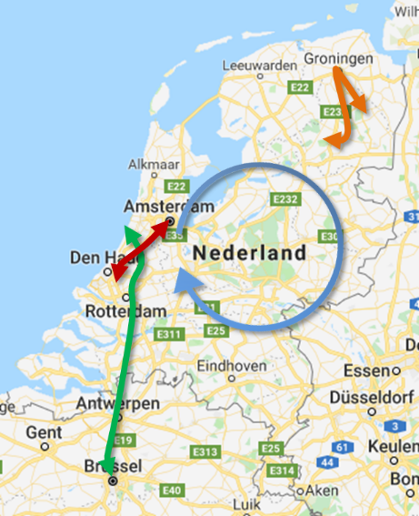


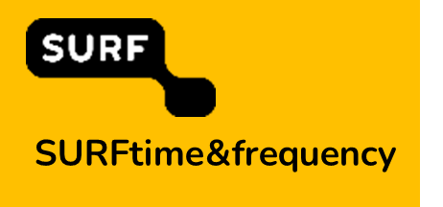
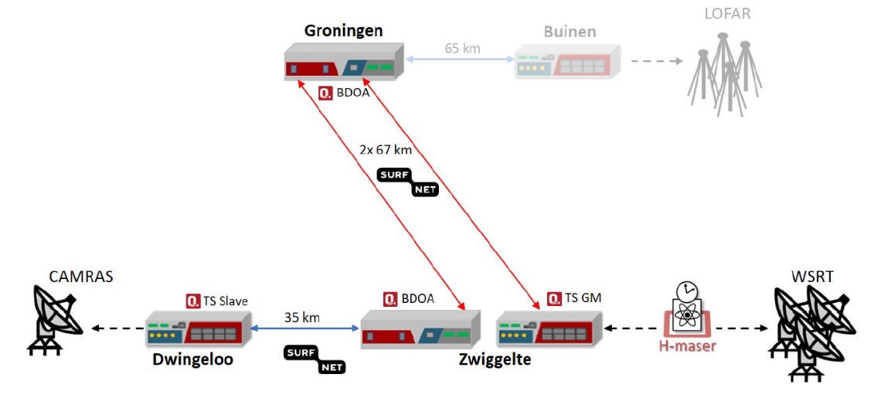
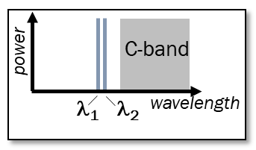

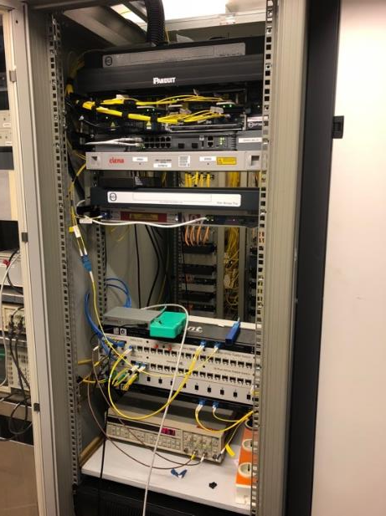
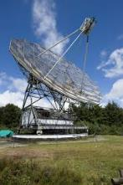
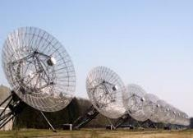
Example: SURFnet8
WR time distribution over live SURFnet8 production network (2019)
Purpose: synchronize Dwingeloo radio telescope to Westerbork telescope array
  H2020 ASTERICS project – VLBI demonstration using WR synchronization
  Similar: LOFAR radio telescope
2024: Nationwide time & frequency network rolled out by SURF
ESTEC
VSL
SMD
169 km WR link
Dwingeloo
Westerbork
P. Boven, C. van Tour, R. Smets. Demonstration of VLBI synchronization via existing SURFnet/LOFAR network. ASTERICS GA Deliverable D5.14. https://www.asterics2020.eu/sites/default/files/documents/asterics-d5.14.pdf

Slide 9
WR and positioning – how?
PNT through hybrid optical-wireless networks: ‘SuperGPS’ project

Slide 10






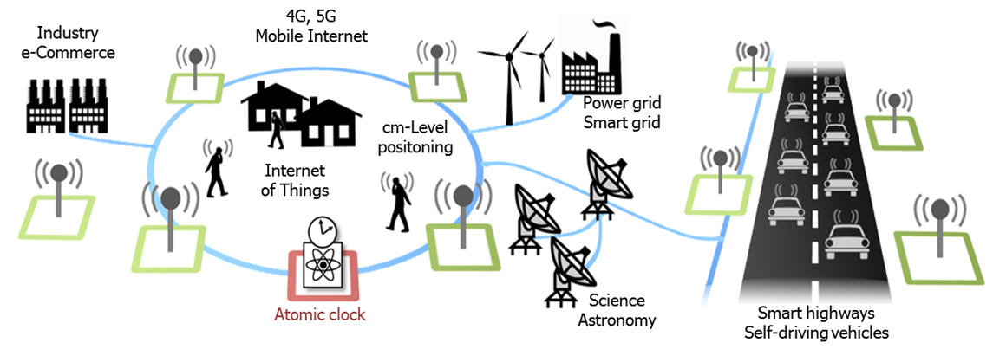

‘SuperGPS’ project
(collaboration with Delft University of Technology, VSL Delft, and private partners)
Gerard
Janssen
Christian
Tiberius
1. Reference atomic clock
2. Subnanosecond time through fixed network
3. Wireless network for decimeter-level positioning (TDoA)
No dependence on satellites in space
Secure (fiber-optic) connections
Received signal power 10⁶ times that of GNSS
GNSS
Aviation
Relativistic geodesy

Slide 11
‘SuperGPS’ project
(collaboration with Delft University of Technology, VSL Delft, and private partners)
Back-up system for PNT through GNSS
Could also support quantum networks and distributed quantum computing
Gerard
Janssen
Christian
Tiberius
1. Reference atomic clock
2. Subnanosecond time through fixed network
3. Wireless network for decimeter-level positioning (TDoA)
No dependence on satellites in space
Secure (fiber-optic) connections
Received signal power 10⁶ times that of GNSS
GNSS
Aviation
Relativistic geodesy

Slide 12
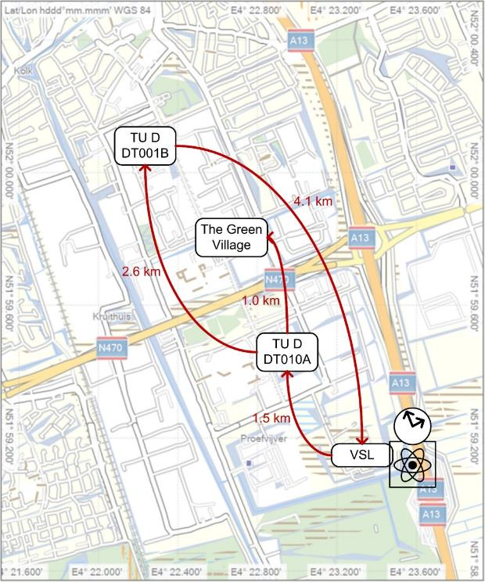
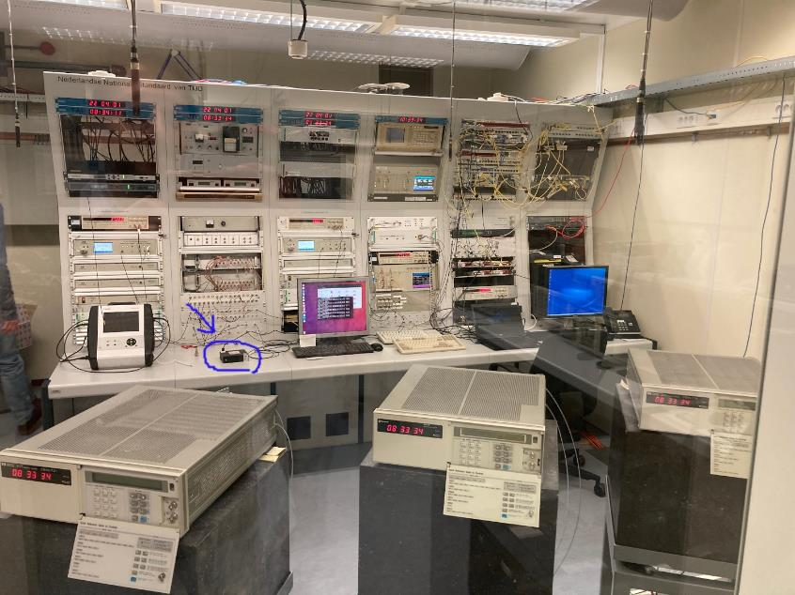



WR network VSL – TU Delft
Network map (Delft)
UTC(VSL)
Erik Dierikx
Yan Xie

Slide 13
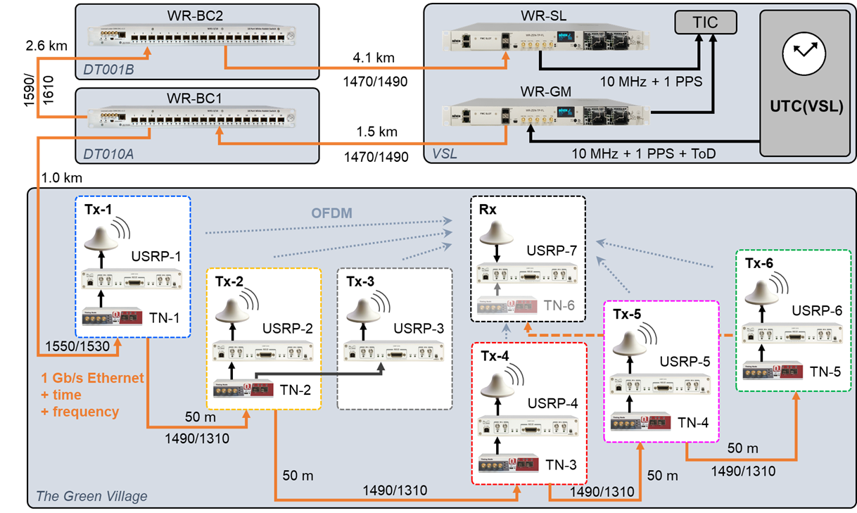
Hybrid optical-wireless network
WR subnanosecond time distribution through optical fiber

Slide 14
Hybrid optical-wireless network
WR subnanosecond time distribution through optical fiber + wireless PNT

Slide 15
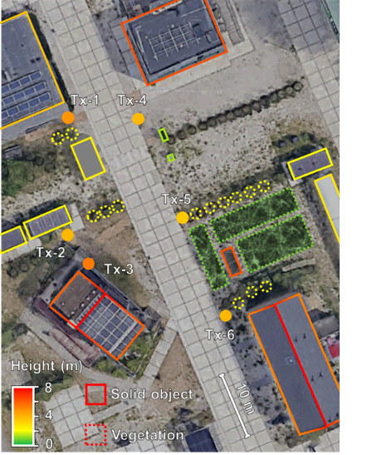
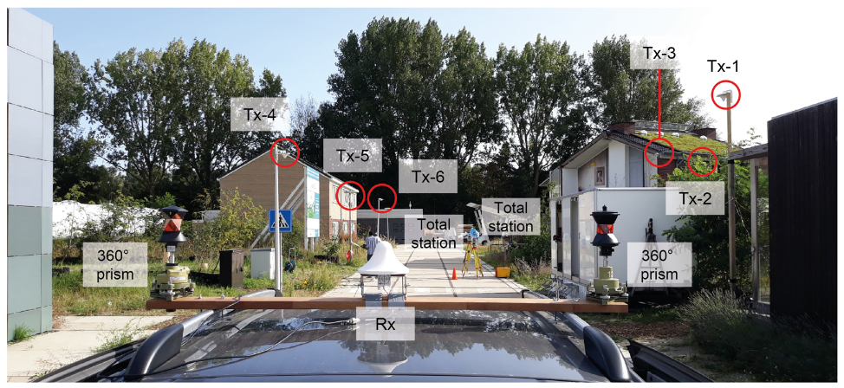
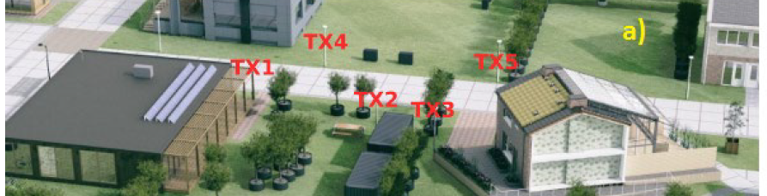
Field trial & performance
The Green Village site @TU Delft, Sep 2020
Network map (Delft)
Positioning with 10 cm uncertainty
Wireless network time distribution with subnanosecond uncertainty
Radio spectrum and modulation similar to 4G/5G networks
Koelemeij et al., Nature 611, 473 (2022);
Tiberius et al., NAVIGATION: J. Inst. Nav. Sep. 2023, 70 (3) navi.589

Slide 16
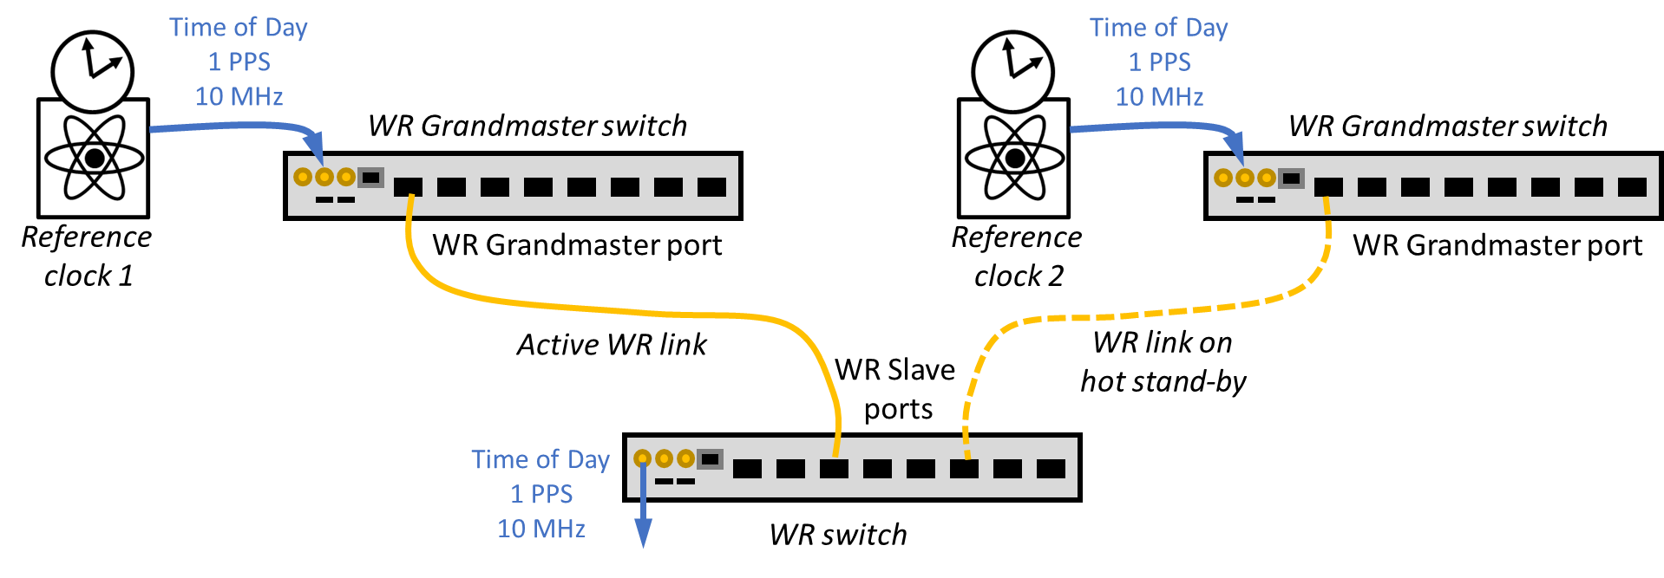
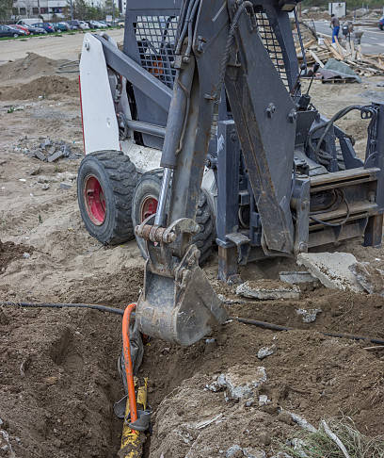
Redundancy and fail-over
GNSS backup & quantum networks: security and reliability are of the essence, and so must be timing accuracy, availability and integrity
BUT: WR designed for single reference clock: single point of failure
Need for redundant clocks and paths + fail-over mechanisms
Challenge: seamless fail-over
(clocks drift by nanoseconds)

Slide 17

Network timescale based on a clock ensemble
WR switch measures time differences
between all three clocks:
{ x₁₂(t), x₁₃(t), x₂₃(t) }
Clock 1
WR
S1
Clock 2
WR
S2
Clock 3
WR
S3

Slide 18
Network timescale based on a clock ensemble
{x₁₂(t), x₁₃(t), x₂₃(t)}
Timescale algorithm
Clock 1
WR
S1
Clock comparison data used by
timescale algorithm to determine
optimum ‘average time’ (=ensemble time)
Clock 2
WR
S2
See for example
Weiss & Weissert, Metrologia 28, 65 (1991)
Greenhall, IEEE TUFFC 59, 491 (2012)
and references therein
Clock 3
WR
S3

Slide 19
Network timescale based on a clock ensemble
Timescale
ouput
Correction 1
{x₁₂(t), x₁₃(t), x₂₃(t)}
Timescale algorithm
WR S1
Clock 1
WR
S1
Timescale algorithm provides time
correction to be applied to each clock
To users
μstepper
Microstepper allows
correcting the clock
output without
disturbing the clock itself
Clock 2
WR
S2
Clock 3
WR
S3

Slide 20
Extensions for increased redundancy
Correction 1
{x₁₂(t), x₁₃(t), x₂₃(t)}
Time-scale algorithm
WR S1
Clock 1
WR
S1
To users
μstepper
Correction 2
WR S2
Clock 2
WR
S2
To users
μstepper
{x’₁₂(t), x’₁₃(t), x’₂₃(t)}
WR S3
Clock 3
WR
S3
Many options for redundant
measurements and systems
To users
μstepper
Correction 3

Slide 21
Time measurement and time production networks
Time production
network
Time measurement
network
Correction 1
Time-scale algorithm
WR S1
Clock 1
WR
S1
μstepper
Correction 2
WR S2
Clock 2
WR
S2
μstepper
Similar concept proposed by
Cosart, Imlau, Zampetti
IEEE Comms. Mag. April 2023, p.28
WR S3
Clock 3
WR
S3
μstepper
Correction 3

Slide 22
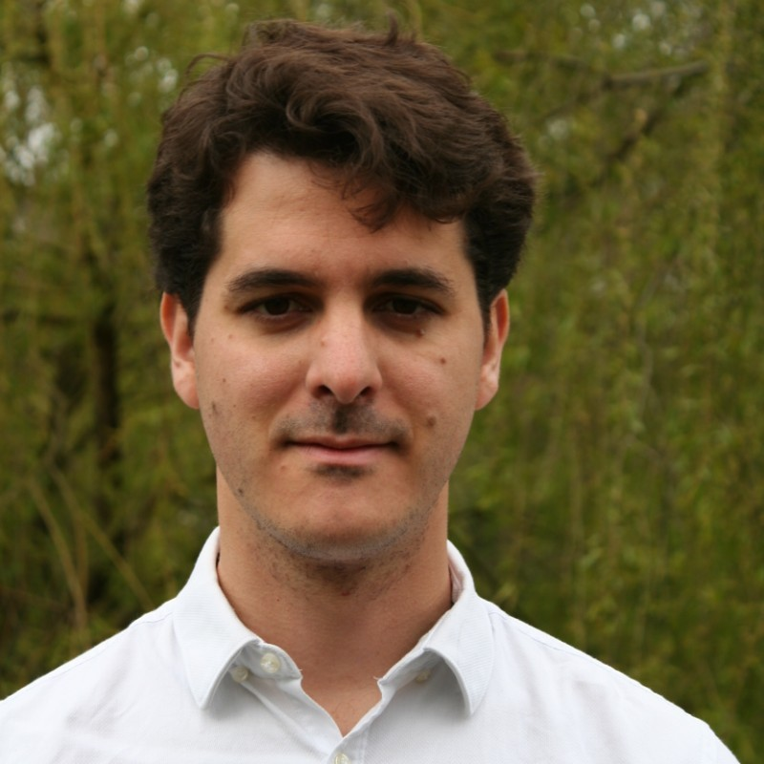
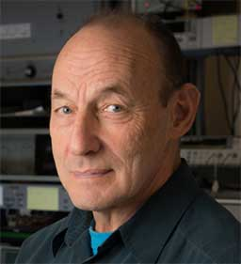
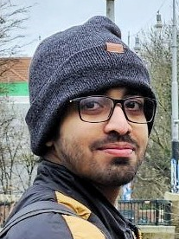
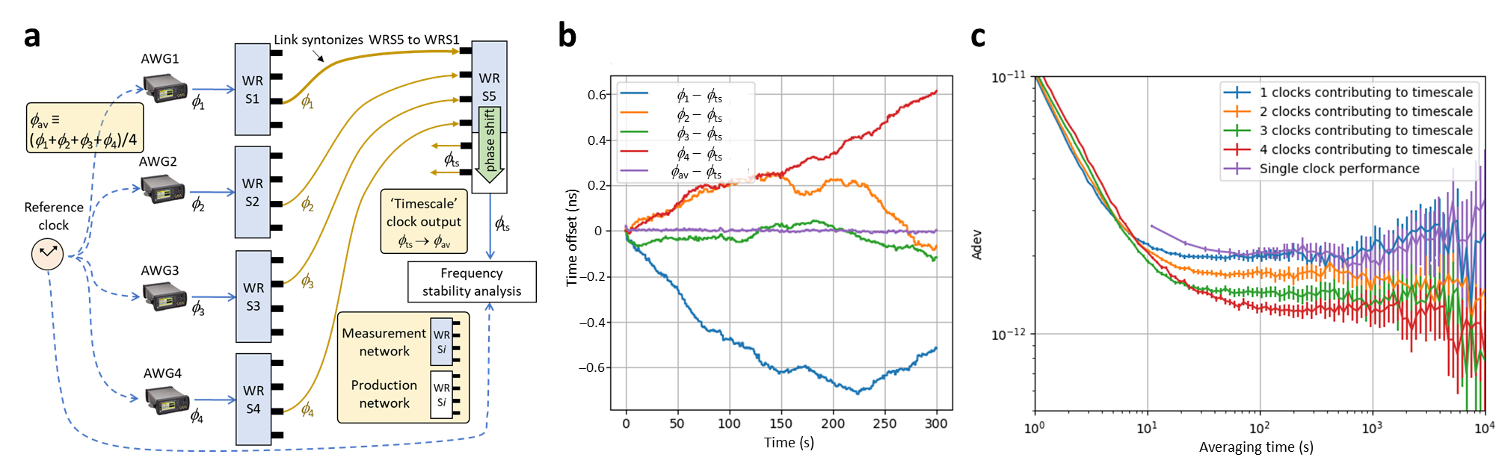
Proof-of-principle clock ensemble
Measurement network monitors four ‘clocks’
Algorithm: simple mean of clock times ⇒ improves stability of production network time
Rodrigo González
Escudero
Marc Weiss
Sougandh
Kannoth Mavila

Slide 23
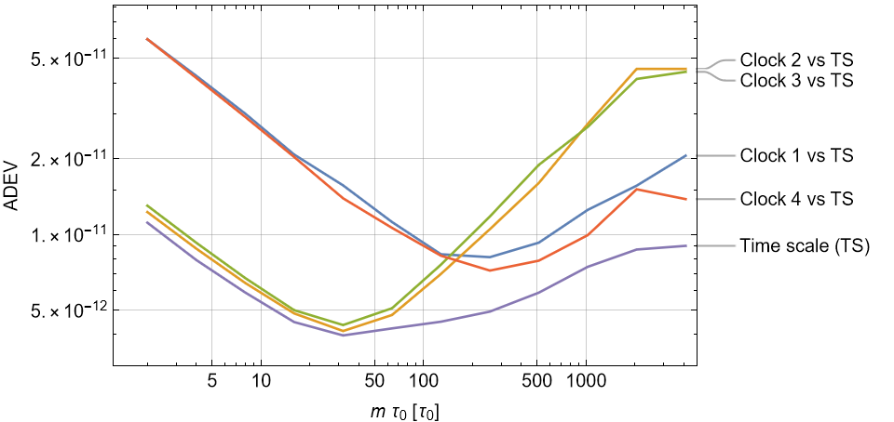
The power of clock ensemble algorithms
Multiple clocks offers not only redundancy, but also more stable network time!
Simulation (to be tested in a WR network with real atomic clocks soon):
Future UTC(?)
Échelle Atomique Libre and TAI based on WR?
Circular T every second (instead of daily/weekly)?

Slide 24

Layered network & organic growth
Redundant UTC time inputs
(e.g. NMI, GPSDO, Galileo receiver, …)
Start with backbone network
Deploy WR only there where necessary
WR gear can also provide time through other protocols (NTP, PTP)
  Energy grids, mobile networks, data centers, financials, …
WDM: add ultrastable laser wave
Reserve 2×4 channels per fiber pair
  Fiber 1: 2× WR, 2× WR calibration
  Fiber 2: 2× WR, 2× ultrastable laser
  25 GHz spacing?
Bidirectional rings and/or other redundant topologies, over shared or
dedicated dark fiber
WR Grandmasters
(GMs)
UTC PoP
WR Boundary
Clocks (BCs)
UTC PoP
UTC PoP
UTC PoP
High-reliability UTC
to cloud over NTP/PTPv2/PTPv2.1
See also: Krehlik et al., IEEE TUFFC 64, 1884 (2017), and:
CLONETS Deliverables, https://www.clonets.eu/clonets.html

Slide 25







Thank you!
Questions: j.c.j.koelemeij@vu.nl
VU Amsterdam
Rodrigo Gonzalez Escudero
Marc A. Weiss (ext. consultant)
Sougandh Kannoth Mavila
Rob Kortekaas
Kjeld Eikema
TU Delft
Han Dun
Cherif Diouf
Christian Tiberius
Gerard Janssen
VSL
Erik Dierikx
Yan Xie
University of Amsterdam
Klaasjan van Druten
Sumit Sarkar
Philippe Bouyer
Florian Schreck
JIVE
Paul Boven
SURF
Rob Smets
Sander Klemann
Paul Klop
CERN
White Rabbit team

