Slide 1
Beam Losses in IR7 during high intensity injection
B.Salvachua and S.Morales (SY-BI-BL)
With inputs from: J.Wenninger, D.Mirarchi, G.Trad, E.Veyrunes and C.Zamantzas
27 Nov 2023 - BLM Threshold Working Group

Slide 2
Introduction
During 2023 proton run, losses in IR7 during injection were dumping the beam with 236b injection trains and only in Beam 1.
These are fast losses in RS01 (40us) reaching the BLM maximum electronics limit of 23 Gy/s at the primary horizontal and skew collimators.
Detailed analysis of these events is on-going…
… we should start the discussion on what are the options to find a mitigation for
  Short term: 2024 run
  Long term: HL-LHC

Slide 3
How many protons impact the primary collimator?
Estimation of protons at 450 GeV impacting the primary collimators during saturation by calibrating another BLM downstream that does not saturate.
S.Morales
Equivalent of 50 Joules in 40us
Saturation level of the TCP.C

Slide 4
How many protons impact the primary collimator?
This estimate of saturation around a pilot is confirmed by a test on 23 June.

Slide 5
Can the losses be reduced?
Can the BLM signal be reduced?

Slide 6
2023 proton injections
236 bpi
164 bpi
128 bpi

Slide 7
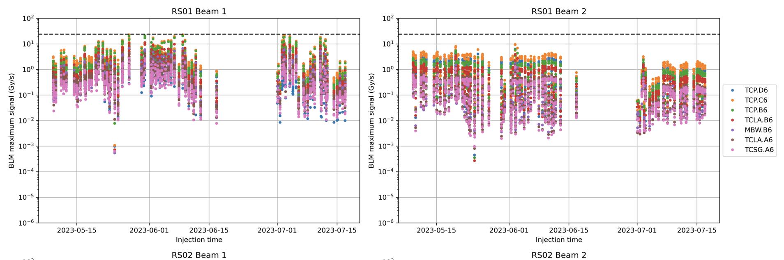
Maximum Beam Loss during Injection
Beam 2 losses are kept under control along all the year
Different pattern Beam 1 vs Beam 2 (horizontal/skew)
Last period at around 5th July and 10th July visible improvement of beam losses

Slide 8
Maximum Calibrated Beam Loss during Injection
6.8e8 protons at 450 GeV

Slide 9
Maximum beam loss per beam and plane
Main difference come from the large tails on the horizontal/skew collimator losses

Slide 10
BLM signal for different trains
Lower beam losses observed on the 164 bpi

Slide 11
BLM signal for different trains

Slide 12
Beam loss scaling with injected intensity

Slide 13
Correlation with TDIS

Slide 14
Correlation with SPS scraping

Slide 15
Correlation with Energy Matching

Slide 16
Can the losses be reduced?
Can the BLM signal be reduced?

Slide 17
Can the BLM signal be reduced?
Displace the Ionisation chamber in order to capture less shower.
  We would need about a factor of 2 reduction for the primaries, then other BLMs will be limiting.
  Need Fluka estimates of the optimal new position —> Anton
  We could install during EYETS an additional IC next to the present one and move the interlock functionality to these one after confirming the new signal factors.
Are there other options?
  Blindable
  LICs

Slide 18
Blindable system in IP7
Brainstorming is to allow 2 BLMs in Beam 1 to inhibit the interlock during injection (probably milliseconds). Keeping the rest of the IR7 interlocked. Procedure would need to be reviewed and limits would need to be defined (how many BLMs, maximum blinding time, etc.)
Need analysis on the impact for combined fast failure scenarios: D1 failure during injection.
No re-cabling is needed. The blindable configuration is already deployed in ALL BLMs. It is enabled only when the blindable time is not zero.
However: blinding is applied to ALL BLMs marked as MASKABLE in LSA database. At present ALL BLMs at the collimators are MASKABLE, this is needed for the loss maps and many machine developments.
No trivial option for EYETS, this can only be implemented if a new flag is created in the database + firmware upgrade to use this new flag.

Slide 19
Usage of LIC detectors
Interlock during injection or for fast losses on the LIC is a possibility, however this is only possible in LS3.
  Stability of the LICs need to be assessed.
  SEM in IR7 would need to be replaced by LICs as soon as possible to gather this data.

Slide 20
Summary
Saturation of BLMs in the primary collimators could be a limitation for 2024 run.
A mitigation needs to be in place during EYETS:
  Displacement of the IC seems the only possible short term option, if the reduction factor gain is sufficient.
  Although losses are not close to the damage limits, understanding the reason of the beam loss and correct it could be done in parallel.
For the longer term:
  Blindable in IR7 still needs further studies and firmware changes.
  Usage of LIC needs to be also further investigated, seems to be the best option of HL-LHC.

Slide 21
Back-up

Slide 23
Introduction
During 2023 proton run losses in IR7 were dumping the beam during the injection of 236b trains in Beam 1.
Fill
8872 | 04-JUN-2023 14.58.19.889000000 | IR7 | Classified as IR3/IR7 losses
8869 | 04-JUN-2023 00.28.55.889000000 | IR2 | Classified as IR3/IR7 losses
8868 | 04-JUN-2023 00.03.51.089000000 | IR7 | Classified as IR3/IR7 losses
8861 | 02-JUN-2023 12.12.18.689000000 | IR7

Slide 24
Maximum Calibrated Beam Loss during Injection

Slide 25
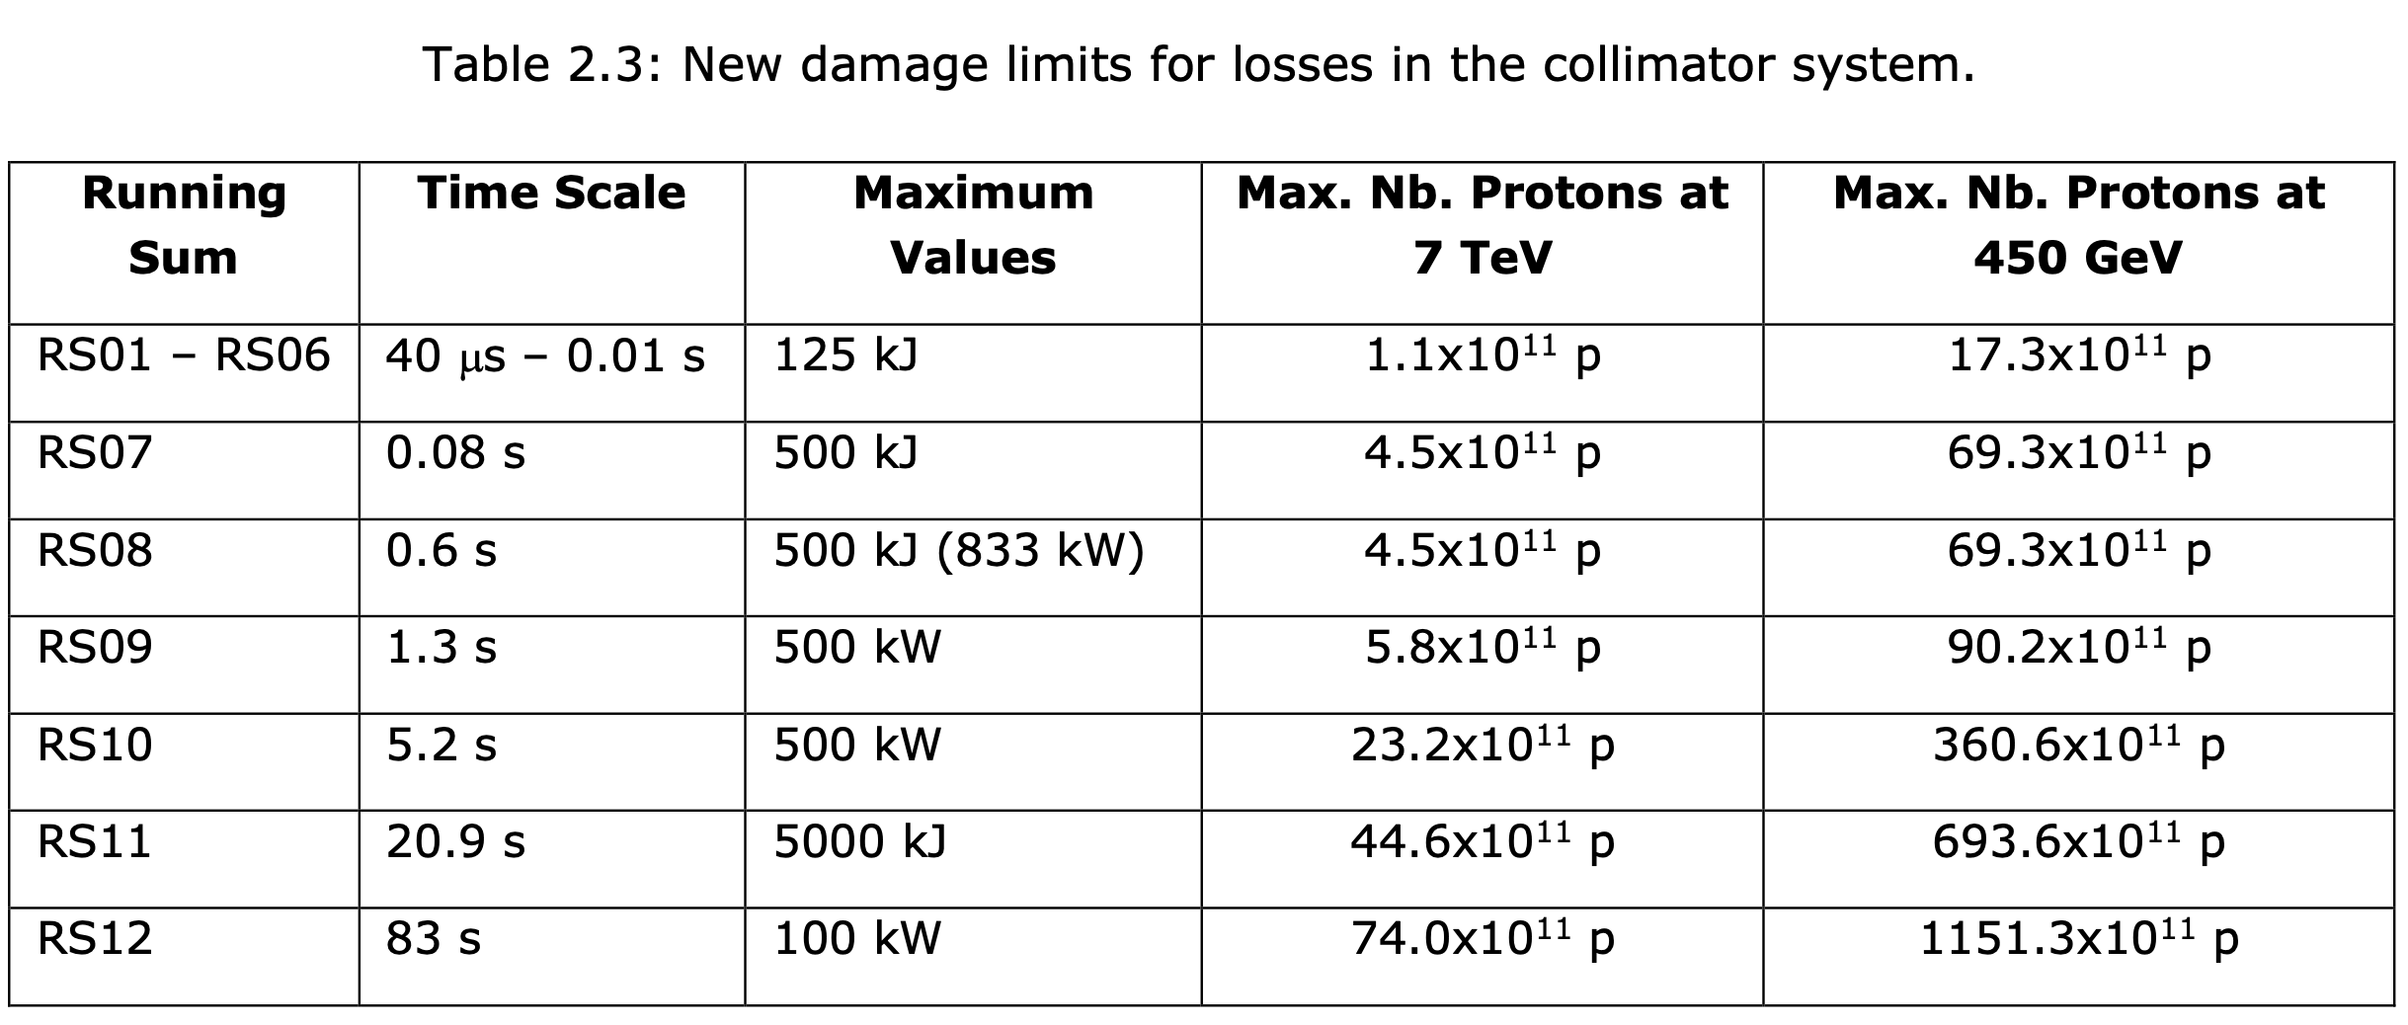

Slide 26
IC vs LIC

