Slide 1
Removal of BLM at
ALFA stations 7R1
B.Salvachua (SY-BI-BL)
27 Nov 2023

Slide 2
De-installation of ALFA 7R1 stations
ECR LHC-XAFP-EC-0007 : https://edms.cern.ch/document/2914324
  The ALFA stations are in the LSS1 on either side of IP1.
  The z-positions of the two stations are 237 m and 245 m, respectively for the A and B stations
  A7L1 and B7L1 for sector 8-1
  A7R1 and B7R1 for sector 1-2 <— Removal during EYETS23 and re-use for proof-of-principle or a double-crystal fixed target setup (TWOCRYST)
Beam 1
Beam 2
IP1
7R1.B1
Exterior outgoing beam line
B. Salvachua - BLMTWG 27/11/2023

Slide 3
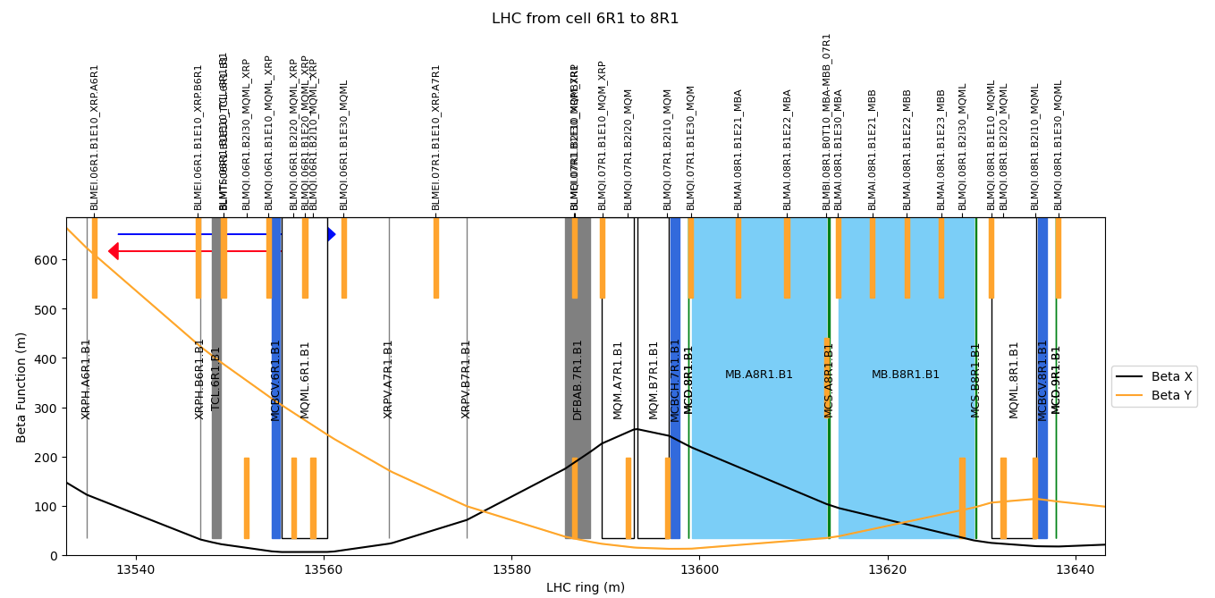
Beam Loss Monitors
B. Salvachua - BLMTWG 27/11/2023

Slide 4
Beam Loss Monitors
XRPV.A7R1.B1 13566.991967
BLMEI.07R1.B1E10_XRP.A7R1 13571.69 m
XRPV.B7R1.B1 13575.249967
BLMEI.07R1.B1E10_XRP.B7R1 13586.42 m
These 2 IC BLMS are only used by ALFA and they are in the interlock chain.
BLM @ A7R1 is easily accessible -> permanently removal
* NEEDS TO BE REMOVED FROM DB
BLM @ B7R1 is behind the DFB, very difficult access. We keep this BLM to be removed in LS3 but we do not connect to the BIC.
* We keep it NOT connected: * We keep it NOT connected
BLM activity planned for the 8th November 2023
DONE!
B. Salvachua - BLMTWG 27/11/2023

