Slide 1
CERN Basketball Club
General Assembly
08th December 2023

Slide 2
Season 2023-2024
The committee announced the CERN1 and CERN2 players
This is the criteria that we have followed for the selection:
  Members of the teams from last year have been given preference
  Attendance to the trainings and/or pickup games
  Basketball level / Team needs
CERN2 roster
1. Jeronimo ORTOLA
2. TONY GALLERY
3. MANUEL GONZALEZ BERGES
4. Francesco GIULI
5. GIUSEPPE MAZZOLA
6. Emanuele VILLA
7. STEFANO SAROGLIA
8. BABEL PAWEL
9. Krzysztof Nienartowicz
10. Adolfo FUELLO
11. William WARNER
12. Marcos VAZQUEZ
13. Christian DELDICQUE
14. Francisco Moreira Huhn
CERN1 roster
1. Miguel Gil Costa
2. Francois Boyer
3. Guillermo Villacanas Redondo
4. Pedro Felix Lopez Macia
5. Georgios Voutsinas
6. Dario Soriano Guillen
7. Roberto Muriel Mauriño
8. Jose Rodriguez Nogueira
9. Szymon Dominik Wlodarczyk
10. Alexandros Petridis
11. Borja Fernandez Adiego

Slide 3
Season 2023-2024
Gyms
  Tuesdays: Chavanne
  Wednesdays: Bude
  Thursdays: Saint Genis - Diamanterie
All info can be found here: https://twiki.cern.ch/twiki/bin/view/SocialActivities/BasketballClub

Slide 4
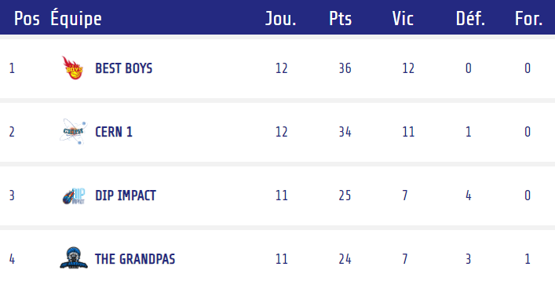
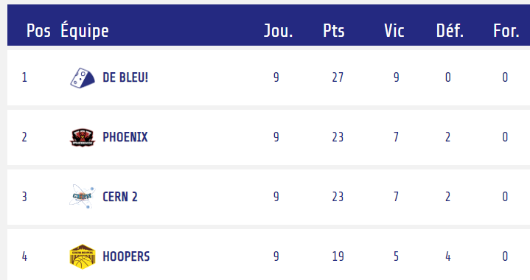
Season 2023-2024
Competitions – GAB
  CERN 1
    https://gabasket.ch/team/cern_1
    League A
    Cup
  CERN 2
    https://gabasket.ch/team/cern_2
    League C
    Cup

Slide 5
2023-2024 Committee
Borja Fernandez Adiego – President/CERN1R (Roberto is taking over CERN1R)
George Iakovidis – Vice President
Pedro Felix Lopez Macia – CERN1R
Jeronimo Ortola Vidal – Treasurer/CERN2R
Manuel Gonzalez Berges – Secretary/CERN2R
Nikolaos Kasioumis – Member
Francois Boyer – Member
Anyone else interested?

Slide 6
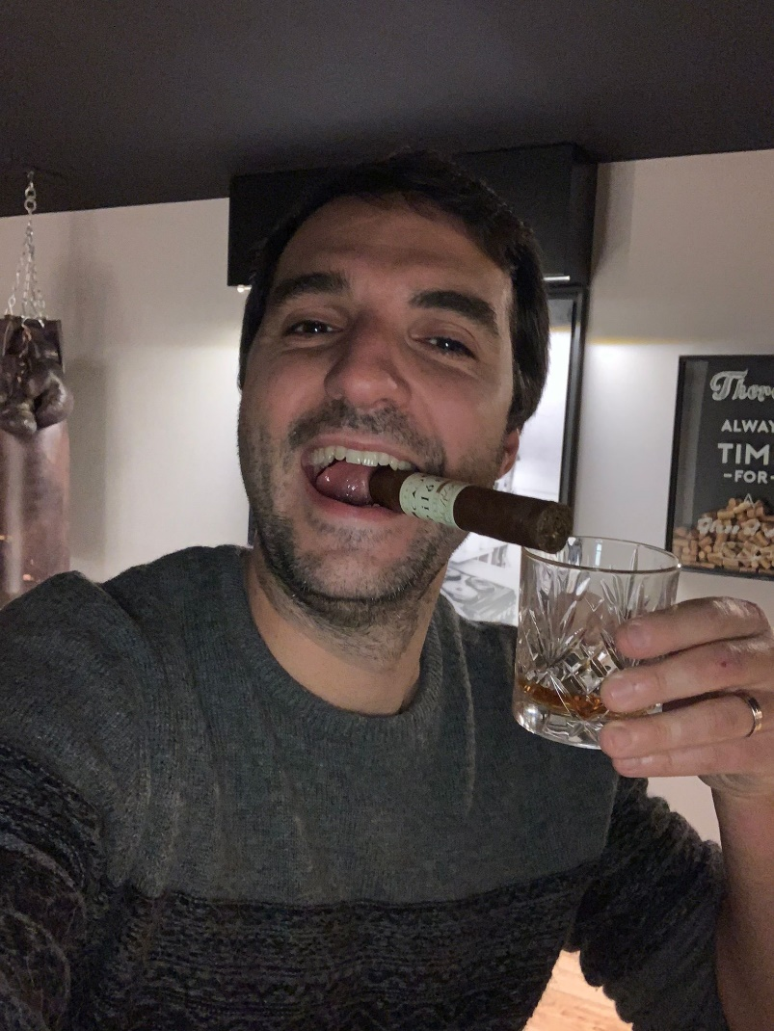
2024-2025 committee
New president: François Boyer!

Slide 7
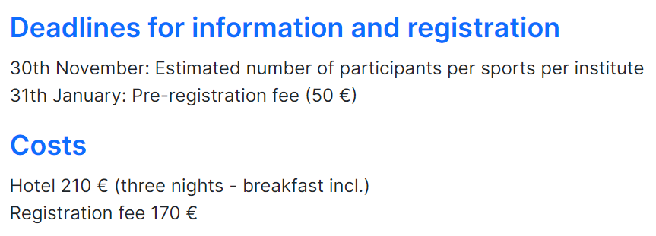
2023-2024 activities
Xmas dinner (Pedro and Roberto)
Mini Atomiades tournament (Roberto) https://www.asceri.eu/?view=article&id=136:mini-atomiade-2024&catid=29
Summer BBQ (?)
Data privacy (?)
New website (Pepe and Alex)
…
Any other volunteer?

Slide 8
Any suggestion, complain?

