Slide 1
CERN Basketball Club
General Assembly
08th December 2023

Slide 2
Agenda
Last season report (President)
Financial state of the club (Treasurer)
Planning for the current season (President)
Discussion

Slide 3
2022-2023 Committee
Borja Fernandez Adiego – President/CERN1R
George Iakovidis – Vice President
Pedro Felix Lopez Macia – CERN1R
Jeronimo Ortola Vidal – Treasurer/CERN2R
Manuel Gonzalez Berges – Secretary/CERN2R
Nikolaos Kasioumis – CERN2R
Francois Boyer – Member
Franck Perret – Coach

Slide 4
2022-2023 Status
Members
  CERN 1: 17 players (14 full season + 3 half season)
  CERN 2: 14 players
  Only trainings: 13 person paid
Gyms
  Tuesdays: Chavanne
  Wednesdays: Bude
  Thursdays: Saint Genis Diamanterie
Competitions – GAB
    CERN 1 - League A / Cup
    CERN 2 - League C / Cup

Slide 5
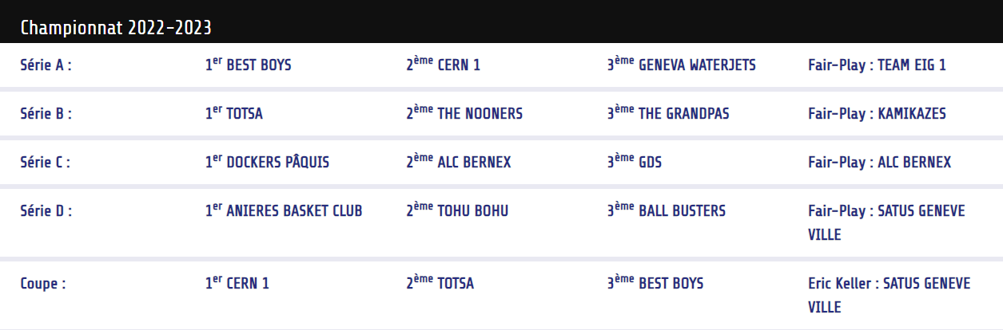
CERN1 2022/23 Championship
https://gabasket.ch/palmares-du-gab/

Slide 6
CERN2 2022/23 Championship
https://gabasket.ch/palmares-du-gab/
7th position of league C

Slide 7
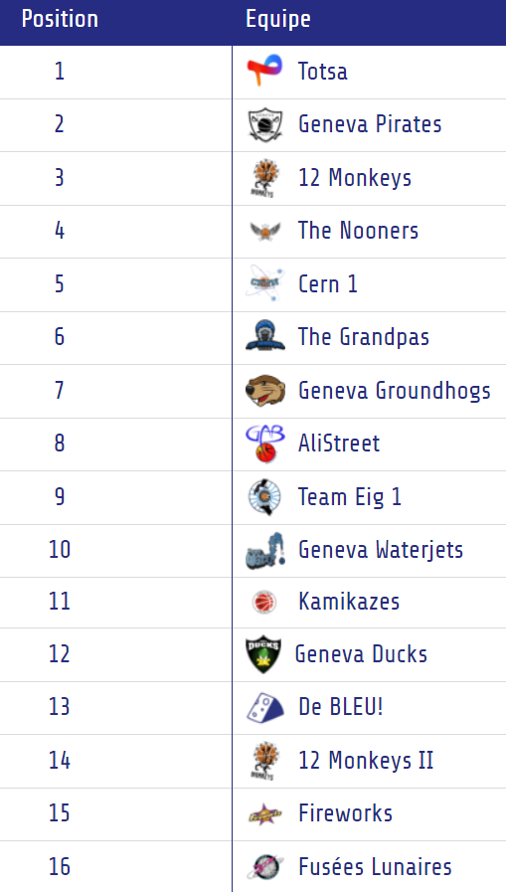
GAB tournament
https://gabasket.ch/tournoi-du-gab-2023/

Slide 8
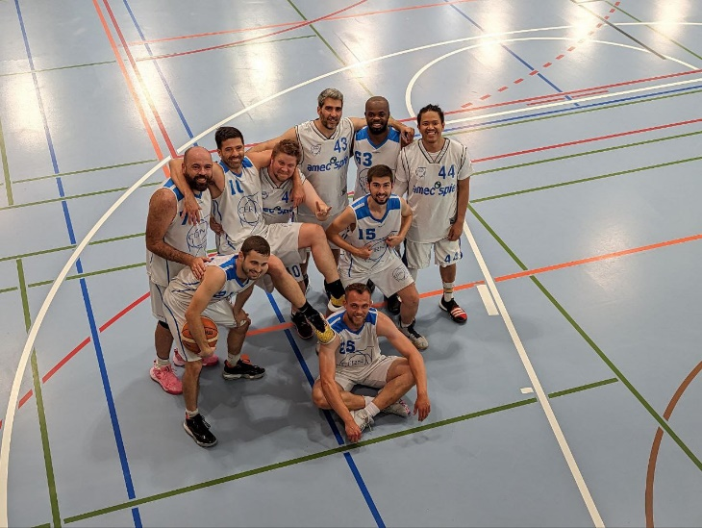
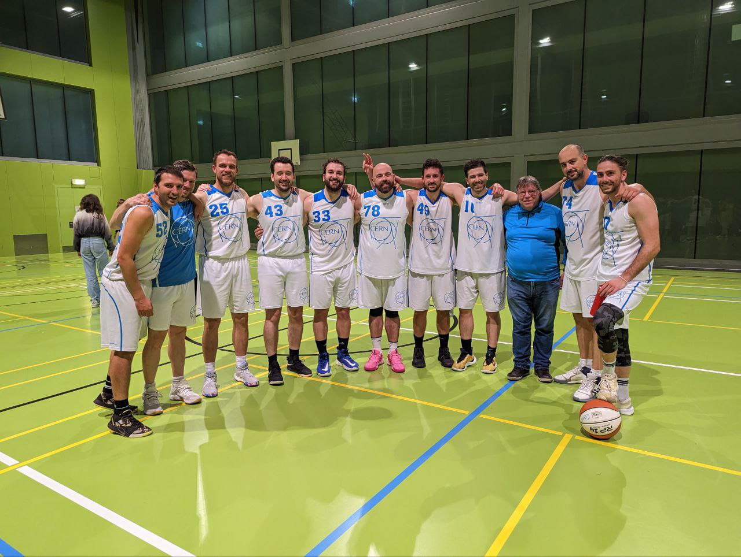
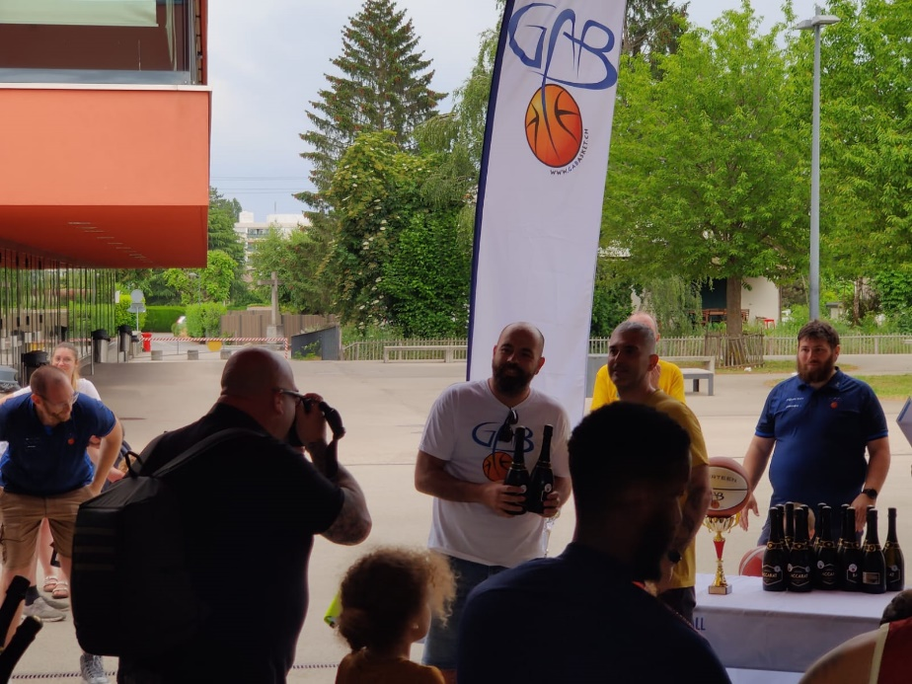
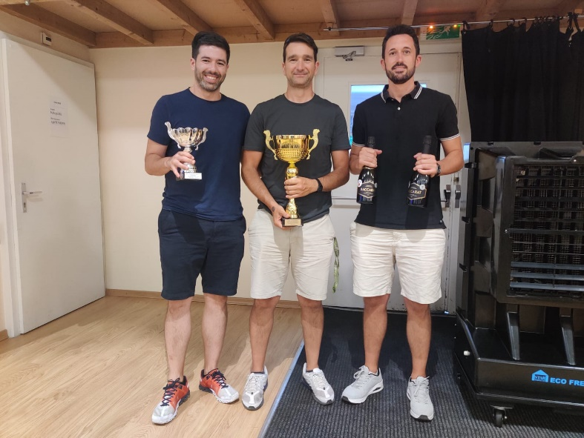
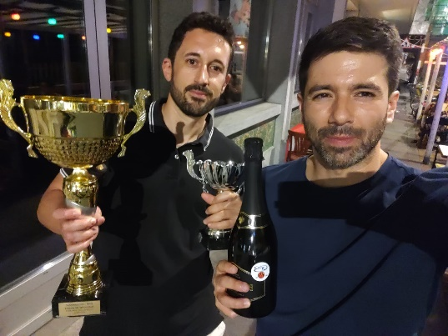
Some photos

Slide 9
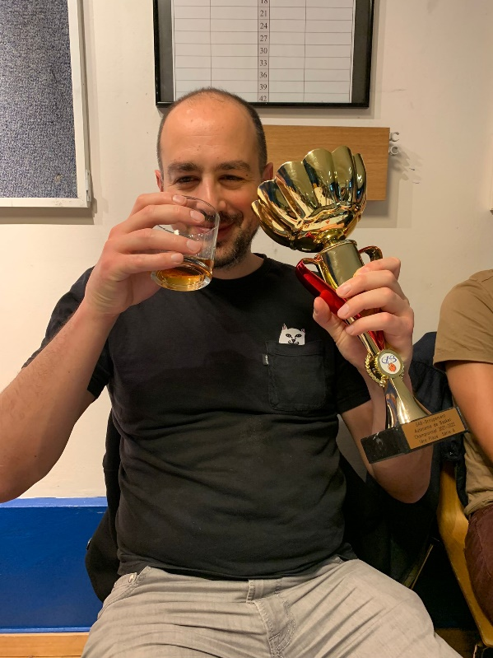
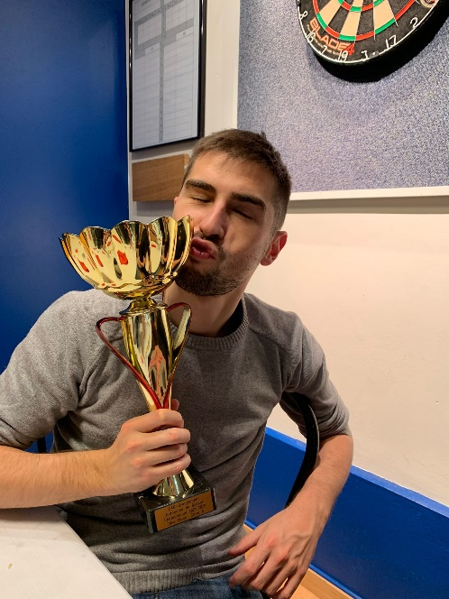
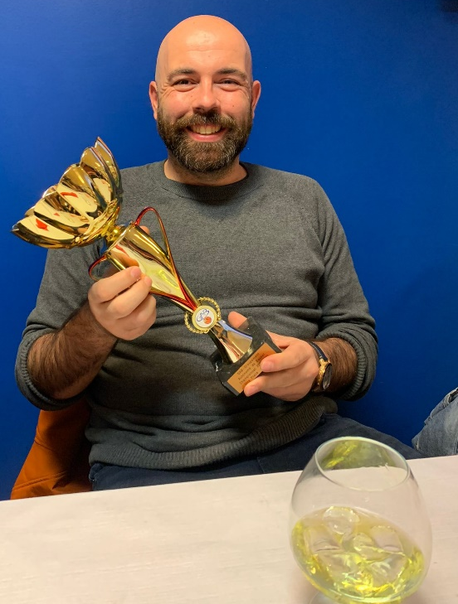
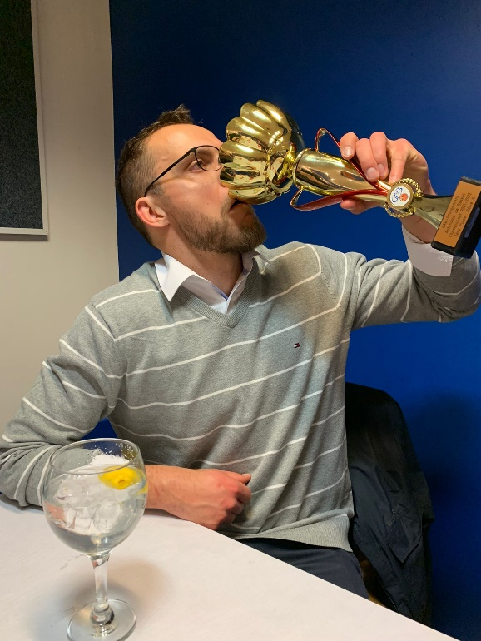
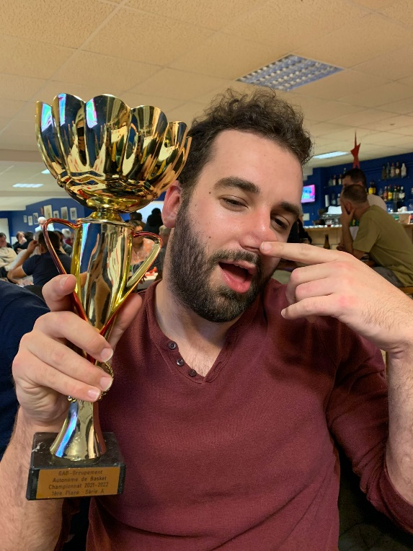
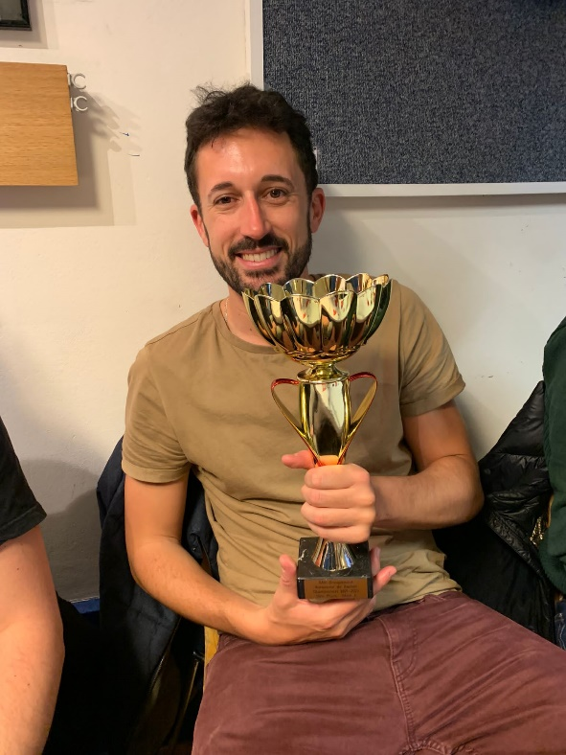
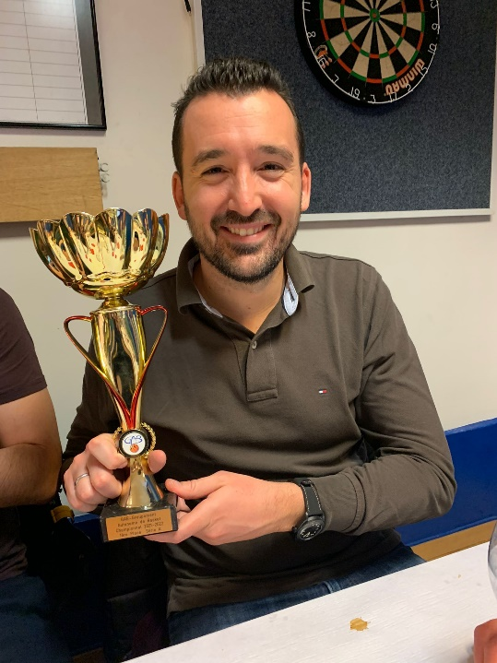
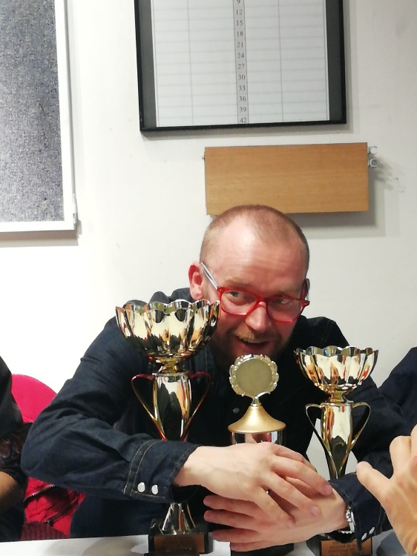
Some photos

Slide 10
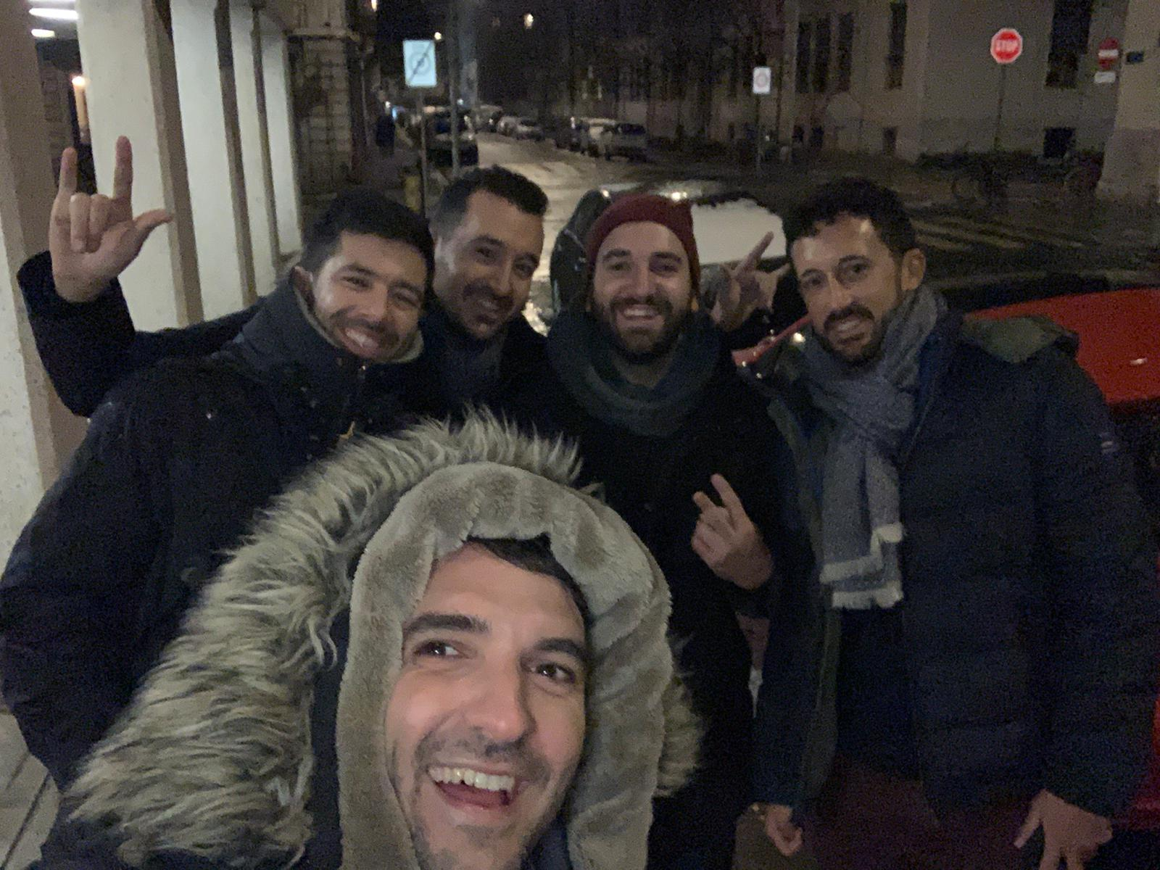
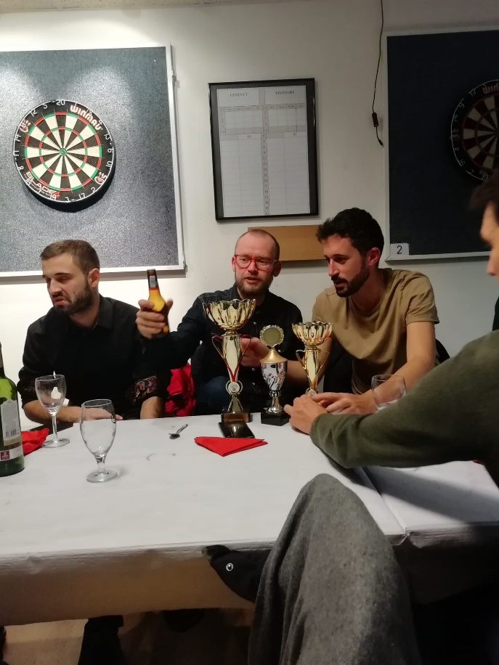
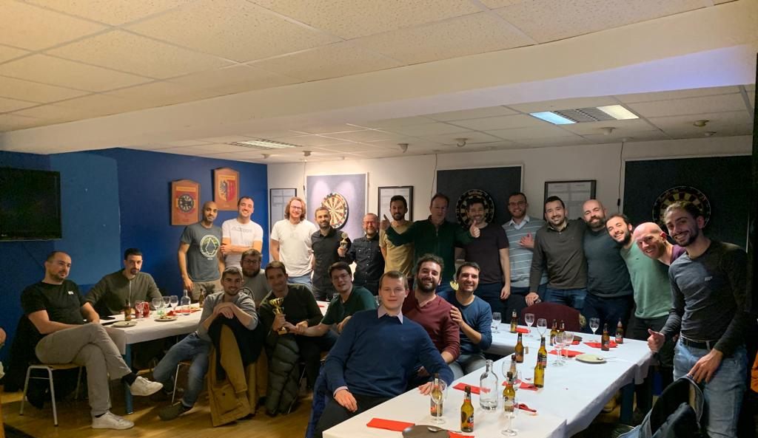
Some photos

Slide 11
Thanks to all the people in the committee and everyone in the club

