Slide 1

Integration of the R2E-HL-LHC60A-10V Power Converters in HL-LHC
With inputs from WP6B (SY-EPC)
Miguel Navarro Baeza, ATS-DO, HL-LHC WP15 Integration
24/11/2023

Slide 2
60 A Power Converters Replacement
HL-LHC warm powering upgrade involves R2E consolidation phase in LS3.
HL-LHC need for radiation-tolerant converters in the upgraded system.
Partial replacement with R2E-HL-LHC60A-10V converters.
These new converters will be installed in LHC ARCs around IP1, IP2, and IP5 (higher irradiated areas).
WP15 produces Equipment Integration Note that details the replacement strategy plan for R2E-HL-LHC60A-10V converters.
References for this study:
HL-MCF Meeting #119 (https://indico.cern.ch/event/1280376/)
HL-TDR
Other past WP15 integration studies

Slide 3
Equipment Integration Note v0.1
Integration of the R2E-HL-LHC60A-10V Power converters in the HL-LHC Machine
The document details the current situation of LHC60A-08V converters, technical information, current configuration and placement under LHC dipoles.
Introduces the R2E-HL-LHC60A-10V power converters, installation plan, and considerations for radiation tolerance.
Presents the R2E-HL-LHC60A-10V integration.
  Overview of the installation distribution
  Updated rack dimensions and available space
  Cable connections for new installation
  Location of the power converters
  Impacted 60A circuits (Not in this version. TBD by SY-EPC if included in next version)
EDMS 3000546

Slide 4
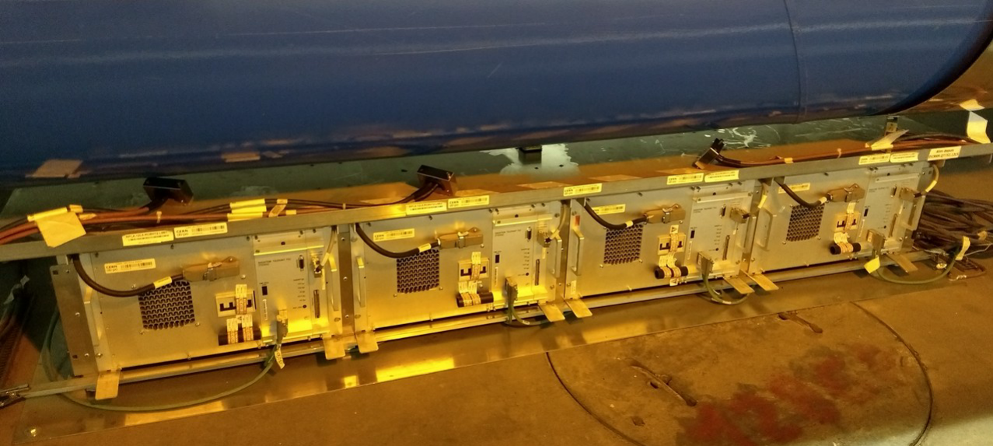
Current situation of LHC60A-08V converters
Installed 4x in a row within 1x rack under the LHC dipoles in the LHC ARCs.
Dimensions of RYLA rack power converter: width=3m, height=0.36m, depth=0.53m.
Type of equipment in the LDB: HCRYLA_ .
Simplified 3D model SmarTeam reference: ST0029024_01.

Slide 5
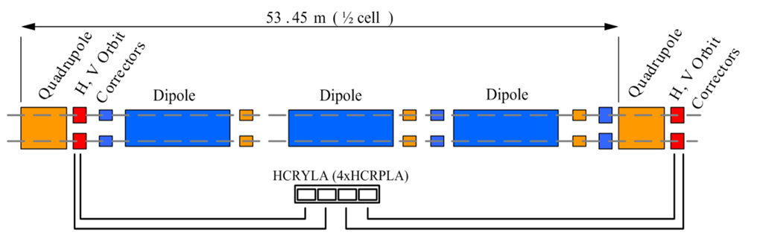
Current situation of LHC60A-08V converters
Occupy the space beneath the second dipole (positioned between quadrupoles)
No racks present in the surroundings – low risk of interference

Slide 6
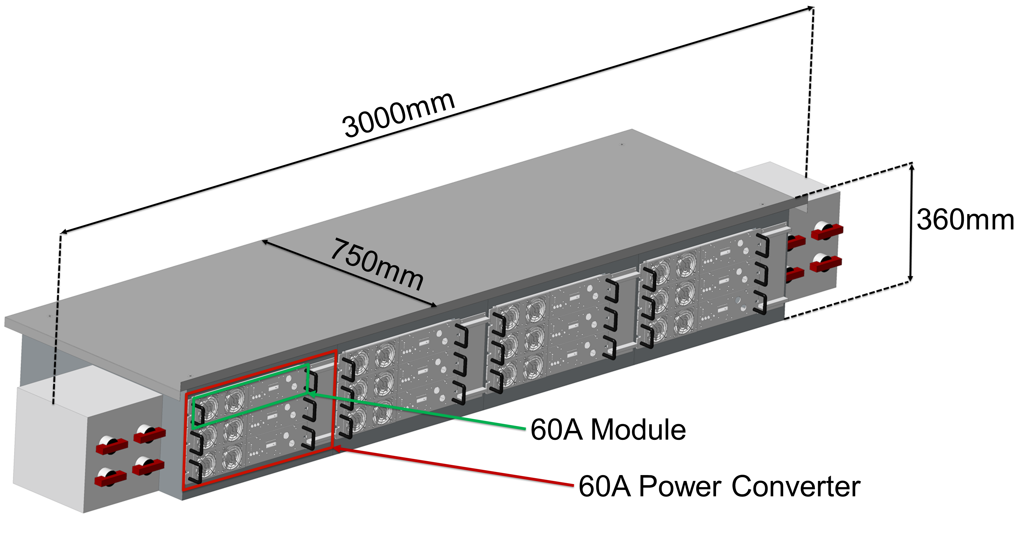
R2E-HL-LHC60A-10V integration
144x R2E-HL-LHC60A-10V power converters installed in 36x RYLAC racks under the LHC dipoles in the LHC ARCs around IP1, IP2 & IP5.
  72x installed for radiation purposes,
  72x installed as rotation units (replacement of the radiation purpose units)
3D model SmarTeam reference used for integration studies is: ST1466988_01.

Slide 7
Overview of the installation distribution
Power converter type | Total Quantity | Circuit locations | Power Converters distribution | Dose [Gy/year]
R2E-HL-LHC60A-10V RPLAC (Radiation purpose) | 72 | Cells 12, 14 and 16 of left and right sides of IP1, IP2 and IP5. | 4x RPLAC power converters per 1x RYLAC rack per cell. | 8x 12(L/R)2 < 10 8x 12L(1/5) < 10 8x 12R(1/5) < 3 48x 14/16-L/R-1/2/5 < 1.5
R2E-HL-LHC60A-10V RPLAC (Rotation Units) | 72 | Cells 18, 20 and 22 of left and right sides of IP1, IP2 and IP5. TBD in LHC Run 3. | 4x RPLAC power converters per 1x RYLAC rack per cell. | 0.5
LHC60A-08V RPLA (LHC) | 608 | All other locations. | N/A | 0.5
Working assumption: 72x rotation units can be positioned "in series" with the first 72x units

Slide 8
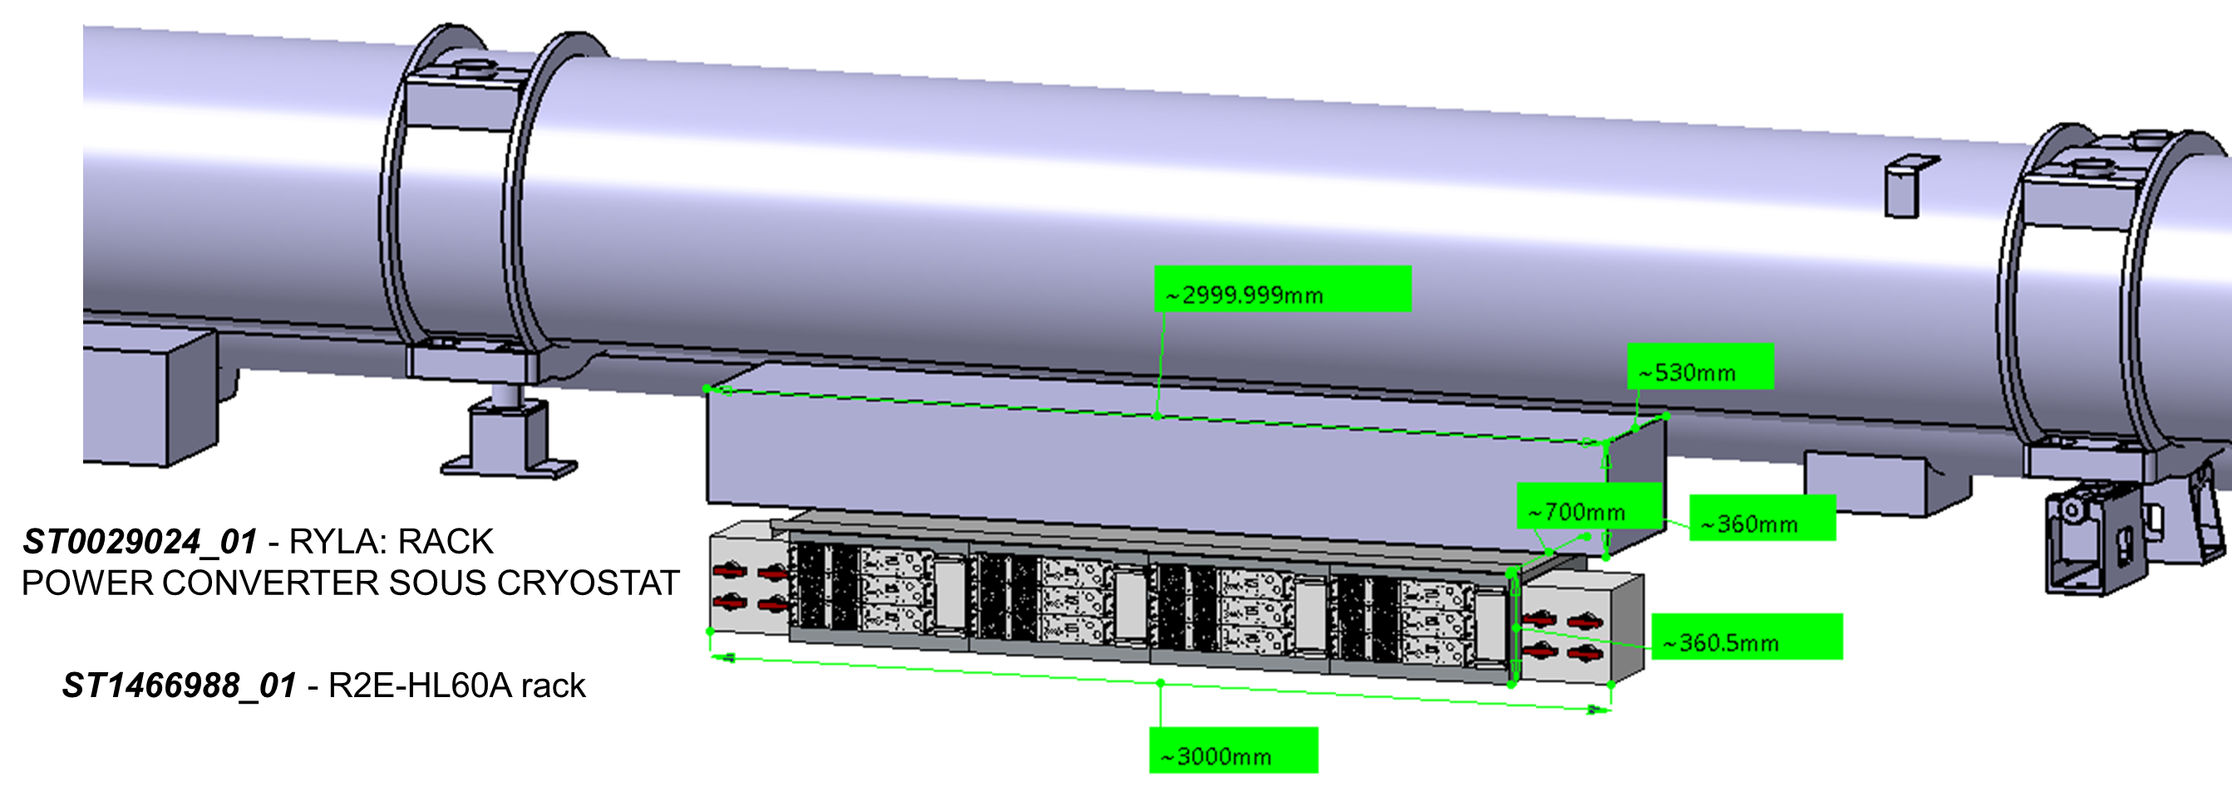
Updated rack dimensions and available space
The installation of the new power converters will replace the existing units in their current locations.
Change in the rack dimensions, new rack being slightly deeper. The updated rack depth measures approximately 0.75 meters, an increase from the previous 0.53 meters.

Slide 9
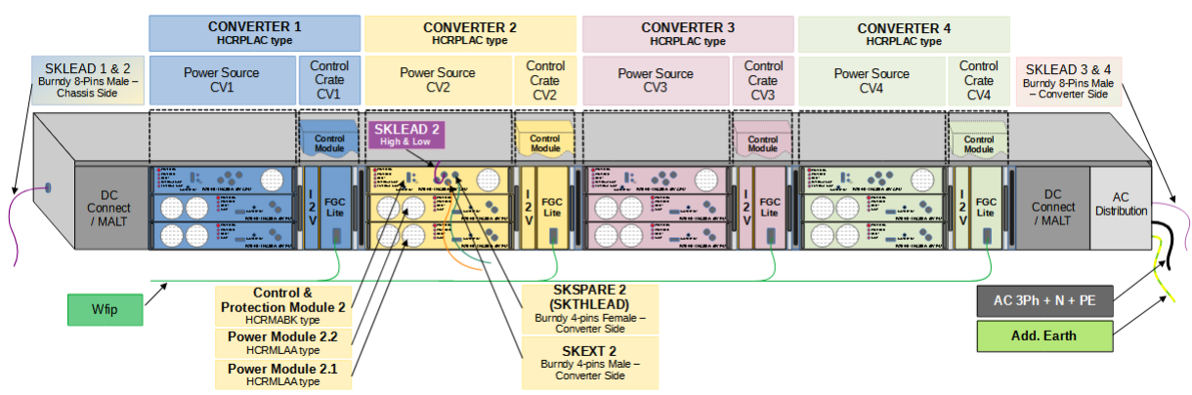
Cable connections
AC, Leads & WFIP Cables update: connectors and their respective locations remain virtually unchanged from the previous configuration. This allows the continued use of the existing cables → no re-cabling efforts.
DC Connection update: Change in the existing DC connector type, which will need to be performed by SY-EPC.

Slide 10
Location of the new power converters
IP Side | LHC60A-08V Rack Name | R2E-HL-LHC60A-10V Rack Name | DCUM (m) | DCUM from Closest IP (m)
IP1 Right | RYLA.12R1 | RYLAC.12R1 | 466.03 | 466.03
 | RYLA.14R1 | RYLAC.14R1 | 572.93 | 572.93
 | RYLA.16R1 | RYLAC.16R1 | 679.83 | 679.83
 | RYLA.18R1 | RYLAC.18R1 | 786.73 | 786.73
 | RYLA.20R1 | RYLAC.20R1 | 893.63 | 893.63
 | RYLA.22R1 | RYLAC.22R1 | 1000.53 | 1000.53
IP2 Left | RYLA.22L2 | RYLAC.22L2 | 2336.74 | -995.62
 | RYLA.20L2 | RYLAC.20L2 | 2443.64 | -888.72
 | RYLA.18L2 | RYLAC.18L2 | 2550.54 | -781.82
 | RYLA.16L2 | RYLAC.16L2 | 2657.44 | -674.92
 | RYLA.14L2 | RYLAC.14L2 | 2764.34 | -568.02
 | RYLA.12L2 | RYLAC.12L2 | 2871.24 | -461.12
IP2 Right | RYLA.12R2 | RYLAC.12R2 | 3797.96 | 465.60
 | RYLA.14R2 | RYLAC.14R2 | 3904.86 | 572.50
 | RYLA.16R2 | RYLAC.16R2 | 4011.76 | 679.40
 | RYLA.18R2 | RYLAC.18R2 | 4118.66 | 786.30
 | RYLA.20R2 | RYLAC.20R2 | 4225.56 | 893.20
 | RYLA.22R2 | RYLAC.22R2 | 4332.46 | 1000.10
IP Side | LHC60A-08V Rack Name | R2E-HL-LHC60A-10V Rack Name | DCUM (m) | DCUM from Closest IP (m)
IP5 Left | RYLA.22L5 | RYLAC.22L5 | 12333.39 | -996.05
 | RYLA.20L5 | RYLAC.20L5 | 12440.29 | -889.15
 | RYLA.18L5 | RYLAC.18L5 | 12547.19 | -782.25
 | RYLA.16L5 | RYLAC.16L5 | 12654.09 | -675.35
 | RYLA.14L5 | RYLAC.14L5 | 12760.99 | -568.45
 | RYLA.12L5 | RYLAC.12L5 | 12867.89 | -461.55
IP5 Right | RYLA.12R5 | RYLAC.12R5 | 13795.47 | 466.03
 | RYLA.14R5 | RYLAC.14R5 | 13902.37 | 571.43
 | RYLA.16R5 | RYLAC.16R5 | 14009.27 | 679.83
 | RYLA.18R5 | RYLAC.18R5 | 14116.17 | 786.73
 | RYLA.20R5 | RYLAC.20R5 | 14223.07 | 893.63
 | RYLA.22R5 | RYLAC.22R5 | 14329.97 | 1000.53
IP1 Left | RYLA.22L1 | RYLAC.22L1 | 25662.83 | -996.05
 | RYLA.20L1 | RYLAC.20L1 | 25769.73 | -889.15
 | RYLA.18L1 | RYLAC.18L1 | 25876.63 | -782.25
 | RYLA.16L1 | RYLAC.16L1 | 25983.53 | -675.35
 | RYLA.14L1 | RYLAC.14L1 | 26090.43 | -568.45
 | RYLA.12L1 | RYLAC.12L1 | 26197.33 | -461.55

Slide 11
60 A Integration - Next Steps
SY-EPC to provide WP15 with 60 A impacted circuits to add them into EIN.
WP15 and SY-EPC visit onsite for verification of integration study.
ALL to add comments and provide feedback on EIN.
WP15 to update draft version and distribute for HL Engineering Approval.
WP15 to release EIN.

Slide 12
Thanks!

Slide 13
Spare Slides

