Slide 1
Mechanical properties for FalconD 12T program
RD Line 4 fourth Forum meeting, - Modelling Tools, Materials Protection and Cryogenics
Authors: N. Sala on behalf of FalconD collaboration
Date: December 5th, 2023

Slide 2
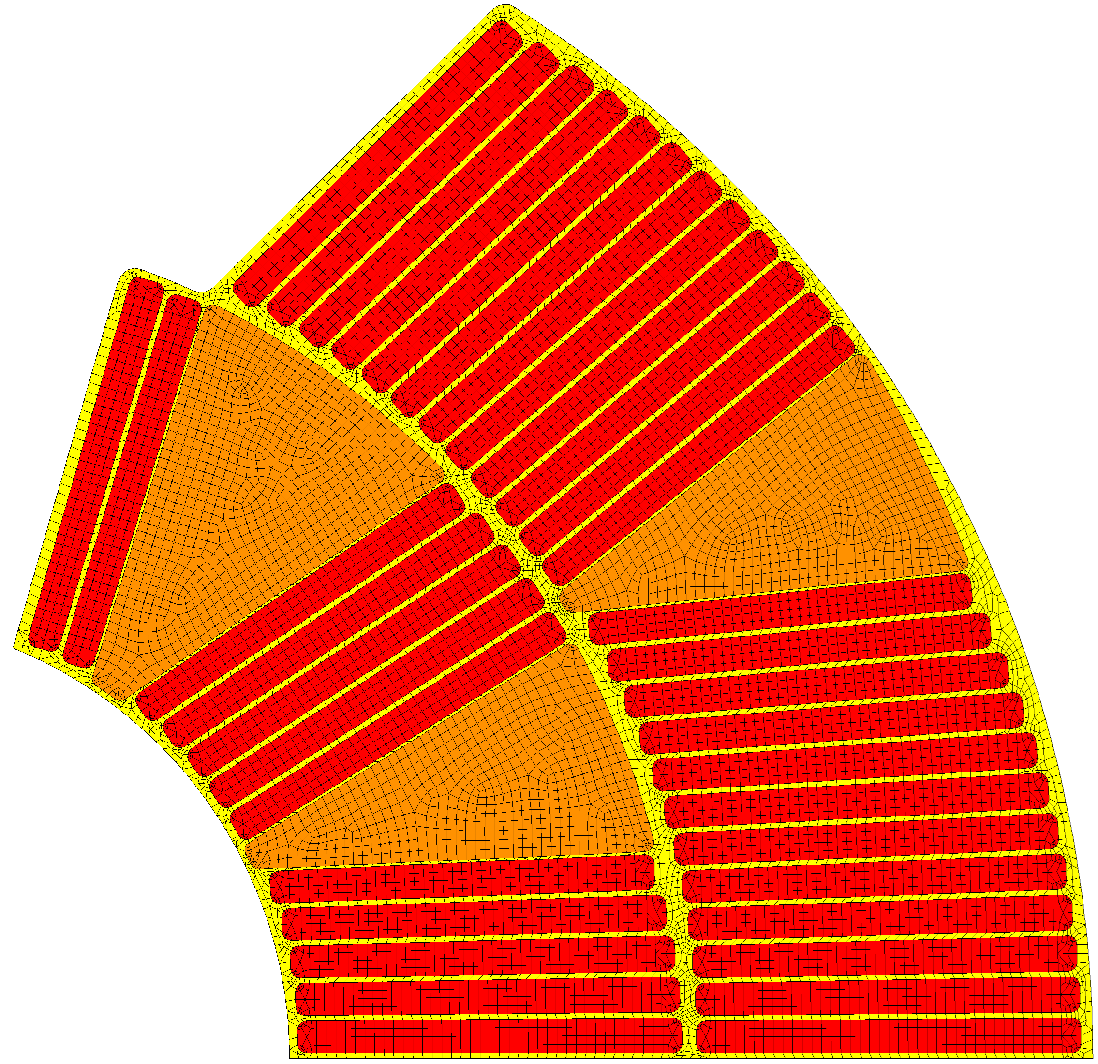
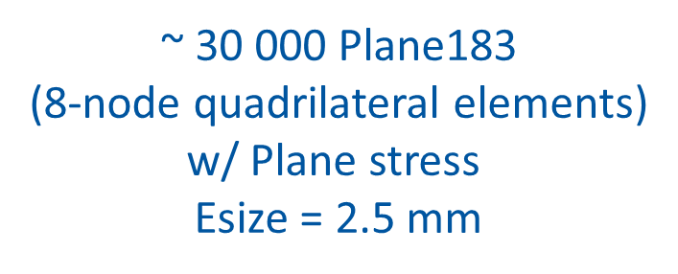
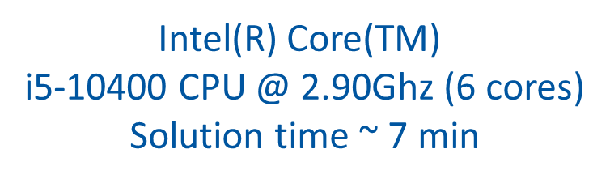
ANSYS Mechanical model: mesh
$\text{\sim }$ 30 000 Plane183
(8-node quadrilateral elements)
w/ Plane stress
Esize = 2.5 mm
Intel(R) Core(TM)
i5-10400 CPU @ 2.90Ghz (6 cores)
Solution time $\text{\sim }$ 7 min

Slide 3




Coils physical properties*
Conductors &
Insulation
Copper
wedges
$α_{rad}=1.68$ mm/m
$$α_{theta}=3.8 \text{mm}\text{/}\text{m}$$
$$α_{z}=2.98 \text{mm}\text{/}\text{m}$$
«Characterization of the thermal contraction of superconducting magnet coils for the High-Luminosity upgrade of the Large Hadron Collider (HL-LHC)» by S. Hoell (2022)
https://cds.cern.ch/record/2845427?ln=en

Slide 4
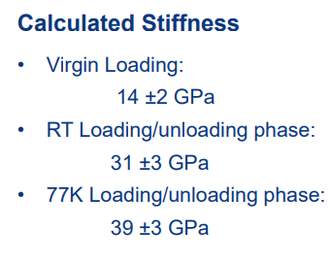
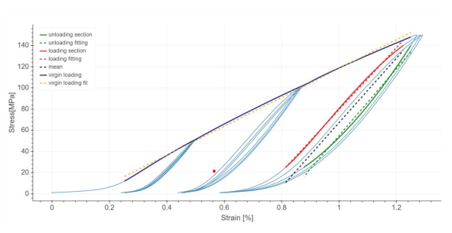
Coils mechanical properties*
*«11T Cable Stacks Compression Tests at RT and 77K» by. O Sacristan (2019)
https://indico.cern.ch/event/850550/contributions/3574865/attachments/1914741/3165117/EDMS_2208499_11T_Cablestacks_Tests2019v2.pdf

Slide 5




Coils mechanical properties*
Conductors &
Insulation
$$σ_{eqv}=σ_{VM}, σ_{theta}, σ_{I}$$
$σ_{limit, R.T.}=100$MPa *
$σ_{limit, 1.9K}=120$MPa *
$σ_{tensile}<20$MPa *
*«Mechanical structures for superconducting dipoles. Different configurations for different applications» by. D. Perini (2022)
https://indico.cern.ch/event/1192313/attachments/2549170/4390531/Seminar.pdf

Slide 6
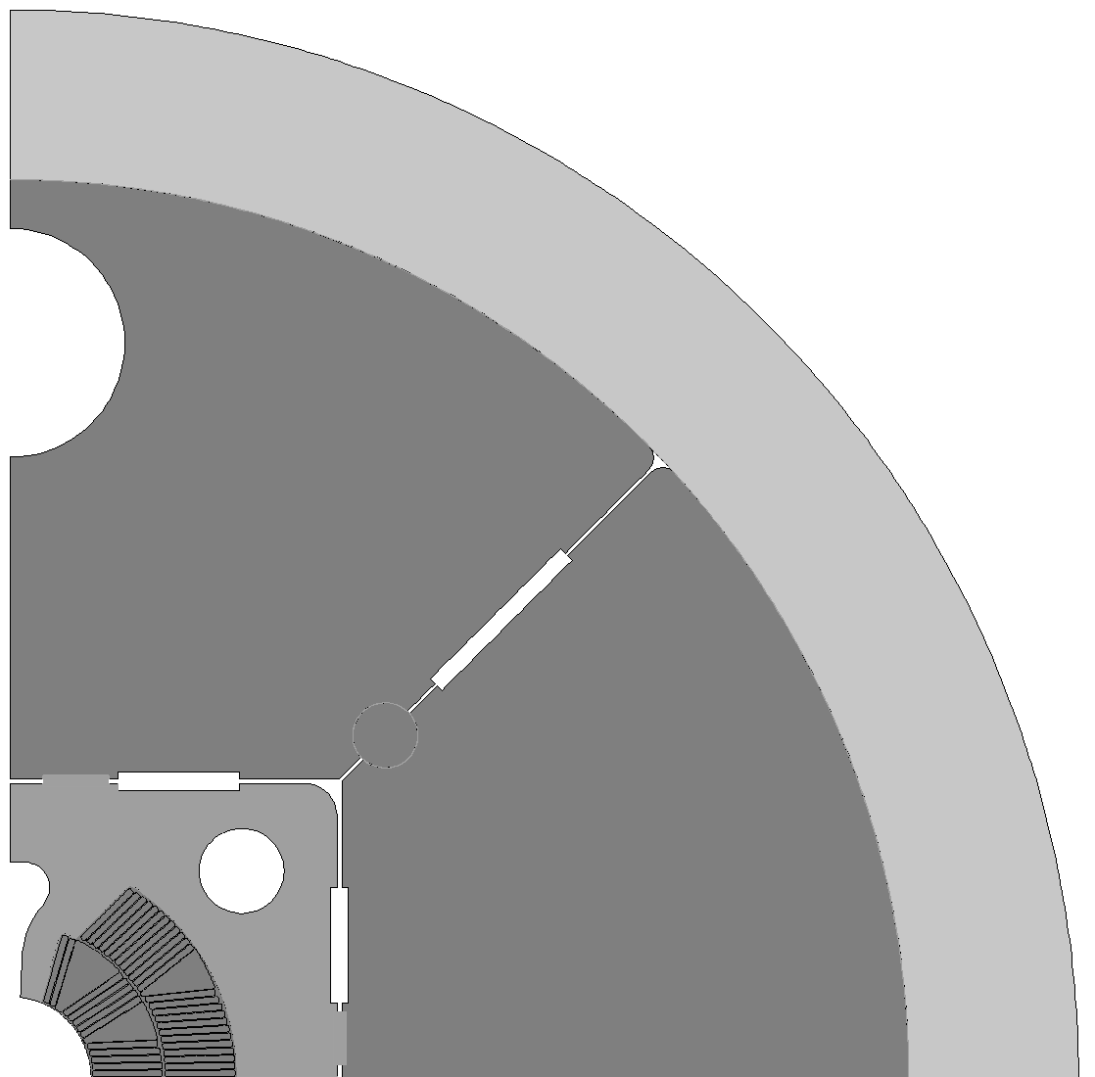

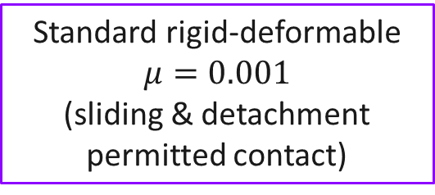
ANSYS Mechanical model: contacts
$$μ=0.2$$
Standard contact (sliding & detachment permitted) contact
No separation (sliding permitted) contact
Standard rigid-deformable $μ=0.001$
(sliding & detachment permitted contact)

Slide 7
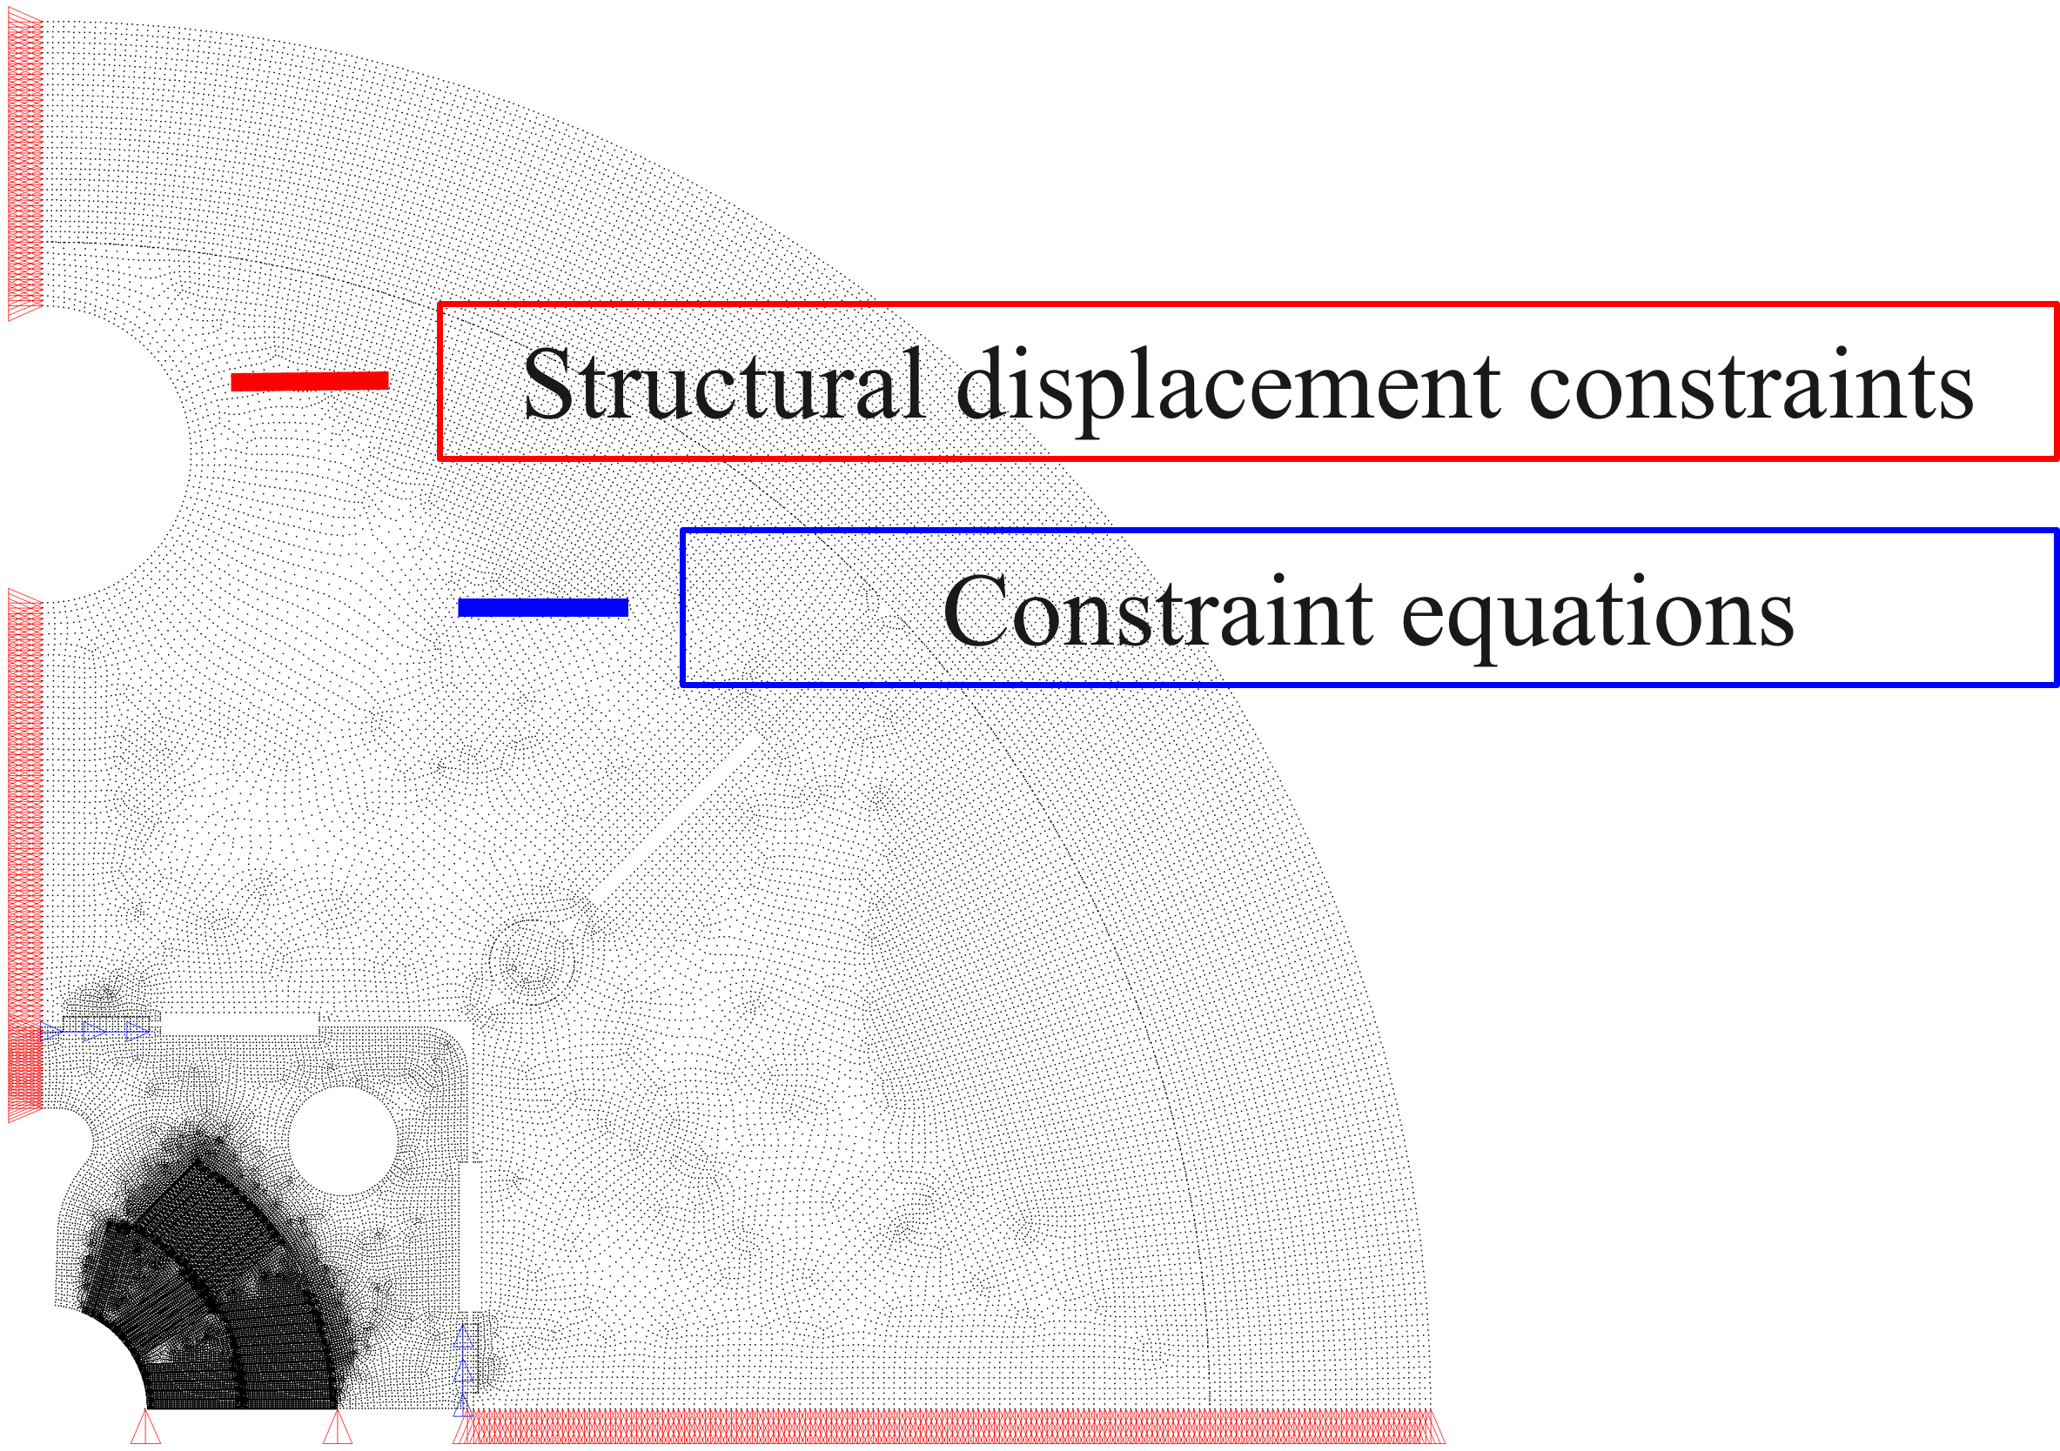
ANSYS Mechanical model: BCs

Slide 8
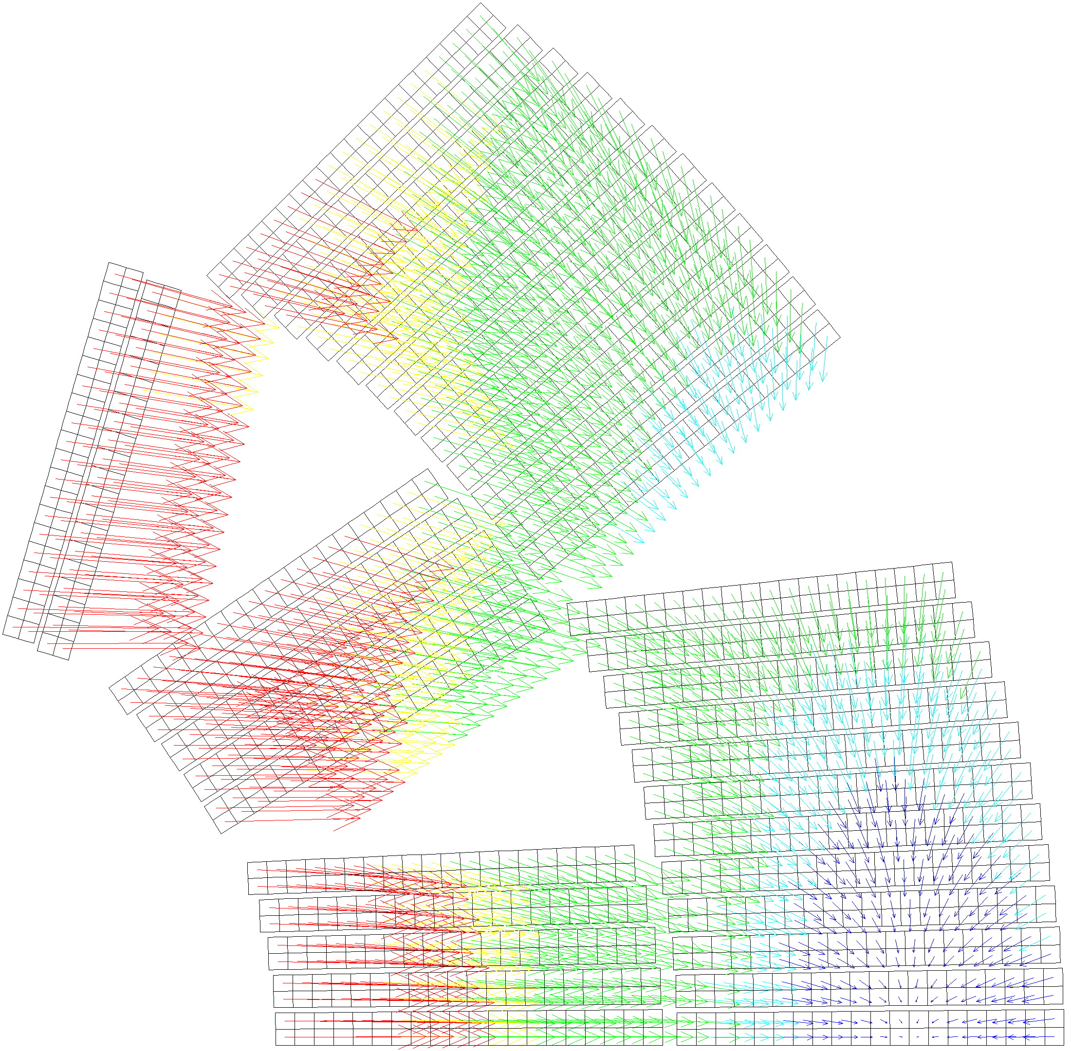
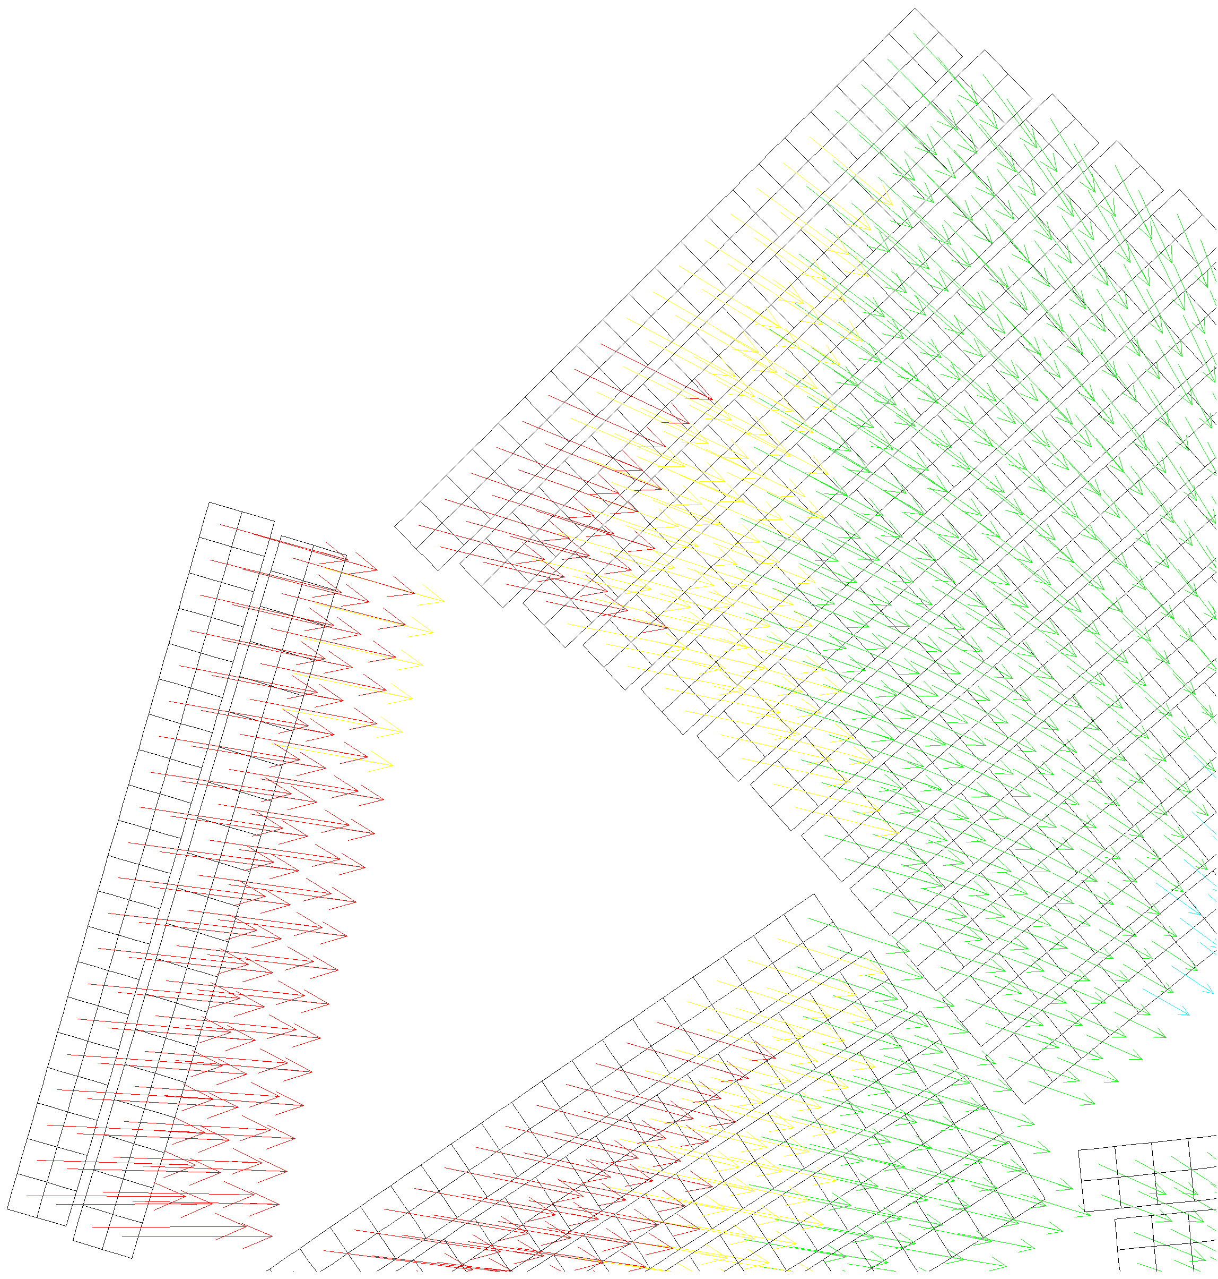
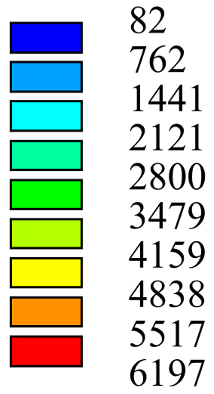
ANSYS Mechanical model: Lorentz forces
Magnetic force [N/m]

Slide 9

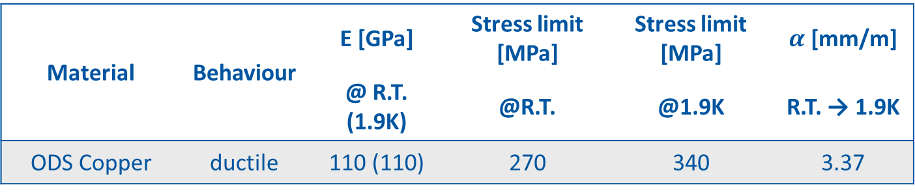
wedges properties
Material | Behaviour | E [GPa] | Stress limit [MPa] | Stress limit [MPa] | $α$ [mm/m]
 |  | @ R.T. (1.9K) | @R.T. | @1.9K | R.T. → 1.9K
ODS Copper | ductile | 110 (110) | 270 | 340 | 3.37
* «A Review of the Mechanical Properties of Materials Used in Nb3Sn Magnets for Particle Accelerators» by G. Vallone (2023)
DOI: 10.1109/TASC.2023.3248544

Slide 10
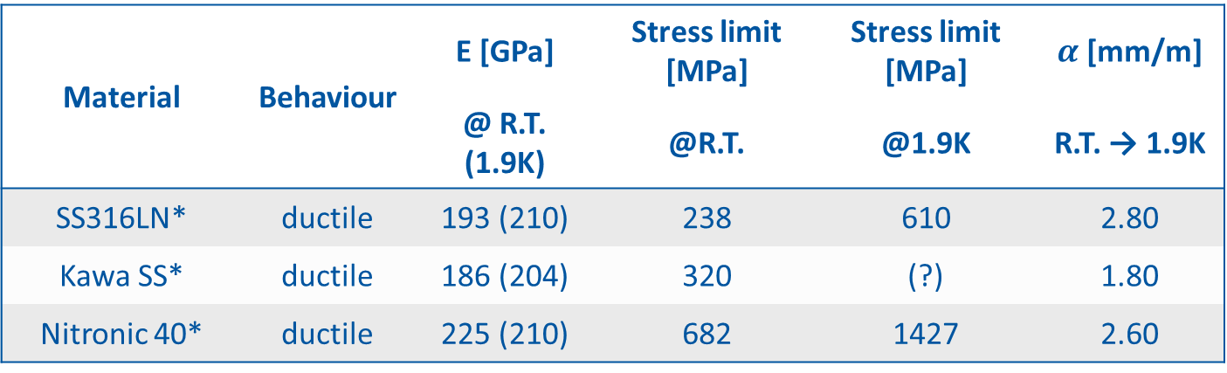
Keys properties
Material | Behaviour | E [GPa] | Stress limit [MPa] | Stress limit [MPa] | $α$ [mm/m]
 |  | @ R.T. (1.9K) | @R.T. | @1.9K | R.T. → 1.9K
SS316LN* | ductile | 193 (210) | 238 | 610 | 2.80
Kawa SS* | ductile | 186 (204) | 320 | (?) | 1.80
Nitronic 40* | ductile | 225 (210) | 682 | 1427 | 2.60
* «A Review of the Mechanical Properties of Materials Used in Nb3Sn Magnets for Particle Accelerators» by G. Vallone (2023)
DOI: 10.1109/TASC.2023.3248544

Slide 11

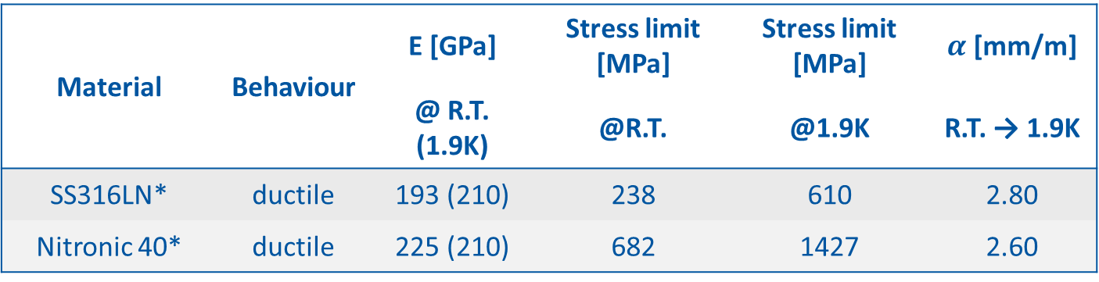
Pad properties
Material | Behaviour | E [GPa] | Stress limit [MPa] | Stress limit [MPa] | $α$ [mm/m]
 |  | @ R.T. (1.9K) | @R.T. | @1.9K | R.T. → 1.9K
SS316LN* | ductile | 193 (210) | 238 | 610 | 2.80
Nitronic 40* | ductile | 225 (210) | 682 | 1427 | 2.60
* «A Review of the Mechanical Properties of Materials Used in Nb3Sn Magnets for Particle Accelerators» by G. Vallone (2023)
DOI: 10.1109/TASC.2023.3248544

Slide 12

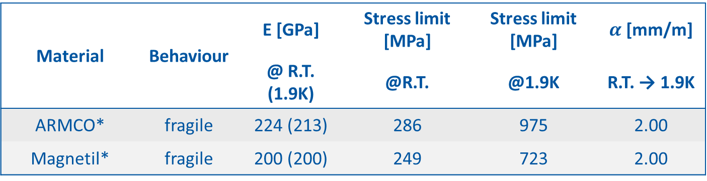

Iron properties
Fragile: ${\text{σ}}_{\text{I}} \text{< 200 }\text{MPa} \text{at}\text{ 1.9}\text{K} \text{∗∗}$
** «Review of Key-and-Bladder structures» by P. Ferracin (2016)
Material | Behaviour | E [GPa] | Stress limit [MPa] | Stress limit [MPa] | $α$ [mm/m]
 |  | @ R.T. (1.9K) | @R.T. | @1.9K | R.T. → 1.9K
ARMCO* | fragile | 224 (213) | 286 | 975 | 2.00
Magnetil* | fragile | 200 (200) | 249 | 723 | 2.00
* «A Review of the Mechanical Properties of Materials Used in Nb3Sn Magnets for Particle Accelerators» by G. Vallone (2023)
DOI: 10.1109/TASC.2023.3248544

Slide 13
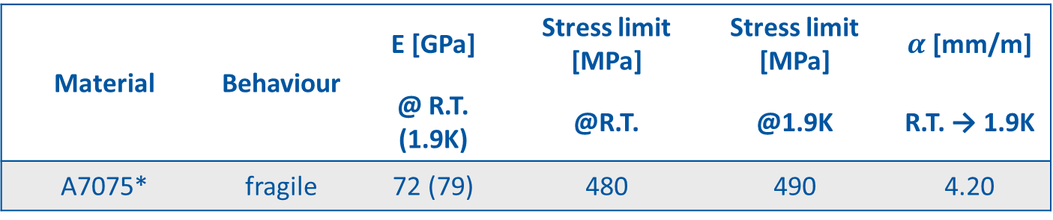
Shell properties
Material | Behaviour | E [GPa] | Stress limit [MPa] | Stress limit [MPa] | $α$ [mm/m]
 |  | @ R.T. (1.9K) | @R.T. | @1.9K | R.T. → 1.9K
A7075* | fragile | 72 (79) | 480 | 490 | 4.20
* «A Review of the Mechanical Properties of Materials Used in Nb3Sn Magnets for Particle Accelerators» by G. Vallone (2023)
DOI: 10.1109/TASC.2023.3248544

Slide 14
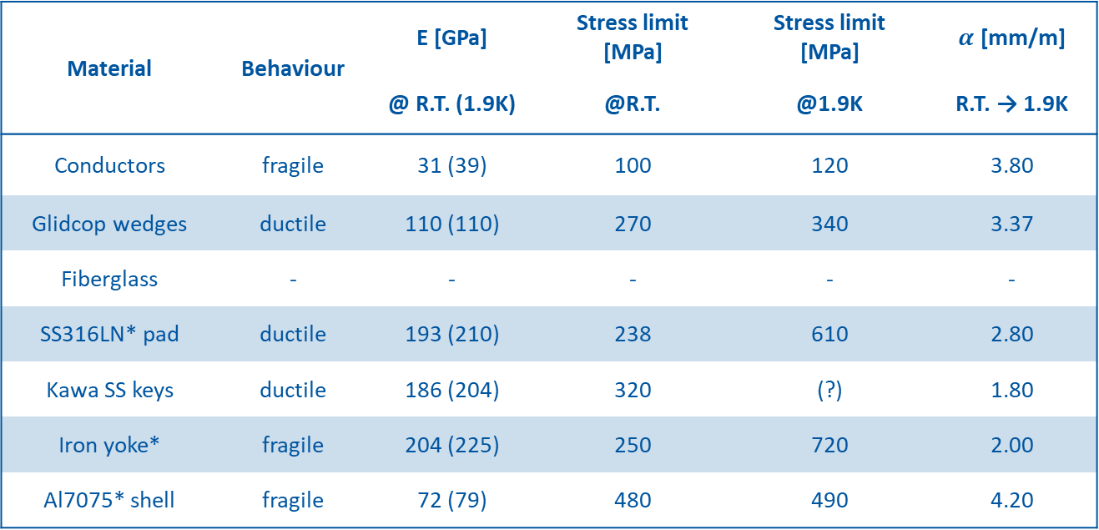
ANSYS Mechanical model: properties*
Material | Behaviour | E [GPa] | Stress limit [MPa] | Stress limit [MPa] | $α$ [mm/m]
 |  | @ R.T. (1.9K) | @R.T. | @1.9K | R.T. → 1.9K
Conductors | fragile | 31 (39) | 100 | 120 | 3.80
Glidcop wedges | ductile | 110 (110) | 270 | 340 | 3.37
Fiberglass | - | - | - | - | -
SS316LN* pad | ductile | 193 (210) | 238 | 610 | 2.80
Kawa SS keys | ductile | 186 (204) | 320 | (?) | 1.80
Iron yoke* | fragile | 204 (225) | 250 | 720 | 2.00
Al7075* shell | fragile | 72 (79) | 480 | 490 | 4.20
* «A Review of the Mechanical Properties of Materials Used in Nb3Sn Magnets for Particle Accelerators» by G. Vallone (2023)
DOI: 10.1109/TASC.2023.3248544

Slide 15
Thanks for the attention

