Slide 1


05.12.23 – RDL4 Mtg
Modelization of Impregnated
Nb₃Sn Cable Composite at PSI
B. Auchmann (PSI/CERN), D. M. Araujo, A. Brem, M. Daly, A. Milanese (CERN)
X. Kong, P. Studer, T. Tervoort (ETHZ/D-MAT/SMG)
This work was performed under the auspices of and with support from the
Swiss Accelerator Research and Technology (CHART) program (www.chart.ch).

Slide 2
CHART / SMACC / Materials
CHART is a research network. LTS ASC competences are distributed
  Conductor, Cable: UniGE, CERN
  Insulation materials (resins, 10-stack characterization): ETHZ SMG, PSI
  Powered samples: PSI, UTwente
  Magnet design and construction: PSI
PSI is working on stress-managed solutions → special requirements for coil composite:
  Training in CCTs and possible all SM solutions scales with length of magnet.
  Minimal-training impregnation material required.
  No RT preload → relatively soft materials are eligible.
The BOX program has identified candidates:
  Paraffin wax
  Filled paraffin wax
  Filled epoxy
No 10-stack data or Walther-spring measurements exists with these materials.

Slide 3

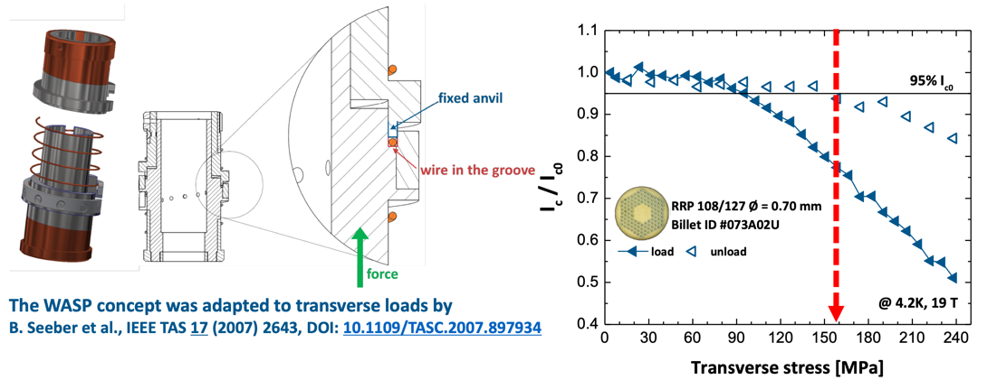
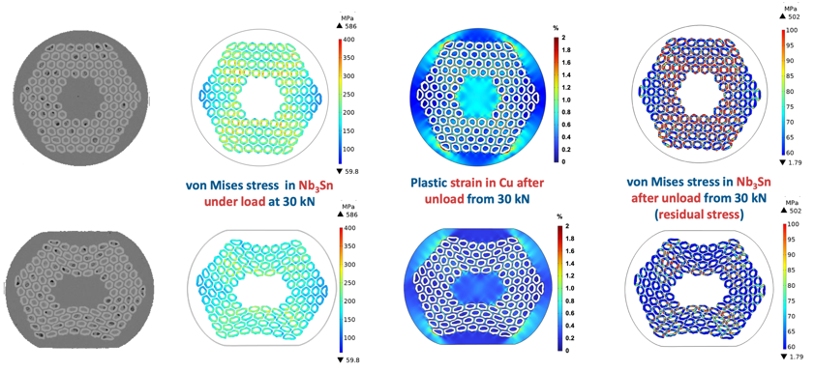
Multi-scale 1/5
WireChar
UniGE: WASP measurement and simulations.
[C. Senatore, M. Bonura, et al.,
CHART annual meeting,
indico link, Oct. 2023.]

Slide 4

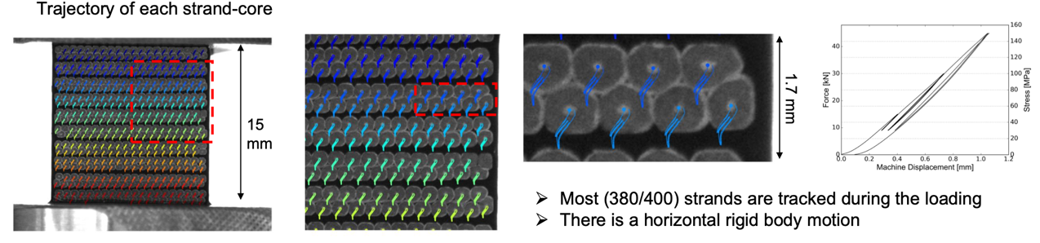
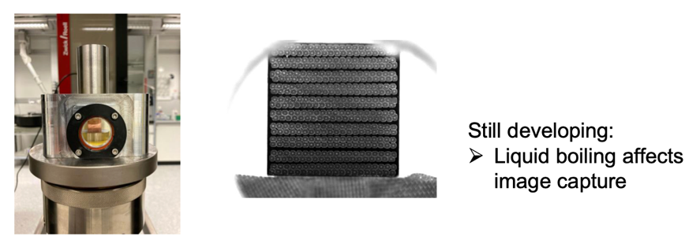
Multi-scale 2/5
MagComp
ETHZ: 10-stack measurements with image analysis (particle-tracking method).
  Epoxy vs. paraffin, vs. filled epoxy and paraffin.
Extraction of homogenized material description for ANSYS (or other) pending.
[X. Kong, T. Tervoort, et al.,
CHART annual meeting,
indico link, Oct. 2023.]

Slide 5

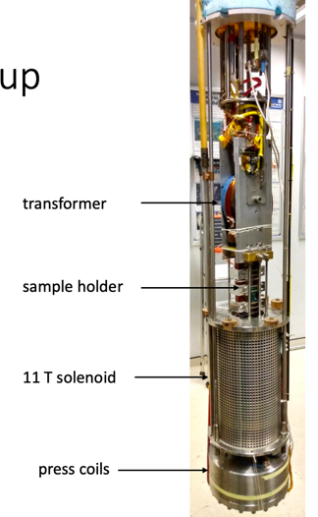
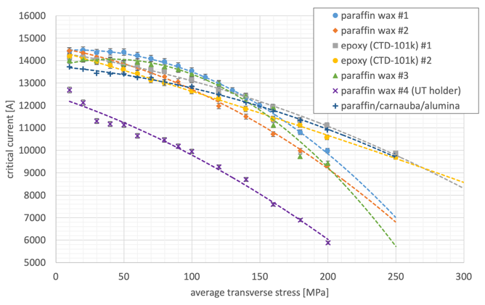
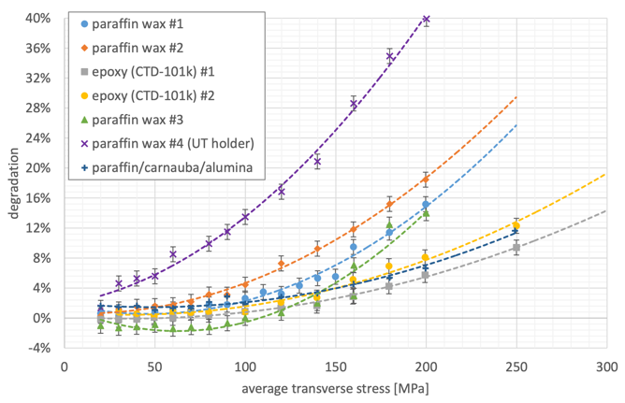
Multi-scale 3/5
MagDev
PSI/UTwente: transverse
pressure characterization
of Rutherford cable in
background field.
[M. Daly, S. Otten, et al.,
CHART annual meeting,
indico link, Oct. 2023.]
Courtesy M. Daly
Courtesy S. Otten et al.

Slide 6



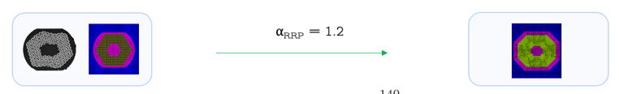
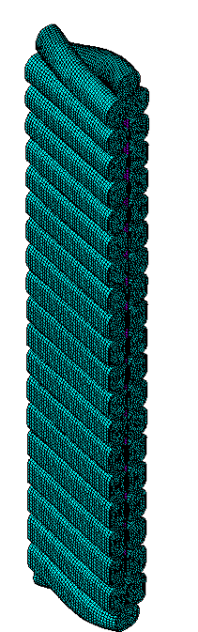
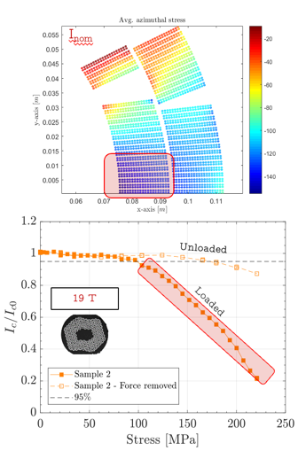
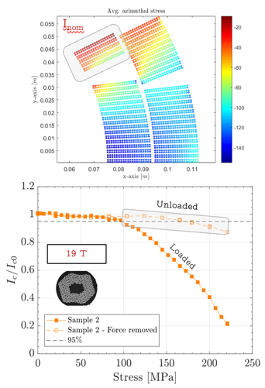

Multi-scale 4/5
2D and 3D Approaches
Comparison of 10-stack to
strand-based 2D models.
CEA CoCaSCOPE ANSYS model of
11-T cable for analysis of ETHZ
10-stack measurements.
Generation of
  10-stack model: 3D constitutive law
  U-shaped UTwente sample: validation of I_{c}($σ$)
[J. Ferradas, TE-MSC Seminar,
indico link, June 2023.]
[G. Lenoir et al.]

Slide 7
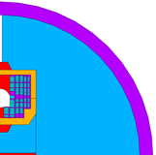
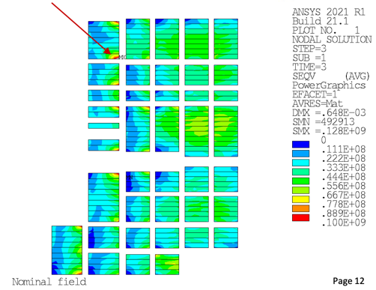
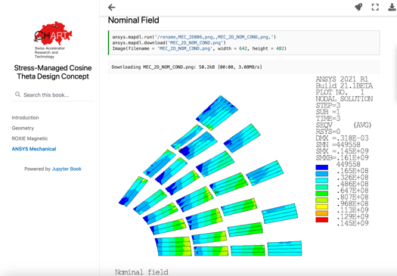
Multi-scale 5/5: Impact on Magnet Design
MagNum2
Include missing mechanical and performance data into
conceptual design of SMACC (Stress Managed Common Coil).
Provide fully consistent, traceable, and repeatable CDR,
including measurement data, multi-scale FEA model
validation, design, and expectations for strain-gauge data,
all via Model-Based Systems Engineering (MBSE).
Versioned CDR as a living document.
PhD at PSI with ETHZ D-ITET-IEF to start in ‘24.
[http://cern.ch/auchmann/chart/magnum
http://cern.ch/auchmann/hts4.]
[D. M. Araujo, HFM Annual Mtg,
indico link, Oct 2023.]

Slide 8
Future Multi-scale Topics
Multi-physics multi-scale:
  Mechanical models, discussed in this meeting,
  Electromagnetic models (coupling currents, etc),
  Thermal behavior.
Up- (homogenization) and down- (return to reference volume) scaling.
LTS and HTS models.
ML homogenization experiments.

