Slide 1
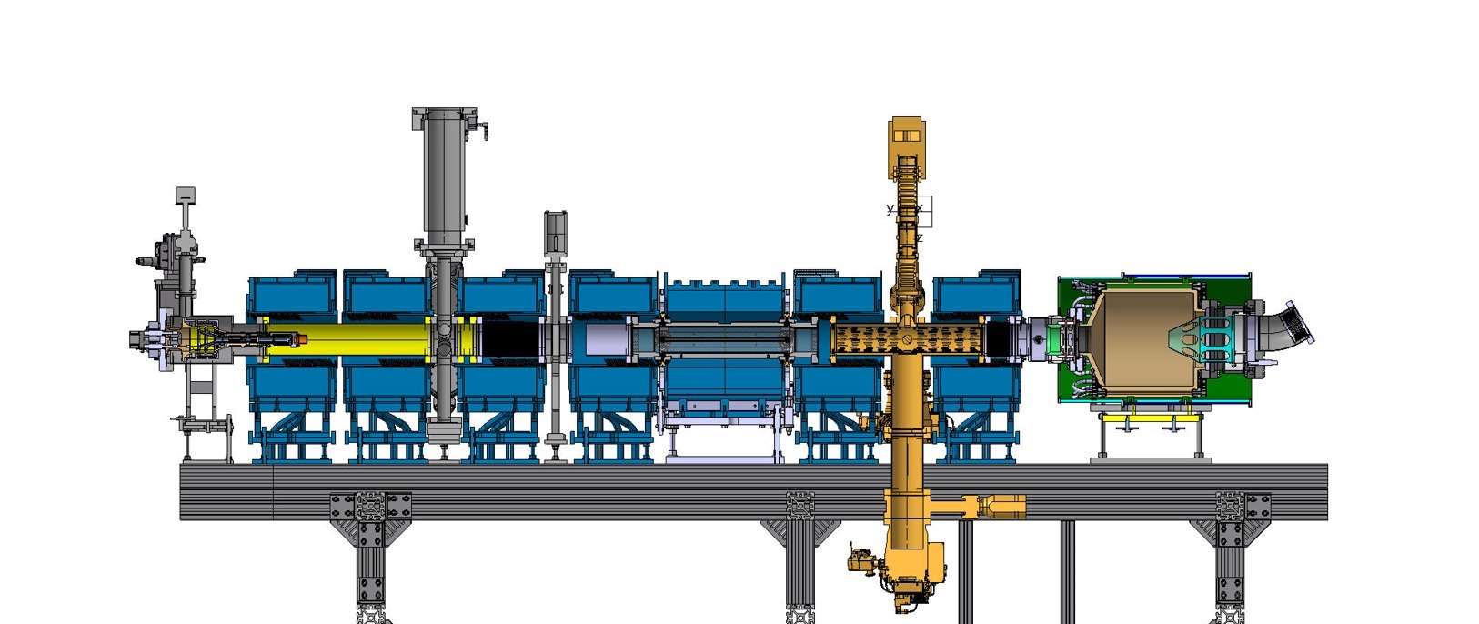

Status of EBTS and Plans for 2024-2025
A. Rossi,
work by M. Sameed, M. Ady, C. Castro, O. Stringer, H. Zhang, …
12 December 2023 @ BGC Collaboration Meeting

Slide 2
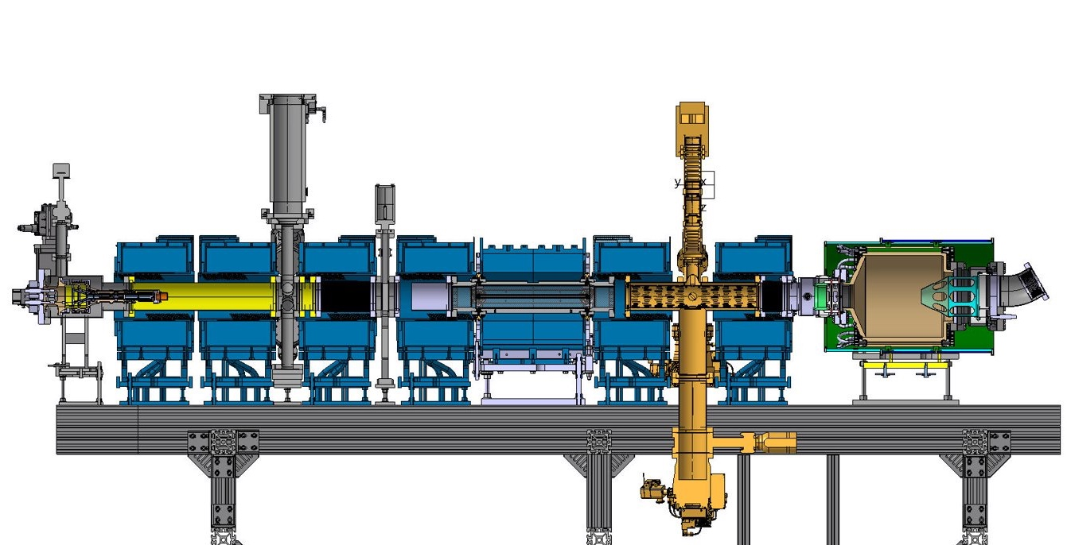
Electron Beam Test Stand (EBTS)
Quick Recap
S. Sadovich, A. Kolehmainen

Slide 3
Outline
Status of Future BGC on EBTS
  Final Design and Integration
Status of HEL Collector
  Fabrication, Assembly and Installation
Summary

Slide 4
BGC v4.1 Requirements
Gas
  Ability to operate with all three gases (N2, Ne, Ar)
  Provision of appropriate gas bottles and pneumatic equipment
Gas jet
  Gas jet density same as v3 instrument (10¹⁶ m⁻³) or larger
  Curtain length to be able to see the beam with 40 mm OD (so 60 mm curtain at 45 degrees).
  Curtain width same as v3 instrument (0.5 mm) or smaller –
  Curtain variation same as v3 instrument (5%) or less
  IC background pressure same as v3 instrument (10⁻⁷ mbar) or less
  Replaceable/adjustable skimmer 3.
Image Acquisition
  Provision of laser + camera for alignment and target/grid for camera focusing
  Provision of optics, image intensifier(s), filter(s), and camera(s), for 3 gases + BTV
  Addition of BTV on the DN63 port (design can be done by CERN)
Performance Evaluation
  Maximum 1 s integration for electron beam of 10 keV, 5 A, 40 mm diameter
  Aiming for 100 µm image resolution at the above parameters

Slide 5
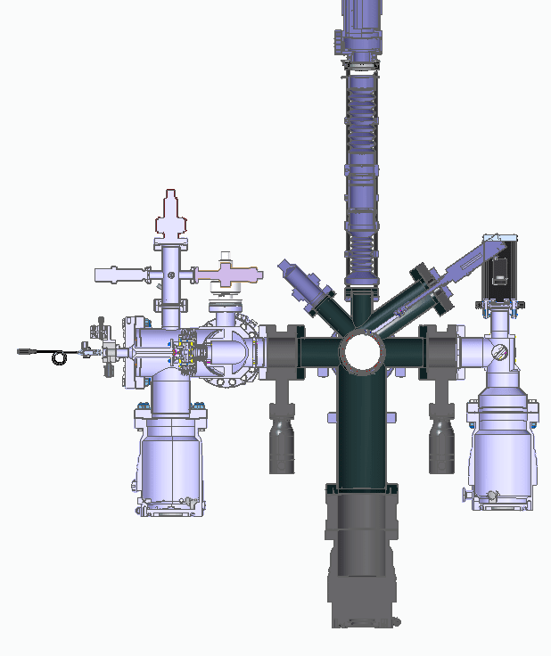
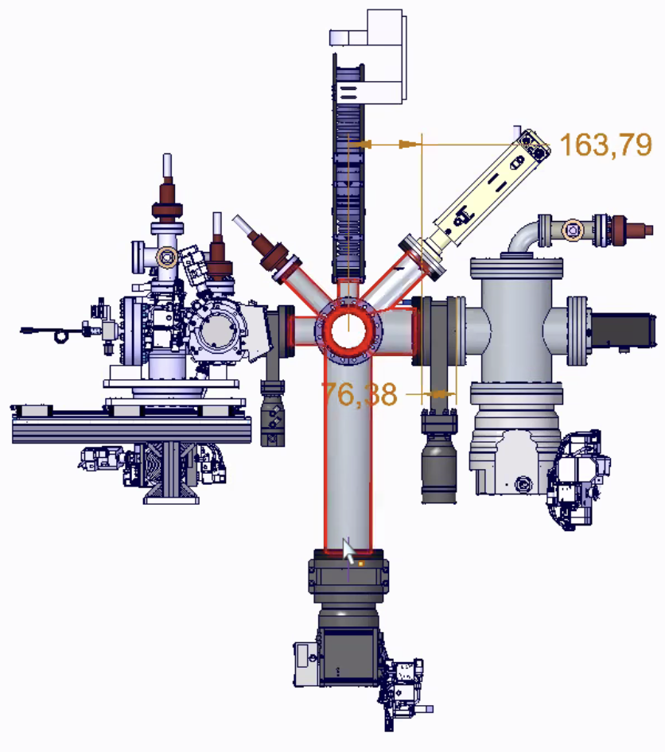
BGC Design @EBTS
BGC v4.1
DN63 port now looks at the center of the interaction chamber
Imagining system
DN40 port now looks at the center of the interaction chamber
BGC v3
Interaction chamber
Insertable target
Gas curtain generation section
4th skimmer
Gas curtain direction
Alignment laser
Beam direction
DN100 port now extends all the way to the pumping group (removed adapter piece)
Dump chamber
DN63 port replaced with DN100 port downstream of the interaction chamber
1 m
M. Ady, O. Sedlacek, C. Castro Sequiero, O. Stringer, H. Zhang

Slide 6
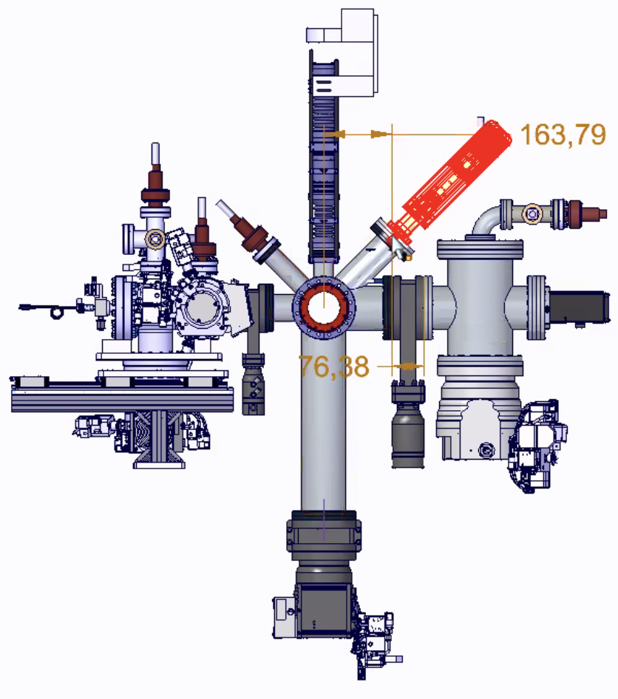
BGC Design @EBTS
BGC v4.1
BTV (with OTR screen) installed on the DN63 port
Imagining system
BGC v3
Interaction chamber
Insertable target
Gas curtain generation section
4th skimmer
Gas curtain direction
Alignment laser
Beam direction
Dump chamber
1 m
M. Ady, O. Sedlacek, C. Castro Sequiero, O. Stringer, H. Zhang

Slide 7
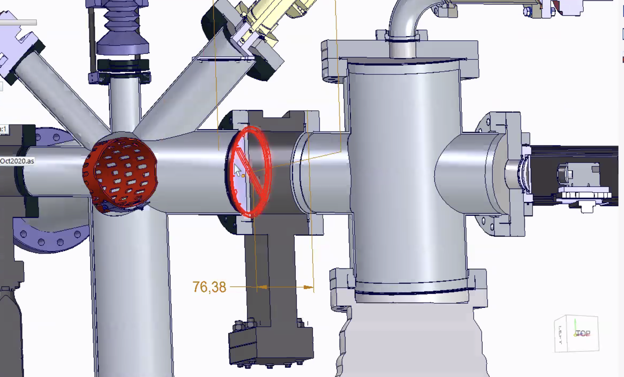
BGC v4.1 Design
BGC v4.1
Imagining system
150 mm
4th Skimmer: 85 mm x 1.12 mm
BGC v3
Interaction chamber
Insertable target
Gas curtain generation section
4th skimmer
Gas curtain direction
Alignment laser
Beam direction
Dump chamber
1 m
Skimmer 4 is now installed on the interaction chamber
M. Ady, O. Sedlacek, C. Castro Sequiero, O. Stringer, H. Zhang

Slide 8
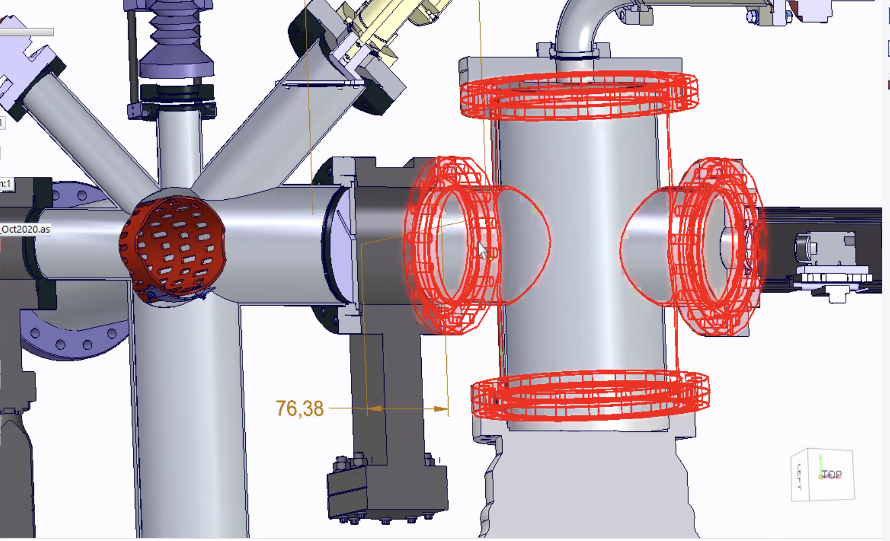
BGC Design @EBTS
Standard Pfeiffer pressure gauges
Dump chamber is now made entirely from standard parts (DN100-DN160 4-Way Reducing Cross)
BGC v3
Imagining system
Interaction chamber
Insertable target
Gas curtain generation section
Gas curtain direction
4th skimmer
Alignment laser
Beam direction
Dump chamber
1 m
DN 100 Gate Valve
Pfeiffer TMP HiPace 700
Camera for alignment laser
M. Ady, O. Sedlacek, C. Castro Sequiero, O. Stringer, H. Zhang

Slide 9
BGC v4.1 Requirements (Simulation Results)
Gas
  Ability to operate with all three gases (N2, Ne, Ar)
  Provision of appropriate gas bottles and pneumatic equipment
Gas jet
  Gas jet density same as v3 instrument (10¹⁶ m⁻³) or larger – 1.3 x 10¹⁶ m⁻³
  Curtain length to be able to see the beam with 40 mm OD (so 60 mm curtain at 45 degrees).
  Curtain width same as v3 instrument (0.5 mm) or smaller – 0.2 mm
  Curtain variation same as v3 instrument (5%) or less – 3%
  IC background pressure same as v3 instrument (10⁻⁷ mbar) or less – 10⁻⁸ mbar
  Replaceable/adjustable skimmer 3.
Image Acquisition
  Provision of laser + camera for alignment and target/grid for camera focusing
  Provision of optics, image intensifier(s), filter(s), and camera(s), for 3 gases + BTV
  Addition of BTV on the DN63 port (design can be done by CERN)
Performance Evaluation
  Maximum 1 s integration for electron beam of 10 keV, 5 A, 40 mm diameter
  Aiming for 100 µm image resolution at the above parameters

Slide 10
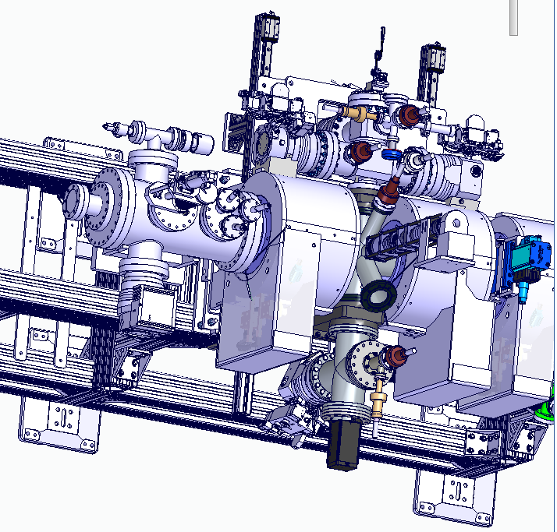
BGC v4.1 Integration
Top View
H. Zhang

Slide 11
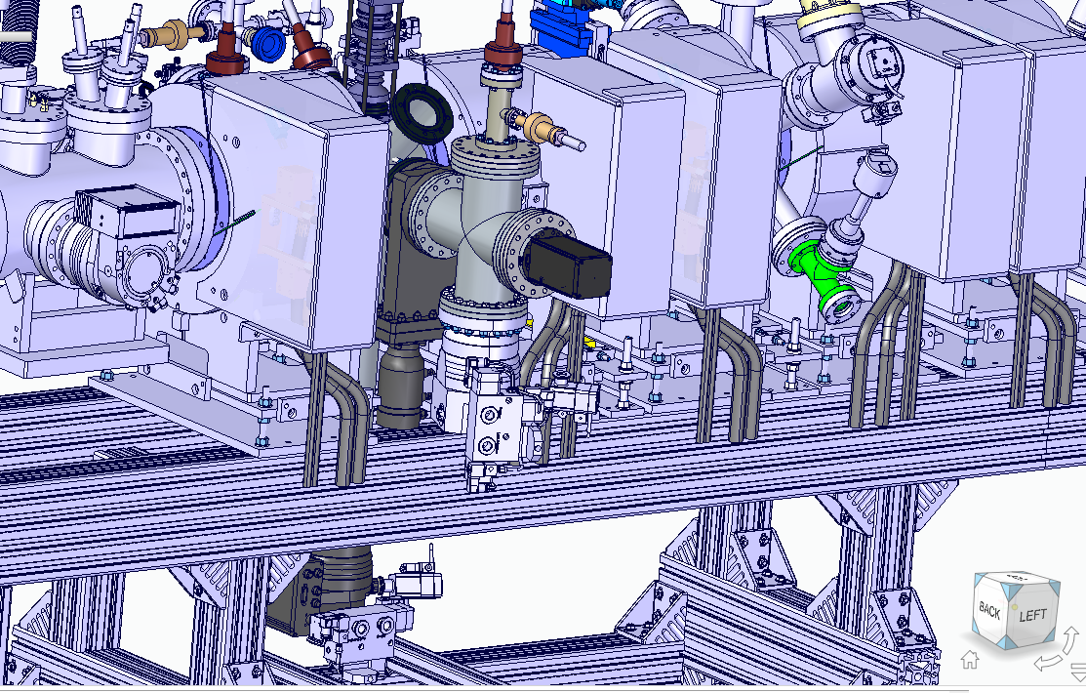
BGC v4.1 Integration
Side View
H. Zhang

Slide 12
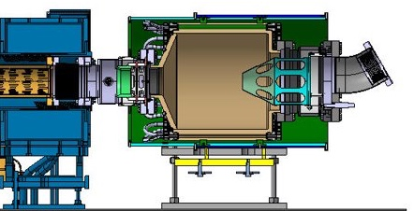
HEL Collector
Retarder
Collector
HEL Collector Details
  Entrance aperture: 80 mm
  Gun-Collector Potential: up to +5 kV
  Beam Current: up to 5 A
Benefits
  Works with both DC and pulsed electron beams
Challenges
  Vacuum/pumping requirements are high
  Reflected / secondary electrons needs to be suppressed → BGC
  Requires high voltage platform
Repeller
Back Repeller
A. Kolehmainen, M. Sameed

Slide 13
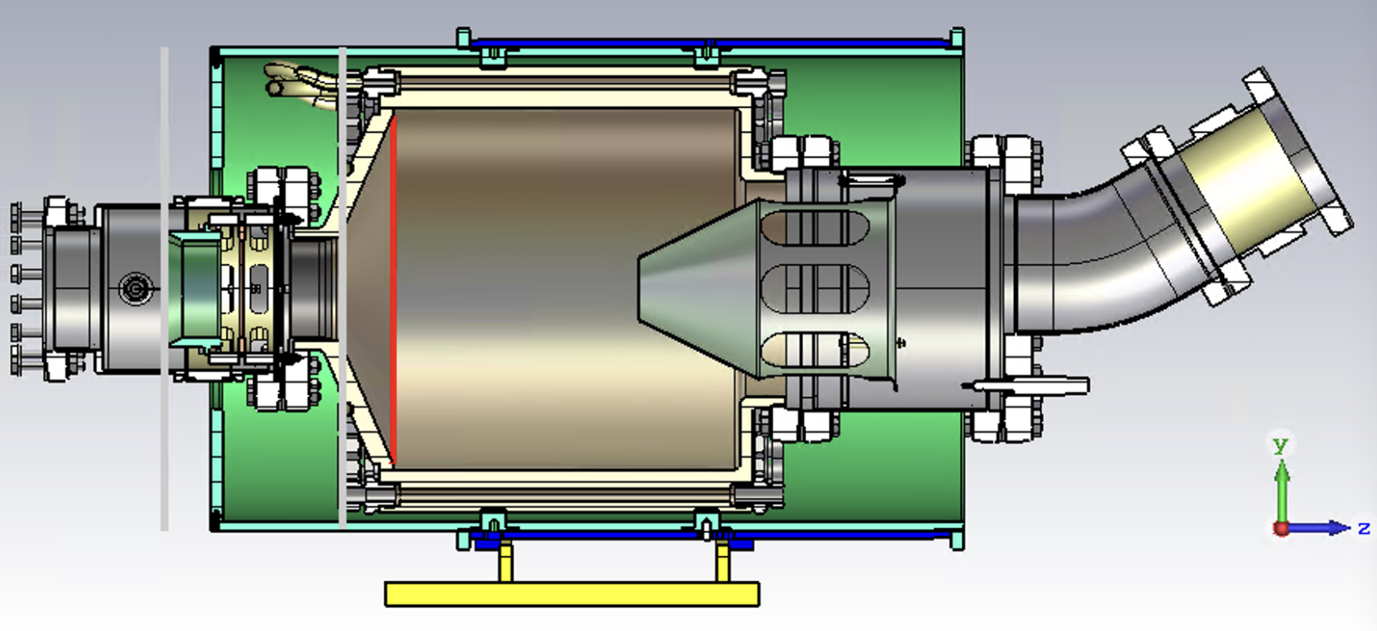
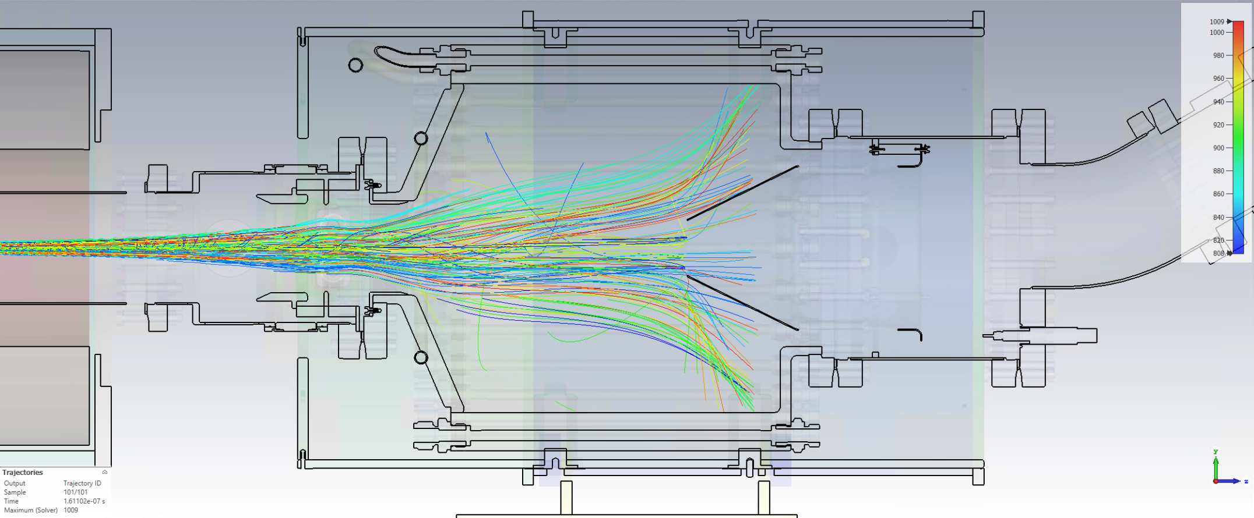
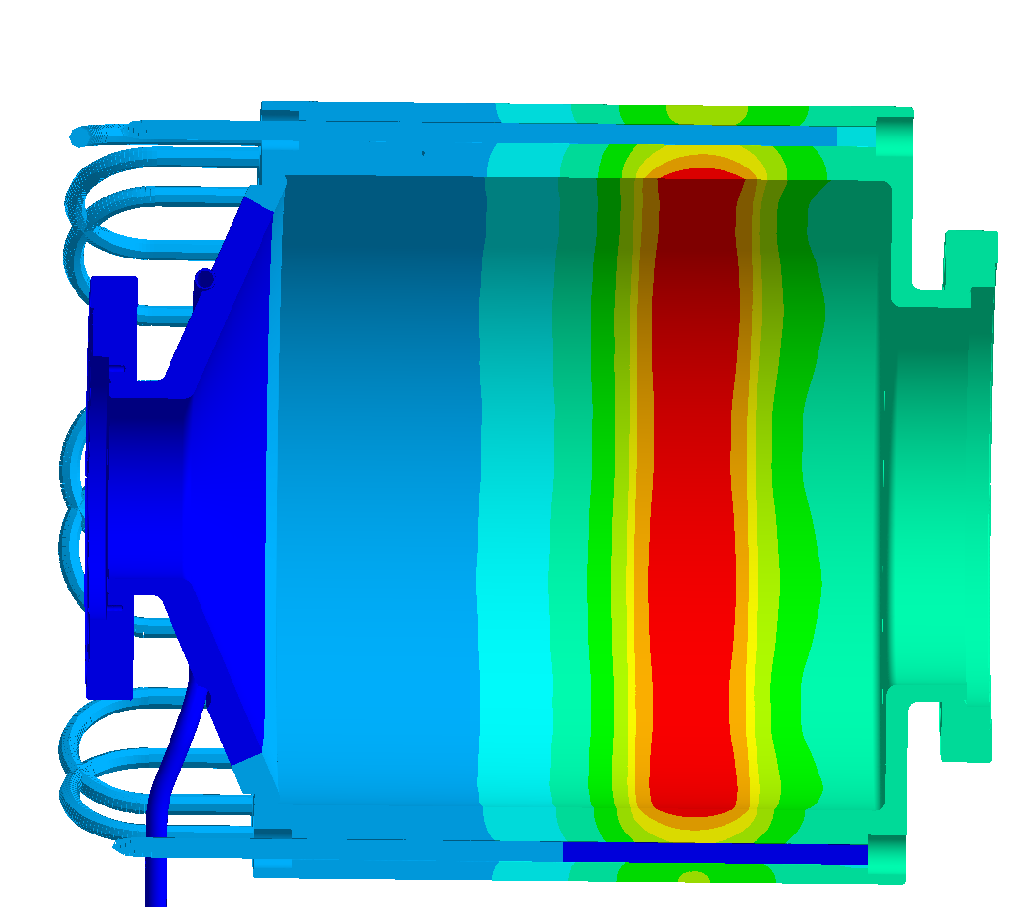
Status of HEL Collector
Design
Simulations
Fabrication
Installation
Complete
Complete
All parts ordered
Fabrication ongoing
Delivery in March 2024
Planned for Q1 2024 (tentatively during week of 11 March)
A. Kolehmainen
I. Tabian
T. Coiffet, A. Gerardin, L. Deparis

Slide 14
Summary
Design, simulations, and integration model for BGC v4.1 on EBTS almost complete…design should be approved during BGC collaboration meeting and drawings should be finalized and approved to start procurement…delivery June 2024?
HEL collector fabrication and assembly underway, delivery scheduled for Q1 2024

Slide 15
Thank You !
Questions?

Slide 16
Backup Slides

Slide 17
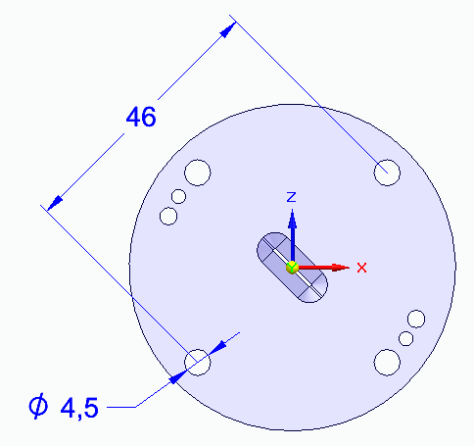
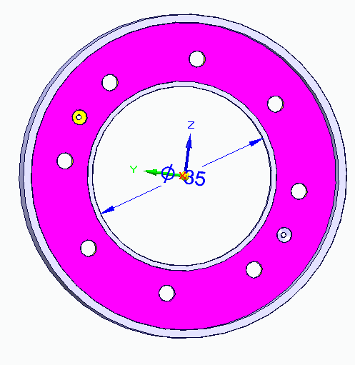
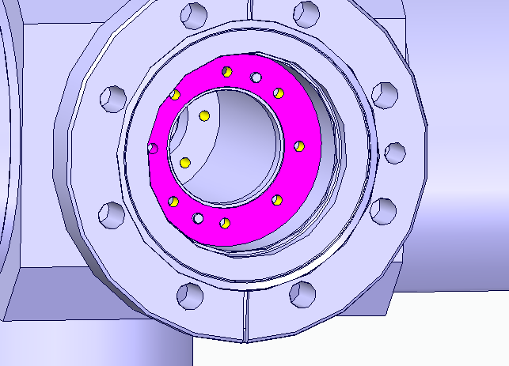
Current 3rd skimmer design, host 35 mm skimmer maximum. Is that enough?

Slide 18
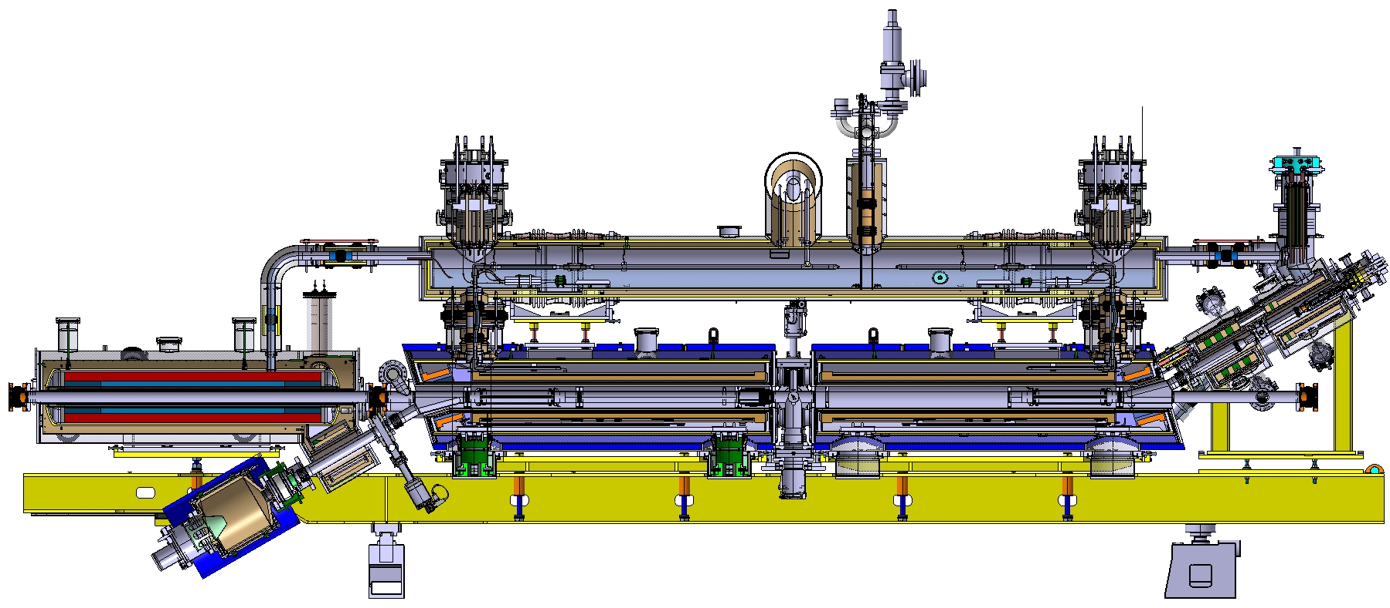
HEL Design under study
beam position monitor (BPM)
Accelerates a hollow electron beam up to
5 A and 15 keV
beam gas curtain (BGC) profile monitor
electron gun
Compensates the kick
produced by the steering solenoids
compensation
dipole
BPM
BPM
p-beam
Hollow e-beam
Collector
(electron beam dump)
SC solenoids
Control the e-beam

Slide 19
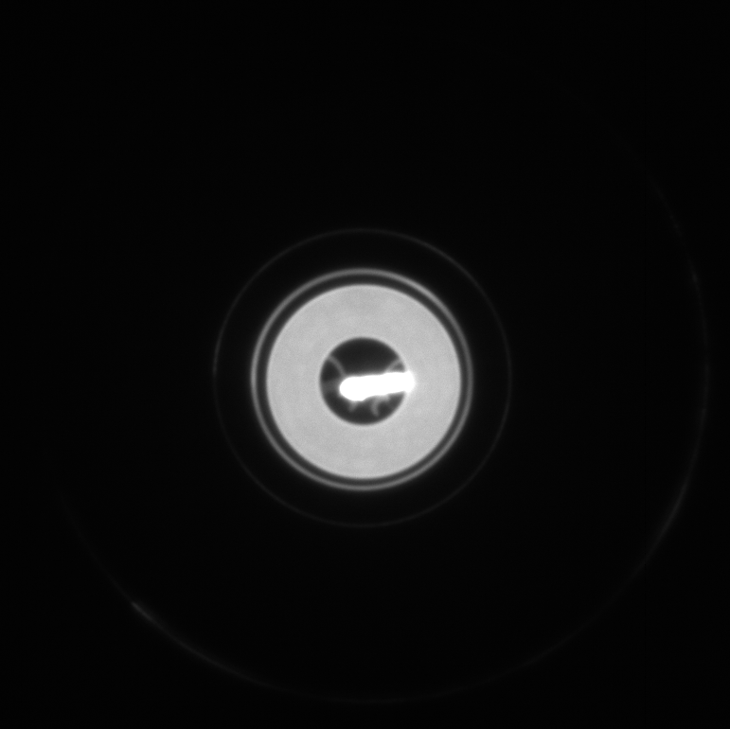
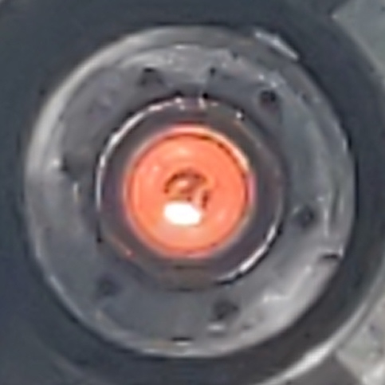
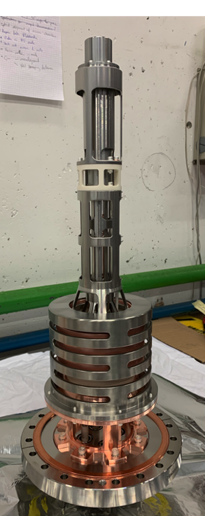
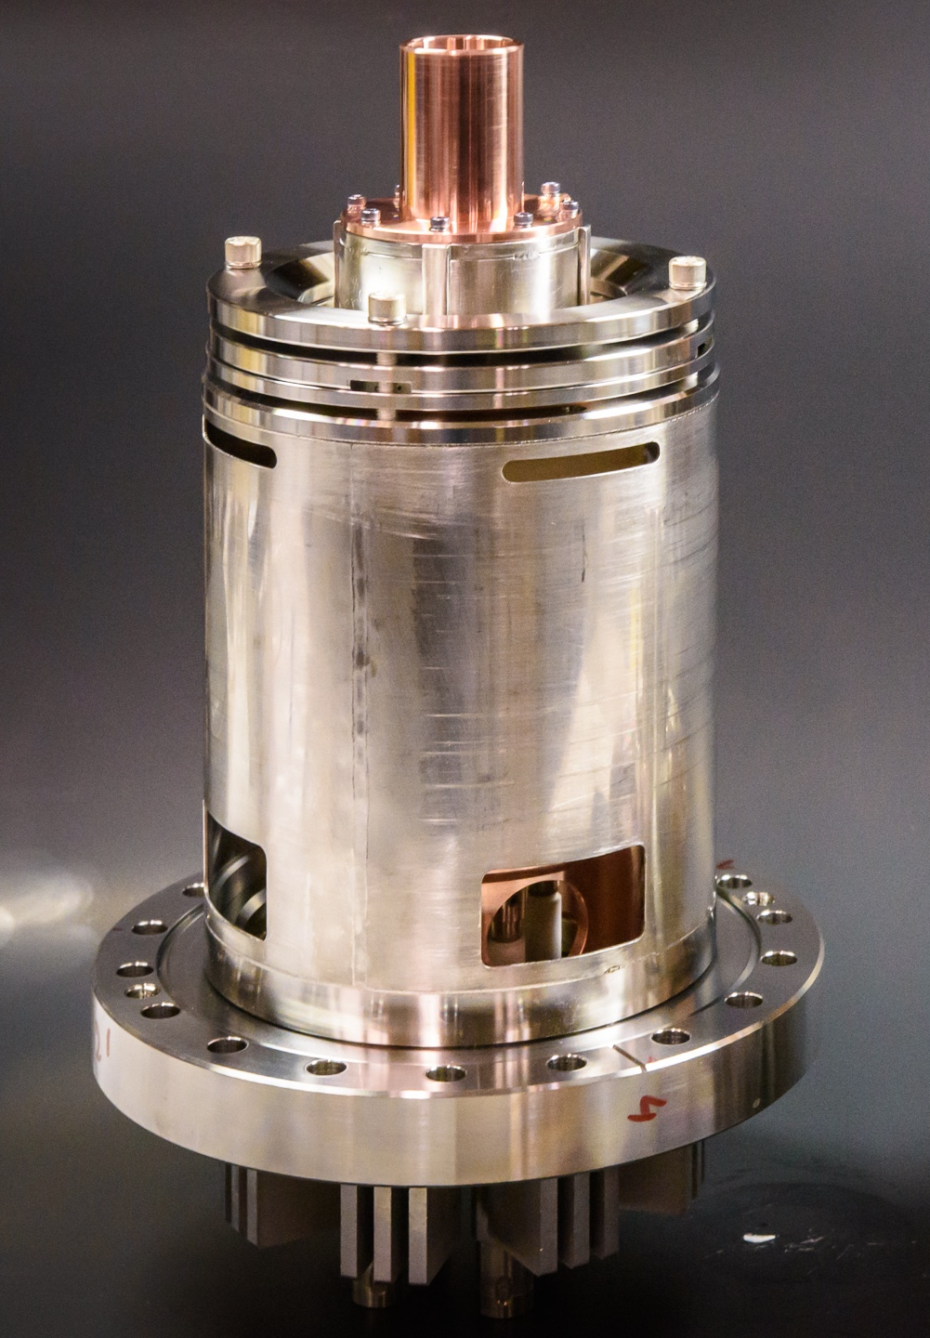
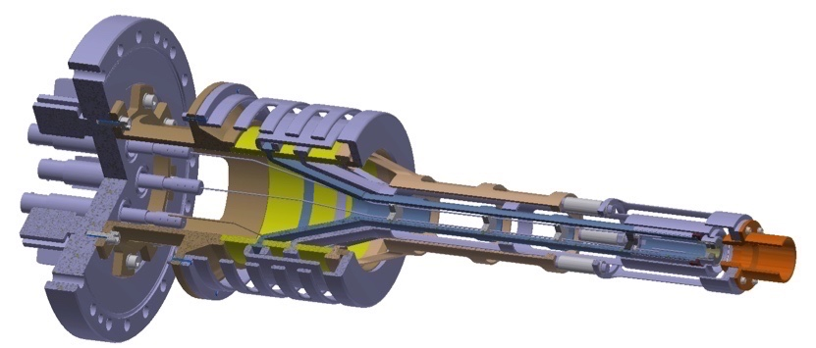
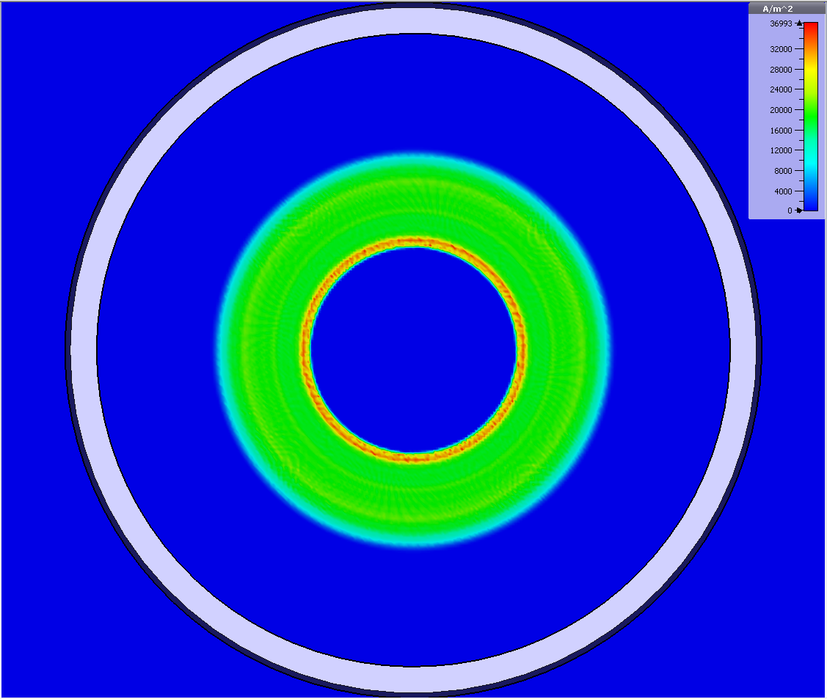
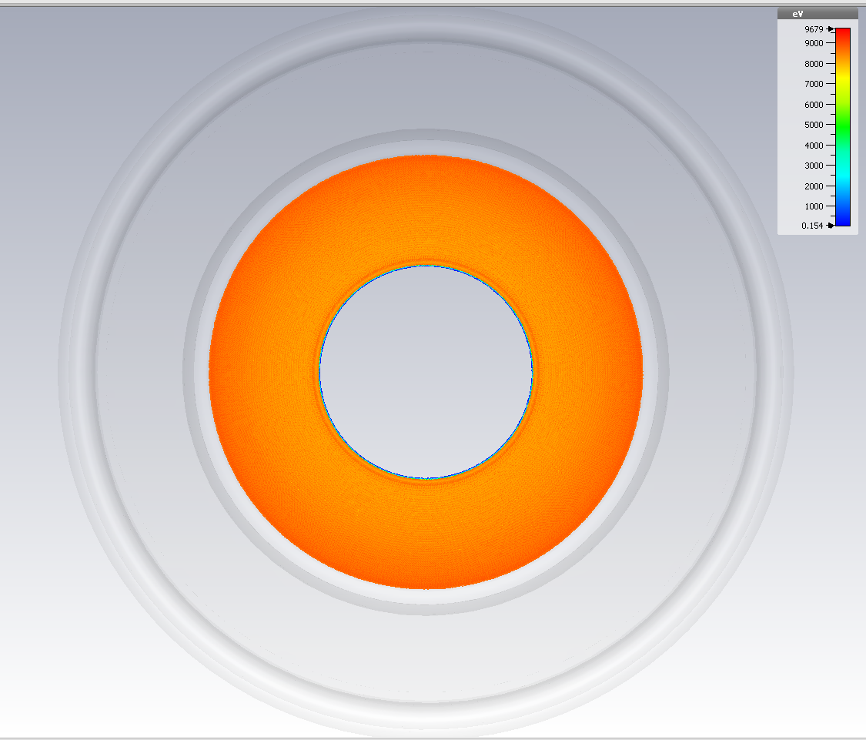
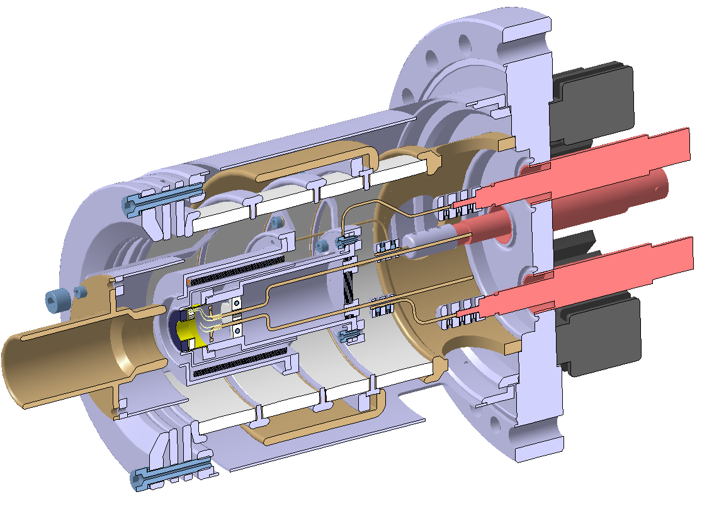
Electron Gun
Glowing Hollow Cathode
Cathode Parameters
  OD: 16.10mm, ID: 8.05mm
  Current Density: 3.3 A/cm²
Electron Beam Parameters
  Beam Current: 0-5 A
  Beam Energy: 0-15 keV
Pulse Modulator (Marx Generator)
  Pulse Duration: 1us - 100us
  Rise/Fall Time: 200 ns
  Repetition Frequency: 1Hz - 50 Hz
HEL Gun v3 (CERN)
HEL Gun v1 (FNAL)
A. Kolehmainen, D. Perini, S. Sadovich, G. Stancari, T. Coiffet, M. Plantier

Slide 20
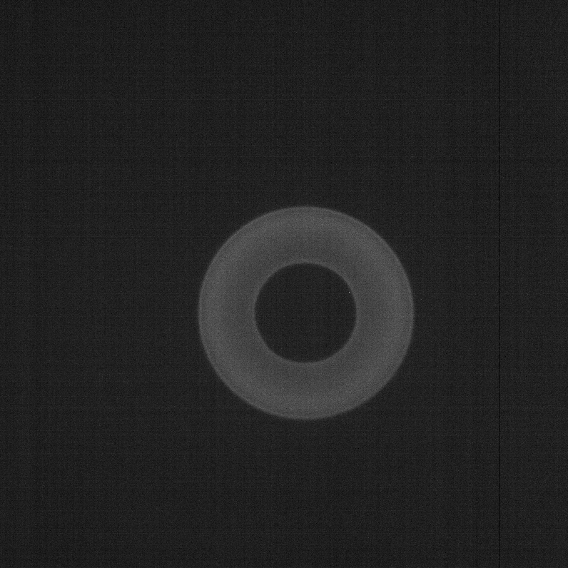
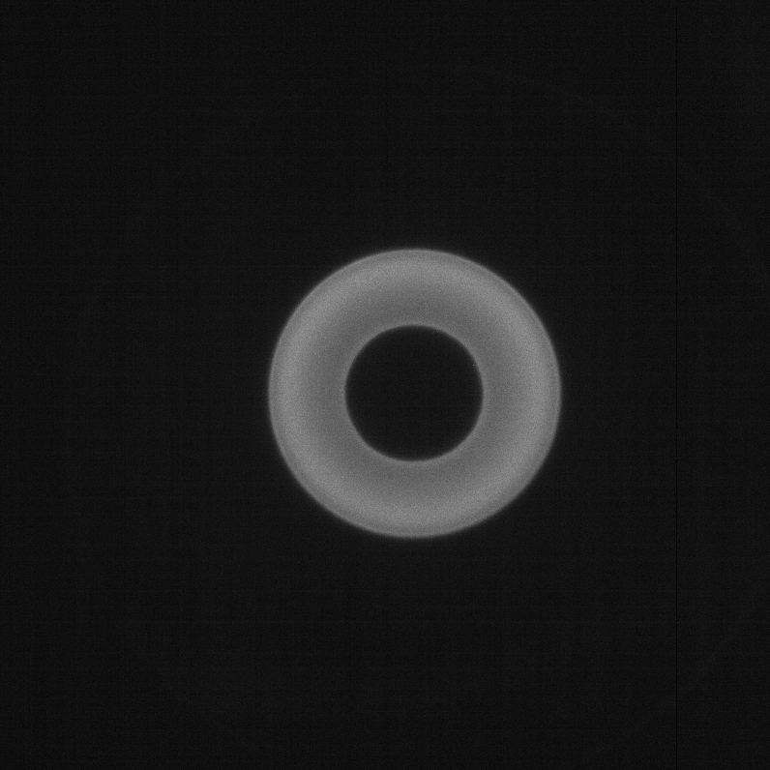
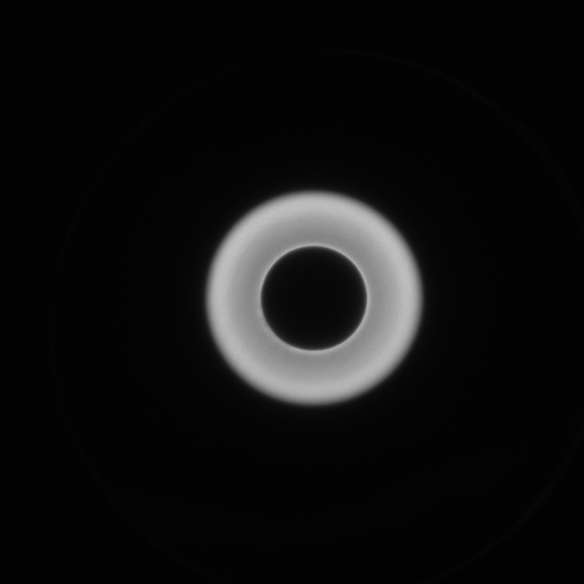
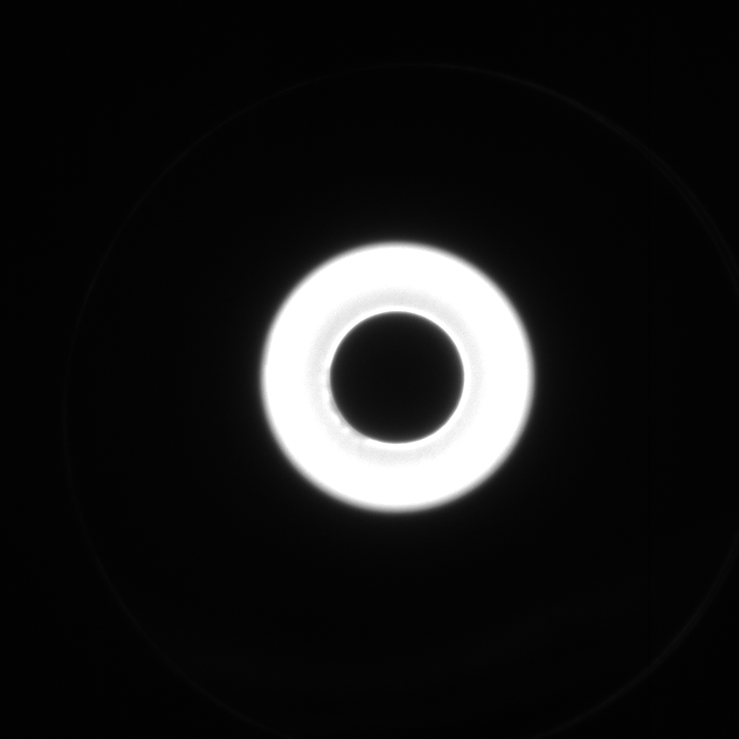
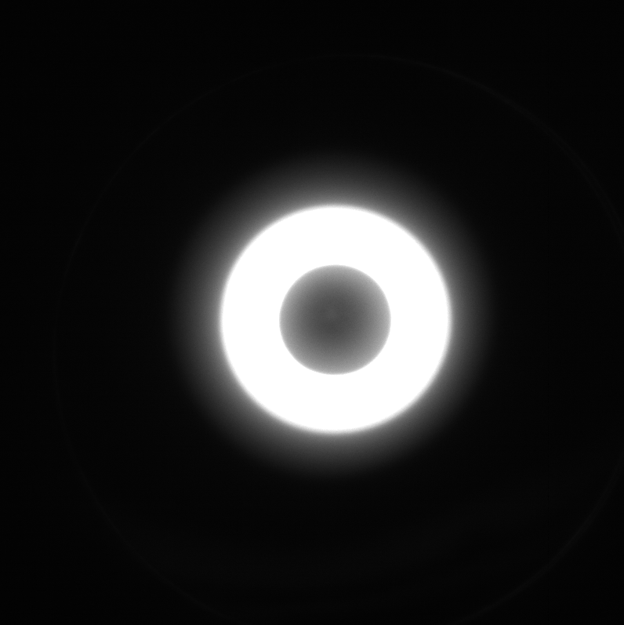
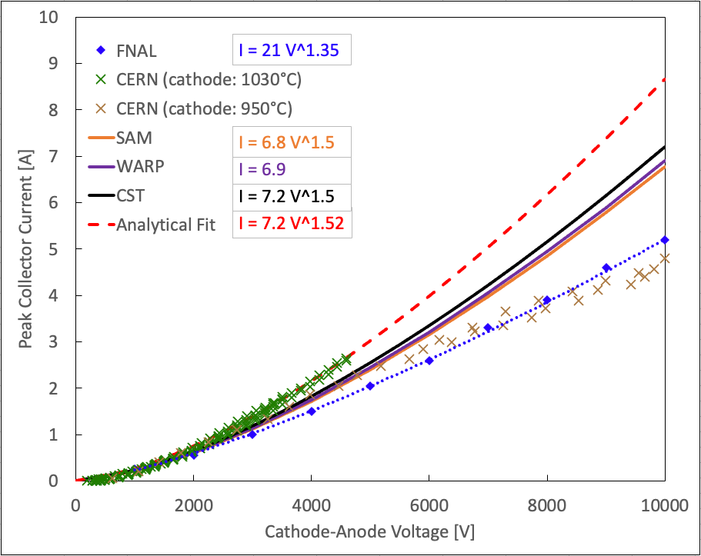
Electron Gun
Gun Characterization
  Measurements at both FNAL and CERN
  Comparison of experimental results with simulations (SAM / WARP / CST / TRAK)
2 mA
25 mA
45 mA
88 mA
139 mA
HEL Gun v3 (CERN)
HEL Gun v1 (FNAL)
A. Kolehmainen, D. Perini, S. Sadovich, G. Stancari, T. Coiffet, M. Plantier

Slide 21
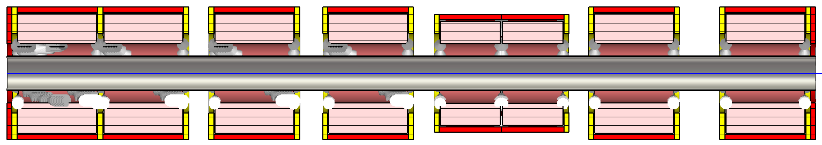
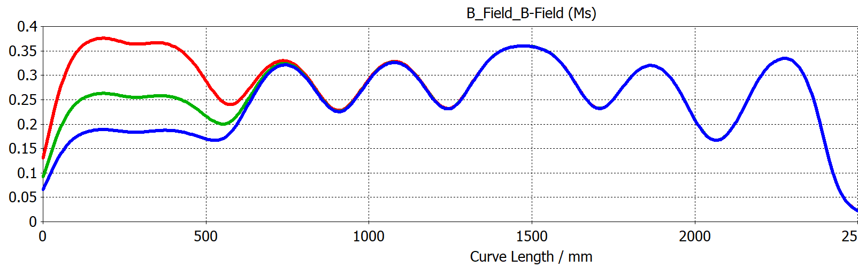
EBTS Solenoids and Correctors
Gun
BDB
BPM
BTV
800A
560A
400A
* Current at Gun Solenoid
A. Rossi
Notes:
A schematic of the Electron Beam Test Facility is shown
in fig. 1. The magnetic system is designed to ensure the
confinement of the electron beam and its transport to the
collector. It is composed of ambient temperature (water
cooled) solenoid magnets, depicted in blue. Each magnet
is provided with horizontal and vertical dipoles to steer the
electron beam to either compensate for mechanical misalign-
ment or displace it and measure the range of the BPM. The
modularity allows to have different magnet configurations
installed, depending on need and number of components
present at the facility. At the gun side, a pair of magnets
provides an extended region of constant field. The vacuum
system is divided into two volumes by an all-metal auto-
matic gate valve. One volume is reserved for the electron
gun and a diagnostic box (detailed later), and the other for
any equipment that needs testing. Each volume is equipped
with a pumping system capable of keeping a pressure in the
range of 10−8 mbar during electron beam operation.

Slide 22
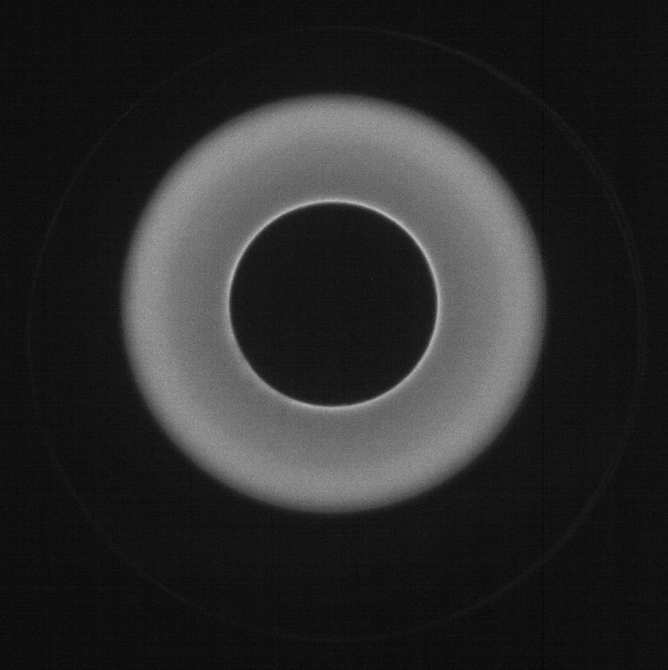
EBTS Solenoids and Correctors
Gun
BDB
BPM
BTV
800A
560A
400A
* Current at Gun Solenoid
A. Rossi
Beam Compression
Notes:
A schematic of the Electron Beam Test Facility is shown
in fig. 1. The magnetic system is designed to ensure the
confinement of the electron beam and its transport to the
collector. It is composed of ambient temperature (water
cooled) solenoid magnets, depicted in blue. Each magnet
is provided with horizontal and vertical dipoles to steer the
electron beam to either compensate for mechanical misalign-
ment or displace it and measure the range of the BPM. The
modularity allows to have different magnet configurations
installed, depending on need and number of components
present at the facility. At the gun side, a pair of magnets
provides an extended region of constant field. The vacuum
system is divided into two volumes by an all-metal auto-
matic gate valve. One volume is reserved for the electron
gun and a diagnostic box (detailed later), and the other for
any equipment that needs testing. Each volume is equipped
with a pumping system capable of keeping a pressure in the
range of 10−8 mbar during electron beam operation.

Slide 23
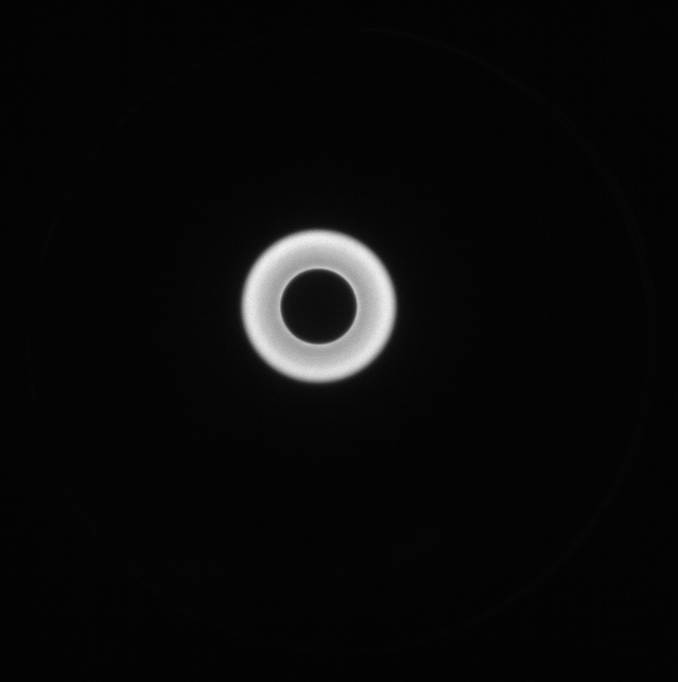
EBTS Solenoids and Correctors
Gun
BDB
BPM
BTV
800A
560A
400A
* Current at Gun Solenoid
A. Rossi
H/V Correction
Notes:
A schematic of the Electron Beam Test Facility is shown
in fig. 1. The magnetic system is designed to ensure the
confinement of the electron beam and its transport to the
collector. It is composed of ambient temperature (water
cooled) solenoid magnets, depicted in blue. Each magnet
is provided with horizontal and vertical dipoles to steer the
electron beam to either compensate for mechanical misalign-
ment or displace it and measure the range of the BPM. The
modularity allows to have different magnet configurations
installed, depending on need and number of components
present at the facility. At the gun side, a pair of magnets
provides an extended region of constant field. The vacuum
system is divided into two volumes by an all-metal auto-
matic gate valve. One volume is reserved for the electron
gun and a diagnostic box (detailed later), and the other for
any equipment that needs testing. Each volume is equipped
with a pumping system capable of keeping a pressure in the
range of 10−8 mbar during electron beam operation.

Slide 24
Beam Instrumentation at EBTS

Slide 25
Beam Profile Monitors
2. Pin-Hole Faraday Cup
4. Beam Gas Curtain (BGC)
3. BTV Screen
(Scintillation or OTR)
1. YAG:Ce Screens
Beam Diagnostic Box (BDB)
BTV+BGC

Slide 26
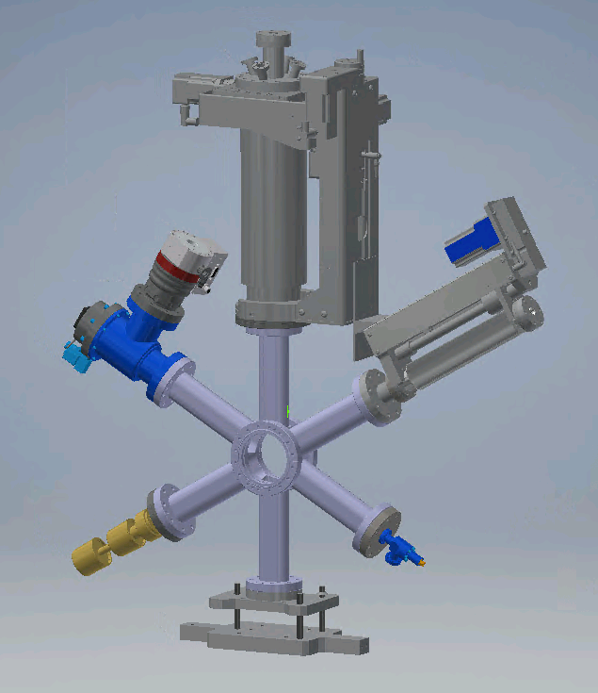
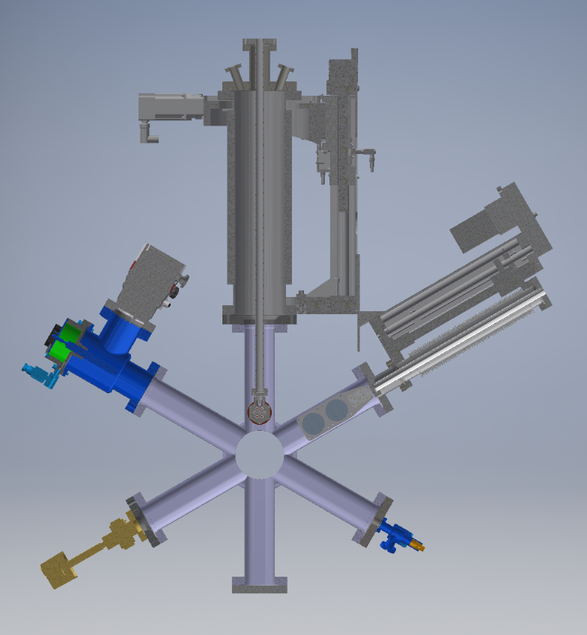
Beam Diagnostic Box
Pin Hole Faraday Cup
Pin Hole Faraday Cup
Vacuum Pump
YAG:Ce Screens
Vacuum Pump
Vacuum Gauge
Gas Injection
Vacuum Gauge
Gas Injection
F. Guillot-Vignot
Notes:
The diagnostic box consists of a 6-arm chamber (pictured
on the left hand side in fig. 2), where a movable YAG Ce
scintillator screen and a multi-hole Faraday Cup (FC) can be
inserted to measure the electron beam profile and intensity.
The other arms are used for gas injection (for venting the vac-
uum system with nitrogen), pressure measurement, support
of the structure, and one spare arm. The light produced at
the YAG screen is collected by a camera positioned behind
a viewport at the back of the collector

Slide 27
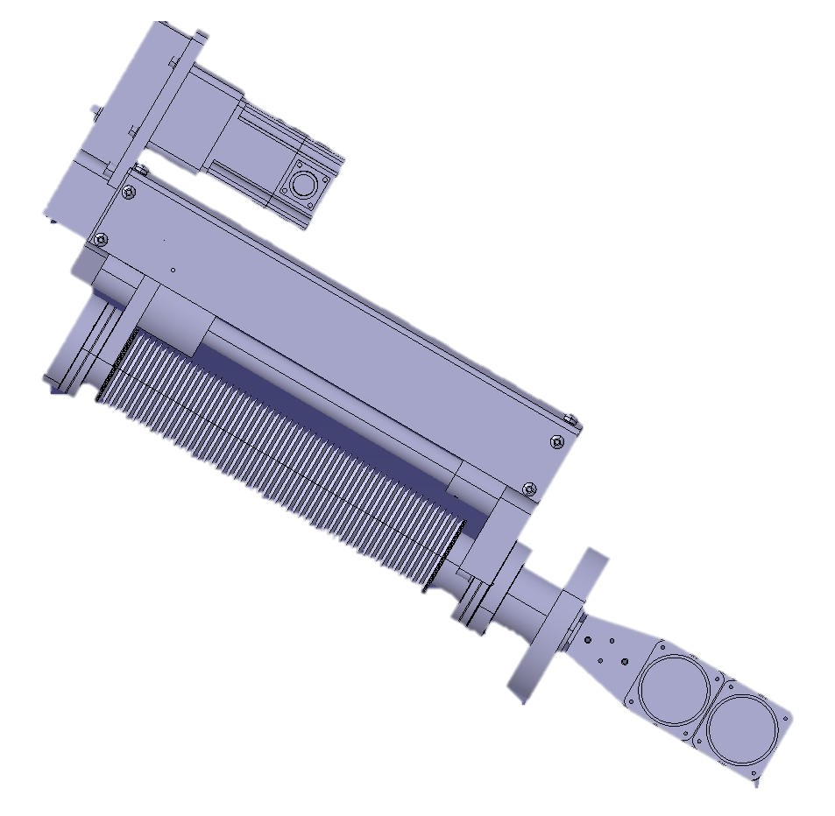
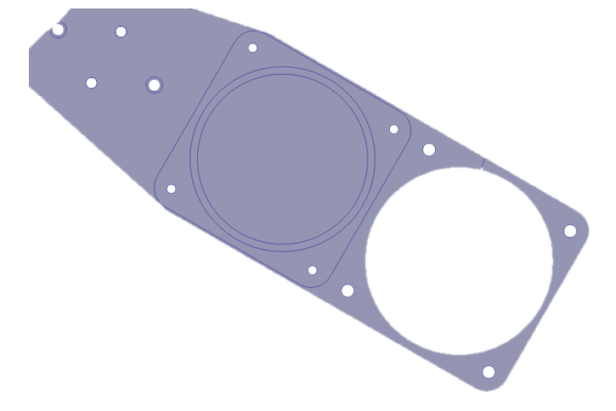
YAG:Ce Screens
Screen Details
  Two screens (Al-coated and ITO-coated) on a linear translator
  50 mm diameter
Benefits
  High photon yield (2 x 10⁴ photons/MeV)
  Short decay time (~100 ns)
  Very high image resolution
Challenges
  Image saturation and/or screen damage at high beam current or long pulse duration
Al-coated
YAG:Ce Screens
ITO-coated
F. Guillot-Vignot
Notes:
The diagnostic box consists of a 6-arm chamber (pictured
on the left hand side in fig. 2), where a movable YAG Ce
scintillator screen and a multi-hole Faraday Cup (FC) can be
inserted to measure the electron beam profile and intensity.
The other arms are used for gas injection (for venting the vac-
uum system with nitrogen), pressure measurement, support
of the structure, and one spare arm. The light produced at
the YAG screen is collected by a camera positioned behind
a viewport at the back of the collector

