Slide 1
Summary of CI Simulations
O. Stringer, H. Zhang, A. Webber-Date, C. Welsch

Slide 2
Contents
Test Particle Monte Carlo simulation introduction
Multi-Objective Genetic Algorithm summary
Optimised geometries
  EBTS – 60mm curtain
  LHC – Hadron only beam

Slide 3
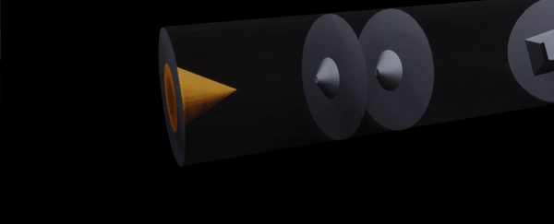

Test Particle Monte Carlo Simulation
0.00
1.00 – 10.00 mm
6.58 – 48.49 mm
174.94 – 241.11 mm
294.94 mm
346.13 – 409.94 mm
Nozzle
1st Skimmer
2nd Skimmer
3rd Skimmer
IP
4th Skimmer
Figure 2: Animation of the Test Particle Monte-Carlo gas jet principal.
Figure 3: Schematic of the injection parameter space used for the optimisation study.

Slide 4
Injection Optimisation
0.00
1.00 – 10.00 mm
6.58 – 48.49 mm
174.94 – 241.11 mm
294.94 mm
346.13 – 409.94 mm
Nozzle
1st Skimmer
2nd Skimmer
3rd Skimmer
IP
4th Skimmer
a
a
d
d
b
b
d: 500 – 7,500 um
d: 30 – 10,000 um
a: 50 – 2,000 um
b: 2 – 60 mm
a: 50 – 10,000 um
b: 2 – 100 mm
Figure 3: Schematic of the injection parameter space used for the optimisation study.

Slide 5
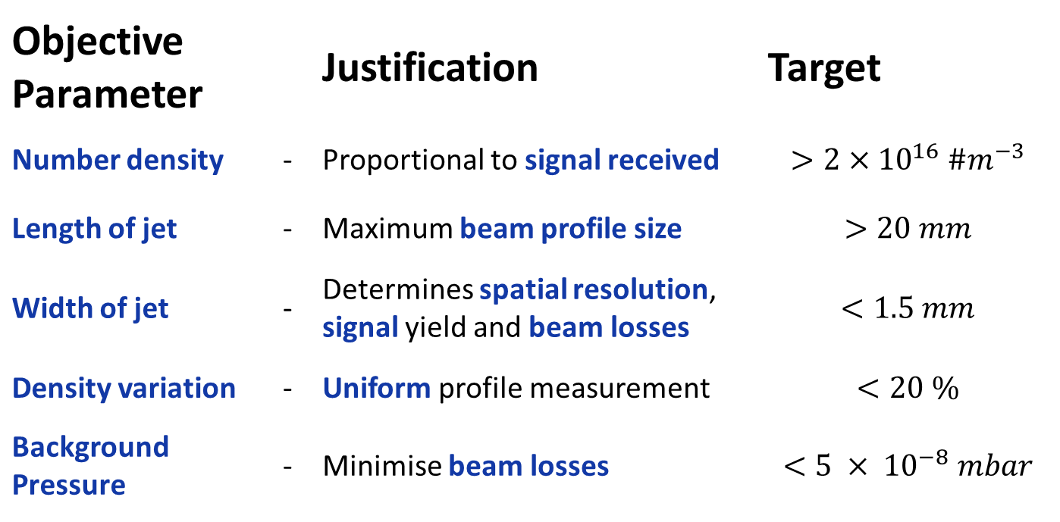
Objective Space
Objective Parameter |  | Justification | Target
Number density | - | Proportional to signal received | $$>2×{10}^{16} \#m^{−3}$$
Length of jet | - | Maximum beam profile size | $$>20 mm$$
Width of jet | - | Determines spatial resolution, signal yield and beam losses | $$<1.5 mm$$
Density variation | - | Uniform profile measurement | $$<20 \%$$
Background Pressure | - | Minimise beam losses | $$<5 × {10}^{−8} mbar$$

Slide 6
MOGA Summary
Some 26 million simulations ran over past 6 months
Undergone several iterations of code
Statistical error has been characterised
Successful confidence testing for local optimum
Started writing up MOGA work
Most relevant two simulations presented

Slide 7
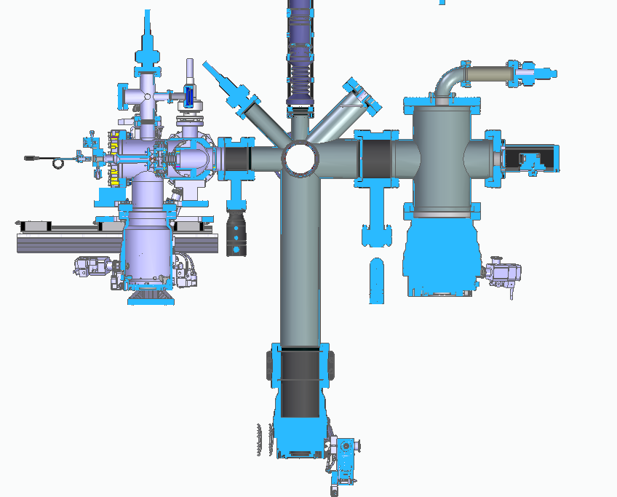
BGC V4 – EBTS Device
BGC made for permanent use on the EBTS
60mm curtain, 5E-8mbar background, N2 gas, different size constraints.
New Dump Chamber
Gas Direction

Slide 8
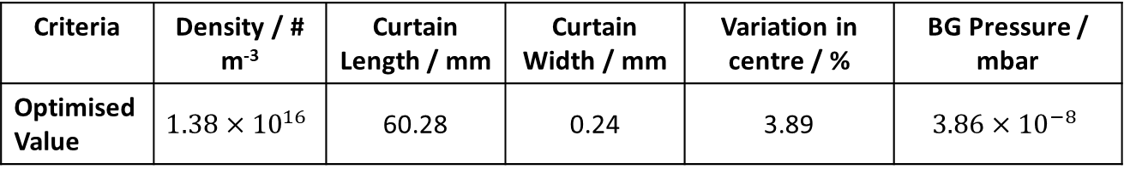
Results – 60mm New Dump
0.00
4.00mm
27.49mm
168.5mm
393.7 mm
543.7mm
Nozzle
1st Skimmer
2nd Skimmer
3rd Skimmer
IP
4th Skimmer
d
d
b
b
a
a
d: 700um
d: 4.49mm
a: 0.11mm b: 26.4 mm
a: 0.91mm b: 85.6mm
Criteria | Density / # m⁻³ | Curtain Length / mm | Curtain Width / mm | Variation in centre / % | BG Pressure / mbar
Optimised Value | $$1.38×{10}^{16}$$ | 60.28 | 0.24 | 3.89 | $$3.86×{10}^{−8}$$

Slide 9
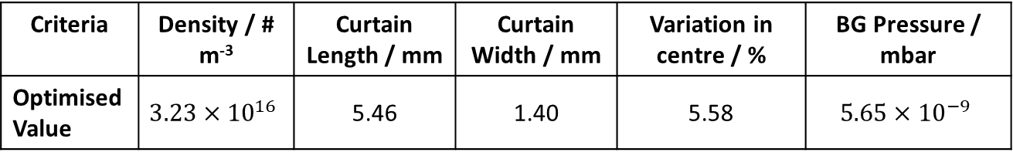
LHC – Hadron Only Beam (Ne gas)
0.00
4.50mm
33.09mm
168.5mm
393.7 mm
595.1mm
Nozzle
1st Skimmer
2nd Skimmer
3rd Skimmer
IP
4th Skimmer
Option for thicker curtain, increased signal at cost of 1D resolution
d
d
b
b
a
a
d: 200um
d: 1.65mm
a: 0.65mm b: 2.37 mm
a: 2.38mm b: 8.47mm
Criteria | Density / # m⁻³ | Curtain Length / mm | Curtain Width / mm | Variation in centre / % | BG Pressure / mbar
Optimised Value | $$3.23×{10}^{16}$$ | 5.46 | 1.40 | 5.58 | $$5.65×{10}^{−9}$$
Projected ~ 4mm

Slide 10
Special Thanks
A. Jury, C. Swain, A. Pollard, N. Kumar

Slide 11
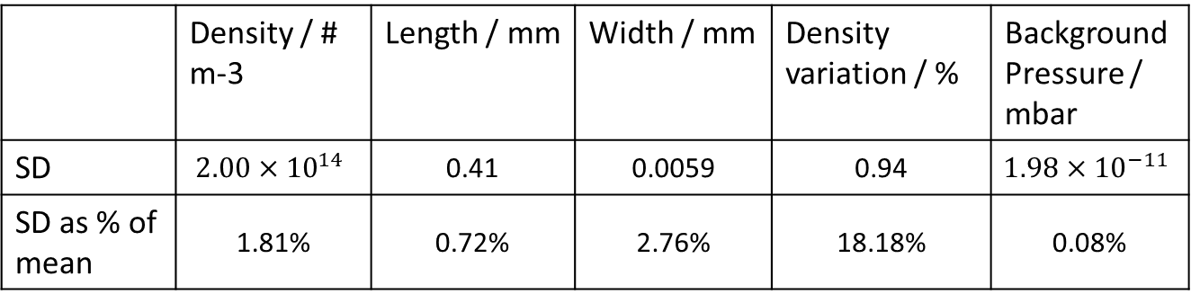
Monte-Carlo Statistical Error
MC inherently a random simulation, statistically improved by more test particles, costing more computational power/time.
Single solution (2bn particles generated), repeated 150 times from scratch with each final values recorded to determine the standard deviation
 | Density / # m-3 | Length / mm | Width / mm | Density variation / % | Background Pressure / mbar
SD | $$2.00×{10}^{14}$$ | 0.41 | 0.0059 | 0.94 | $$1.98×{10}^{−11}$$
SD as % of mean | 1.81% | 0.72% | 2.76% | 18.18% | 0.08%

Slide 12
Confidence Testing
Take optimum solution
Manually vary each size individually by some small value (delta << current size)
Compare final score and include a consistency check with S.D. of Monte Carlo error
Solution | Initial Score | Best manual Score | S.D of initial score | Conditions at Best Manual
60mm | 3.44 | 3.53 | 0.16 | Skim 3 length + 0.6mm
60mm, DN63 | 3.07 | 3.23 | 0.24 | Skim 3 length - 0.6mm
Within 1σ of initial score

Slide 13
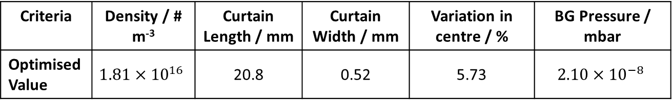
Results – V3 (Benchmark)
Out of Date skimmer values (i.e tunnel is different), but still used for benchmark other sims
0.00
4.00mm
27.49mm
168.5mm
393.7 mm
595.1mm
Nozzle
1st Skimmer
2nd Skimmer
3rd Skimmer
IP
4th Skimmer
d
d
b
b
a
a
d: 400um
d: 2.00mm
a: 0.3mm b: 9.0 mm
a: 7.0mm b: 31.0mm
Criteria | Density / # m⁻³ | Curtain Length / mm | Curtain Width / mm | Variation in centre / % | BG Pressure / mbar
Optimised Value | $$1.81×{10}^{16}$$ | 20.8 | 0.52 | 5.73 | $$2.10×{10}^{−8}$$

Slide 14
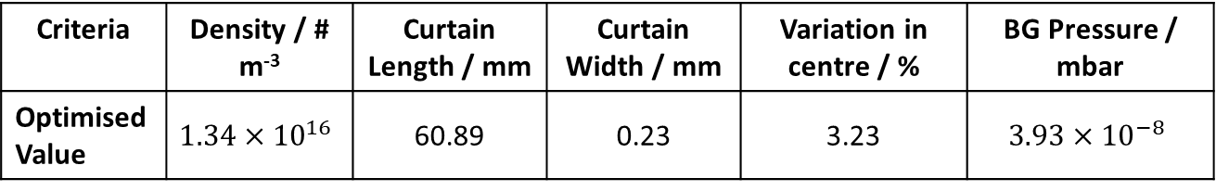
Results – 60mm
0.00
4.00mm
27.49mm
168.5mm
393.7 mm
595.1mm
Nozzle
1st Skimmer
2nd Skimmer
3rd Skimmer
IP
4th Skimmer
d
d
b
b
a
a
d: 700um
d: 4.49mm
a: 0.11mm b: 26.4 mm
a: 1.12mm b: 103.4mm
Criteria | Density / # m⁻³ | Curtain Length / mm | Curtain Width / mm | Variation in centre / % | BG Pressure / mbar
Optimised Value | $$1.34×{10}^{16}$$ | 60.89 | 0.23 | 3.23 | $$3.93×{10}^{−8}$$

Slide 15
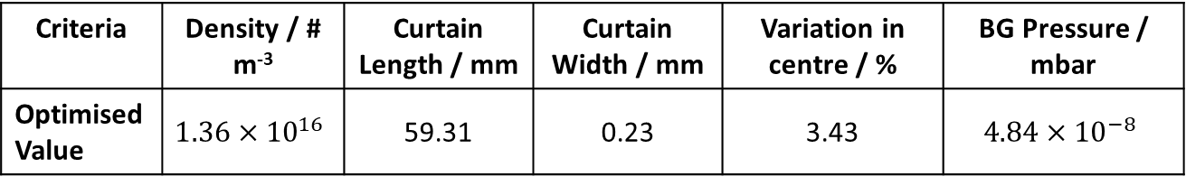
Results – Rectangular 2nd Skimmer
0.00
4.00mm
27.49mm
168.5mm
393.7 mm
595.1mm
Nozzle
1st Skimmer
2nd Skimmer
3rd Skimmer
IP
4th Skimmer
d
b
b
b
a
a
a
d: 700um
a: 0.4mm b: 4.4 mm
a: 0.10mm b: 25.5 mm
a: 1.2mm b: 52.9mm
Criteria | Density / # m⁻³ | Curtain Length / mm | Curtain Width / mm | Variation in centre / % | BG Pressure / mbar
Optimised Value | $$1.36×{10}^{16}$$ | 59.31 | 0.23 | 3.43 | $$4.84×{10}^{−8}$$

Slide 16
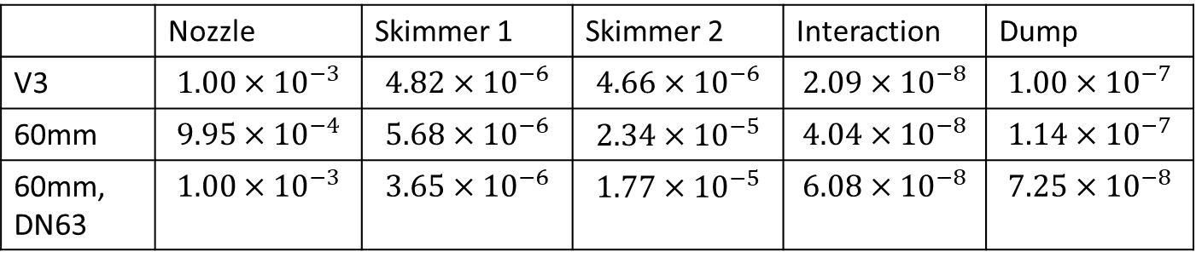
Chamber Pressure Profiles
All Pressures as BG chamber pressure, calculated with MC simulation – in mbar
 | Nozzle | Skimmer 1 | Skimmer 2 | Interaction | Dump
V3 | $$1.00×{10}^{−3}$$ | $$4.82×{10}^{−6}$$ | $$4.66×{10}^{−6}$$ | $$2.09×{10}^{−8}$$ | $$1.00×{10}^{−7}$$
60mm | $$9.95×{10}^{−4}$$ | $$5.68×{10}^{−6}$$ | $$2.34×{10}^{−5}$$ | $$4.04×{10}^{−8}$$ | $$1.14×{10}^{−7}$$
60mm, DN63 | $$1.00×{10}^{−3}$$ | $$3.65×{10}^{−6}$$ | $$1.77×{10}^{−5}$$ | $$6.08×{10}^{−8}$$ | $$7.25×{10}^{−8}$$
Largest discrepancy between calculated and true measured value of BG in nozzle chamber, where transitional flow occurs. Converges to similar value at lower pressures.

