Slide 1
Final cooling RF cavity and solenoid coil integration.
Alexej Grudiev
30.11.2023

Slide 2
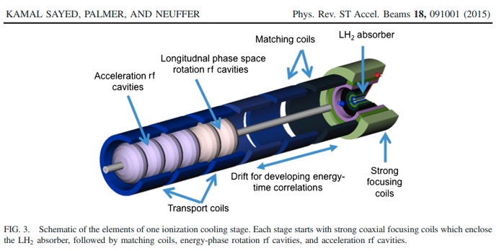
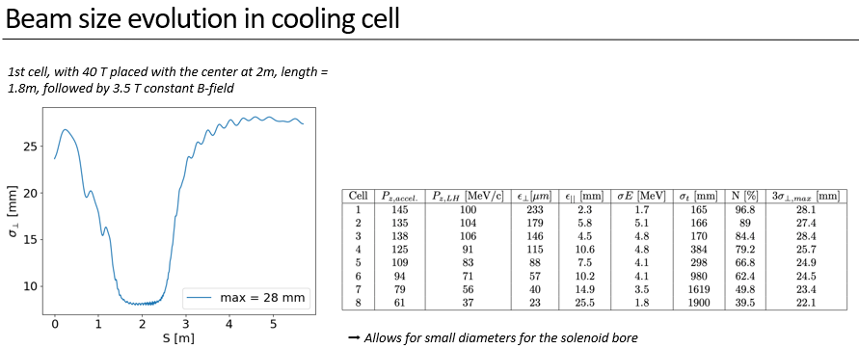
Example of final cooling design
Transverse size of the muon beam in transport solenoid: 3sigma ~ 30mm
To transport the beam a beam pipe of ~ 50 mm radius would be fine.
Solenoids of ~100 mm inner radius could provide such a transport channel
Elena Fol
Preliminary

Slide 3
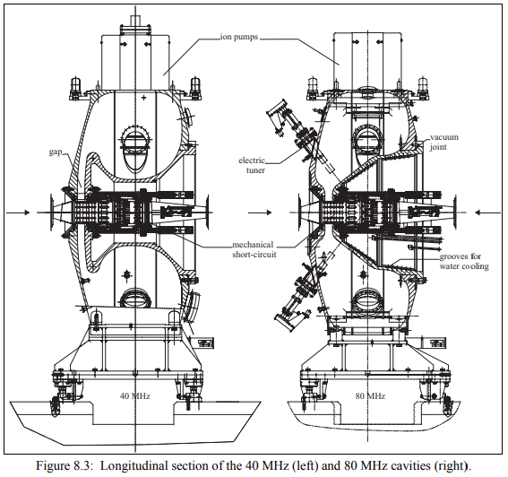
Example of RF cavity
RF frequency range: 20 – 200 MHz
CERN PS 40 MHz RF cavity: 1.6m diameter, 1m long
Far from fitting into the schematic on previous slide
Would be very difficult if not impossible to put inside of a 3.5T solenoid
LHC TDR v3, p59

Slide 4
Possible combination of RF cavities and coils
Interleaving RF voltage gaps with solenoid coils allow to combine small solenoid radius with large cavity radius
Bz is not constant in such a channel. Implication on the beam transport must be evaluated
It will define the maximum gap size for a given coil radius
solenoid
solenoid
solenoid
solenoid
solenoid
solenoid
solenoid
solenoid

Slide 5
Some conclusions
Obvious disadvantage is that accelerating gaps are separated by the coils. Impact on the real estate gradient must be evaluated.
Main advantage of proposed cavity-coil layout is potential reduction of the magnetic stored energy (~R²), etc
There might be other “side-effect” advantages
  Easier access to the cavity: RF coupler, tuner, RF probes, vacuum pumping, etc
  Using ferrite loaded cavity outside of the solenoid coils becomes not impossible
  Coupling cavities into a larger accelerating structure, “a la” DTL, becomes an interesting option
Similar approach might be applied to other solenoid coil transport channels (Front end, bunch merge, reacceleration, …)

