Slide 1
The CLIC
Damping Rings
F. Antoniou, Y. Papaphilippou
CERN
April 13, 2011

Slide 2
DR parameter optimization
Parameters | 1GHz | 2GHz
Energy [GeV] | 2.86
Circumference [m] | 427.5
Energy loss/turn [MeV] | 4.0
RF voltage [MV] | 5.1 | 4.5
Stationary phase [°] | 51 | 62
Natural chromaticity x / y | -115/-85
Momentum compaction factor | 1.3e-4
Damping time x / s [ms] | 2.0/1.0
Number of dipoles/wigglers | 100/52
Cell /dipole length [m] | 2.51 / 0.58
Dipole/Wiggler field [T] | 1.0/2.5
Bend gradient [1/m2] | -1.1
Phase advance x / z | 0.408/0.05
Bunch population, [e9] | 4.1
IBS growth factor x/z/s | 1.5/1.4/1.2
Hor./ Ver Norm. Emittance [nm.rad] | 456/4.8 | 472/4.8
Bunch length [mm] | 1.8 | 1.6
Longitudinal emittance [keVm] | 6.0 | 5.3
Space charge tune shift | -0.10 | -0.11
Reduced circumference by 15%
  Lower space-charge tune-shift and relaxed collective effects
Decreased dipole field by 25% (cell length increased by 5%)
  Lower energy loss per-turn for reducing RF stationary phase
Doubled momentum compaction factor
  Longer bunch for reducing space-charge tune-and increasing CSR instability threshold
Considered RF frequency of 1GHz (2 trains)
  Half peak power/current and harmonic number, thereby reducing transient beam loading and bunch length
  Less e-cloud production due to double bunch spacing
  Less pronounced Fast Ion Instability
  Train recombination in a delay loop

Slide 3
e⁻ linac to PDR transfer line
X-ray dump
e⁻ Pre-damping Ring
X-ray dump
X-ray dump
e⁻ PDR to DR transfer line
e⁻ Damping Ring
X-ray dump
e⁻ DR to Booster linac transfer line
Damping Rings Complex layout
Delay loop
e⁺ DR to Booster linac transfer line
X-ray dump
e⁺ Damping Ring
e⁺ PDR to DR transfer line
X-ray dump
X-ray dump
e⁺ Pre-damping Ring
e⁺ linac to PDR transfer line
X-ray dump

Slide 4
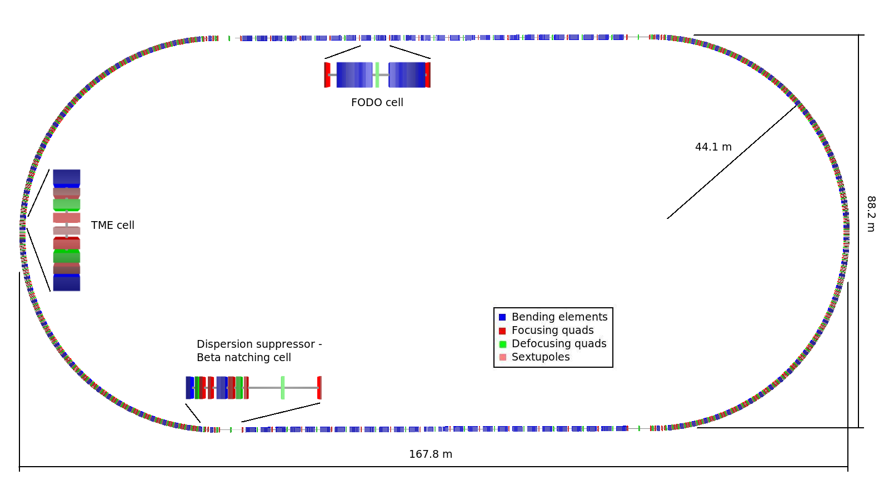
DR layout
Racetrack shape with
  96 TME arc cells (4 half cells for dispersion suppression)
  26 Damping wiggler FODO cells in the long straight sections (LSS)
  Space reserved upstream the LSS for injection/extraction elements and RF cavities
Circumference reduced (30% less wigglers)

Slide 5
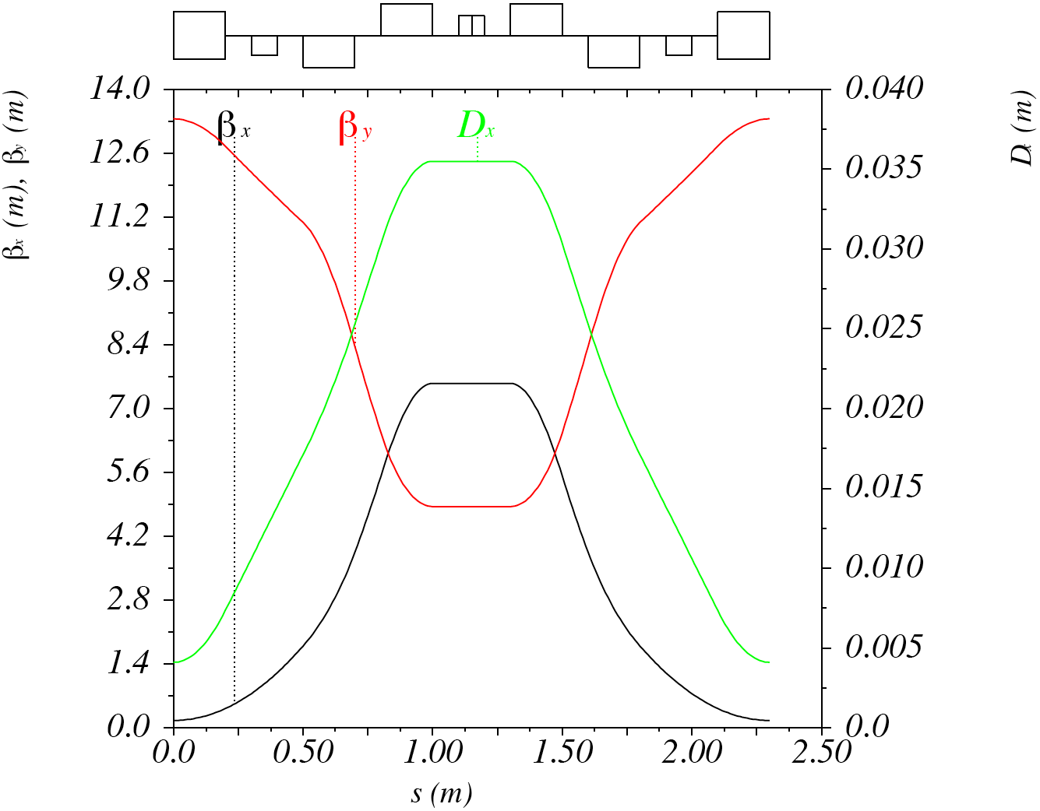
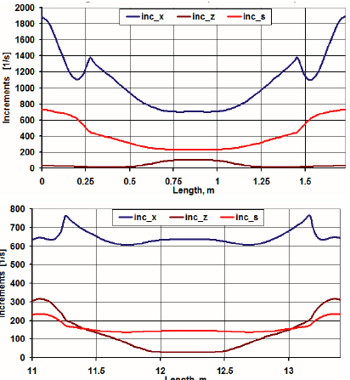
DR arc cell and IBS
S. Sinyatkin, et al., EPAC 2009
Increasing space, reducing magnet strengths
Reducing chromaticity, increasing DA
IBS growth rates reduced, i.e. zero current equilibrium emittance increased but IBS dominated emittance not changed
Combined function bends with small gradient (as in NLC DR and ATF)
Notes:
5

Slide 6
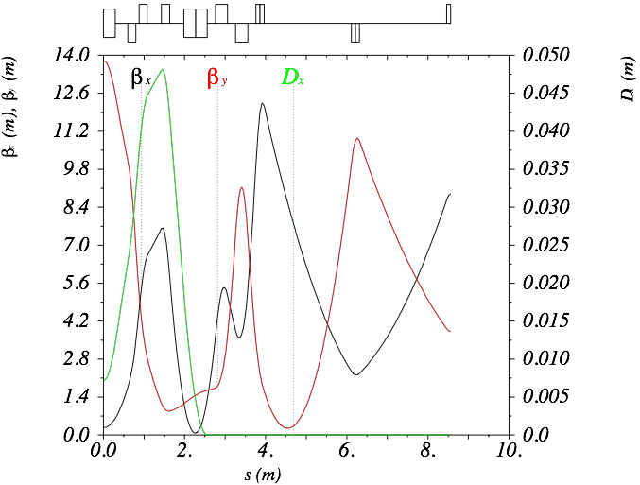
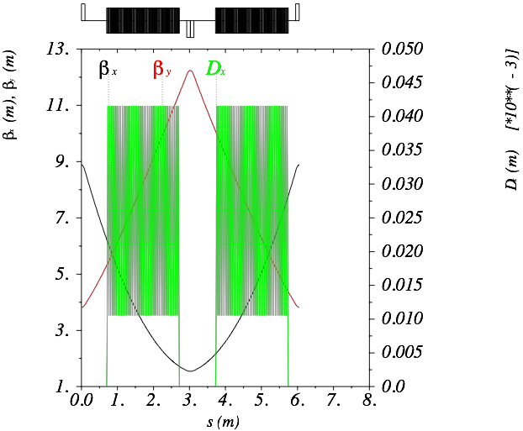
Wiggler cell and Dispersion suppressor
S. Sinyatkin, F. Antoniou
LSS filled with wiggler FODO cells of around ~6m
Horizontal phase advance optimised for minimizing emittance with IBS, vertical phase advance optimised for aperture
Drifts of 0.6m downstream of the wigglers (more length for absorbers, vacuum equipment and instrumentation)
Dispersion suppressors re-designed adding space for RF cavities and beam transfer elements

Slide 7
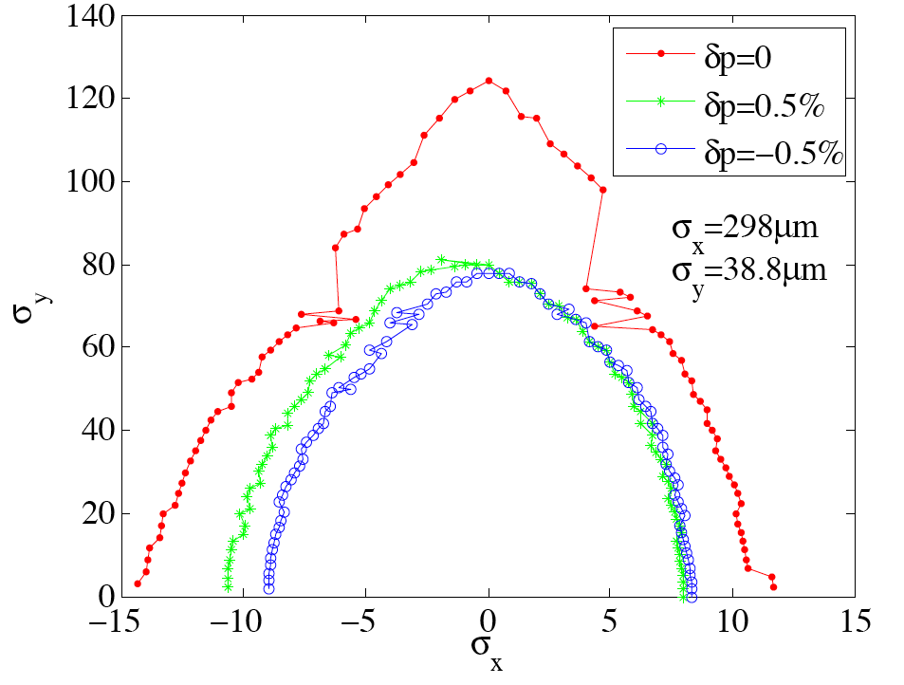
Dynamic Aperture
F. Antoniou
Tracking with chromatic sextupoles and misalignments
Very large DA translated to around +/- 5mm in both planes for on-momentum
Further DA optimisation on-going
  Working point, magnet errors, wiggler effect

Slide 8
Collective effects
G. Rumolo
Space-charge reduced <0.1 with combined circumference reduction and bunch length increase
Intrabeam scattering simulated showing excellent agreement with theory
  Parameter choice (energy, optics,…) for minimizing the growth
e-cloud in the e⁺ DR imposes limits in PEY (99.9%) and SEY (<1.3) achieved with wiggler absorption scheme and chamber coatings (amorphous carbon)
Fast ion instability in e⁻ DR constrains vacuum pressure to around 0.1nTorr
Single bunch instabilities avoided with smooth vacuum chamber design
  Simulations for instability thresholds for resistive wall
Resistive wall coupled bunch controlled with feedback
Impedance estimates for effect of multiple material layers
Notes:
8

Slide 9
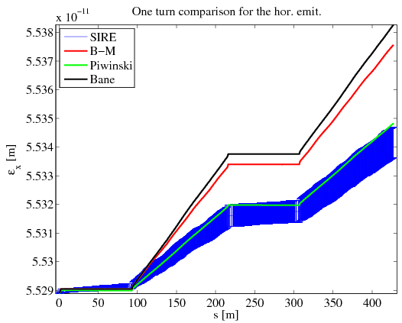
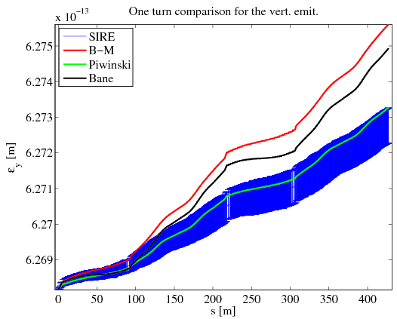
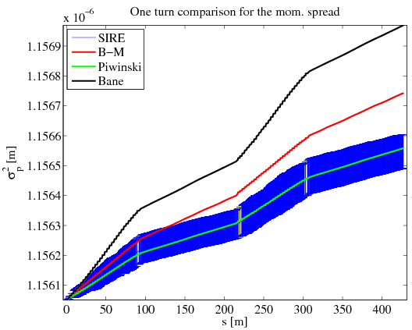
SIRE Benchmarking with theories
Comparison of SIRE results (dark-blue) and Bjorken-Mtingwa (red), Piwinski (green) and Bane (light-blue) theories
One turn behavior of the horizontal (top) and vertical (bottom,left) emittance and energy spread (down, right). For the SIRE results the 1σ error bars are also shown.
SIRE and Piwinski in very good agreement
Same trend on the emittance evolution!

Slide 10
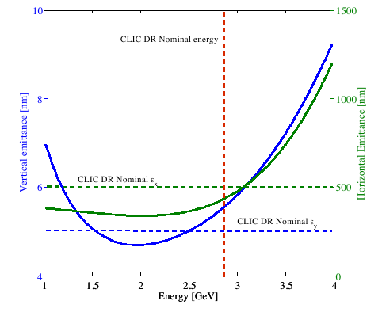
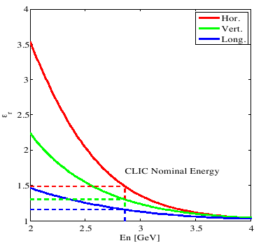
IBS effect – Scan on Energy
Ratio between steady state and zero current emittances (indicates the IBS effect) for constant longitudinal emittance.
Steady-state normalized horizontal and vertical emittances for constant output longitudinal emittance.

Slide 11
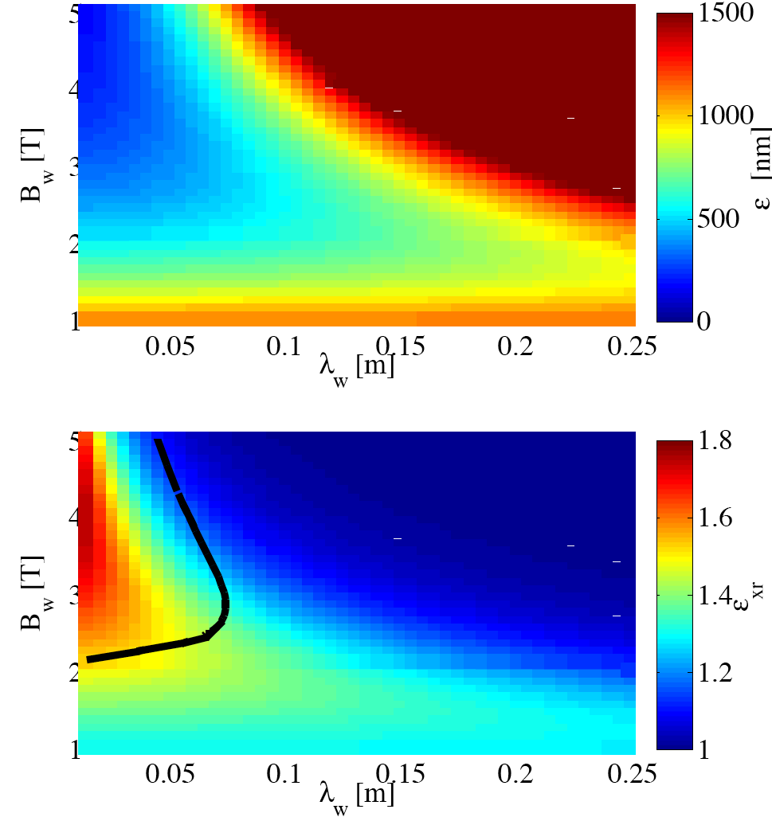
Wigglers’ effect with IBS
Stronger field and moderate wavelength reduces IBS effect while reaching target emittance
Current density can be increased by different conductor type
Nb₃Sn can sustain higher heat load (~10 times higher than NbTi)
Two wiggler prototypes
  2.5T, 5cm period (CERN/BINP)
  2.8T,4cm period, (CERN/KIT)
  Mock-ups magnetically tested
  To be installed in storage ring for beam measurements
Parameters | BINP | CERN
B_{peak} [T] | 2.5 | 2.8
λ_{W} [mm] | 50 | 40
Beam aperture full gap [mm] | 13
Conductor type | NbTi | Nb₃Sn
Operating temperature [K] | 4.2
500nm limit

Slide 12
RF system
A. Grudiev
RF frequency of 2GHz
  Single train of 312 bunches spaced at 0.5ns
  R&D needed for power source
  High peak and average power introducing transient beam loading to be handled by LLRF system
The 1GHz frequency was chosen as baseline
  Two trains of 156 bunches spaced at 1ns
  Eases beam dynamics (e.g. e-cloud)
CLIC DR parameters
Circumference [m] | 427.5
Energy [GeV] | 2.86
Momentum compaction | 13x10⁻⁵
Energy loss/turn [MeV] | 4.0
RF voltage [MV] | 5.1 | 4.5
RF frequency [GHz] | 1.0 | 2.0
Peak/Aver. current [A] | 0.66/0.15 | 1.3/0.15
Peak/Aver. power [MW] | 2.8/0.6 | 5.5/0.6
  Drives the RF system to more conventional parameters for power source and LLRF
  Complication with train recombination (to be studied and tested in CTF3)
Conceptual design for RF system including LLRF performed for both frequencies
Scaling for both frequencies suggest that total transverse impedance is ~10 times below threshold

Slide 13
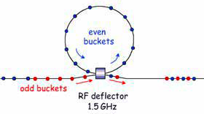
Delay loop considerations
Delay loop
RF deflector
1GHZ
Unique α-shape loop (as in CTF3) for both species and circumference of ~260m, i.e. half of the damping rings
Optics tuned to achieve high-order iso-chronism
  TME cells and sextupole tuning
Emittance growth due to synchrotron radiation
  Negligible (low energy and relatively short length)
Path length very critical (+/-3mm in CTF3)
  Wiggler, orbit correctors and optics tuning for correction
Systematic energy loss is roughly ~half of the DR
  Corrected with RF cavities of a few hundred kV.
Notes:
13

Slide 14
Summary
A solid design with reduced circumference and collective effects is our baseline for the CDR
The 1 GHz option is chosen as the baseline for the RF system
A delay loop is needed in order to recombine the trains

