Slide 1
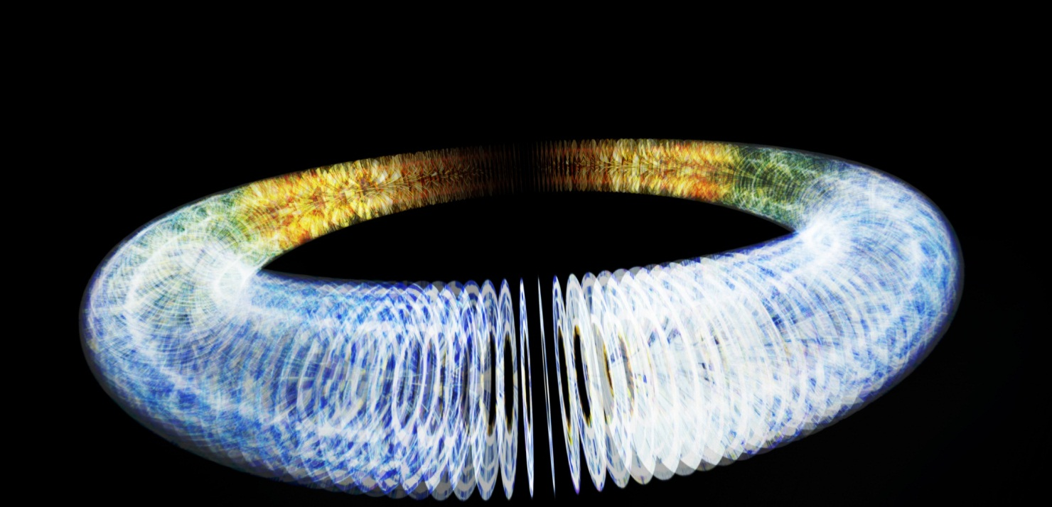
Design of the CLIC Main Damping Ring lattice for low emittance
Supervisors:
Roger Rassool
Mark Boland
Ioannis Papaphilippou
Kent Wootton
13th April 2011
Notes:
Good morning!
My name is Kent Wootton and I am a PhD student at the University of Melbourne
Where I am supervised by
Roger Rassool in the Experimental Particle Physics Group
My Co supervisors are
Mark Boland at the Australian Synchrotron and Ioannis Papaphilippou at CERN
Today I am presenting to you my confirmation talk entitled “Design of the CLIC Main Damping Ring lattice for low emittance”

Slide 2
Outline
AIM: To demonstrate the feasibility of an ultra low emittance damping ring for the CLIC linear accelerator
Experimental results so far
  Beam profile and emittance measurements
  Low emittance tuning study
  Precision beam energy measurement
  Lattice calibration
Modelling so far
  MADX alignment sensitivities
  Dynamic aperture mapping
Notes:
The aim of my research is to demonstrate the feasibility of an ultra-low emittance damping ring for the CLIC linear accelerator. In this talk I will outline my progress so far and the plans for the next year of my PhD research.
In order to demonstrate the feasibility of the 1 pm vertical emittance called for in the CLIC design, I have embarked on an experimental and modelling program at the Australian Synchrotron.
Using the 3 GeV electron storage ring as a test bed, I have conducted experiments to measure the beam profile to determine the vertical emittance as part of a low emittance tuning study. I also made a precise measurement of the beam energy which allowed me to calibrate the lattice model.
In parallel to the experimental program I have been developing the skills to modelling a damping ring lattice using MADX and related software tools. Building on the existing lattice from the CLIC damping ring working group I have modelled the alignment tolerances and identified the magnets to which the vertical emittance is most sensitive. I have also started to look at the effect of misalignments on the dynamic aperture of the damping ring. My goal is to get these modelling results to a stage that they can be included in the CDR due later this year.

Slide 3
CLIC Critical Feasibility Issues
Two-beam acceleration scheme
  Drive beam generation
  Beam driven Rf power generation
  Two beam module
RF structures
  Accelerating Structures (CAS)
  Power production Structures (PETS)
Ultra-low emittance and beam sizes
  Emittance preservation during beam generation, acceleration and focusing
  Alignment and stabilisation
Detector
  Adaptation to short interval between bunches
  Adaptation to large backgrounds at high beam collision energy
Notes:
The CLIC steering committee has identified nine issues as critical in demonstrating the feasibility of the CLIC project. Each of these items needs to be demonstrated at least once in a working prototype.
My work contributes to the design of accelerators to produce beams of emittances lower than has ever been achieved.

Slide 4
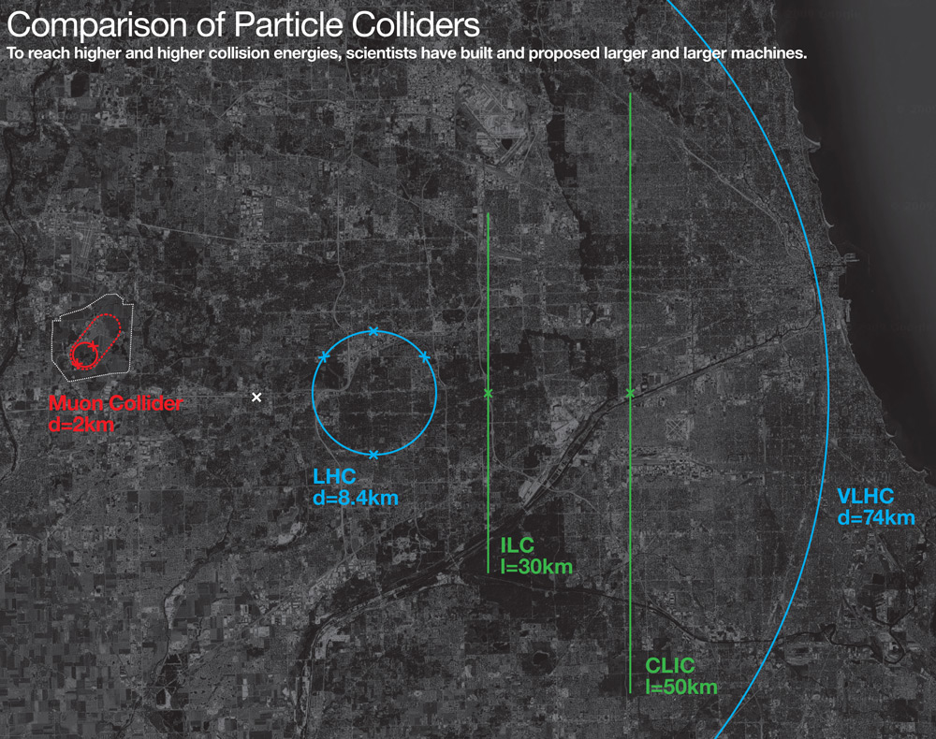
Future colliders at the Energy Frontier
Notes:
Motivating the CLIC project.
Illustrated here is a map of several candidate colliders at the energy frontier.
LHC experiments are anticipated to make discoveries of new resonances in the TeV energy regime. The colliding partons however have a range of energies, resulting in large uncertainties.
A lepton-antilepton collider places a tight constraint on the collision centre of mass energy. The highest energy electron-positron collider was LEP, at 195 GeV CoM. Overcoming the ‘radiative losses’ of synchrotron radiation can be achieved by constructing a linear electron-positron collider.

Slide 5
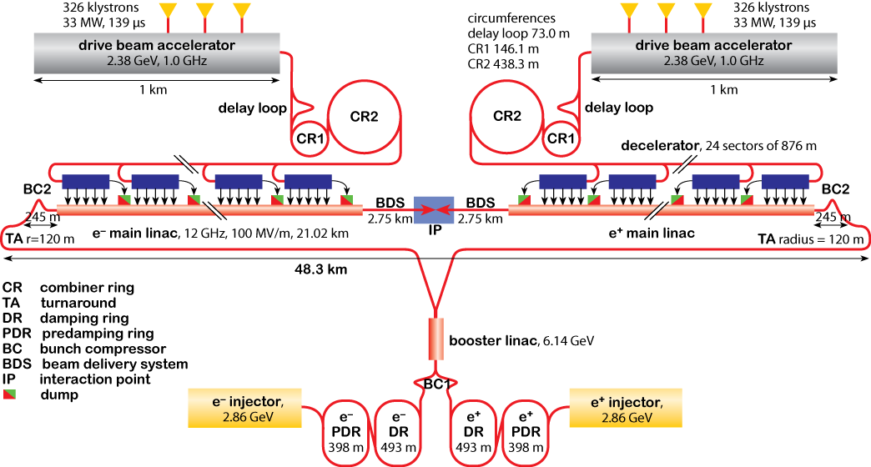
CLIC – Compact Linear Collider
Notes:
Looking in detail at the CLIC accelerator complex, it can be described as two main accelerator complexes producing two beams:
Drive beam complex, providing a high-current, low-energy electron beam which is decelerated,
coupling power to the main beam complex, providing low-current positron and electron beams accelerated to high-energy.
My work contributes to the design of the positron and electron main damping rings. The damping rings are designed to have a high energy loss per turn to synchrotron radiation to damp the emittance volume of the beam. The importance of the damping rings is that this is the component that defines the minimum emittance.

Slide 6

Emittance and Collider Luminosity
$$ℒ=f\frac{n^{2}}{4\sqrt{ε_{x}β_{x}^{∗}ε_{y}β_{y}^{∗}}}$$
Notes:
The motivation for low emittance rings is the luminosity requirement of the collider.
The damping rings of both CLIC and ILC call for beams of emittances lower than has ever been achieved.
Shown here are a selection of vertical and horizontal emittances of constructed (in blue) and proposed (in red) storage and damping rings. The blue dots show the minimum measured emittances, with red showing the proposed design emittances.
Importantly, the AS storage ring has demonstrated the picometre vertical emittance required for the linear collider damping rings.

Slide 7
Lightsource Storage and Damping Rings
52m wiggler LSS
RF
Inj
100 TME arc cells
IDs
RF
Inj/extraction
CLIC main damping rings
Notes:
So, let’s compare the lattices of the ASLS and CLIC DR. The AS storage ring is composed of double-bend achromat cells, distributing insertion devices around the ring circumference. Importantly, this provides space for many photon beamlines.
The CLIC damping ring is a racetrack geometry ring, with theoretical minimum emittance arc cells, and two long FODO wiggler insertion straights. The inclusion of high-field damping wigglers in zero-dispersion straights dominates the horizontal emittance, and brings the transverse damping time down to 2 milliseconds. This lattice is at the limit of feasibility, in all dimensions of emittance.

Slide 8
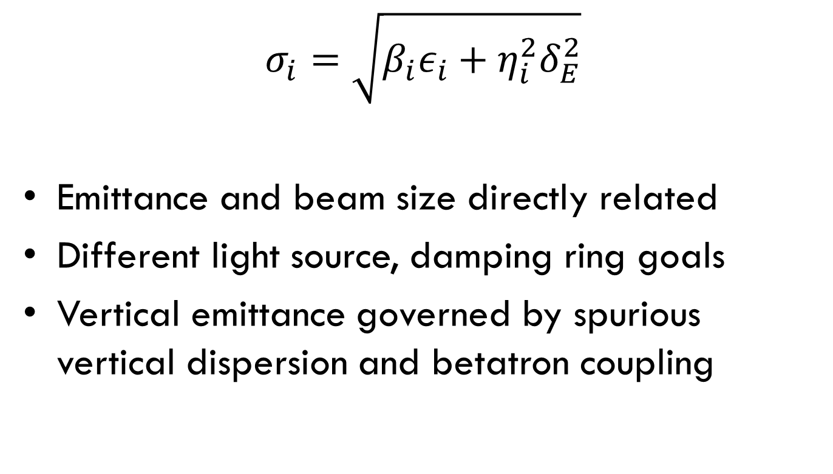
Emittance Experiments
$$σ_{i}=\sqrt{β_{i}ε_{i}+η_{i}^{2}δ_{E}^{2}}$$
Emittance and beam size directly related
Different light source, damping ring goals
Vertical emittance governed by spurious vertical dispersion and betatron coupling
Light sources
Damping rings
Notes:
So shown here are the parameters of the beam from which a direct measurement of the emittance can be made.
The transverse beam size, sigma and energy spread, delta can be directly observed. The linear lattice betatron and dispersion functions are periodic solutions to the magnetic lattice, which can be solved. What is important is that the emittance and beam size are directly related.
The optimisation for storage ring light sources is the beam size, whilst damping rings seek to minimise emittance, which is almost the same optimisation. From measurements of the beam size, the maximum emittance can be inferred.

Slide 9
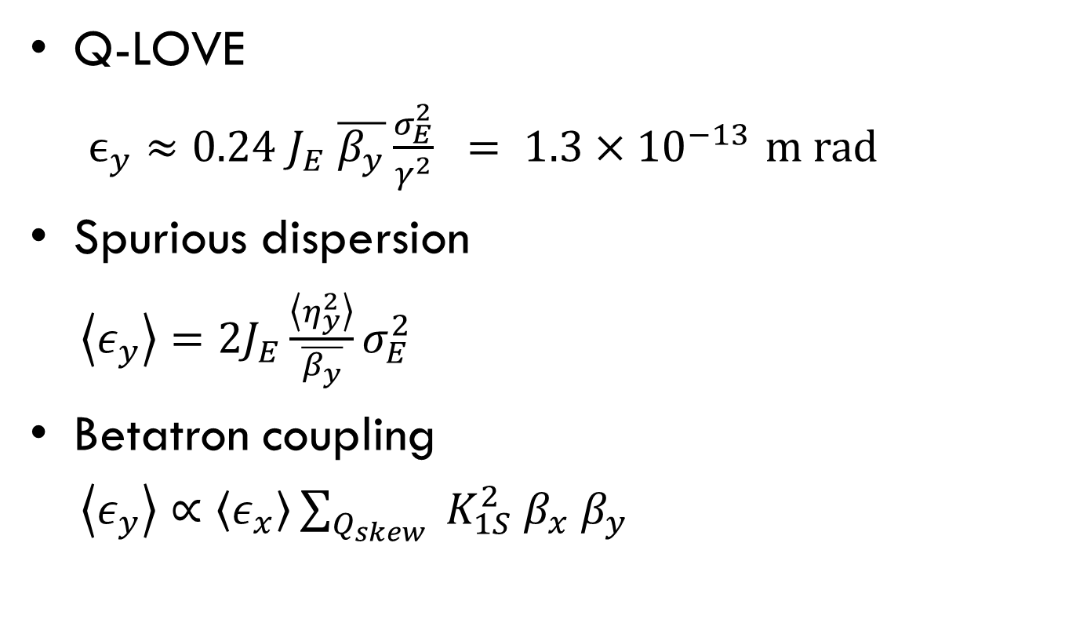
Vertical emittance – analytical estimates
Q-LOVE
  $ϵ_{y}≈\text{0.24} J_{E} \overline{β_{y}}\frac{σ_{E}^{2}}{γ^{2}} = 1.3×{10}^{−13}$ m rad
Spurious dispersion
$\left\langle ε_{y}\right\rangle =2J_{E}\frac{\left\langle η_{y}^{2}\right\rangle }{\overline{β_{y}}}σ_{E}^{2}$
Betatron coupling
$\left\langle ε_{y}\right\rangle ∝\left\langle ε_{x}\right\rangle \sum_{Q_{skew}}{{ K}_{1S}^{2}{ β}_{x}{ β}_{y}}$
SR
Quadrupole vertical offsets
Dipole rolls
Sextupole vertical offsets
Quadrupole rolls
Notes:
It is worth briefly qualifying the sources of the equilibrium vertical emittance. An electron or positron beam in a planar, horizontal ring with no vertically dispersive elements (bends) damps to an equilibrium quantum limit of vertical emittance. Under the damping action of synchrotron radiation, this limit is governed by the opening angle of synchrotron radiation. Typically the observed vertical emittance is several orders of magnitude larger than this quantum limit. Importantly for CLIC, the tight design picometre emittance isn’t even an order of magnitude greater than the quantum limit.
The minimum vertical emittance of typical storage rings is governed by the ability to correct an orbit passing through misaligned magnetic centres. Two main contributions arise from spurious dispersion (vertical kicks) and coupling large magnitude betatron oscillations from the horizontal into the vertical, via skew quadrupole components. We will come back to simulations I’ve made of the source of vertical emittance, later in the presentation. Instead, let’s consider the measurement of the vertical emittance.

Slide 10
Synchrotron Radiation Interferometer
σy, ρ
R0
a
Slit 2
bandpass
linear polariser
Slit 1
a
R1
R₁
R₀
Notes:
Measurements of the Australian Synchrotron storage ring emittance have been made using a synchrotron radiation interferometer. The interferometer is based on Mitsuhashi’s synchrotron radiation interferometer, after Michelson’s double slit stellar interferometer.
Illustrated here is the interferometer I designed for my honours project. This arrangement shows two single slits, each mounted on separate linear translation stages for independent motion. The interferogram resulting from illumination of the double slits by an extended, thermal source is shown in the left plots, with a cross-section illustrated. A high-coherence wavefield results on propagation from a narrow source at a long distance, giving a fringe visibility approaching unity.

Slide 11
Pinhole diameters
Pinhole | Single slit diffraction | SR Interferometer
- | [µm] | [µm]
1 | 15 ± 2 | 15 ± 2
2 | 42 ± 3 | 38 ± 2
3 | 174 ± 10 | 171 ± 5
Notes:
The interferometer was calibrated by measuring the diameter of pinhole sources. This plot illustrates the variation of fringe visibility with slit separation, for various hard-edged pinhole sources. The profile of visibility with slit separation is given by the Fourier transform of the transverse source size. Shown here is the measurement of 15, 38 and 171 micron pinholes.

Slide 12
XDB calibration with SRI
Notes:
I have made measurements with the interferometer in the calibration of the X-ray diagnostic pinhole camera. Shown here is the measured electron beam source size, with variation in the emittance ratio.
It can be seen that the resolution of the pinhole camera is about 5 um, compared with approximately 2 um resolution of the interferometer
A minimum vertical beam size of approximately 40 microns is possible with the interferometer. For the X-ray pinhole camera, the measured vertical beamsize is the electron beam size convolved with the point-spread function of the finite dimension pinhole. This limits the minimum measurable beam size, as we see on the next slide.

Slide 13
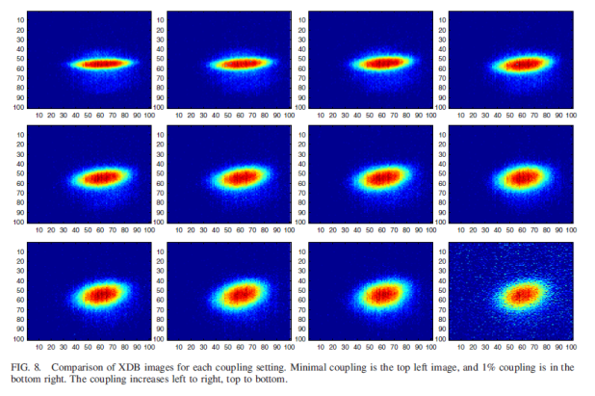
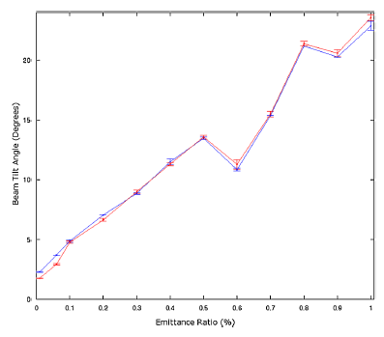
Q-LOVE and Intra-Beam Scattering
Dowd, R. et al., PRST:AB, 14:012804, 2011.
Notes:
The original motivation for measurement of the storage ring minimum vertical emittance was the Quantum-LOVE prize: the quantum limit of vertical emittance. While the convolution of the electron beam size and diffractive pinhole prevented an accurate measurement of the electron beam source size, the XDB pinhole camera was reliably used in the measurement of the rotation of the beam ellipse. Shown here is the rotation of the beam ellipse over a range of emittance ratios. The measured data is shown in blue, the LOCO model in red, with lines to guide the eye.
This shows the zero-bunch current limit of vertical emittance. I have made preliminary measurements using the interferometer of the increase in beam size of a single bunch, with increasing bunch population, for high chromaticity settings (blue) and low chromaticity settings (red). The interferometer is useful at a low stored current of 10mA. The interpretation of these results is that the emittance volume is increasing in dimensions that were unmeasured, including the horizontal and longitudinal.
As the RF voltage cannot be further increased, achieving high IBS bunch densities requires operation of the storage ring at energies below 3 GeV. Eugene and I have developed ramp tables for the storage ring, allowing us to ramp the storage ring from 3.0 down to 1.5 GeV. In this way, the bunch length will be decreased.
But how do you measure the energy?

Slide 14
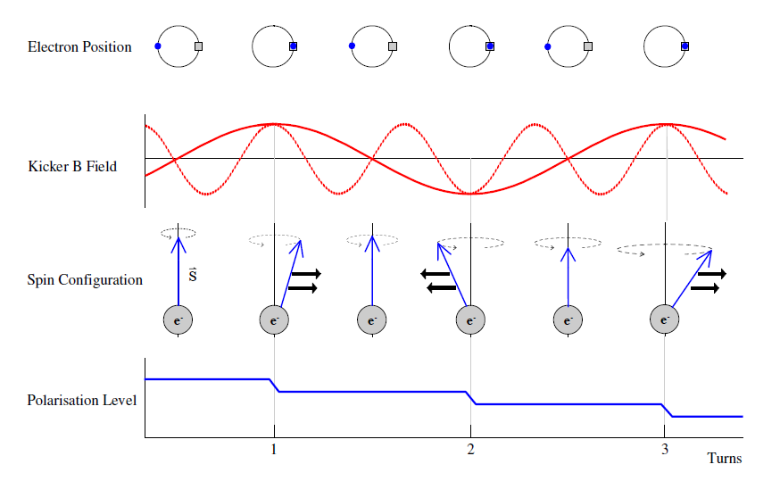
Resonant Spin Depolarisation
Notes:
The precision measurement of the beam energy was achieved using the technique of spin resonant depolarisation. Throughout 2010, I worked with Masters’ student Harris Panopoulos in the measurement of the beam energy.
This figure illustrates technique of resonant electron spin depolarisation. Under the influence of a uniform bending field, the random initial orientations of electron and positron magnetic moments tends to align anti-parallel or parallel to the field, with a precession rate which is the product of the anomalous magnetic moment of the electron (measured to precision in the 12th significant figure), and the relativistic gamma. The spin vector can be rotated with a resonant series of kicks from a transverse magnetic field, reducing the polarisation.

Slide 15
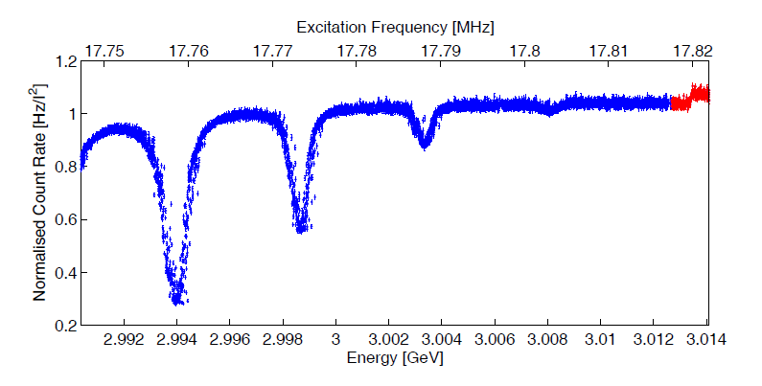
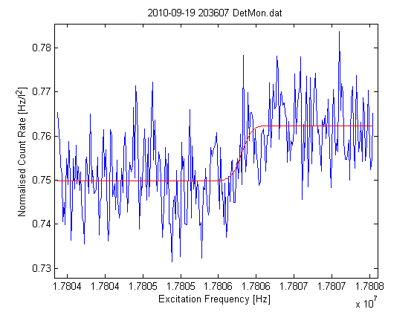
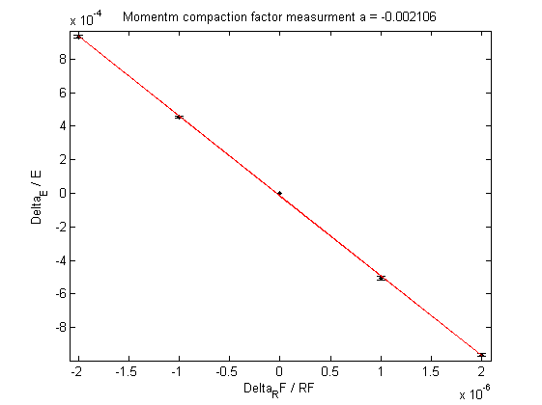
Resonant Spin Depolarisation → α_{c}
E = 3.013408(8) GeV
α_{c} = 0.00211(5)
Notes:
And using this technique, the beam energy was measured accurate to the sixth significant figure.
Shown here is the first resonant depolarisation, where the increase in counts highlighted in red, indicates the loss in polarisation of the beam.
By varying the RF frequency, we were able to measure the momentum compaction factor, accurate to three significant figures.

Slide 16
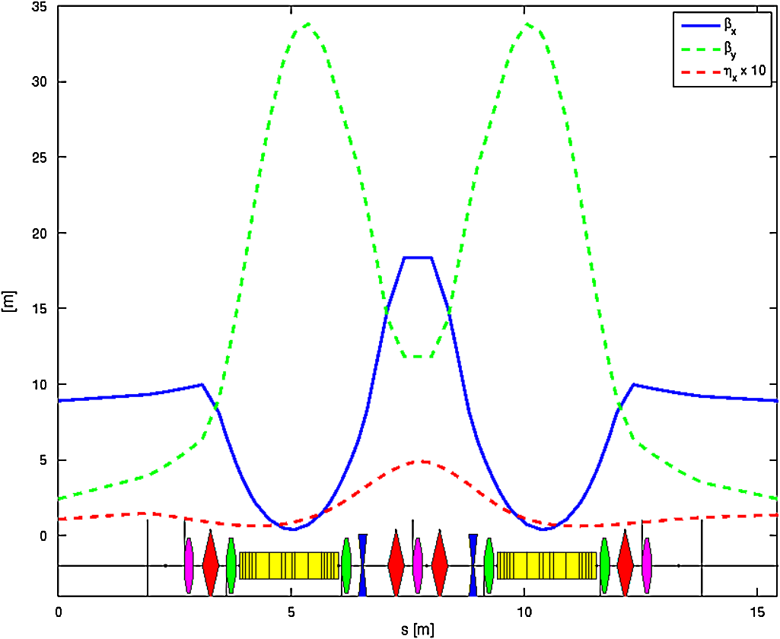
assr4_splitbends → α_{c}
α_{c} = 0.00210
Dowd, R. et al., PRST:AB, 14:012804, 2011.

Slide 17
Modelling and MAD-X
Linear transport code
  Methodical Accelerator Design (MAD-X)
  Accelerator Toolbox (AT)
Accelerator subdivided into lattice elements
6-D coupled motion

Slide 18
CDR – Demonstration of Feasibility
9 critical feasibility issues
  Generation and preservation of low emittances
  H = 600 nm, V = 5 nm (norm)
  = γ 1 pm rad (geom)

Slide 19
Alignment tolerances for multipoles
Magnet displacement
  Quadrupole vertical
  Quadrupole roll
  Sextupole vertical
  Dipole roll
Gaussian, 2.5σ

Slide 20
Results
200 seeded machines
Analytical estimate
5%, mean, 95%

Slide 21
Further work
Correct orbit, dispersion in LSS, chromaticity
  Specification of correctors, BPMs
Zero bunch current
  Intra-beam scattering (IBS)
No field errors
Notes:
The next step in this work is to introduce corrector magnets and beam position monitors into the lattice.

Slide 22
Dynamic aperture
Notes:
Survival plot, at injection, on momentum.
The aperture of this lattice is small due to strong sextupoles and wigglers. The aperture need not be large, because

Slide 23
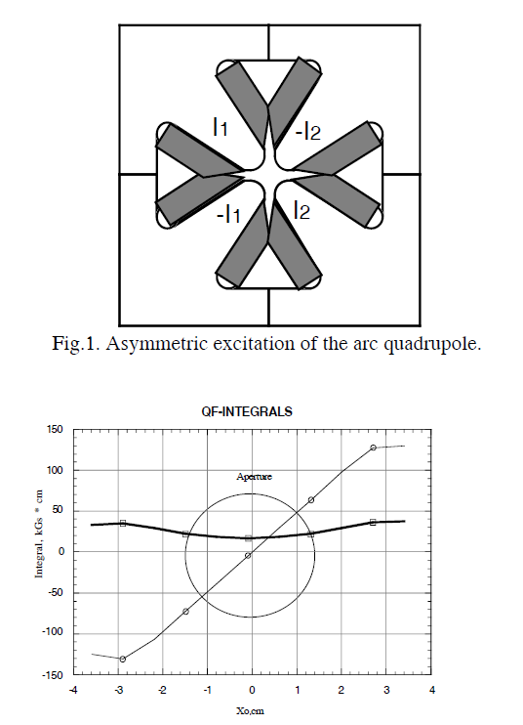
Asymmetric powering of multipoles
Tight everyday alignment tolerances
Asymmetric powering introduces dipole, sextupole moment
Duke SR
  20% →2.25 mm shift
2% →200 μm shift?

Slide 24
CLIC Damping Ring - DBA
50 wigglers
Save on photon absorber-quad in wiggler insertions
This ring 345 m
  Add cells for RF
Inj-ext – insertion length difficult
Notes:
I’m also working on my own DBA damping ring lattice. I believe that the benefits of increased symmetry outweigh the cost from the increased equilibrium horizontal emittance.

Slide 25
Experimental Plan
SRI + XDB calibration
E → 1.5 GeV for IBS
RDP for energy mismatch
Horizontal emittance: bare, wigglers
Injection transients (SRI + ICCD)
LOCO coupling
Notes:
My plan for experiments during the coming year

Slide 26
CLIC DR Modelling – further work
Dynamic aperture with misalignments
Corrector/BPM requirements
Arc girder requirements

Slide 28
Concerns with the lattice
Alignment of quads in LSS
8 cm gap between magnets
Circumference for RF
Circumference used for SR absorbers in LSS
DA of only several mm

