Slide 1
RFQ2 Tuning Update
L. Millar, A. Grudiev
SY-RF-MKS
RFQ2 46th Meeting - 27/11/2023
Notes:
https://indico.cern.ch/event/1351255/

Slide 2

Overview
Since last time:
Tuners re-machined and reinstalled due to a 70 kHz frequency error.
Cavity remeasured (results in following slides).

Slide 3
RFQ2 Final Measurement

Slide 4
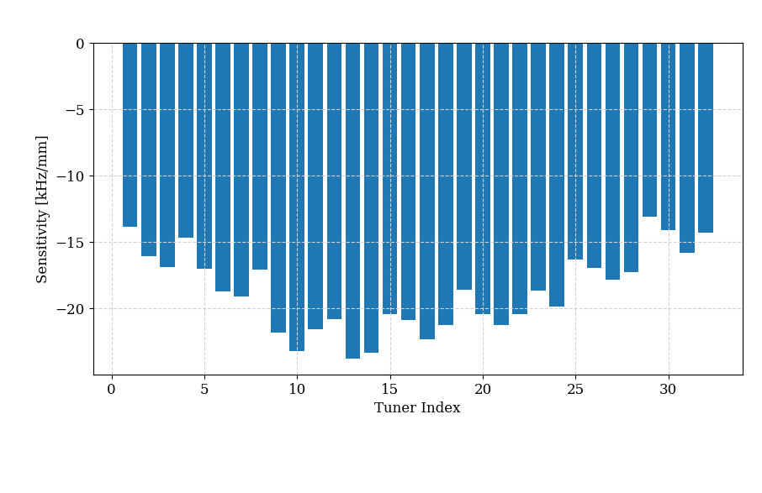
Tuner Remachining
Avg. single tuner response: 18.66 kHz/mm
All 32 tuners: 18.66*32 = 597.12 kHz/mm
To correct a 70kHz error, we need:
70/597.12 = 0.11722 mm or ~120 microns.

Slide 5
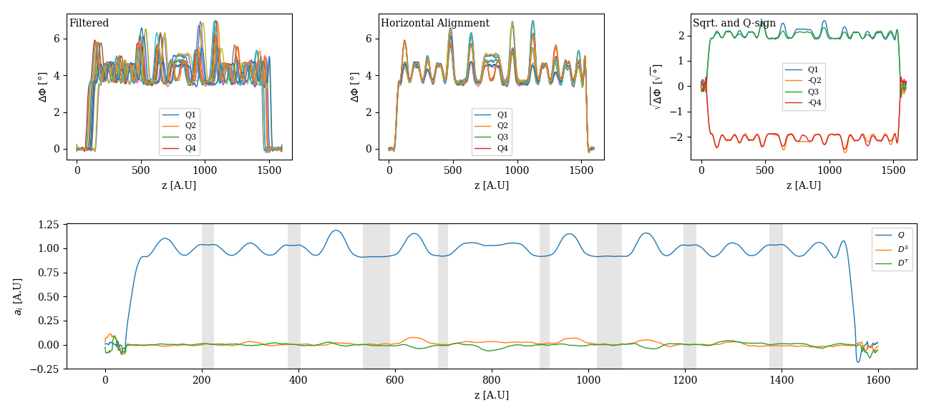
Tuning Summary

Slide 6
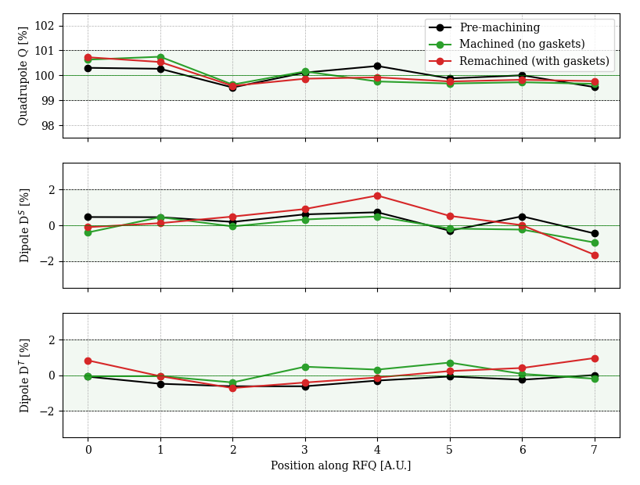
Tuning Summary
Tuners now installed with gaskets.
Current parameters:
Q: 100 ± 0.73%. ✅
Dipole 1 (Ds): ± 1.7%. ✅
Dipole 2 (DT): ± 1 %. ✅
f0 = 352.2218 MHz @ 25° in vacuum. ✅
21.8 kHz error ➔ 28.5 ° in vacuum.

Slide 7
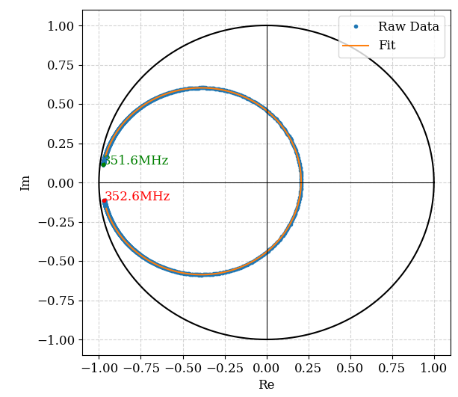
Tuning Summary – Q Factor
Results for the 352.2 MHz operating mode:
Q₀ = 6047 (~10.8% lower than RFQ1 = 6772)
Q_{ext} = 4175 (~1.7% lower than RFQ1 = 4250)
β = ~1.45
Final effect on operation shown following…

Slide 8

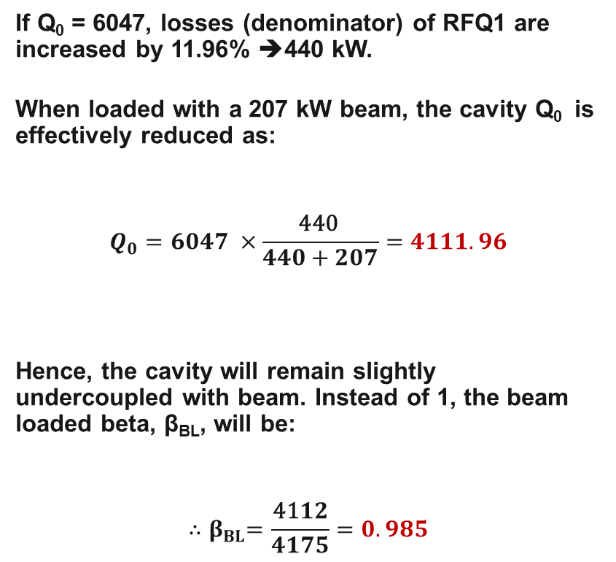
Effect on Operation
If Q₀ = 6047, losses (denominator) of RFQ1 are increased by 11.96% ➔440 kW.
When loaded with a 207 kW beam, the cavity Q₀ is effectively reduced as:
$$Q_{0}=6047 ×\frac{\text{440} }{440+207}=4111.96$$
Hence, the cavity will remain slightly undercoupled with beam. Instead of 1, the beam loaded beta, β_{BL}, will be:
$${∴β}_{BL}=\frac{\text{41}12}{4175}=0.985$$
Parameter | Value
F_{o} | 352.2 MHz
Q_{O,} | 6047
Q_{Ext} | 4175
β | 1.45
I_{Beam} | 70 mA
Beam energy | 0.045 MeV
Beam output energy | 3.0 MeV
Beam Power, P_{Beam} | 207 kW peak
Resistive losses, P_{Loss} | 1.1198*393 = 440 kW
Total losses, P_{Tot} | 207+440 = 647 kW

Slide 9
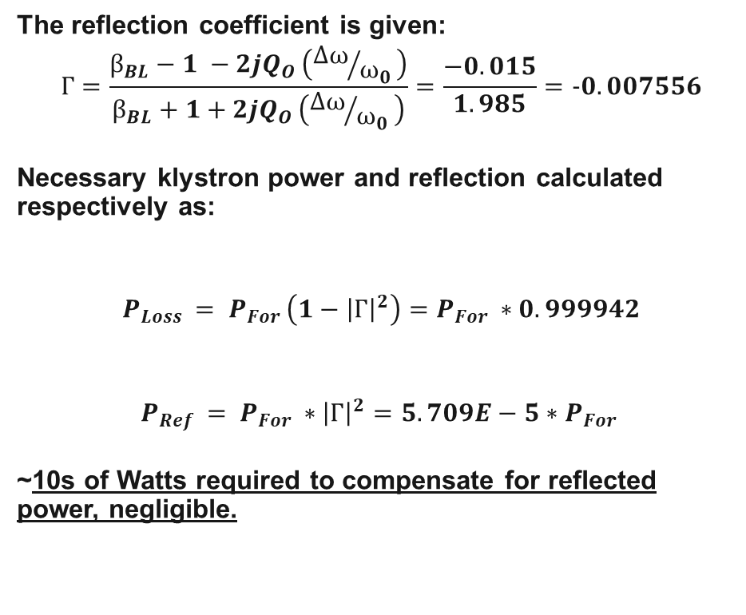
Effect on Operation
The reflection coefficient is given:
$$Г=\frac{β_{BL}−1 −2jQ_{O }\left({Δω}/{ω_{0 }}\right)}{β_{BL}+1+2jQ_{O }\left({Δω}/{ω_{0 }}\right)}=\frac{−0.015}{1.985}=−0.007556$$
Necessary klystron power and reflection calculated respectively as:
$$P_{Loss }= P_{For }\left(1−{\left|Г\right|}^{2}\right)=P_{For }∗0.999942$$
$$P_{Ref }= P_{For }∗{\left|Г\right|}^{2}=5.709E−5∗P_{For }$$
~10s of Watts required to compensate for reflected power, negligible.
Parameter | Value
F_{o} | 352.2 MHz
Q_{O,} | 6047
Q_{Ext} | 4175
β | 1.45
I_{Beam} | 70 mA
Beam energy | 0.045 MeV
Beam output energy | 3.0 MeV
Beam Power, P_{Beam} | 207 kW peak
Resistive losses, P_{Loss} | 1.1198*393 = 440 kW
Total losses, P_{Tot} | 207+440 = 647 kW

Slide 10
Effect on Operation
In summary, the consequences are:
7.8% (47 kW) more power required from klystron.
Relative to RFQ1, there will be a 12% increase in surface heating. Corresponds to an additional ~47 W for water cooling (1.12*393kW=440kW, pulsed at 1 ms at ~1Hz).

Slide 11
RFQ1 and RFQ2 Comparison

Slide 12
Comparison: RFQ2 vs. RFQ1
Parameter | RFQ1 | RFQ2
f_{o} | 352.2 MHz at 26° in vacuum? | 352.2 MHz at 28.5° in vacuum.
Q Component | –0.63 to +0.47% (Table 108, pg. 196) | -0.32 to +0.73%.
Dipole 1 Component (Ds) | –2.96 to +3.45% | -1.65 to 1.67%.
Dipole 2 Component (Ds) | –2.27 to +2.29% | -0.72 to 0.96%.
Q_{O,} | 6772 | 6047
Q_{Ext} | 4250 | 4175
β | 1.6 | 1.45
Resistive losses | 393 kW | 440 kW
Req. input power | 600 kW | 647 kW

Slide 13
Discussion

Slide 14
Measurement Plan for Full Assembly
Use Ø 12 mm dummy iris for coupler
Use copper RF plugs
Copper ridge2, waveguide, wg-coax transition.
Tuner lengths fixed
Confirm
bead-pull/Qex, antenna calibration
Tune Q_{ex} using 3 aluminum dummy irises
Assemble all modules and auxiliaries
Bead-pull measurement / Tuning
Tuner recutting,
antenna spacers fabrication
Final bead-pull/tuning if necessary
Coupler iris fixed
Coupler (ridge1) fabrication & installation
✅
✅
✅
✅
✅
Roughly
here
✅
✅
with copper ridge1
(final configuration)
Drawing of tuner body w/o antenna hole
Drawing of coupler iris (ridge1 body)
Drawing of tuner body w/ antenna hole
Drawing of ridge1 assembly
Drawing of antenna spacer
Drawing of dummy RF plug body
Drawing of dummy RF plug assembly

Slide 15
Discussion
The proposed next steps are:
Perform additional bead pulls today for averaging to further reduce error (12-15 total).
Proceed with antenna spacer fabrication and installation.
Calibrate the antennas w.r.t. the bead pull.
Remove bead pull rig and perform vacuum test.
Transport to test stand and remeasure field profile with antennas.
Additional task: Tuner mechanisms and auxiliaries (dummy couplers etc.) to be moved to storage area.

