Slide 1
Timepix BLM
Gabriela Cabrera Castellano (SY-BI-XEI)

Slide 2
Project goal
Beam loss monitor with nanosecond time resolution.
Capable of identifying the bunch responsible for the beam loss.
“Fast deploy” requiring only a single-mode fibre pair and a power supply.
Easy to setup and use.
Radiation tolerant to 1000Gy.
Timepix-BLM project kickoff (14 Oct 2022): https://indico.cern.ch/event/1200777/

Slide 3
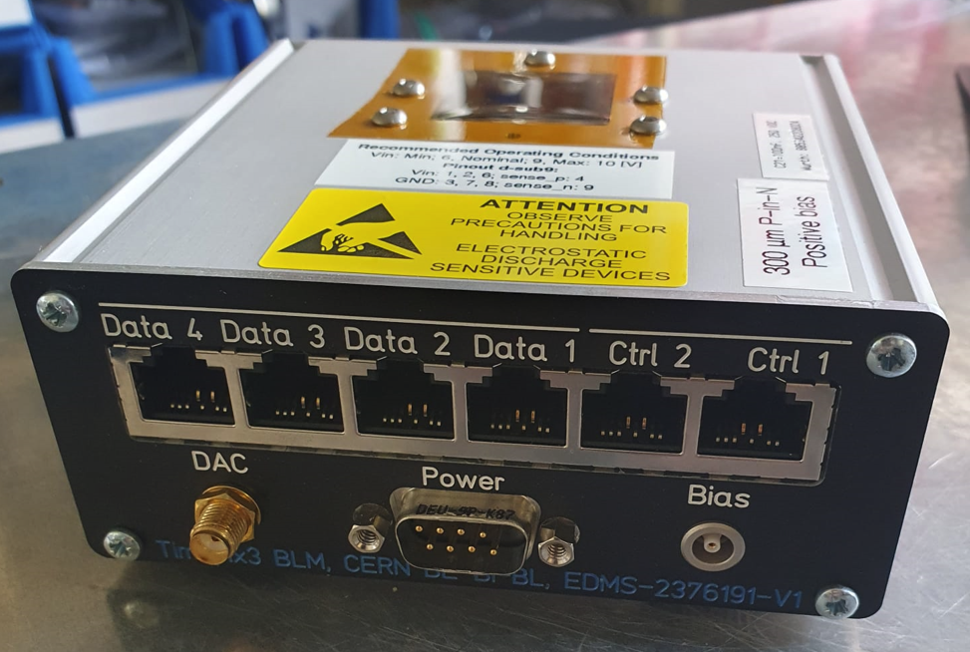
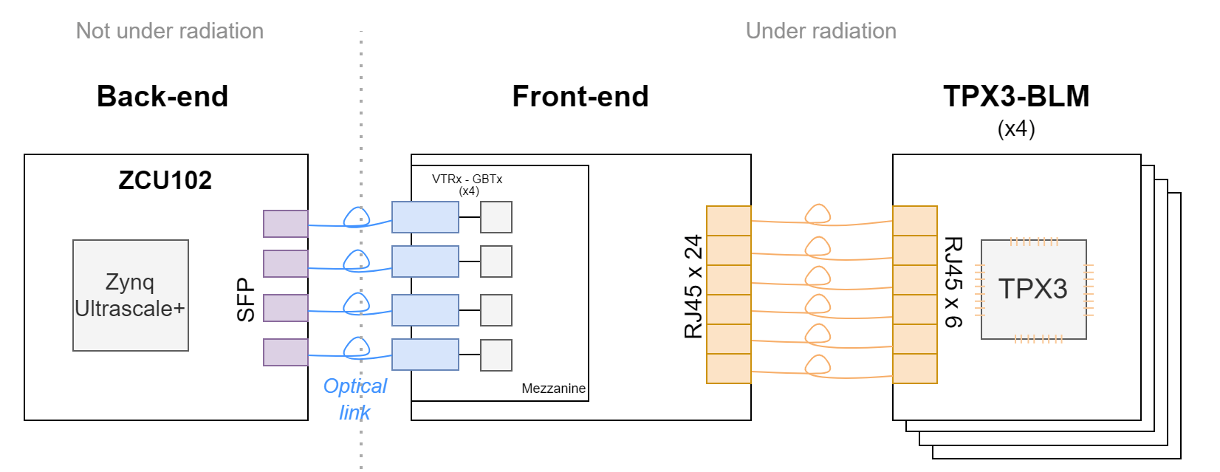
TPX3-BLM
Based on Timepix3:
Position (65k pixels with 55um pitch)
ToA (1,56 ns of resolution)
ToT (< 2KeV of energy resolution)
BIPXL readout (same used in TPX3-BGI):
Optical links in single mode for communication Back-end with Front-end.
Four TPX3-BLM can be connected to the same Back-end.
https://edms.cern.ch/document/2376191/1

Slide 4
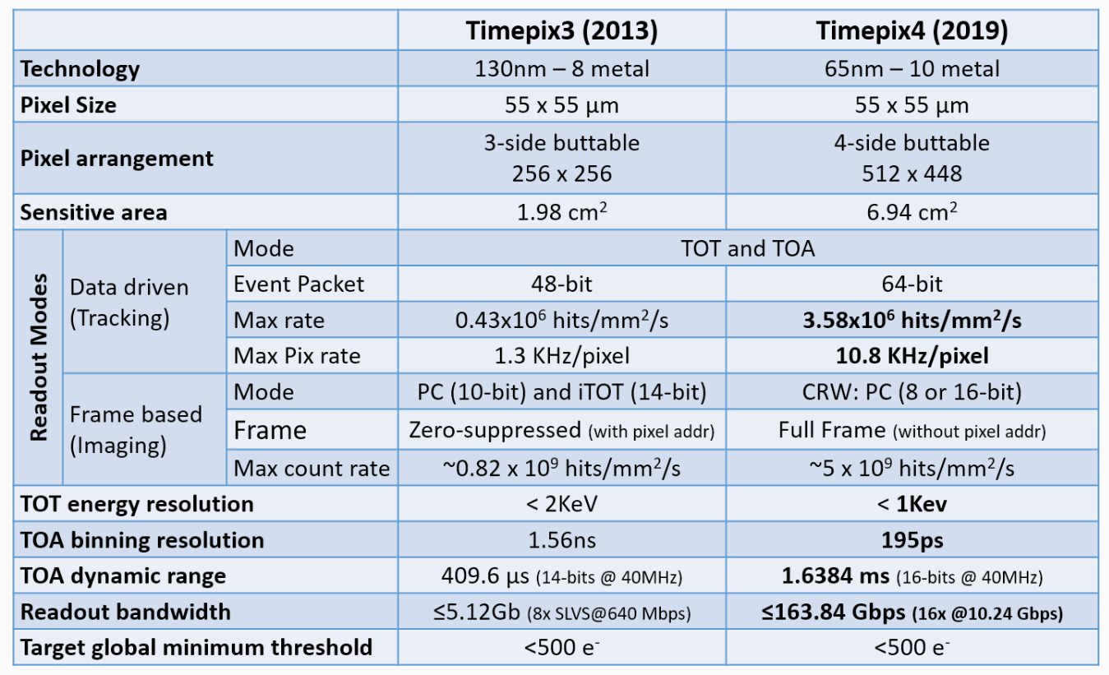
TPX3 vs TPX4
Notes:
TPX4 brings better timing resolution and more event per pixel.

Slide 5
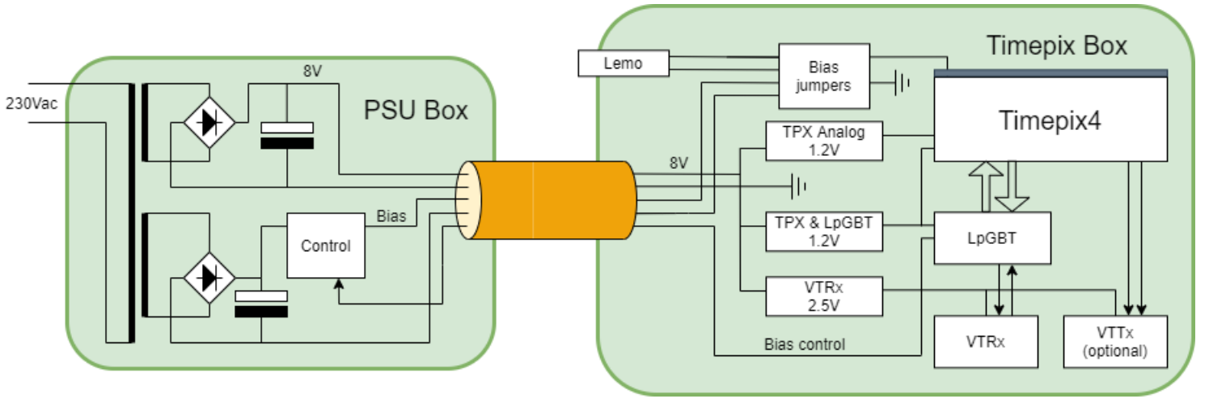
TPX4-BLM
Specifications: https://edms.cern.ch/document/2802519/1
Changes in the optical link:
lpGBT
VTRx and VTTx single mode (based on CWDM), collaboration project (EP-ESE and BI).
Power supply in a different box to avoid the radiation exposure.
It should provide an unregulated 8V @1A and a regulated bias voltage of up to 80V.
Notes:
Coarse Wavelength Division Multiplexing (CWDM)

Slide 6
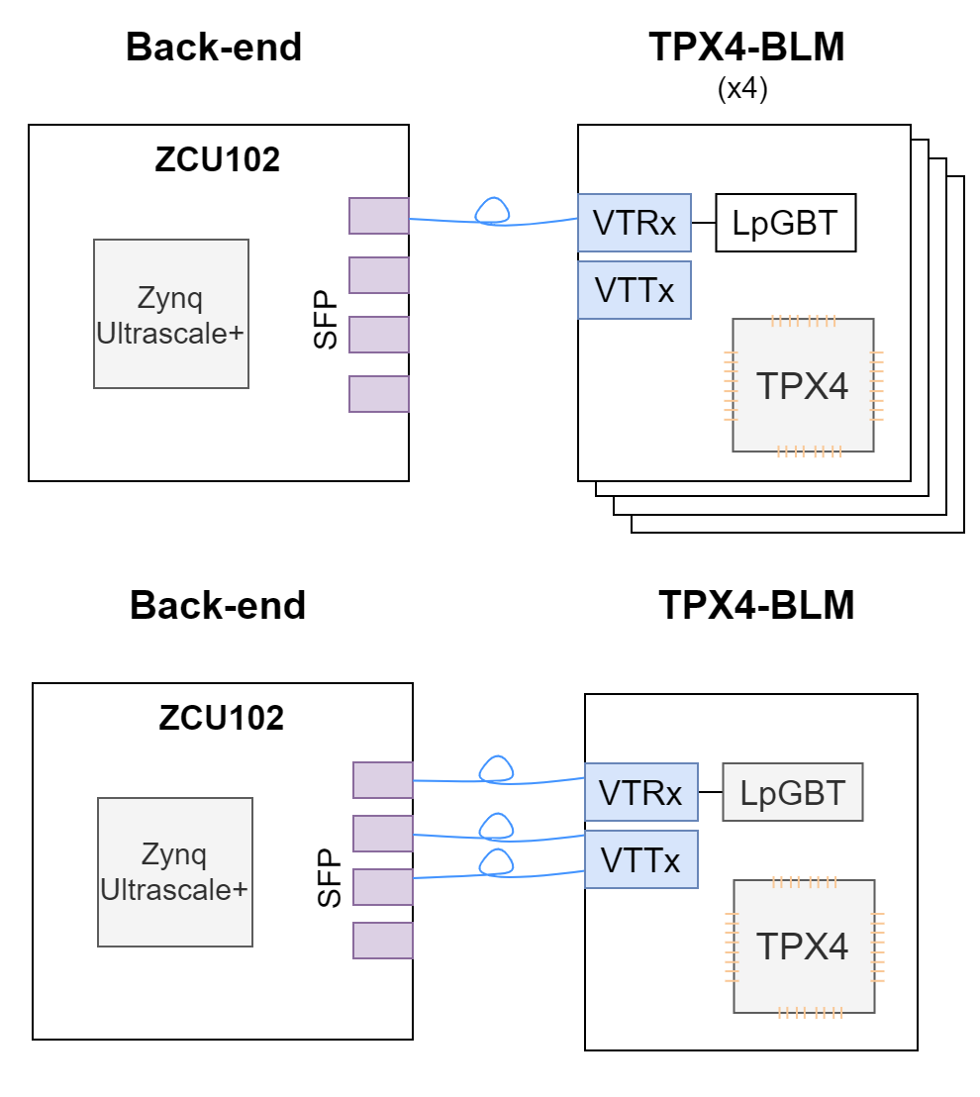
Architecture
Signals to be transmitted:
Slow-control signals and serial_out signals from the TPX4.
Three possible modes:
Standard: 3840 Mbit/s (~58 MEvent/s):
4 BLM per Back-end
Fast: 10240 Mbit/s (~155 MEvent/s):
1 BLM per Back-end
Double-fast: 20480 Mbit/s (~310 MEvent/s).

