Slide 1
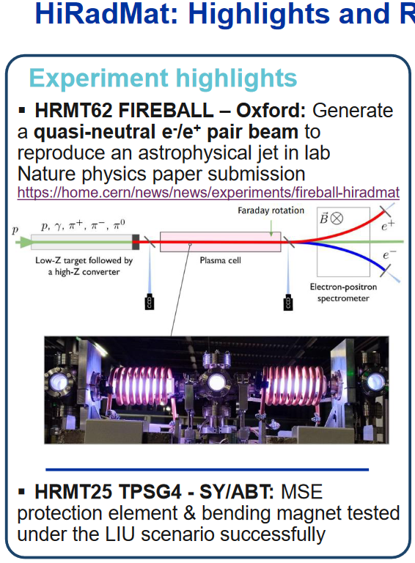
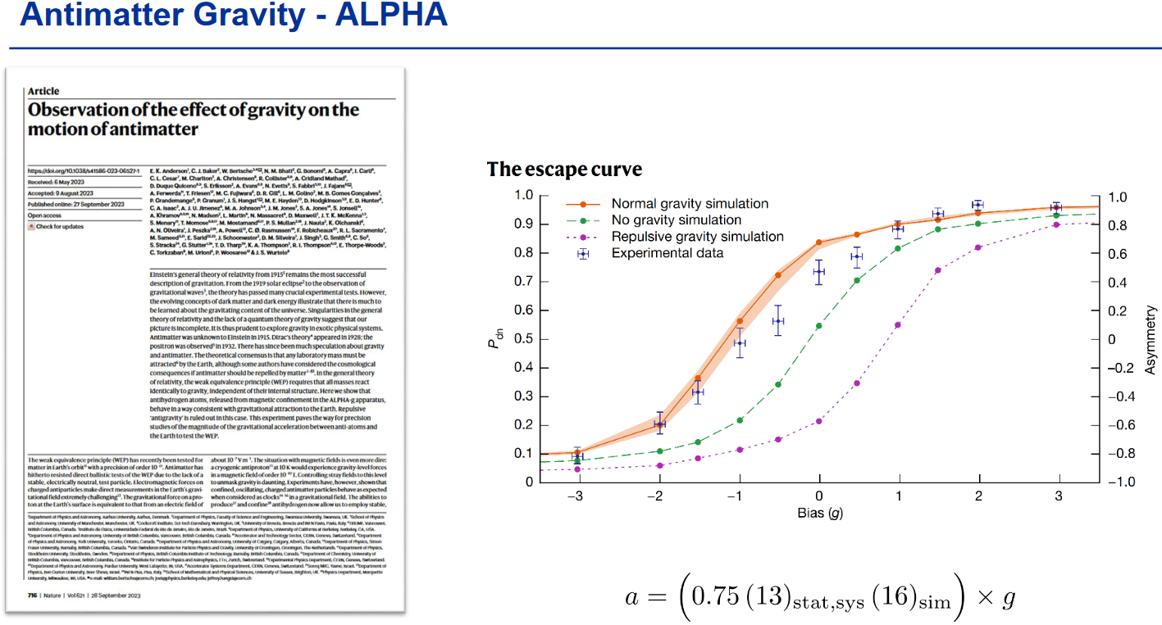
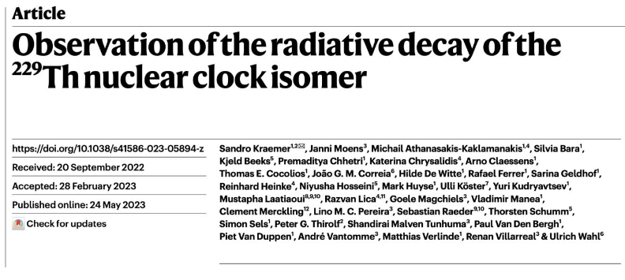
Summary/highlights from JAP
E.H.Maclean, LNO meeting, 15 December 2023
Eva Holzer – FT experiments feedback
→ Lots of research highlights from injectors FT program
Probably main feed-back points concerned better communication between users/control room
Desire for better planning / advance warning around beam-stops / LHC filling to allow users to schedule interventions in shadow of accelerator downtime
Particularly critical for detector R&D programs where can’t benefit from increased intensity / only figure of merit is shots on target
General desire for better stability of beam-conditions (e.g. shot-to-shot for AD/ELENA, day-to-day variations in beam parameters affecting AWAKE, variation in beam-centering for T8)
Overall however many improvements to injectors deliver in 2022 vs 2023! Experiments very grateful

Slide 2
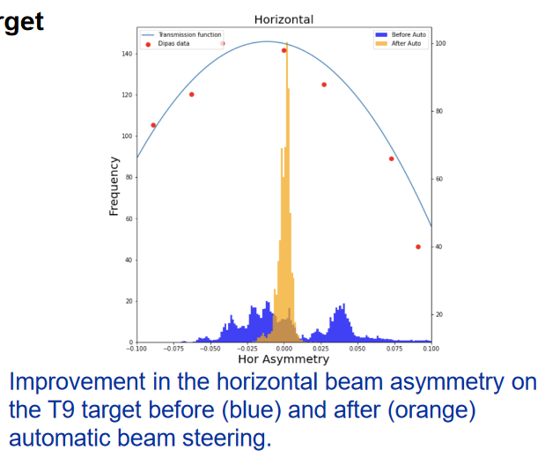
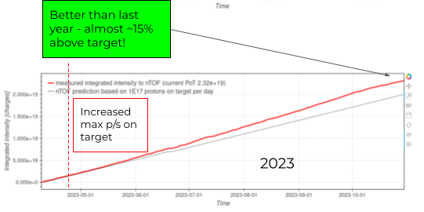
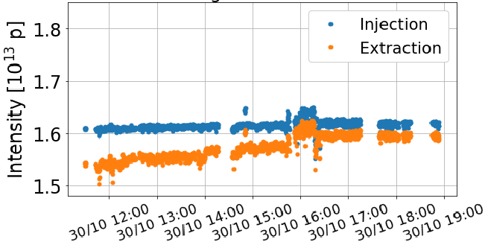
Summary/highlights from JAP
E.H.Maclean, LNO meeting, 15 December 2023
Franchesco Veloti – Summary of FT operation
Very successful 2023, good availability, improvements in delivered beam to most experiments
Benefiting from increased beam intensity, updated RP thresholds at target, improved beam control
Tirsi Prebibaj – Transmision of proton beams in 2023 and beyond
Particular highlight was success for high-intensity L4/PSB MB program
(highlighted in numerous talks, Eva/Franchesco/Tirsij)
100 turn injection from (typical max in OP is around 50), Achieved good transmission via optimization of WP/resonance compensation/…
Demonstrated these MDs could be done in parallel in 2024

Slide 3
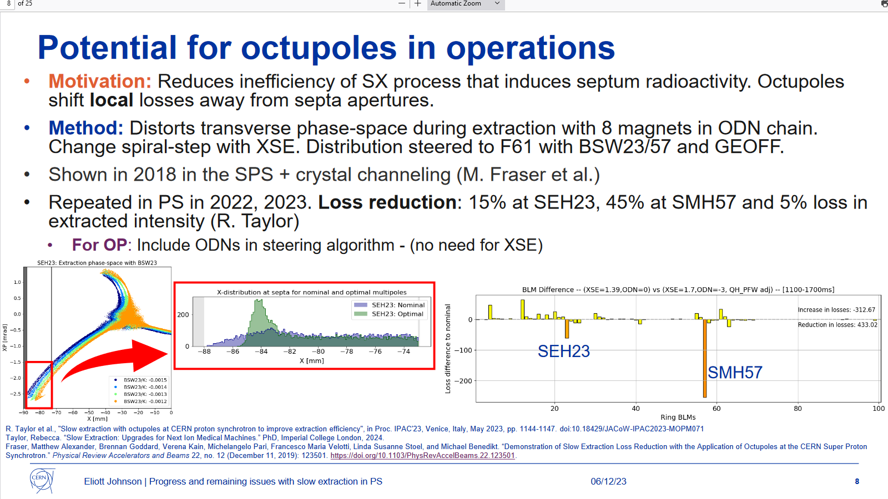
Summary/highlights from JAP
E.H.Maclean, LNO meeting, 15 December 2023
Eliot Johnson – Slow extraction R&D
Some cool results in PS and SPS from ABT group using NL-correctors to shape beam to re-distribute losses away from septa during slow extraction

Slide 4
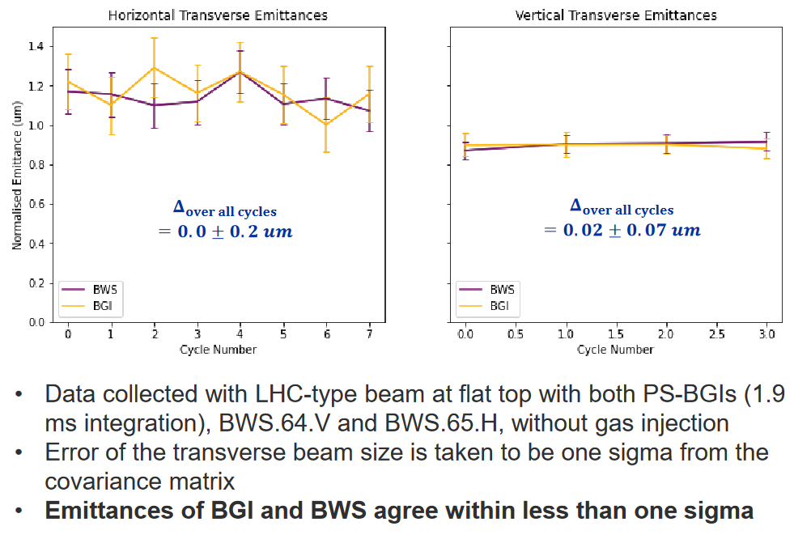
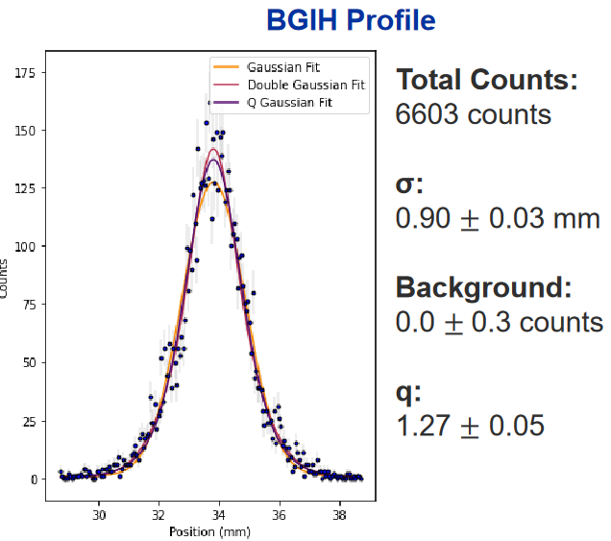
Summary/highlights from JAP
E.H.Maclean, LNO meeting, 15 December 2023
Clara Feisig – Comparing BGI and WS
Lots of progress on BGI performance in PS during 2023
Moving towards operational tool – one of key goals for coming year(s?) is to make non-expert

Slide 5
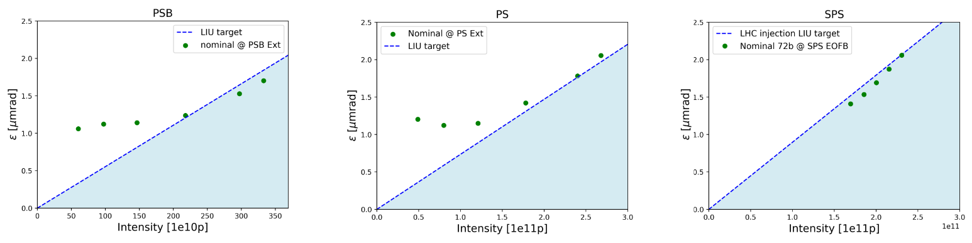
Summary/highlights from JAP
E.H.Maclean, LNO meeting, 15 December 2023
Elleanor Lamb – Brightness along the train
Reaching LIU targets in SPS -- not discussed at JAP but I guess we aren’t very close to getting the low-emittance pilots…?...

Slide 6
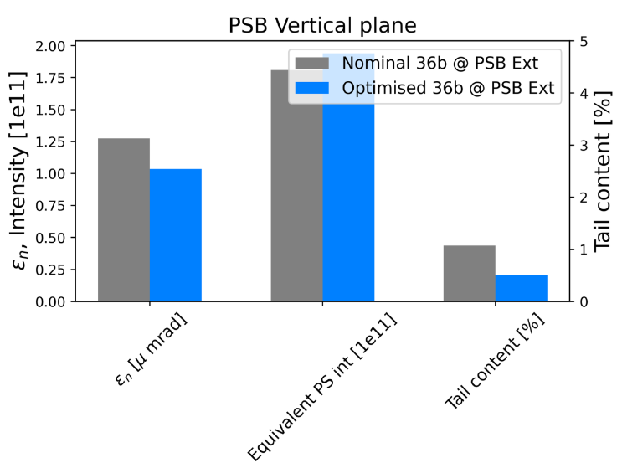
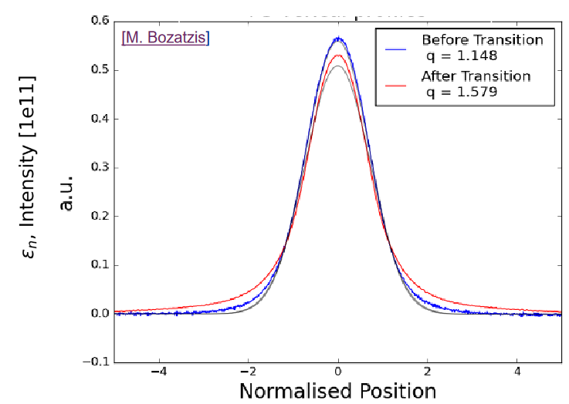
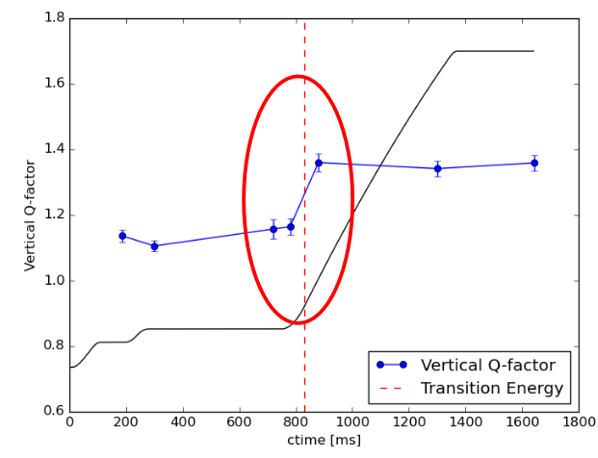
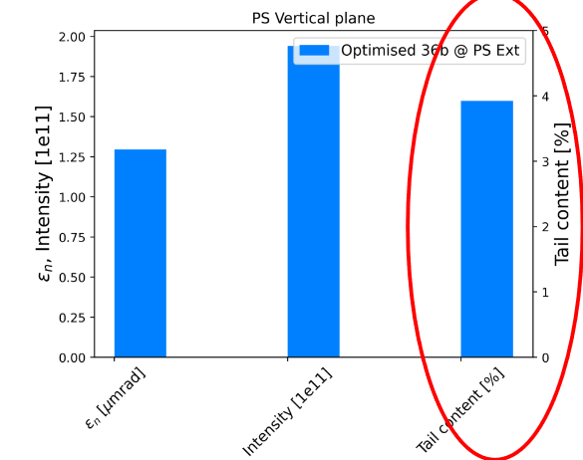
Summary/highlights from JAP
E.H.Maclean, LNO meeting, 15 December 2023
Elleanor Lamb – Brightness along the train
Tail generation one of the hot topics – appears to mostly be generated in PS
In particular during transition crossing

Slide 7
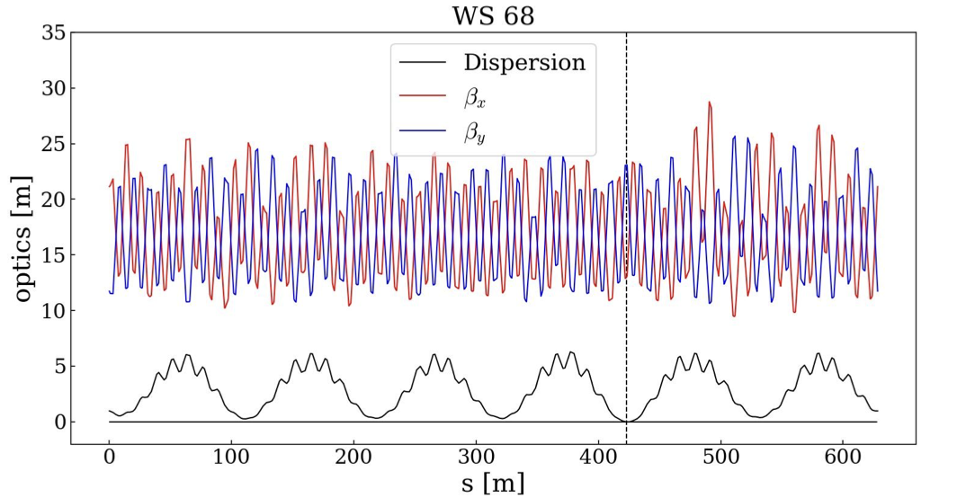
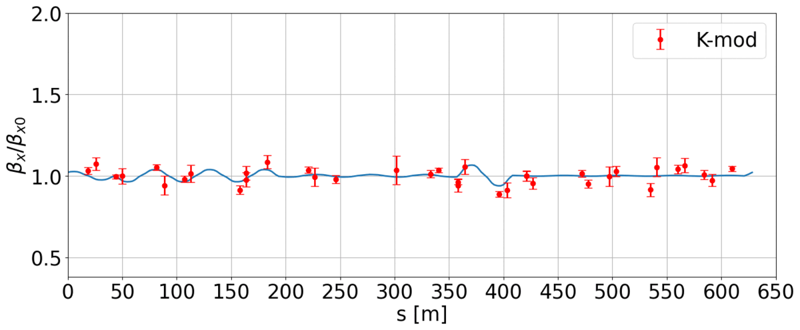
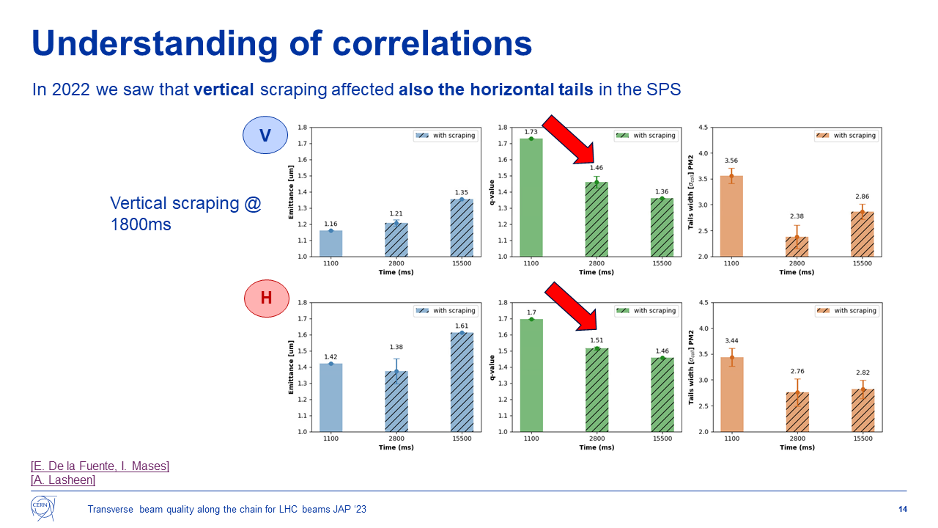
Summary/highlights from JAP
E.H.Maclean, LNO meeting, 15 December 2023
Elleanor Lamb – Brightness along the train
Value of zero dispersion optics from Wietse to understanding emittance evolution and tail generation highlighted in several talks
First K-mod analysis from Tirsi of beta-shifts during flat-cycle MDs discussed at last LNO show good agreement of modelled and expected optics changes from gamma-tr jump knobs
Corelations of tails identified in SPS also a question to be followed up --- some offline discussion regarding possibility for more OMC in SPS in 2024 – ADT-Acdipole plans in the works

Slide 8
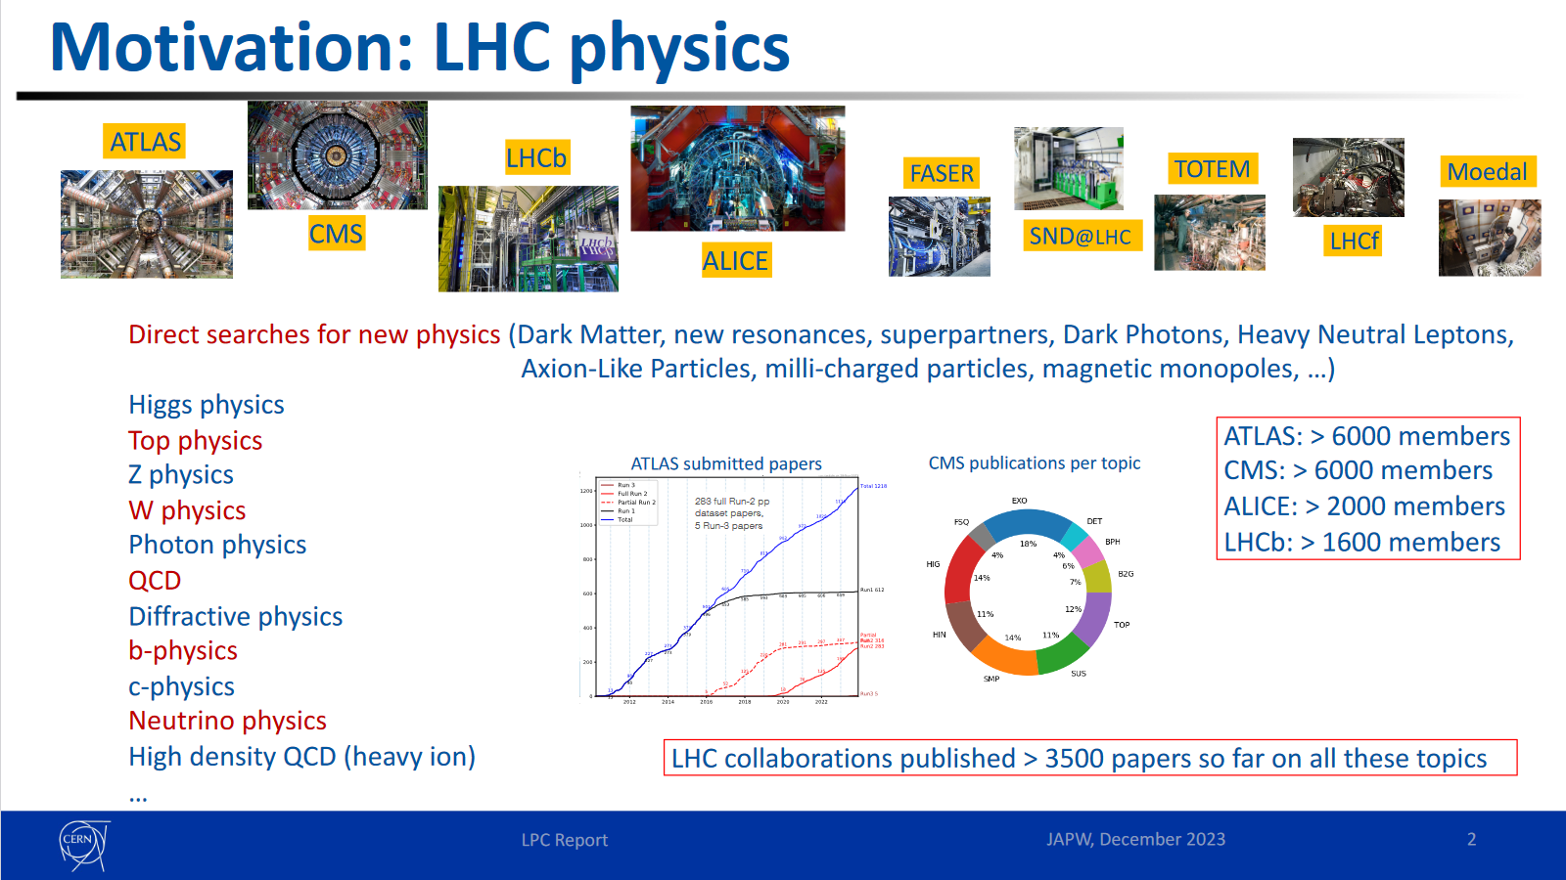
Summary/highlights from JAP
E.H.Maclean, LNO meeting, 15 December 2023
Filip Moortgat – LHC experiments feedback from 2023 and desiderata 2024
Highlighted quantity of work/papers produced from LHC HEP program
Priority for 2024 should be production of significant pp dataset

Slide 9
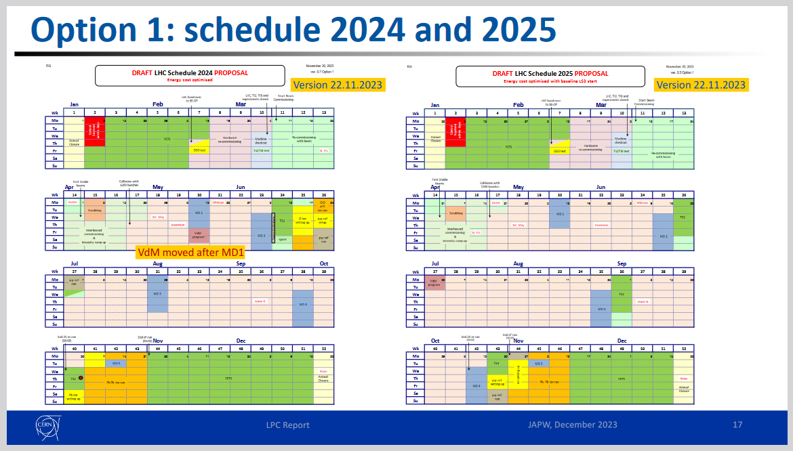
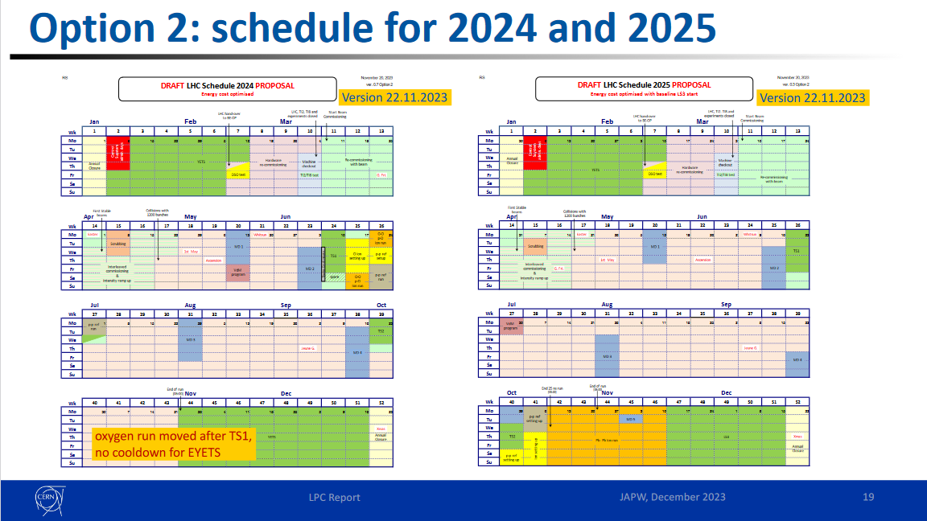
Summary/highlights from JAP
E.H.Maclean, LNO meeting, 15 December 2023
Filip Moortgat – LHC experiments feedback from 2023 and desiderata 2024
Discussion of schedule options for 2024/2025
Schedule mostly defined by placement of ion runs
Option 1: short PbPb runs in 2024 + 2025. Oxygen in 2024
Option 2: single long PbPb in 2025. Oxygen in 2024
Announced at JAP they go for option “1-prime”
→ Short PbPb runs in both 2024 and 2025, but oxygen delayed to 2025
2023 luminosity precision
Initial fills had 13% IP1/5 lumi imbalance – solved by correction of Xing
End-of-year numbers so far quoted as <1% lumi imbalance but in practice experiments haven’t got final calibrations yet
Highlighted that VDM scans in Run3 show much high non-factorization bias (correlation of bunch profiles between planes) than Run1/2

Slide 10
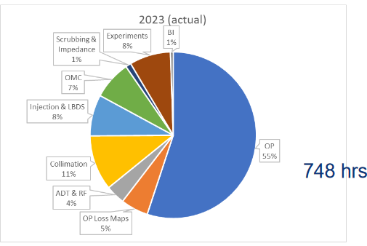
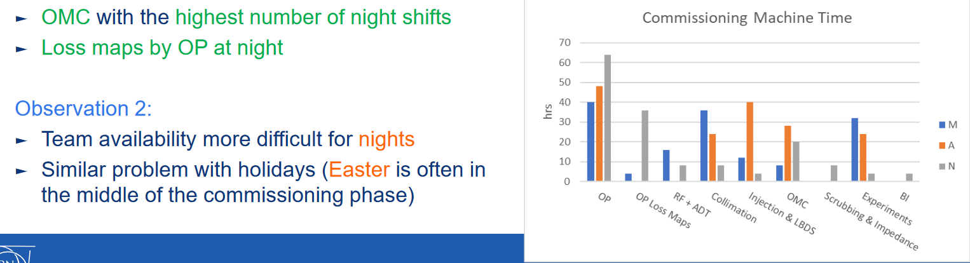
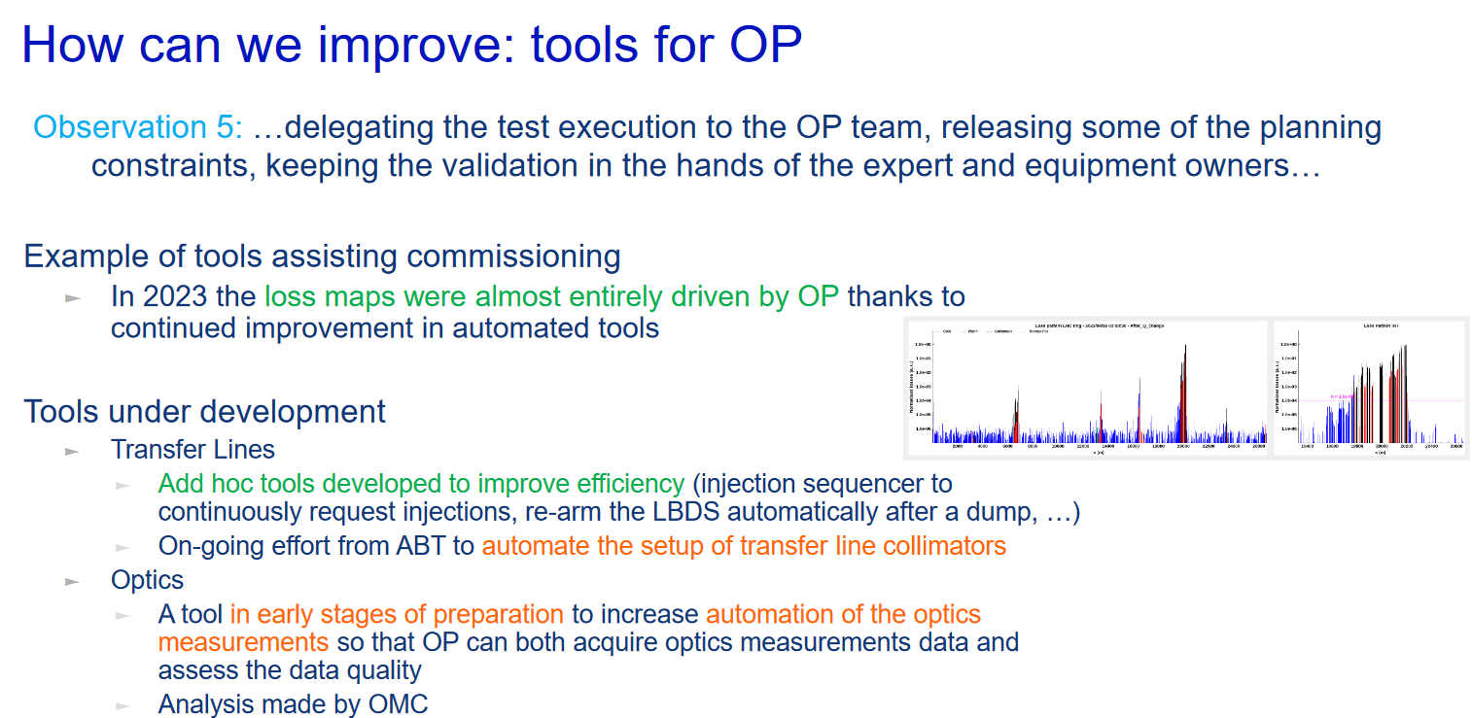
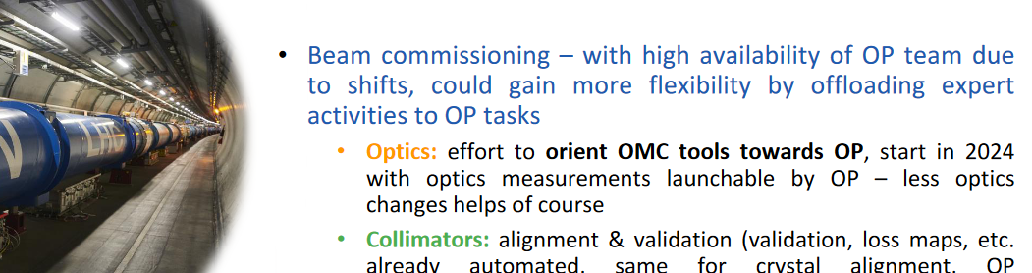
Summary/highlights from JAP
E.H.Maclean, LNO meeting, 15 December 2023
David Nisbet – LHC commissioning overview
OMC took less time than collimation for 2023 commissioning (12% in 2022)
But still did the most night shifts!
Several talks pointed to automation of OMC activities to improve efficiency of commissioning/operation
Kevin Li – How to improve commissioning

Slide 11
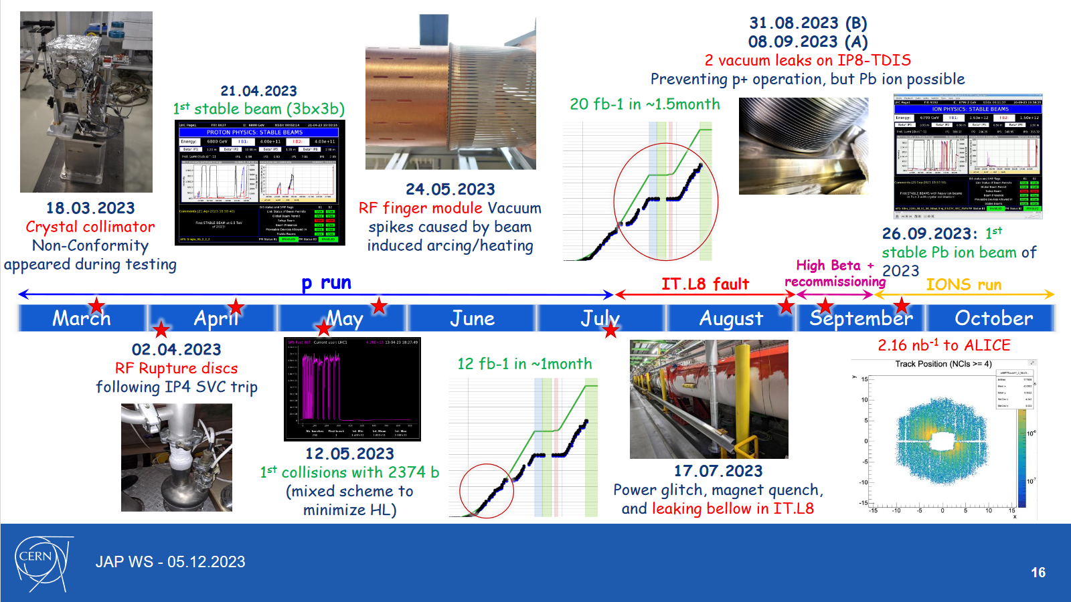
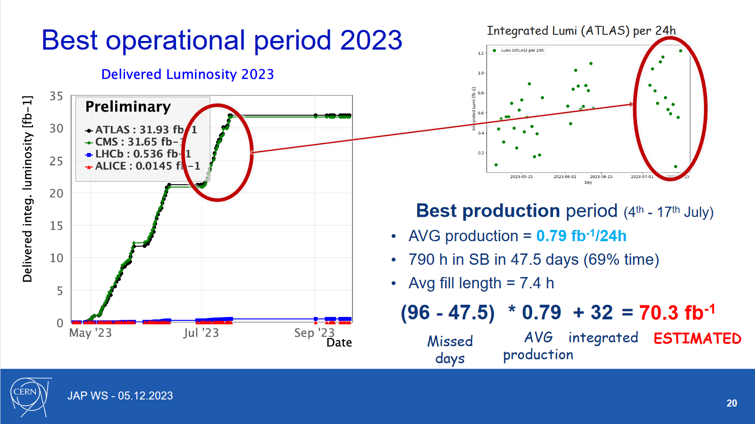
Summary/highlights from JAP
E.H.Maclean, LNO meeting, 15 December 2023
Matteo Solfaroli Camillocci – summary of LHC operation
Overview of the many issues faced by LHC in 2023
Once commissioning was complete best production period in July gave excellent rate of delivered int.lumi
If had been able to return to pp operation after ITL8 bellow repair would still have been very close to target lumi 75[fb-1]
In spite of issues more data delivered in 2023 than 2022

Slide 12
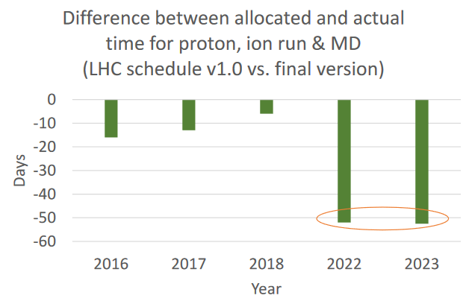
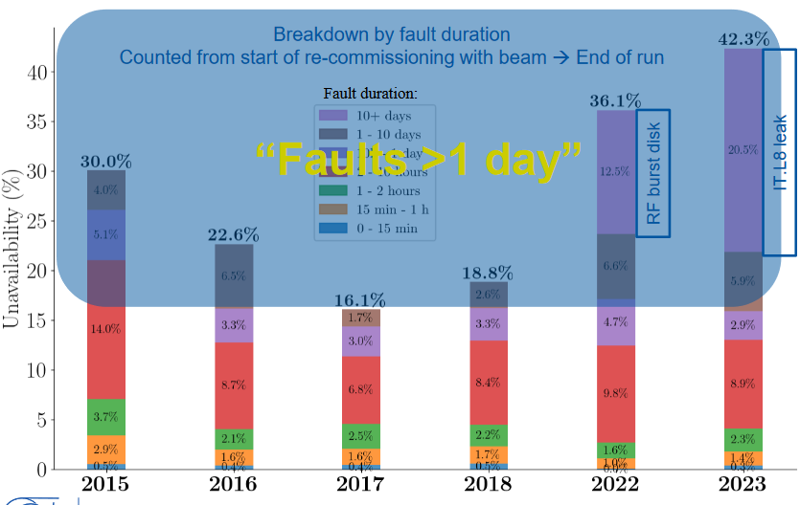
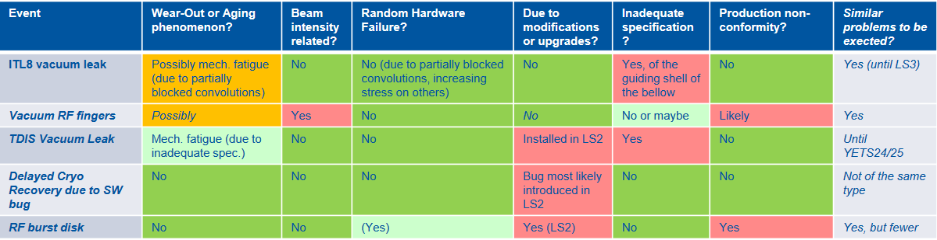
Summary/highlights from JAP
E.H.Maclean, LNO meeting, 15 December 2023
Lukas Felsberger: LHC – is it falling apart?
In practice Run3 LHC downtime dominated by small number of long faults > 1day
In 2023 5 faults contributed 60% of the down-time
Number of lost days of OP appear to increase in Run3
Not simply a case of LHC aging – some faults associated with age but also non-conformity and inadequate specifications

Slide 13
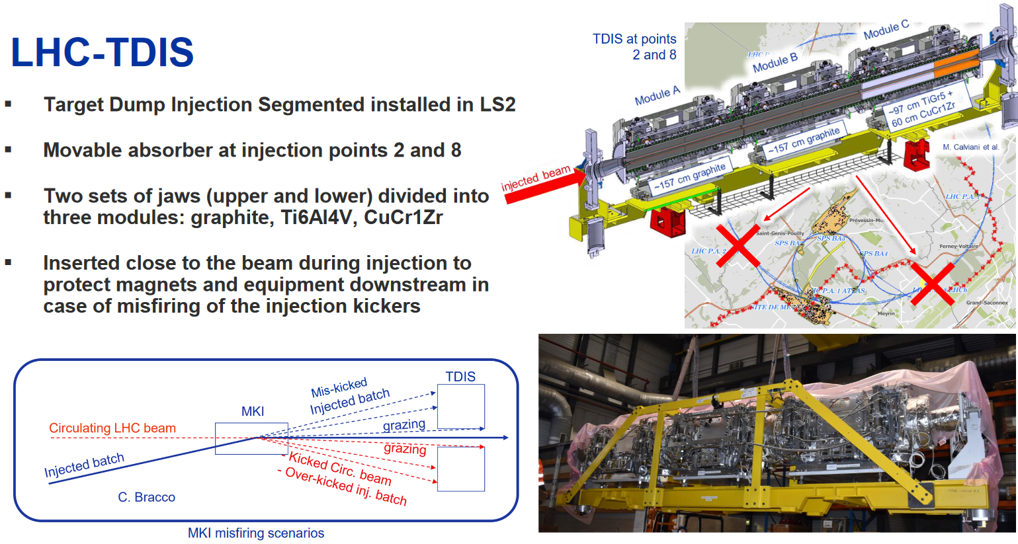
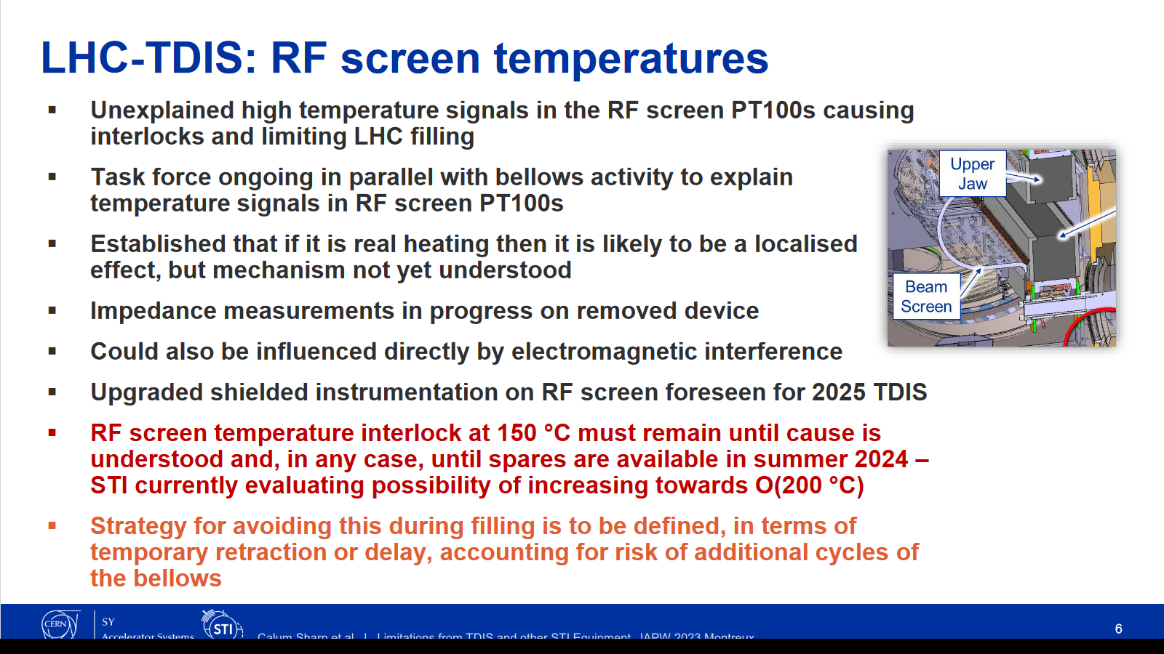
Summary/highlights from JAP
E.H.Maclean, LNO meeting, 15 December 2023
Calum Sharp: Limitations from TDIS and other STI equipment
TDIS bellow vacuum leak caused by mis-specification
Spare TDIS (with bad bellows) to be installed in YETS.
Aim is to have compliant spares by summer 2024
No bunch intensity limitation due to TDIS bellow
Cycling of TDIS jaws to be avoided if unnecessary!!
So we have a clear motivation to request leaving TDIS at parking during optics commissioning and MD (as in Run1)
→ Another issue with anomalous high temperature signals in TDIS
Unclear if real heating or measurement issue. But interlock on temperature remains until spares available in summer 2024
Implication for filling / bunch intensity still to be determined
(some discussion that might limit bunch intensity to 1.6 until
spares ready?)

Slide 14
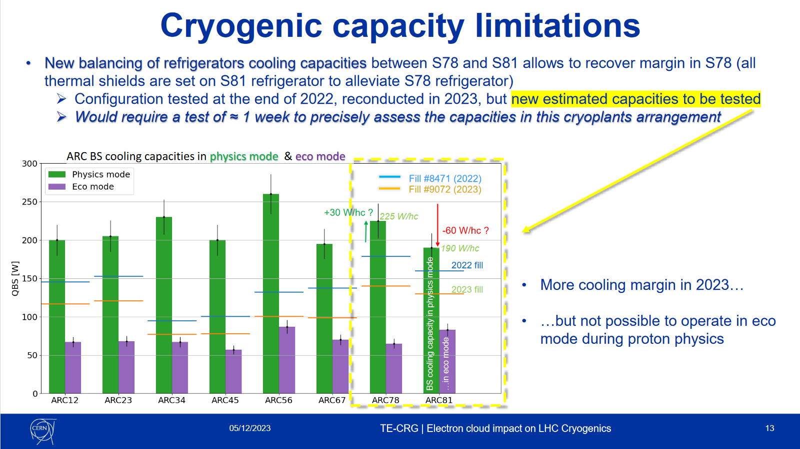
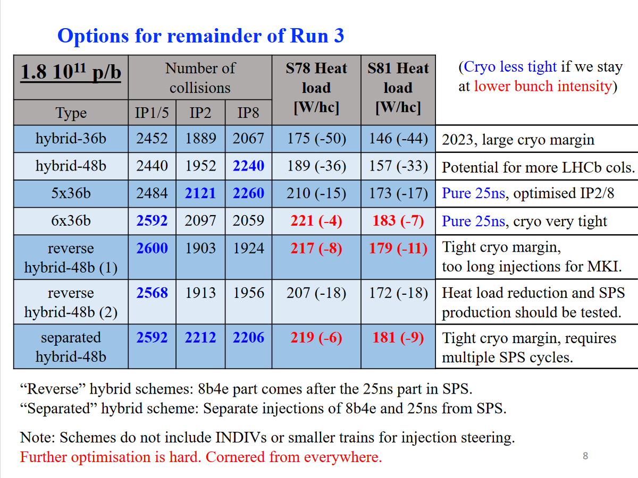
Summary/highlights from JAP
E.H.Maclean, LNO meeting, 15 December 2023
Laurent Delprat: ecloud impact on LHC cryo
→ Rebalancing of cryo capacity should give more margin for 2023!!!
Konstantinos Paraschou: ecloud in LHC
Increased cryo margin could potentially allow
return to pure 25ns at 1.8p/b !!!

Slide 15
Summary/highlights from JAP
E.H.Maclean, LNO meeting, 15 December 2023
Stephane Fartoukh: RP optics options for 2024 and beyond
IP1/IP5 triplet lifetime limited by radiation dose received from experiments
Problem can be alleviated for Run3 by use of new reversed polarity (RP) optics
Several options for implementation – no RP/Full RP in 24/25
- partial RP / Full RP in 24/25
→ Partial RP in 2024 is safest option in case of extension of run into 2026!

Slide 16
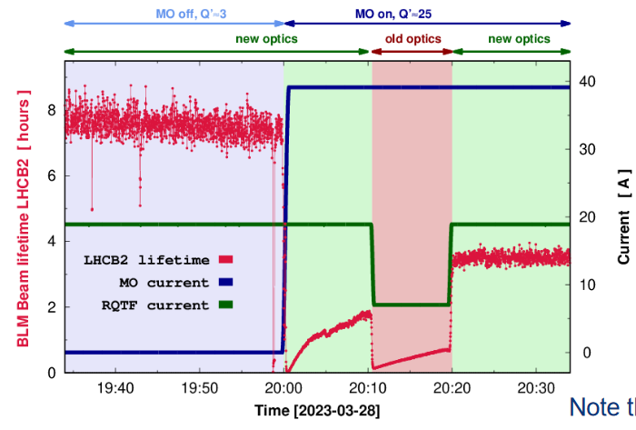
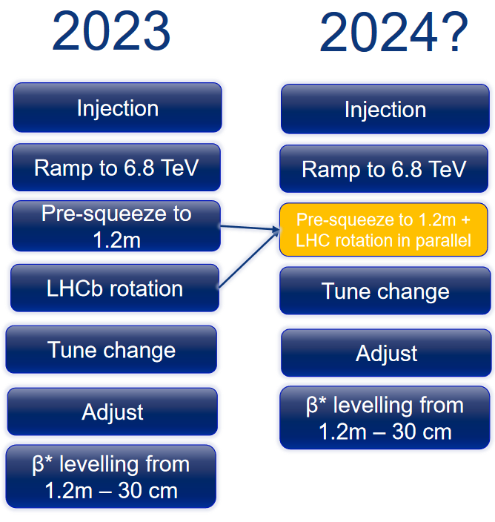
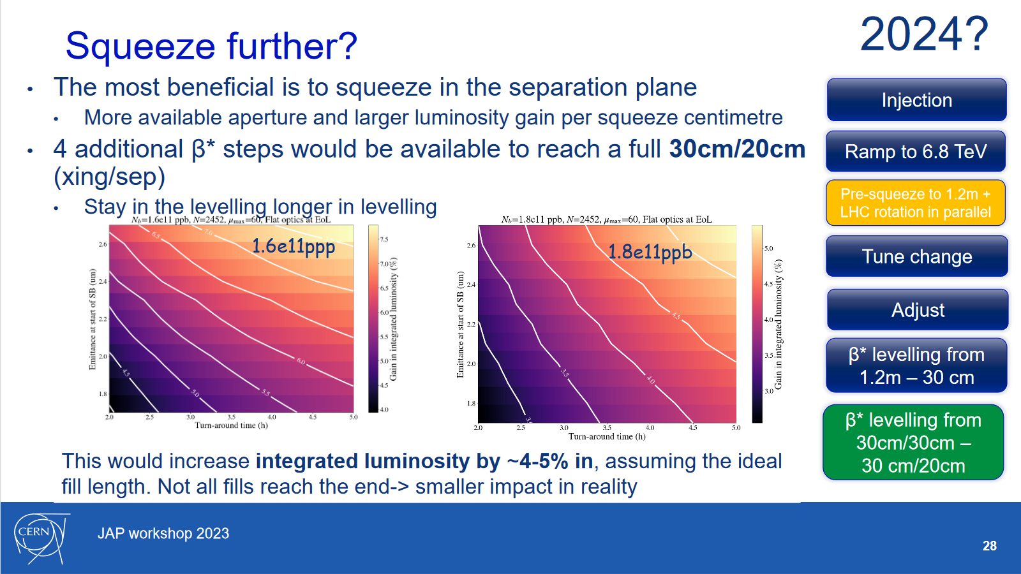
Summary/highlights from JAP
E.H.Maclean, LNO meeting, 15 December 2023
Tobias Persson: 2023 OP experience + view for 2024
Highlighted lifetime improvement coming from new injection optics in 2023
Proposed several minor changes to cycle which could deliver improvement to delivered Lumi in case no RP option is taken in 2024
Parallel LHCb rotation, and additional squeeze to 30/20cm

Slide 17

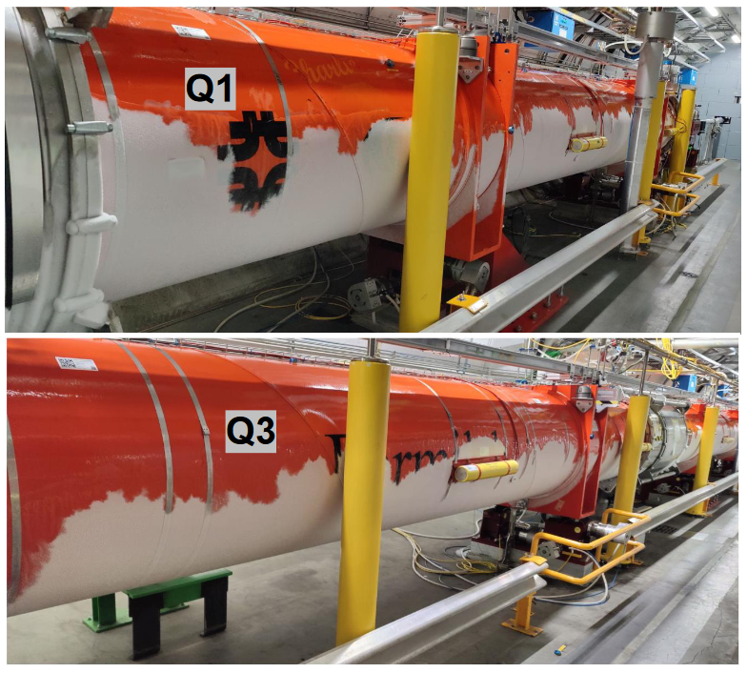
Summary/highlights from JAP
E.H.Maclean, LNO meeting, 15 December 2023
Merry Christmas!

