Slide 1

FCC-ee IR Tuning Knobs
Satya Sai Jagabathuni
with inputs from Frank Zimmermann, Michael Hofer, Felix Simon Carlier, and Leon Van Riesen-Haupt
LNO section meeting, 15 Dec 2023

Slide 2
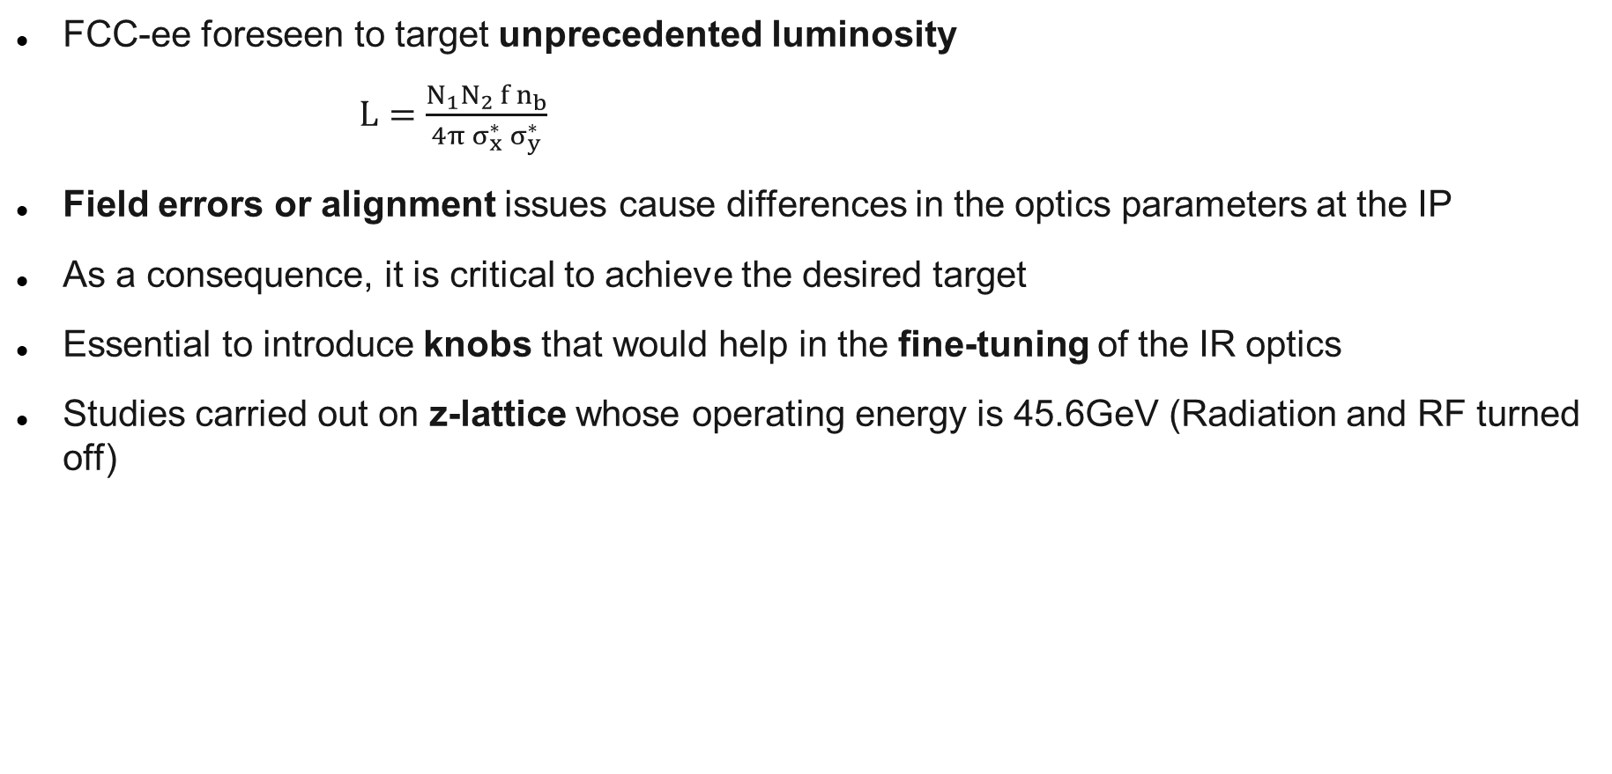
Introduction
FCC-ee foreseen to target unprecedented luminosity
$L=\frac{N_{1}N_{2 }f n_{b}}{4π{ σ}_{x}^{∗} σ_{y}^{∗}}$
Field errors or alignment issues cause differences in the optics parameters at the IP
As a consequence, it is critical to achieve the desired target
Essential to introduce knobs that would help in the fine-tuning of the IR optics
Studies carried out on z-lattice whose operating energy is 45.6GeV (Radiation and RF turned off)
2

Slide 3

The term “Tuning knobs”
Magnet excitations in specific linear combinations forming the so-called “Tuning Knobs”
The term tuning knob is commonly used for one or several magnets which are used to tune one variable
Find out which magnet groups/combinations can be used to achieve the desired value of the IP parameters
Linear changes in the magnet strengths correspond to the target parameter
3

Slide 4

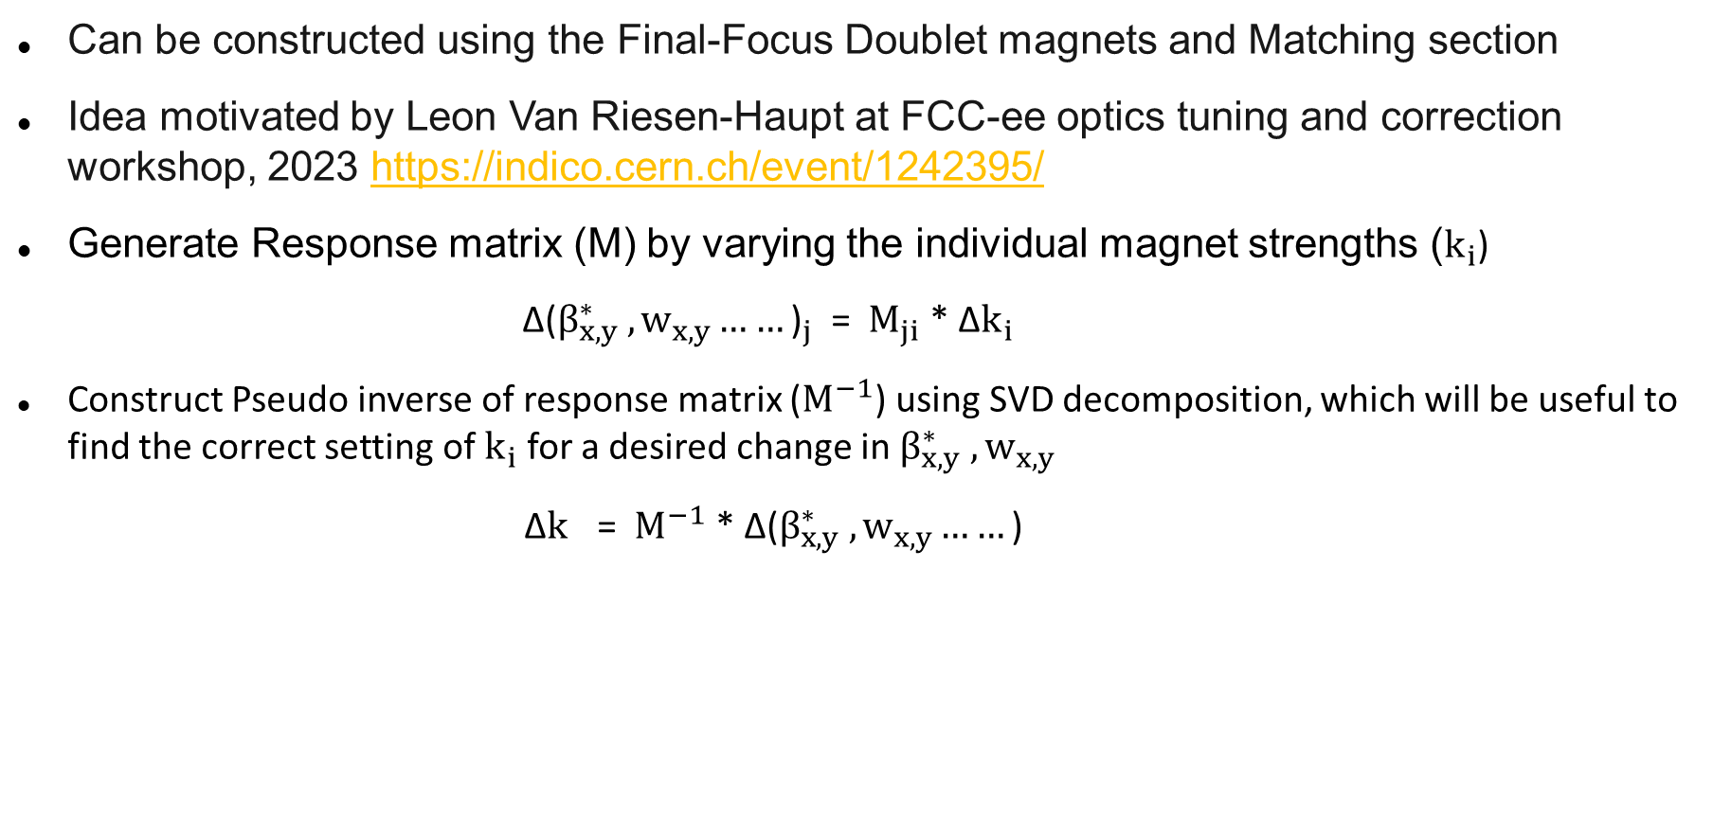
${Implementation:β}_{x,y}^{∗}$ and $w_{x,y}$ knobs
Can be constructed using the Final-Focus Doublet magnets and Matching section
Idea motivated by Leon Van Riesen-Haupt at FCC-ee optics tuning and correction workshop, 2023 https://indico.cern.ch/event/1242395/
Generate Response matrix (M) by varying the individual magnet strengths ($k_{i}$)
${\text{Δ}\text{(}β_{x,y}^{∗} ,w_{x,y}……\text{)}}_{j}$ = ${ M}_{ji}$ * Δ$k_{i}$
Construct Pseudo inverse of response matrix ($M^{−1}$) using SVD decomposition, which will be useful to find the correct setting of $k_{i}$ for a desired change in $β_{x,y}^{∗} ,w_{x,y}$
Δ$k_{}$= $M^{−1}$* ${\text{Δ}\text{(}β_{x,y}^{∗} ,w_{x,y}……\text{)}}_{}$
4

Slide 5

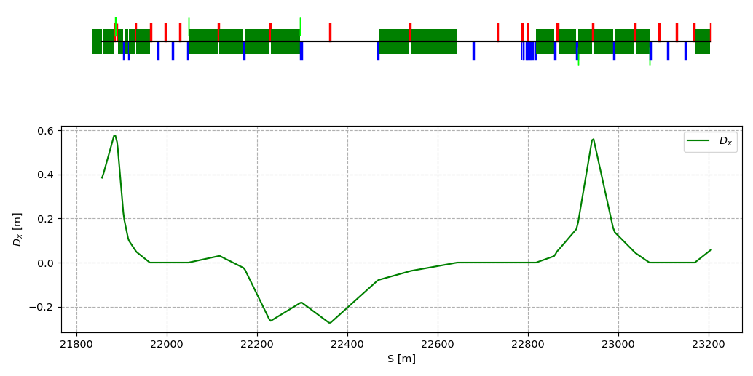

$β_{x,y}^{∗}$ and $w_{x,y}$ knobs
Final-Focus
Doublet
Matching Section
Matching Section
5

Slide 6
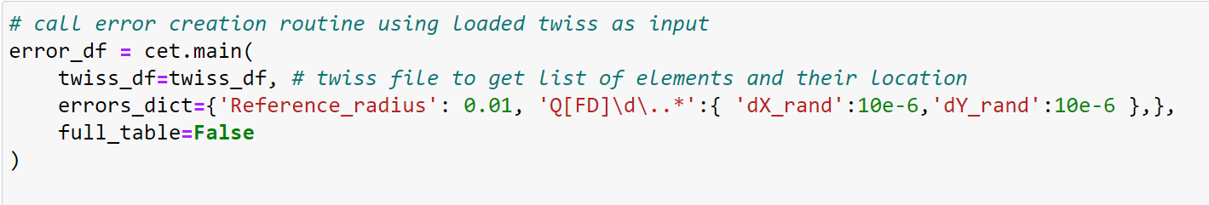
Lattice with Errors
Demonstrated the effectiveness of knobs on the ideal lattice
Examine the functionality of knobs on an error lattice
Include random distribution of alignment errors in the lattice
Error creation routine written in Python is available
https://gitlab.cern.ch/mihofer/fccee_xample_longrange_alignment
Applied to the arc quadrupoles only
6

Slide 7
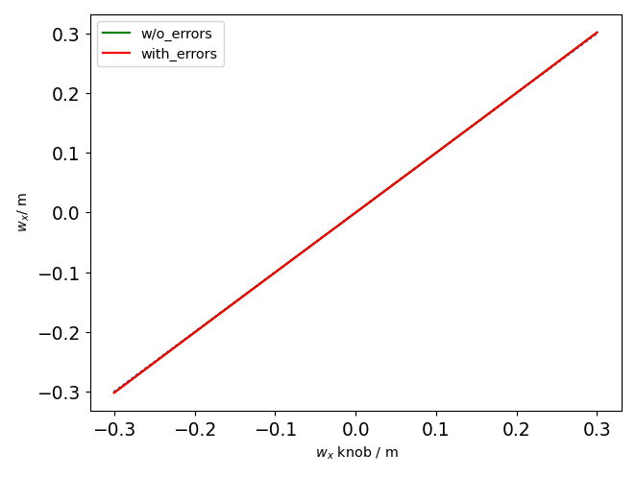
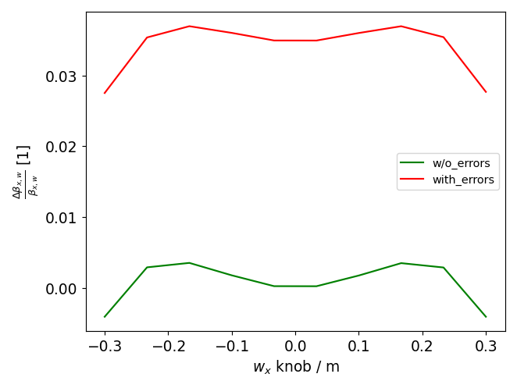
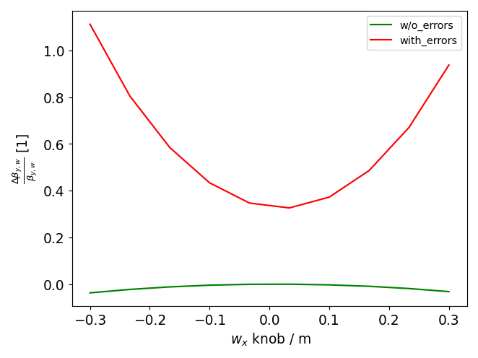
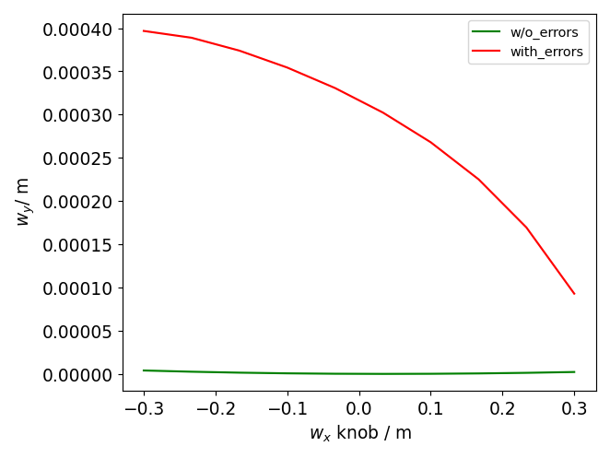


$w_{x}$ knob robustness: Ideal vs Error Lattice
Performance of $w_{x}$ knob on the other linear parameters for both the ideal & error lattices is demonstrated
Working range seems to be 0.3m
Expecting the curves (ideal & error case) to be identical
Non-linear aberrations noticed on $β_{y}^{∗} and w_{y}$ when the knob is applied on error lattice
7

Slide 8
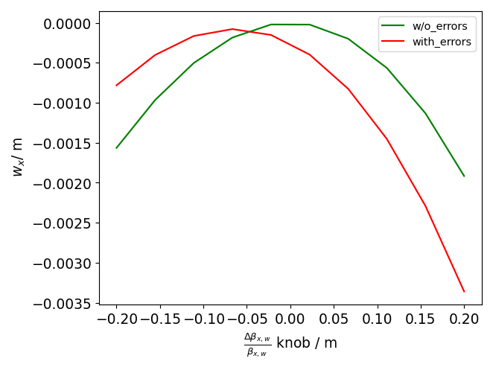
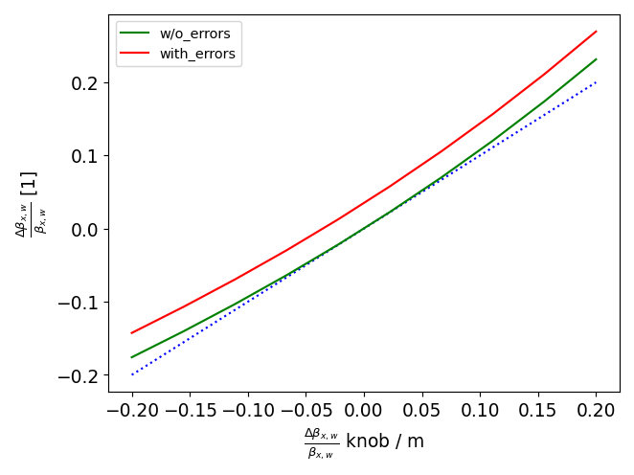
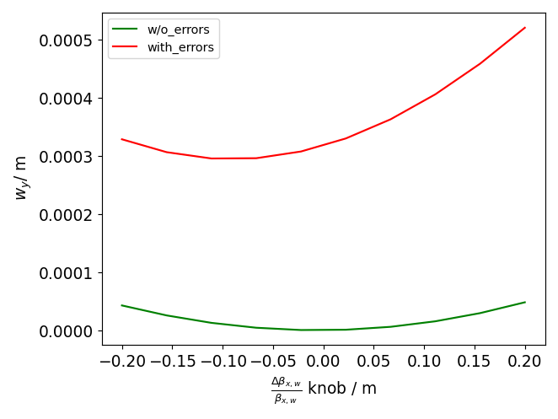
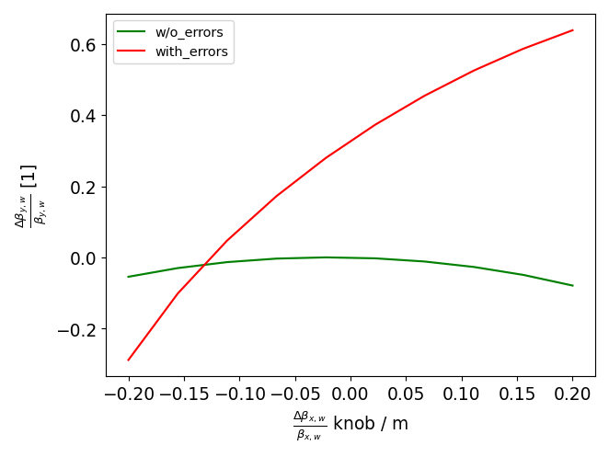


$β_{x }^{∗}$knob robustness: Ideal vs Error Lattice
Performance of $β_{x }^{∗}$knob on the other linear parameters for both the ideal & error lattices is demonstrated
Tuning range appears to be 20%
Knob impacts $β_{y}^{∗},w_{y} and { w}_{x}$ in a non-linear fashion
8

Slide 9
Orbit correction
Knobs have a significant impact on
the performance of linear optics
within a lattice subjected to errors
9

Slide 10
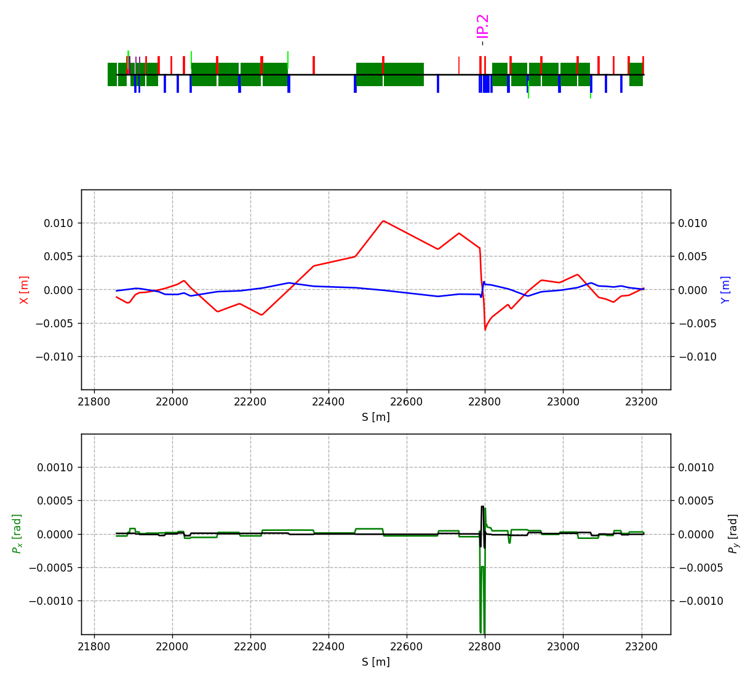
Orbit correction
Knobs have a significant impact on
the performance of linear optics
within a lattice subjected to errors
This arises from the distortion of
the orbit within the knob region
10

Slide 11
Orbit correction
Knobs have a significant impact on
the performance of linear optics
within a lattice subjected to errors
This arises from the distortion of
the orbit within the knob region
The remedy is to correct the orbit
11

Slide 12
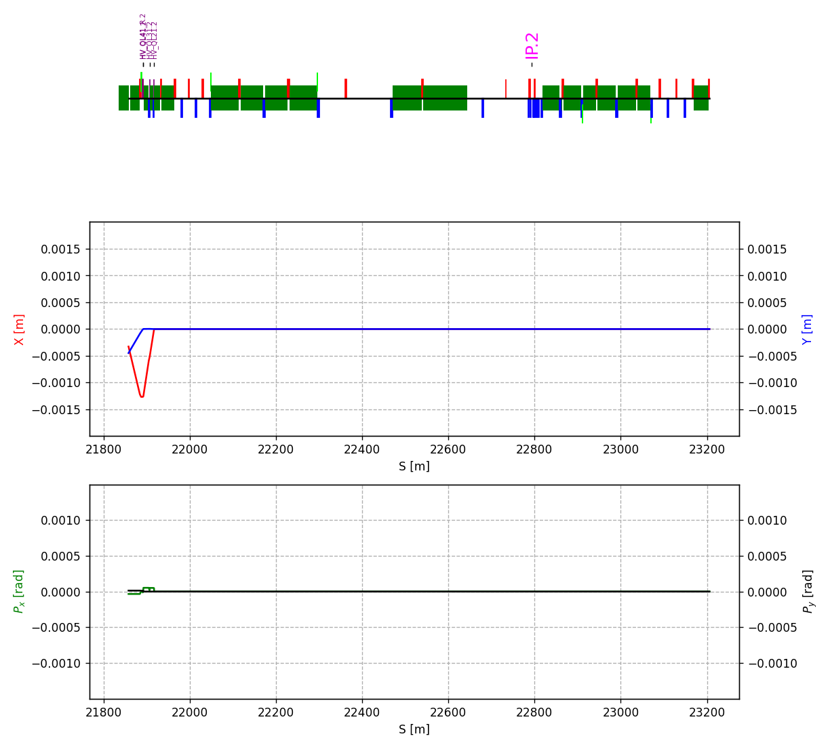
Orbit correction
Knobs have a significant impact on
the performance of linear optics
within a lattice subjected to errors
This arises from the distortion of
the orbit within the knob region
The remedy is to correct the orbit
Install orbit correctors upstream of
matching section
12

Slide 13
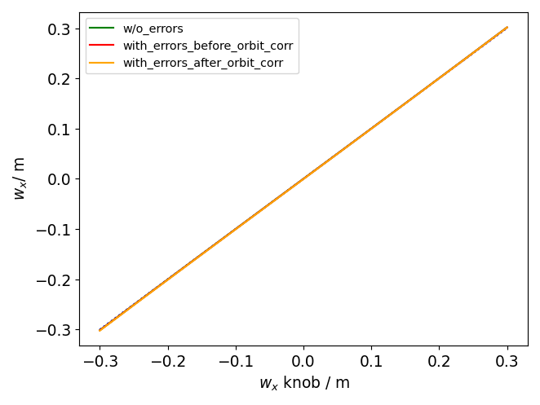
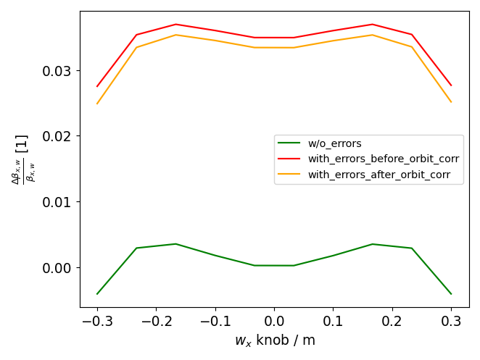
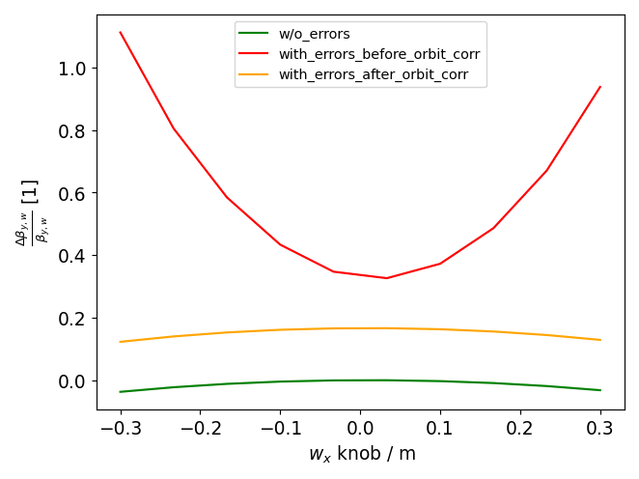
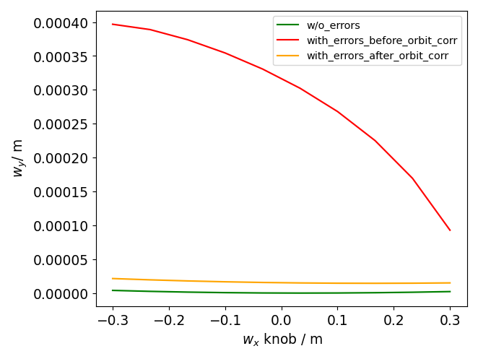
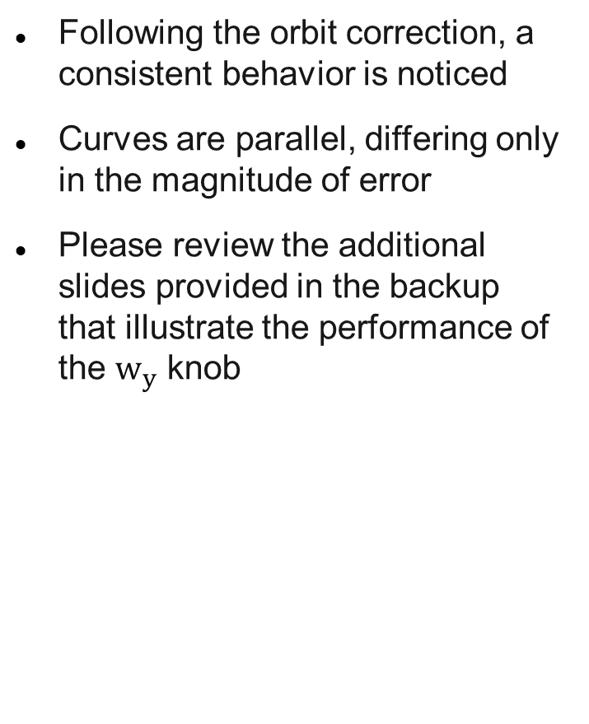

$w_{x}$ knob post orbit correction
Following the orbit correction, a consistent behavior is noticed
Curves are parallel, differing only in the magnitude of error
Please review the additional slides provided in the backup that illustrate the performance of the $w_{y}$ knob
13

Slide 14
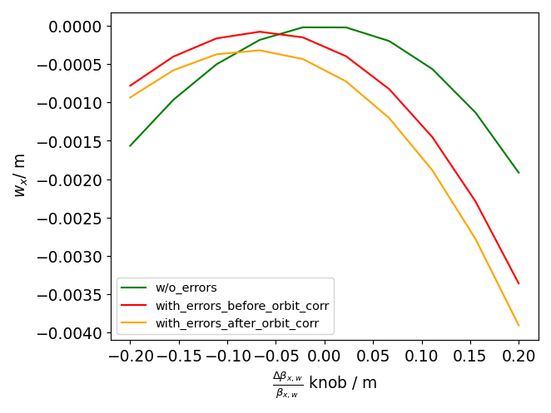
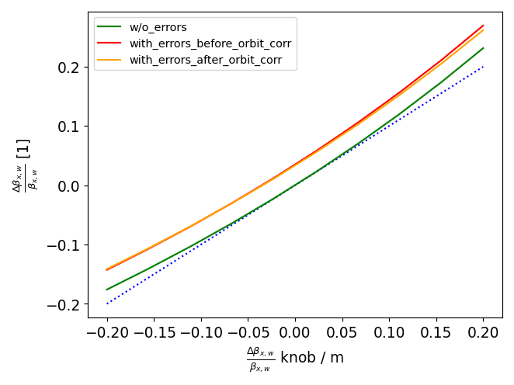
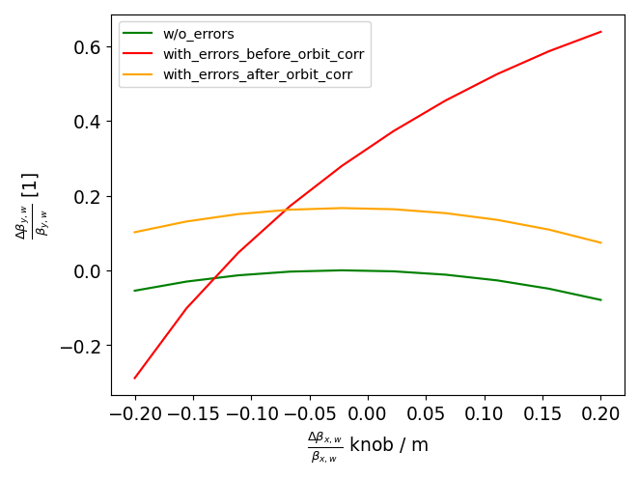
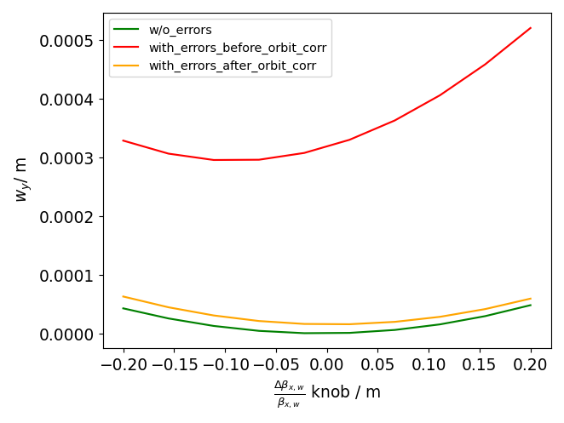


$β_{x }^{∗}$knob post orbit correction
Following the orbit correction, a consistent behavior is noticed
Need to comprehend the behavior of $w_{x}$
For $β_{y }^{∗}$ knob, kindly have a look at the end of the presentation
14

Slide 15
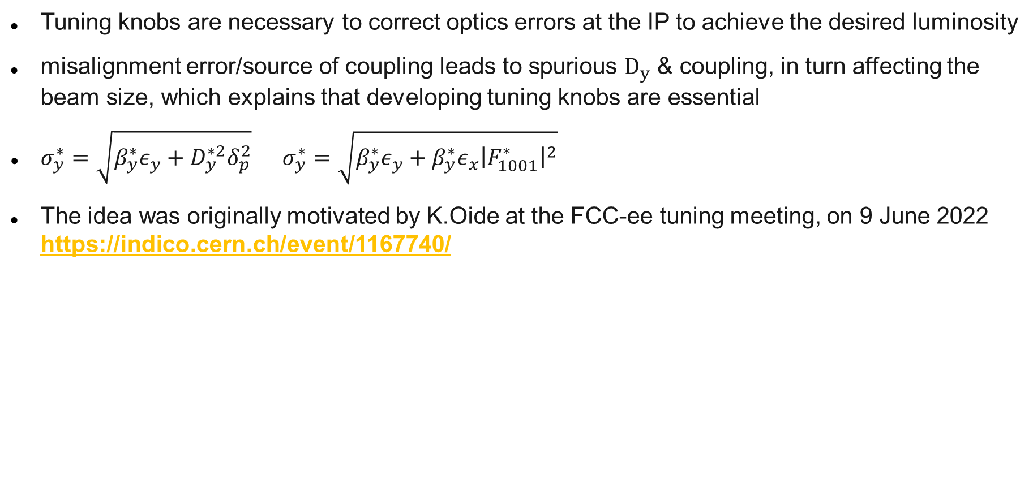
Motivation (Vertical Dispersion & Coupling knobs)
Tuning knobs are necessary to correct optics errors at the IP to achieve the desired luminosity
misalignment error/source of coupling leads to spurious $D_{y}$ & coupling, in turn affecting the beam size, which explains that developing tuning knobs are essential
$σ_{y}^{∗}=\sqrt{β_{y}^{∗}ε_{y}+D_{y}^{∗2}δ_{p}^{2}}$ $σ_{y}^{∗}=\sqrt{β_{y}^{∗}ε_{y}+β_{y}^{∗}ε_{x}{\left|F_{1001}^{∗}\right|}^{2}}$
The idea was originally motivated by K.Oide at the FCC-ee tuning meeting, on 9 June 2022 https://indico.cern.ch/event/1167740/
Terms to be vanished in $σ_{y}^{∗}$
15

Slide 16
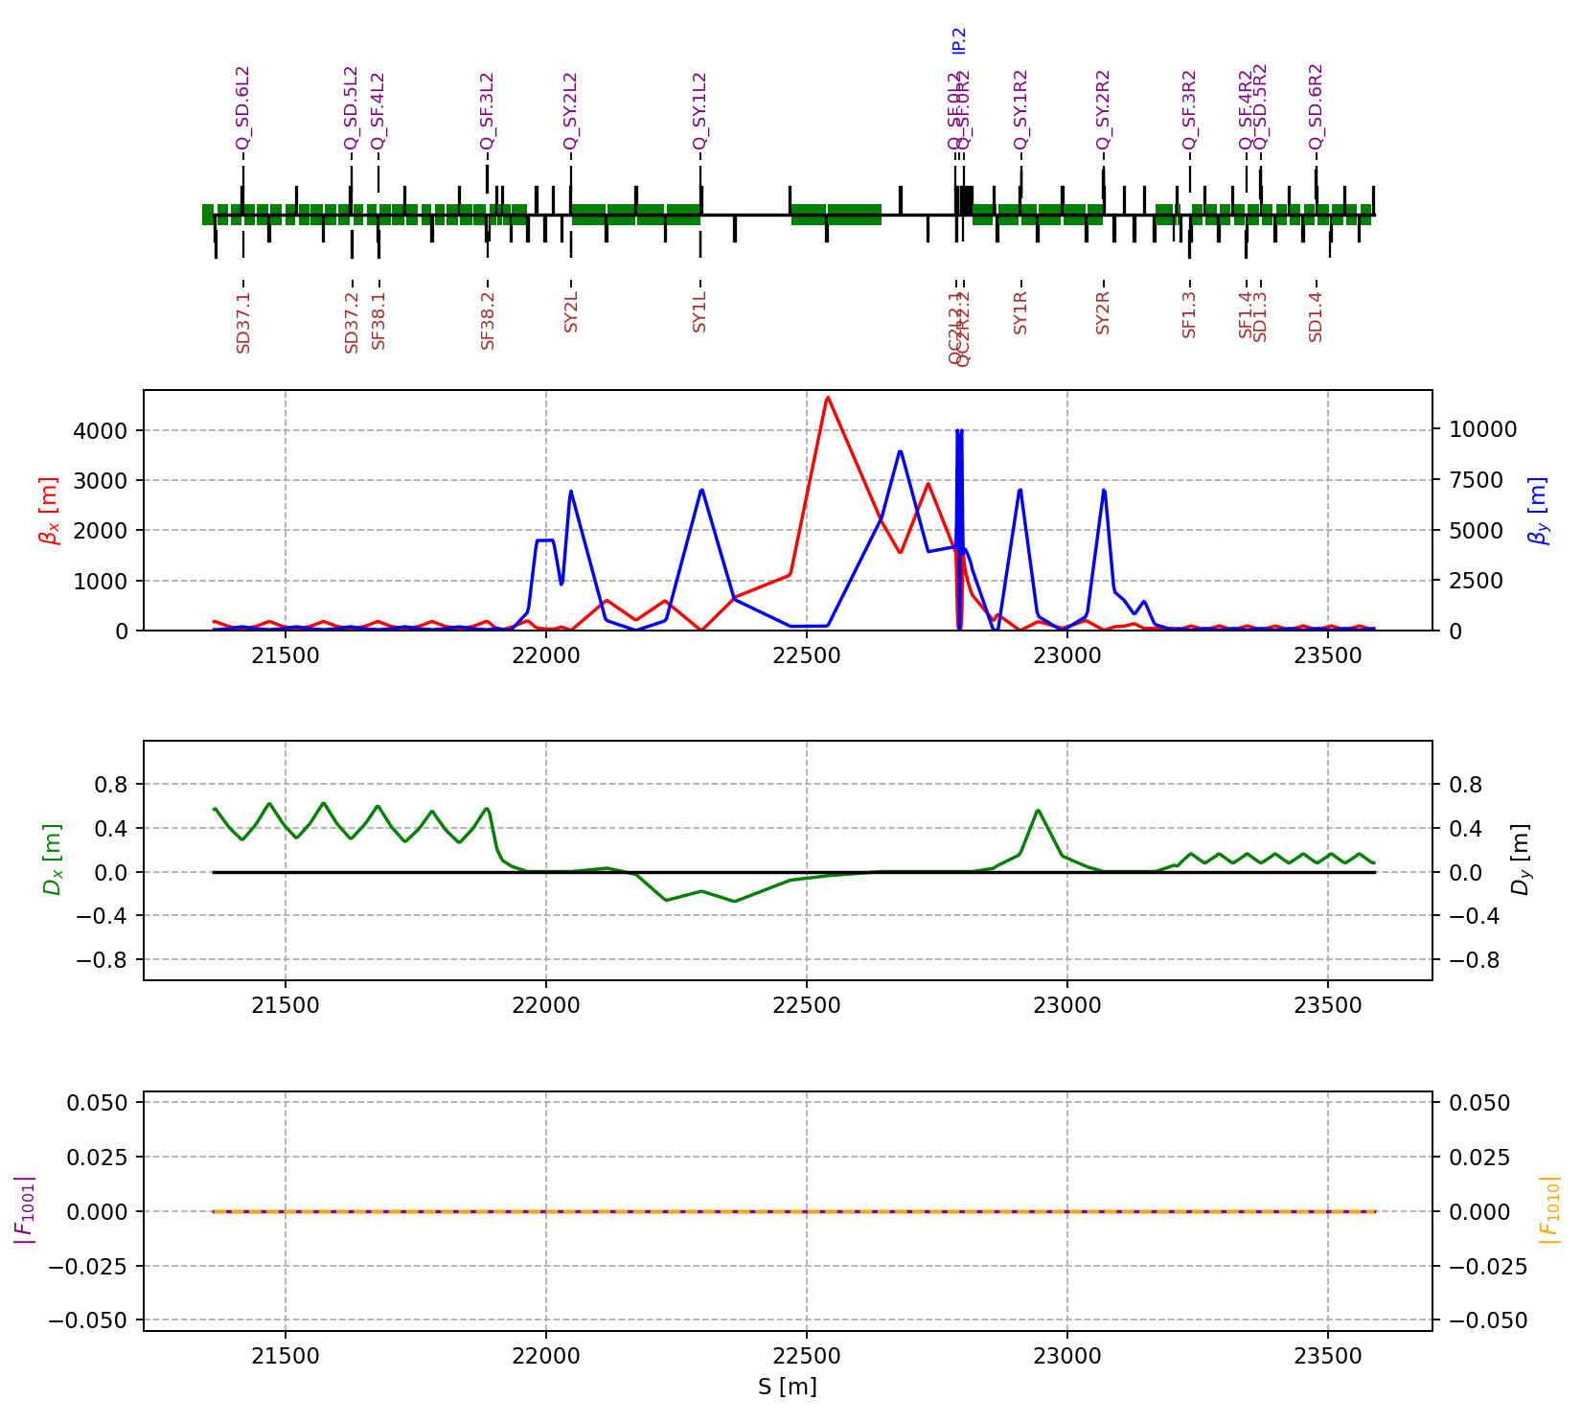
Motivation
Extra skew windings at the Final-Focus
doublet and at least the nearest
6 sextupoles on each side of IP, which
eventually helps in controlling vertical
dispersion & coupling at the IP
Skew quads
Final doublet
Sextupoles
16

Slide 17
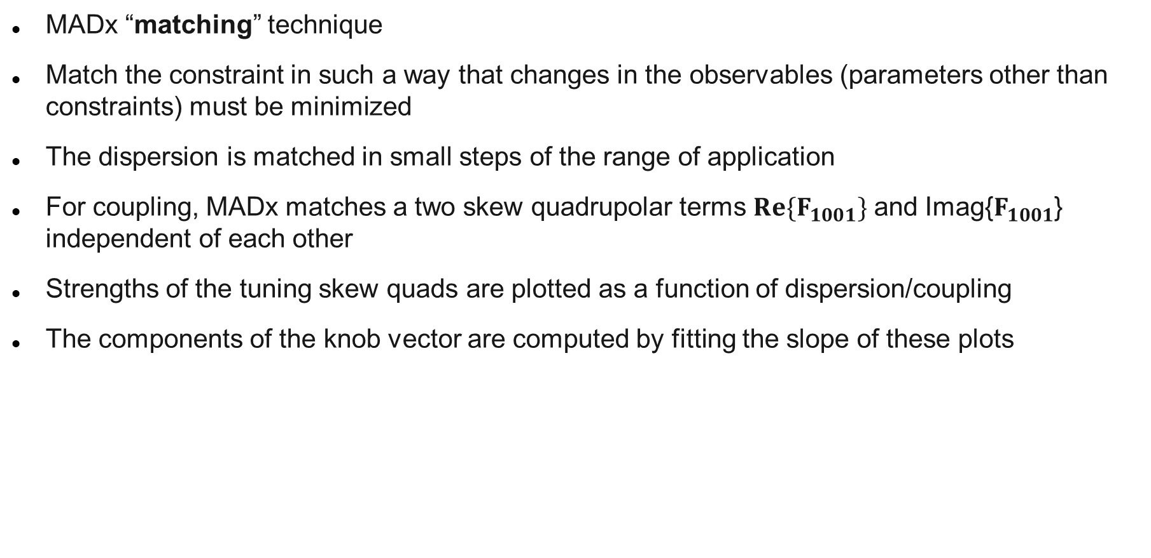
Implementation
MADx “matching” technique
Match the constraint in such a way that changes in the observables (parameters other than constraints) must be minimized
The dispersion is matched in small steps of the range of application
For coupling, MADx matches a two skew quadrupolar terms ${Re\{F}_{1001}\}$ and Imag{$F_{1001}$} independent of each other
Strengths of the tuning skew quads are plotted as a function of dispersion/coupling
The components of the knob vector are computed by fitting the slope of these plots
17

Slide 18
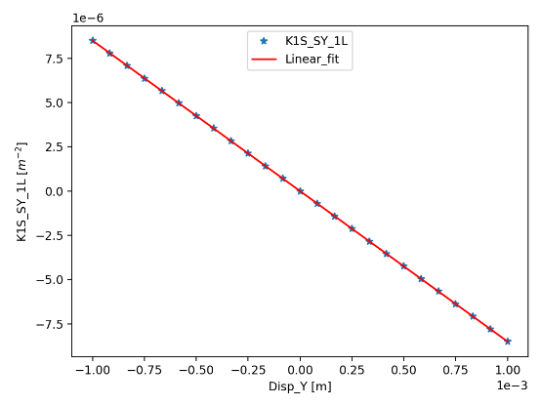
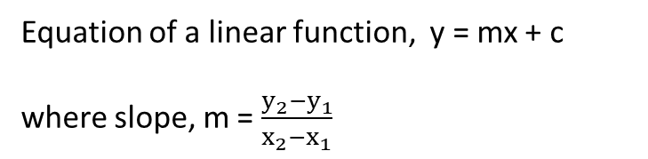

Slopes from the linear fitting
* $\left[\begin{aligned}{K1S}_{1}^{I} \\ {K1S}_{2}^{I} \\ {K1S}_{3}^{I} \\ . \\ . \\ . \\ . \\ {K1S}_{n}^{I}\end{aligned}\right]$ $\left[\begin{aligned}{K1S}_{1} \\ {K1S}_{2} \\ {K1S}_{3} \\ . \\ . \\ . \\ . \\ {K1S}_{n}\end{aligned}\right]$
Equation of a linear function, y = mx + c
where slope, m = $\frac{y_{2}−y_{1}}{x_{2}−x_{1}}$
Knob_setting
18

Slide 19
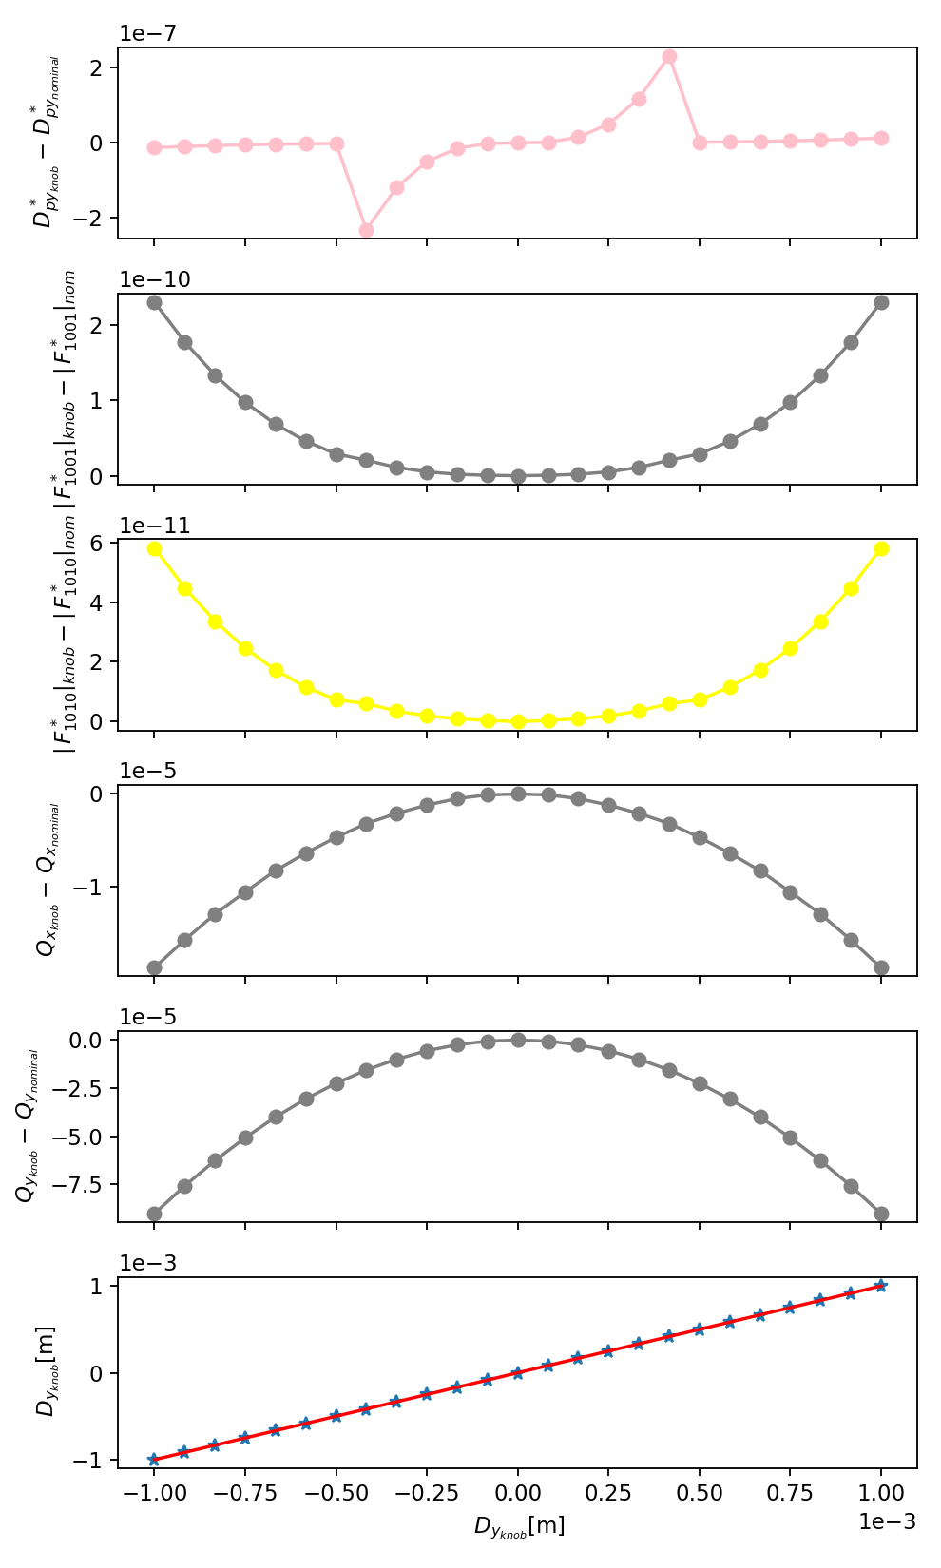
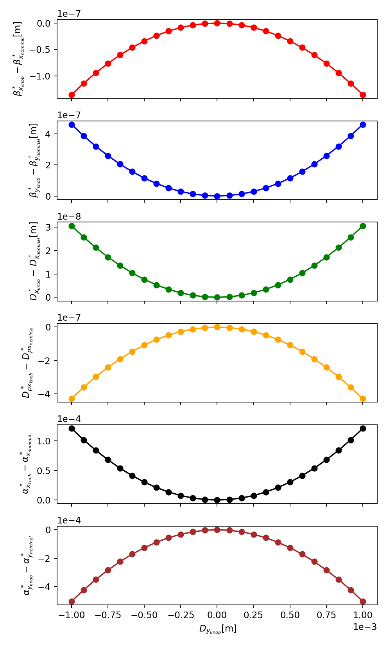

Cross talk of $D_{y}^{∗}$Knob
Aberrations are quadratic being the impact on other IP parameters negligible
Tuning range is simulated to be 1mm
19

Slide 20
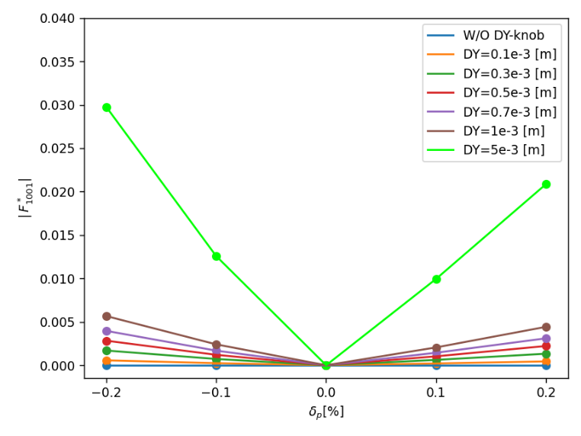
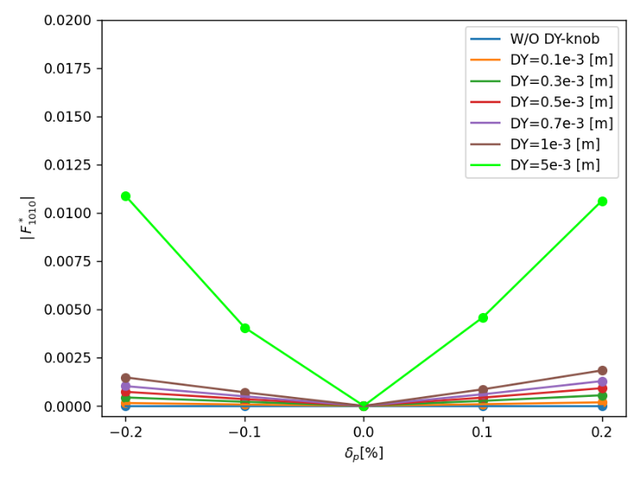
Chromatic variations of β, α, tune and Coupling
Knob influence on chromatic behavior mirrors that of an ideal lattice
knob setting of 5mm has a significant impact
20

Slide 21
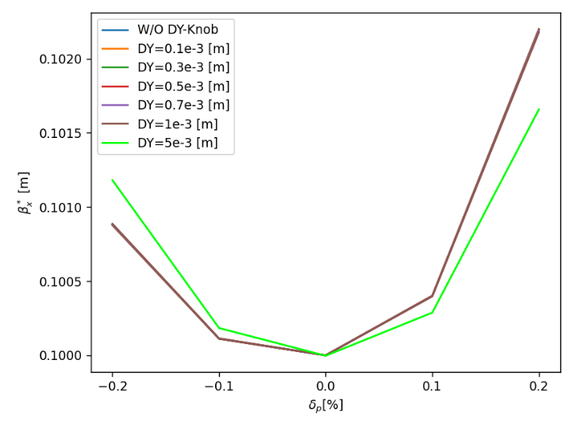
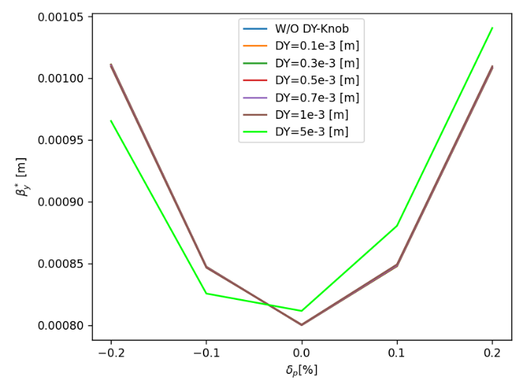
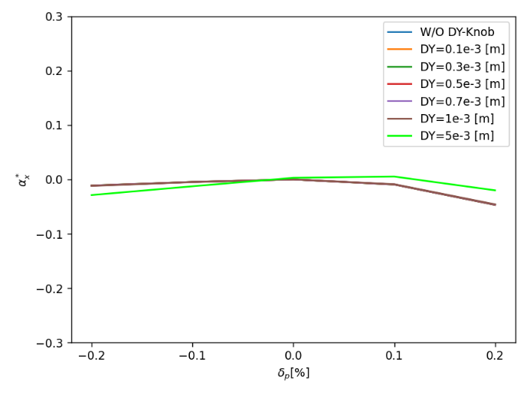
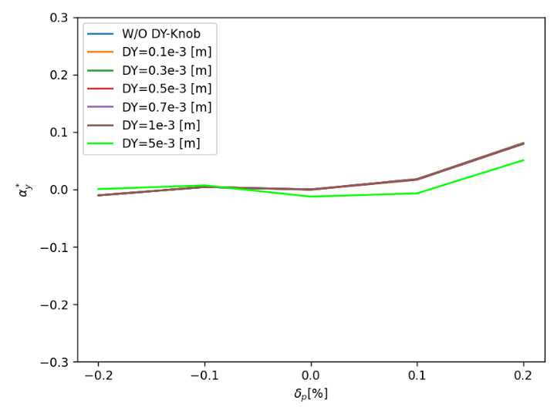
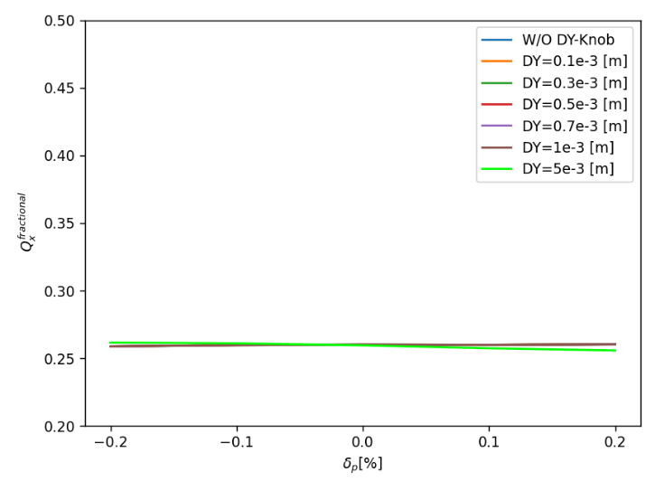
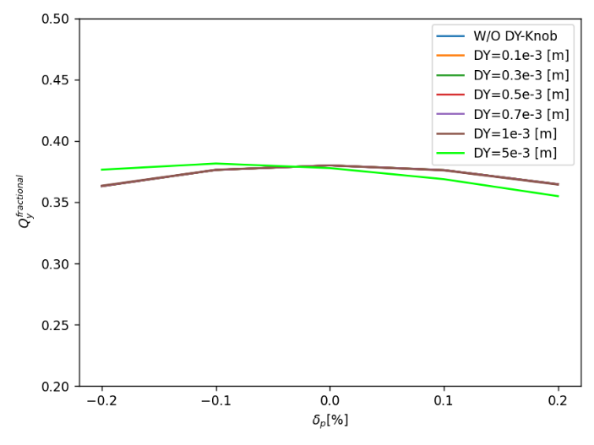
Chromatic variations of β, α, tune and Coupling
Knob influence on chromatic behavior mirrors that of an ideal lattice
knob setting of 5mm has a significant impact
21

Slide 22
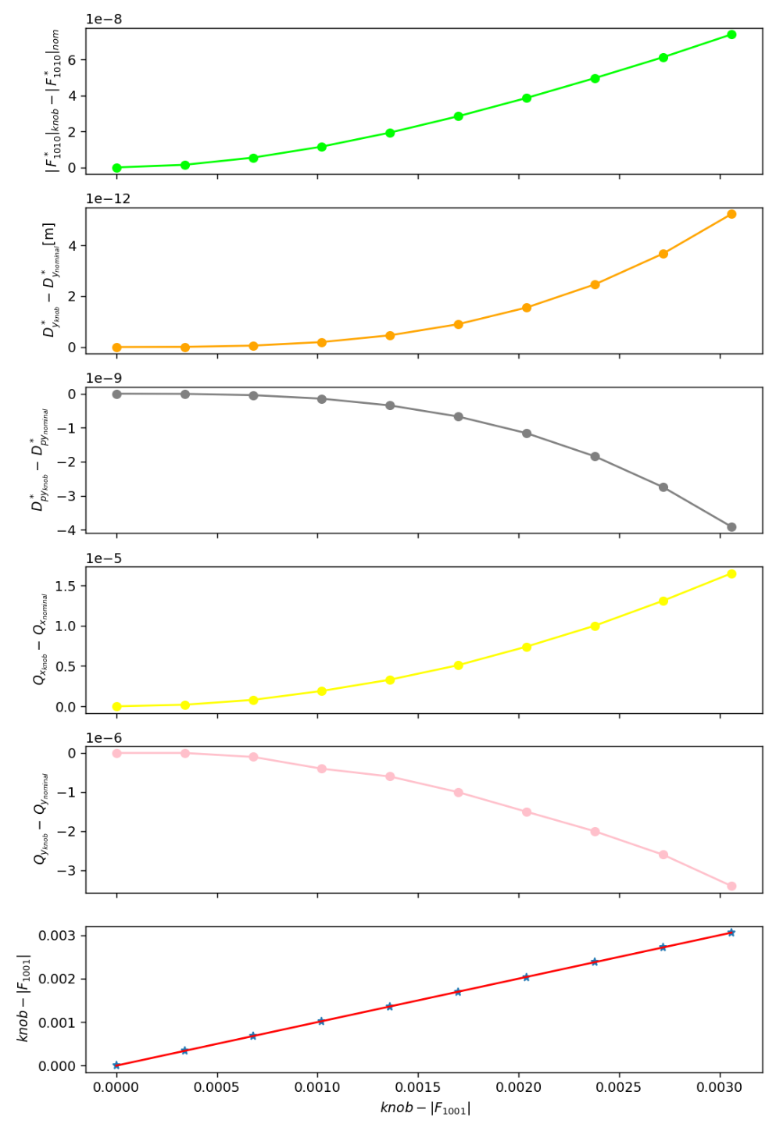
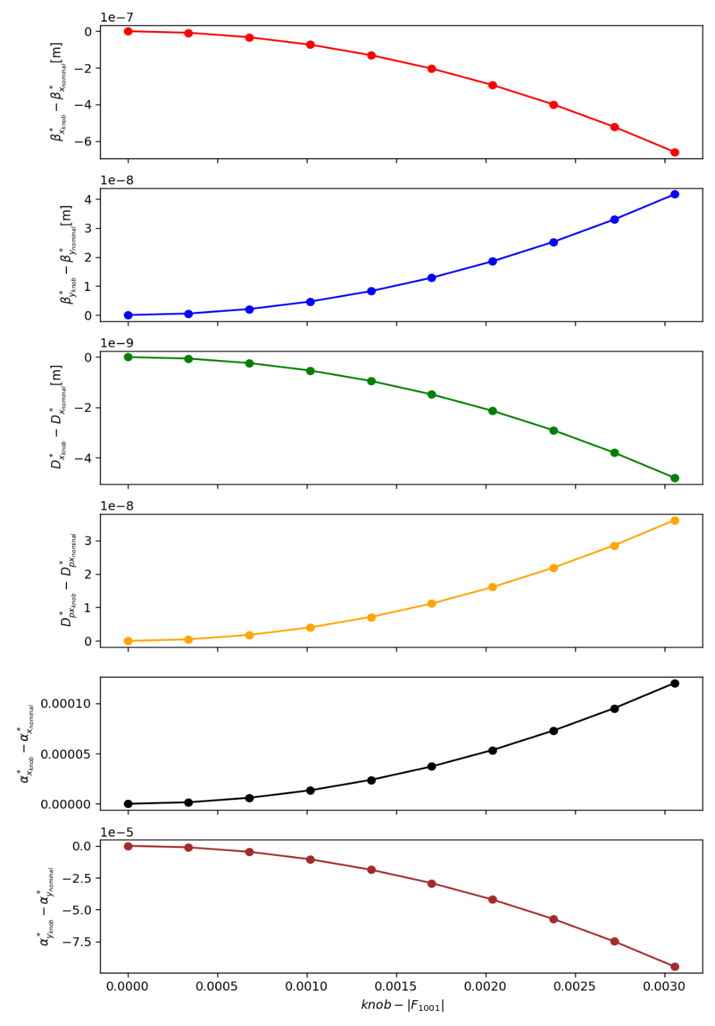


Cross talk of |$F_{1001}^{∗}$| Knob
Knob created has no potential to influence other linear optics
Kindly review the backup slides provided for the replicated studies concerning the | $F_{1010}^{∗}$| knob
22

Slide 23
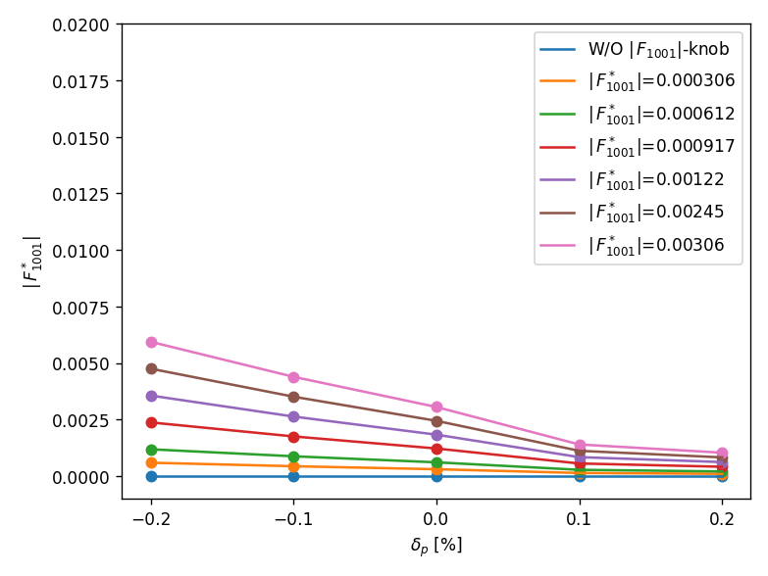
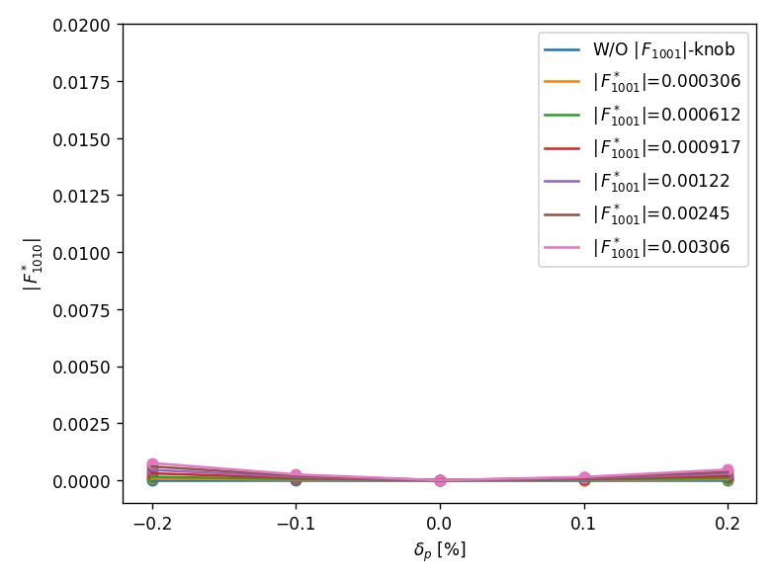
Chromatic variations of β, α, tune and Coupling
Chromatic coupling in various situations runs similarly, with the only distinction being the specific value we assign with the knob
The chromatic pattern remains consistent in both the ideal scenario and with the knob
23

Slide 24
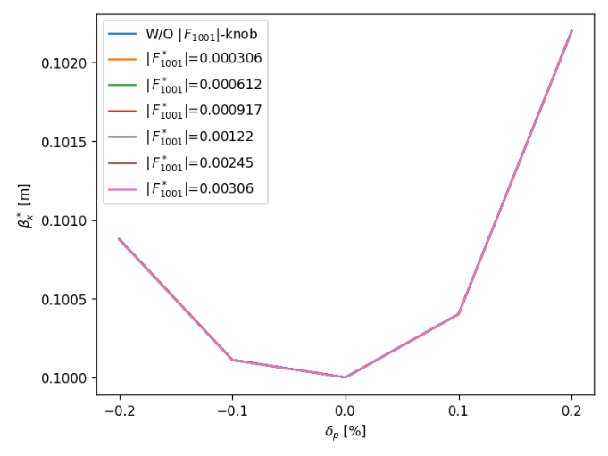
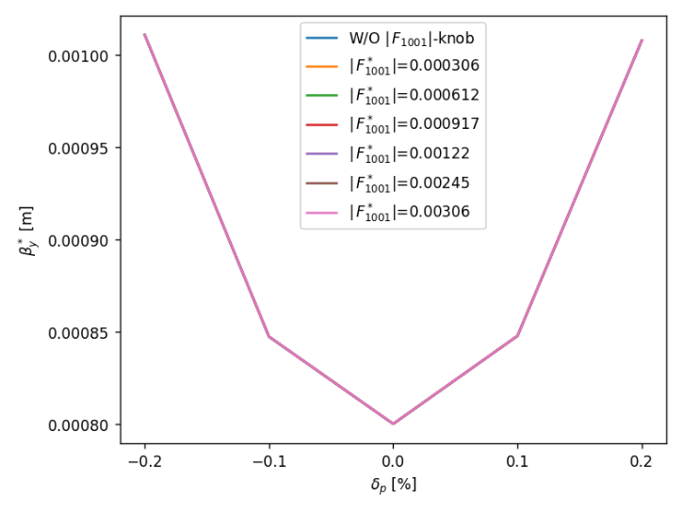
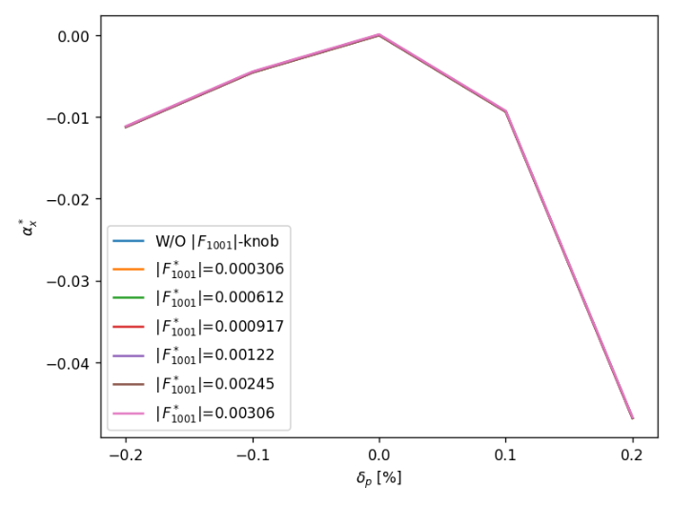



Chromatic variations of β, α, tune and Coupling
Chromatic coupling in various situations runs similarly, with the only distinction being the specific value we assign with the knob
The chromatic pattern remains consistent in both the ideal scenario and with the knob
24

Slide 25


$D_{y}^{∗}$ and Coupling - after orbit correction
Orbit adjustment in the arc section must be necessary, as the $D_{y}^{∗}$ and coupling knobs extends over the arc
Place the appropriate correctors to make the orbit zero in the skew quads
25

Slide 26

$D_{y}^{∗}$ and Coupling - after orbit correction
Orbit adjustment in the arc section must be necessary, as the $D_{y}^{∗}$ and coupling knobs extends over the arc
Place the appropriate correctors to make the orbit zero in the skew quads
26

Slide 27

Conclusions & Further Work
IP tuning knobs are necessary for precise tuning of optics
Studied linear optics knobs for Z-lattice
  Orbit distortion made it critical for the knobs to work in a lattice with errors
  Performed orbit correction by placing the appropriate correctors
Developed $D_{y}^{∗}$ & coupling knobs for the ideal lattice
  Vertical dispersion knob setting of 5mm or above demonstrates an influence on the chromatic behavior
Next Steps:
Include errors in the straight sections (IR’s) as well and examine any further corrections are required to enhance the effectiveness of knobs
Need to implement $D_{x}^{∗}$ knob
27

Slide 28
Thank you for your attention

Slide 29
Backup Slides

Slide 30





$w_{x}$ knob on ideal lattice
28

Slide 31





$β_{x }^{∗}$knob on ideal lattice
29

Slide 32





$w_{y}$ knob wrt linear optics parameters
30

Slide 33





$β_{y }^{∗}$knob wrt linear optics parameters
31

Slide 34





$w_{y}$ knob robustness: Ideal vs Error Lattice
32

Slide 35





$β_{y }^{∗}$knob robustness: Ideal vs Error Lattice
33

Slide 36





$w_{y}$ knob post orbit correction
34

Slide 37





$β_{y }^{∗}$knob post orbit correction
35

Slide 38

Cross talk of |$F_{1010}^{∗}$| Knob
36

Slide 39








Chromatic variations of β, α, tune and Coupling
37

