Slide 1


Update on HL-LHC optics studies
Supervisor: Riccardo De Maria
Yannis Angelis
Aristotle University of Thessaloniki, CERN
LNO Meeting, 15.12.2023

Slide 2
Contents
Rematching IR15 and effects on crossing angle and crabbing angle
Rematching of chromatic functions
Flat optics and octupoles

Slide 3

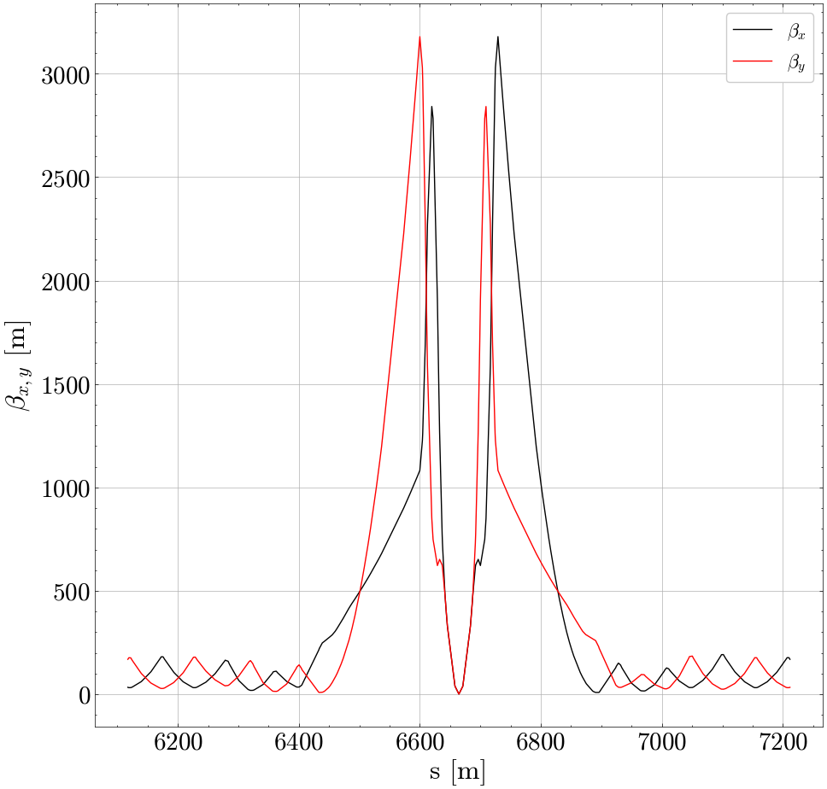
How not to match the crossing angle

Slide 4
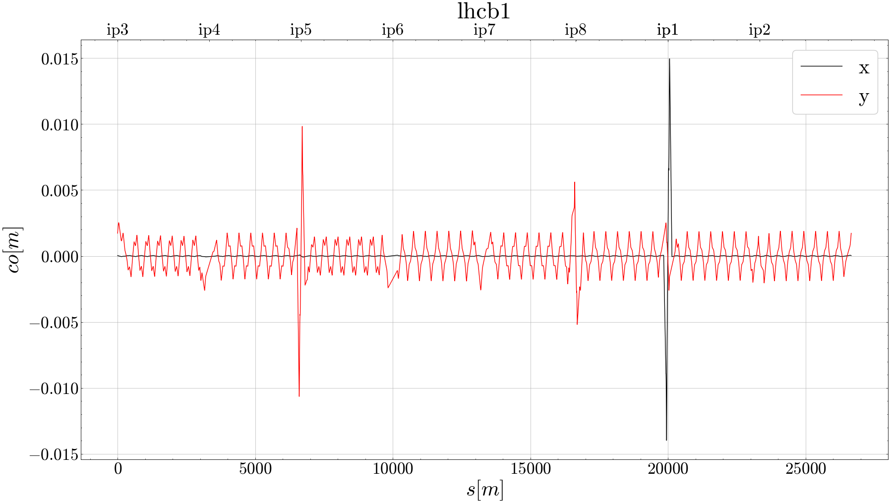
How not to match the crossing angle
Can we do something for the peaks?
Rematching HL optics for some β*
And you get this ‘beautiful’ orbit
Do β around IP affect xing angle correctors??
on_x1 = 250,on_x5 = 250

Slide 5
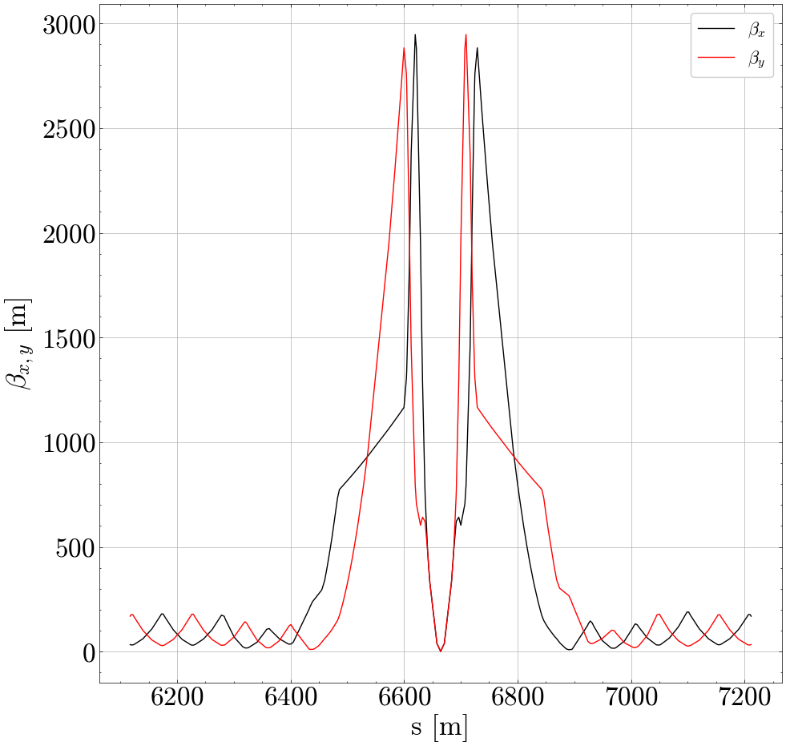
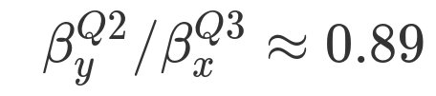
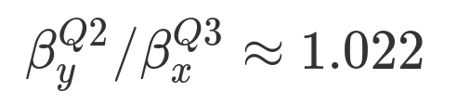
How not to match the crossing angle
Rematch IP but with a constraint for the ratio of the peaks

Slide 6
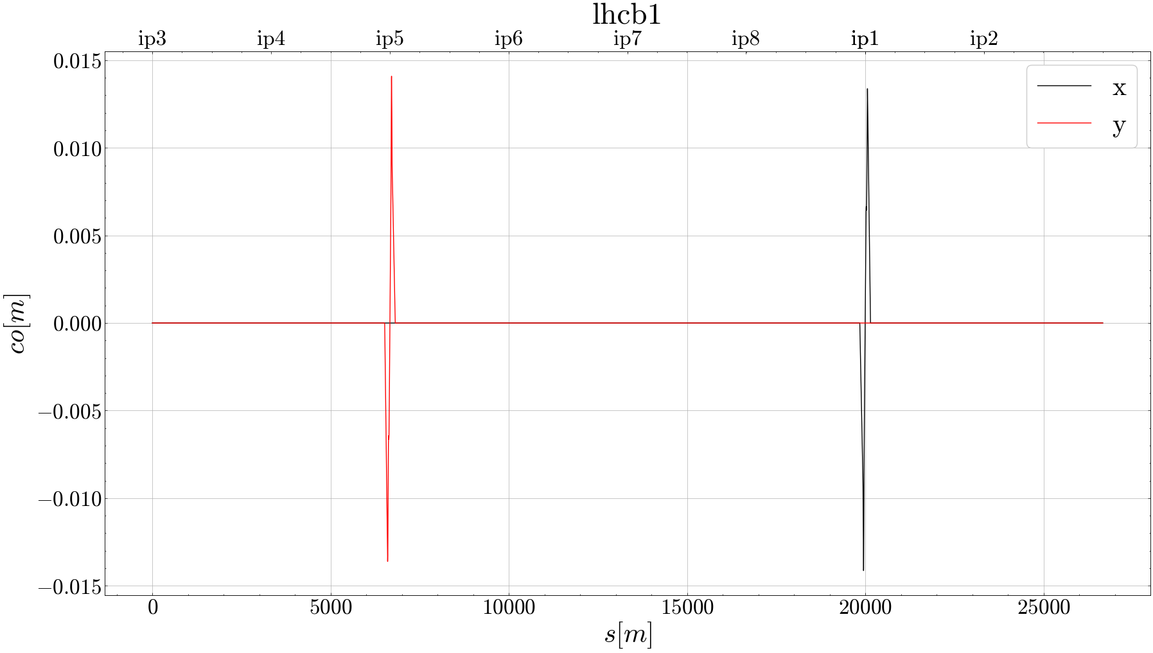
How not to match the crossing angle
Rematch IP but with a constraint for the ratio of the peaks

Slide 7
Are we happy with this?

Slide 8
How not to match the crossing angle crabbing angle
CC Angle: H=365, V=367
CC Angle: H=314, V=317

Slide 9
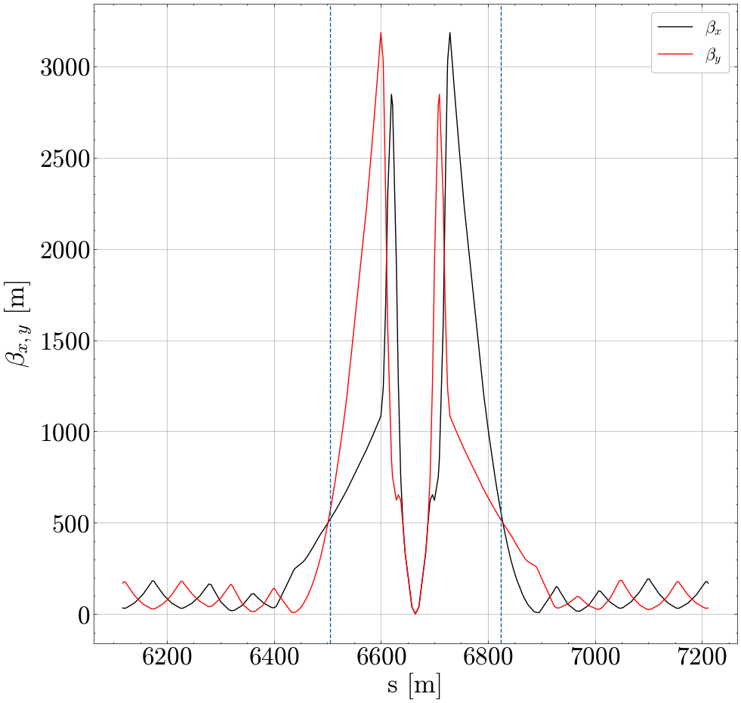
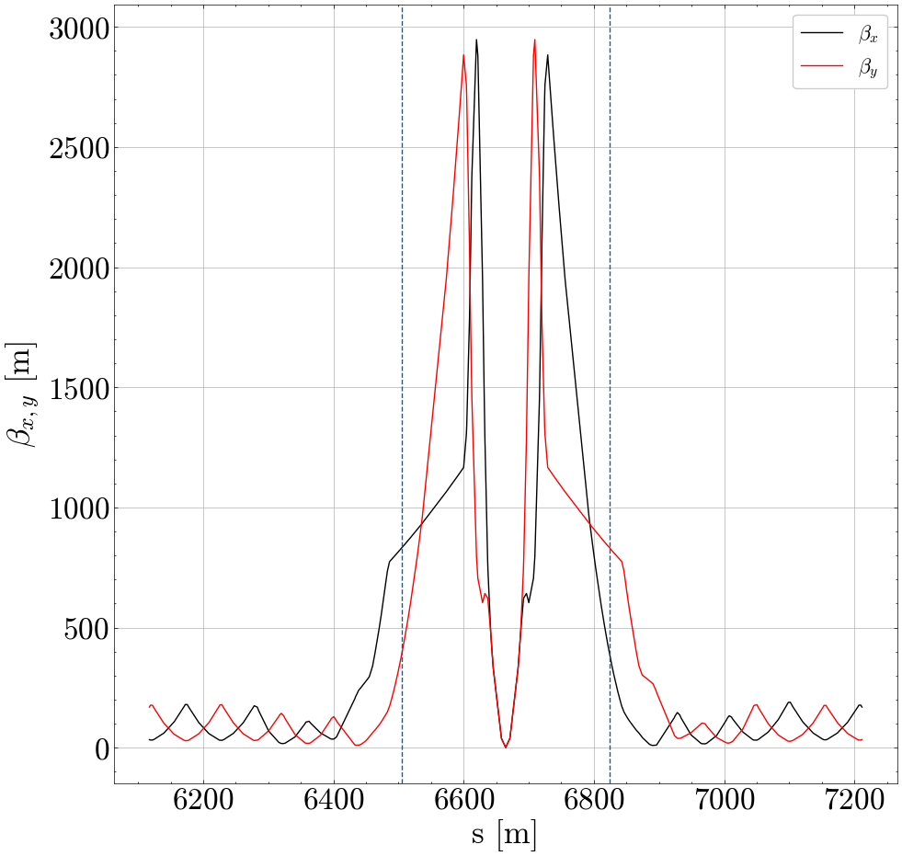
How not to match the crossing angle crabbing angle
Excellent…
Let’s try to optimize the beta ratio at the CC
CC Angle: H=365, V=367
CC Angle: H=314, V=317

Slide 10
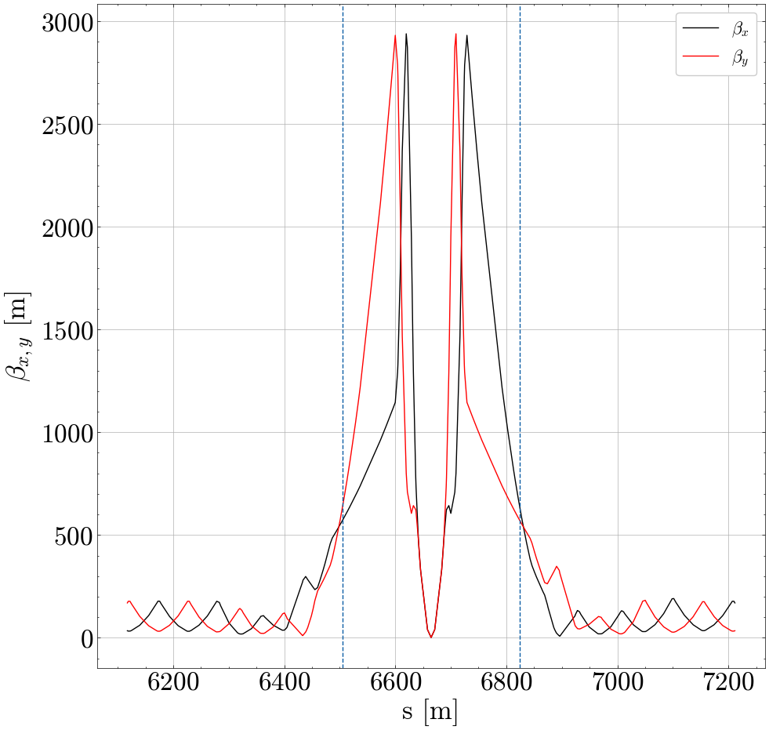
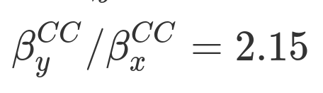
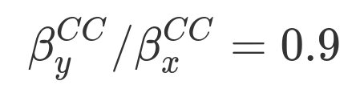
How not to match the crossing angle crabbing angle
Excellent…
Let’s try to optimize the beta ratio at the CC
CC Angle: H=389, V=391
CC Angle: H=314, V=317

Slide 11
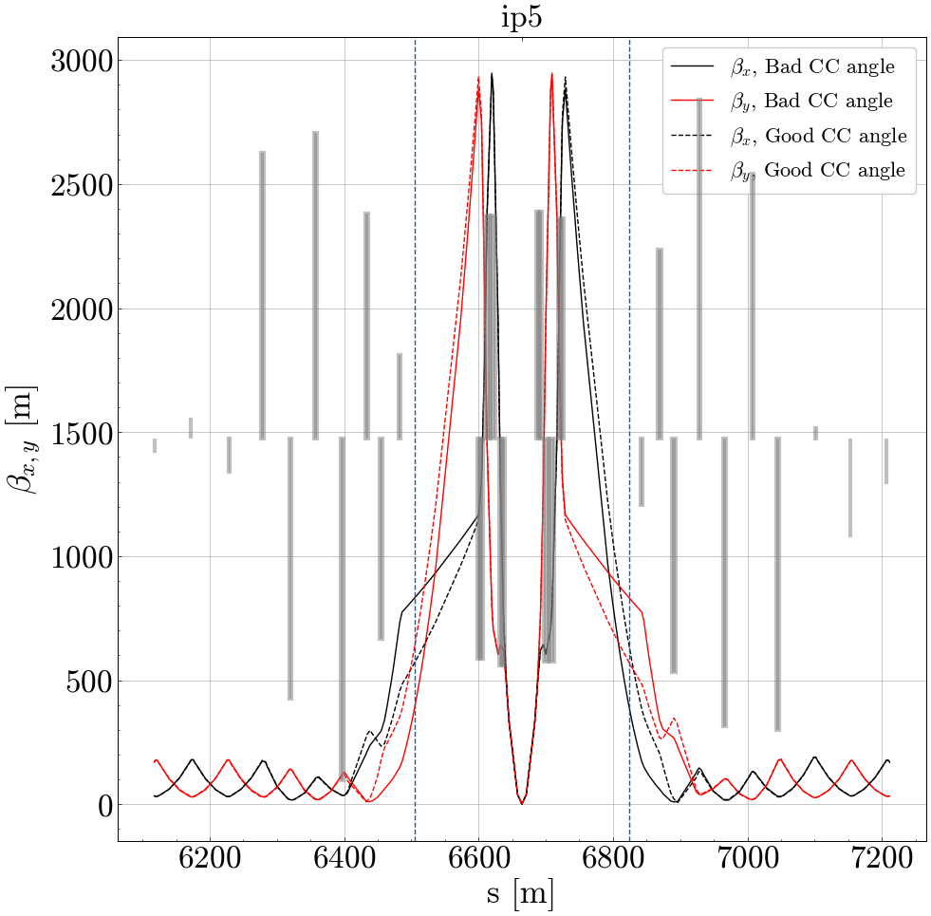
Are we happy with this?
‘Bumps’ at Q5-Q6 might introduce ‘bumps’ at the orbit.
Orbit leakage from CC should be checked
Next step: reduce beta at the CC

Slide 12
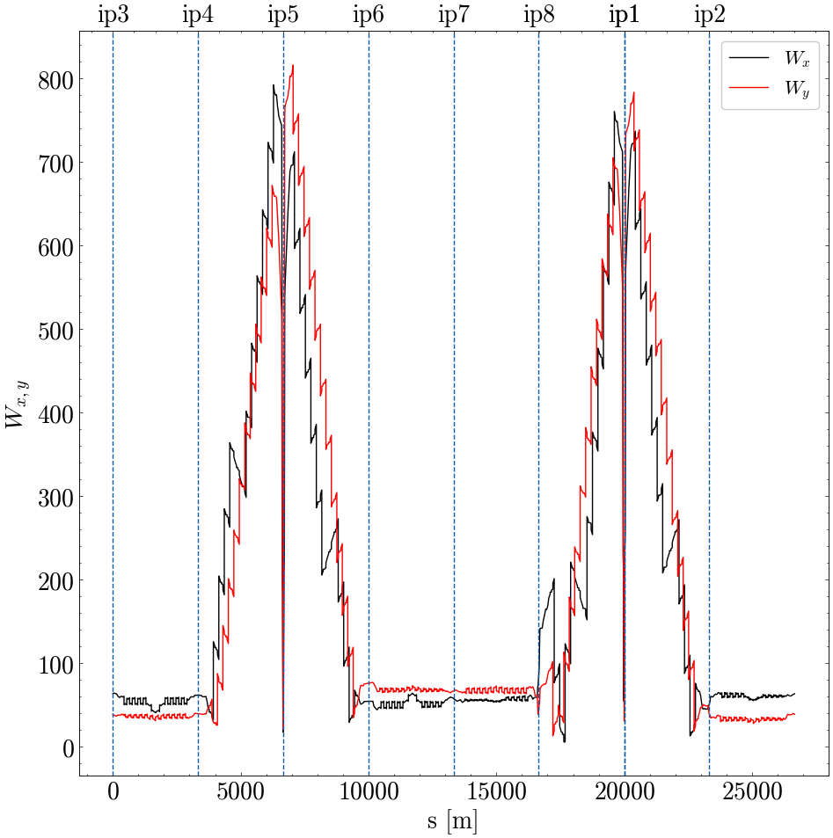
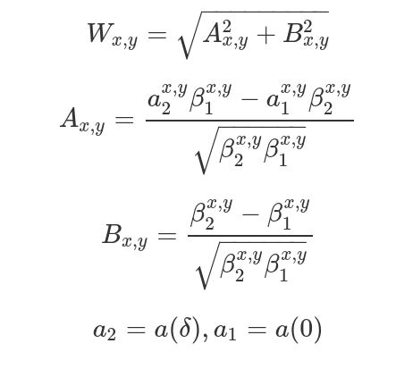
Rematching chromatic functions
Chromatic Functions
How it should be

Slide 13
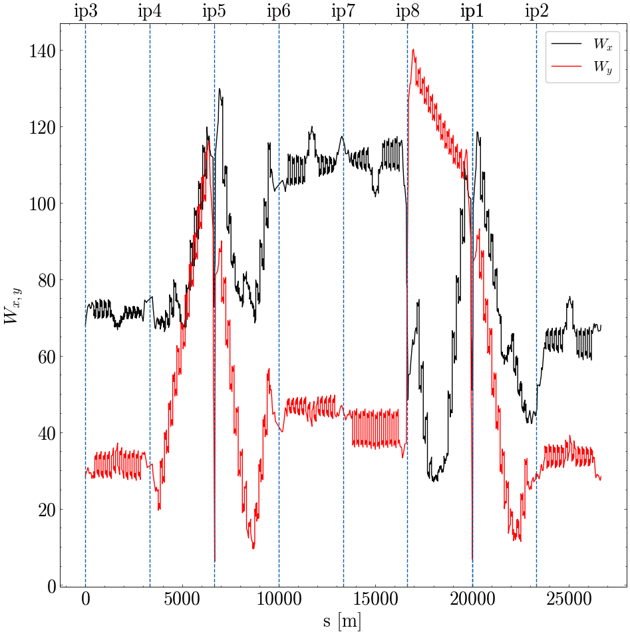
Rematching chromatic functions
Chromatic Functions
How it is

Slide 14
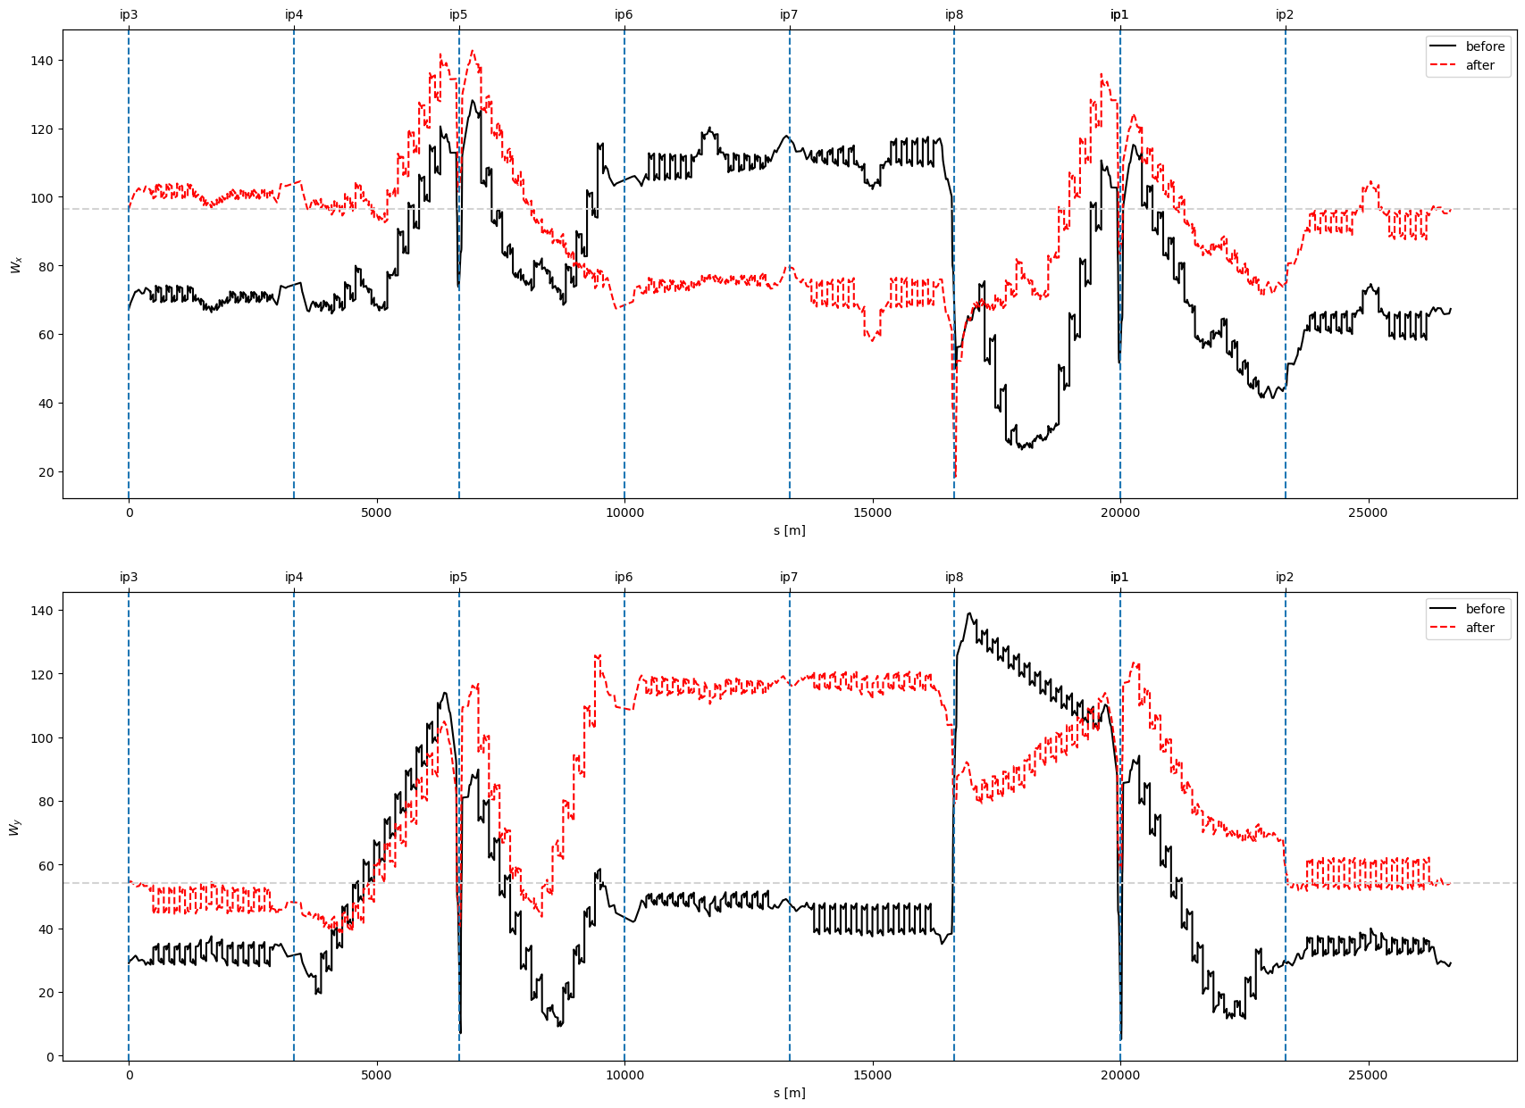
Rematching chromatic functions
Chromatic Functions
Attempt of rematching with constraints on W values for sextupoles left and right of IP1,5
How it is

Slide 15
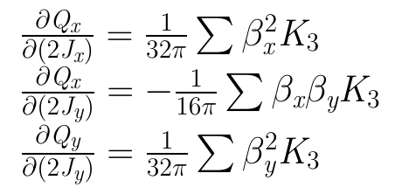
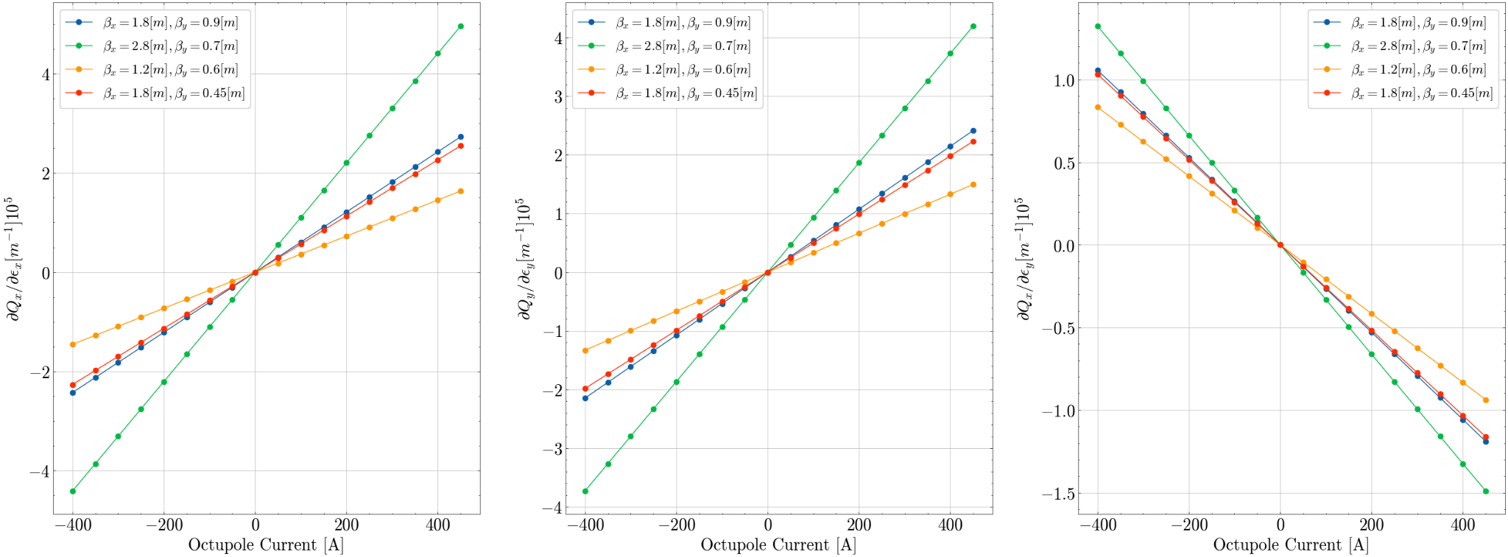
Flat optics and detuning

Slide 16
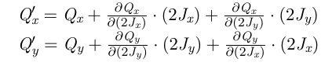
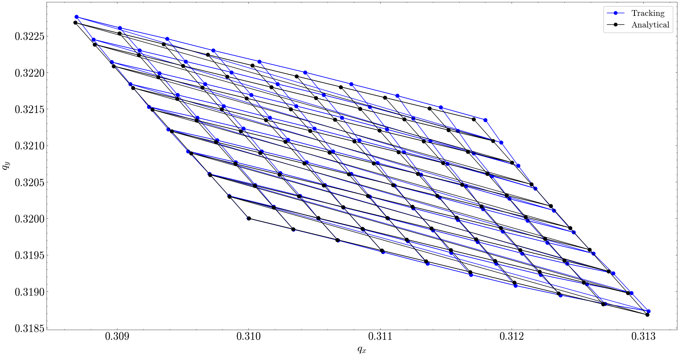

Flat optics and detuning
Footprint for 100 turns, with Ioct = 450 A

Slide 17
Conclusions and Next steps
A way to control the effectiveness of crossing angle correctors and maximum crab angle by exploiting the betas at IP1,5
Chromatic functions not behaving nice
Detuning effects from octupoles
Check the beta bumps at Q5-Q6 and the effect on the orbit
Crossing and crabbing angle optimisation for flat optics
Port remaining rematch_hllhc madx scripts in xsuite

