Slide 1




Radiochemistry Developments on ²²⁴Radium(²²⁴Ra)
MUHAMMAD INZAMAM
(PINSTECH, Pakistan Atomic Energy Commission)

Slide 2
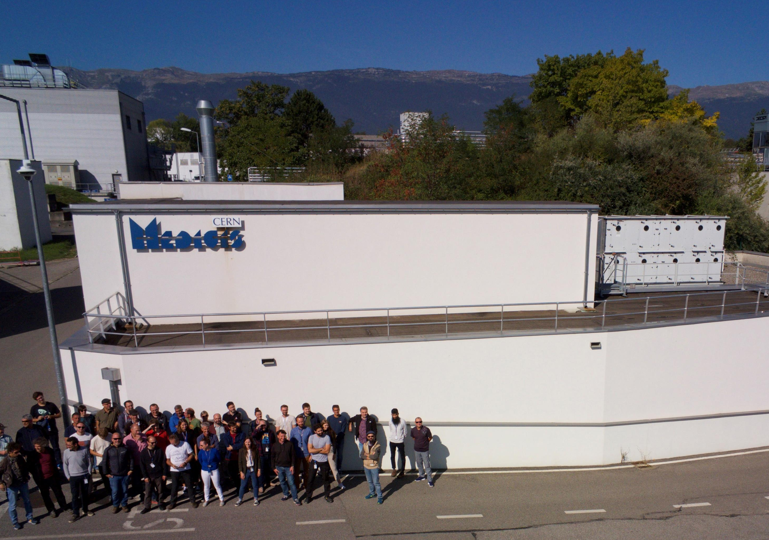
Layout
Introduction
Production of ²²⁴Radium (²²⁴Ra)
²²⁴Ra/²¹²Pb Generator Production
Labelling of ²¹²Pb with DOTA
Conclusion

Slide 3
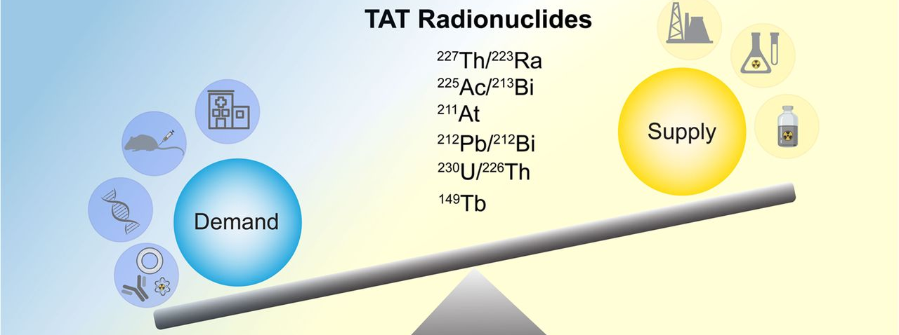
Introduction
²²⁴Radium is a pure alpha emitter
Favorable half life 3.6 day
Short lived daughter product
Notes:
Radium is very situabile candidate for the
The demand of these radionuclides is significantly high than the available resources but international efforts are under way to increase the number and production capacity of such radionuclides.Ra is not very much popular in nuclear medicine for direct use as in case of 223Ra simple salt of radium is an only EMA and FDA approved alpha emitting drug used for treatment of metastatic prostate cancer

Slide 4
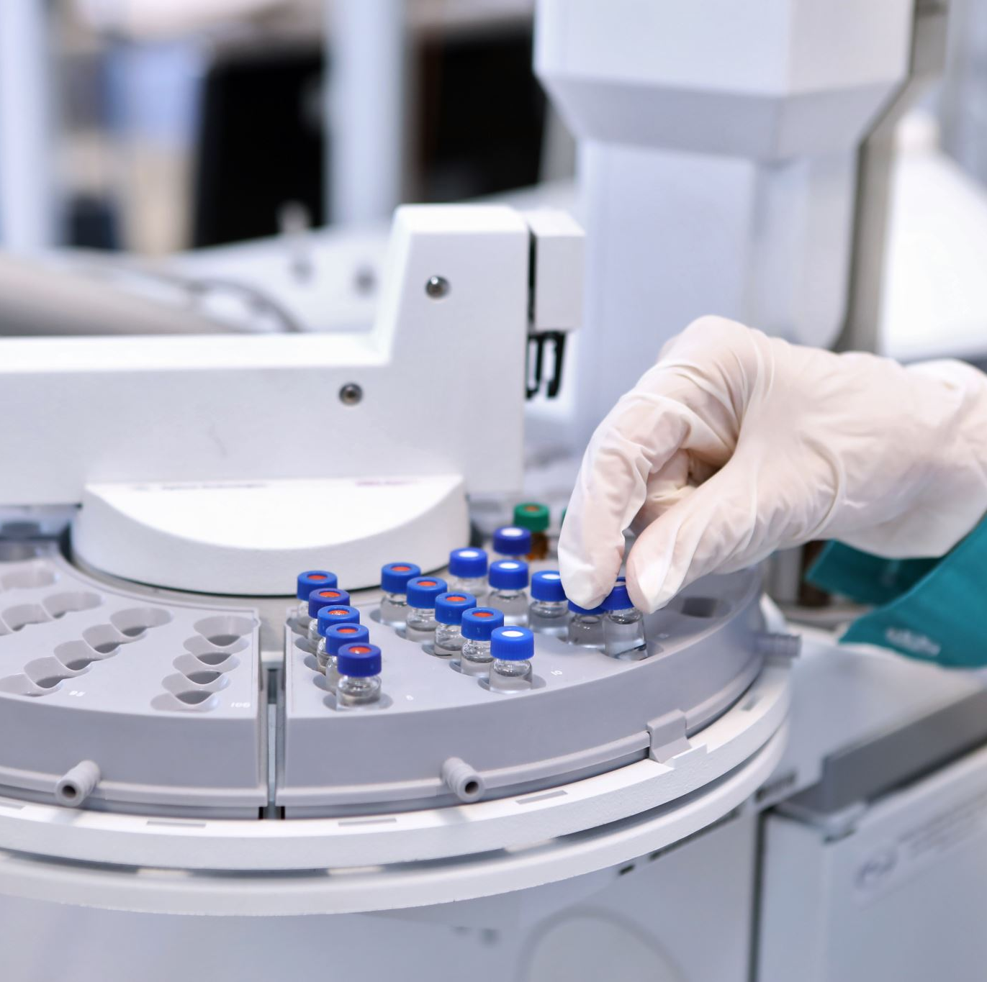
Production of ²²⁴Radium
Several method for the production
  Radiochemical separation from the Th/U
  Spallation reaction of thorium by proton irradiation
  ²²⁸Th/²²⁴Ra Generator

Slide 5
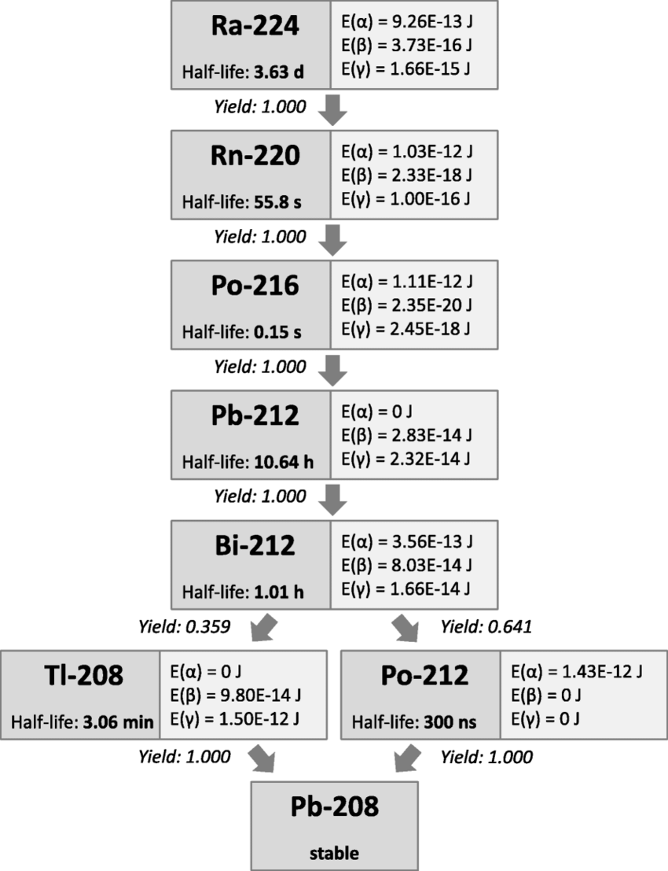
²²⁴Radium/²¹² Lead Generator Production
There are two methods of ²²⁴Ra/²¹²Pb generator production
  Collection of emanated radon from radium source
  Radiochemical separation of using cation exchange resin.

Slide 6
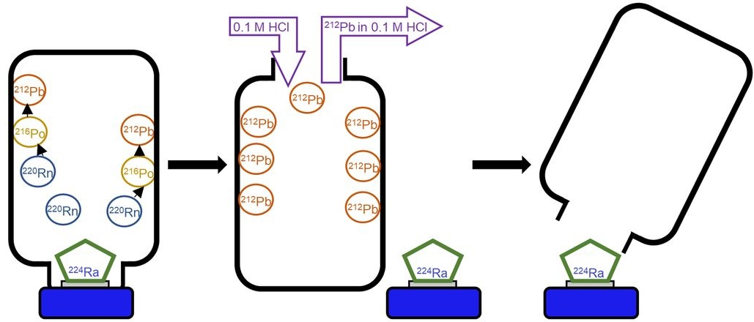
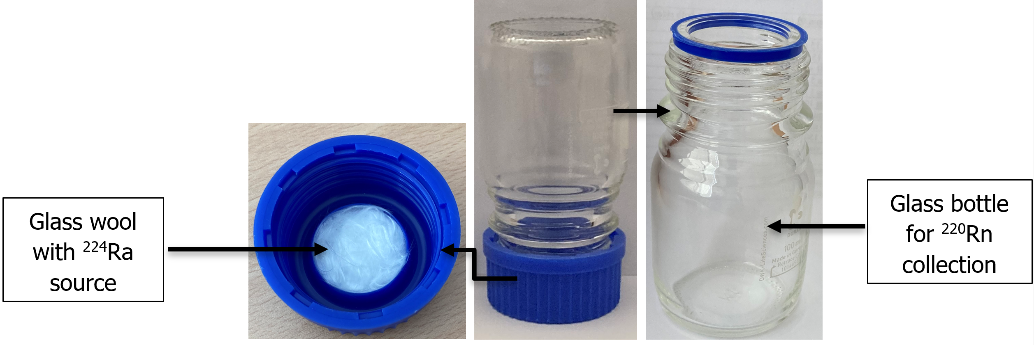
²²⁴Ra/²¹²Pb Generator by Radon Collection
²²⁴Radium is used as source in the generator
Glass bottle with plastic lid as generator body
Source adsorbed on the glass wool
Collection chamber for radon
Decays into ²¹²Pb

Slide 7
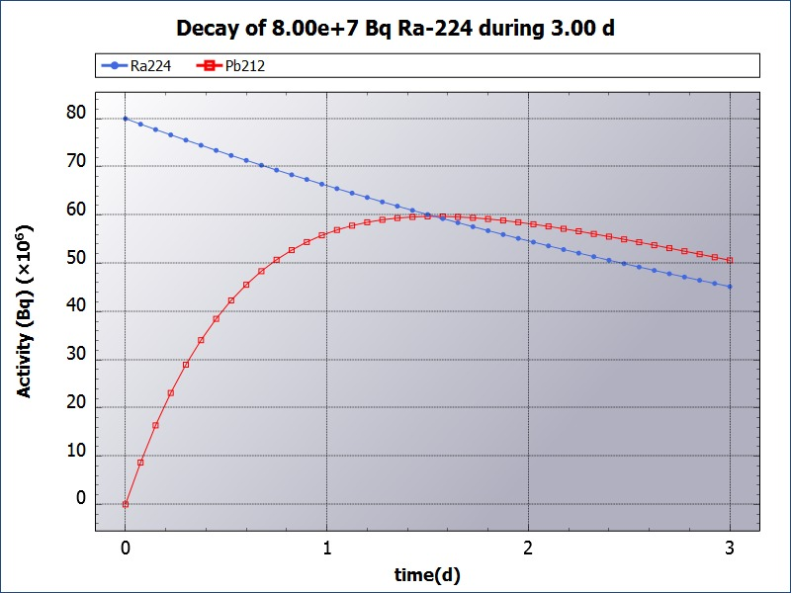
Elution of Generator
Elution of generator after the establishment of secular equilibrium
Elution of ²¹²Pb with 0.1M HCl

Slide 8
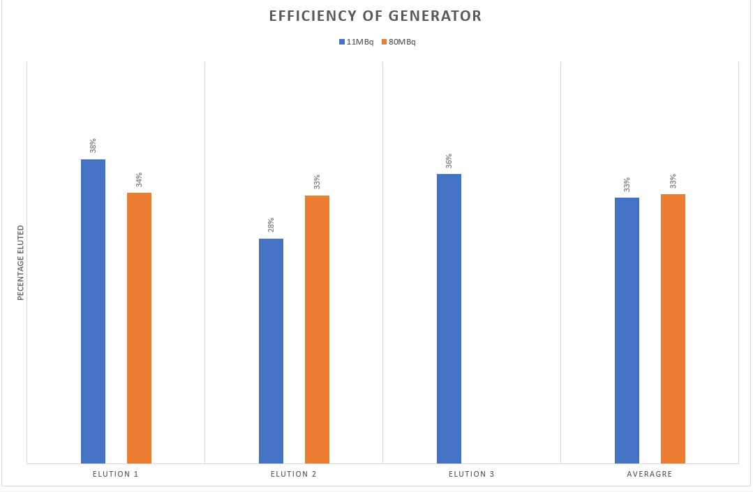
Efficiency and Stability
Generator from few kBq to 80MBq are produced
Elution are taken every two days for several weeks
Generators are eluted with average efficiency of 33%
High activity did not damage the generator structure

Slide 9
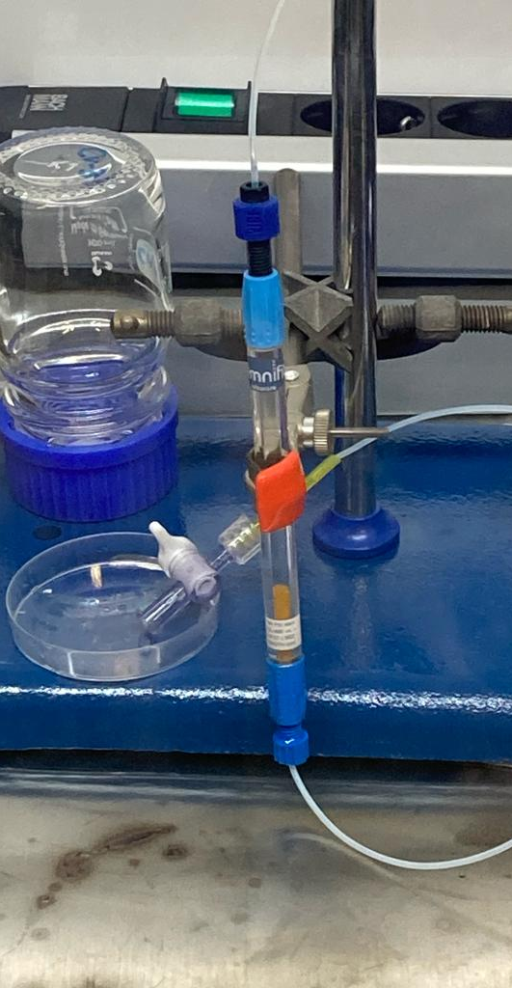
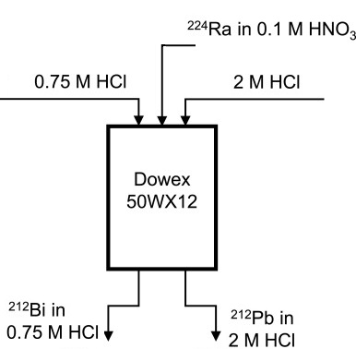
²²⁴Ra/²¹²Pb Generator by Cation exchange resin
Generator consist of a glass column
Cation exchange resin for adsorption of radium source
Preconditioning of column
²²⁴Ra loading on the column followed by washing
Elution of generator with few ml of HCl

Slide 10
Efficiency of the Generator
Generator eluted for three time after every two day
Average 56% of the ²¹²Pb recovered from the generator
Ra breakthrough was observed in the elution up to 9%
Some issues identified during experiment which will lead to improvement

Slide 11
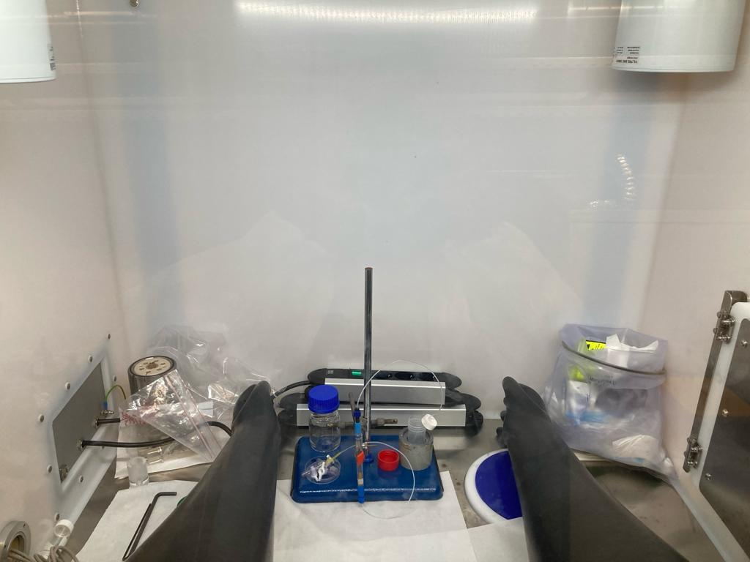
Radiation Safety
All the following steps for generators carried out in Gloves box
  ²²⁴Ra foil retrieval for target holder
  Dissolution of the ²²⁴Ra
  Generator production
  Elution
  No release of radon or any contamination

Slide 12
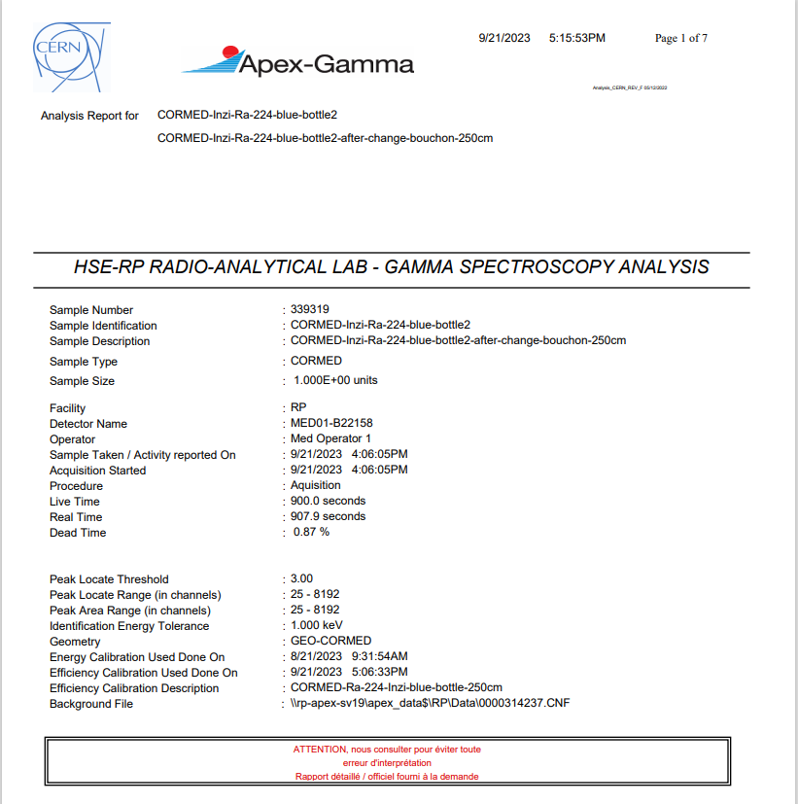
Quality of ²¹²Pb from Generator
Gamma spec. analysis of elution
In first generator, no radium was detected (<²²⁴Ra MDA) in elution
Generator of activity ~80MBq dispatch to one of partner institute for further evaluation/labelling studies
In cation exchange resin, up to 9% radium was detected used internally only on experimental work

Slide 13
Labelling and Further Studies
Radon collection type generator of 80MBq dispatch to partner institute for further studies
  Labelling of the ²¹²Pb with DOTATATE
  Stability of Pb-DOTA Complex in mouse serum
Request trough PRISMAP for clinical translation studies in Dresden University Hospital

Slide 14
Conclusion
Production of ²²⁴Ra/²¹²Pb generator of two different types
With generator efficiencies up to 33% and 56%.
High quality product with safe operation
Good labelling result and stability results

Slide 15


