Slide 1
X-Box Update
06.12.2023

Slide 2
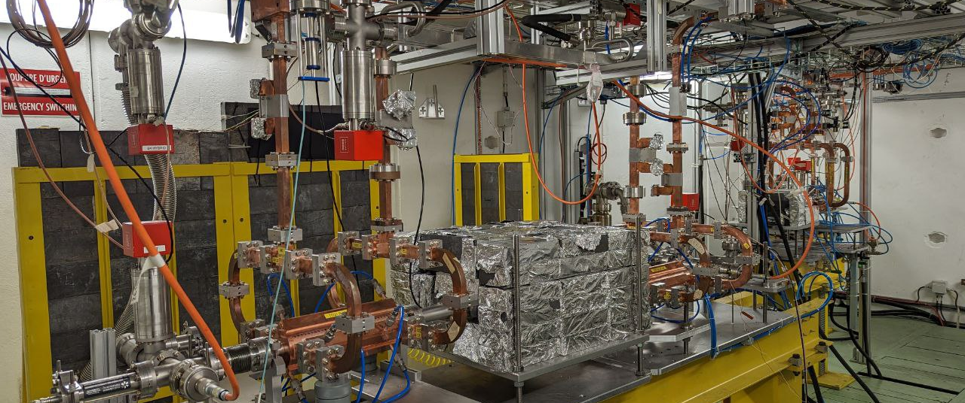
X-Box 2: TD31 N3 N4

Slide 3
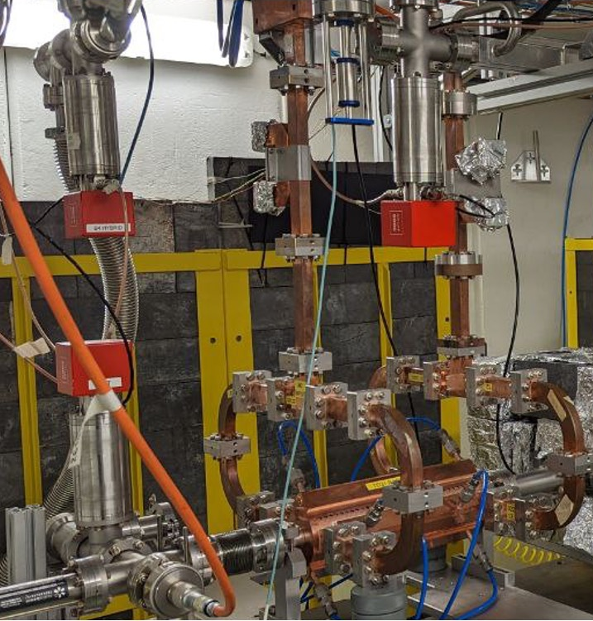
X-Box 2 TD31 N3 N4: Structure B
Stopped 11.07.2023
Restarted 01.12.2023
Calibration done
Current peak power: 30 MW

Slide 4
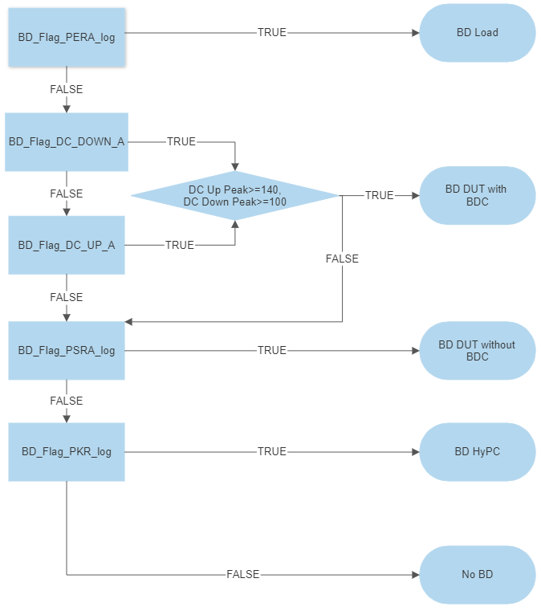
Xbox 2 Breakdown definition

Slide 5
X-Box 2: 06. June 2023 13:17:19
Log 0
Log 1
Log 2

Slide 6
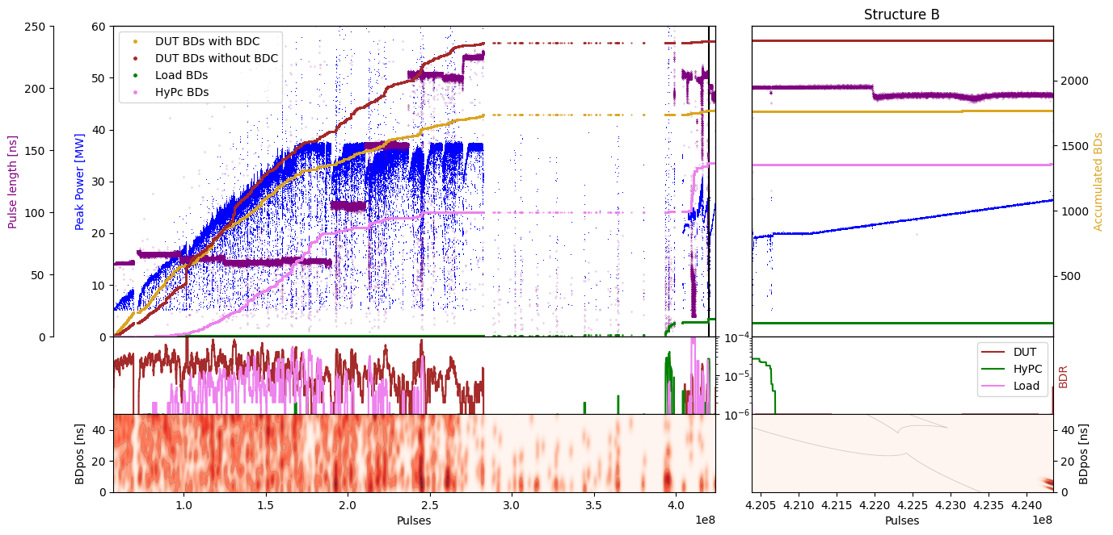
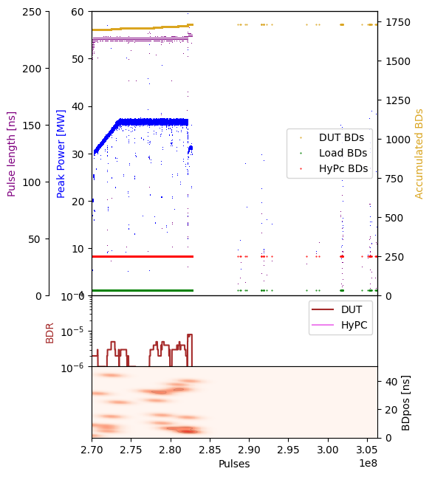
X-Box 2: TD31 N3 N4 Structure B – Peak Power

Slide 7
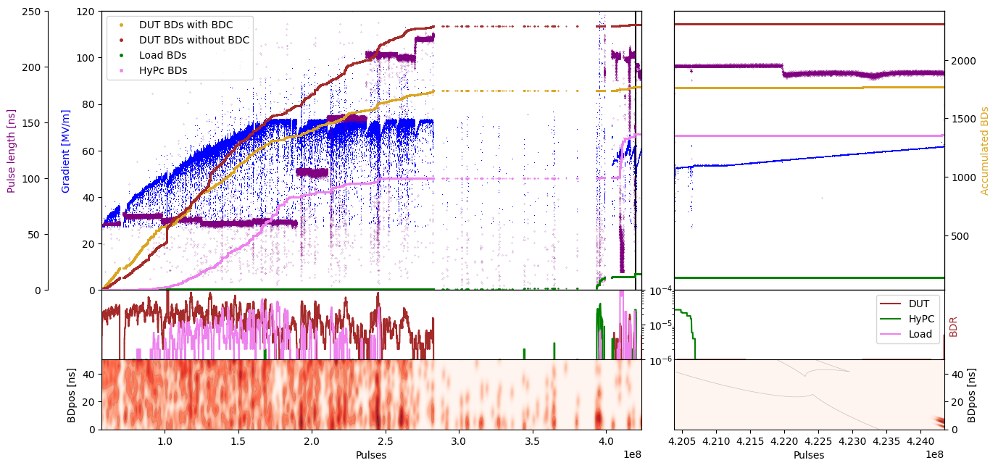
X-Box 2: TD31 N3 N4 Structure B – Gradient

Slide 8
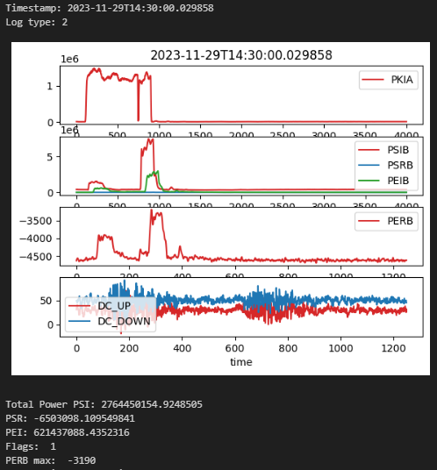
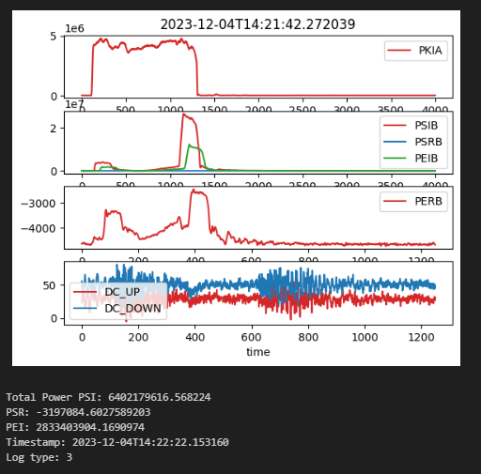
Conditioning
Short Pulse (200 ns), 7MW, BD
Long Pulse (300ns), 23MW, no BD

