Slide 1
X-Box Update
14.12.2023

Slide 2
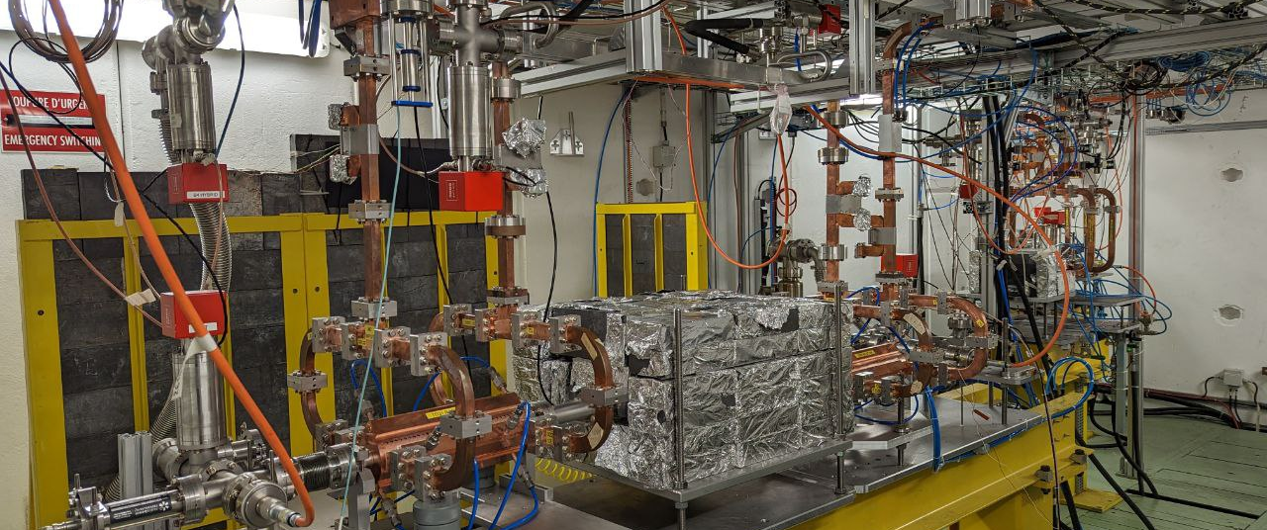
X-Box 2: TD31 N3 N4

Slide 3
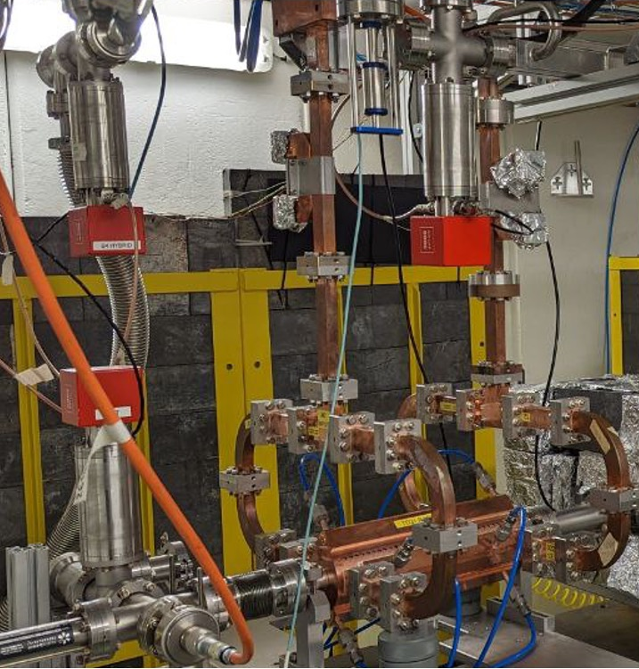
X-Box 2 TD31 N3 N4: Structure B
Stopped 11.07.2023
Restarted 01.12.2023
Calibration re-done at higher power levels
Current peak power: 34.66 MW
Current pulse length: 120 ns

Slide 4
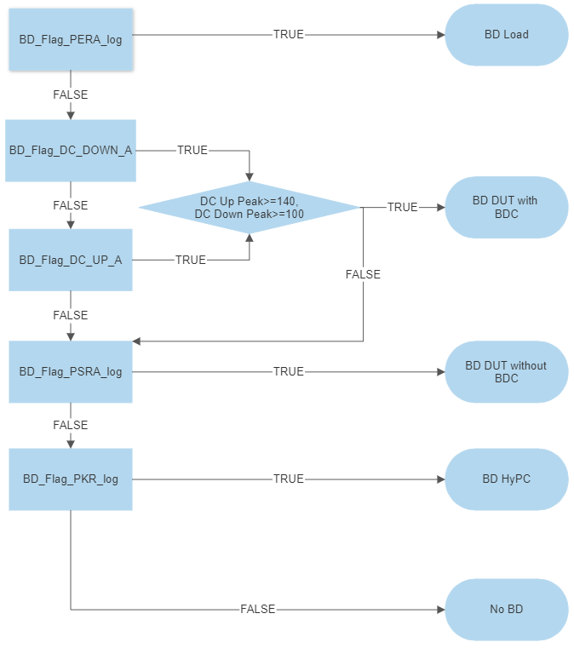
Xbox 2 Breakdown definition

Slide 5
X-Box 2: 06. June 2023 13:17:19
Log 0
Log 1
Log 2

Slide 6
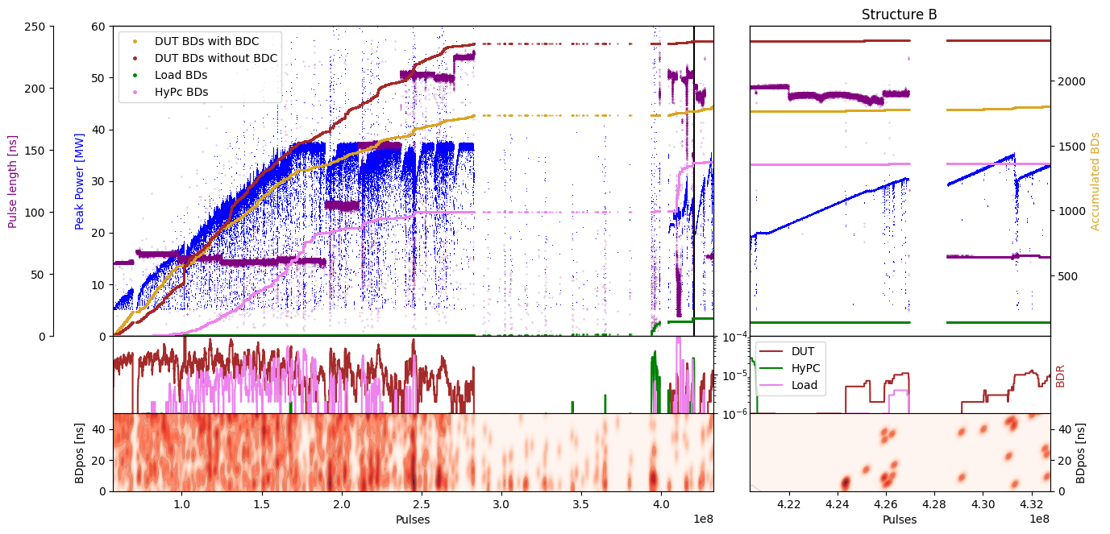
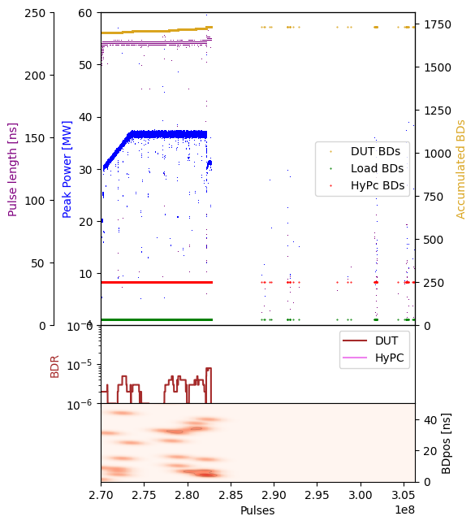
X-Box 2: TD31 N3 N4 Structure B – Peak Power

Slide 7
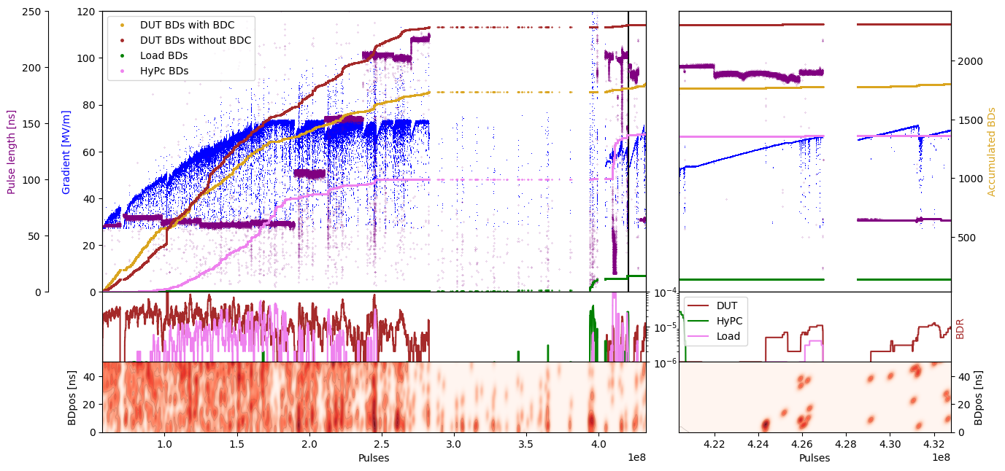
X-Box 2: TD31 N3 N4 Structure B – Gradient

Slide 8
Coditioning pulse

Slide 9
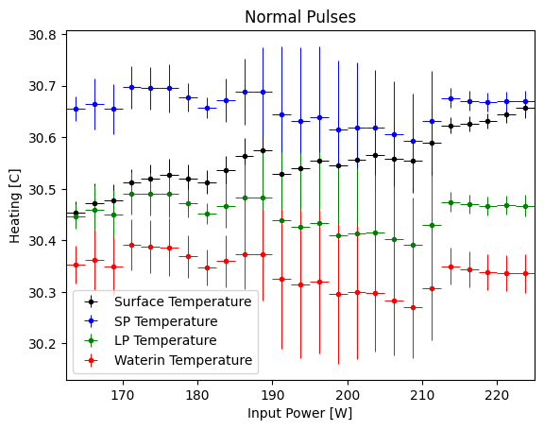
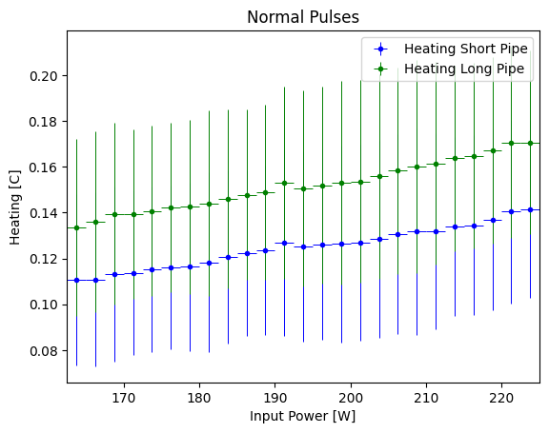
Water Measurement
Offset Short Pipe Structure B: -0.192C
Offset Long Pipe Structure B: 0.039C

Slide 10
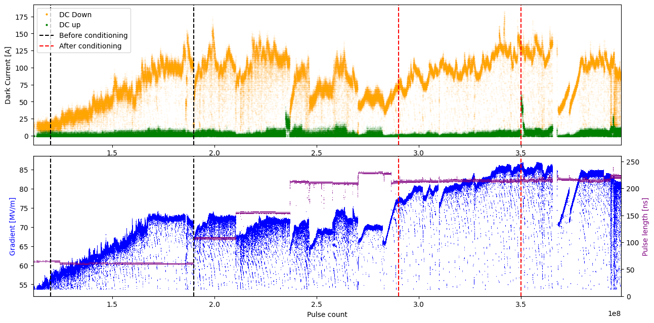
Beta Plots Xbox-2 Structure A

Slide 11
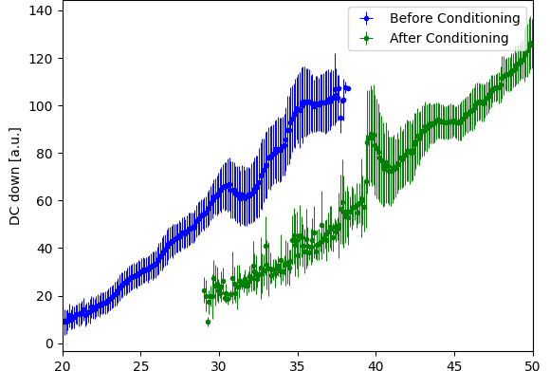
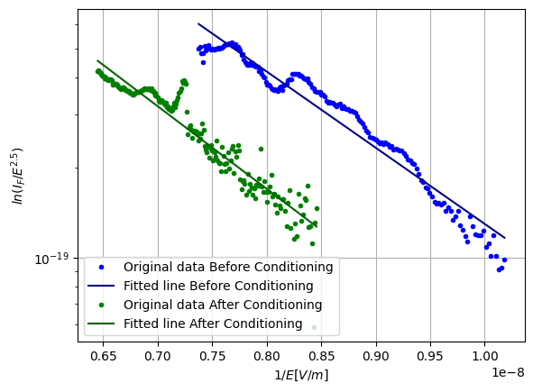
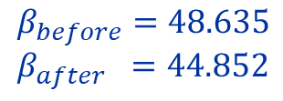
Beta Plots Xbox-2 Structure A
DC down
$$β_{before}=48.635 \\ β_{after} =44.852$$
FN plot

Slide 12
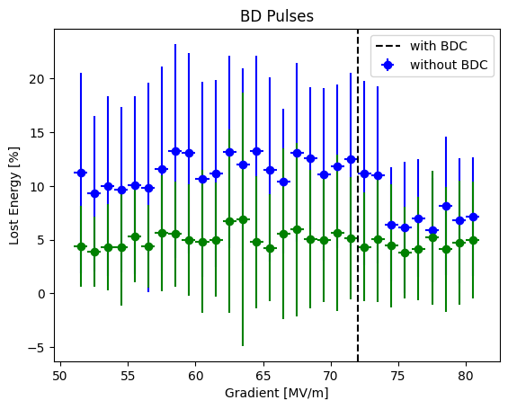
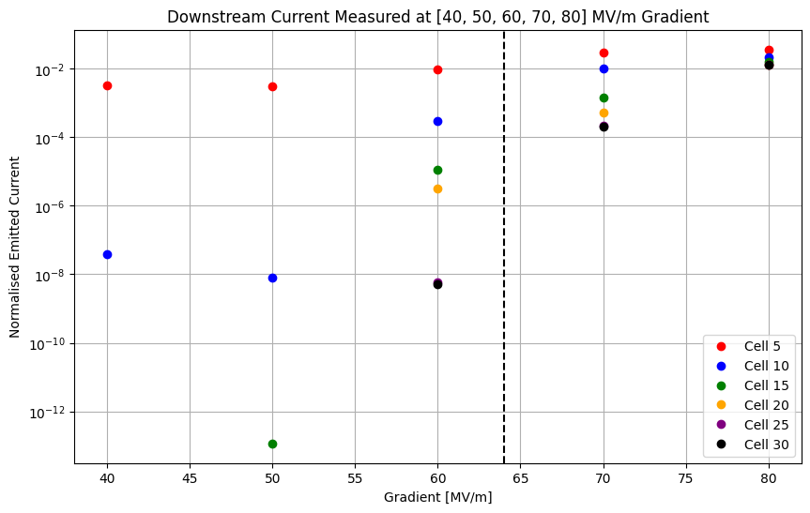
Lost Energy – Capture Gradient

