Slide 1
Radiation levels in the LHC during the Pb run 2023 – Point 2 and QPS rack locations
Daniel Söderström, Auriane Canesse, Giuseppe Lerner, Rubén García Alía (SY-STI-BMI, R2E/MCWG)
with input from Reiner Denz (TE-MPE-EP)
11/2023

Slide 2
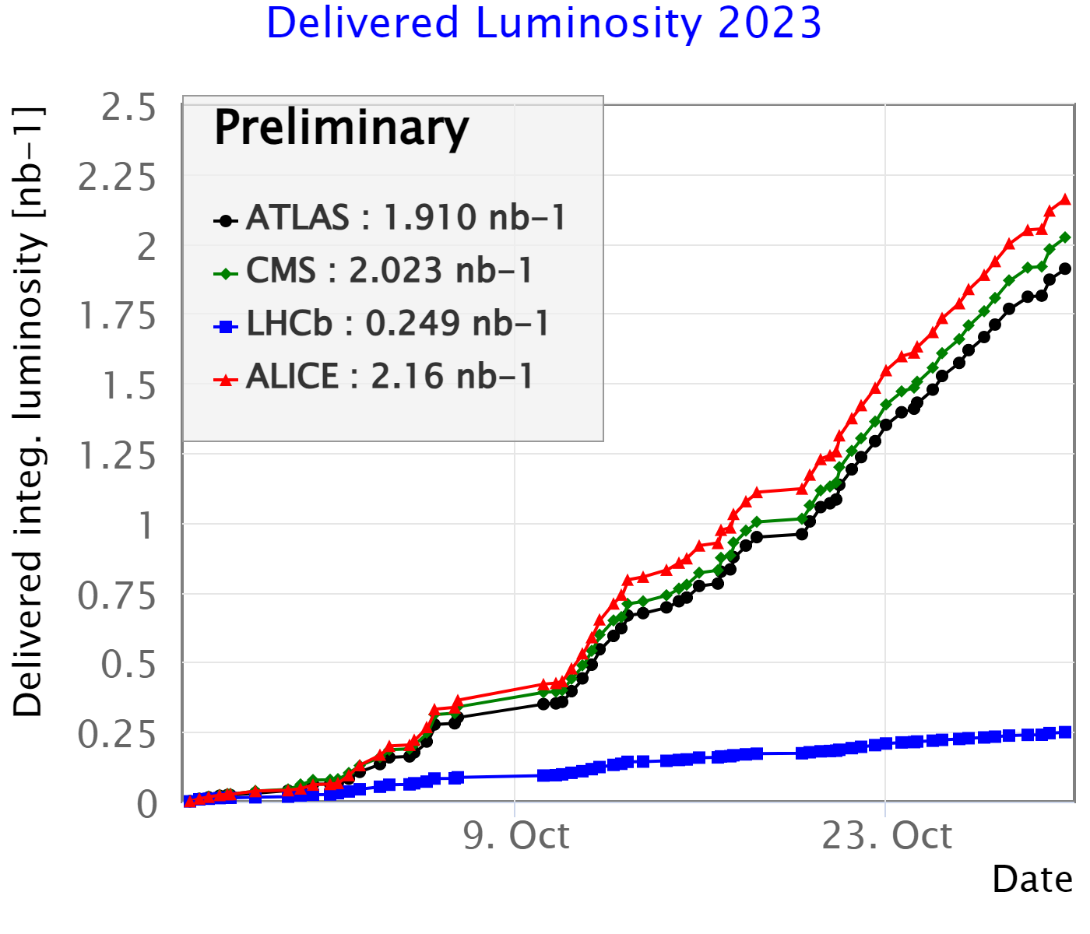
Beam overview, luminosity statistics
Using data from lpc.web.cern.ch
IR | Luminosity (1/nb) Ions 2023 | Luminosity (1/nb) Ions 2018
1 | 1.91 | 1.797
2 | 2.16 | 0.905
5 | 2.02 | 1.802
8 | 0.249 | 0.235
Compared to the 2018 ion run, the luminosity is similar in all IPs except for IP2, where it increased by 2x

Slide 3
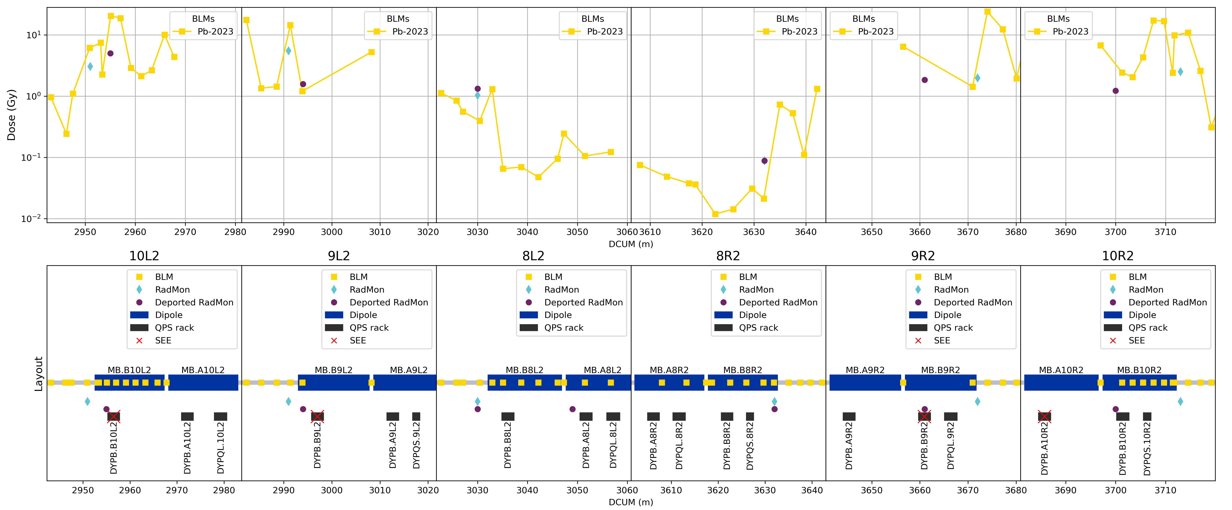
QPS racks and radiation monitor layout
- IR2 cells 8-10
iQPS under every main dipole
nQPS under the B-dipoles together with iQPS

Slide 4
R2E effects observed in the QPS system
 | Date | Time | Rack | Fault type | DCUM | Short description
1 | 5/10/2023 | 8:34:22 | DYPB.B10L2 | SEU | 2957 | nQPS DQQBS, Busbar splice protection system trigger causing circuit fast power abort
2 | 7/10/2023 | 0:24:27 | DYPB.B9R2 | Latch-up | 3661 | nQPS DQQDS RB, Symmetric quench detection system triggering causing heater firing and magnet quench; communication board failed before
3 | 11/10/2023 | 8:38:10 | DYPB.B10L2 | SEU | 2957 | nQPS DQQBS#3A, Busbar splice protection system trigger causing circuit fast power abort
4 | 12/10/2023 | 13:40:05 | DYPB.B9L2 | SEU | 2997 | nQPS DQQBS RQD, Busbar splice protection system trigger causing circuit fast power abort during ramp down after operator dump
5 | 13/10/2023 | 22:45:48 | DYPB.B12R2 | Latch-up | 3792 | nQPS DQQDS RB, Symmetric quench detection system triggering causing heater firing and magnet quench; communication board failed before
6 | 14/10/2023 | 20:52:09 | DYPQ.12L2 | Latch-up? | 2886 | iQPS MQ.11L2 nDQQDL, Quench detection system trigger causing heater firing and magnet quench
7 | 15/10/2023 | 7:57:08 | DYPB.B12R1 | SEU | 460 | nQPS DQQBS, Busbar splice protection system trigger causing circuit fast power abort
8 | 15/10/2023 | 13:47:38 | DYPQ.A12R2 | Latch-up | 3782 | iQPS MQ.11R2 nDQQDL, Quench detection system trigger causing heater firing and magnet quench
9 | 20/10/2023 | 23:45:45 | DYPB.B11L1 | SEU | 26244 | nQPS DQQBS RQD, DQQBS trigger provoking FPA
10 | 21/10/2023 | 14:40:00 | DYPB.A12R1 | SEU | 445 | iQPS DQHSU, Wrong DQHDS voltage reading by DQHSU board would have caused trigger of DQHDS software and slow power abort. Programmed dump by OP before; cleared by remote power cycle
11 | 22/10/2023 | 7:58:06 | DYPB.B10L2 | SEU | 2957 | nQPS DQQBS RB, DQQBS trigger provoking FPA
12 | 24/10/2023 | 8:18:01 | DYPB.B8L5 | Latch-up | 13034 | nQPS DQAMG, Fast power abort - no quench. DQAMG to be replaced.
13 | 29/10/2023 | 13:33:50 | DYPB.A10R2 | SEU | 3686 | iQPS DQAMGNMB, COM lost - OK after power cycle

Slide 5
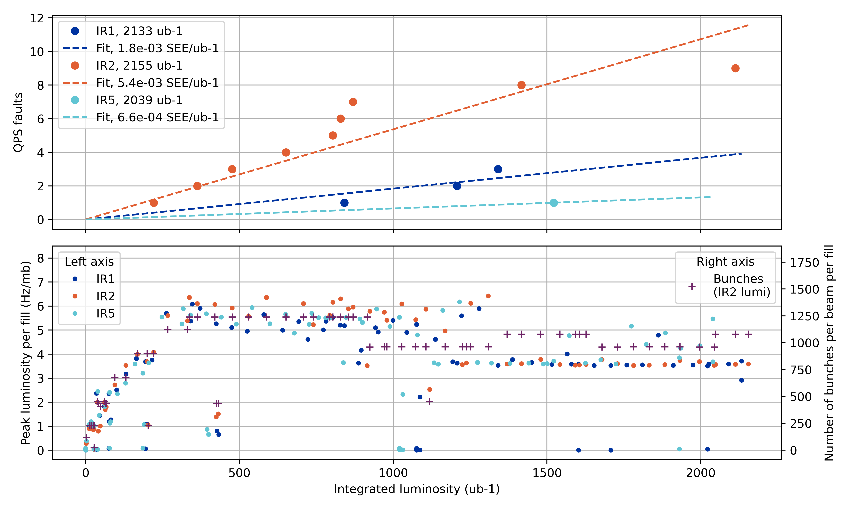
SEEs in the QPS racks as a function of luminosity
Scaling coeficients of SEEs in the QPS racks per IR as a function of integrated luminosity in the IR
The number of bunches and bunch trains were levelled around the ”SEE storm” occurring in IR2 before 1 nb⁻¹
(Data from LHC supertable)

Slide 6
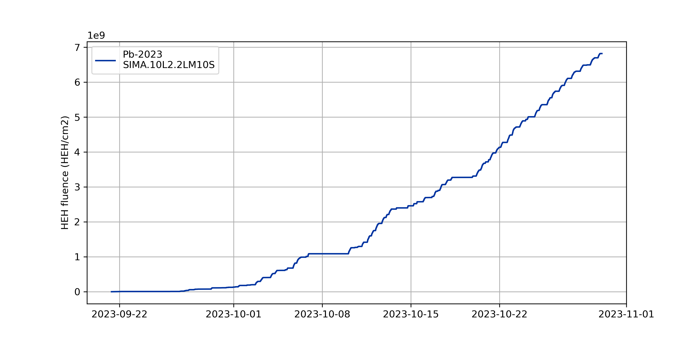
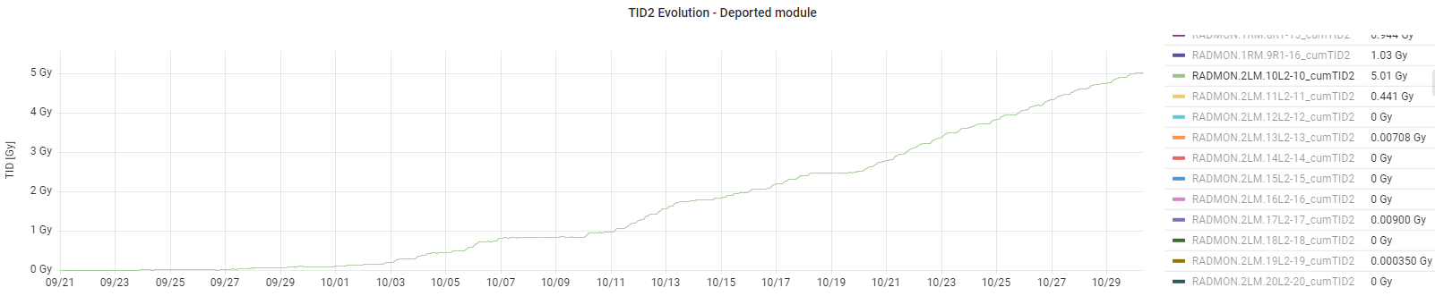
Radiation levels close to QPS rack locations
Example: QPS rack DYPB.B10L2 @ dcum 2957, with three SEEs
Deported modules close to DYPB-racks (only TID)
Full RadMon modules further away
SIMA.10L2.2LM10S, HEH Pb 2023
RadMon data | Dose at dcum 2955 | HEH fluence at dcum 2951
Pb-2023 | 5.02 Gy | 6.8*10⁹ HEH/cm²
Pb-2018 | 0.25 Gy | 2.4*10⁹ HEH/cm²
Proton-2023 | ~0 Gy | 3.7*10⁷ HEH/cm²
Not huge doses in terms of TID effects
SIMAD.10L2.2LM10S, Pb 2023
r2e-monitoring.web.cern.ch

Slide 7
Deported RadMon module data of half-cells 8, 9, 10
Doses measured by deported radmon modules, generally close to QPS racks, in half-cells 8, 9 and 10 left and right of points 1, 2 and 5. The number of QPS faults in these half-cells are also marked. The resulting number of SEEs per dose per half cell is similar among the time periods (low statistics).
Half-cells, SEEs | TID Pb-2023 (Gy) | TID Pb-2018 (Gy) | TID p-2023 (Gy) | TID p-2018 (Gy)
8L/R1, #SEE | - / 0.9, 0 | 0.9 / 0.5, 1 | - / ~0, 0 | 10.5 / 6.9, 5
8L/R2, #SEE | 1.3 / 0.1, 0 | 0.1 / -, 0 | 1.4 / ~0, 0 | 1.1 / -, 0
8L/R5, #SEE | 1.1 / 0.1, 1 | 1.0 / 0.2, 0 | 0.1 / 0.2, 0 | 28.9 / 9.7, 4
9L/R1, #SEE | 0.7 / 1.1, 0 | 0.4 / 0.9, 0 | ~0 / 0.1, 0 | 4.1 / 5.1, 2
9L/R2, #SEE | 1.6 / 1.9, 2 | 0.6 / 0.4, 1 | ~0 / ~0, 0 | ~0 / ~0, 0
9L/R5, #SEE | 0.7 / 1.1, 0 | 0.6 / 0.9, 1 | 0.5 / 0.1, 0 | 4.3 / 6.3, 2
10L/R1, #SEE | - / ~0, 0 | - / ~0, 0 | - / ~0, 0 | - / ~0, 0
10L/R2, #SEE | 5.0 / 1.2, 4 | 0.2 / 0.3, 0 | ~0 / ~0, 0 | ~0 / -, 0
10L/R5, #SEE | ~0 / -, 0 | ~0 / -, 0 | ~0 / -, 0 | ~0 / -, 0
SEE per Gy per half-cell | 6.2 (2.5, 13) | 6.3 (1.3, 19) | 0 (0, 24) | 2.5 (1.4, 4.3)
(1 Gy ↔ 3∙10⁹ HEH/cm²)
[Calculated value (lower limit, upper limit)]

Slide 8
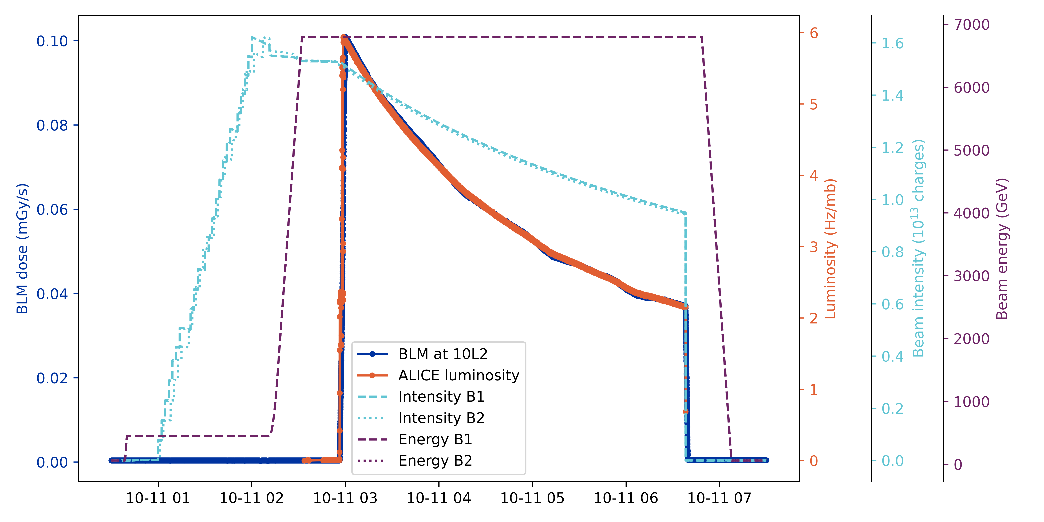
BLM signals used for dose distribution monitoring
- Induced dose around an interaction point scales well with the integrated luminosity of that point

Slide 9
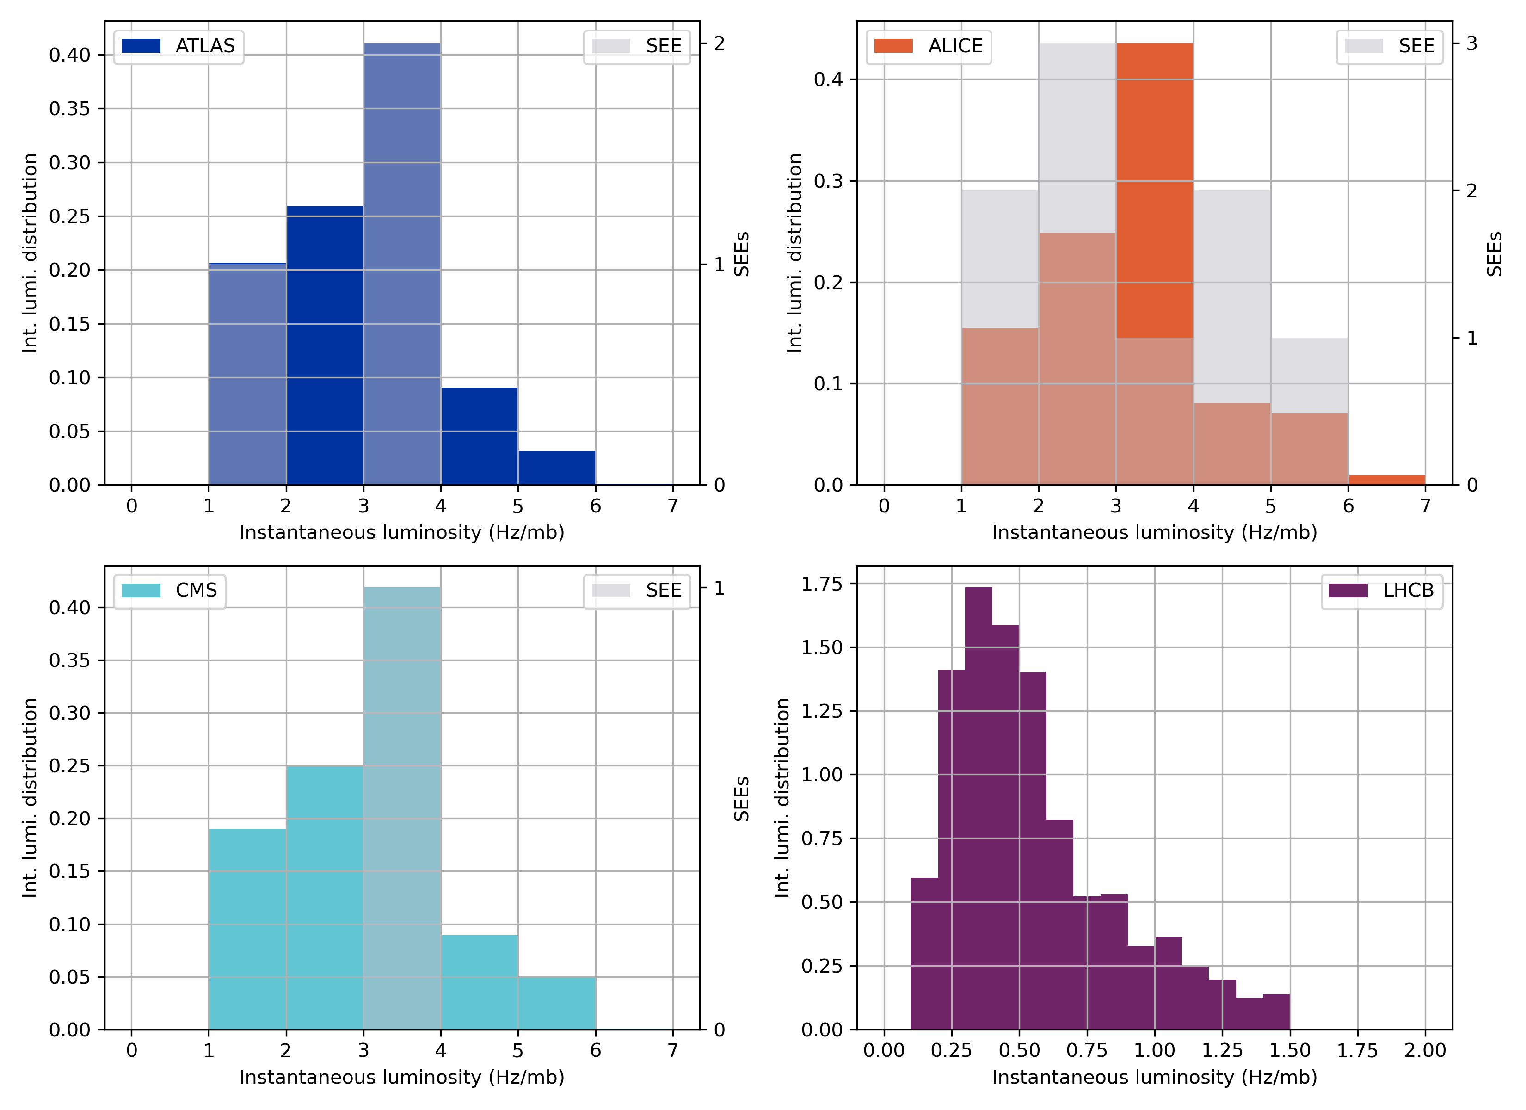
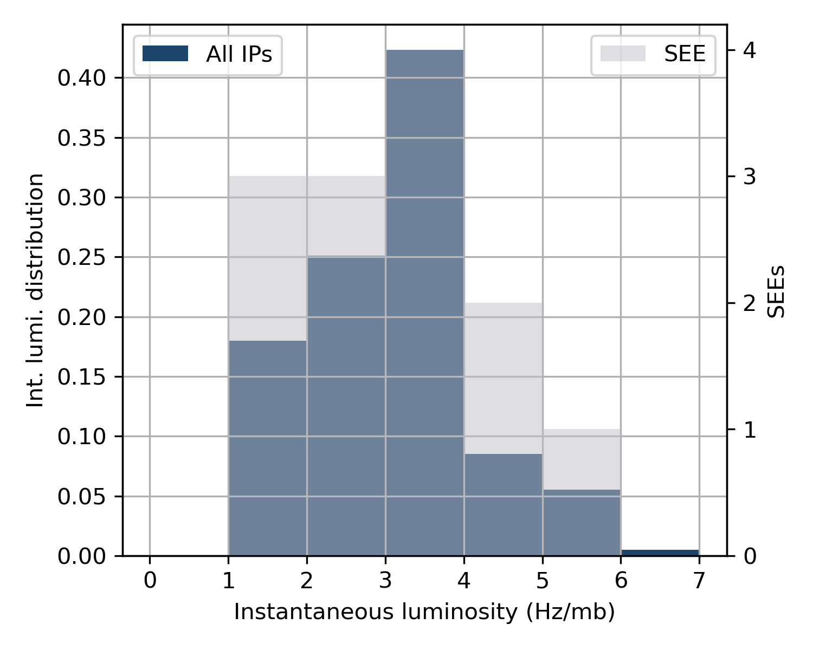
Instantaneous and integrated luminosity
The delivered integral luminosity of bins of instantaneous luminosities in LHC during the ion run
The radiation levels around the IP is proportional to the IP luminosity, so the SEEs should follow the same distribution as the integrated luminosity
Low statistics, but no clustering of SEEs at specific instantaneous luminosity values

Slide 10
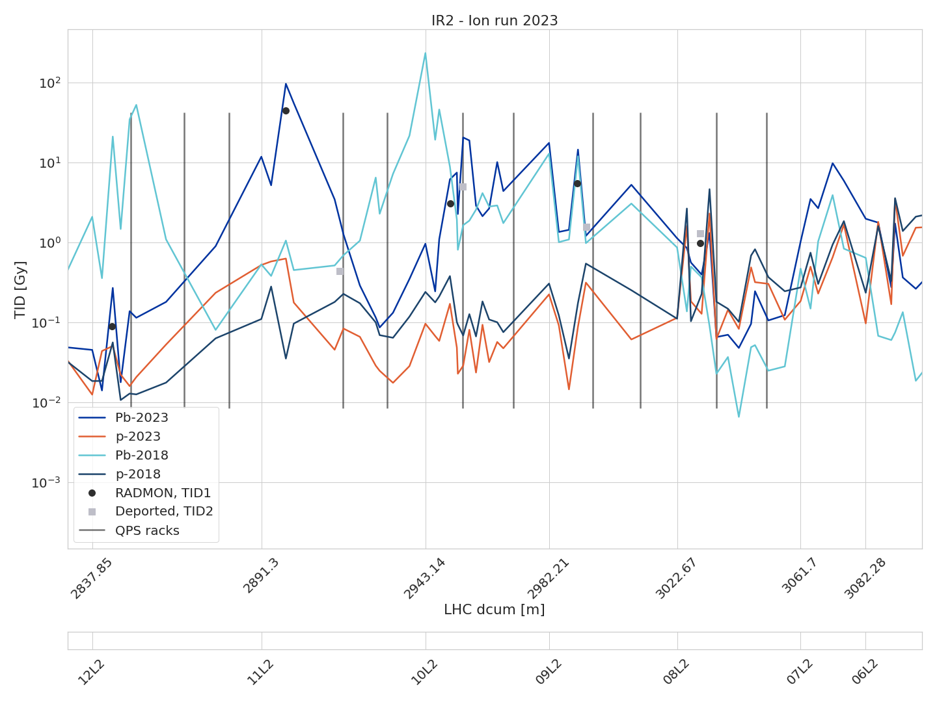
Left of Point 2 - Dose distribution DS, 2018 vs 2023
Only DYPB racks marked
Comparing the total BLM dose during the 2018 and 2023 ion and proton runs, left of IP2
Note: the lines between the points are visual guides and do not represent real dose values.
The dose in the DS is dominated by the ion runs
The dose peaks shifted compared to the 2018 run, due to the new TCLD location (and the related optics change)
3xSEE
1xSEE
Integrated luminosities in IR2:
Pb 2023: 2.16 nb⁻¹
Pb 2018: 0.905 nb⁻¹
(p 2023: 14.5 pb⁻¹)

Slide 11
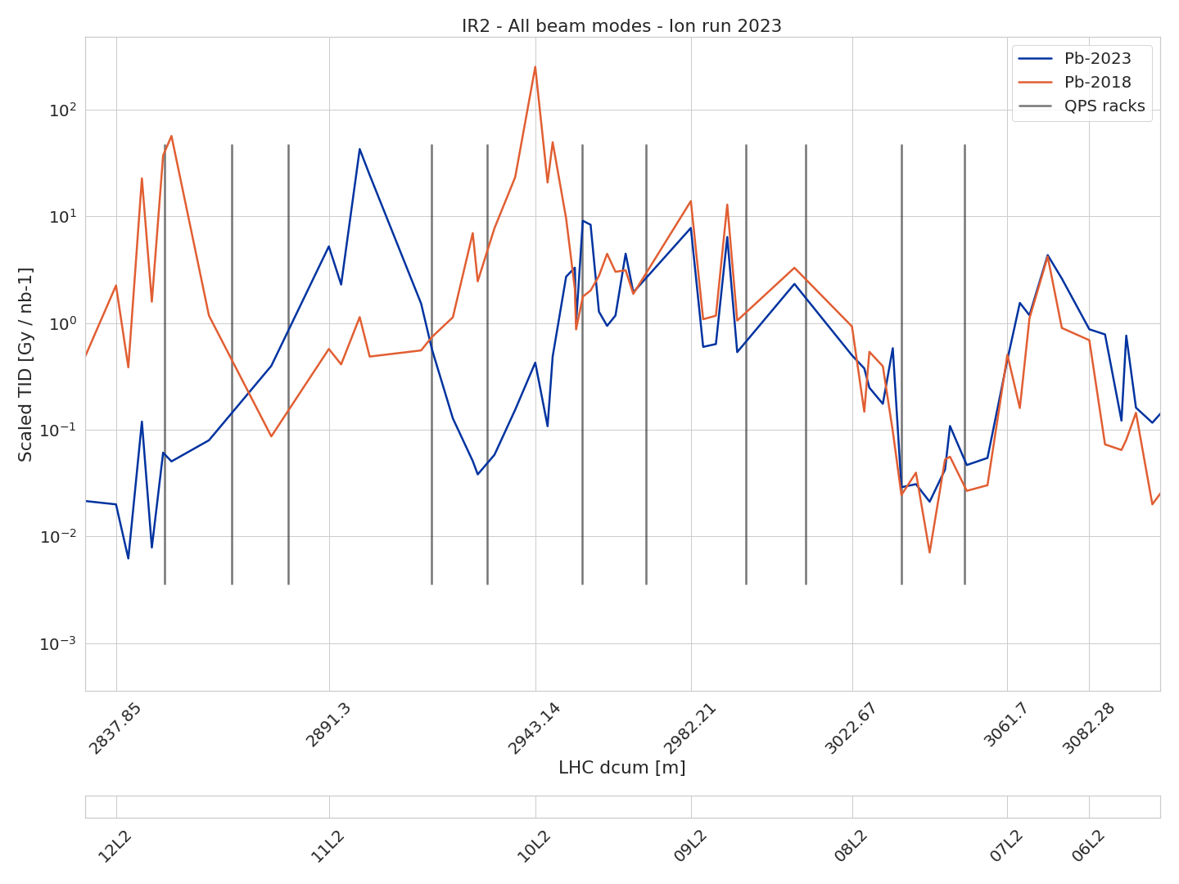
Left of Point 2 - Dose distribution DS, scaled doses
A comparison between the dose levels left of point 2 for ion runs 2018 and 2023
Doses are normalized by the integrated luminosity in IR2
3xSEE
1xSEE
Integrated luminosities in IR2:
Pb 2023: 2.16 nb⁻¹
Pb 2018: 0.905 nb⁻¹

Slide 12
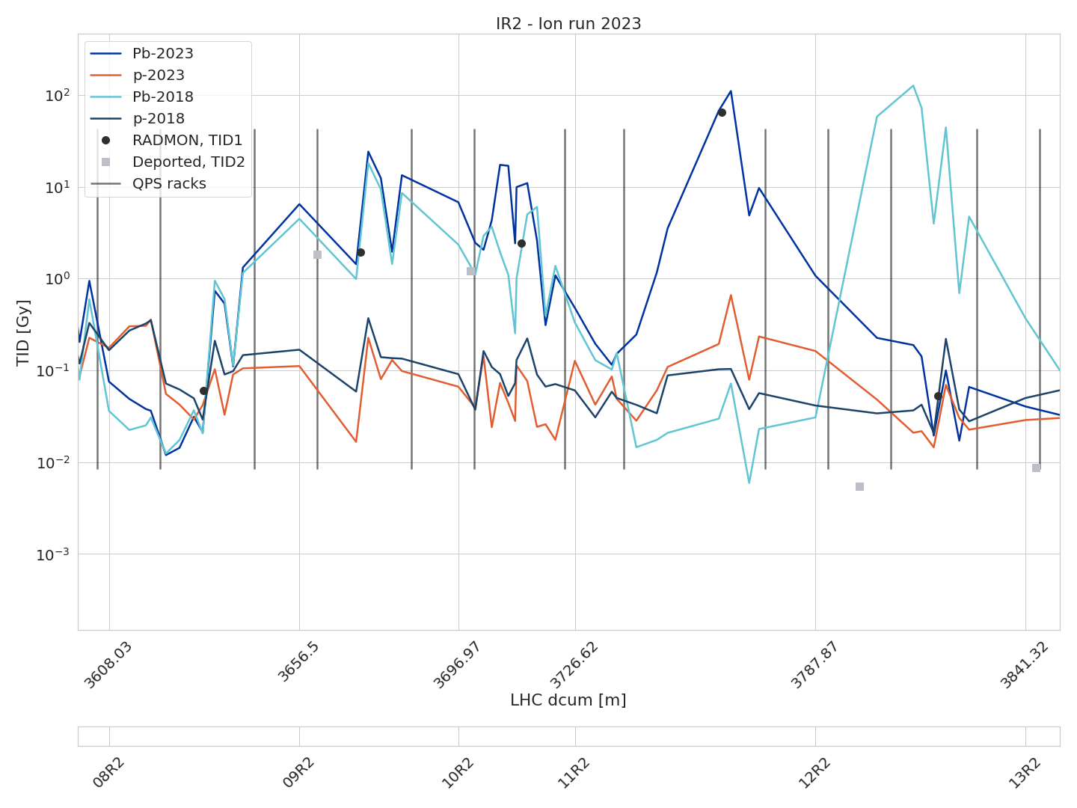
Right of Point 2 - Dose distribution DS, 2018 vs 2023
Comparing the total BLM dose during the 2018 and 2023 ion runs, and during the 2023 proton run, right of IP2
Note: the lines between the points are visual guides and do not represent real dose values.
The dose in the DS is dominated by the ion runs
The dose peaks shifted compared to the 2018 run, due to the new TCLD location (and the related optics change)
1xSEE
1xSEE
1xSEE
Integrated luminosities in IR2:
Pb 2023: 2.16 nb⁻¹
Pb 2018: 0.905 nb⁻¹
(p 2023: 14.5 pb⁻¹)

Slide 13
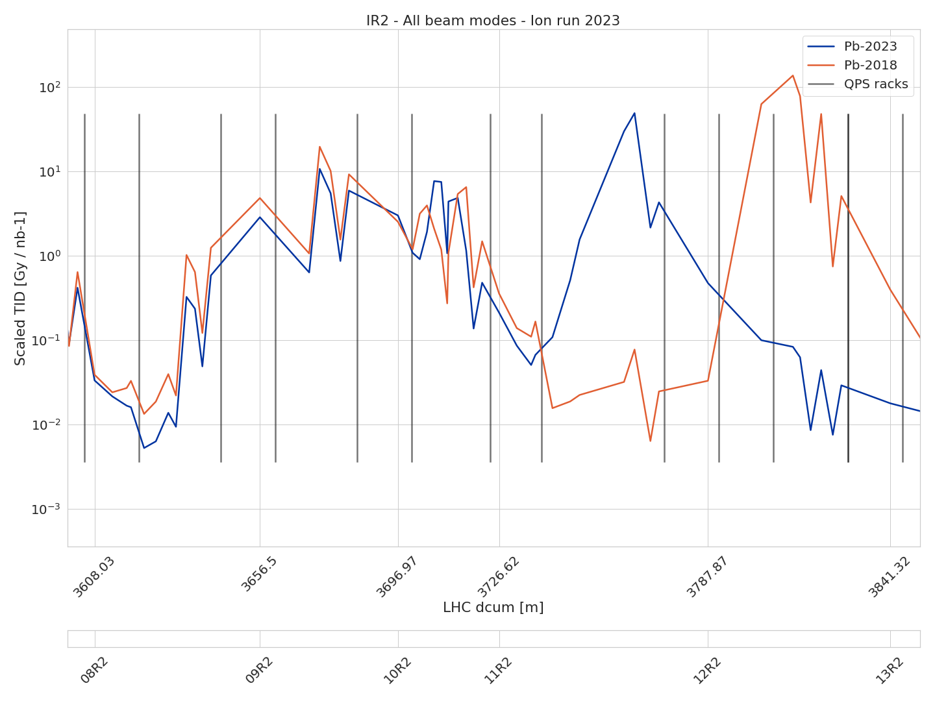
Ion run doses scaled by luminosity, Right of IR2
Same view, but radiation levels scaled by the integrated luminosity (only ion runs)
1xSEE
1xSEE
1xSEE
Integrated luminosities in IR2:
Pb 2023: 2.16 nb⁻¹
Pb 2018: 0.905 nb⁻¹

Slide 14
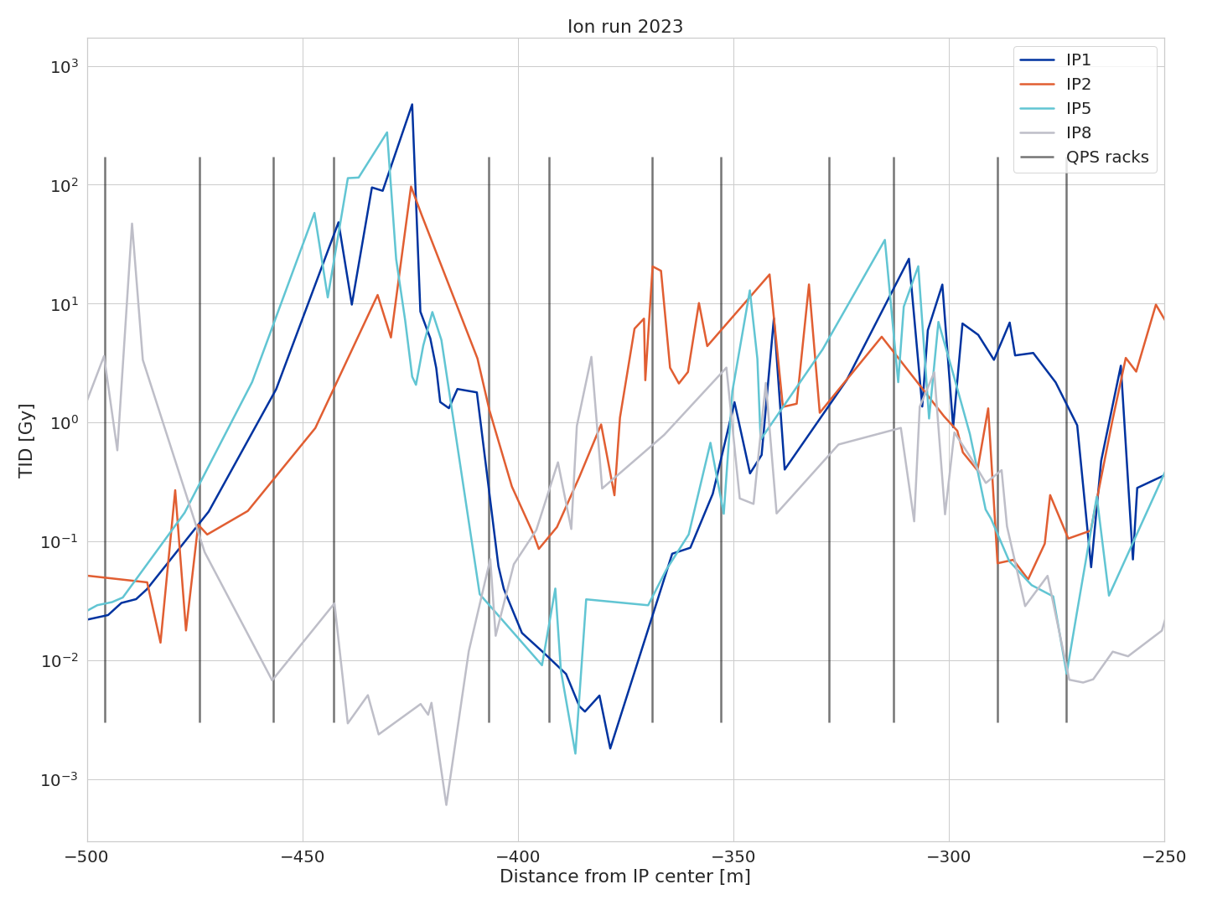
Left of IRs1-2-5-8 – 2023 ion BLMs
Within the 2023 Pb run, we observe relatively higher dose in cells 9-10 in IR2 (and, partially, IR8) compared to IR1-IR5. This is reflected in a larger amount of QPS issues in cells 9-10 of IR2.
The main dose peak is in cell 11 in IR1-IR5 (BFPP) and IR2 (TCLD) while it is in cell 12 in IR8
IR | Luminosity (1/nb)
1 | 1.91
2 | 2.16
5 | 2.02
8 | 0.249

Slide 15
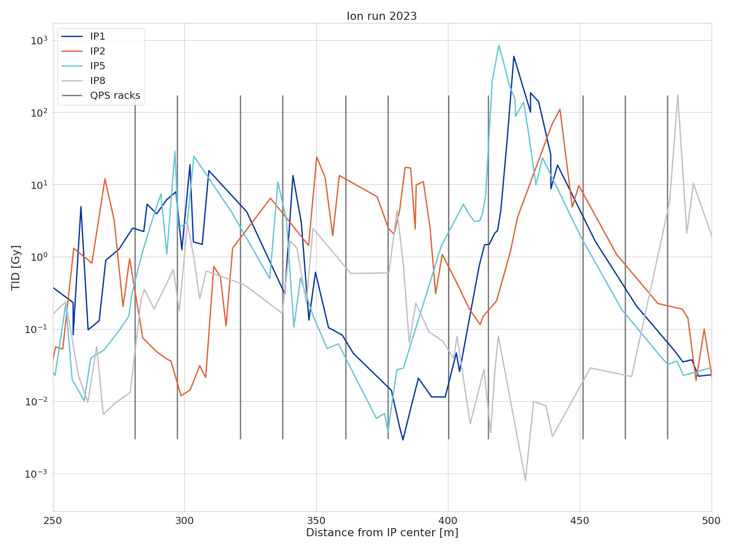
Right of IRs1-2-5-8 – 2023 ion BLMs
Within the 2023 Pb run, we observe relatively higher dose in cells 9-10 in IR2 (and, partially, IR8) compared to IR1-IR5. This is reflected in a larger amount of QPS issues in cells 9-10 of IR2.
The main dose peak is in cell 11 in IR1-IR5 (BFPP) and IR2 (TCLD) while it is in cell 12 in IR8
IR | Luminosity (1/nb)
1 | 1.91
2 | 2.16
5 | 2.02
8 | 0.249

Slide 16
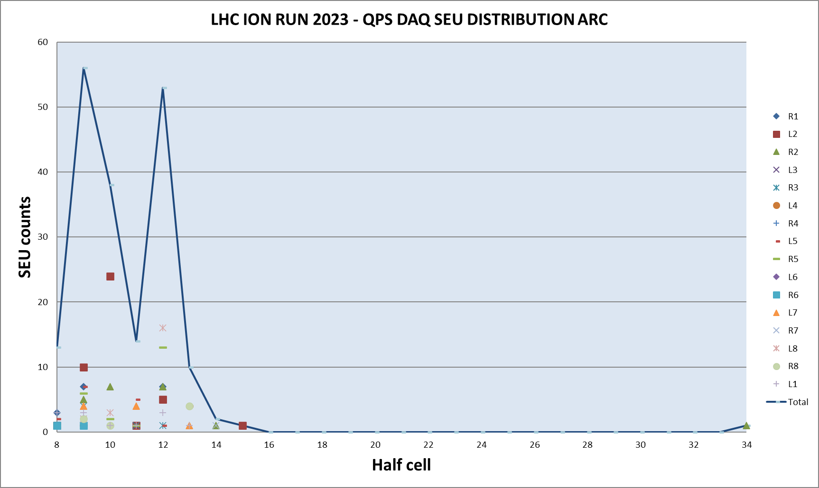
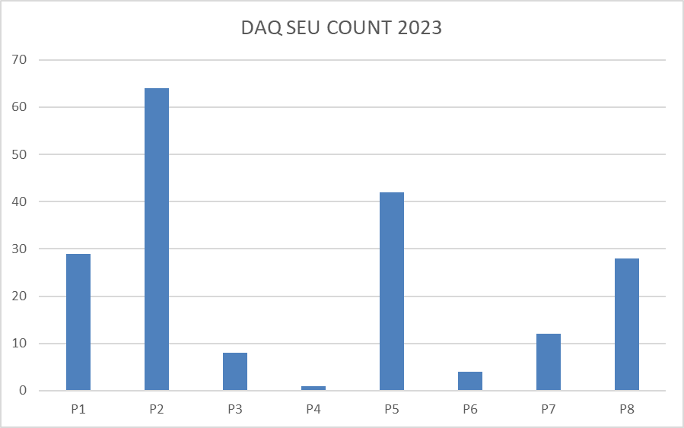
QPS DAQ SEEs (input from R. Denz)
The SEU counters from the QPS DAQ are confirming the picture outlined by BLMs and RadMons:
  In 2023, IR2 is the region with the largest number of SEUs
  The number of SEUs in IR2 is concentrated in cells 9, 10 and 12, where most issues have occurred

Slide 17
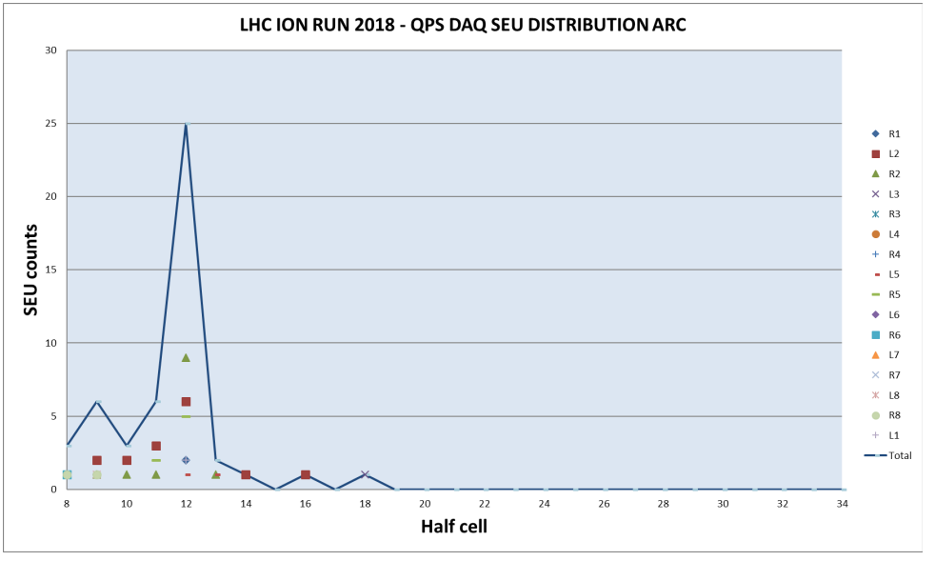
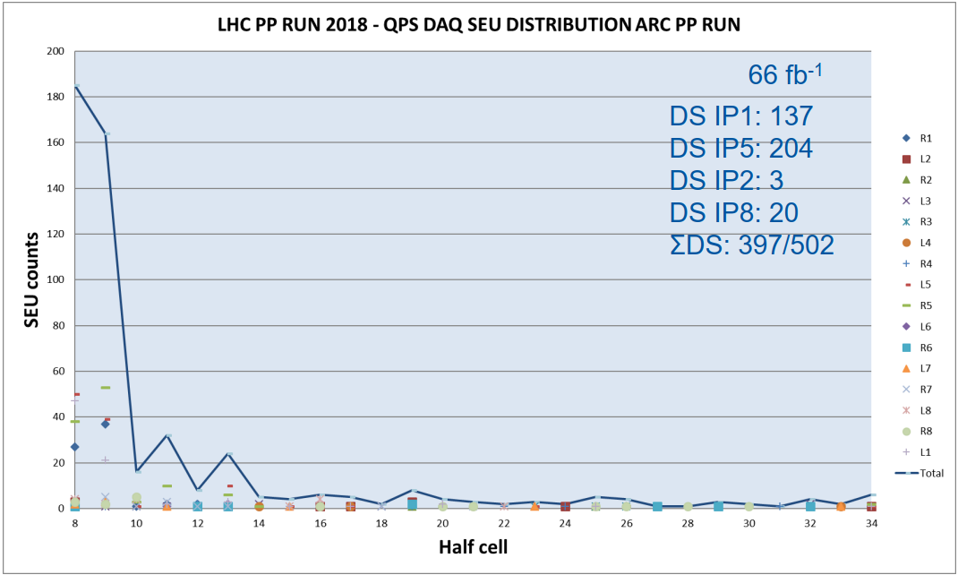
QPS DAQ SEEs (input from R. Denz)
2023 pattern compared to 2018
  The 2023 ion run with most events in half cells 9,10 and 12
  2018 pp run dominated in 8 and 9, while the ion run saw most events in 12

Slide 18
Summary
A total of 13 QPS failures attributed to R2E occurred during the 2023 ion run, with 9 in IR2
The radiation levels on (or near) the QPS racks, as measured by the BLMs and the RadMons, are generally well correlated with the distribution of the faults
Compatible number of QPS SEEs per radiation level between 2018 and 2023 ion and proton runs
When comparing the 2023 ion run experience with 2018, it is important to consider that:
  The integrated luminosities in IR1-5-8 in the two years were similar, while in IR2 the 2023 integrated luminosity is larger by more than 2x
  → a relative increase of IR2 SEEs can be expected
  The radiation level profile in the tunnel in IR2 in 2023 is very different from 2018, due to the TCLD installation and the associated optics changes
Most QPS faults in IR2 are in cells 9-10, i.e., upstream of the TCLD, with two exceptions
The radiation level distribution measured by RadMons and BLMs is confirmed by the SEU distribution in the QPS DAQ (input from R. Denz)

Slide 19
Bonus slides

Slide 20
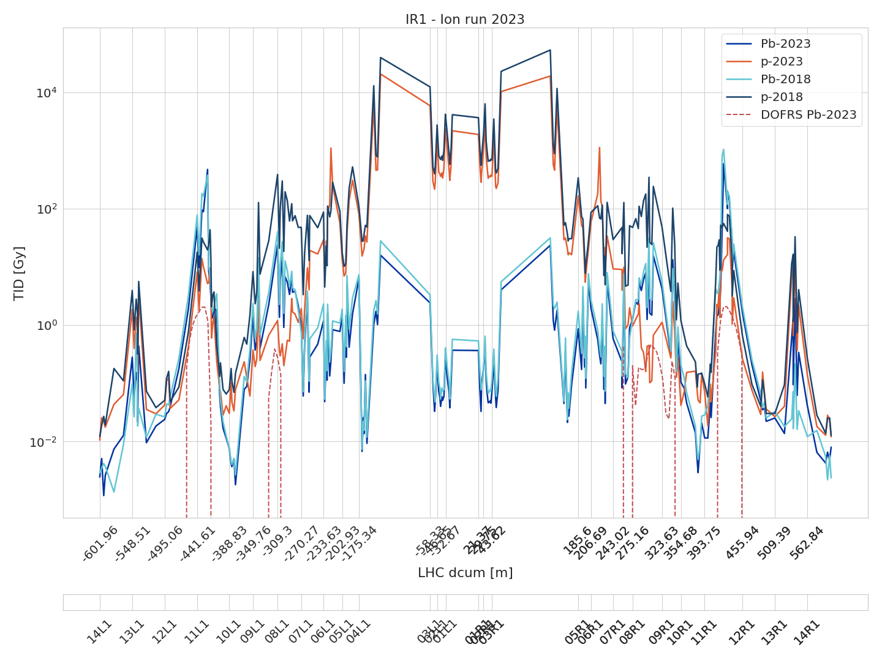
Ion and proton run doses in IR1

Slide 21
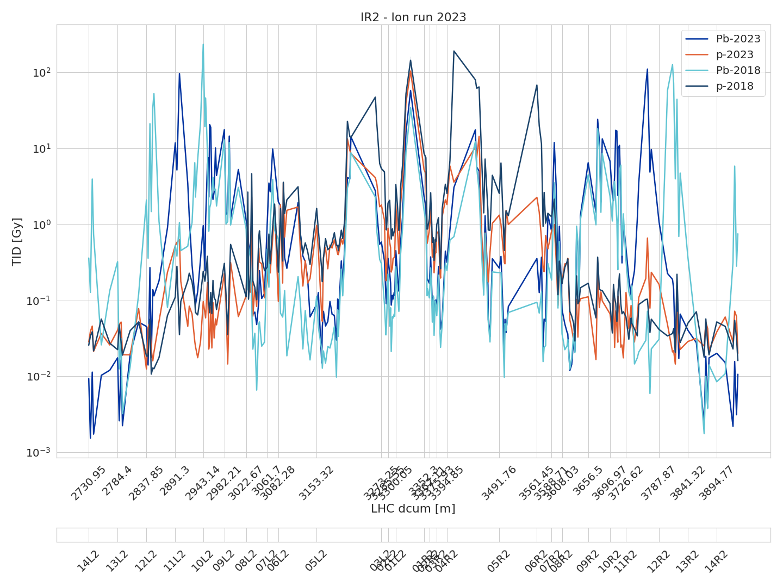
Ion and proton run doses in IR2

Slide 22
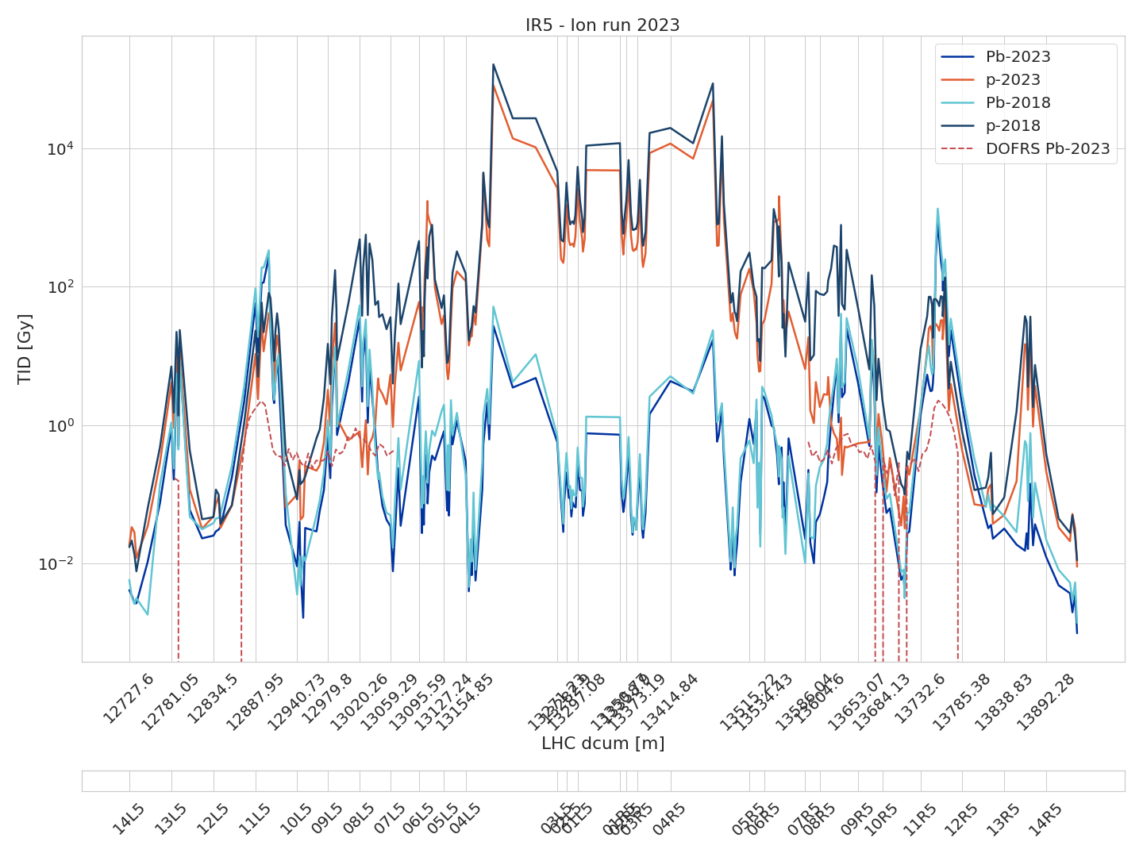
Ion and proton run doses in IR5

Slide 23
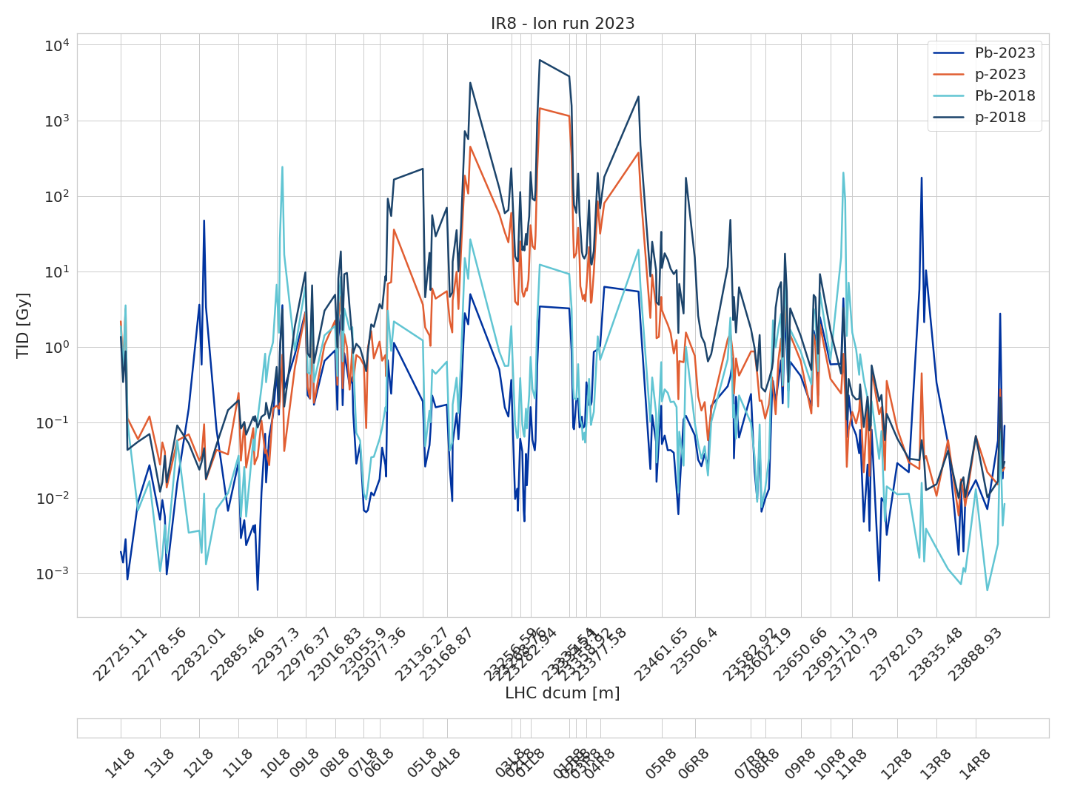
Ion and proton run doses in IR8

Slide 24
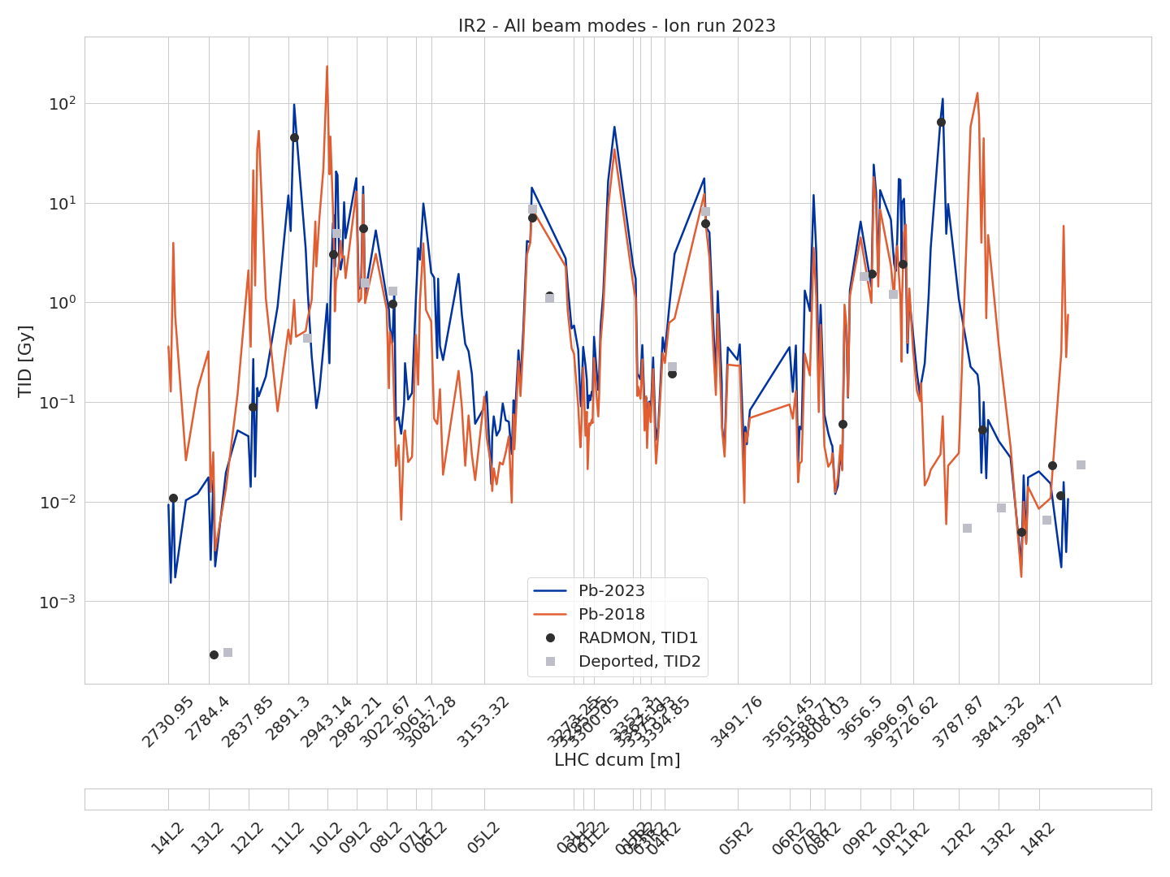
Dose distribution around IP2
Overview of IP2
Ion runs of 2023 and 2018 compared
Asymmetry between the left and right sides of the IP (the highest peak of 2018 at 10L2 is for instance not as severe in 10R2)
TID measurements from RadMons included, with the internal fg-dose (TID1) and deported module (TID2) measurements shown separately

Slide 25
RadMon dose measurements close to QPS racks
For most QPS racks where SEEs occurred, we have a RadMon deported module measuring TID within <10m (green racks). In other racks the RadMon is either within <20m (yellow) or not available (red)
RadMons measuring HEH fluence are typically further away from the QPS racks
Rack (N_{SEE}) | DCUM (m) | Closest RadMon (dcum) | RadMon HeH fluence (HeH/cm²) | Closest deported RadMon (dcum) | Deported RadMon dose (Gy)
DYPB.B11L1 (1x) | 26244 | 26226 | 2.56E+11 | - (26243, inactive) | - (75.3 @ 26226 m)
DYPB.A12R1 (1x) | 445 | 432 | 1.03E+12 | 466 | 0.09
DYPB.B12R1 (1x) | 460 | 487 | 4.91E+07 | 466 | 0.09
DYPQ.12L2 (1x) | 2886 | 2899 | 1.29E+11 | 2871 | 45.3 @ 2899 m
DYPB.B10L2 (3x) | 2957 | 2951 | 6.82E+09 | 2955 | 5.02
DYPB.B9L2 (1x) | 2997 | 2991 | 9.80E+09 | 2994 | 1.58
DYPB.B9R2 (1x) | 3661 | 3672 | 5.53E+09 | 3661 | 1.85
DYPB.A10R2 (1x) | 3686 | 3672 | 5.53E+09 | 3700 | 1.23
DYPQ.A12R2 (1x) | 3782 | 3764 | 1.92E+11 | 3799 | 2 mGy
DYPB.B12R2 (1x) | 3792 | 3819 | 8.04E+07 | 3799 | 2 mGy
DYPB.B8L5 (1x) | 13034 | 13030 | 5.62E+09 | 13032 | 1.13

Slide 26
RadMon dose and HEH fluence estimations
Table with further included estimated dose and HEH fluence estimations. Primarily from nearby RadMon units, secondarily from BLM dose measurements if a BLM is nearby. Dose to HEH fluence conversions if necessary have been made using a factor of 1 Gy = 3∙10⁹ cm⁻².
Rack (N_{SEE}) | DCUM (m) | HeH/cm² Pb-2023 | Gy Pb-2023 | HeH/cm² p-2023 | Gy p-2023 | HeH/cm² Pb-2018 | Gy Pb-2018 | HeH/cm² p-2018 | Gy p-2018
DYPB.B11L1 (1x) | 26244 | 5.74E+09 | 1.91 | 4.23E+09 | 1.41 | 6.30E+09 | 2.10 | 8.43E+07 | 0.03
DYPB.A12R1 (1x) | 445 | 5.59E+10 | 18.64 | 8.82E+09 | 2.94 | 7.40E+10 | 24.68 | 2.60E+10 | 8.66
DYPB.B12R1 (1x) | 460 | 2.58E+08 | 0.09 | 7.94E+08 | 0.26 | 2.89E+07 | 0.01 | 1.97E+09 | 0.66
DYPQ.12L2 (1x) | 2886 | 3.55E+10 | 11.83 | 1.57E+09 | 0.52 | 1.60E+09 | 0.53 | 3.30E+08 | 0.11
DYPB.B10L2 (3x) | 2957 | 6.82E+09 | 5.02 | 3.66E+07 | 0.08 | 2.39E+09 | 0.26 | 5.36E+07 | 0.13
DYPB.B9L2 (1x) | 2997 | 9.80E+09 | 1.58 | 4.30E+07 | 0.31 | 3.78E+09 | 0.61 | 5.55E+07 | 0.54
DYPB.B9R2 (1x) | 3661 | 5.55E+09 | 1.85 | 3.34E+08 | 0.11 | 1.39E+09 | 0.46 | 5.03E+08 | 0.17
DYPB.A10R2 (1x) | 3686 | 4.01E+10 | 13.35 | 2.95E+08 | 0.10 | 2.56E+10 | 8.55 | 4.02E+08 | 0.13
DYPQ.A12R2 (1x) | 3782 | 3.22E+09 | 1.07 | 4.87E+08 | 0.16 | 9.20E+07 | 0.03 | 1.24E+08 | 0.04
DYPB.B12R2 (1x) | 3792 | 6.64E+06 | 0.00 | 4.87E+08 | 0.16 | 8.22E+07 | 0.03 | 1.24E+08 | 0.04
DYPB.B8L5 (1x) | 13034 | 5.62E+09 | 1.13 | 2.27E+08 | 0.06 | 3.13E+09 | 1.04 | 5.91E+10 | 28.96

Slide 27
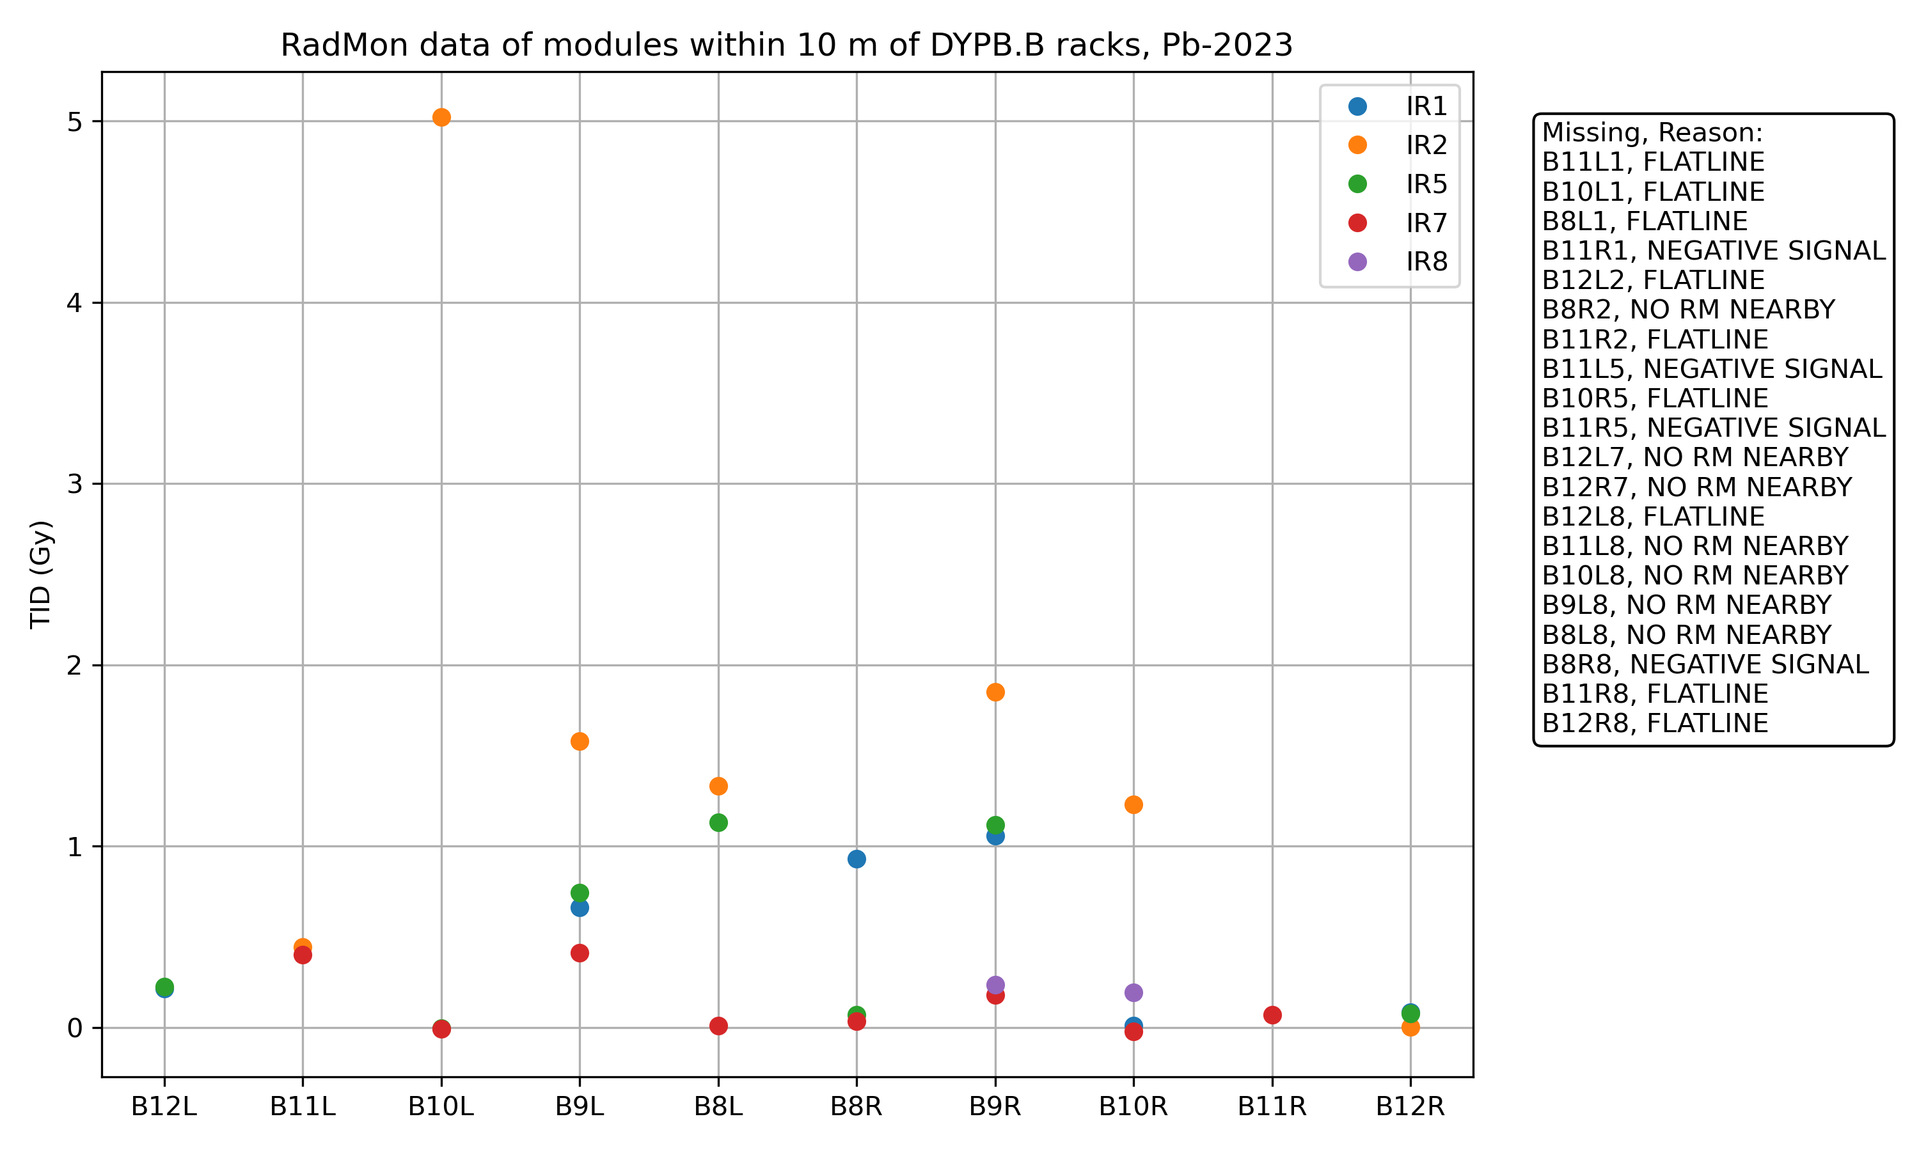
RadMons closest to the DYPB.Bxxx racks
All DYPB-racks
Sorted by deported RadMon dose
Doses close to the DPYB.B racks are large in IR2, where the majority of radiation effects have been observed
Rack | dcum | Radmon dcum | Dep RM dcum | Radmon HEH fluence Pb-2023 | Dep RM TID Pb-2023
DYPB.B10L2 | 2957 | 2951 | 2955 | 6.82E+09 | 5.02
DYPB.A10L2 | 2972 | 2991 | 2955 | 9.80E+09 | 5.02
DYPB.B9R2 | 3661 | 3672 | 3661 | 5.53E+09 | 1.85
DYPB.B9L2 | 2997 | 2991 | 2994 | 9.80E+09 | 1.58
DYPB.B8L2 | 3036 | 3030 | 3030 | 2.66E+09 | 1.33
DYPB.A10R2 | 3686 | 3672 | 3700 | 5.53E+09 | 1.23
DYPB.B10R2 | 3701 | 3713 | 3700 | 9.34E+09 | 1.23
DYPB.B8L5 | 13034 | 13030 | 13032 | 5.62E+09 | 1.13
DYPB.A8L5 | 13049 | 13030 | 13032 | 5.62E+09 | 1.13
DYPB.A9R5 | 13642 | 13629 | 13656 | 6.41E+09 | 1.12
. . .
(3xSEE)
Showing only SEEs in type-B DYPB racks
1x SEE (L1)
0x SEE
Racks marked in red caused SEE-induced issues
0x SEE
1x SEE (L2)
1x SEE (R2)
0x SEE
3x SEE (L2)
0x SEE
1x SEE (L5)
2x SEE (1xR1, 1xR2)
The QPS racks where the RadMons measured the highest TID are generally the ones that suffered SEE-induced issues

Slide 28
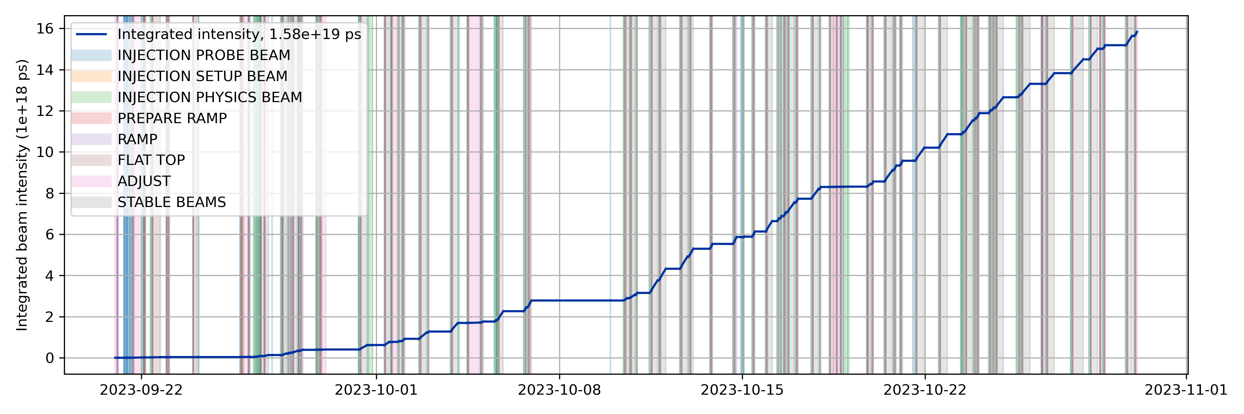
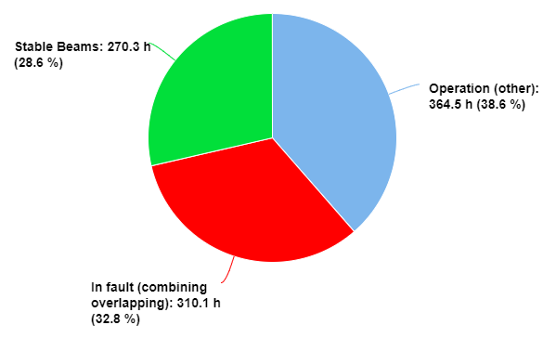
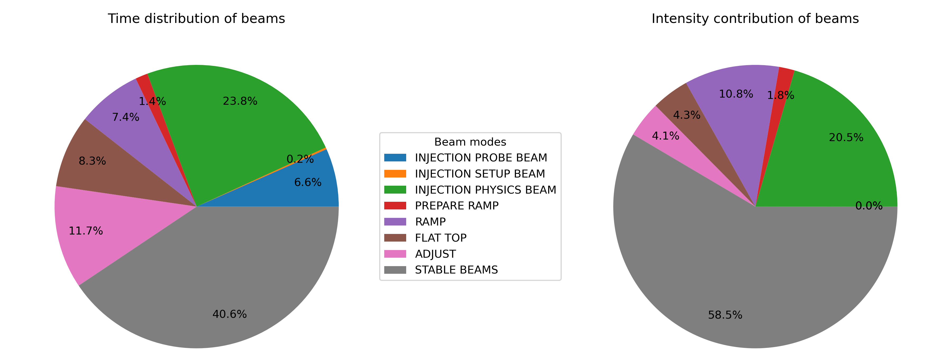
Beam overview, beam intensity statistics
From aft.cern.ch:

Slide 29
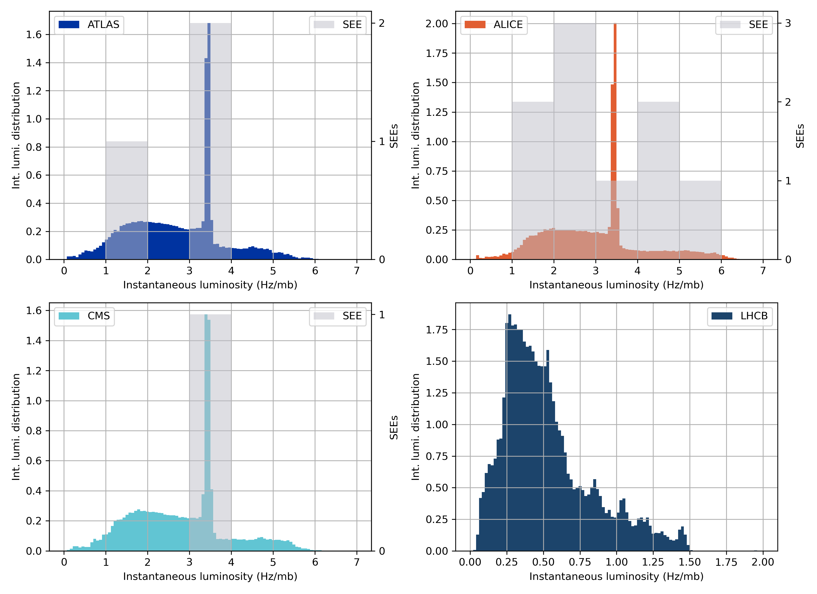
Instantaneous and integrated luminosity
The delivered integral luminosity of bins of instantaneous luminosities in LHC during the ion run
The radiation levels around the IP is proportional to the IP luminosity, so the SEEs should follow the same distribution as the integrated luminosity
Low statistics, but no clustering of SEEs at specific instantaneous luminosity values

Slide 30
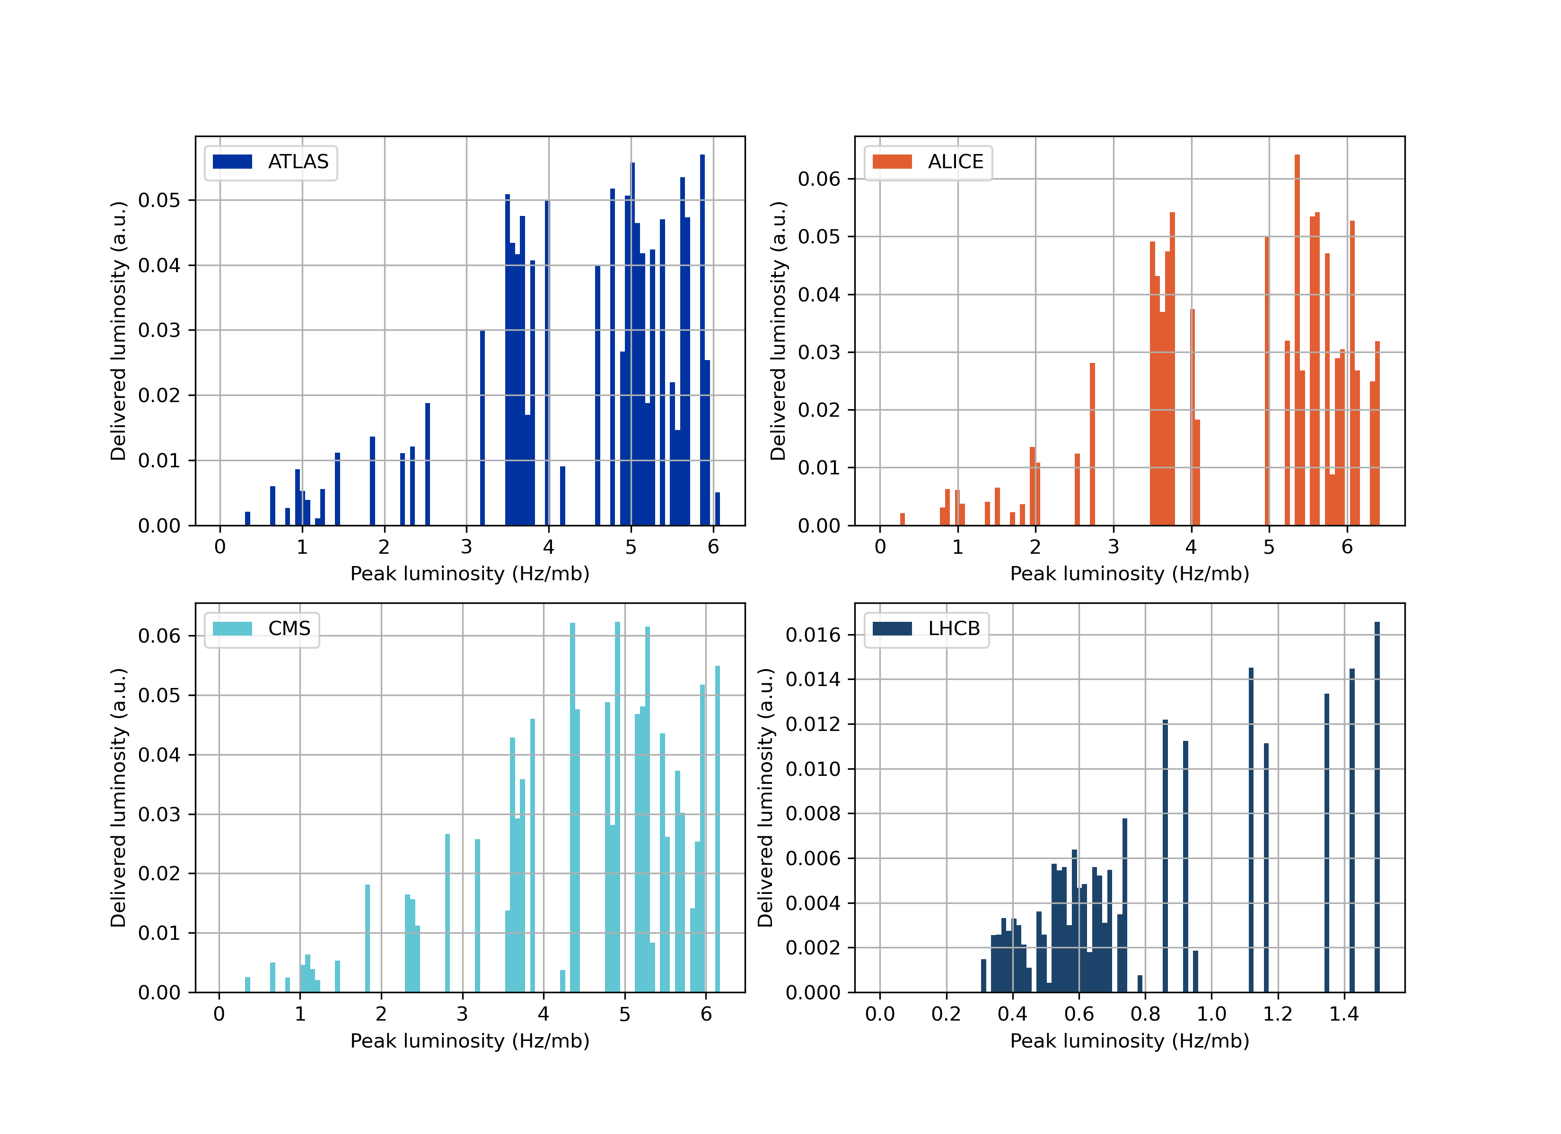
Peak luminosity and integrated luminosity
The delivered luminosity as a function of peak luminosity per LHC fill is shown
As the peak luminosity of the fill gets larger, also the integrated luminosity of the fill increases (as would be expected)
At high peak luminosities, the increase in delivered luminosity per fill falls of, perhaps due to the observed effects of high-luminosity fills ending prematurely

Slide 31
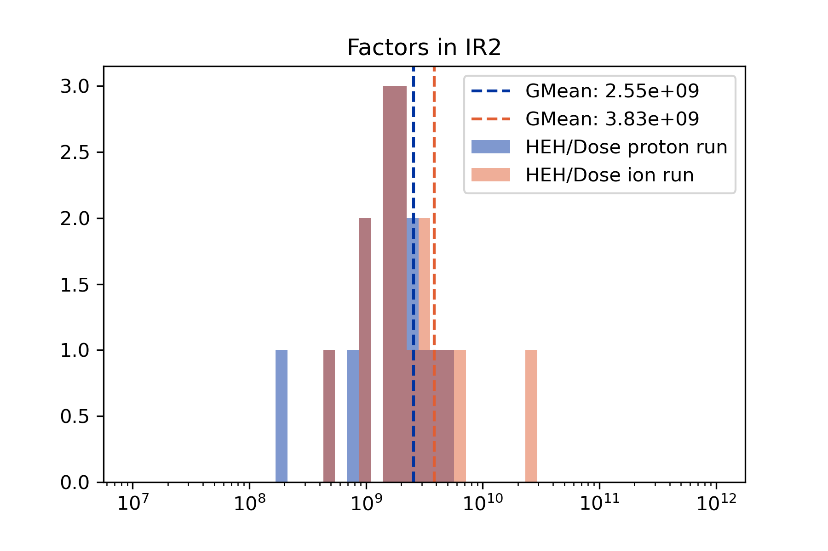
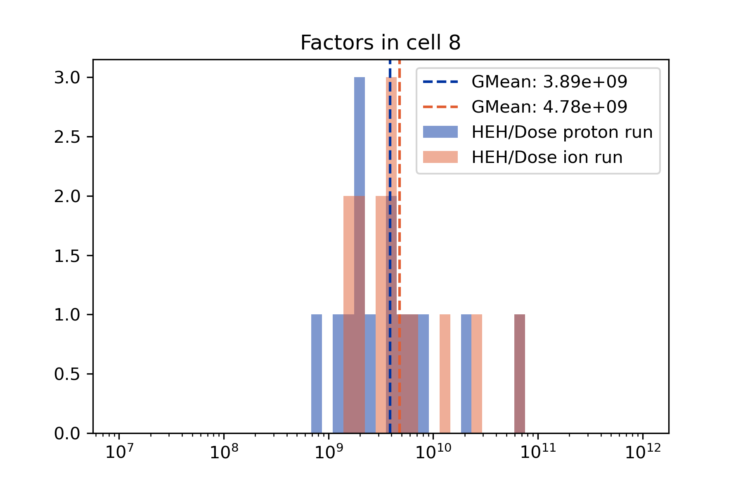
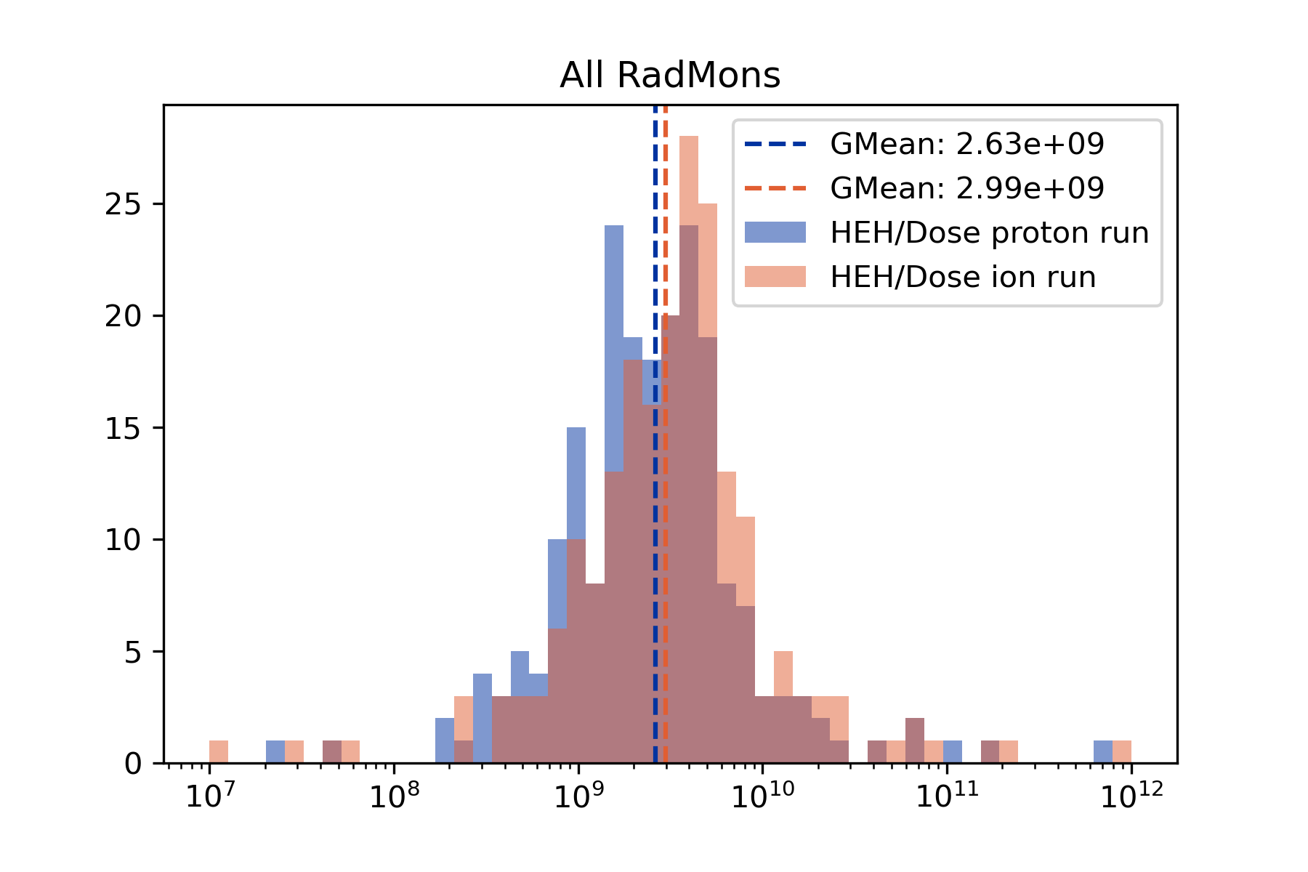
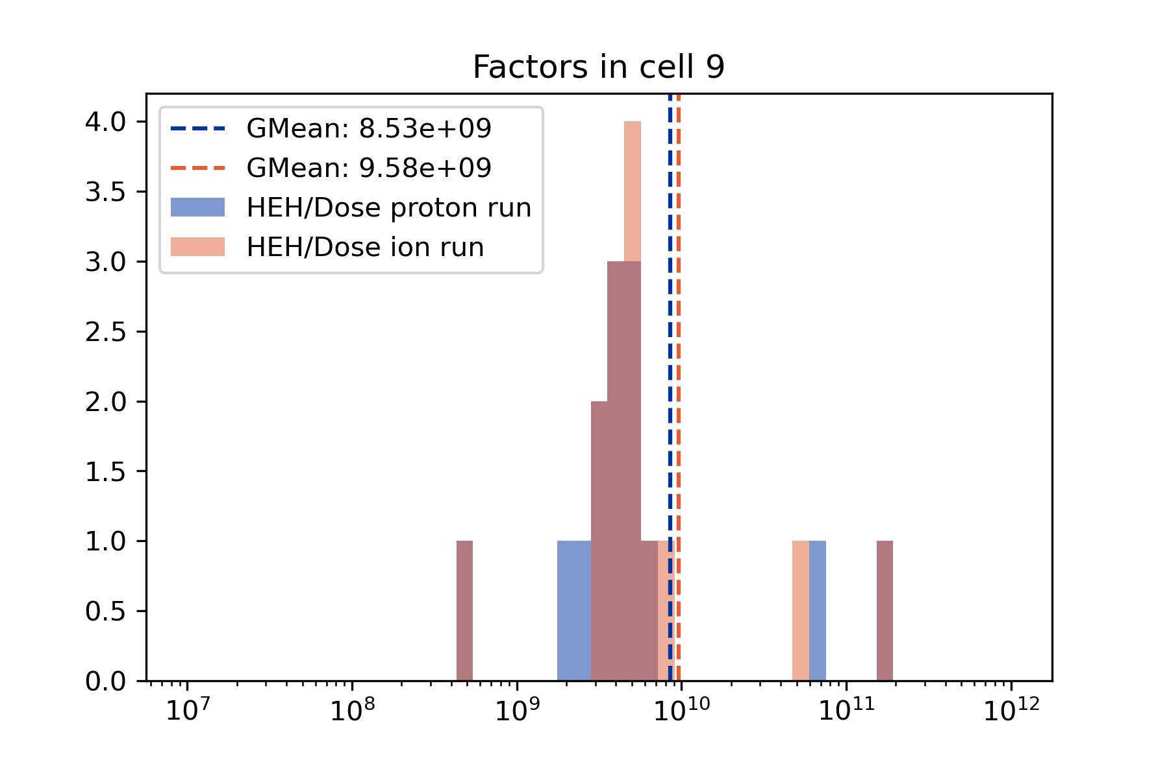
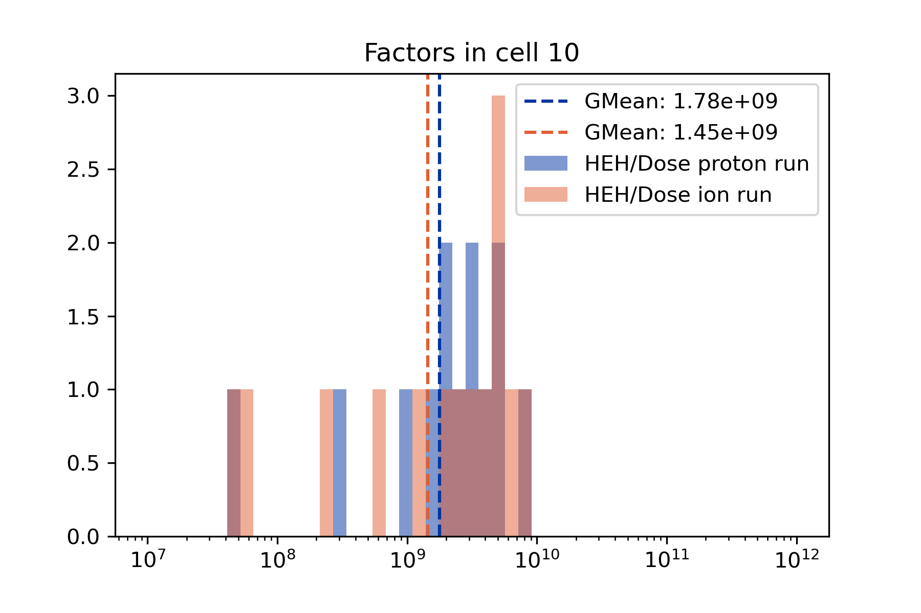
TID to HEH fluence conversion

Slide 32
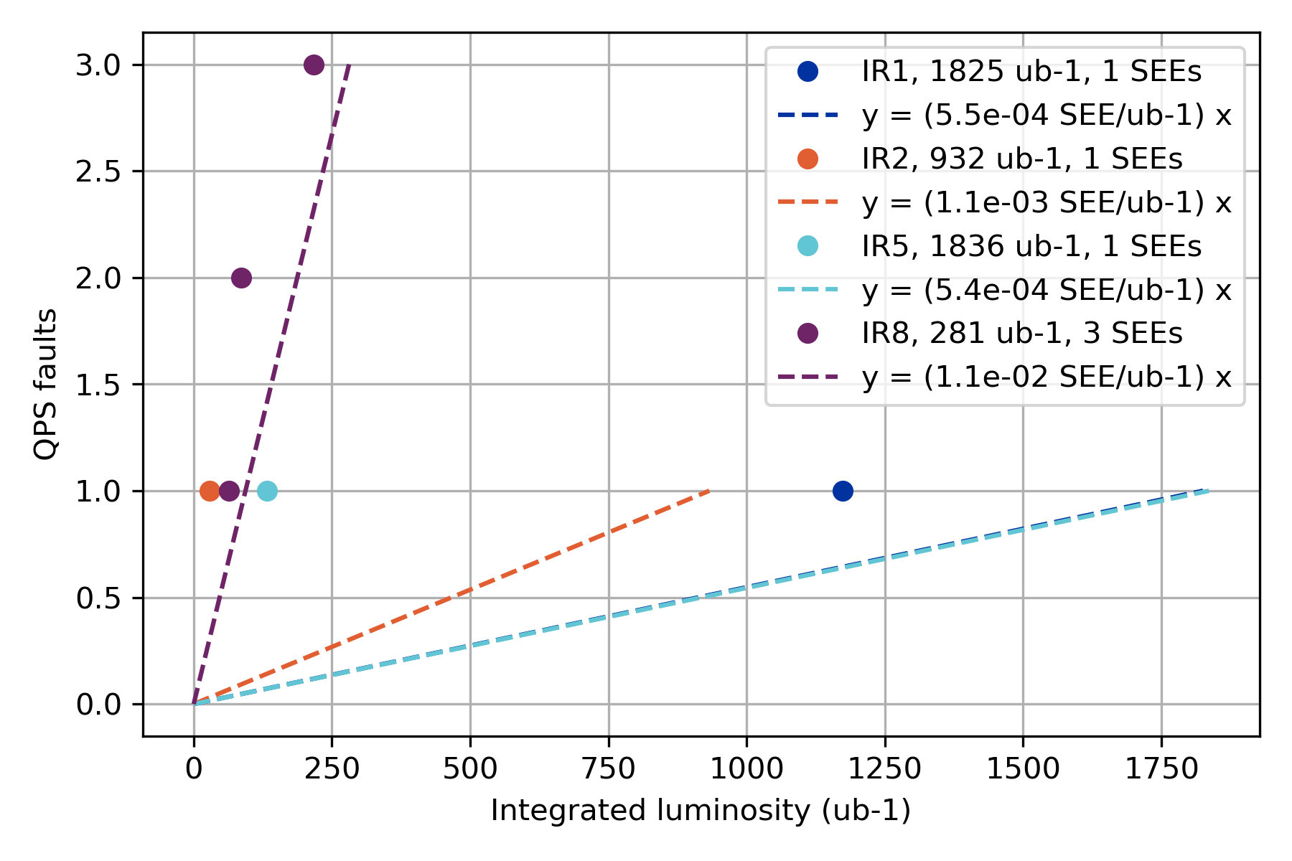
QPS SEEs as a function of luminosity ion run 2018

Slide 33
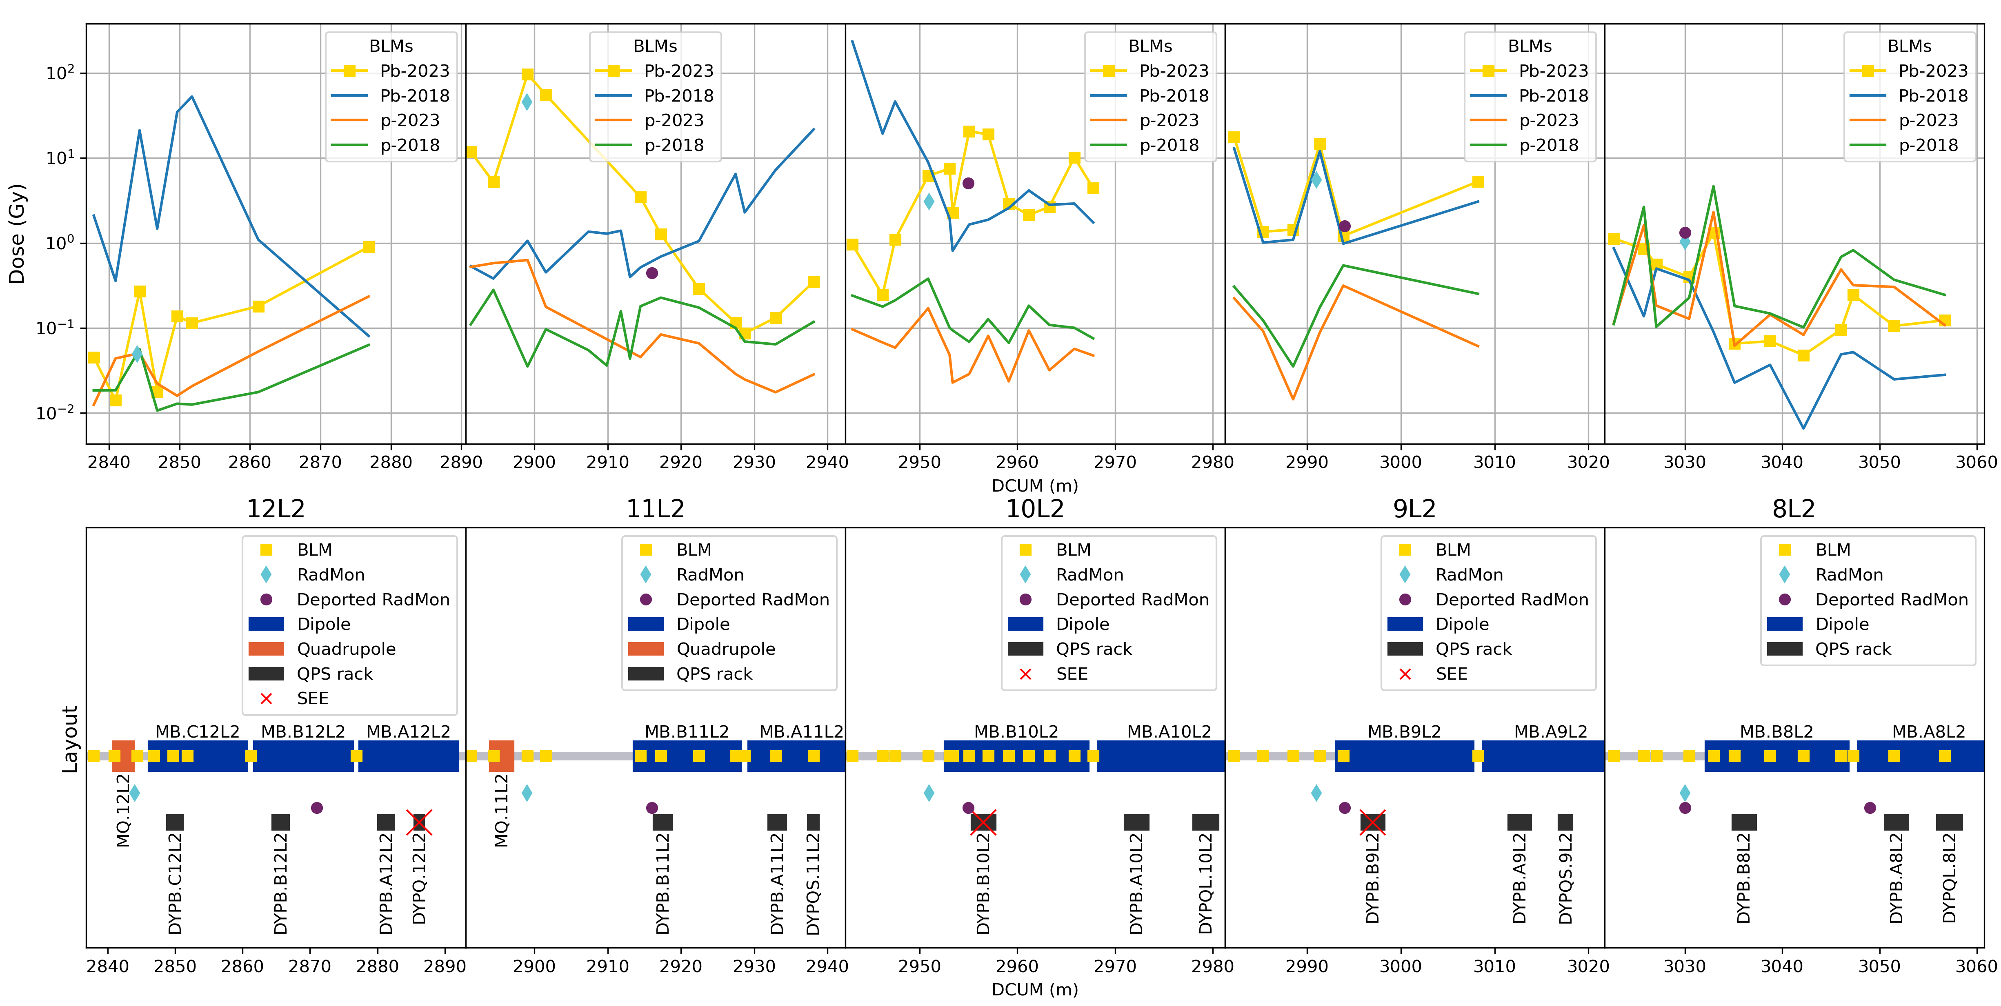
Left of Point 2 - Dose distribution DS, 2018 vs 2023
Comparing the total BLM dose during the 2018 and 2023 ion and proton runs, left of IP2
Note: the lines between the points are visual guides and do not represent real dose values.
The dose in the DS is dominated by the ion runs
The dose peaks shifted compared to the 2018 run, due to the new TCLD location (and the related optics change)
Integrated luminosities in IR2:
Pb 2023: 2.16 nb⁻¹
Pb 2018: 0.905 nb⁻¹
(p 2023: 14.5 pb⁻¹)

Slide 34
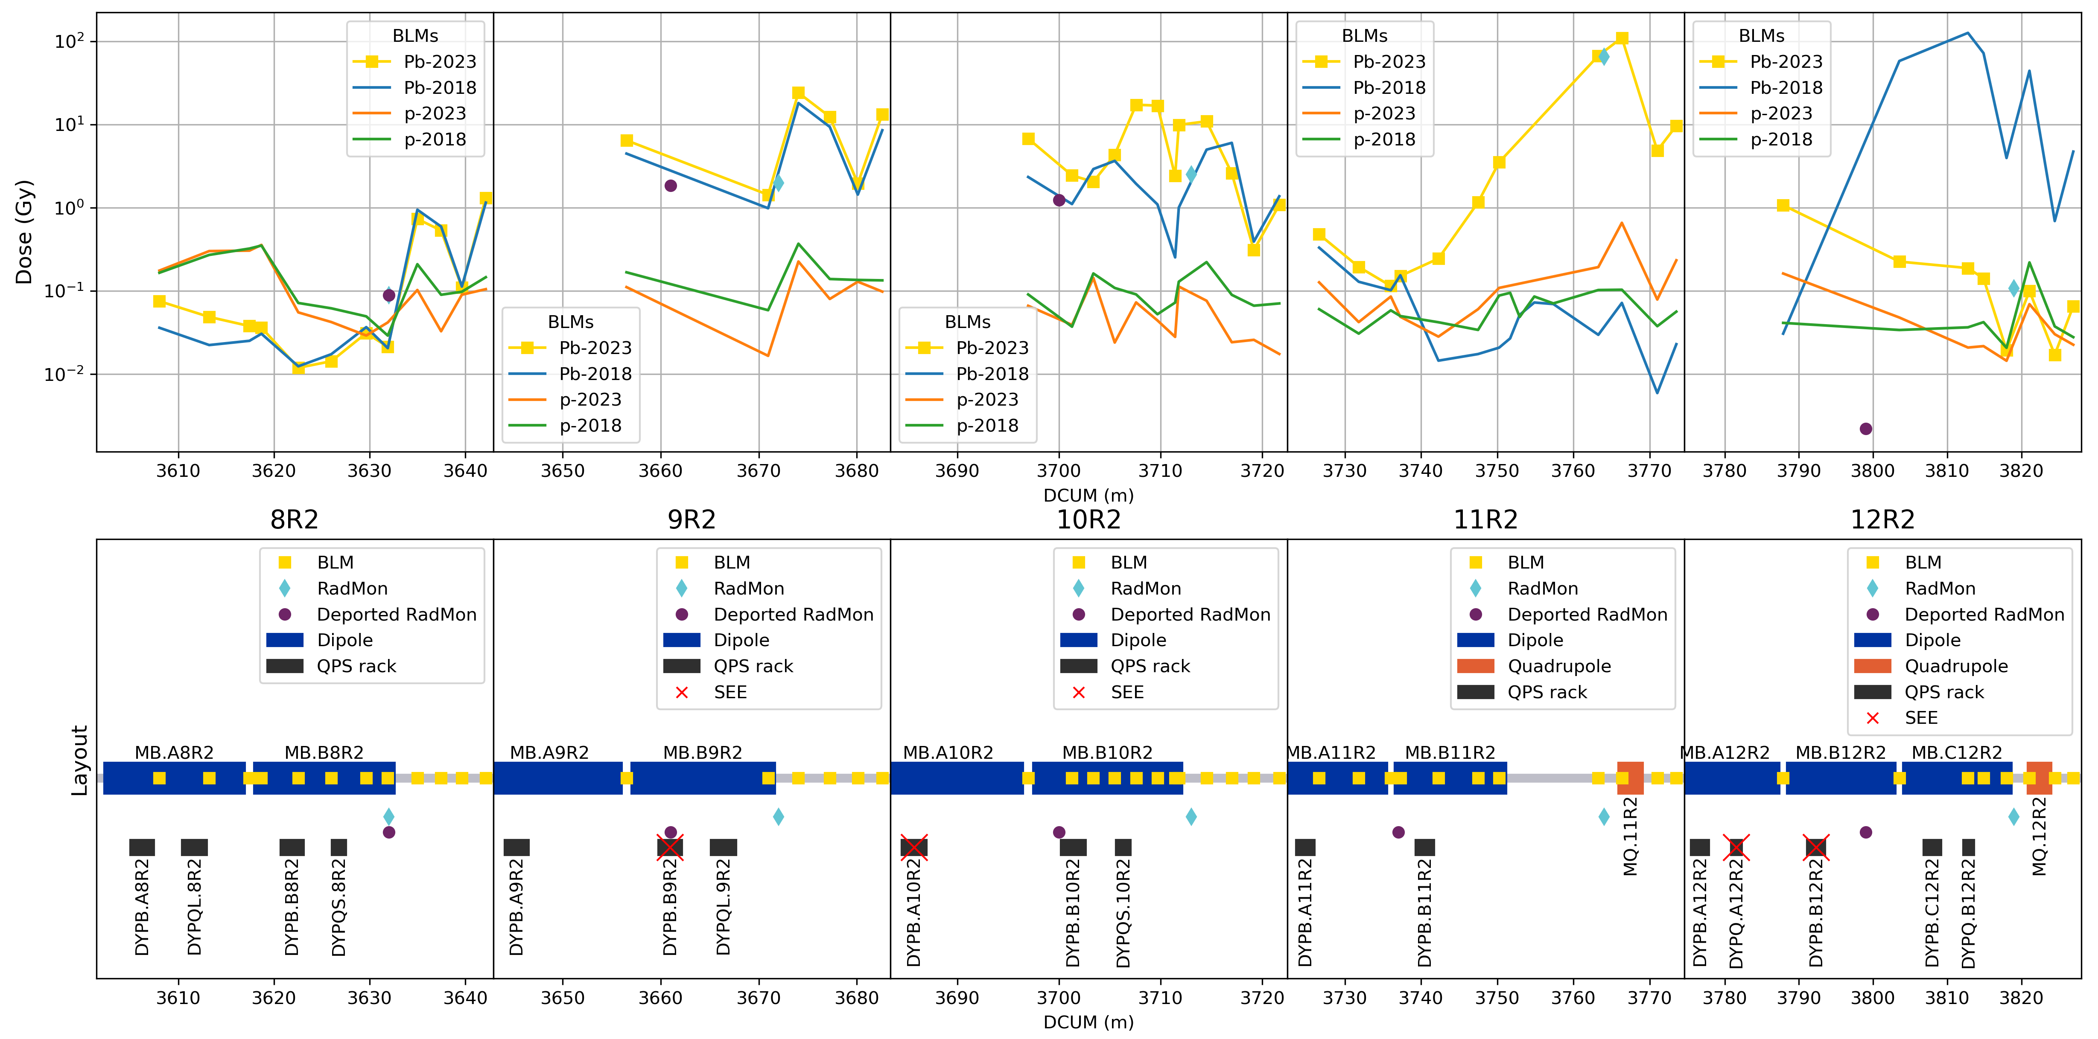
Right of Point 2 - Dose distribution DS, 2018 vs 2023
Comparing the total BLM dose during the 2018 and 2023 ion runs, and during the 2023 proton run, right of IP2
Note: the lines between the points are visual guides and do not represent real dose values.
The dose in the DS is dominated by the ion runs
The dose peaks shifted compared to the 2018 run, due to the new TCLD location (and the related optics change)
Integrated luminosities in IR2:
Pb 2023: 2.16 nb⁻¹
Pb 2018: 0.905 nb⁻¹
(p 2023: 14.5 pb⁻¹)

