Slide 1
QDS R2E events during 2023 LHC ion run
'z'
Jens Steckert, Jelena Spasic, Tomasz Podzorny, Reiner Denz – TE-MPE-EP
Thanks to R2E and RadWG

Slide 2
Content
Radiation data
Event Overview
R2E classes of the QDS during 2023 ion Run
Mitigation measures and Timeline

Slide 3
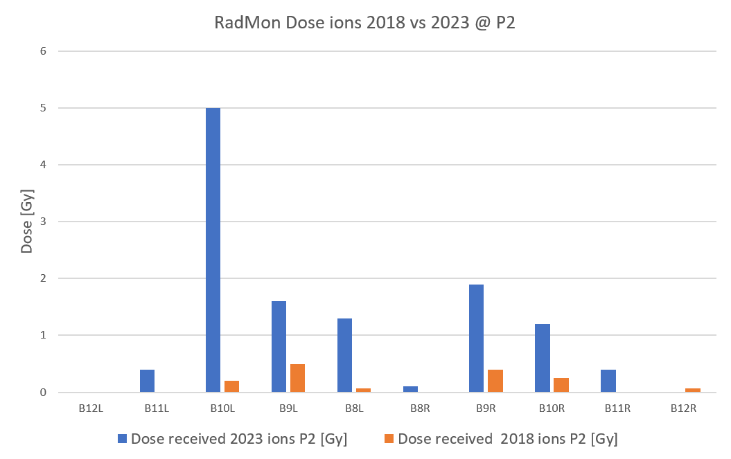
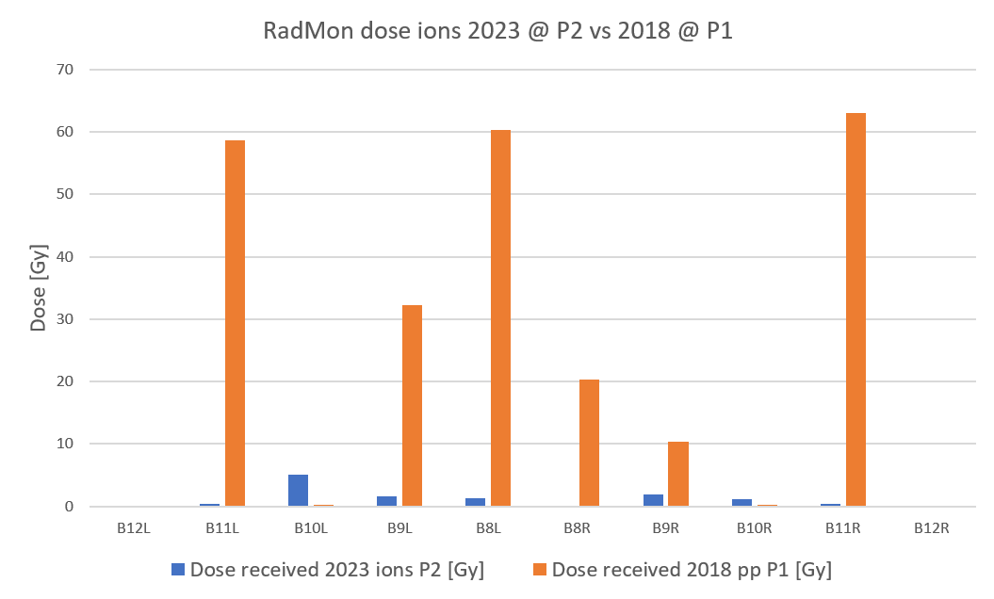
Setting the scene – Doses 2023 vs 2018
During 2023 ions, dose recorded by RadMons is >2x higher than in ions 2018
In terms of dose recorded, P2 losses are negligible compared to doses recorded in P1 during 2018 pp run

Slide 4
Event Type Overview
2023 ion run lead to far more radiation induced (R2E) trips of the LHC QDS than expected
We found 4 different classes of R2E events (2 known, 2 new ones)
  Class 1: DAQ triggers (mitigated) no effect on operation (act as mini rad mon)
  Class 2: SEU in bus bar splice detector (DQQBS) causing a fast power abort (FPA)
  Class 3: SEL in base layer for MQ (DQQDL) causing MQ heater firing and FPA
  Class 4a: SEL in nQPS communication board (DQAMG) causing FPA
  Class 4b: SEL in nQPS communication board (DQAMG) causing FPA 3xMB heater firing
Class 1 & Class 2 were known and (to a certain extend) expected
Class 3 & Class 4 did not happen before
(1 class 4 event found during proton run after re-analysis)

Slide 5
Ion run 2023 – R2E Event overview
Date | Location | Event class | Consequence
Oct 5 | B10L2 | 4a | FPA (precycle required)
Oct 7 | B9R2 | 4b | FPA, Heater discharge MB (quench)
Oct 11 | B10L2 | 2 | FPA (precycle required)
Oct 12 | B9L2 | 2 | FPA (precycle required)
Oct 12 | B8L5 | 4a | FPA (precycle required)
Oct 13 | B12R2 | 4b | FPA, Heater discharge MB (quench)
Oct 14 | A12L2 | 3 | FPA, Heater discharge MQ (quench)
Oct 15 | A12R2 | 3 | FPA, Heater discharge MQ (quench)
Oct 15 | B12R1 | 2 | FPA (precycle required)
Oct 20 | B11L1 | 2 | FPA (precycle required)
Oct 22 | B10L2 | 2 | FPA (precycle required)
In 2023 ion run we saw 11 unmitigated R2E events leading to FPA or worse
Weekend 14th and 15th of October was especially troublesome
In 2018 ion run we saw 2 class 2 events only
In 2018 proton run we saw 6 class 2 and 1 class 4 events

Slide 6
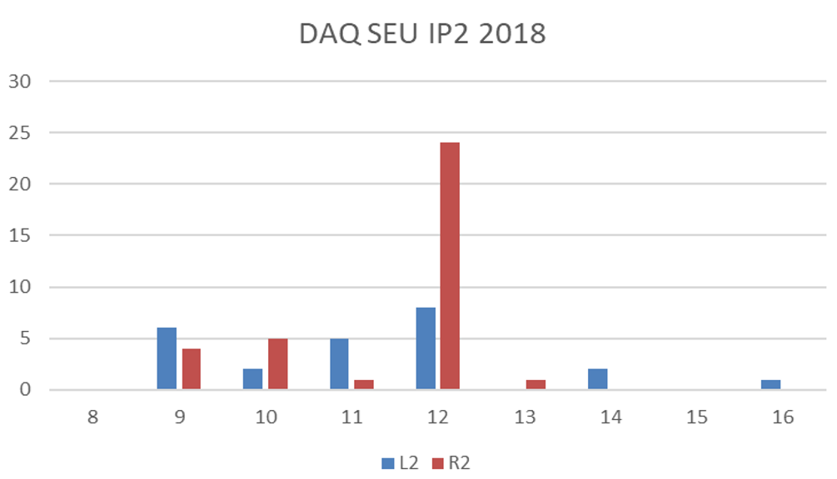
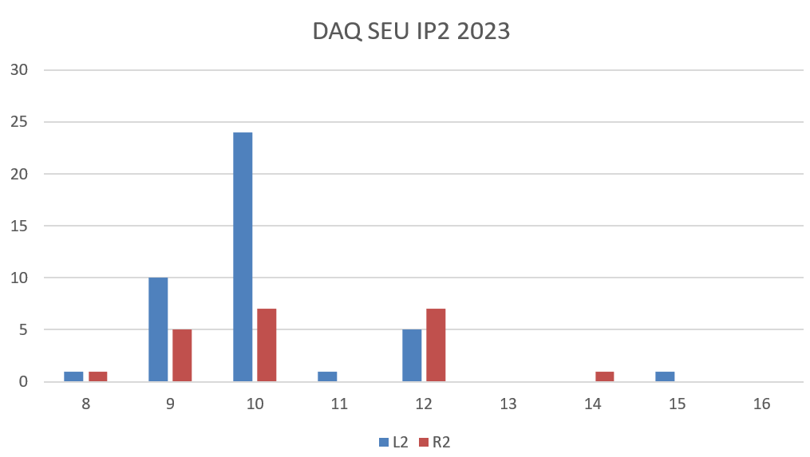
Class 1 events – DAQ triggers (mitigated)
Known R2E issue of the base layer QDS for dipoles
Digital isolator changes logic level due to SEU
Mitigated in firmware since many years
Used as a “radiation detector:
Rack 10L2 is displaced compared to R2, cannot be moved due to other equipment
(slight mitigation by changing sequence of modules could “win” 1-2m)

Slide 7
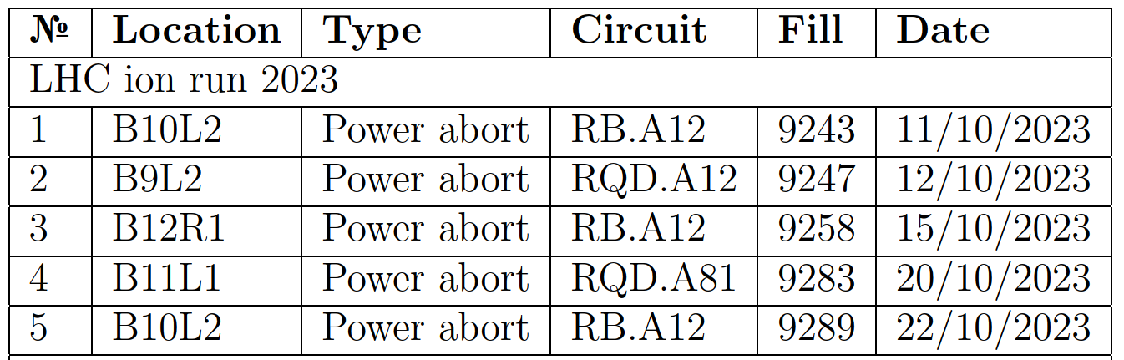
Class 2 events – DQQBS triggers
Well known issue, happens also sporadically during high intensity PP runs
DQQBS is based on ADuC834, a uC with integrated sigma delta ADC. SEU in this microcontroller lead to a spurious FPA
5 events in 2023 ion run, 1 in 2023 protons:
Comparison 2023 vs 2018:
Year | Run type | Events
2023 | pp | 1
2023 | ions | 5
2018 | pp | 6
2018 | Ions | 2

Slide 8
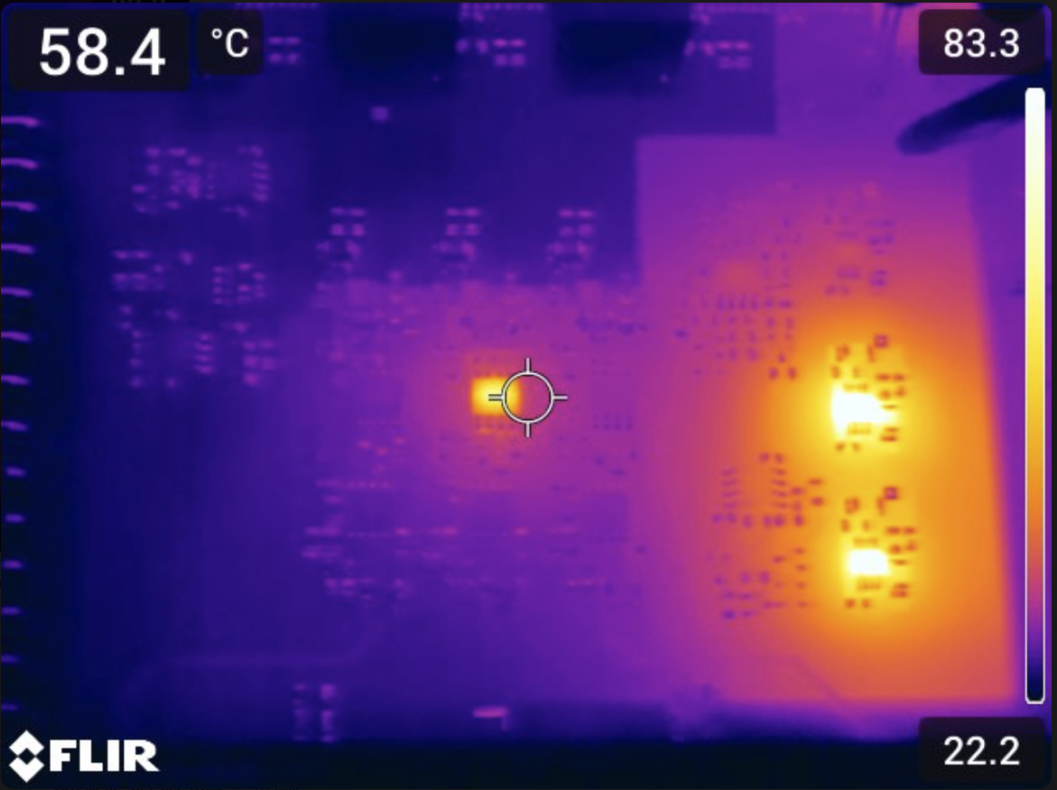
Class 3 events – DQQDL (MQ) SEL, FPA + HDS trigger
2 Events at Oct 14 and Oct 15, symmetrically around P2 11L
  1st event, MQ11L2: one ADC channel saturated, isolated power supply indicates out of spec. voltages.
  Power cycle un-latched component and device resumed normal operation
  2nd event, MQ11R2: One complete isolate domain (3 ADC channels) saturated values, indication of bad isolated power. Power cycle did not restore function → piquet intervention to change card
Post mortem analysis in lab on damaged board revealed the
faulty component
Single Event latch up in OPA2192 operational amplifier
of the DQQDL for quadrupoles
After replacing this opamp, DQQDL was fully functional again
No further event recorded after Oct. 14th/15th

Slide 9
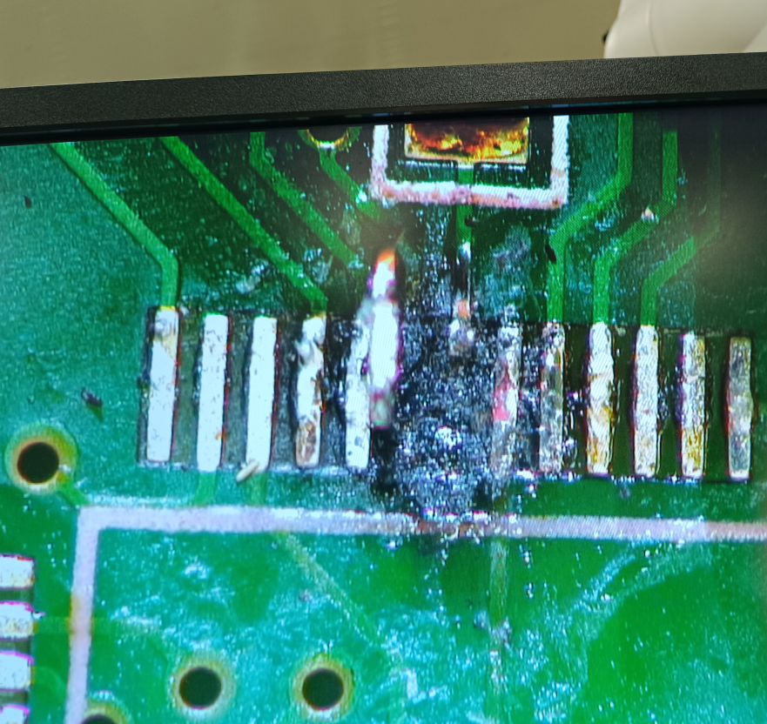
Class 4 events – nQPS FPA and HDS firing on 3xMB
Loss of communication to the nQPS (DQLPU-S) crate
Instantaneous or delayed FPA and/or trigger of quench heaters by symmetric quench detection card, DQQDS
Crate controller’s microcontroller (ADuC831) physically destroyed by destructive SEL
Controller can switch off power rails of DQQDS and DQQBS by setting proper
output pin high
Local SEL probably causes voltage fluctuations on power cycle pins
leading to deactivation of two different power rails feeding DQQDS
and DQQBS
→ Causes Fast power abort (4a)
→ Fires heaters, quenching magnet (4b)

Slide 10
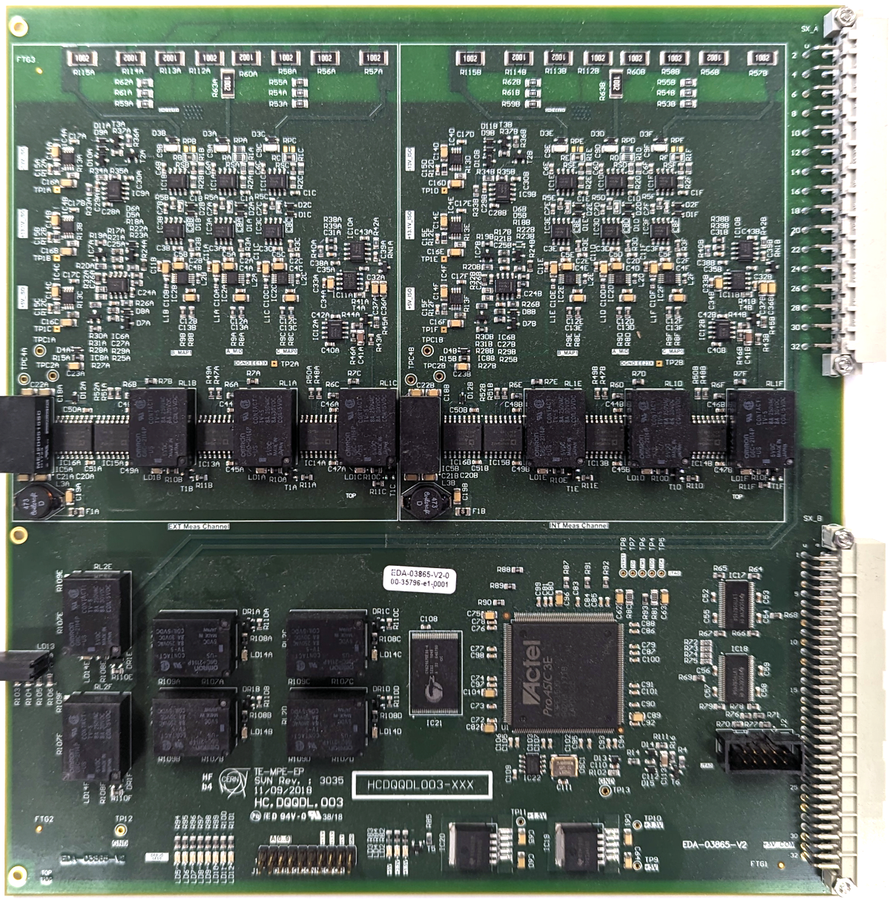
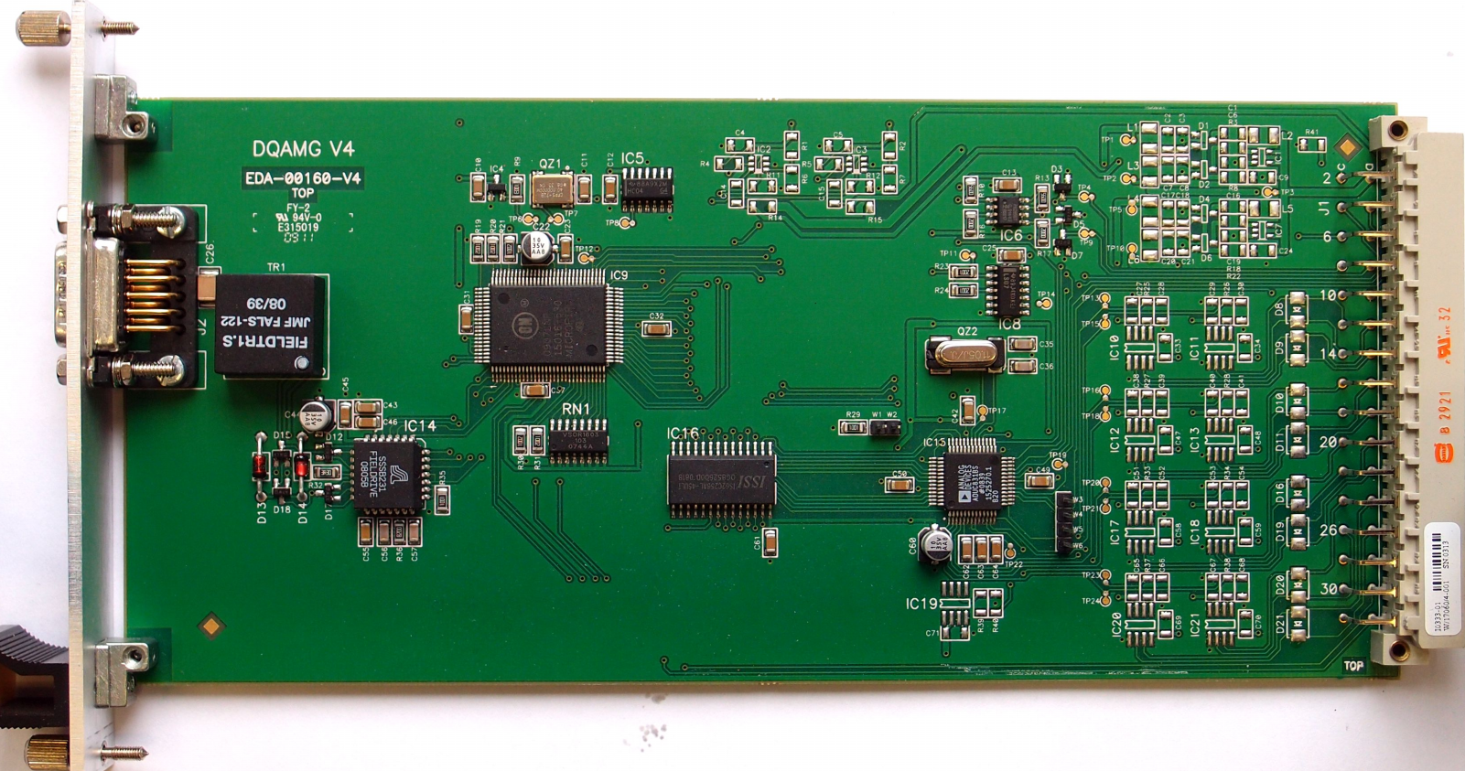
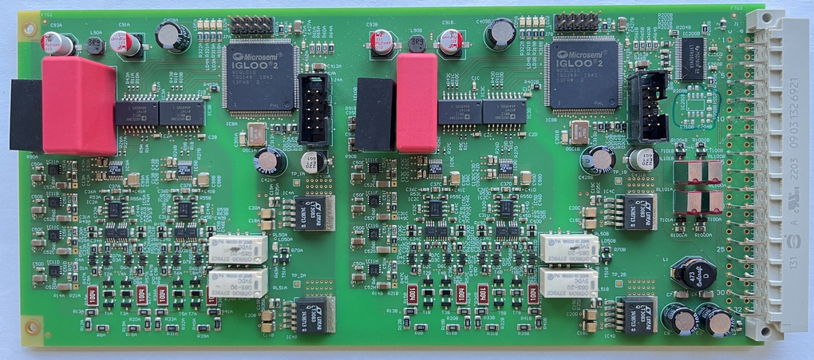
Mitigation
Class | Element | Mitigation | Time frame (optimistic)
Class 2 | DQQBS | New implementation of DQQBS with FPGA and rad tol SAR ADC. Install around P1, P2, P5 | End of EYETS 2023/2024
Class 3 | DQQDL (MQ) | Replace op amp by compatible type in different technology on 4 DQQDL and 2 DQCSU in racks A12 L2 & R2 | EYETS 2023/2024
Class 4 | DQAMGS | Produce slightly modified version of crate controller with E-Fuse & Pi filter mitigating consequence of SEL | End of EYETS 2023/2024
DQQDL
DQQBSv2
DQAMGS

Slide 11
Conclusion/Outlook
2023 ion run lead to an overproportional amount of radiation induced events in the QDS
These events do not scale with dose measured by radmons
Probably the spectrum shifts to a higher LET which would explain the destructive events observed
Error modes of the different classes are clear
We will address all three non-mitigated error classes by modifications to the QDS to be completed until end of EYETS

