Slide 2
Injection optics for 4IP lattice
S. Yue, Y. Dutheil, P. Martinek
SY-ABT

Slide 3
Outline
Baseline: top-up injection
R&D: SR on electrostatic septa
Machine protection
Prospects

Slide 4
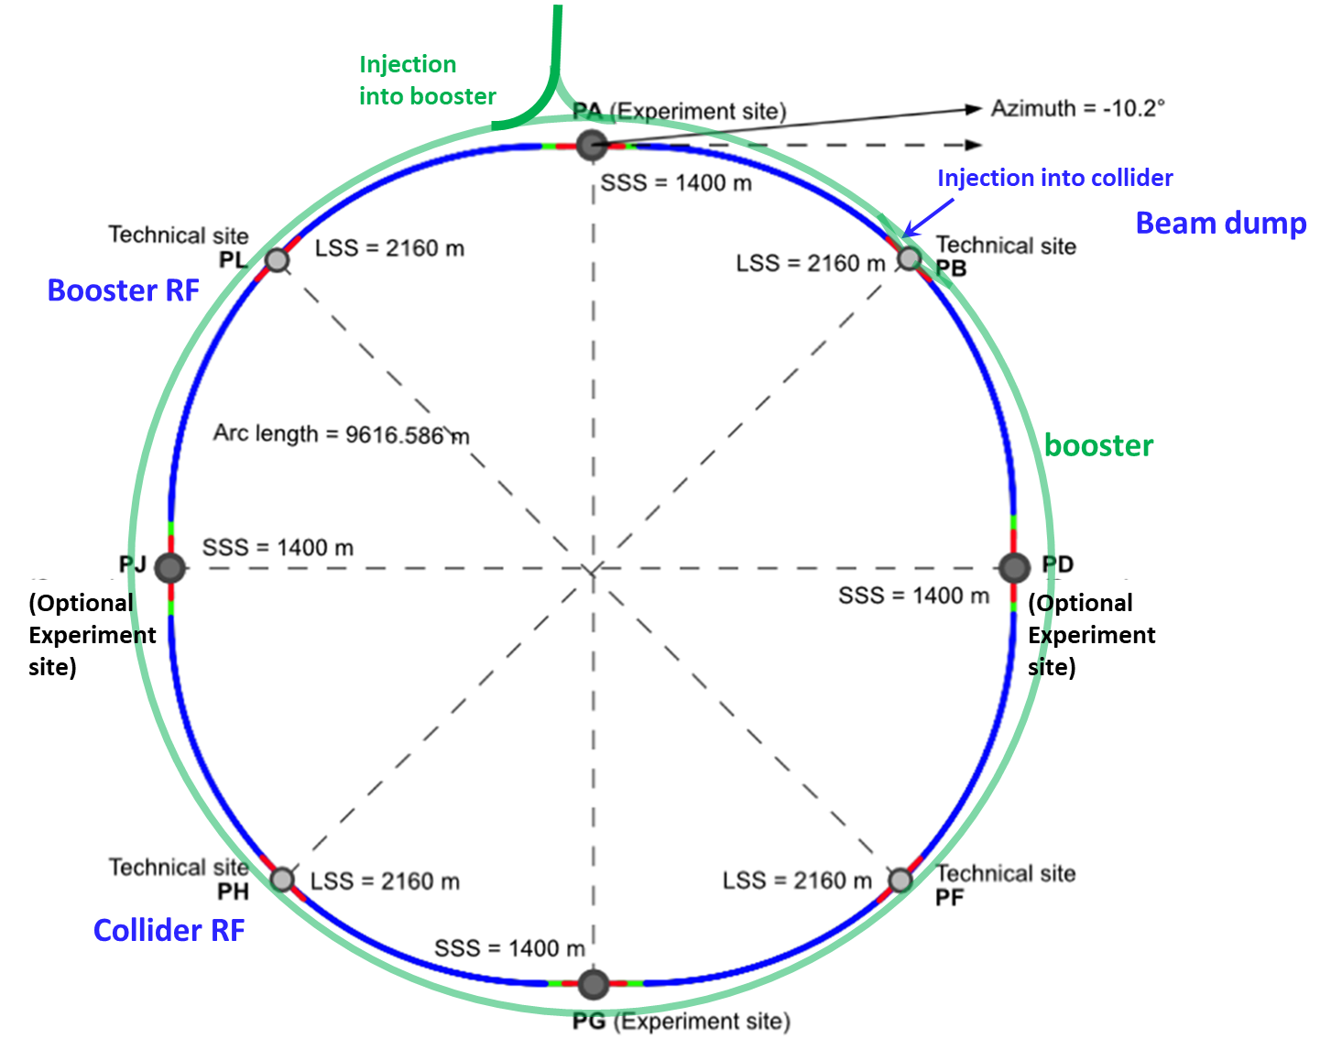
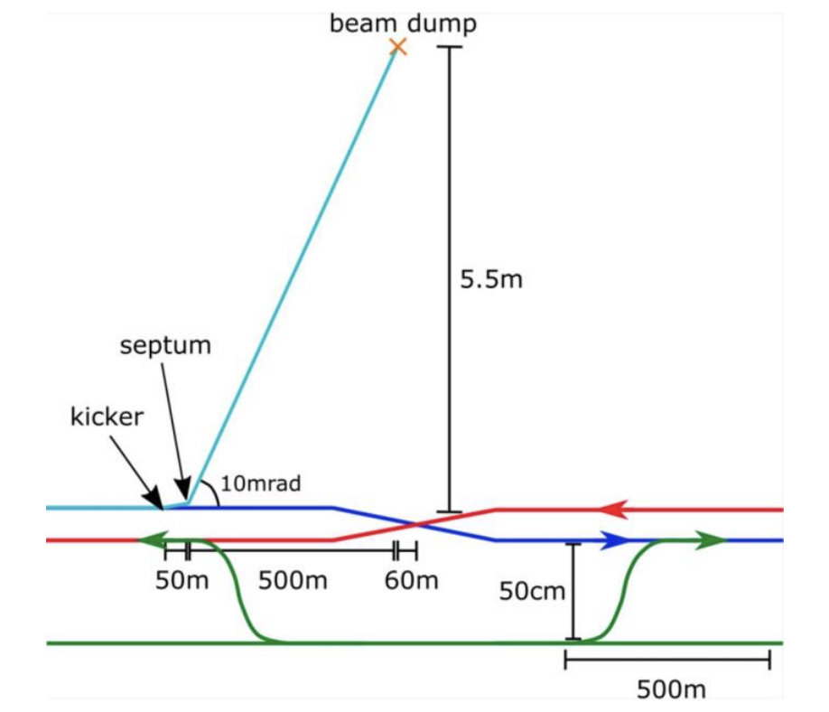
The injection/extraction in collider ring
[2]
To maximize the integrated luminosity, the top-up injection^{[1]} is required
Up to 10 % of collider maximum intensity will be injected each time
Repetition rate of Booster extraction is ~0.1 Hz
[1]
Both injection and extraction are located at the straight section of PB
The design of injection and extraction are independent
[1] Y. Dutheil, Top-up injection baseline scenario, FCCweek23
[2] T. Raubenheimer, FCC Accelerator Overview, FCCWeek23

Slide 5
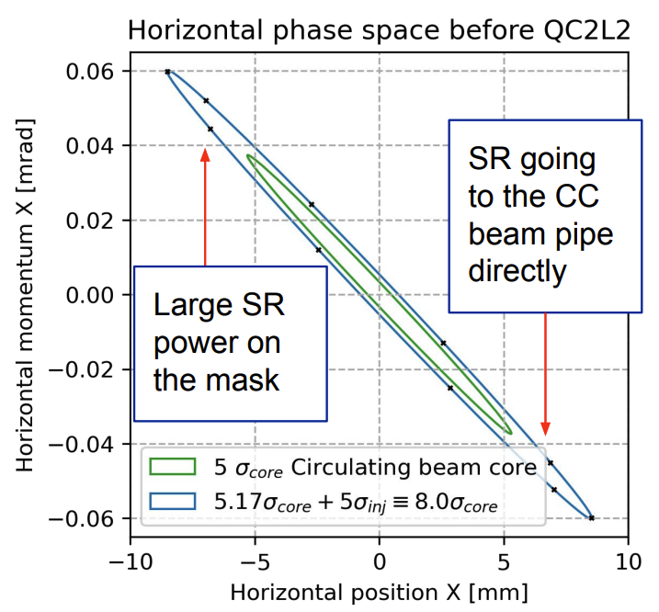
Off axis injection
Off axis injection: injected beam has a transvers offset relative to its orbit
It usually doesn’t have energy offset, transverse offset $>5σ_{cir}+S+5σ_{inj}$
S: septa thickness
[1]
Off axis injection will increase beam horizontal size around the IP
The horizontal distance between collimator and beam is only 11 $σ_{cir}$ ^{[2]}
$5σ_{cir}+S+10σ_{inj}<11σ_{cir}$ : very challenging
On axis injection and extraction design for Z mode in the latest lattice version will be presented!
Z mode has the highest stored energy: 20 MJ^{[3]}
[1] K.D.J. Andre, Synchrotron Radiation Background Studies @ FCC-ee, FCCweek23
[2] A. Abramov, FCC-ee collimation studies, FCCweek23
[3] A. Krainer, A semi-passive beam dilution system for the FCC-ee collider, EPJ TI

Slide 6
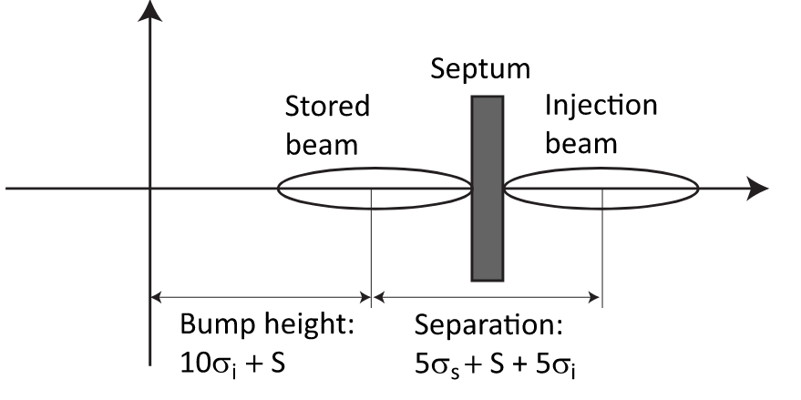
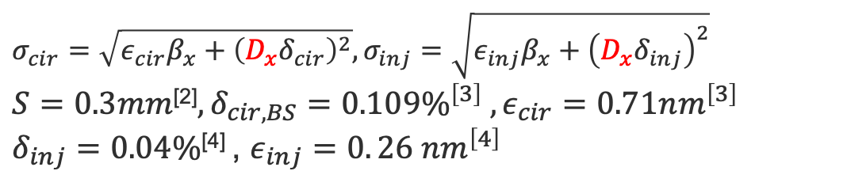

On axis injection concept
The injected beam will be injected at off energy orbit
Requirements: $\left|D_{x}δ_{offset}\right|=5σ_{cir}+S+5σ_{inj}$
On axis injection limitation:
Energy offset < ±1 %^{[1]}
Off energy orbit will merge to normal orbit
Longitudinal damping time: 1168 turns^{[3]}
$$σ_{cir}=\sqrt{ε_{cir}β_{x}+{\left(D_{x}δ_{cir}\right)}^{2}},σ_{inj}=\sqrt{ε_{inj}β_{x}+{\left(D_{x}δ_{inj}\right)}^{2}}$$
$S=0.3mm$^{[2]}$,δ_{cir, BS}=0.109\%^{\left[3\right]} ,ε_{cir}=0.71nm^{\left[3\right]}$
$δ_{inj}=0.04\%$^{[4]} , $ε_{inj}=0. 26 nm^{\left[4\right]}$
[5]
Bumped orbit
Off energy orbit
[1] K. Oide, Small changes in the baseline optics, FCCIS 170th
[2] Parameters of kicker and septum
[3] Parameters of FCC-ee collider
[4] A. Chance, FULL-ENERGY BOOSTER, FCCweek23
[5] M. Aiba, Top-up injection schemes for future circular lepton collider, NIMA

Slide 7
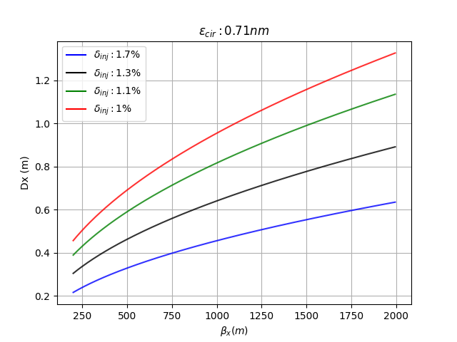
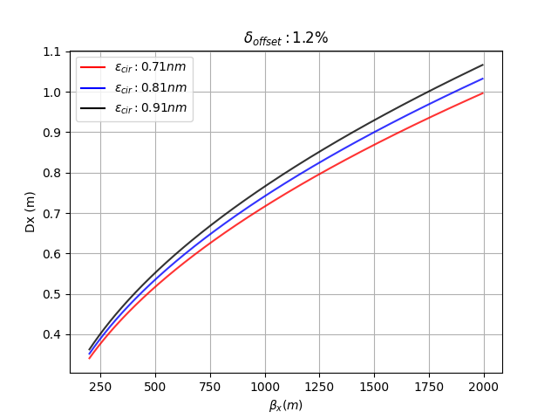

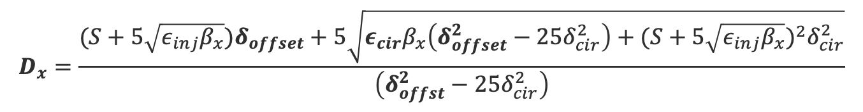
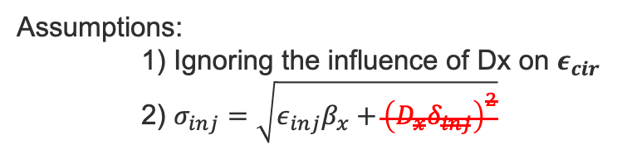
On axis injection analytical optimization
Assumptions:
1) Ignoring the influence of Dx on $ε_{cir}$
2) $σ_{inj}=\sqrt{ε_{inj}β_{x}+{\left(D_{x}δ_{inj}\right)}^{2}}$
Requirement: $\left|D_{x}δ_{offset}\right|=5σ_{cir}+S+5σ_{inj}$
$$D_{x}=\frac{(S+5\sqrt{ε_{inj}β_{x}})δ_{offset}+5\sqrt{ε_{cir}β_{x}\left(δ_{offset}^{2}−25δ_{cir}^{2}\right)+{(S+5\sqrt{ε_{inj}β_{x}})}^{2}δ_{cir}^{2}}}{\left(δ_{offst}^{2}−25δ_{cir}^{2}\right)}$$
The relation between $D_{x}$ and $β_{x}$ for different $ε_{cir}$ and $δ_{offset}$
$$D_{x} linked \sqrt{β_{x}}$$
The energy offset has a larger influence on the Dx

Slide 8

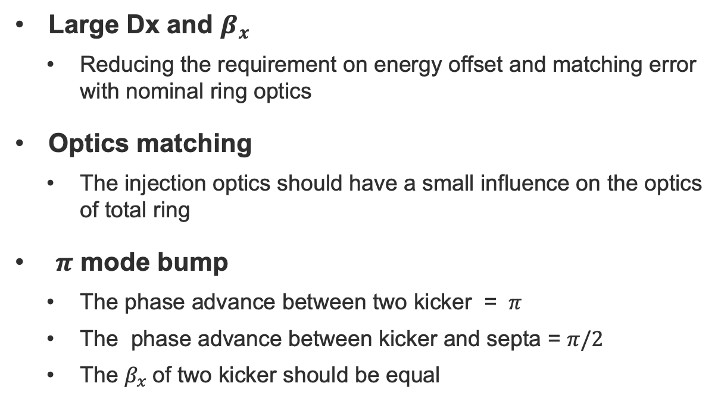
Optics design and matching
injected beam
$$\left|D_{x}δ_{offset}\right|=5σ_{cir}+S+5σ_{inj}$$
septa
Large Dx and $β_{x}$
  Reducing the requirement on energy offset and matching error with nominal ring optics
Optics matching
  The injection optics should have a small influence on the optics of total ring
$π$ mode bump
  The phase advance between two kicker = $π$
  The phase advance between kicker and septa = $π/2$
  The $β_{x}$of two kicker should be equal
circular beam
kicker1
kicker2
Starting from Rebecca's solution on an older lattice version

Slide 9
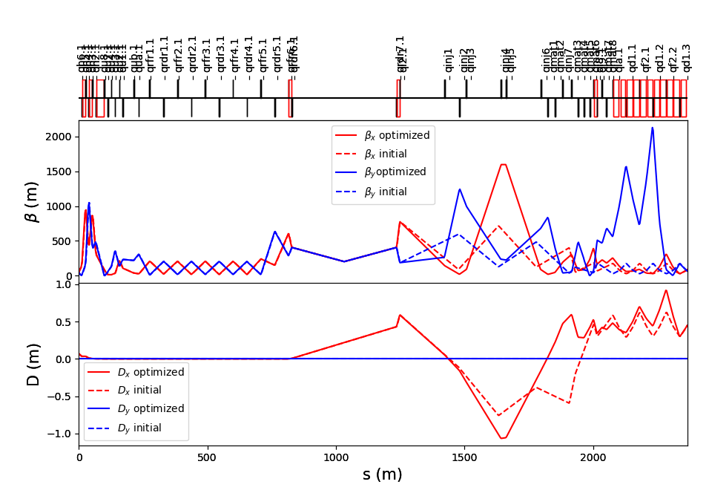

Numerical Optimization
Max $β_{x}$ =1650 m Min Dx = -1.08m
Lattice design:
  Inserted 15*quadrupole magnets
  Adjusted the strength of original 8*quadrupole magnets
  Removed some quadrupole
Twiss parameters difference at the end point between injection and original optics
 | x | y
Mu | 1e-6 | 4e-6
beta | 1.8e-8 | 1e-10
Alfa | 1.3e-7 | 3.5e-8
Dx | 5e-5 | 0
Dpx | 2e-4 | 0

Slide 10
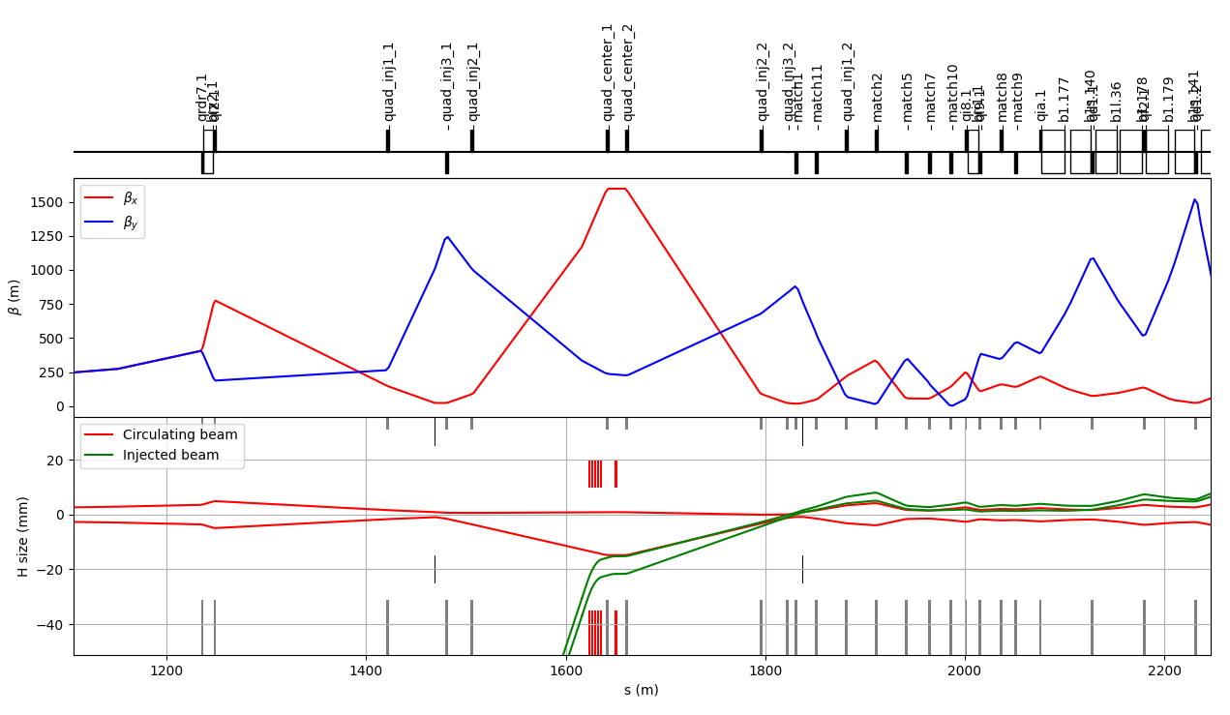
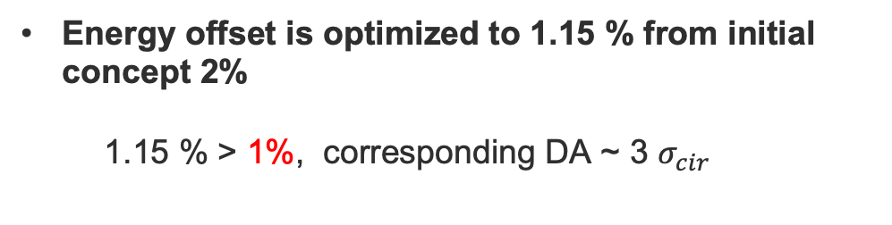


Beam envelope
Inserted elements:
  1*electrostatic septa,10*magnetic septa, 2* bump kicker magnets
  Kicker rise & fall time: 1 $μ$s, flat-top time: 304 $μ$s
Bump height : $S+10σ_{inj}$
Energy offset is optimized to 1.15 % from initial concept 2%
1.15 % > 1%, corresponding DA ~ 3 $σ_{cir}$
Merged a request in Gitlab，and it’s influence on beam dynamics is under studied.
Kicker
Septa

Slide 11
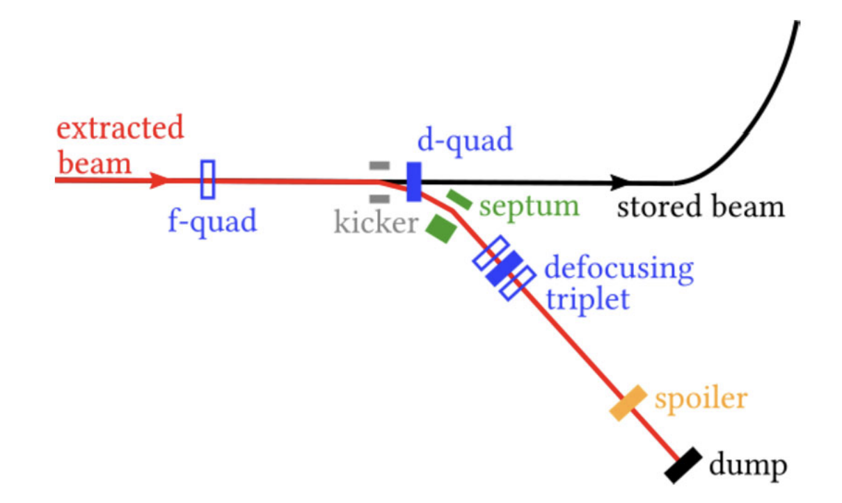
Beam Extraction
The stored beam energy can be 20 MJ in Z mode^{[1]}, which is 100 times larger than other lepton machine
A new design: semi-passive beam dumping system is adopted^{[1]}
  Studied in 2022 by ABT & STI
  Using a defocusing triplet and spoilers for beam dilution
[1]
My study: review extraction design with the new lattice and combined injection and extraction in single straight section
[1] A. Krainer, A semi-passive beam dilution system for the FCC-ee collider, EPJ TI

Slide 12
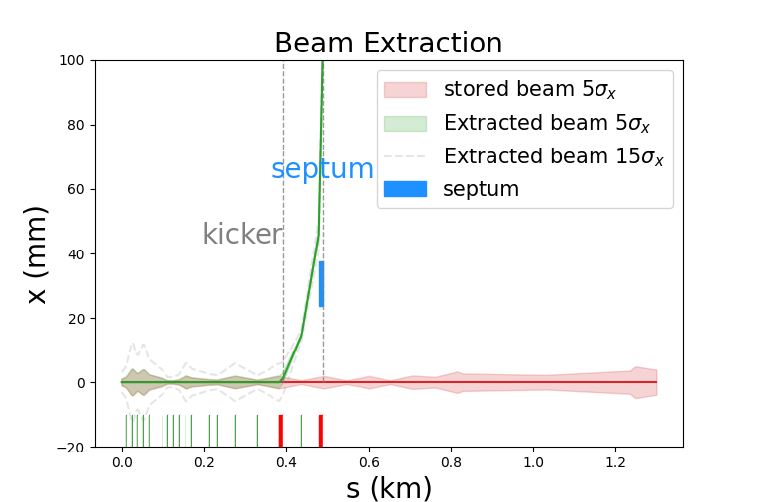
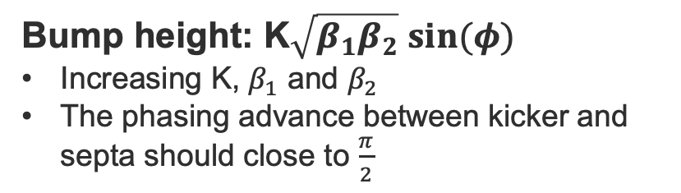
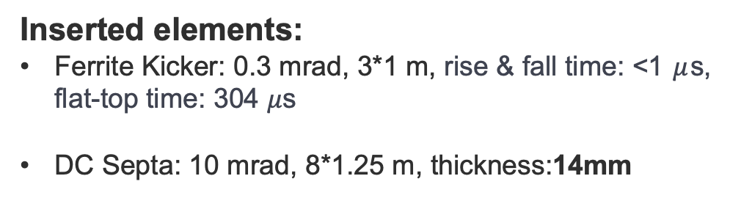
Beam Extraction review status
Inserted elements:
Ferrite Kicker: 0.3 mrad, 3*1 m, rise & fall time: <1 $μ$s, flat-top time: 304 $μ$s
DC Septa: 10 mrad, 8*1.25 m, thickness:14mm
Bump height: K$\sqrt{β_{1}β_{2}} sin⁡(φ)$
Increasing K, $β_{1}$ and $β_{2}$
The phasing advance between kicker and septa should close to $\frac{π}{2}$
Placing kicker and septa magnets at both side of defocusing quadrupole (without changing the lattice)

Slide 13
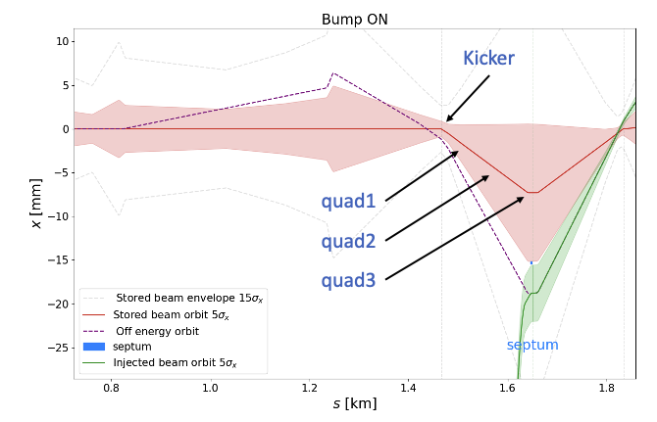
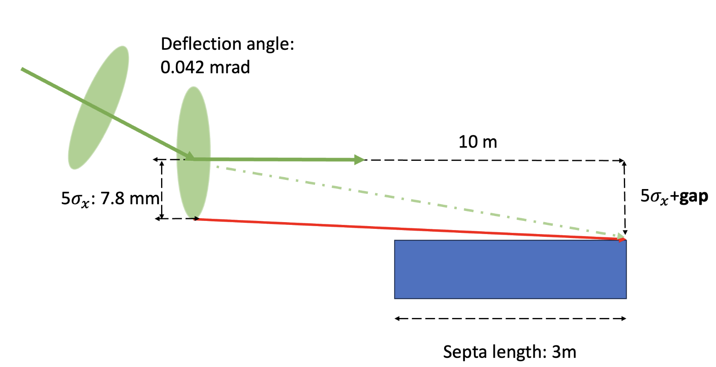
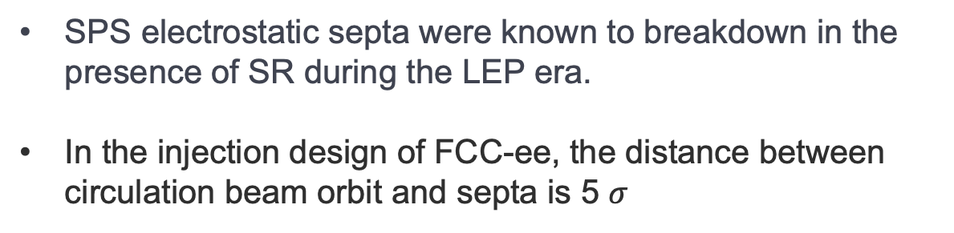
R&D: SR on electrostatic septa
SPS electrostatic septa were known to breakdown in the presence of SR during the LEP era.
In the injection design of FCC-ee, the distance between circulation beam orbit and septa is 5 $σ$
The SR from kicker and three quadrupole mangnets may hit the septa
Need to investigate the breakdown probability in the presence of SR
[1] S. Yue, Synchrotron Radiation from kicker & quadrupole, CodiMD

Slide 14
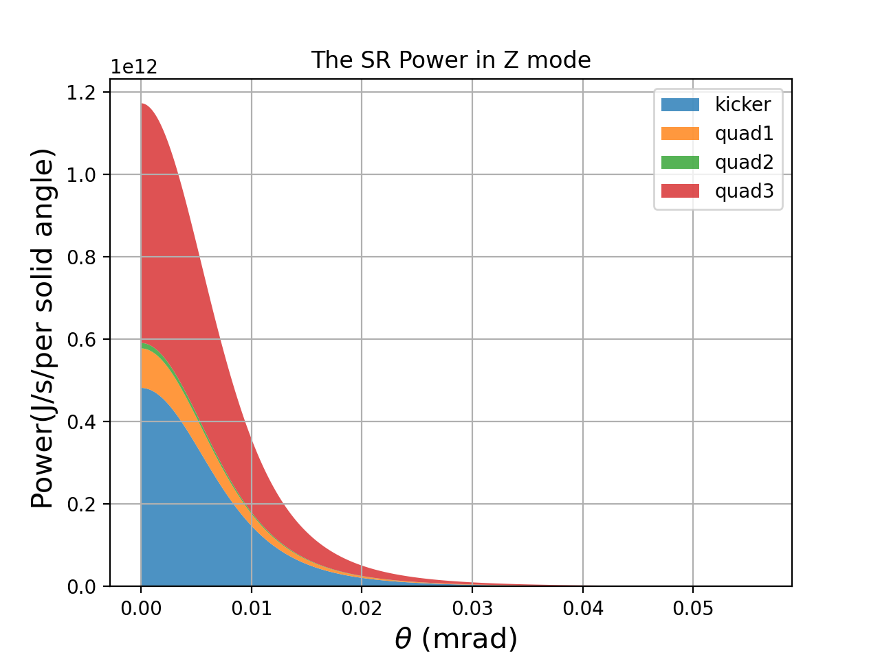
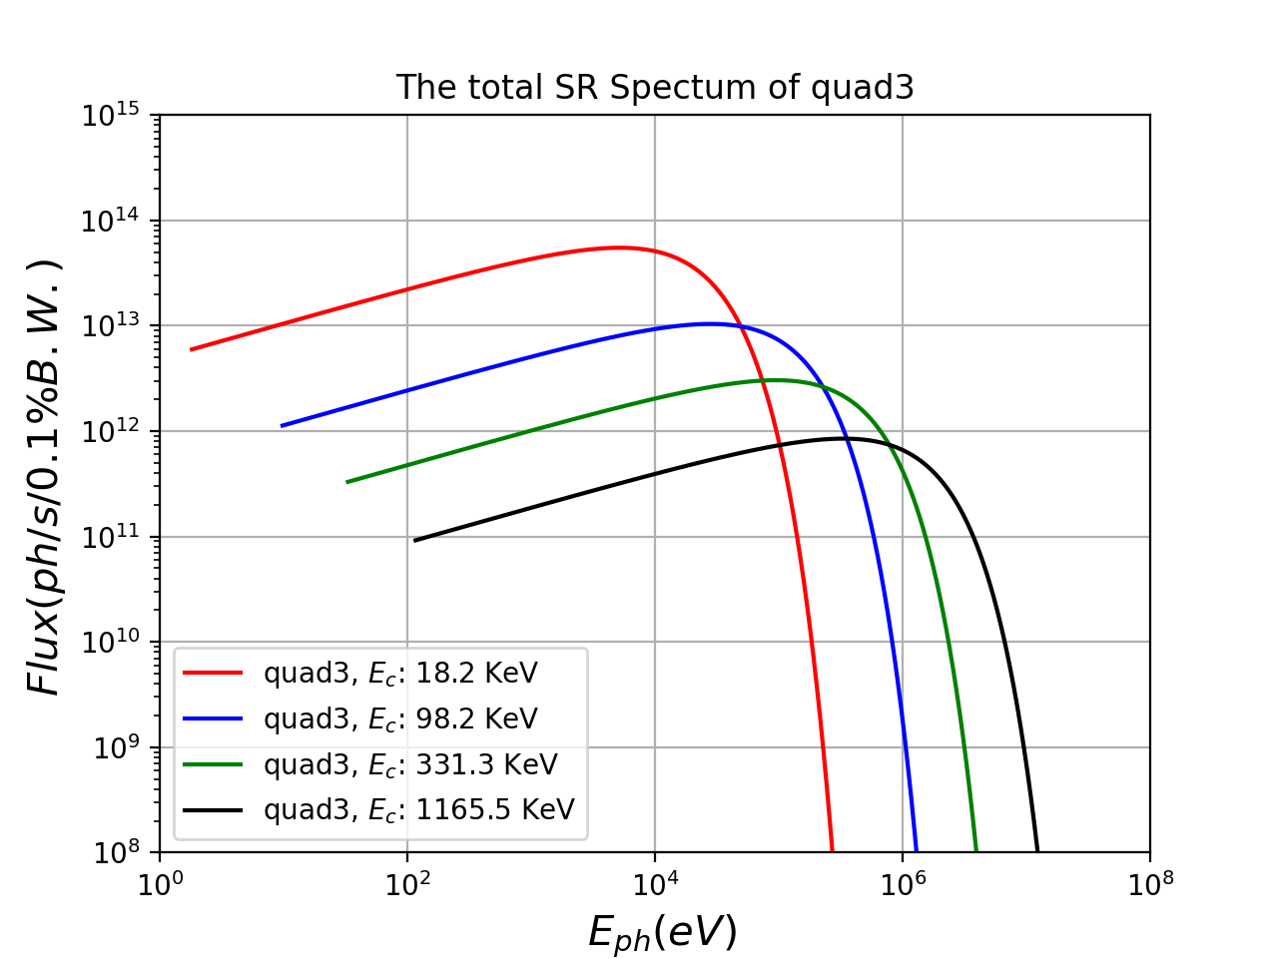
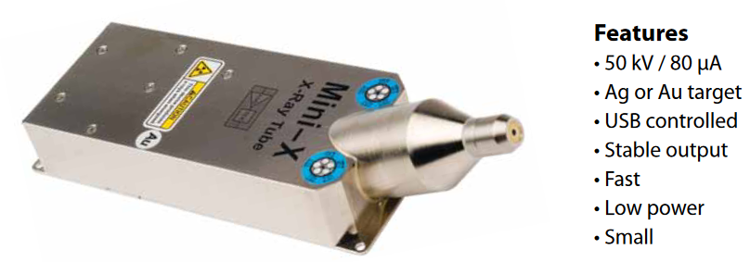
R&D: SR on electrostatic septa
SR power is mainly from the kicker and quad3 magnet
(assuming the quadrupole as dipole magnet)
It’s hard to reproduce the spectrum in workshop^{[1]}
Concerned by machine protection, it’s necessary to include those considerations in the design, due to the high energy density of the beam
SY-ABT- SE section is preparing a test-stand with an Xray source to probe the breakdown limit.
Its photon peak energy is close to the SR critical energy in SPS (24 KeV)
But it photon number is much smaller than that of SR
[1] S. Yue, Synchrotron Radiation from kicker & quadrupole, CodiMD

Slide 15
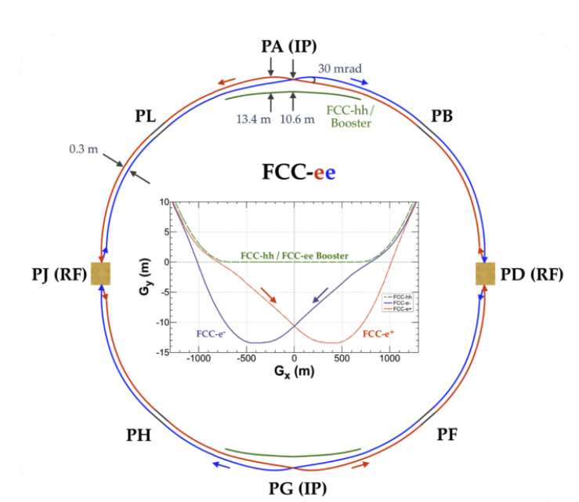
Machine protection
To reduce the impact of an septa failure split each injection into 10 chunks
  Up to 1% of collider maximum intensity will be injected each time (within ~1s)
Hardware: It will not have a significant effect on the cost and power consumption
  304us flat-top will be divided into 10 pieces + 10 pieces 1us abort gaps
Due to the detector, the circumference of collider ring and booster ring is not same
  There maybe an issue in beam synchronization, under checked by A.L. Vanel (RF section)
[1]
[1]FCC-ee: The Lepton Collider | The European Physical Journal Special Topics

Slide 16
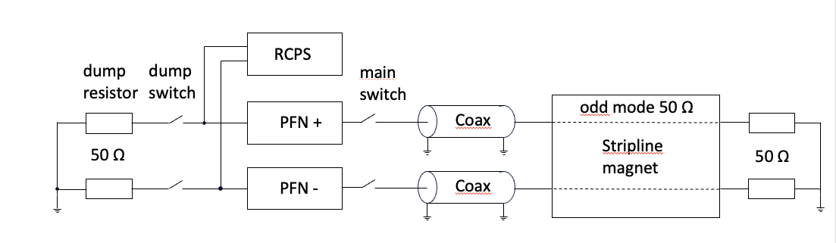
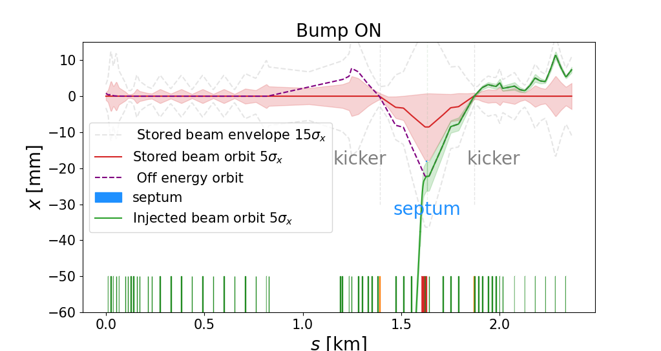
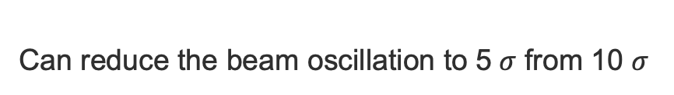
Machine protection
[1]
Possible failure in injection:
1) RCPS/PFN voltage drop
2) Self trigging
3) Stripline kicker & electrostatic septa: spark
Mitigation measures:
Splitting each kicker into 2 pieces
Can reduce the beam oscillation to 5$σ$ from 10 $σ$
[1] P. Martinek, Summary of current kicker magnet developments for all systems in FCC-ee, ABT general, 19 Dec

Slide 17
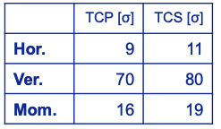



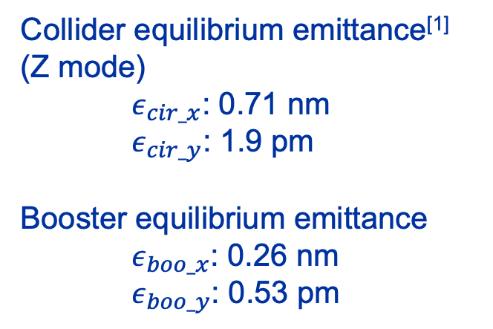

Prospect - Beam rotation
Due to the limitation of damping time in booster, the actual horizontal emittance might be larger than the equilibrium value challenging to top-up injection
$$D_{s}δ=5σ_{cir}+S+5 σ_{inj}$$
Rotating the beam in X/Y plane to reduce the horizontal size of injected beam
  First consider rotating the beam in the transfer line of booster extraction
Collider equilibrium emittance^{[1]}
(Z mode)
$ε_{cir_x}$: 0.71 nm
$ε_{cir_y}$: 1.9 pm
Booster equilibrium emittance
$ε_{boo_x}$: 0.26 nm
$ε_{boo_y}$: 0.53 pm
Collimator gap in collider
$$\frac{ε_{y}}{ε_{x}}=k$$
[3]
Limitation: $5\sqrt{ε_{inj_y}}<70\sqrt{ε_{cir_y}}$
Max $ε_{inj_y}={14}^{2}×ε_{cir_y}=0.37$ nm
This vertical emittance is being reviewed by Kevin to check the effect of the SR cone around the IP
[1] Parameters of FCC-ee collider
[2] A. Chance, BOOSTER OPTICS, FCCIS WP2 workshop23
[3] A. Abramov, FCC-ee collimation studies, FCCweek23

Slide 18
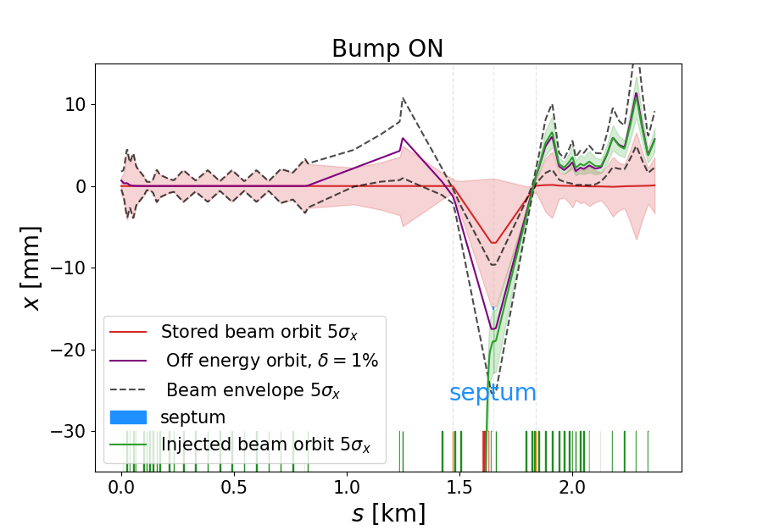
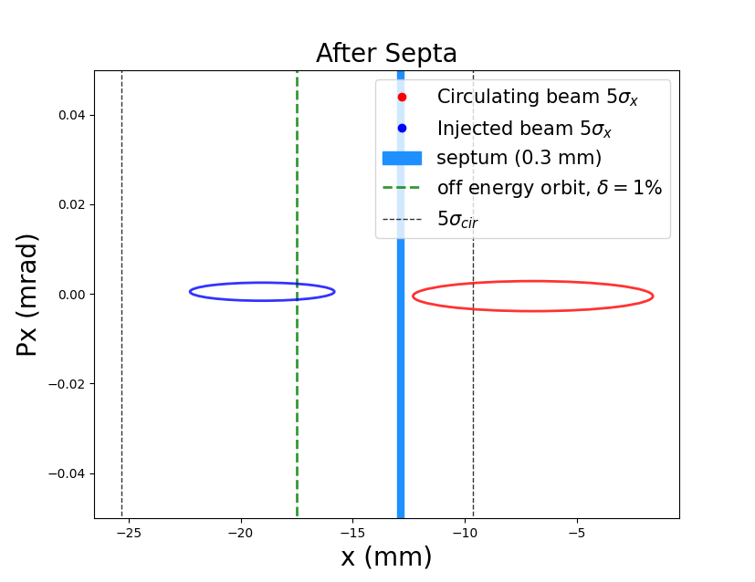
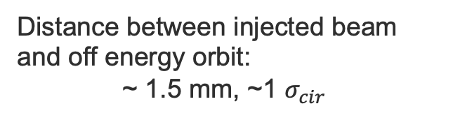


Prospect - Hybrid on axis& off axis injection
Due to the limited energy acceptance Moving beam away from off energy orbit
$$D_{s}δ<5σ_{cir}+S+5 σ_{inj}$$
Offset = $5σ_{cir}+S+5 σ_{inj}$ - $D_{s}δ$
Taking the orbit with an energy offset of 1% as an example
Distance between injected beam and off energy orbit:
~ 1.5 mm, ~1 $σ_{cir}$
In current design, a small beam offset can meet the injection requirements

Slide 19
Conclusion
Baseline : On axis injection & extraction
  The injection & extraction lattice design for Z mode is completed
  The optimized energy offset is 1.1%, and made a merge request in Gitlab
SR on electrostatic septa
  SR can make septa breakdown, and it’s necessary to estimate its influence
Machine protection
  Splitting each bump kicker into 2
  Splitting injected beam in to 10 chunks
Prospect
  Consider rotating injected beam to reduce its horizontal size
  Try to use the hybrid on axis & off axis injection

Slide 20
Thank you for your attention.

Slide 21
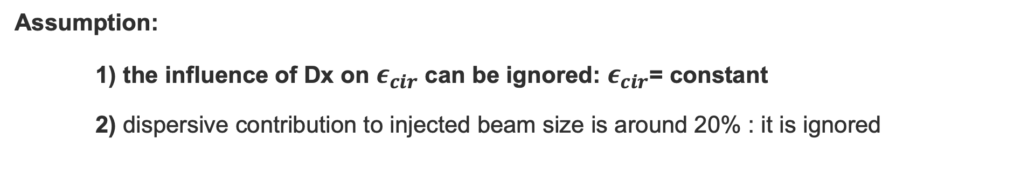
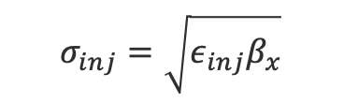

On axis injection analytical optimization
Assumption:
1) the influence of Dx on $ε_{cir}$ can be ignored: $ε_{cir}$= constant
2) dispersive contribution to injected beam size is around 20% : it is ignored
$$σ_{inj}=\sqrt{ε_{inj}β_{x}}$$
$$\left|D_{x}δ_{offset}\right|=5σ_{cir}+S+5σ_{inj}$$
$${{ A=σ_{cir}^{2}=ε}_{cir}β}_{x}, B=S+5σ_{inj}$$
Quadratic equation
$${\left(D_{x}δ_{offset}−B\right)}^{2}=25\left(A+{\left(D_{x}δ_{cir}\right)}^{2}\right)$$
$$\left(δ_{offset}^{2}−25δ_{cir}^{2}\right)D_{x}^{2}−2Bδ_{offset}D_{x}+B^{2}−25A=0$$
Solution
$$D_{x}=\frac{2Bδ_{offset}±\sqrt{4B^{2}δ_{offset}^{2}−4\left(δ_{offset}^{2}−25δ_{cir}^{2}\right)(B^{2}−25A)}}{2\left(δ_{offset}^{2}−25δ_{cir}^{2}\right)}=\frac{Bδ_{offset}±\sqrt{B^{2}δ_{offset}^{2}−\left(δ_{offset}^{2}−25δ_{cir}^{2}\right)(B^{2}−25A)}}{\left(δ_{offset}^{2}−25δ_{cir}^{2}\right)}$$

Slide 22
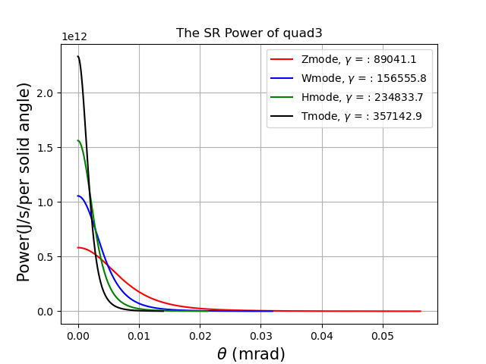


SR of quad3 in FCC-ee

